Slide 1
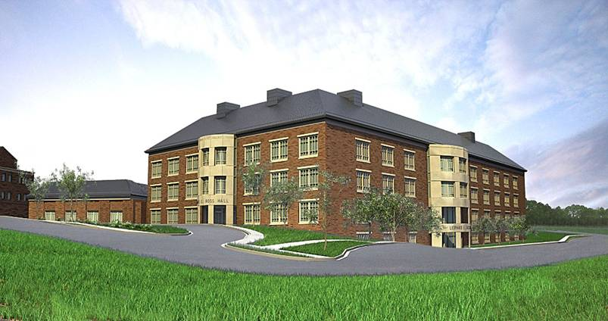

East Carolina University
School of Dental Medicine:
From Vision to Reality
GRANTMAKERS IN HEALTH WEBINAR
16 AUGUST, 2012
Michael L. Scholtz, DMD

Slide 2
“ You are not healthy
……… unless you have good oral health”
C. Everett Koop
Former U.S. Surgeon

Slide 3
The Challenge
Dental caries remains the most common chronic disease of childhood
Almost 40% of children in NC have already had decay in primary teeth when they start school
Individuals with lower income and fewer years of education are more likely to have had teeth removed because of tooth decay or gum disease

Slide 4
NC Demographics
NC is the 10th largest state (about 9.5M)
NC is the 5th fastest growing state
NC will be the 7th largest state by 2030
- Population will be 12.4M – a growth rate of 52%
Population: 50/50 Rural-Urban split

Slide 5
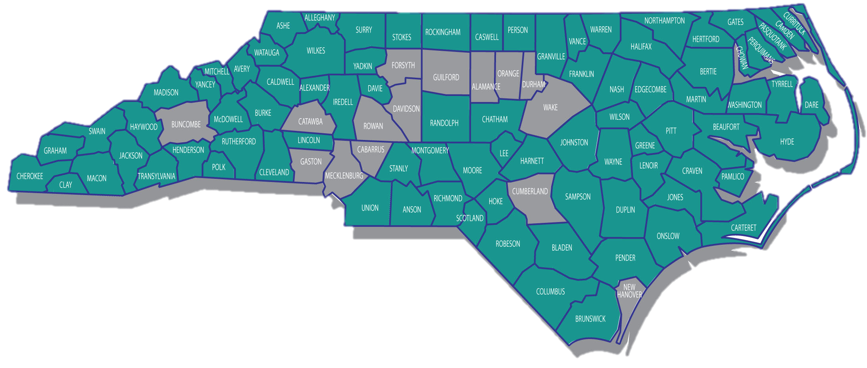

RURAL AND URBAN COUNTIES
North Carolina
North Carolina Rural Economic Development Center, Inc.
ArcGIS 9 ESRI Data & Maps

Slide 6
Dental Workforce
In 2010 there were 4,178 dentists
NC ranks 47th in the number of dentists to 10K population
28 Counties where 2 or fewer dentists serve as many as 10,000 population…….. including 4 counties, all in eastern NC, that have no dentist
About 1/3 of the dentists practicing today are 55 years of age and older
Does not reflect the diversity of the State
*Source: North Carolina Health Professions Data System, Cecil G. Sheps Center for Health Services Research, University of North Carolina at Chapel Hill, with data derived from the respective licensing board, 2010. (Includes those who are licensed and active within the profession as well as those with unknown activity status; inactive are excluded.)

Slide 7
Dentists per 10,000 Population
US and NC, 1979-2009
4.4
Sources: North Carolina Health Professions Data System, 1979 to 2009 with data derived from the North Carolina State Board
of Dental Examiners; HRSA, Bureau of Health Professions; US Bureau of the Census; North Carolina Office of State Planning.
Figures include all licensed active dental hygienists. North Carolina population data are smoothed figures based on 1980, 1990 and 2000 Censuses.
*Note: US population data for 2001-2002 are slightly different than previous years and may partially account for the slight drop in dentists per 10,000 population at the national level.

Slide 8
NC Dentists per 10,000 Population by Metropolitan and
Non-Metropolitan Counties, 1979 to 2007
Source for Metropolitan-Nonmetropolitan definition: Office of Management and Budget, 1999.
Sources: North Carolina Health Professions Data System, 1979 to 2007 with data derived from the North Carolina State
Board of Dental Examiners; North Carolina Office of State Planning. Figures include all licensed active, in-state, dentists.

Slide 9
Dental Demographics
Dentists per 10,000 Population
US Average 6.0
NC Average 4.4
4.9
Metropolitan
3.1
Non-Metropolitan

Slide 10
NC Counties with < 2
Dentists/10K Population, 2010
ASHE
ALLE-
GHANY
WARREN
NORTH-
AMPTON
GATES
CAM-
DEN
CURRITUCK
SURRY
STOKES
ROCKING-
HAM
CASWELL
GRAN-
VILLE
VANCE
HERT-
FORD
PASQUO-
TANK
PERSON
HALIFAX
PER-
QUIMANS
MITCHELL
WATAUGA
WILKES
YADKIN
FORSYTH
ORANGE
BERTIE
CHO-
WAN
YAN-
CEY
AVERY
CALDWELL
ALEX-
ANDER
GUILFORD
ALA-
MANCE
FRANKLIN
MADISON
DAVIE
DAVID-
SON
DURHAM
NASH
EDGE-
COMBE
MARTIN
WASH-
INGTON
BURKE
IREDELL
WAKE
WILSON
TYRRELL
DARE
HAY-
WOOD
BUN-
COMBE
MCDOWELL
CATAWBA
ROWAN
RANDOLPH
CHATHAM
PITT
BEAU-
FORT
SWAIN
RUTHER-
FORD
LINCOLN
JOHNSTON
GREENE
HYDE
GRAHAM
JACK-
SON
HENDER-
SON
CLEVE-
LAND
GASTON
CABARRUS
LEE
WAYNE
CHEROKEE
MACON
TRAN-
SYLVANIA
POLK
STANLY
MONT-
GOMERY
MOORE
HARNETT
LENOIR
CRAVEN
CLAY
MECKLEN-
BURG
CUMBER-
LAND
PAM-
LICO
UNION
ANSON
RICH-
MOND
HOKE
SAMPSON
DUPLIN
JONES
SCOT-
LAND
ONSLOW
CARTERET
Counties with NO dentists (4)
ROBESON
BLADEN
PENDER
Counties with 1 or less dentists/10K (3)
COLUMBUS
NEW
HANOVER
Counties with 2 or less dentists/10K (21)
BRUNSWICK
Source: UNC Sheps Center; 2010

Slide 11
Dental Workforce is “Graying”
Over 42% of NC dentists are 50 or older
  31% are 55 or older
The average age of all NC dentists is 47.4 years.
  Average age in metropolitan counties is 46.7 years
  Average age in non-metropolitan counties is 49.9 years
Female dentists in NC (22%) are 10.5 years younger than male dentists, on average.
The Dentist Workforce in North Carolina; UNC The Cecil G. Sheps Center for Health Service Research; January 2009

Slide 12
Workforce – Racial Diversity
Race | NC Population* | NC Dentists^
Caucasian | 68.5% | 84.2%
African American | 21.5% | 8.2%
Hispanic | 8.4% | 1.1%
Asian | 2.2% | 4.2%
American Indian | 1.3% | 0.4%
Other/Unknown | 6.5% | 1.9%
*Source: US Census Bureau, 2010 Data
^Source: UNC Sheps Center; 2010 Data

Slide 13
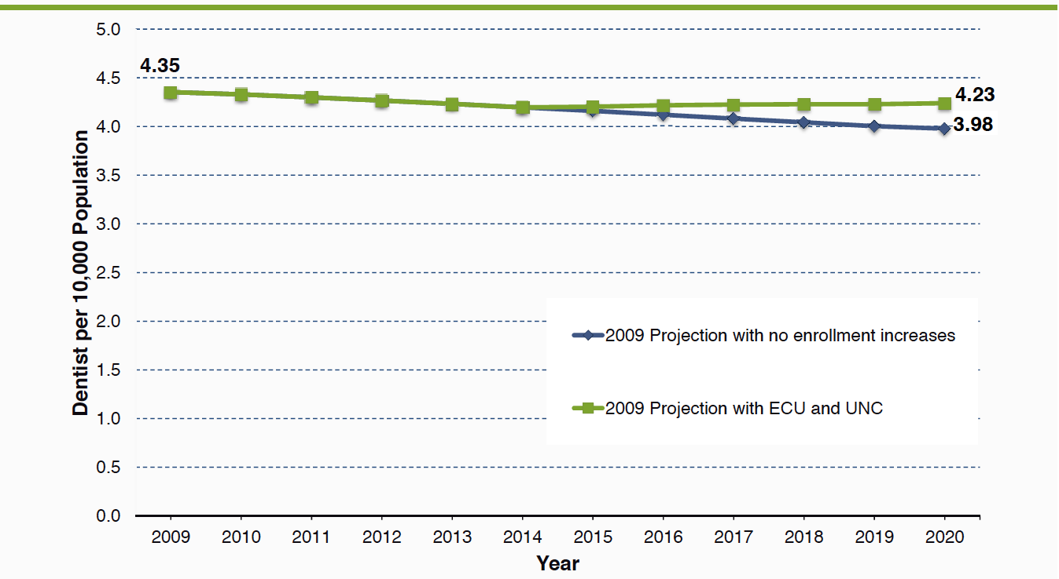
Projections Show Decline in
Dentists per Population by 2010

Slide 14
North Carolina’s Dental Workforce
Bottom Line:
Shortage and Maldistribution

Slide 15
East Carolina University
School of Dental Medicine
Our Vision:
  Improving the health and quality of life of all North Carolinians by creating leaders with a passion to care for the underserved and by leading the nation in community-based, service learning oral health education.

Slide 16
Our Mission
Prepare leaders with outstanding clinical skills, an ethical bearing, sound judgment and a passion to serve;
Provide educational opportunities for individuals from historically underrepresented groups, disadvantaged backgrounds and underserved areas;
Provide and enhance oral health services for underserved North Carolinians through implementation of community-oriented service learning and interprofessional collaborations;
Foster an environment where creativity, collaboration and diversity are embraced;
Guide future clinical practice and dental education through innovation and discovery.

Slide 17
“The ECU Model”
Primary Care
Increasing Access: educating/providing care
Traditional Values: education/service/research
Facilities:
  Greenville
    Approximately 188K sq. ft. - three floors initially outfitted (fourth floor – shelled-in space)
  Community Service Learning Centers (10)
    Across the state in rural/underserved communities
Curriculum/Use of technology
All students from NC

Slide 18
Educational Priorities
  50 pre-doctoral dental students per year
  4-5 General Practice Residents per year
  Up to 22 Advanced Education in General Dentistry (AEGD) residents per year
  3-4 Pediatric Dental Residents per year
  Continuing education for dental professionals
  Oral health promotion - general public

Slide 19
Our Current Status?
(as of AUG 2012)
32 Faculty/Senior Administration & 42 Staff
52 Students – Class of 2015 (2ND Year Students)
52 Students – Class of 2016 (1st Year Students)
Facilities
  Offices in 3 modular units on the health sciences campus
  Temporary teaching facilities in Brody School of Medicine
  Ross Hall under construction, completion planned late Summer of 2012
  CSLC #1 opens June 2012; #2 opens in November/December 2012
Faculty and staff recruiting continues
Innovative curriculum, classrooms and simulation labs
CODA Accreditation (DMD, GPR & AEGD)
Notes:
Fac/Staff COMING ON BOARD
3 Staff mbrs by END of Feb 2012
4-6 Fac mbrs by END of June 2012

Slide 20

Technology
“Innovation With a Purpose”
Use is NOT an option
All Apple (MacBook, iPad, iPhone)
State-of-the-Art Clinical Technology
7 iBook Platforms (facilitate problem-solving in class, chairside and at home)
Yammer
New Learning Management System (LMS)
Robust connectivity to CSLCs

Slide 21
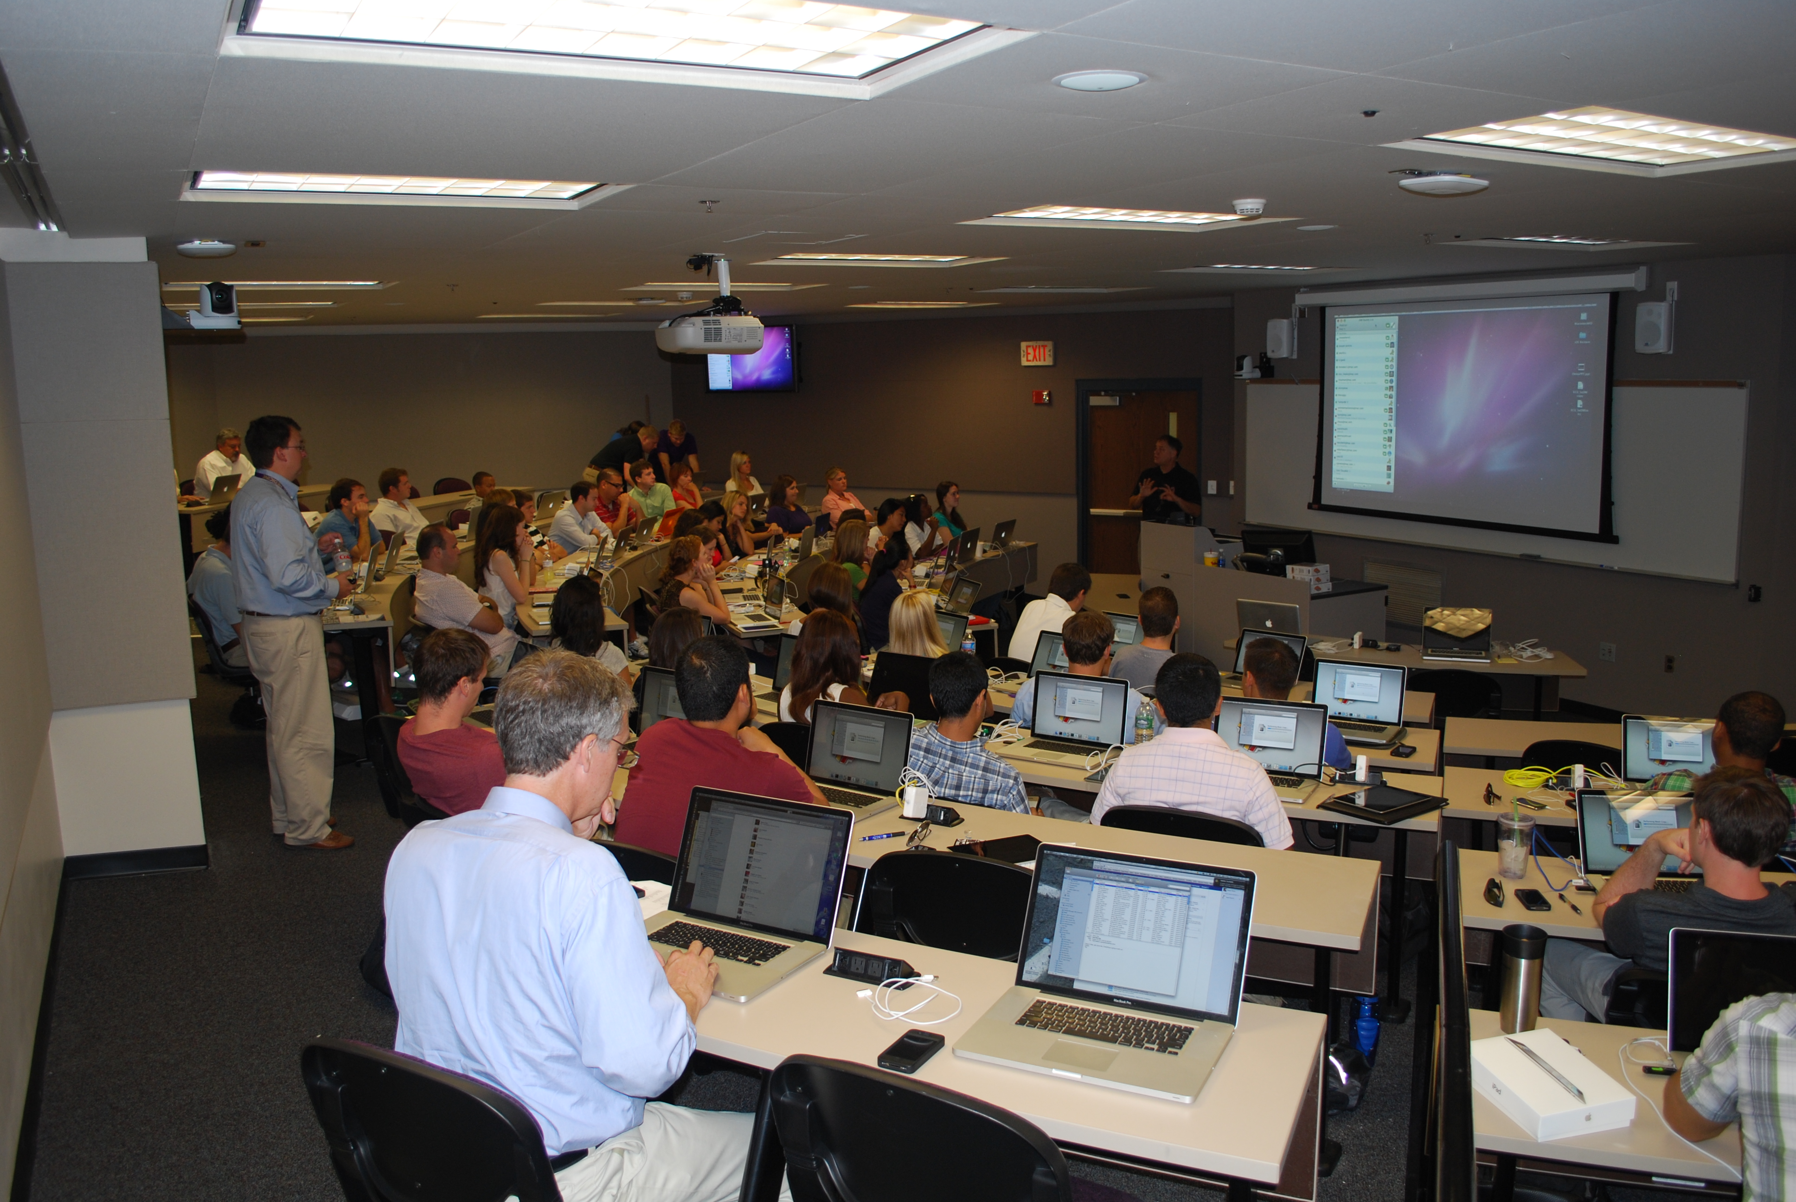
Temporary Classroom

Slide 22
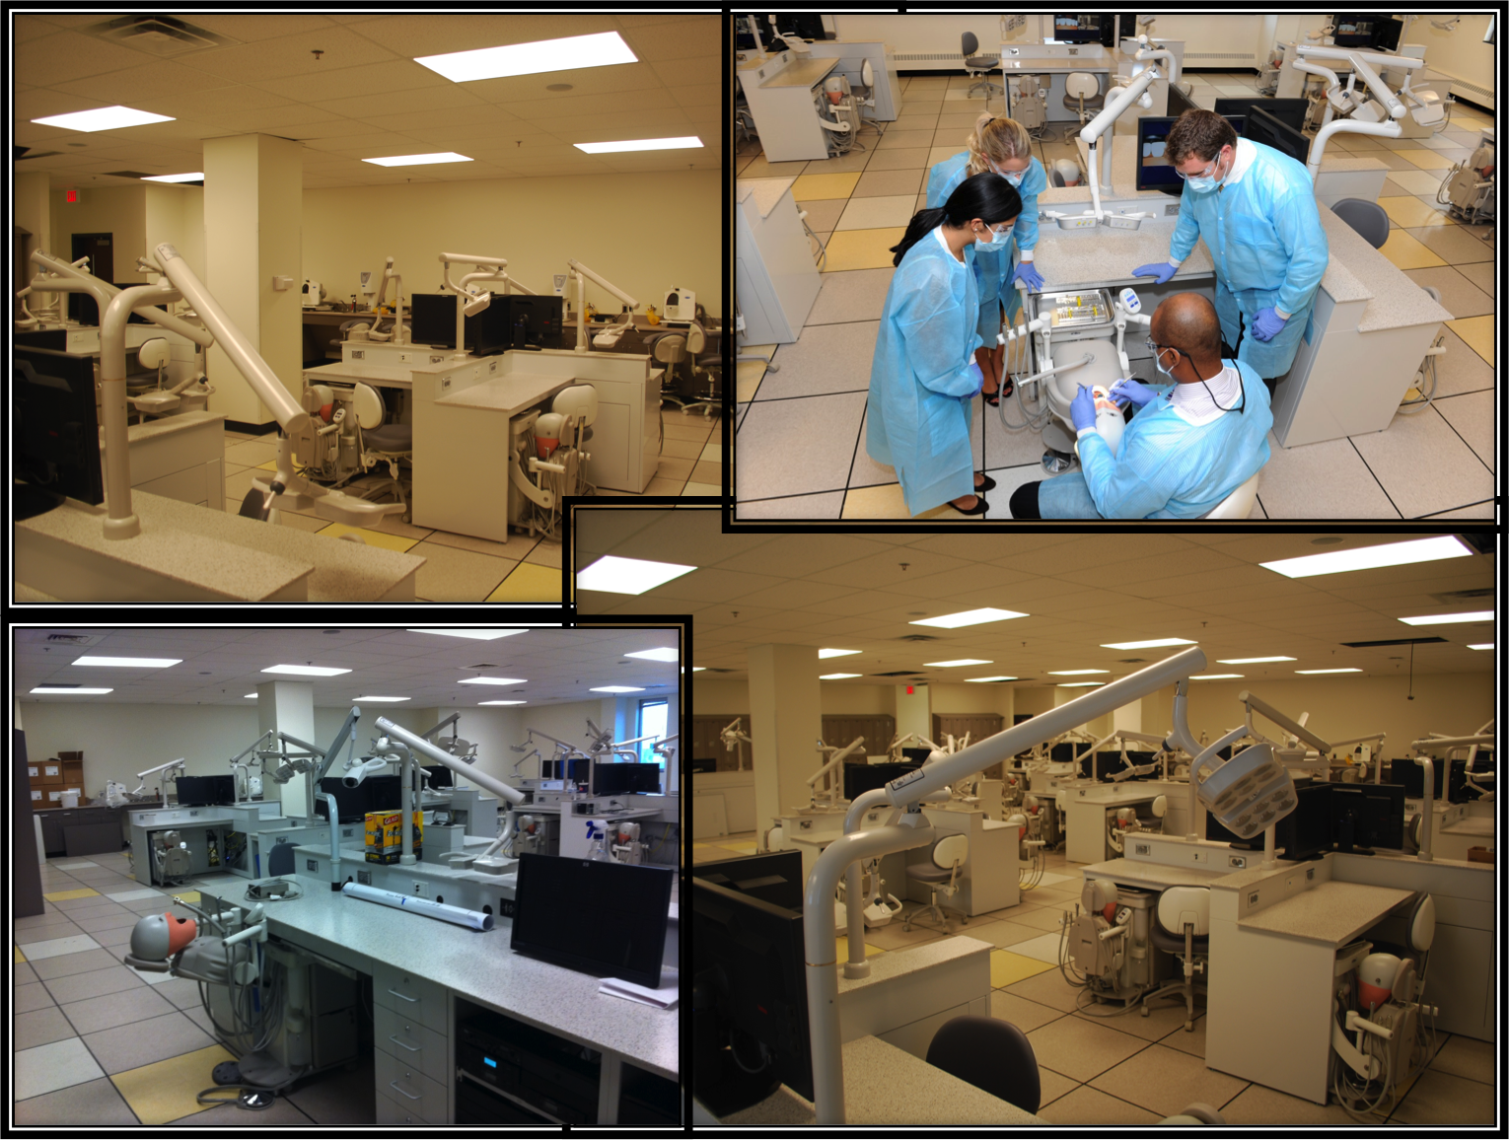
Simulation Lab

Slide 23
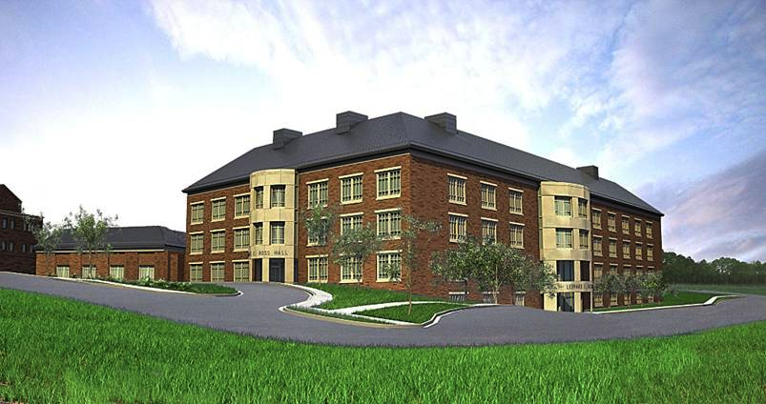
Ledyard E. Ross Hall

Slide 24
Ross Hall
  Two lecture halls plus small group seminar rooms
  State-of-the-art preclinical simulation labs
  Clinical space for about 50 dental students per year, 6-8 Pediatric dentistry residents, 2-4 GP residents and faculty/staff
  Clinical and educational support areas
  Offices and conference/seminar rooms
  Special needs and clinical research suite
  Shelled-in space – room for expansion, research and/or more faculty offices

Slide 25
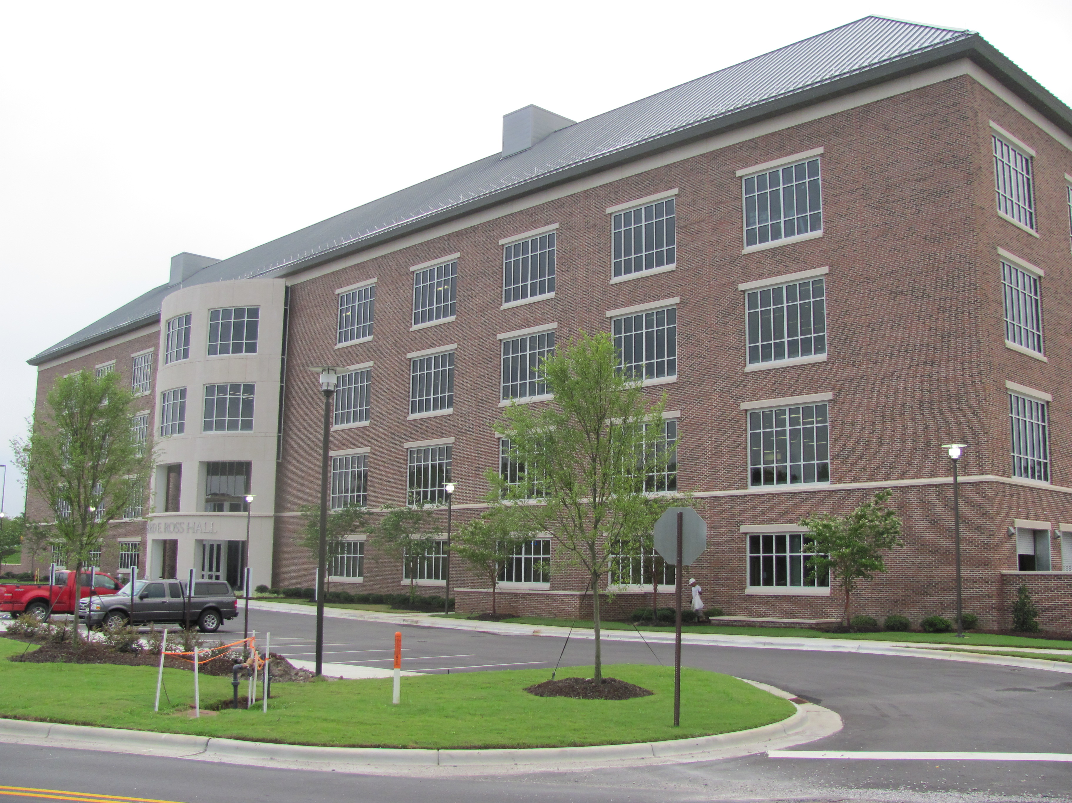

Slide 26
Community Service Learning Centers:
“The ECU Model”
Community-based, economically sustainable dental practices of the School of Dental Medicine where students will advance their skills and knowledge under the supervision of dental faculty while living in rural areas across North Carolina.
Education  Access  Sustainable

Slide 27
Community Service Learning Centers
(Education  Access  Sustainable)
4th Floor Concept
Traditional vs. Medical Education
Partnership/Collaboration
Regional Approach
Safety Net Provider

Slide 28
Community Service Learning Centers
(10 Sites Across North Carolina)
Faculty
  1.5 FTE (practicing general dentist)
  Community dentists
Residents
  2 AEGD residents
Students (4th Year)
  4-5 per site, each student rotates to three sites
Staff
  Business manager and staff
  Dental assistants
  Hygienists
  Patient coordinator/dental social worker

Slide 29
Support
Practitioners
Resource to State
Economic Impact
Referral
Resource
Increase Healthcare Infrastructure
Selection
Tele-dentistry
Patient Care Experience
University Presence
Create Jobs
Work with
Auxiliaries
Return to Rural Area
Support
Continuing
Education
More Clinical
Relate directly with Rural Patient Needs
Mentoring
Observe County
Board of Health
More
Diagnostic
CSLCs..
The Hypothesis
Hands on Practice Management
Community Outreach
Interdisciplinary with
Primary Care Partners
Community
Experiences
Live in
Rural Areas
See Faculty
Actually Practice
Actual Practice
Experience
Medicaid
Pipeline Development
Business
Office
Safety Net
Assist Faculty
Dental Student
Patients
Remove Part of
4th Year Expense
Multiple Locations
Comprehensive
Care
Faculty Produce
Income
Access to Care
Cost of
Dental Education

Slide 30
Impact on the Oral Health Workforce
Educational opportunities – student selection
Educating more primary care dentists (pre-doctoral and post-doctoral programs)
Educational experiences in rural/underserved areas
Delivering primary care in rural/underserved areas
Recruit applicants to return to areas of need

Slide 31
Impact On Access to Care
Patient Population
Indigent/Medicaid
Sliding Scale (From RCCHC forming a “Medical Home”)
Full Pay/Insurance
Regional Approach to Delivering Care
Full General Dentistry Services Including Implants
3 D Technology/Extraoral Imaging/
Endodontic Microscopes
Advisory Board at Each Site
Members From Various Walks of Life
Facilitate Community Service

Slide 32

ECU School of Dental Medicine
Community Service Learning Centers Locations
Elizabeth
City
Spruce Pines
Ahoskie
Davidson
Sylva
Lillington
ECU
Announced Community Service Learning Centers
ECU School of Dental Medicine

Slide 33
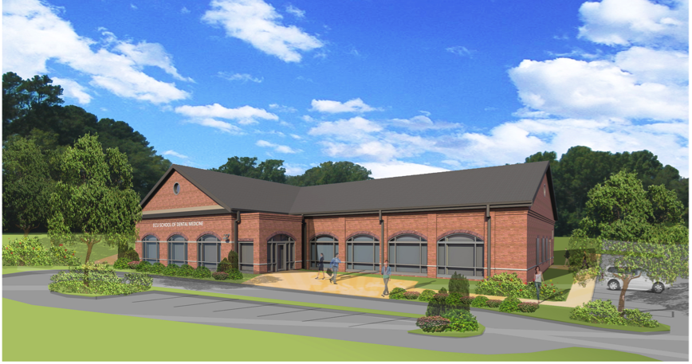
Architectural Rendering of
Community Service Learning Center

Slide 34
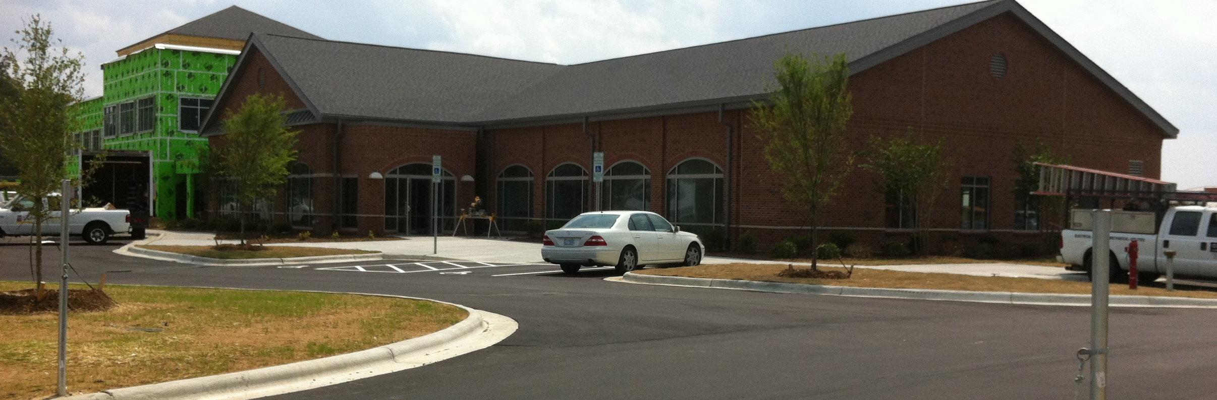
Ahoskie Community Service Learning Center
April 2012

Slide 35
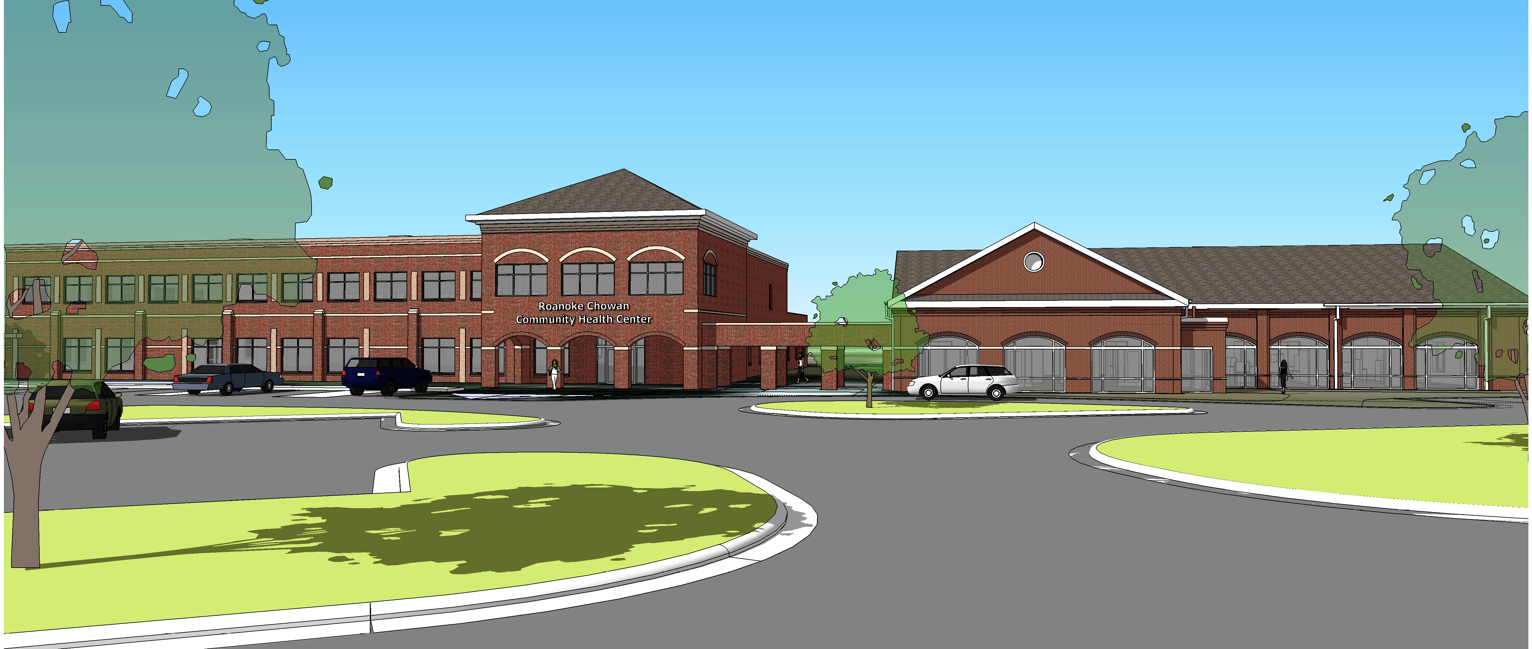
Architectural Rendering of
Roanoke-Chowan Community Health Center
& ECU Community Service Learning Center

Slide 36

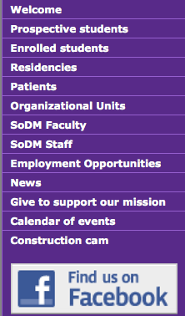
www.ecu.edu/dentistry

