Slide 1

8/16/2012
www.dakmed.org

Slide 2
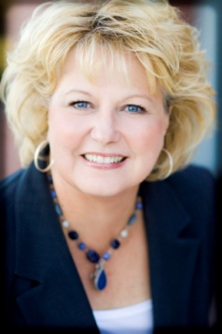
Dakota Medical Foundation
Fargo, ND
Health conversion foundation – 1996
$90 million – assets
Annual grants: $3 – $4 million
$48 million to nearly 400 nonprofits
11 staff
Deb Watne
Grants Director

Slide 3

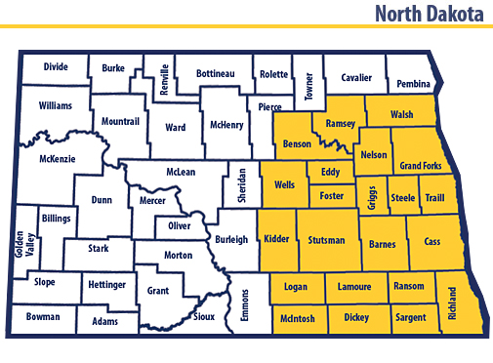
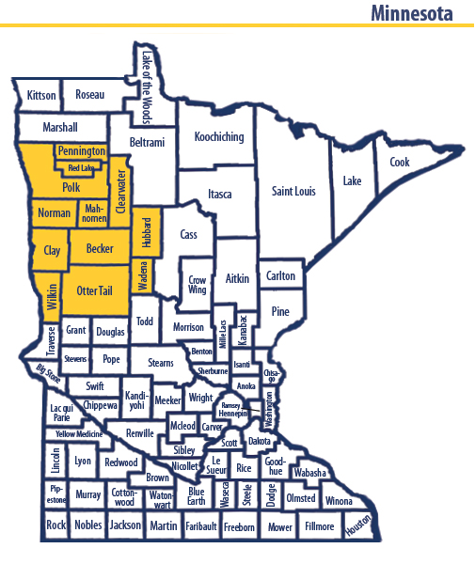
Service area

Slide 4
Healthcare Workforce Initiative
$4.2 million invested since 2001
  22% of ND and 5.3% of MN designated as a health professional shortage area
  26 of 53 ND counties designated as nurse shortage areas
  Aging population; aging workforce; rural recruitment

Slide 5
Service area issues – Nursing
Education program waiting lists
Nurse faculty
Limited clinical sites
Rural recruitment

Slide 6
Strategy:
Nursing Education Access
Increase number of nursing education slots
  Build nurse faculty workforce
  Simulation equipment – clinical demand
Education access – rural areas
  “Grow Your Own” – distance education
  Scholarships targeting rural students
  CNA training
  Health careers programs

Slide 7
Nursing Education Expansion
Tri-College (two Moorhead, MN colleges, one Fargo, ND college)
  $376,556/3yrs (start up costs, faculty salary, simulation equipment)
    54 new slots by end of 3 yrs
    New freshman track that starts nursing curriculum in freshman year
    LPN to BSN program (6 semesters including summers)
    Second degree program for those with existing degrees (12 month program)
Jamestown College – $96,000, 12 new nursing education slots

Slide 8
“Grow Your Own” Programs
Lake Region State College, Devils Lake, ND
  CNA to LPN rural distance education programs
Valley City State College, Valley City, ND
  New LPN/RN program in partnership with long term care facility
Northland Community College, Thief River Falls, MN
  Partnership with White Earth Tribal and Community College (CNA, LPN, RN)
Mayville State University, Mayville, ND
  Pre-Nursing Program-LPN, Assoc. Degree Nurse (in partnership with Lake Region State College)

Slide 9
Nurse Faculty Initiative
Non-Master’s clinical supervisors – LPN programs
BSN nurses
  Tuition assistance – Master’s education to become nurse faculty

Slide 10
Outcomes – North Dakota
2004:
2007:
2011:
LPNs: 3,434
RNs: 8,618
LPNs: 3,634
RNs: 9,634
LPNs: 3,667
RNs: 12,219

Slide 11
18 BSN nurses obtained Master’s Degrees and are serving as nurse faculty
80 new nursing education slots
50 new CNAs trained
14 LPNs trained through distance education
600 health careers scholarships

Slide 12
Lessons Learned
Know the landscape
Program sustainability

Slide 13
www.dakmed.org 701-271-0263

