Slide 1
Megaphones are Preventive Medicine: Supporting Community Voices for Health and Health Equity
Grantmakers In Health Annual Meeting
March 7, 2014

Slide 2
Vanessa Daniel Groundswell Fund

Slide 3
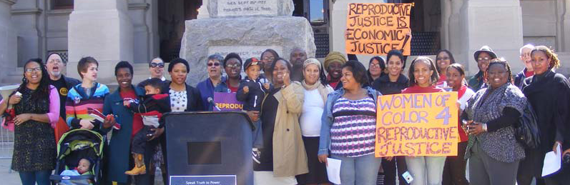
Grantmakers in Health
Atlanta, GA
March 7, 2014

Slide 4
Direct Service
+
Organizing

Slide 5
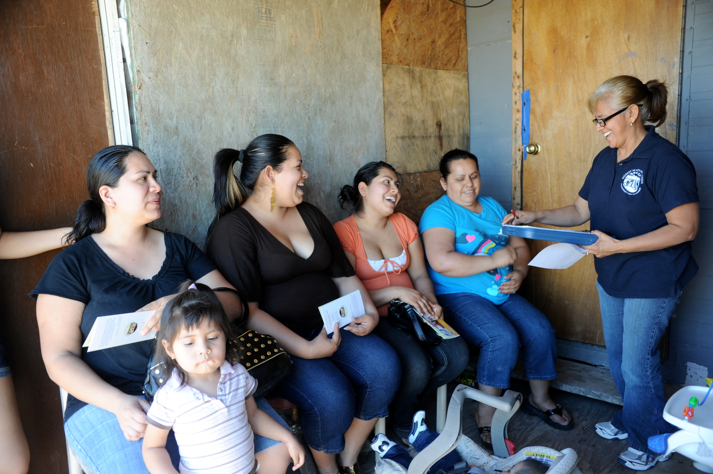

Slide 6
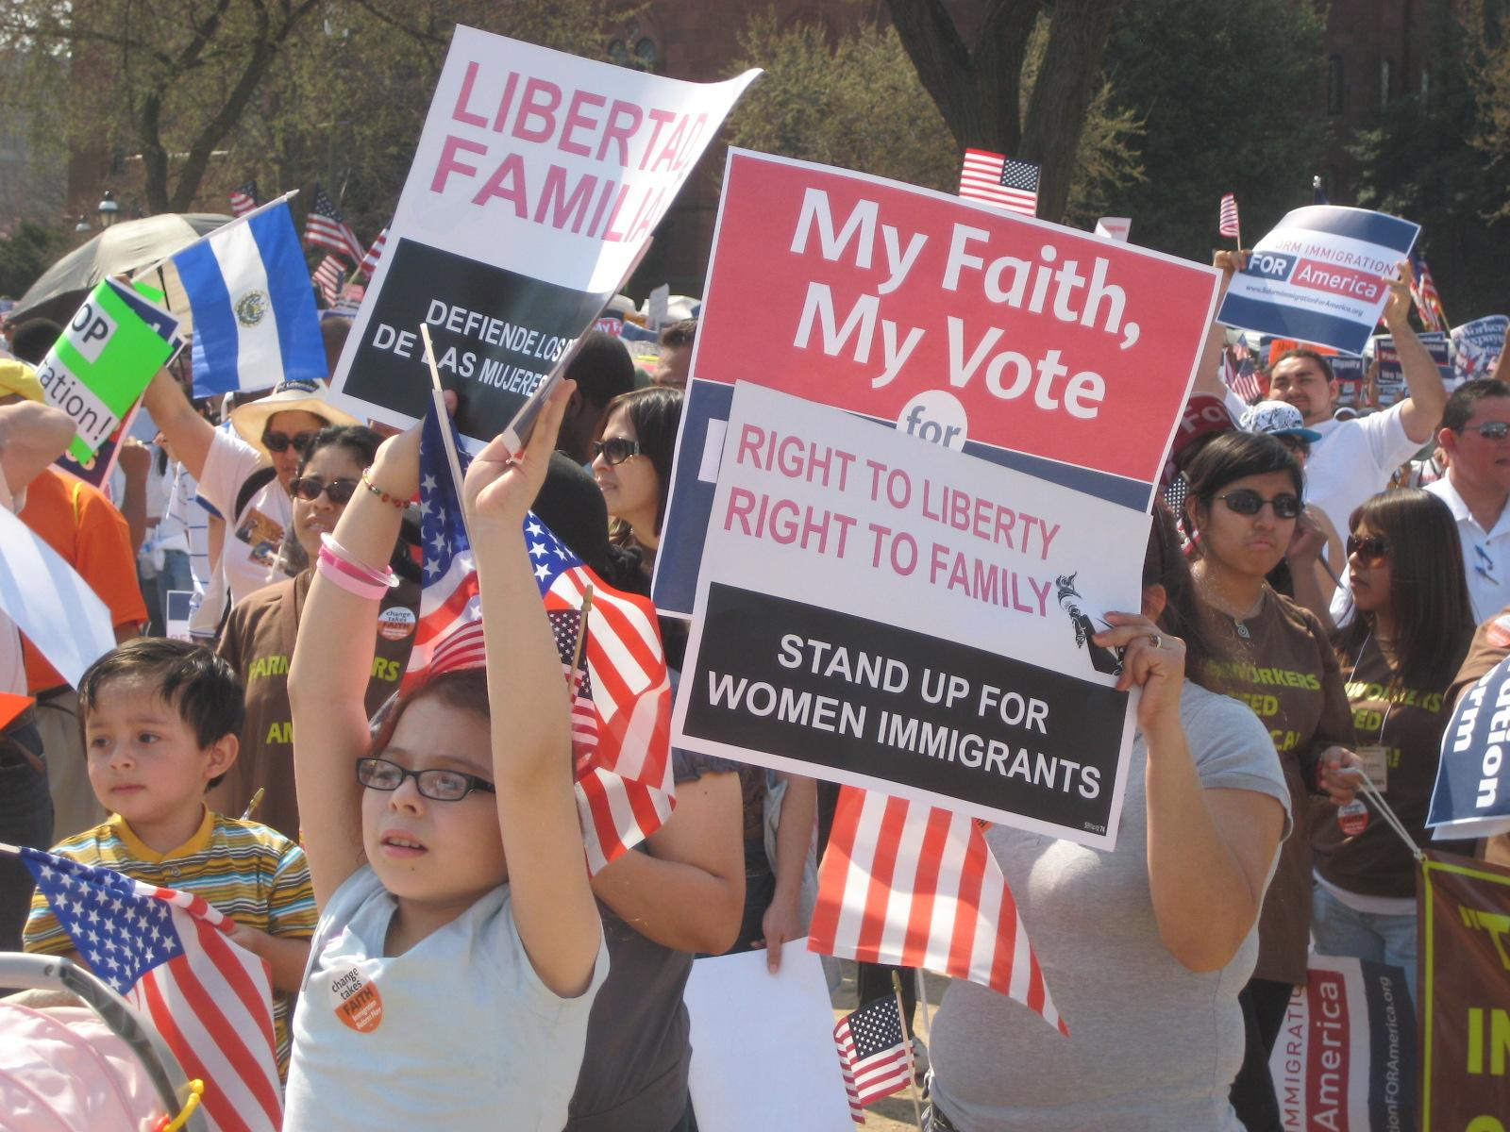

Slide 7
Research
+
Organizing

Slide 8
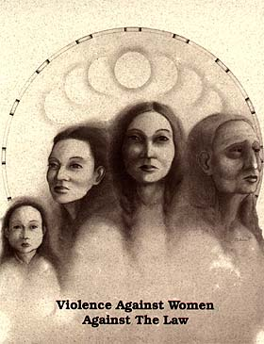

Slide 9
Policy
+
Organizing

Slide 10
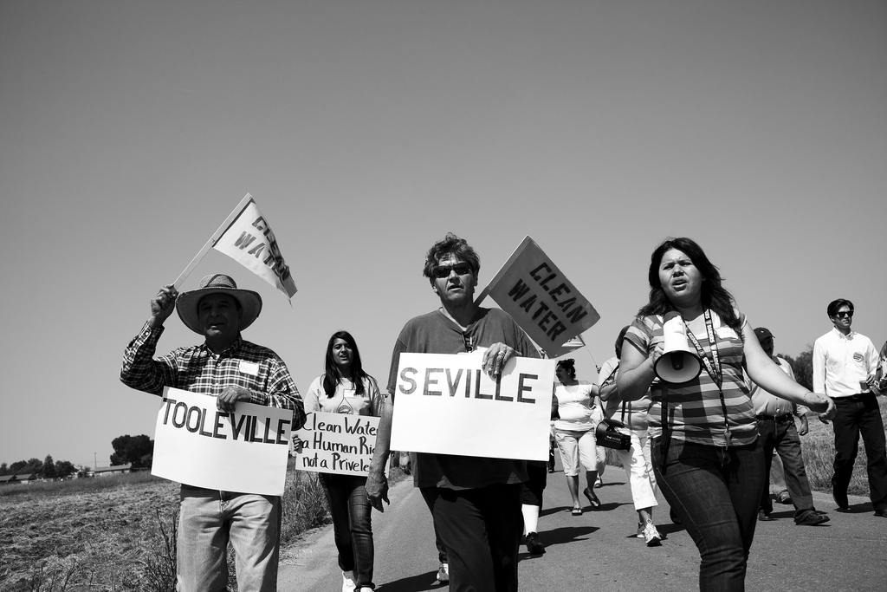

Slide 11
Communications
+
Organizing

Slide 12
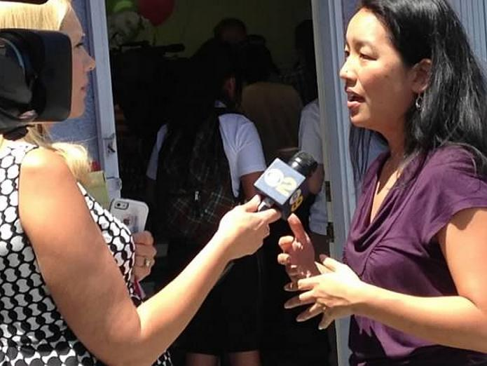

Slide 13
3%

Slide 14
5%

Slide 15
6.4%

Slide 16
Lisa Fu California Healthy Nail Salon Collaborative

Slide 17
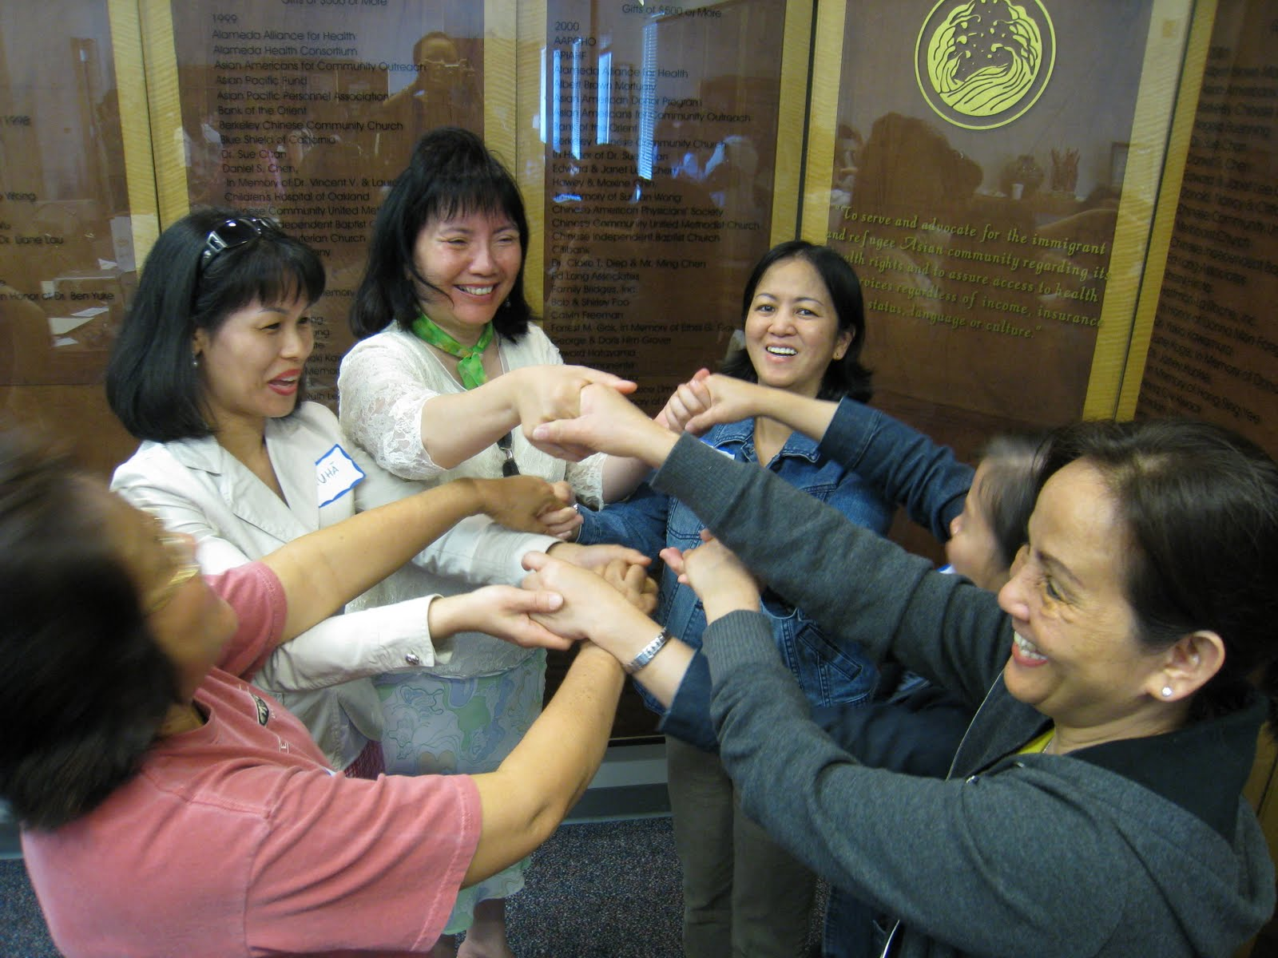
California Healthy Nail Salon Collaborative
Lisa Fu
Program and Outreach Director
GIH - March 7, 2014
Notes:
Mission: To improve the health, safety and rights of the nail and beauty care workforce to achieve a healthier, more sustainable and just industry.
The California Healthy Nail Salon Collaborative was formed in 2005 out of growing concern for the health and safety of nail salon and other cosmetology workers, owners, and consumers. The Collaborative coordinates, leverages, and builds upon the respective expertise and activities of its diverse members and partners to advance a preventative environmental health agenda for the nail salon sector in California. Composed of public health and environmental advocates, nail salon workers and owners, community-based groups, and allies in government agencies, the Collaborative seeks to proactively address health and safety concerns facing the nail salon worker community through an integrated approach using policy advocacy, research, outreach, and education strategies.
Focuses on providing space and momentum for policy advocacy, research, and community outreach groups to work together on cross strategies and activities.

Slide 18
Nail Salon Community in CA
60-80% Vietnamese
95% Women of reproductive age
Average income $21,800 per year
Recent immigrants
Long term exposure to toxic chemicals and products
Notes:
Estimated 60-70% are Vietnamese in CA, 40% Asian across country
95% are women of reproductive age
Many are recent immigrants with limited English
Lack access to health care
Long-term chronic exposures
Homeland exposures to chemical warfare from the Vietnam War
Occupational exposures in the beauty industry
Low socioeconomic status
Most earn less than $18,200 per year
Lack of job security
Most workers are not employees but rent a stations in shops
Lack of worker-based health insurance
Long daily hours (>8 hours per day)
Unstable nature of nail shop business; high turnover of shops and ownership
As first generation immigrants:
1) Lower socioeconomic status
2) Language barrier with respect to English
Lack of knowledge about legal and health care systems
Cosmetology is the fastest growing profession in California. Over the last two decades, nail salon services alone have more than tripled. Currently, there are over 83,000 manicurists in California, the majority of who are women of color (an estimated 60 - 80 percent, Vietnamese immigrants), and more than half are of reproductive age.
Over the last two decades, nail salon services alone have more than tripled. Currently, there are over 83,000 manicurists in California, the majority of who are women of color (an estimated 60 - 80 percent, Vietnamese immigrants), and more than half are of reproductive age. Many of these women speak limited English, do not have access to health care coverage, and lack understanding of the U.S. legal and health care systems. Nail salon workers tend to earn less than $16,000 a year and work in conditions that can be hazardous to their health. On a daily basis and often for long hours at a stretch, nail salon technicians handle solvents, glues, and other nail care products, containing a multitude of chemicals known or suspected to cause cancer, respiratory or reproductive harm.
Given their occupational exposures, history of immigration, low awareness of health risks, and limited access to health care, the nail salon workers have complex health profiles that places them at risk for occupational-related health impacts. While acute impacts, such as rashes and respiratory aliments have been well-documented, little research has been conducted to date on the long-term chronic health impacts of toxic occupational exposures on salon workers. Additionally, there remains a paucity of culturally and linguistically appropriate educational and outreach materials intended to build awareness about environmental exposures and to help workers and owners implement safety precautions and use least-toxic salon products.
Over 97,100 manicurists in CA
Nail salons have tripled over the last twenty years
A growth sector for new immigrants and small business owners
Earned $6 billion in 2011
The professional nail care market had 25% percent growth globally in 2012 – highest growth of all cosmetics
There is very limited regulation and review of the chemicals used in cosmetic and personal care products. Of the more than 10,000 chemicals used in personal care and nail products 89 percent have not been tested independently for their safety or impacts on human health before entering the marketplace.

Slide 19
Toxic Trio
Chemical | Health effects | Also used in
Dibutyl Phthalate (DBP) | Low birth weight, cleft palate, asthma. | Glue
Formaldehyde | Increased risk for cancers of nose and throat. Burning, watering eyes. Skin rashes. | Cigarette smoke Embalming
Toluene | Birth defects, stunted mental abilities and growth | Explosives Glue Paint thinner
Notes:
Three top ingredients of concern in many nail polishes are toluene, formaldehyde and dibutyl phthalate, which have been linked to reproductive harm including miscarriages, infertility, and birth defects, as well as cancer. Several strong solvents such as acetone and alcohols are also regularly used to remove nail polish. Exposure to these solvents can lead to immediate side effects such as nose, throat, lung, skin and eye irritation, as well as headaches, dizziness and confusion. Acrylic nail application leads to exposure to nail dusts and acrylic polymers such as methyl methylacrylate (MMA) and ethyl methylacrylate (EMA). Both EMA and MMA have a very strong odor even at low concentrations and are irritating to the eyes and respiratory system. They are also sensitizers, so individuals exposed over time often become allergic with reactions that include asthma and dermatitis

Slide 20
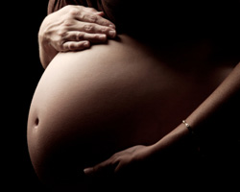
Reproductive Health Impacts
Birth defects
Miscarriages
Difficulty conceiving
Reproductive cancers
Notes:
Cancer
Regular exposure to known and suspected carcinogens
Birth Defects & Other Reproductive Health Issues
Phthalates transferred to the placenta
Toxins passed to newborns when breastfeeding
Miscarriages
qualitative stories we've heard about miscarriages and birth defect stories not just in ca but from other grps in Oregon, washington and maybe from the so cal needs assess. Then go more into detail to just briefly mention cancer (repro related like breast cancer) and the reproductive effects are long term concerns but paucity if research them

Slide 21
Other Health Impacts
Acute symptoms
& illnesses
Respiratory illness
Rashes and skin irritation
Nose and throat irritation
Chronic pain
Carpal tunnel
Back pain
Notes:
Complexities of the nail salon community like how its not uncommon that workers may be indep contractors vs employees, that owners sometimes are workers too, that this work is their livlihood and an entry Pt into US workforce (to set up the context for explaining why the collab was set up- to address and acknolwdege the complexities by bringing together diverse expertise and assets)
Other environmental influences
Poor ventilation
Ergonomics
Lack of culturally & linguistically appropriate materials and trainings

Slide 22
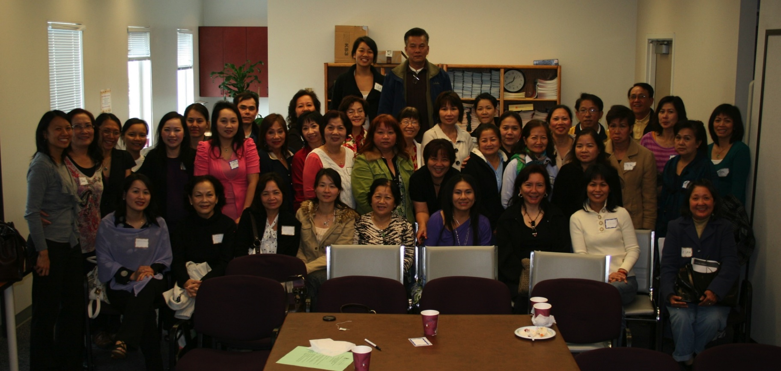
Leadership Development and the Salon Community
Building the leadership, decision-making, and power of the nail salon community to improve
their health, safety and rights.
Notes:
The Collaborative focuses on fostering the inherent strength of immigrant nail salon workers to take an active role in problem solving and advocating for positive outcomes towards safe, healthy and fair working conditions that are free from environmental and workplace hazards and toxins. The nail salon population is a tight knit, family and culture focused community, with up to 80% immigrants from Vietnam. Manicurists take pride in their craft, but most work long hours, for low wages, and in unsafe conditions. Similar to most immigrants, nail salon workers seek to improve their lives and provide for their families.
The Collaborative recognizes the power of the nail salon community to create change for themselves and thousands of others in their community. The Collaborative’s leadership development approach builds upon nail salon workers’ natural strengths, assets, and experiences to organize the salon community through culturally tailoring our work. Trainings are conducted in Vietnamese, the language most commonly spoken by nail salon workers, and focus on building salon workers’ knowledge of ergonomics, chemical exposure, infectious disease, and workplace rights. Core Leaders participate in intensive leadership development training to become advocates, leaders and spokespeople. They also participate in skills building trainings to build their confidence to communicate concerns to decision makers, receive deeper guidance and opportunities for leadership and community building, and increase their leadership in the campaigns. This culturally and linguistically tailored leadership development training curriculum encourages and challenges nail salon workers and owner to lead and create sustainable change to improve the health and well-being of themselves, their families and communities.

Slide 23
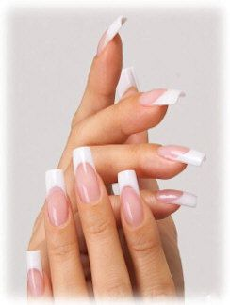
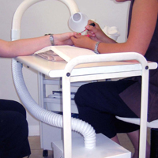
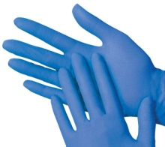
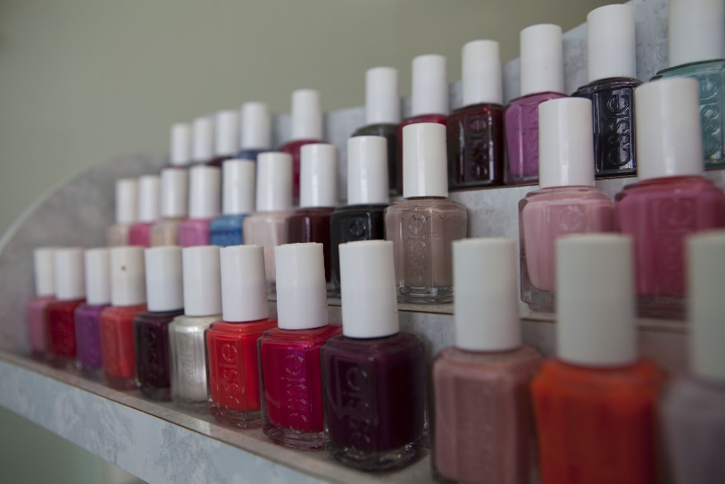
Reducing Toxic Chemicals: Healthy Nail Salon Campaign
Notes:
Use nail polishes without the toxic trio
Use safer nail polish removers
Avoid using nail polish thinners
Wear nitrile gloves
Better ventilation
Install mechanical ventilation unit(s)
Use safer artificial nail products
Train all nail salon staff on safer practices
Do not allow customers to bring in products unless they meet program criteria

Slide 24
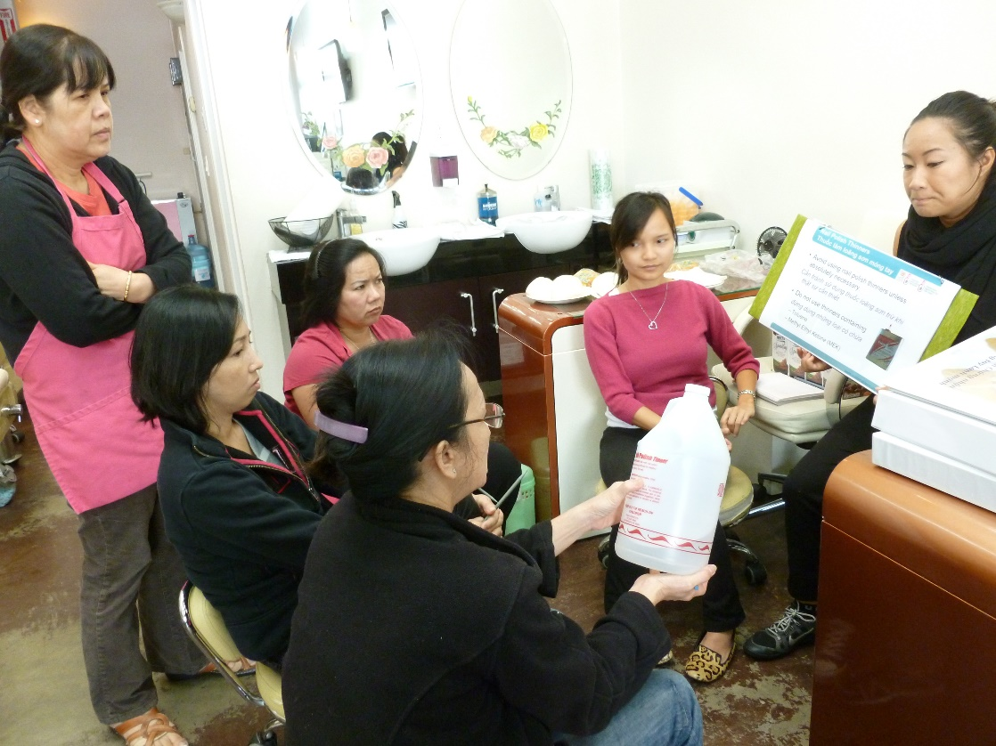
Community Leadership Development

Slide 25
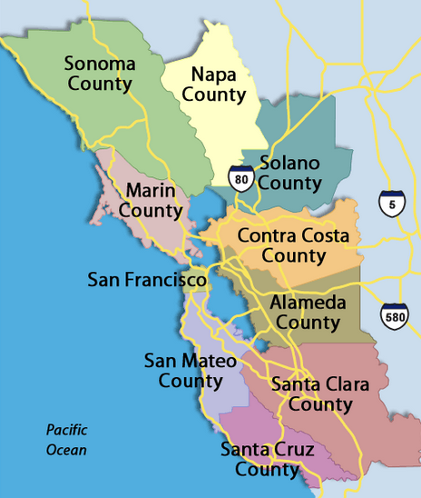
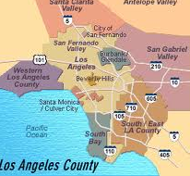
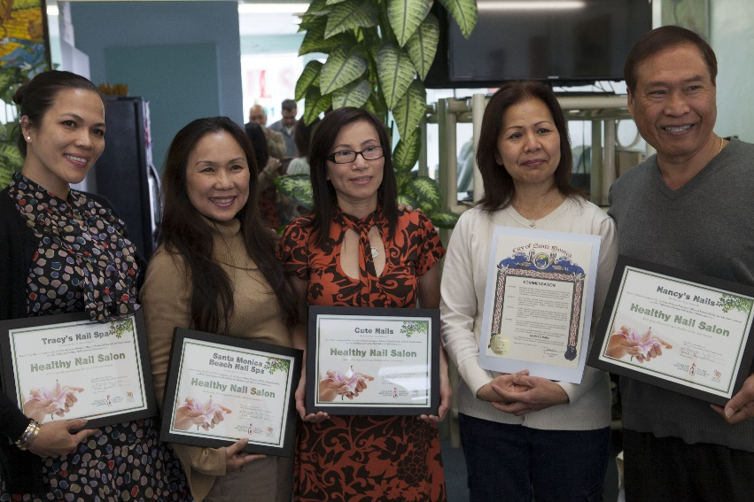
Expanding the HNS Program
Notes:
Salon owners go through a training program run by the city or county, and they commit to adopting the following healthy salon practices (see next slide)

Slide 26
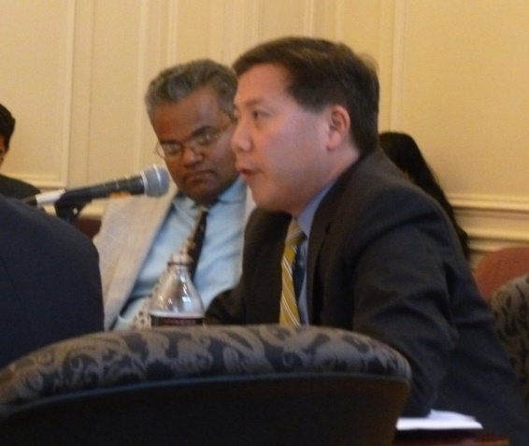
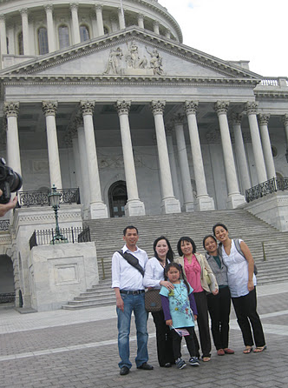
National Impact

Slide 27
Lisa Fu lfu@cahealthynailsalons.org www.cahealthynailsalons.org

Slide 28
Chris Peters Seventh Generation Fund for Indigenous Peoples

Slide 29
Anna Rondon Navajo Nation Division of Health

Slide 30
Megaphones are preventive health
Anna Rondon, Dine
Navajo Birth Cohort Study
Southwest Indigenous Uranium Forum (1987)
annarondon@msn.com
Dine Peoples’ Megaphone Worked!

Slide 31
Dine Peoples: Example of Successful Community Based Advocacy
Dine peoples have been subjected to public health determinants due to gross negligence by the United States government on the uranium mining legacy.
The past 40 years there has been more uranium impacted community based organizing with citizens uniting and bring a strong voice to the world. 7genfund has been a critical collaborator that provided organizing funds to the communities.

Slide 32
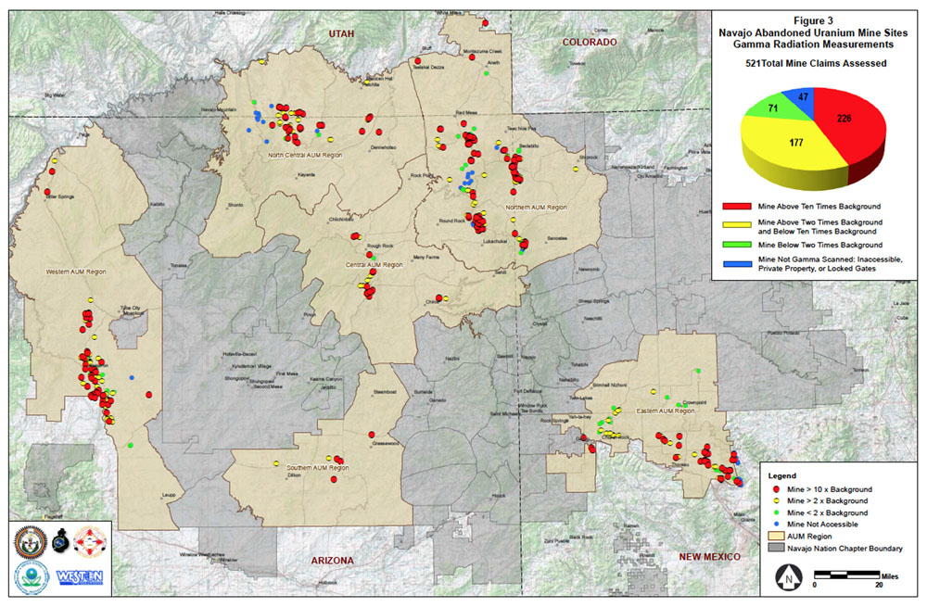

Slide 33
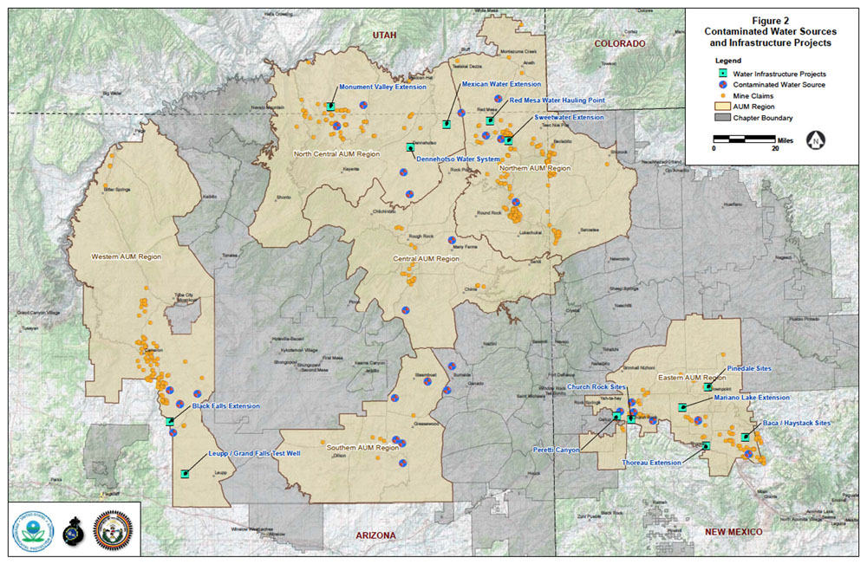

Slide 34
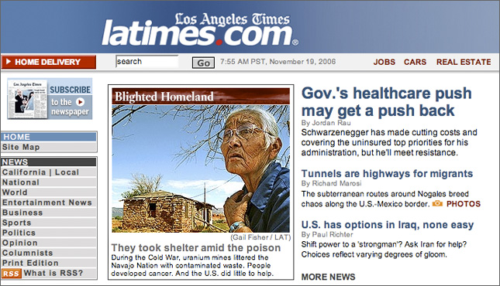
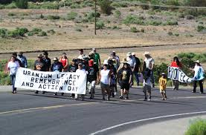
Congressional committee outraged over Navajo uranium legacy.
First of four:
By Kathy Helms, Dine Bureau, Gallup Independent
WINDOW ROCK – A picture may be worth a thousand words, but the sound of an instrument used to detect radioactive contamination, clicking away over a soil sample from Tuba City, set a federal oversight committee on its ear Wednesday during a hearing in Washington.
Chairman Henry Waxman’s Committee on Oversight and Government Reform heard from a Navajo Nation delegation about the health and environmental impacts of uranium contamination during a four-hour hearing.
Several congressional leaders expressed outrage at the federal government for allowing such conditions to remain unchecked on Navajoland for so many years, saying they were “ashamed” and “embarrassed.” They offered apologies to the Navajo people.

Slide 35
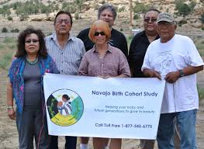
Resource Links
http://www.epa.gov/region9/superfund/navajo-nation/
http://www.latimes.com/extras/navajo/Day1/
http://www.sric.org/index.php
Like us on FACEBOOK:
Navajo Birth
Cohort Study
Dr. Johnnye Lewis, UNM
Dr. David Begay, Cora Maxx, Teddy Nez, Malcolm Benally

Slide 36
Robby Rodriguez W.K. Kellogg Foundation

Slide 37
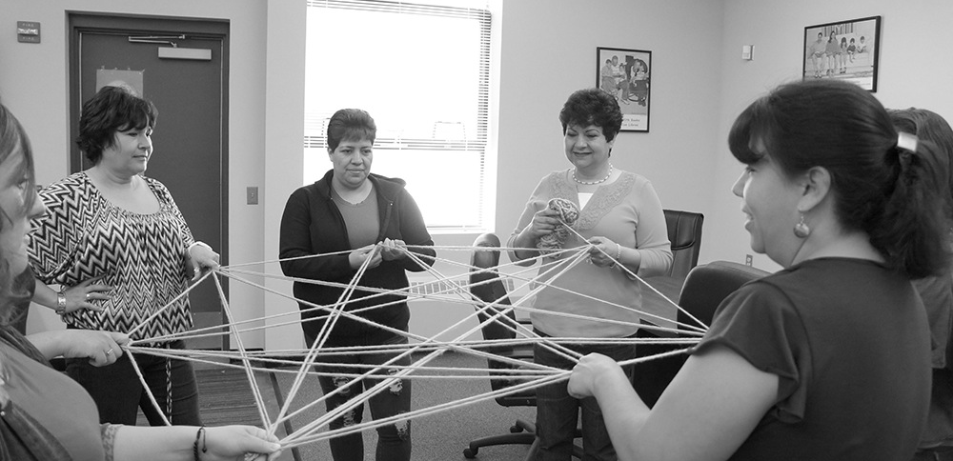
Ensures people
are part of
making change.
Community Voice

Slide 38
Mobilize People
Issue Environment
Develop Leaders
Economies of Scale

Slide 39
Polling
Modeling
Tracking

Slide 40
Tannia Esparza Young Women United

Slide 41
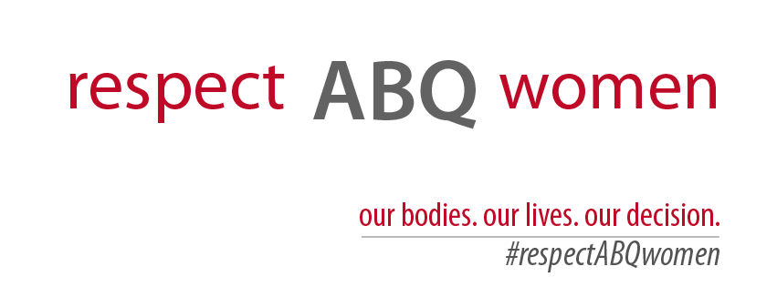
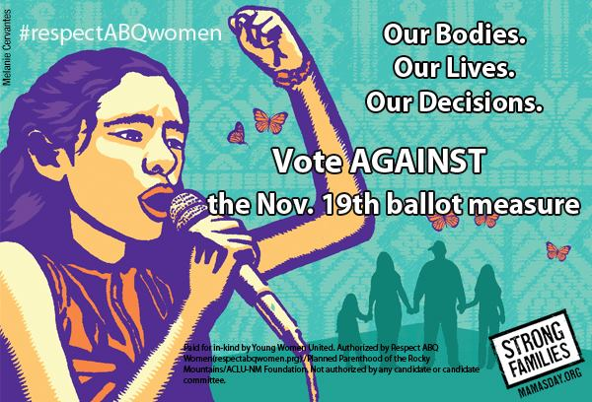

Slide 42
We Respected ABQ Women and We Won
55% AGAINST , 44% FOR
Notes:
-On the summer of 2013 anti abortion activists gathered signatures to introduce an anti-abortion ballot measure that would ban abortion after 20 weeks in abq
-The first municipal attempt ever
-We won

Slide 43
Creating the Respect ABQ Women Campaign
Respect ABQ Women Steering Committee: ACLU-NM, NM Religious Coalition for Reproductive Choice, Planned Parenthood of NM, Southwest Women’s Law Center, Southwestern Women’s Options, Strong Families NM, & Young Women United

Slide 44
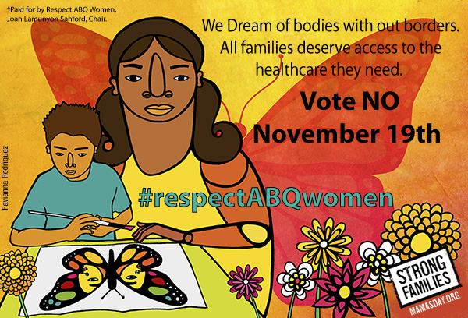
Campaign Long Term Goals
Defeat the abortion ban ballot measure
Build infrastructure of data management and volunteers to last beyond the campaign
Build capacity of individual organizations to maintain access to repro health & rights
Build strength within key legislative districts
Notes:
Take out?

Slide 45
Shifting the Narrative on Abortion
Shifted messages away from polarizing
pro-life/pro-choice
frame
Recognized values already held by New Mexico Families
Decades working in our communities and in Reproductive Justice
Notes:
-Shifted narrative bc traditional messages were going to move our base but not people who hadn’t been asked to weigh in
- Framed this election as a complex health decision that needed to remain in the hands of women, families and their doctors.

Slide 46
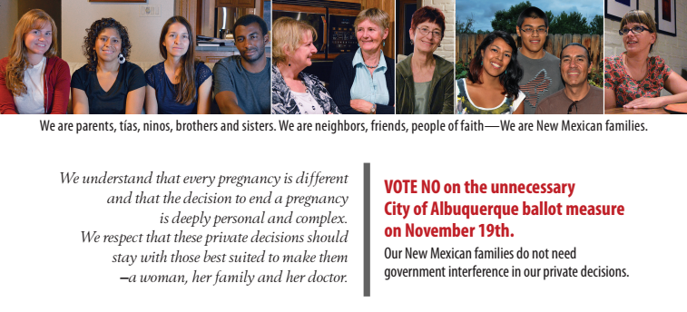
Shifting the Narrative on Abortion
Together we acknowledged that:
abortion is complex
a family frame is necessary
these healthcare decisions need to remain with women and doctors, without government interference

Slide 47
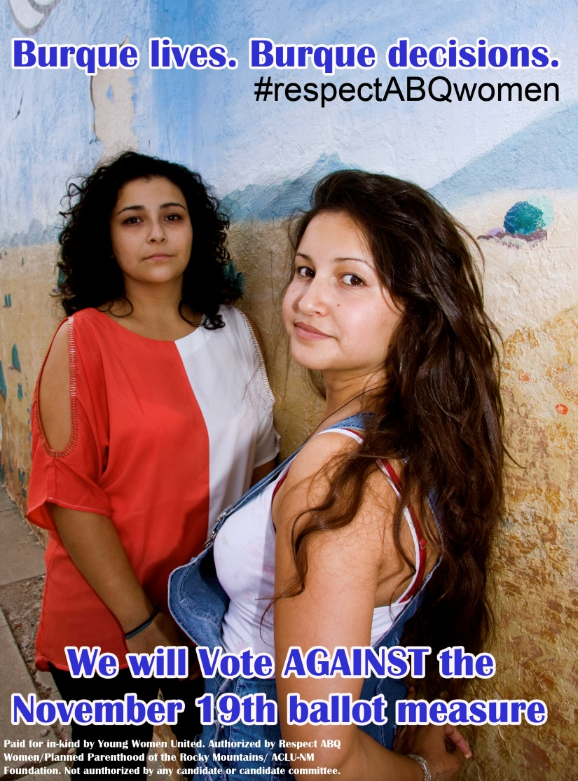
Creating a Successful Media Strategy
Social Media
Radio
Earned Media

Slide 48
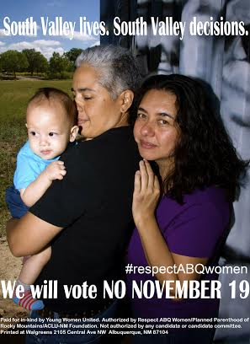
Field Highlights
Voter contact:
403,471 attempts
68,002 contacts
23,424 vote against ID's
80,000 + people voted
Brought 25% of voters

Slide 49
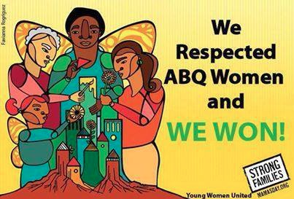
Ongoing Civic Engagement
State and National
Elections
School
Board Elections
State Legislative Session
State Legislative Session
November 2012
2013
November 2013
Elections
2014

Slide 50
HEFN
helps
funders
learn,
connect &
collaborate
for
greater
impact on
environmental
health &
justice
HEFN Annual Meeting:
Oct. 27-28, 2014
Los Angeles, CA
www.hefn.org

