Slide 1
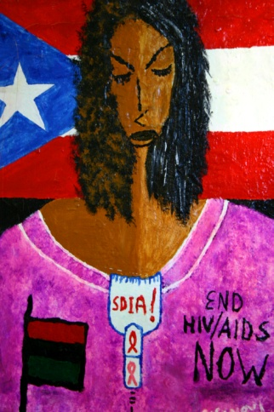
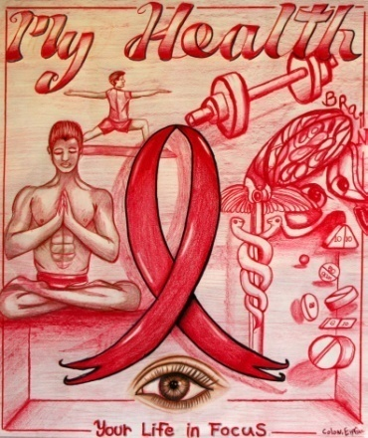
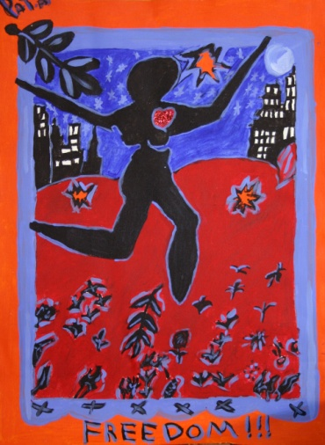
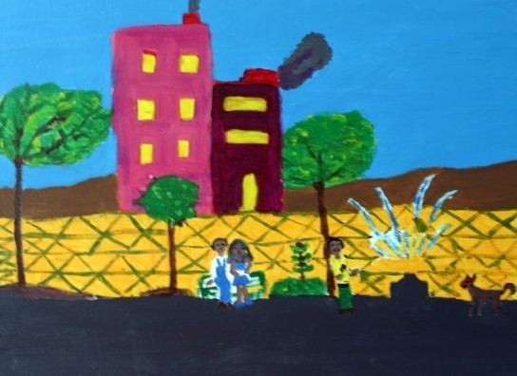
Access NY Collaboration
Positive Charge
Positive Charge
Amida Care (AC) & PCDC
AIDS United/BMS
NYC AIDS Fund & United Hospital Fund

Slide 2
ACCESS NY Project Rationale
National HIV/AIDS Strategy (2010)
NYC Ryan White Planning Council’s CHAIN Study (2005)
While past efforts to bring individuals into care were initially successful, when combined with the complexity of target populations and deficiencies within the systems of care to address those needs 40% of people living with HIV/AIDS never established a true medical home for ongoing care or dropped out of care when other safety issues or life needs went unmet.

Slide 3
Barriers to Care Access/Retention
Consumers
Medicaid
Providers
Stigma, Fear & Shame
Unstable Housing/Transiency
Substance Use
Mental Illness
Hopelessness & Learned Helplessness
Use of Emergency Room for care
Uninsured/Co-pays ?
One medical service a day per facility
PCPs who aren’t HIV Specialists
People like being able to go anywhere that accepts Medicaid (Shop Around)
Providers often don’t talk to each other
What do you do on nights & weekends?
It can be difficult to get medical documentation
Length of time it takes to get appointments
Rigid Medicaid formularies for medical necessity decisions
Length of wait times
Many providers at different locations
Overloaded systems
Under staffed or under utilization
Unable to respond w/ same day access (walk-in)
Pedagogical/ disrespectful approaches
40% PC practices lose money
STRENGTHS
STRENGTHS

Slide 4
ACCESS NY Project Goals
ACCESS & RETENTION:
Register/re-engage 1,650 new patients in medical homes over 3 years
Facilitate real linkages to HIV Specialist PCPs, with coordinated specialty, behavioral health, case mgt, and peer support services
Retain 75% in regular comprehensive care and on/adherent to HAART as medically appropriate
SYSTEM REDESIGN:
Redesign HIV primary care provision to become more effective, efficient and patient-centered through
Provider Learning Collaborative for 6 CHCs/CBO
Provide individualized training and TA to further strengthen and personalize the provider organization’s redesign
Teach/Spread through a Best Practices Manual

Slide 5
Investing in Innovation
Be Mobile:
Community Health Outreach Workers
Health Navigators
Escorts
Mobile Engagement Teams (Psychiatric/Substance Use)
Better Days (formerly incarcerated)
Involve Consumers in Decision-Making:
Program Development (LYL Program)
Compensation
Wellness Focus & Foster Self-Mgt/Responsibility:
Be Real & Believe (in Me) & “Meet Me Where I’m At”
Cultural Competence (LYL Program)
Incentivizing Desired Outcomes
Consumer-to-Consumer Inspiration
Redesign Systems:
Secret Shopper Calls
Overbooking = ⬆ No Show Rates
Same Day / Next 3rd Day Access
Cycle Time Studies
Capacity / Productivity
Teams

Slide 6
Amida Care’s Care Coordination Model
Member Services & Care Coordinator
CLOW
CHOW
Member
Primary Care Provider
Community
Case Manager
Health Navigator
PEER MAC
Specialty Care Providers
Behavioral Health Provider

Slide 7
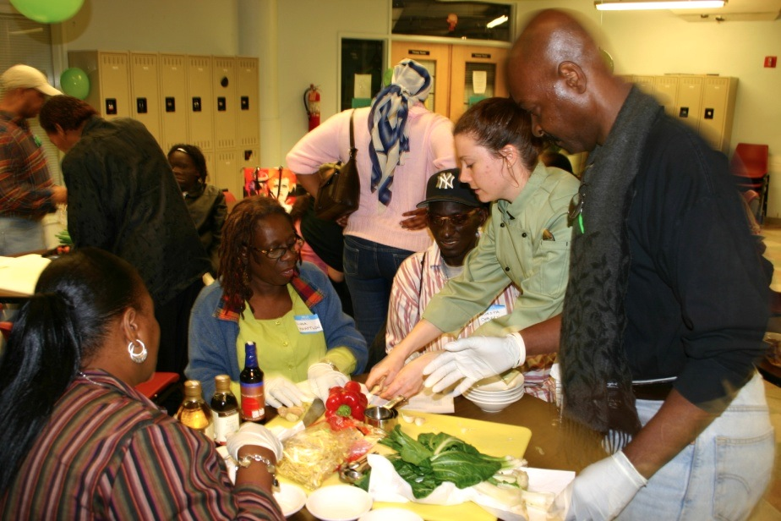
Telling Our Stories: Many Paths to Healing & Wellness
Before joining Amida Care:
Maria, East Harlem – age 35, dropped out of care, became depressed, isolated and hurting
Clarence, Central Harlem – age 47, became homeless living on a park bench, diabetic, psychiatric issues, detox/rehab stays, not in care
Robert, Brooklyn – age 40, had been waiting for Medicaid to approve wheelchair for 10 months; dropped out of care
Paula, Bronx – age 22, busy community college student, left care /stopped HIV treatment for 18 months resulting in high virus and low t-cells, low energy and experienced tough side effects
Since joining Amida Care:
Maria – got a new provider she likes, had surgery to remove disfiguring keloid and received outpatient mental health care
Clarence – received detox/rehab treatment, was housed within 48 hours and now in regular care
Robert – received wheelchair within 10 days of his doctors order, back in regular care
Paula – has a new provider in community clinic, is back on HIV medication, is undetectable after six months, has energy, back in care and going to school
Members attending a monthly LIVE YOUR LIFE health promotion event on healthy cooking for energy and immune system boost!

Slide 8
Founded In 1999 by 7 non-profit, community-based AIDS organizations who formed a health plan specifically designed to meet the needs of people living w/ HIV/AIDS (HIV SNP):
Harlem United, Housing Works, Acacia Network (Promesa/Basics), Project Samaritan, St. Mary’s Episcopal Center, Village Care, Greyston/Mattri Foundation
Over 5,000+ Members (2012)
90% hard drug use histories/30% active use; 50% mental health issues (depression to major mental illness); 40% experienced homeless since HIV diagnosis; 92% in routine care w/ HIV monitoring
Lewin Group independent study (2010) documented that HIV SNPs saved 15% over FFS Medicaid (no Care Mgt/Cost Containment)
Saving was from reduced use of costly services (such as inpatient readmissions and detox/rehab) while maintaining outpatient utilization of routine and preventative care, supportive services and increasing medically appropriate pharmacy.
For more information, visit www.AmidaCareNY.org. or contact: Doug Wirth, President/CEO
(646) 786-1800 / dwirth@amidacareny.org

