Slide 1
Jewish Healthcare Foundation
HIV/AIDS Readmission Reduction Project
Grantmakers in Health
Annual Conference
March 8, 2012
Scott Rosenblum
Notes:
In role since 1992, one of seven across state
Manages more than $3 million annually from multiple funding sources
PA DoH – State, Ryan White (Federal), HOPWA (HUD)
City of Pittsburgh - HOPWA
Biannual procurement process to select subgrantees
2011/13 just completed, 15 subgrantees in next period
Monitoring, data reporting, quality management, technical assistance, and payment

Slide 2
JHF’s commitment to the HIV/AIDS community
Fiscal agent for southwestern PA
since 1992
  Manages more than $3 million annually from multiple government funding sources
  15 subgrantees
  Monitoring, data reporting, quality management, technical assistance, and payment
Foundation grants to support community
  Quality improvement and capacity building
  Needs assessment
  Seed funding

Slide 3


Agenda
The opportunity
  High hospital readmissions rates among HIV+ population
The strategy
  Perfecting Patient CareSM training/coaching + federally-sponsored services + private funding
Challenges and
takeaways

Slide 4

Conclusions from data analysis on
HIV/AIDS readmissions
High rates of co-morbid depression and/or substance abuse
High rates of other chronic diseases, including hypertension and diabetes
HIV/AIDS is similar to other chronic conditions with which PRHI has been successful
Notes:
As our researchers delved into the PHC4 Data, we found that among chronic conditions, people living with HIV/AIDS had one of the highest hospital readmission rates. <click> This launched deeper exploration into the data that found:
Not only did this population have high rates of co-morbid depression and substance abuse, but those with substance abuse disorders were significantly more likely to be readmitted to the hospital within 30 days.
The readmission rate for those who were discharged to skilled nursing facility was 35%, the highest among the discharge options and even higher than “left against medical advice.”
These patterns are similar to other chronic diseases on which we have worked, namely COPD….

Slide 5
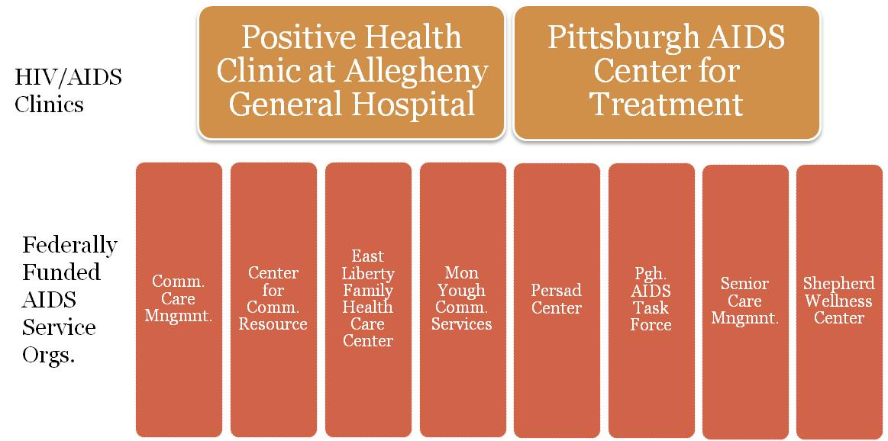

Our question
Can we reduce unnecessary hospital readmissions by applying Lean process improvement principles with federally funded AIDS service organizations?
+

Slide 6
A Two-pronged strategy
On-site coaching to HIV/AIDS clinic to restructure processes
  Improve outpatient care to patients
  Free up time to work with hospitalized patients
  Better track and communicate about hospitalized patients
Activating the Ryan White Part B Network
  Create a cross-agency workgroup to coordinate services
  Provide training and support to realign resources
  Develop communication and data sharing systems
Notes:
Hospitals can’t do it alone and neither can clinics… how often are patients readmitted b/c of gaps in the community safety net…

Slide 7
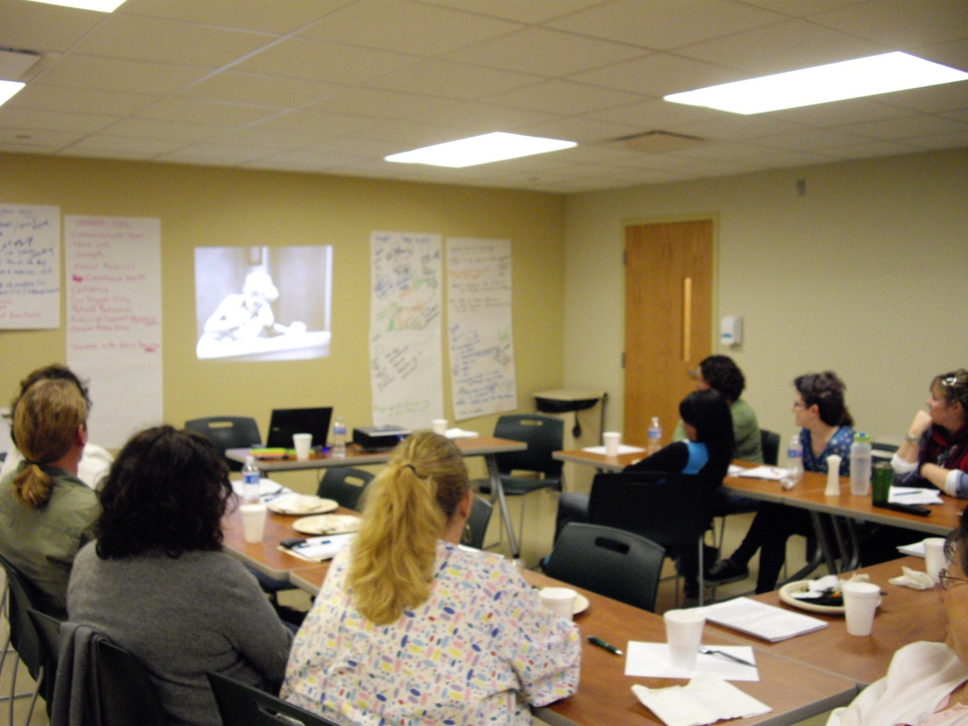
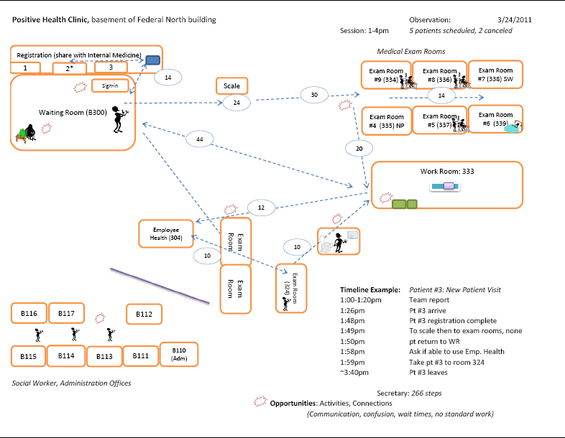
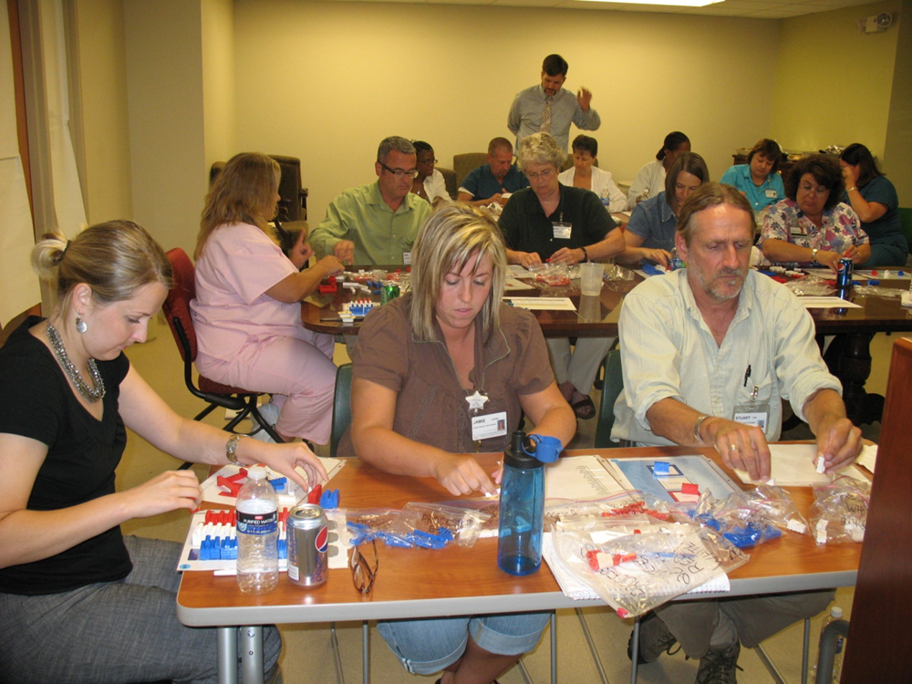
First steps: Initial engagement with clinic
Brainstorming session
Observations
Identification of engagement areas
Process improvement training
Notes:
Possibly use smart art pictures with this…

Slide 8
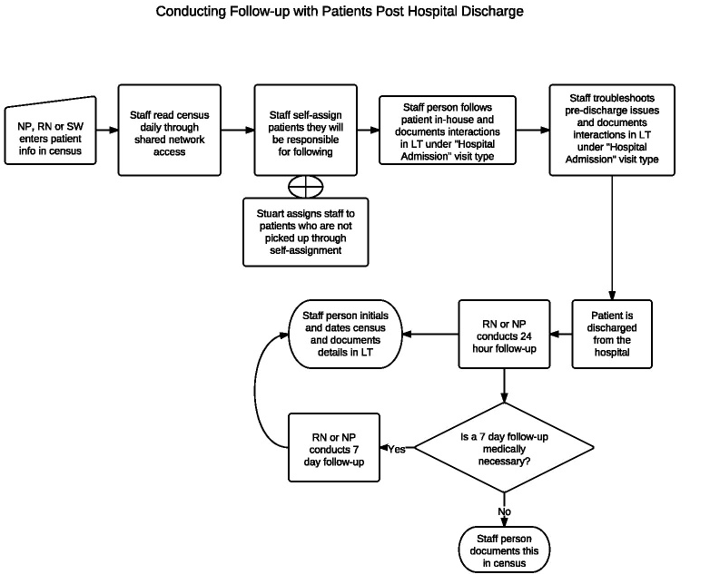
Seeing with new eyes:
Training leads to new and improved processes
New patient rooming process established at clinic
  August 2011
New process during hospitalization
  September 2011
Notes:
With each bullet, bring in other visual
New patient rooming process, opened their eyes into what was possible, what they could do internally to fix themselves…

Slide 9
Encouraging results through December 2012

Slide 10
Encouraging results through December 2012

Slide 11
Continuous learning,
Continuous quality improvement
Continued QI training
New project: Patient flow in the social work clinic
Future challenge: Effectively incorporating EHRs, i.e. meaningful use
Notes:
Really tried to listen to what their need was now…
Integrate the two parts of the clinic
Overcome resistance, training opportunities building on eachother
Bring pictures in smaller

Slide 12

Challenges tackled
Communicated the value of the Lean approach
Developed leadership in the clinic
Created contacts and connections to the hospital

Slide 13
Challenges activating the network
Accomplishments
Challenges
Focused brainstorming sessions
ASOs working together and communicating in new ways
  Consent to share information
  Communication networks
  Data sharing pilots
Engagement among competing priorities
Varied comfort with data sharing
Creating an open/non-competitive atmosphere
Notes:
Engagement among competing priorities
Varied comfort with data sharing
Creating an open atmosphere
Add challenges here? And delete last slide….

Slide 14
Lessons learned
It’s possible to reduce hospital readmissions even among very challenging patient populations.
Organizations may have the necessary resources, but need to be challenged and coached to restructure operations.
Foundations can play an important catalyzing role in this process.

