Slide 1
Hospital Community Benefits and Community Health Improvement: Reference Materials
Abbey Cofsky, MPH
Senior Program Officer
Robert Wood Johnson Foundation
Acofsky@rwjf.org

Slide 2
Contents
A Call for Community Action:
RWJF Commission to Build a Healthier America, 2013 Recommendations
A Platform for Community Action:
The County Health Rankings & Roadmaps
Stories of Community Action:
RWJF Culture of Health Prize; Newpublichealth.org

Slide 3
Why Act Now? America is Unhealthy
Nearly 1/5th of Americans live in unhealthy neighborhoods:
Limited job opportunities
Low-quality housing
Limited access to healthy food
Few opportunities for physical activity
www.rwjf.org/commission
Notes:
When it comes to health, a person’s ZIP code may be more important than their genetic code. This is where the community development sector – which is in the ZIP code-improving business – comes in.
Today, one-fifth of all Americans live in low-income neighborhoods that offer few opportunities for healthy living:
Limited job opportunities
Low-quality housing
Limited access to healthy food
Few opportunities for physical activity

Slide 4
Recommendations:
1
Make investing in America’s youngest children a high priority.
Fundamentally change how we revitalize neighborhoods, fully integrating health into community development.
Broaden the mindset, mission, and incentives for health professionals and health care institutions from treating illness to helping people lead healthy lives.
2
3
Notes:
Commissioners issued three broad recommendations:
Support our nation’s children, especially those who are most vulnerable, beginning in the earliest years;
Transform communities—especially low-income communities—to make healthy decisions possible; and
Broaden the mission of the health care system to address non-medical factors that affect health AND connect patients to resources and services in the community that can improve their ability to pursue better health.

Slide 5
Recommendation 1: Make investing in America’s youngest children a high priority
Create stronger quality standards, link funding to quality, and guarantee access: fund enrollment for all low-income children under age 5 (2025 goal).
Help parents who struggle to provide healthy, nurturing experiences for their children.
Invest in research and innovation.

Slide 6
Recommendation 2: Fundamentally change how we revitalize neighborhoods, fully integrating health into community development
Support and speed the integration of finance, health, and community development to revitalize neighborhoods and improve health.
Establish incentives and performance measures to spur collaboration.
Replicate promising, integrated models. Invest in innovation.

Slide 7
Recommendation 3: Broaden the mindset, mission, and incentives for health professionals and health care institutions from treating illness to helping people lead healthy lives.
Adopt new health “vital signs” to assess non-medical indicators for health.
Create incentives tied to reimbursement for health professionals and health care institutions to address non-medical factors that affect health.
Incorporate non-medical health measures into community health needs assessments.

Slide 8
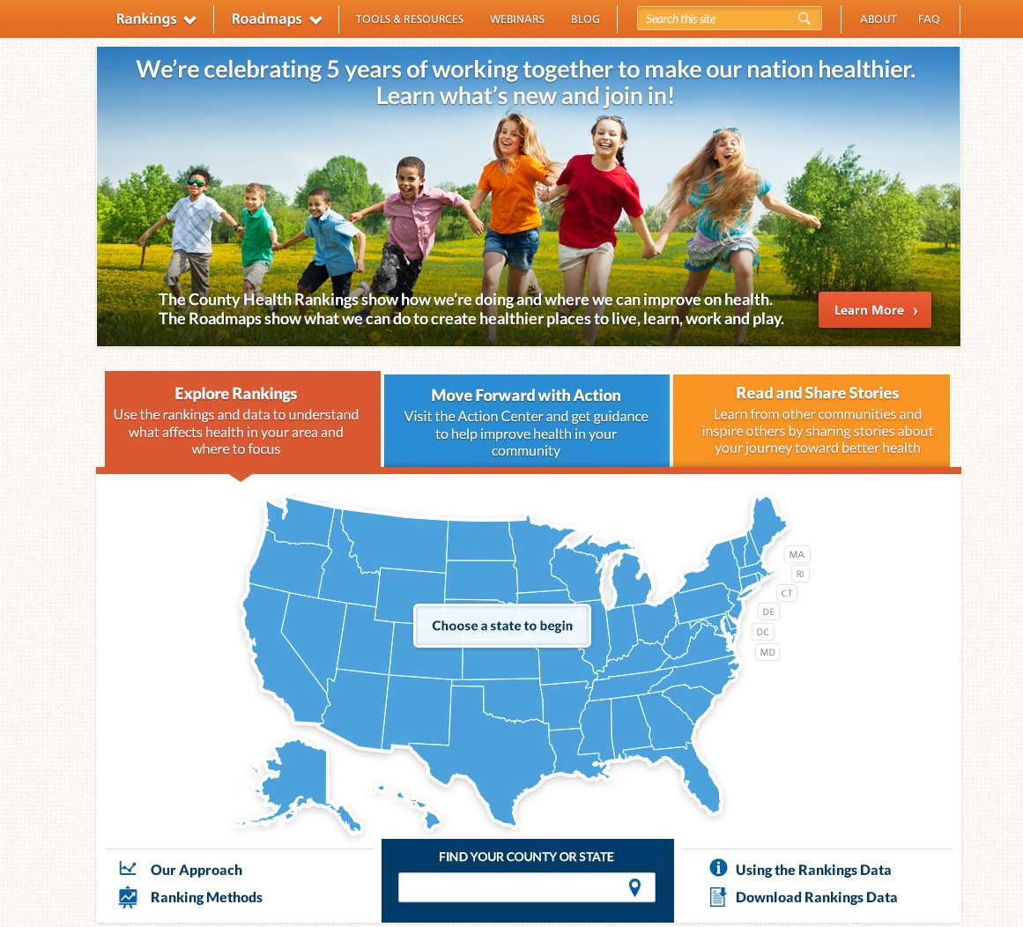
www.countyhealthrankings.org

Slide 9
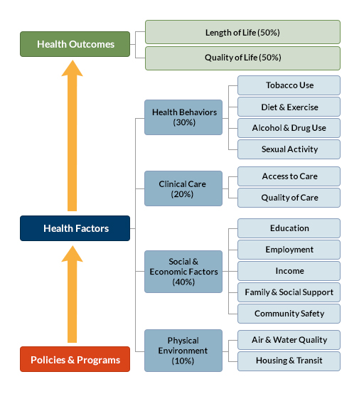

Slide 10
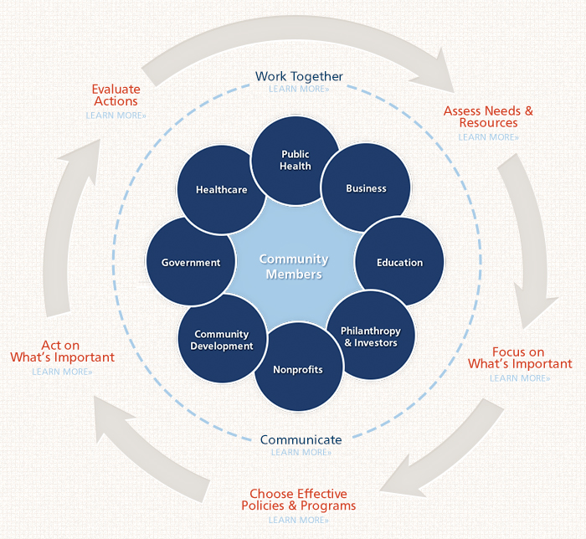

Slide 11
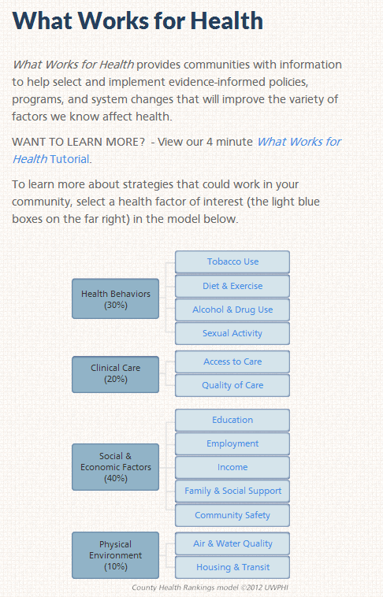
What Works for Health
Find effective programs and policies at www.countyhealthrankings.org/what-works-for-health

Slide 12
RWJF Culture of health prize
Annual prize
Honoring outstanding community efforts and partnerships
Winning communities receive a $25,000 cash prize
2014 winners to be announced Summer of 2014
www.countyhealthrankings.org/roadmaps/prize

Slide 13
Rwjf Culture of Health Prize Winner
“None of us can do it alone, we have to work together.”

Slide 14
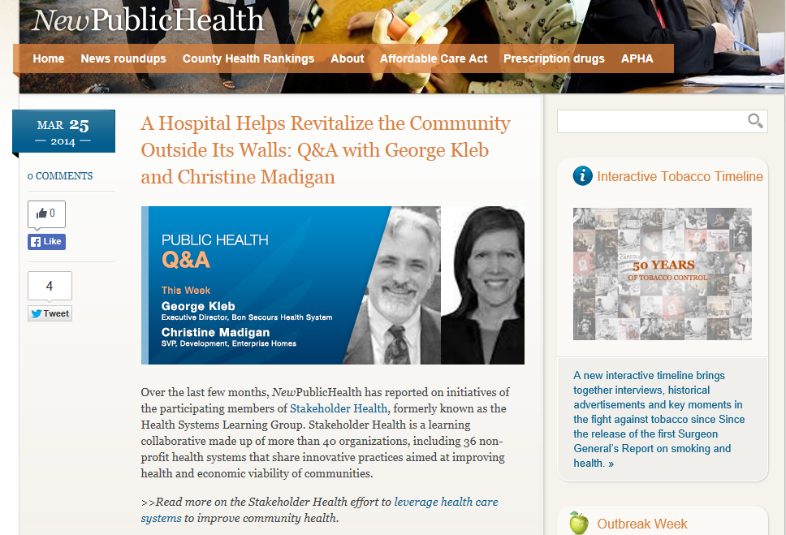
Newpublichealth.org

