Slide 1
THE VOICE OF PHILANTHROPY IN EFFECTING HEALTH SYSTEMS CHANGE
Regina M. Benjamin, MD, MBA
18th Surgeon General of the United States
Gail C. Christopher, DN
Vice President for Program Strategy, W.K. Kellogg Foundation
Wayne Jonas, MD
President and CEO, Samueli Institute
Steven H. Woolf, MD, MPH Center on Society and Health, Virginia Commonwealth University
Moderated by: Gerald Solomon, JD
Executive Director, Samueli Foundation
GRANTMAKERS IN HEALTH ANNUAL CONFERENCE | March 5-7, 2014 |Atlanta, GA

Slide 2
Gerald Solomon, JD
Executive Director, Samueli Foundation

Slide 3
STEM Education: Lessons Learned 2007 Call to Action
In a world where advanced knowledge is widespread and low-cost labor is readily available, U.S. advantages in the marketplace and in science and technology have begun to erode. A comprehensive effort is urgently needed to bolster U.S. competitiveness and pre-eminence in these areas. This congressionally requested report makes four recommendations along with 20 implementation actions to create high-quality jobs and focus new science and technology efforts on meeting the nation's needs:
Increase America's talent pool by vastly improving K-12 mathematics and science education;
Strengthen the nation's commitment to long-term basic research;
Develop, recruit, and retain top students, scientists, and engineers from both the U.S. and abroad; and
Ensure that the United States is the premier place in the world for innovation. Some actions will involve changing existing laws, while others will require financial support that would come from reallocating existing budgets or increasing them.
Source: National Research Council. Rising Above the Gathering Storm: Energizing and Employing America for a Brighter Economic Future. Washington, DC: The National Academies Press, 2007.

Slide 4
Building on the Past; Preparing for the Future
2005-07
2009 - 2011
2011 – 2013

Slide 5
Changing the Landscape – A STEM Ecosystem
Change The Equation
National Funders Network
National STEM Initiatives
Federal Support…RTTP, i3, etc
State Networks
State STEM Initiatives
Regional Network
County STEM Initiatives
Early Learning
Elementary School
Middle School
High School
Higher Education
Birth
1 yr
2 yr
3 yr
4 yr
K
1st
2nd
3rd
4th
5th
6th
7th
8th
9th
10th
11th
12th
13th
14th
15th
16th
Career
Next Generation Science Standards
Common Core State Standards
Implementation
Adoption
Parents
Students
Businesses
Community-Based Organizations
Education
Local STEM Education Funding Community

Slide 6
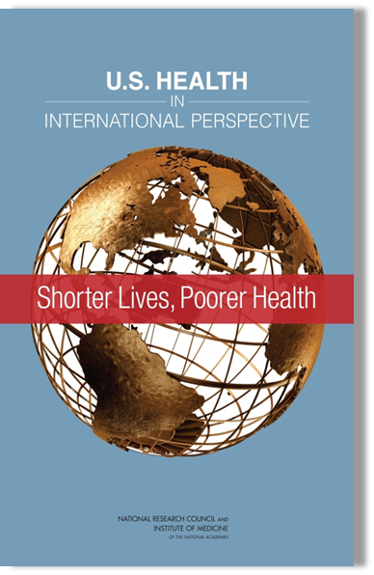
Shorter lives, poorer health: the national research council/(IOM) institute of medicine Report Steven H. Woolf, MD, MPH Center on Society and Health Virginia Commonwealth University

Slide 7
Overview of Comparison Group
17 comparable high-income nations
Australia, Austria, Canada, Denmark, Finland, France, Germany, Italy, Japan, Norway, Portugal, Spain, Sweden, Switzerland, the Netherlands, the United Kingdom, and the United States

Slide 8
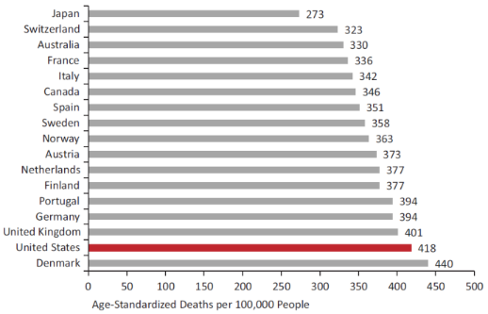
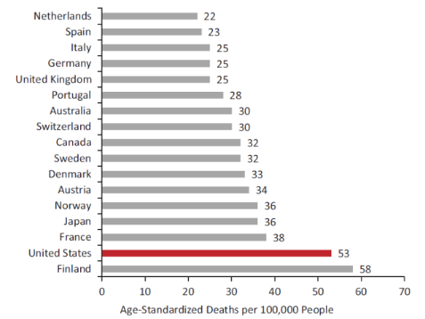
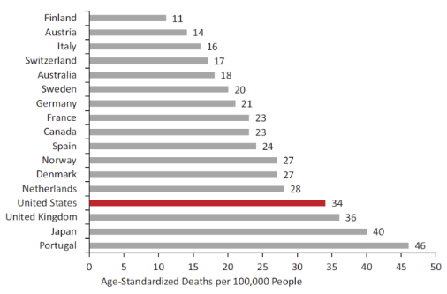
Mortality Rates in Peer Countries, 2008
Non-communicable diseases
Communicable diseases
Injuries

Slide 9
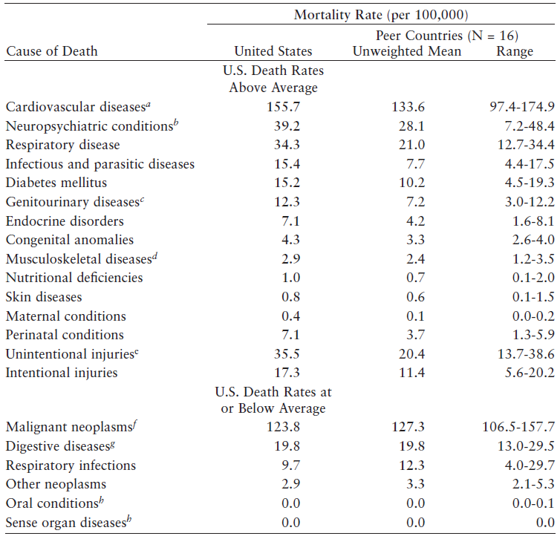
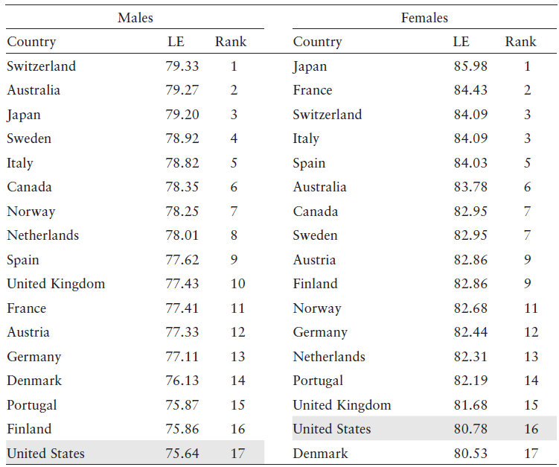
Higher Mortality Rates and Lower Life Expectancy
Mortality Rates by Cause of Death
Life Expectancy

Slide 10
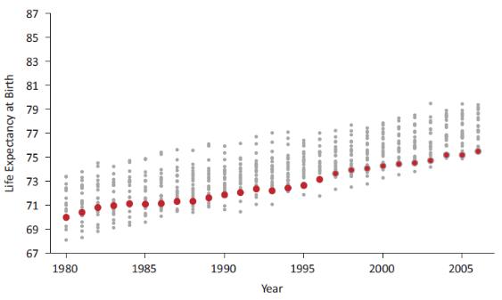
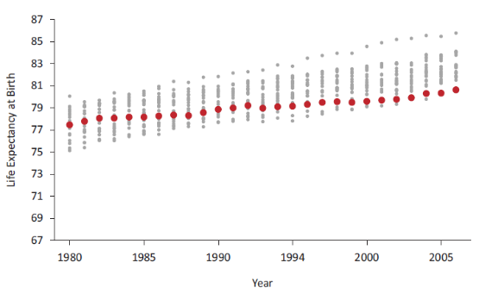
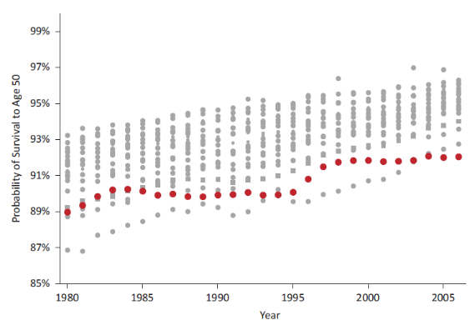
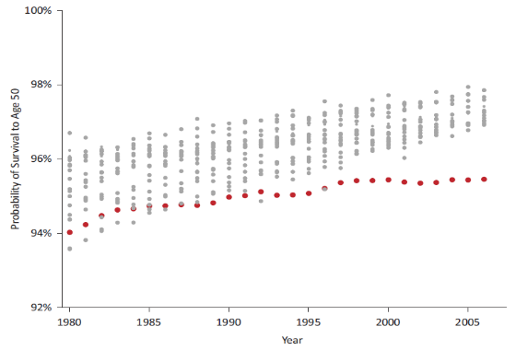
Changes in Life Expectancy over Time
Life Expectancy at Birth - Male
Life Expectancy at Birth - Female
Probability of Survival to Age 50 - Male
Probability of Survival to Age 50 - Female

Slide 11
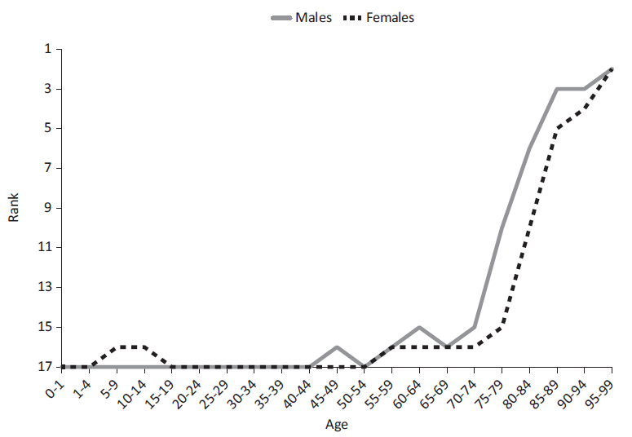
Low Life Expectancy at Every Age
Ranking of US Mortality Rates by Age Group vs. Peer Countries, 2006-2008
For either sex, the US rank is never better than 15th out of 17 until age 75.

Slide 12
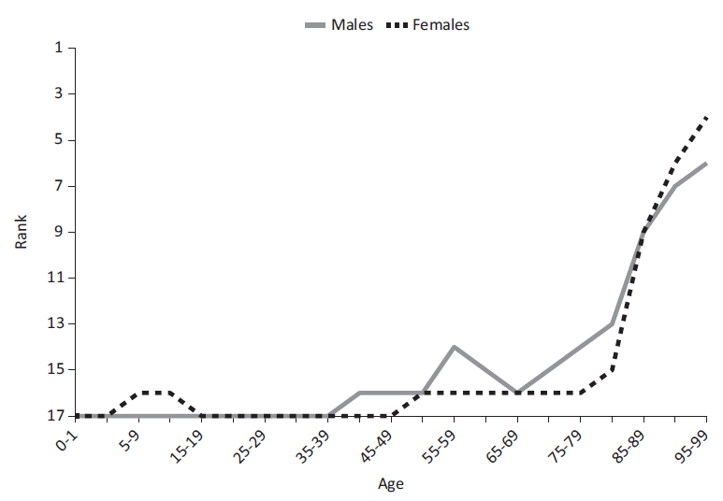
Low Life Expectancy for Non-Hispanic Whites
Ranking of Mortality of Non-Hispanic Whites by Age Group vs. Peer Countries, 2006-2008
For either sex, the US rank is never ranked higher than 16th out of 17 until age 55.

Slide 13
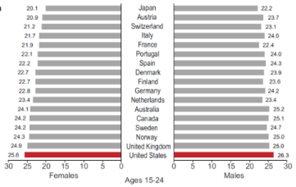
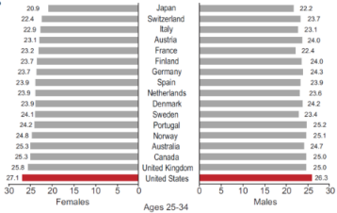
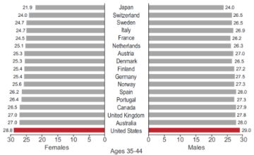
BMI and Obesity
Average BMI in Peer Countries, 2008
The US has the highest prevalence of adult obesity among all OECD countries, a position it has held for decades.
As of 2009, the prevalence of obesity in the US was twice the OECD average.
Notes:
As of 2009, the prevalence of obesity in the US (34%) was twice the OECD average (17%).

Slide 14
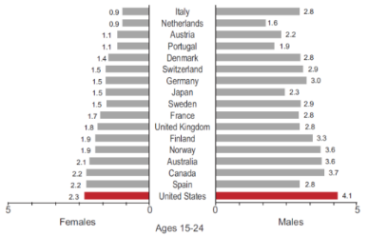
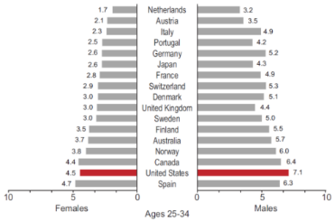
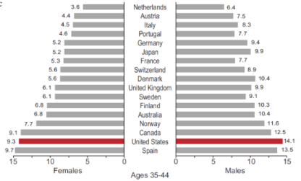
Diabetes
Self-Reported Diabetes Prevalence
in Peer Countries, 2008
As of 2010, the US had close to the highest prevalence of diabetes in adults aged 20-79 in all peer countries (and all OECD countries except Mexico).

Slide 15
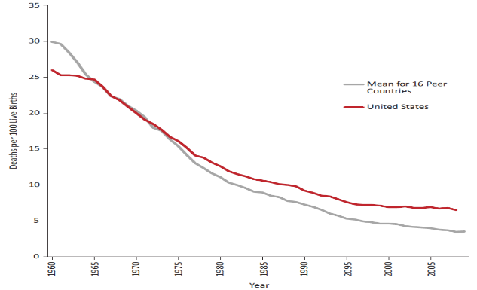
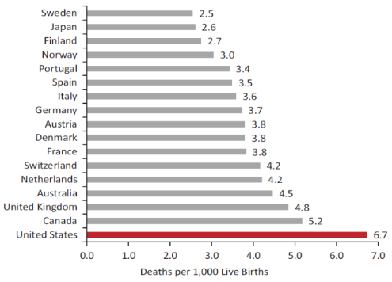
Infant Mortality in Peer Countries
Deaths per 1,000 Live Births
From 2005-2009, the US had the highest infant mortality rate of the peer countries and the 9th highest in the OECD.
Well-educated non-Hispanic whites and mothers have higher infant mortality rates in the US than those in other countries.
Since the 1970s, US infant mortality has not kept pace with declines achieved by other countries.
US infant mortality declined by 20% from1990-2010, but comparable high-income countries halved their rates.

Slide 16
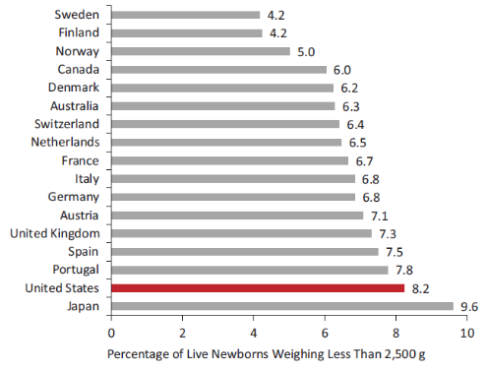
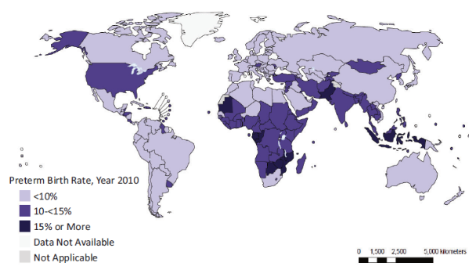
Other Birth Outcomes
Low Birth Weight in Peer Countries
The US prevalence of low birth weight is the second highest of the peer countries.
US stillbirths and perinatal mortality rates are also among the highest.
A 2012 analysis found that the US preterm birth rate (12%) was comparable to that of sub-Saharan Africa.
Global Preterm Birth Rates
Blencowe et al. 2012
Notes:
The US prevalence of low birth weight (8.2% for 2005-2009) is the second highest among the peer countries.

Slide 17
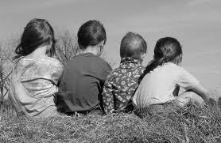
US Children’s Health Disadvantage
Children in the US have the highest probability of dying before age 5 of any of the peer countries.
In 2004, 11% of US deaths before age 5 were from injuries.
In 2006, the US had the highest rate of child deaths due to negligence, maltreatment, or physical assault.
The violent death rate among US boys aged 1-4 has exceeded the OECD average since the late 1960s
The US is ranked 24th of 30 (OECD) and 21 of 21 (UNICEF) on selected measures of children’s well-being.
Notes:
The probability of children dying before age 5 (8 per 1,000) is higher in the US than in the 16 peer countries.
In 2004, 11% of US deaths before age 5 were from injuries, the second largest proportion of the peer countries.
The violent death rate among US boys aged 1-4 has exceeded the OECD average since the late 1960s; the same has been true for unintentional injury deaths for boys and girls.

Slide 18
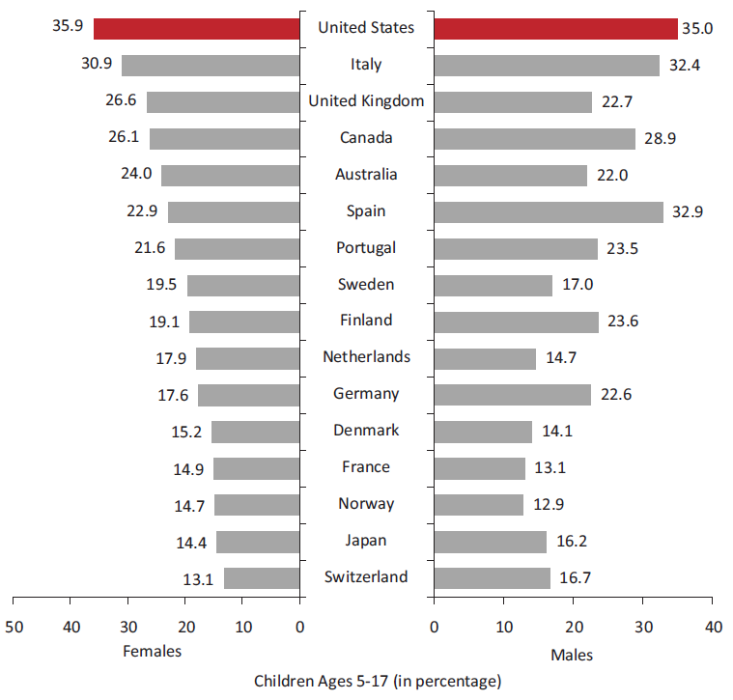
US Adolescent Health Disadvantage
Prevalence of overweight (including obese) children in peer countries (2011)
Adolescent obesity rates in the US far exceed those in comparable nations
In 2010, the US had the 5th highest prevalence of diabetes among children ages 0-14 in peer countries.
Among teens aged 15-19 in 2005, the US had the highest all-cause mortality rate among peer countries.
Notes:
In 2011, one-third of US children aged 5-17 were overweight/obese, the highest rate among peer countries.
US mortality rates at ages 15-24 have been higher than the OECD mean since the 1950s for males and since the 1970s for females.
As of 2005, the obesity rate for youth 12-17 years of age was more than double the OECD mean.
Obesity among US non-Hispanic whites aged 5-13 was higher than the OECD average for ages 5-19.

Slide 19
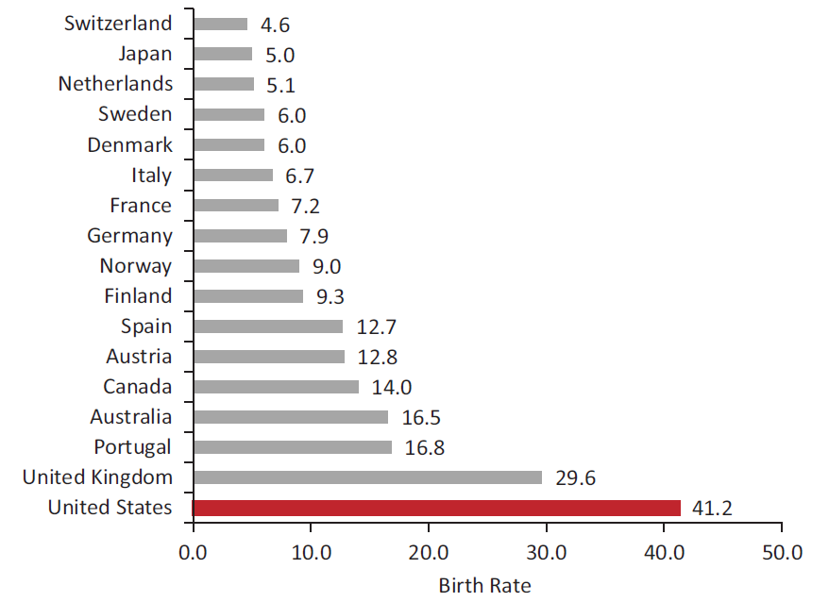
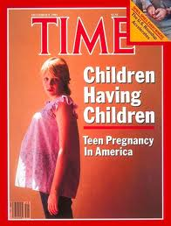
Adolescent Sexual Health
The US has the highest teen pregnancy rate, nearly 3.5 times the average of peer countries in 2010.
The US has a higher prevalence of syphilis, gonorrhea, and chlamydia among15-19 year-olds than any other high-income country that provided comparison data.
Among high-income countries, the US has the highest prevalence of HIV infection at ages 15-24.
Adolescent Birth Rate, 2010
Notes:
Note: each of the bullets refers to a different study, which uses a different comparison group. For more, see book.

Slide 20
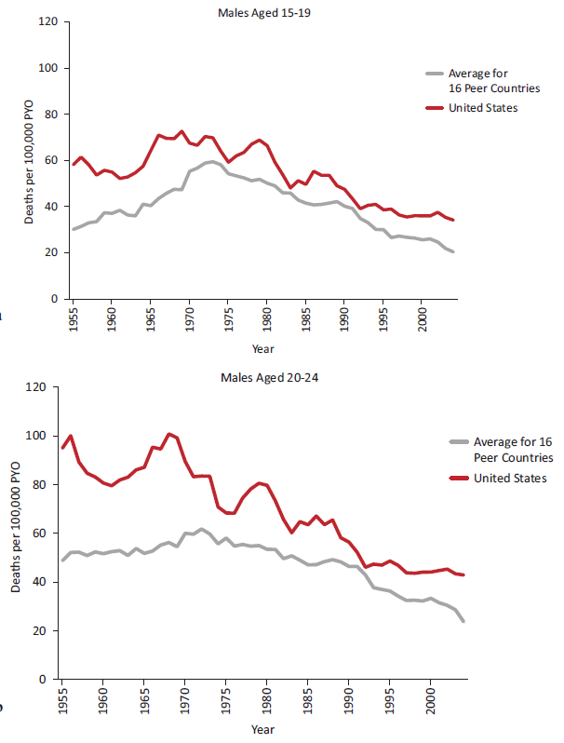
Youth Injury Mortality
Transportation-related Mortality in Peer Countries
Among adolescents aged 15-19 in 2005, the US had the highest injury mortality rate.
Since the 1950s, transport injury mortality at ages 15-24 has been higher in the US than in peer countries.
Since the 1960s, the US has had higher non-transport injury mortality among children aged 5-9, and especially among males aged 10-19.

Slide 21
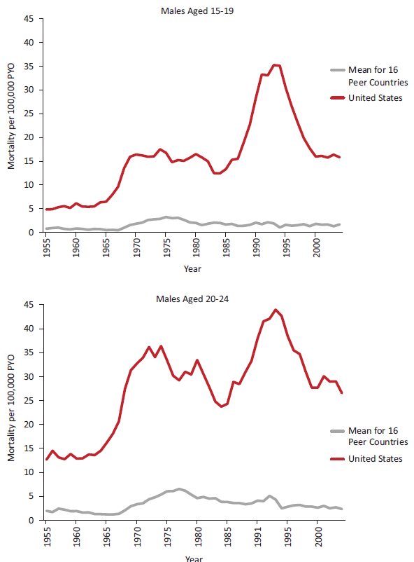
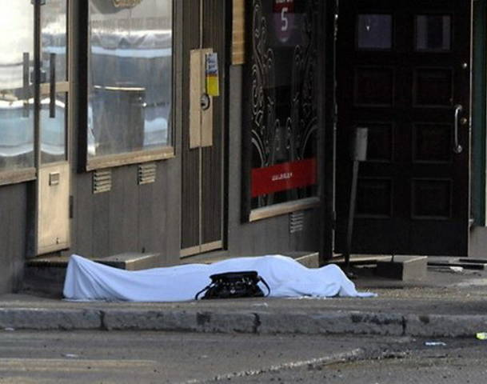
Youth Mortality from Violence
Violent Mortality in Peer Countries
Since the 1950s, males aged 15-24 have been far more likely to die from violence in the US than in the peer group.
US males aged 15-19 are 5 times more likely to die from violence than those in other OECD countries.

Slide 22
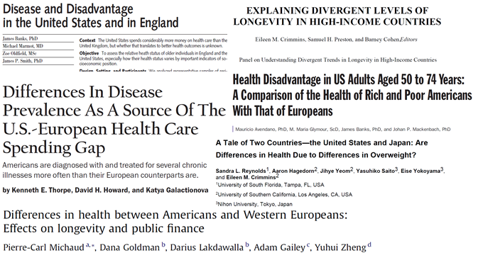
Age 50 and Above
Conditions more prevalent in the US among those age 50 and older
Obesity
Diabetes
Hypertension
Heart disease
Myocardial infarction
Stroke
Chronic lung disease
Asthma
Cancer
Arthritis
Activity limitations

Slide 23
Nine Areas of US Health Disadvantage
Infant
Mortality &
Low Birth Weight
Injuries & Homicides
Adolescent Pregnancy & STIs
HIV & AIDS
Drug-related Deaths
Obesity & Diabetes
Cardiovascular Disease
Chronic Lung Disease
Disability
Notes:
In this report, we bring together hundreds of studies, the combined expertise of our panel members and others who contributed to the study to conclude that we absolutely fare worse in life expectancy and nine key health areas in comparison with other high-income countries.
We documents that American males and females of all ages—from birth to age 75—have shorter life expectancies than their counterparts in 16 other rich nations. But the scope of the U.S. health disadvantage is pervasive and involves more than life expectancy: the United States ranks at or near the bottom for multiple diseases, biological and behavioral risk factors, and injuries. Many of these conclusions have been made earlier, but this report puts them together and paints a very bad news picture of the health of our people compared with peer countries.

Slide 24
Determinants of Health
Health Systems
Insurance and access barriers
Weak primary care
Coordination and errors
The Environment
Physical environment
Social environment
Social Factors
Low income/poverty
Education
Social mobility
Incarceration
Single-parent households
Individual Behaviors
Caloric intake
Drug use
Sexual practices
Driver safety
Firearm possession

Slide 25
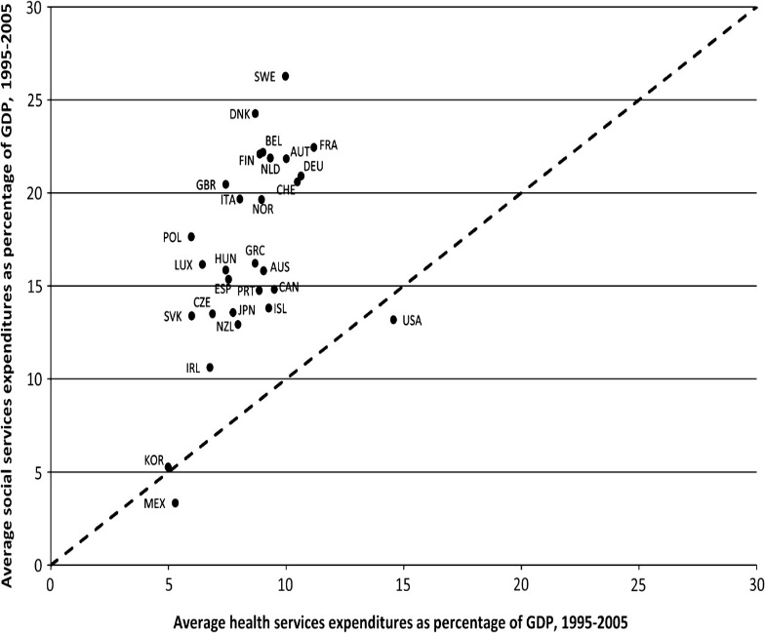
Policies and Social Values
Bradley E H et al. BMJ Qual Saf 2011;20:826-831

Slide 26
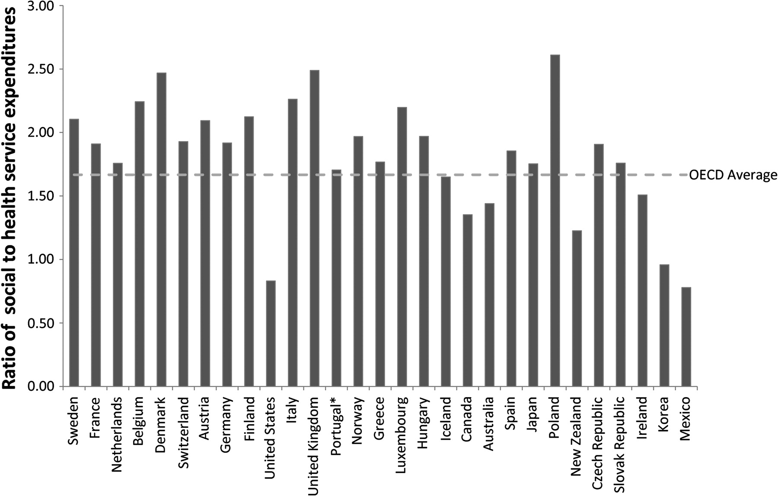
Ratio of social to health service expenditures for OECD countries, 2005.
Bradley E H et al. BMJ Qual Saf 2011;20:826-831
Copyright © BMJ Publishing Group Ltd and the Health Foundation. All rights reserved.
Notes:
Ratio of social to health service expenditures for Organization for Economic Co-operation and Development (OECD) countries, 2005. The ratio is calculated by dividing total expenditures on social services by total expenditures on health services. *The ratio for Portugal is from 2004, owing to missing data for 2005. Source: OECD Health Data 2009 (accessed June 2009); OECD Social Expenditure Dataset (accessed December 2009); authors' calculations.

Slide 27
Policy Recommendations
Recommendation 4: Intensify efforts to achieve established national health objectives that are directed at the specific disadvantages documented in this report and that use strategies and approaches that reputable review bodies have identified as effective.
Recommendation 5: Commission a review of the available evidence on (1) the effects of policies on the areas in which the US has an established health disadvantage, (2) how these policies have varied over time across high-income countries, and (3) the extent to which these policy differences may explain cross-national health differences.

Slide 28
Communication Recommendation
Recommendation 6: The philanthropy and advocacy communities should organize a comprehensive media and outreach campaign to inform the general public about the U.S. health disadvantage and to stimulate a national discussion about its implications for the nation.

Slide 29
Contact Information
Steven H. Woolf, MD, MPH
Director, VCU Center on Human Needs
Virginia Commonwealth University
swoolf@vcu.edu

Slide 30
Whole Person, Whole Systems Healing
Photo Goes Here
Wayne B. Jonas, MD
President and CEO, Samueli Institute
Professor, Department of Family Medicine, USUHS
Professor, Department of Family Medicine,
Georgetown University School of Medicine
March 6, 2014

Slide 31
OUR MISSION
HEALTH AND WELL-BEING
THROUGH
RESEARCH
INNOVATION
EDUCATION
Notes:
Our Mission is to create a flourishing society through the scientific exploration of wellness and whole person healing.
Founded as a non-profit, 501(C)3 research organization in 2001 by Susan and Henry Samueli, major supporters of holistic and integrative health care research, our service members and their families
Our mission is to create a flourishing society through the scientific exploration of wellness and whole-person healing

Slide 32
Samueli Institute Uncovers the Science of Health
THROUGH
FOR
TO
Achieve and maintain wellness
Reduce chronic symptoms
Improve performance
RESEARCH
INDIVIDUALS
INNOVATION
WARFIGHTERS
EDUCATION
SYSTEMS
Notes:
Our vision is a world in which healing processes are the formative concept for improving performance, preventing illness, achieving and maintaining wellness and ameliorating chronic disease.

Slide 33
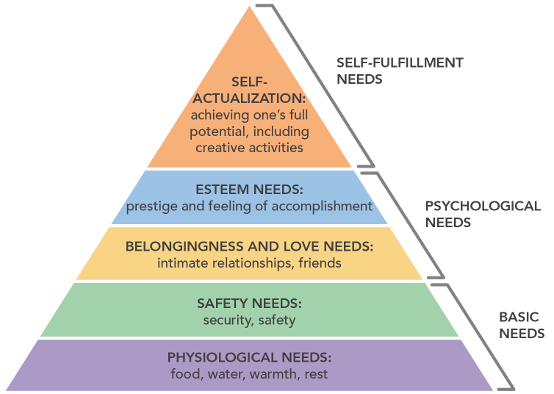
What Creates Human Flourishing?
Maslow’s Hierarchy

Slide 34
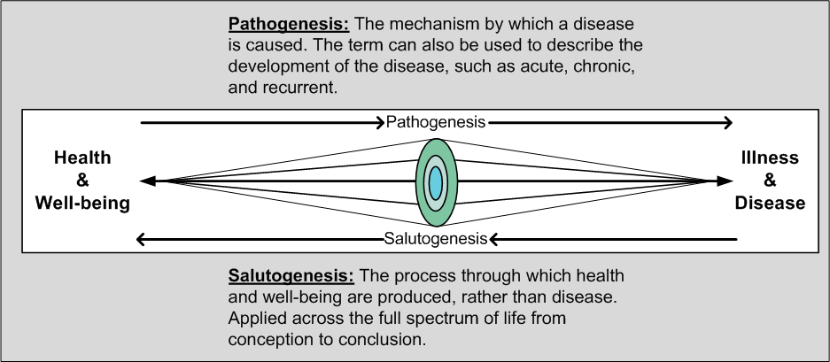
The Solution is Salutogenesis: The Process of Healing
Notes:
Potential Copyright Issue: Do we have the rights to use this graphic?

Slide 35
Core Components of Human Flourishing
PHYSICAL ENVIRONMENT
Psychological
Resilience
Exercise &
Sleep
SOCIAL
ENVIRONMENT
LEADERSHIP
ENVIRONMENT
PURPOSE
Social
Cohesion
Optimum
Nutrition
HEALTH CARE ENVIRONMENT

Slide 36
Multi-Stakeholder Cultural Change
The conditions for cultural change are:
a common vision, agenda and plan;
mutually reinforcing activities based on the plan;
shared measurement systems;
continuous communication among the team; and
a backbone support organization.
John Kania & Mark Kramer. Collective Impact. Stanford Social Innovation Review. Winter 2011, p. 36-41.

Slide 39
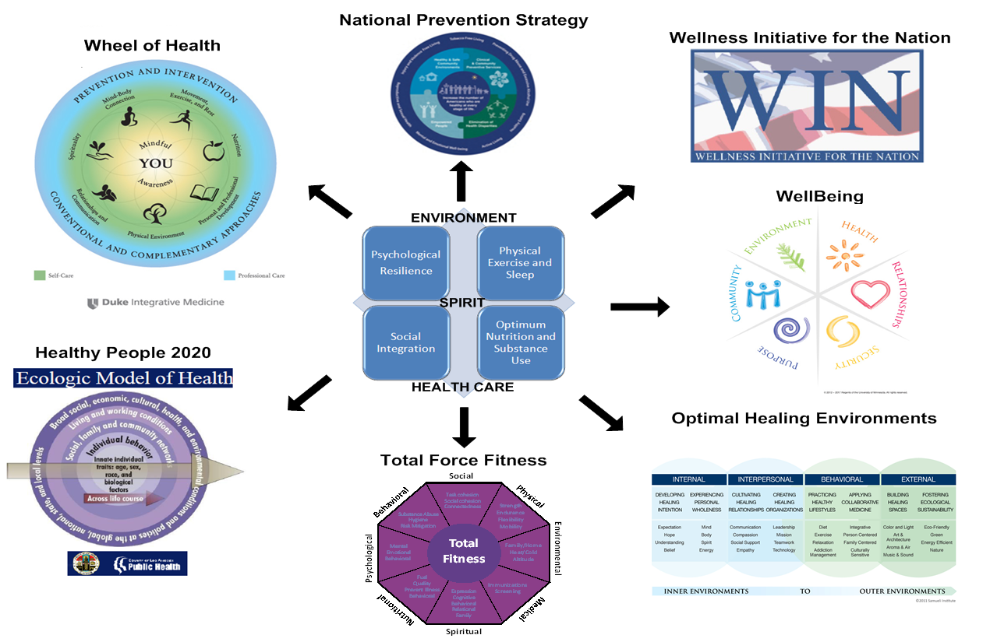
Customizing Whole Systems Wellbeing
Notes:
Charge for the next two days:
We will provide theory and scientific evidence for practices that facilitate healing and health creation.
You will have opportunities to experience some of these practices.
You will also have the opportunity to discuss what you have heard with a diverse group of colleagues.
Think about each of the components of whole person health creation and determine for yourself:
How do I live?
How do I lead?

Slide 40
PURPOSE
PEOPLE
PLACE

Slide 41
Connect with us
ACCESS RESEARCH AND SIGN UP FOR E-NEWS:
www.SamueliInstitute.org/Connect

Slide 42
Regina M. Benjamin, MD, MBA
18th Surgeon General of the United States

Slide 45
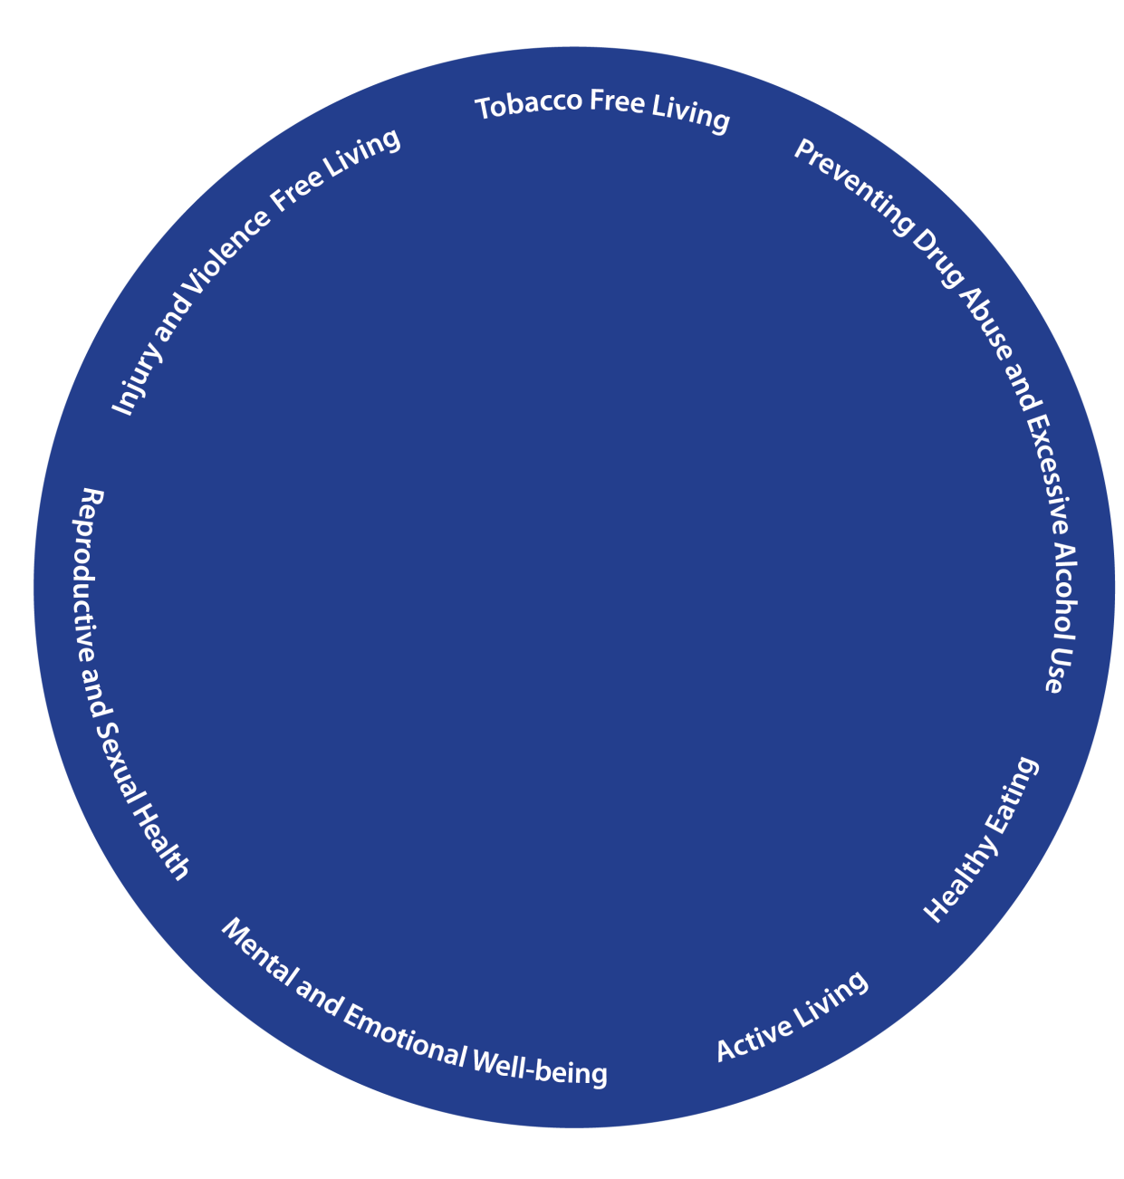
NATIONAL PREVENTION STRATEGY
Notes:
Animation Option 1
45

Slide 46
Gail C. Christopher, DN
Vice President for Program Strategy
W.K. Kellogg Foundation
Grantmakers in Health
Session Title: The Voice of Philanthropy in Effecting Health Systems Change
March 3, 2014

Slide 47
Our Vision, Our Mission
Vision
We envision a nation that marshals its resources to assure that all children have an equitable and promising future — a nation where all children thrive.
Mission
The W.K. Kellogg Foundation supports children, families and communities as they strengthen and create conditions that propel vulnerable children to achieve success as individuals and as contributors to the larger community and society.
Notes:
Narration: When Mr. Kellogg started the Foundation in 1930 with a $65 million trust, he said his money was to help people help themselves through the practical application of knowledge, which he believed would come from formal education. Mr. Kellogg was particularly concerned about children.
It is Mr. Kellogg’s mandate that drives OUR Vision, OUR Mission, and OUR Values, which serve as the foundation of OUR overall strategy/framework.

Slide 48
Children experience double jeopardy when they live in BOTH poor families and poor neighborhoods
20.5
percent
16.8
1.4
Notes:
Slide 4 – Double Jeopardy Slide
Our mission at the Foundation is to propel vulnerable children to success. As you can appreciate from this slide (and can read more about in the handout “Toward a Policy Relevant Analyses…Dr. Dolores Acevedo’s research..” ), vulnerable children are not just disproportionately represented in communities of color, most are exposed to what Dr. Acevedo has coined as “double-jeopardy:” The inability of succeeding, not only due to poverty, but also due to poorly resourced neighborhoods. My colleague will give you more specific examples as to how this connects to our structural racism work… …read the slide

Slide 49
Racism and Health: Mechanisms
Institutional discrimination can restrict socioeconomic attainment and group differences in SES and health.
Segregation can create pathogenic residential conditions.
Discrimination can lead to reduced access to desirable goods and services.
Internalized racism (acceptance of society’s negative characterization) can adversely affect health.
Racism can create conditions that increase exposure to traditional stressors (e.g. unemployment).
Experiences of discrimination may be a neglected psychosocial stressor.

Slide 50
Racial Equity
Racial Equity ≠ Diversity
(Diversity = Variety)
Racial Equity ≠ Inclusion
(Inclusion = Representation)
Racial Equity ≠ Equality
(Equality = Sameness)
Racial Equity = Fairness and Justice
Notes:
Slide 14 – Racial Equity
Alice
Explain diversity, inclusion, equality – all are necessary but not sufficient conditions. Important to do the first three – but consider who you are and what is the source of your oppression? When I come into the room as a white person, I come with privileges from the condition of my birth – I did not earn them nor do I consistently think about them. However, if the room is filled with people of color, how do they experience me – am I one of their oppressors? Until we create a relationship, that is unknown – but it is important as we consider words as big as racial equity. What does it require of me to work in a racially equitable manner? What are my responsibilities and what must I take ownership for? Then, as we think about the people of color – what diversity and inclusion fail to address adequately, is what is the burden of a person of color “representing a population or race?” How often do we consider one voice in a room adequate for an inclusive strategy.
When we talk about the importance of healing – this personal level is a critical step forward to equity.

Slide 51
Theory of Change
Reason
Research
Real World Events
Resources & Rewards
Redescription
Resistances
Resonance
Howard Gardner Changing Minds

Slide 52
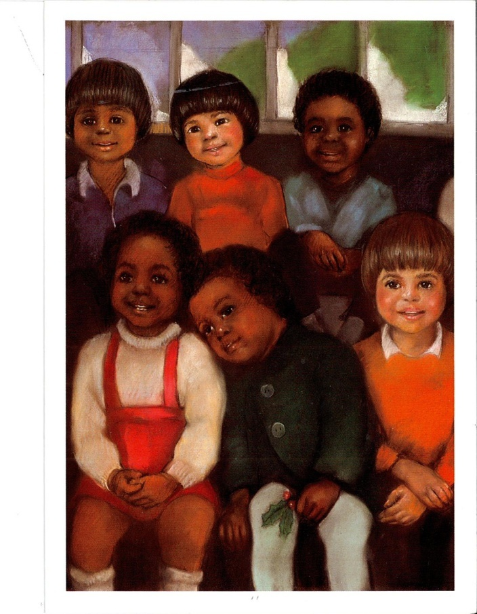
Notes:
Slide 17 – Thank You (add the slide that has all the children together in different colors…)
Your work is so important to racial equity and we appreciate being invited to share with you today. Thank you for being open and wanting to share and learn. When people apply for jobs, YOU are the front line – it is commitment to diversity, inclusion and racial equity that those getting know your institution will experience. In terms of your organization’s culture, YOU are the front line – in many organizations part of your work is creating the environment where equity will thrive for everyone. YOU are the ombudsmen – the keeper of stories and YOU are primary to much of the systems change within our organizations – and that changes how we relate in the larger world. The implication is that we all need more training and exposure to this work – to change our systems and structures to reflect the best we all have to offer to create a different world for ALL of our children.
It takes courage, compassion and insight every day…. This is a journey we are all on together – no one has ever completed this work. Thank you for your interest, your willingness to be here today – clearly you are committed to creating and innovating our way forward.

Slide 53
Discussion – Q & A

