Slide 1



Slide 2
NHAS Components
Outcomes oriented
  Population level impact
Diagnosis of challenges
Focus on agency coordination
Sets four goals:
  Reduce incidence by 25%
  Increase care access
  Reduce HIV-related health disparities
  Improve coordination and management

Slide 3
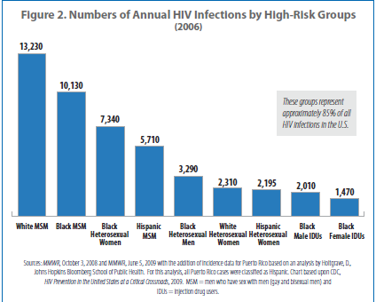

Slide 4
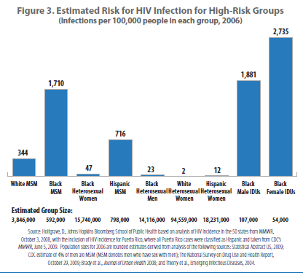

Slide 5
NHAS to Date/Looking Forward
Successes
  The “conversation” about AIDS in America
  Funding follows epidemic
  High impact prevention
  Examples of success
Work in progress
  Interagency coordination; streamlining funds; reducing reporting burdens; 12 Cities Project; syringe exchange funding
Looking forward
  Affordable Care Act implementation/Medicaid option
  Strategic/targeted combinations: testing, biomedical, behavioral, structural, PrEP

