Slide 1
Water Fluoridation: Why It Still Matters
Matt Jacob
Grantmakers in Health Webinar
November 2, 2012

Slide 2
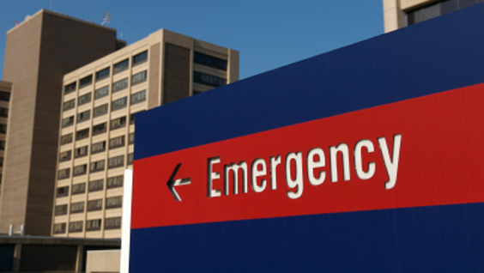
Why prevention matters
Preventable dental conditions were the primary diagnosis in 830,000+ visits to hospital ERs nationwide in 2009 — a 16% increase from 2006.
Children accounted for nearly 50,000 of these ER visits.
Source: “A Costly Dental Destination,” Pew Center on the States, (February 2012).
2

Slide 3
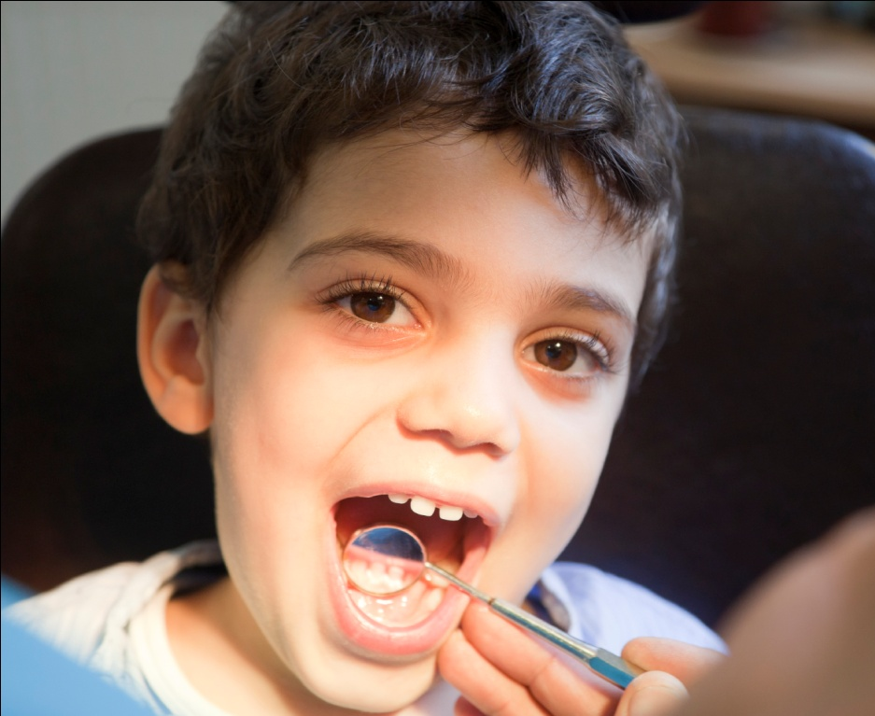
Quick facts: water fluoridation
Community water fluoridation is endorsed by the American Academy of Pediatrics, the American Dental Association and other leading health authorities.
Fluoridated water reduces tooth decay by 25%.
It’s the most cost-effective oral health intervention. Every $1 invested in water fluoridation saves $38.
Source: Centers for Disease Control and Prevention, www.cdc.gov/fluoridation

Slide 4
Quick facts: water fluoridation
Community water fluoridation is endorsed by the American Academy of Pediatrics, the American Dental Association and other leading health authorities.
Fluoridated water reduces tooth decay by 25%.
It’s the most cost-effective oral health intervention. Every $1 invested in water fluoridation saves $38.
A 2002 study: Fluoridation is “probably the most significant step we can take toward reducing the disparities in dental [decay]. It therefore should remain as a public health priority.”
Source: B.A. Burt, Journal of Public Health Dentistry, (December 2002).

Slide 5
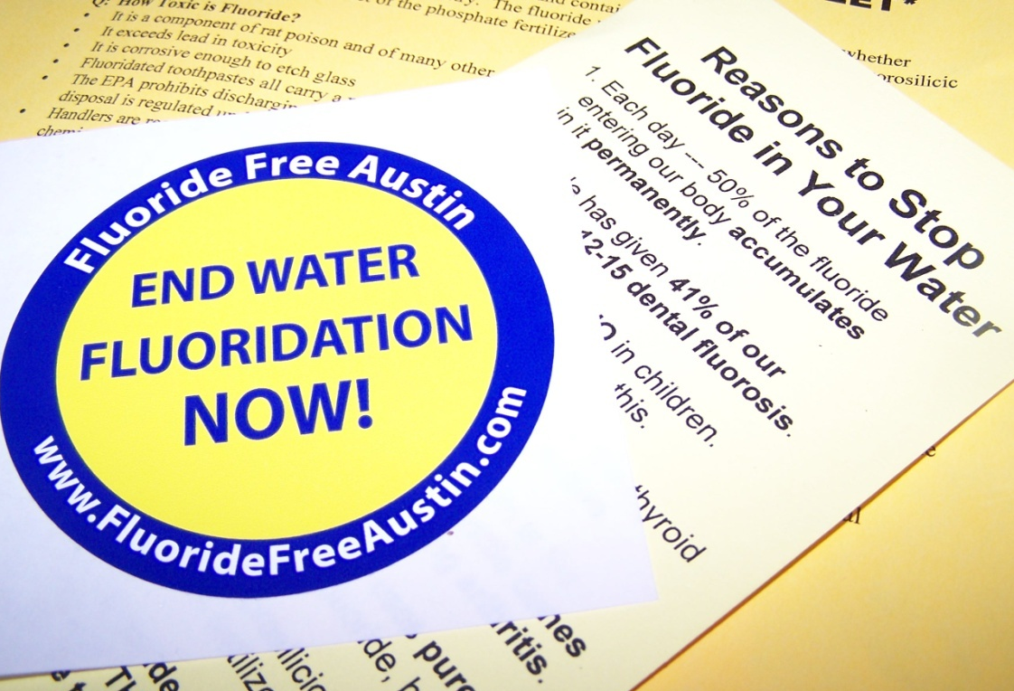
The challenge we face
72 million Americans still do not receive community water fluoridation.
Milwaukee, Phoenix and other cities have had to fend off recent attacks on fluoridation.
l
Tennessee’s Speaker of the House publicly urged state officials to stop promoting fluoridation.
In Nebraska, 80% of the towns voting chose to opt out of a fluoridation law (2008-2010).
One of Florida’s largest counties voted in 2011 to discontinue CWF.
l
l
Source: Centers for Disease Control and Prevention, www.cdc.gov/fluoridation

Slide 6
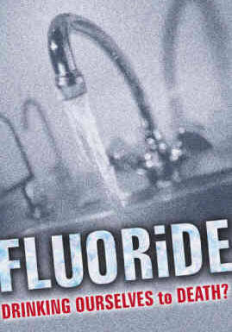
Comparing each side’s tactics
They are speaking to the public and successfully targeting key audiences.
They use ordinary language to spread fear and doubt.
They have a strong presence online and in social media.
We are more likely to communicate through conferences and list-servs.
We often use clinical language and don’t do much to correct distortions.
We have a relatively low profile on the web and in social media.
Water Fluoridation:
A Corporate-Inspired Scam

Slide 7
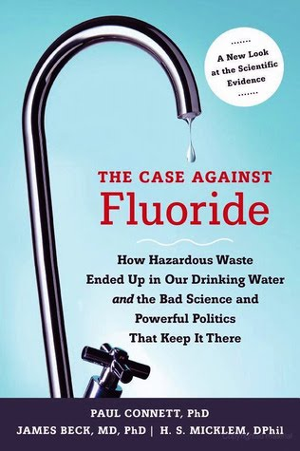
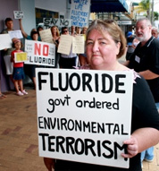
How opponents operate
Cherry-pick certain phrases from legitimate studies and use them in ways that misrepresent the findings
Circulate studies that were poorly designed and conducted overseas — having little connection to how public water systems fluoridate in the U.S.

Slide 8
How opponents operate
Cherry-pick certain phrases from legitimate studies and use them in ways that misrepresent the findings
Circulate studies that were poorly designed and conducted overseas — having little connection to how public water systems fluoridate in the U.S.
“
I do not find Dr. Connett or his organization, Fluoride Action Network, a credible source of information.
– Mayor Sam Adams (Portland, OR)
”

Slide 9
A perfect storm
The vacuum of public knowledge gets filled by the misinformation online
The public’s distrust of government’s role in health care or other issues
The public health community is complacent
Opponents have learned to package their arguments as “science”

Slide 10
Fluoridation: What Pew Is Doing

Slide 11
The Campaign for Dental Health
Objectives:
Create a national network of CWF advocates who can share ideas, offer insights, and support one another
Improve the quality and accuracy of web content about oral health and CWF
Provide state and local advocates with fact sheets, PowerPoint slides and other helpful resources to support their work

Slide 12
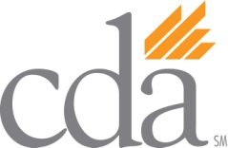
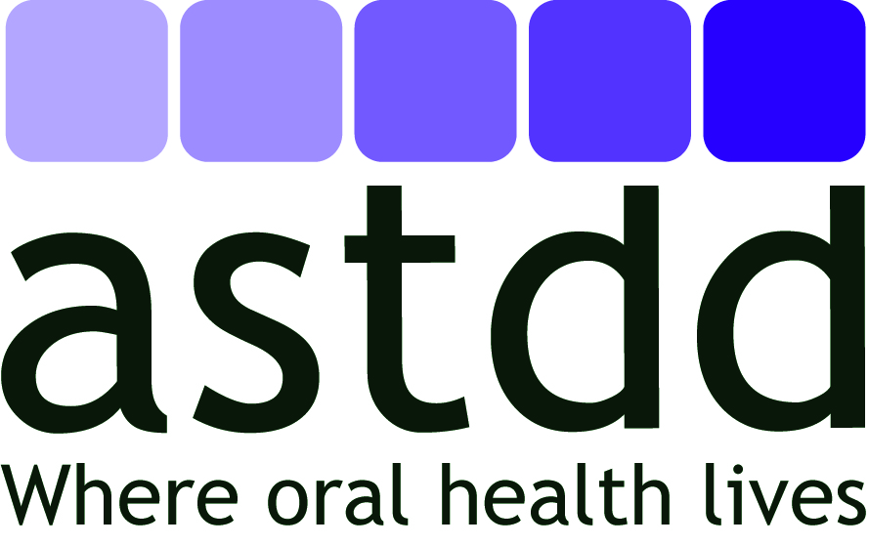
The Campaign for Dental Health
A campaign with diverse partners:

Slide 13
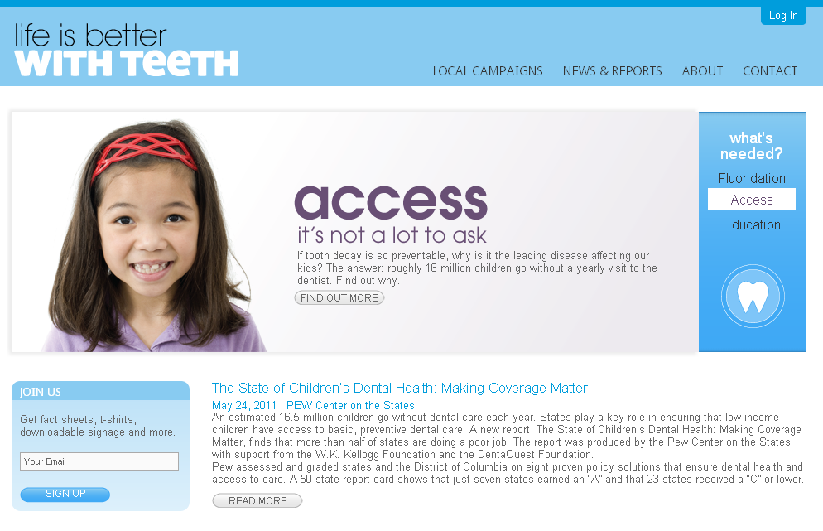
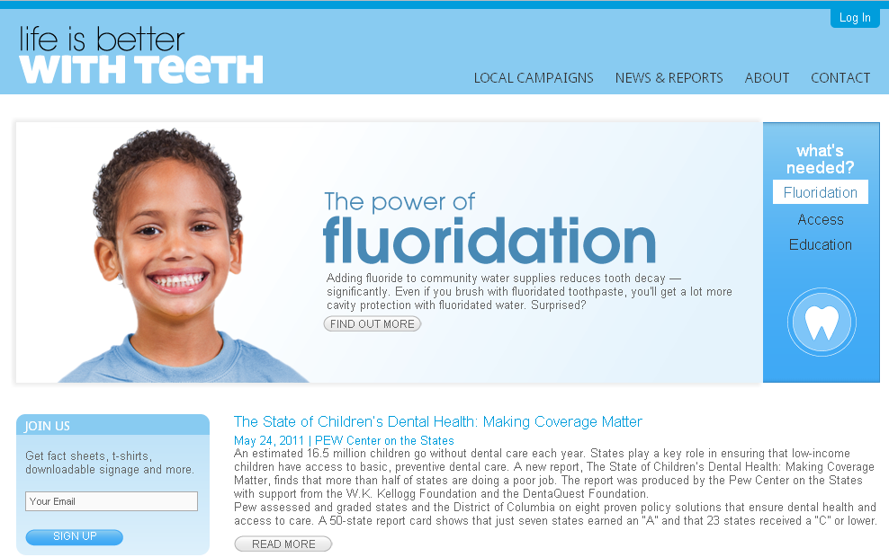
Start reclaiming the web
iLikeMyTeeth.org
frames CWF in the broader context of oral health (protecting teeth)

Slide 14
Provide scientifically accurate info

Slide 15
Assist local health advocates
Allowing advocates to create a locally customized web presence for their CWF campaign

Slide 16
PowerPoint slides for advocates

Slide 17
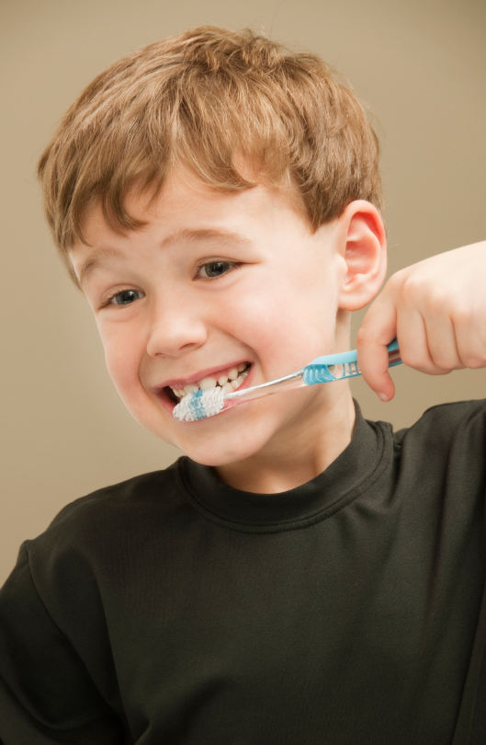
The campaign’s progress
More than 430 users are registered to access materials at iLikeMyTeeth.org — an increase of 23% since May.
Local websites have been created by advocates in 9 states.
The Campaign provided talking points and other assistance to local advocates in Montana, Florida, Oregon and Wisconsin who successfully won local fluoridation votes.
More than 600 Tweets have been sent since our Twitter account was launched in January.

