Slide 1
at Denver Housing Authority
Healthy Living
Current Status, Progress and Visions for the Future

Slide 2
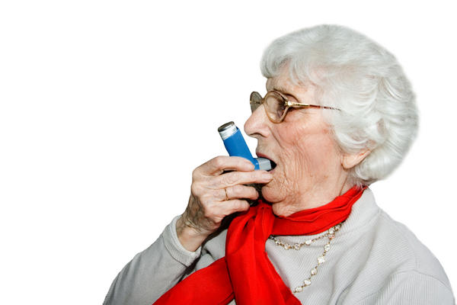
Mariposa Health Statistics
38% have been diagnosed with diabetes
39% have been diagnosed with asthma
64% have high blood pressure
Notes:
The health statuses of Mariposa residents reflect the nationwide over-arching, negative correlation between income and obesity, leaving heart disease, diabetes, and asthma as by-products of unhealthy lifestyles. DHA administered a survey to a sample of Mariposa residents; health histories and attitudes toward healthy living were recorded. Of the sample population: 38% reported that they have been told by a doctor that they have diabetes; 39% have been told they have asthma; and 64% report having been told that they have high blood pressure. Of the same sample, only 25% of respondents are at a “Normal” weight (as calculated by BMI measurements): 7% are underweight, 39% are overweight, and 29% are obese.
As noted, the survey also measured attitudes toward healthy living. When asked “Would you be interested in healthy living and/or exercise activities,” 70% of respondents answered “Yes.”

Slide 3
Mariposa Health Statistics
7%: Underweight
29%: Obese
25%: Healthy Weight
39%: Overweight
Notes:
The health statuses of Mariposa residents reflect the nationwide over-arching, negative correlation between income and obesity, leaving heart disease, diabetes, and asthma as by-products of unhealthy lifestyles. DHA administered a survey to a sample of Mariposa residents; health histories and attitudes toward healthy living were recorded. Of the sample population: 38% reported that they have been told by a doctor that they have diabetes; 39% have been told they have asthma; and 64% report having been told that they have high blood pressure. Of the same sample, only 25% of respondents are at a “Normal” weight (as calculated by BMI measurements): 7% are underweight, 39% are overweight, and 29% are obese.

Slide 4
Mutual Health Goals
Active Design
DHA is Striving to Build:
Two Active Design Staircases
An Active Living Center Courtyard
Raised Planter Boxes
Additional Kiosks and Street Lighting
Notes:
Risa Lavizzo-Mourey, of the Robert Wood Johnson Foundation, wrote, “For decades, policy makers, scholars, public health workers, community development leaders, advocates, and others have worked to address the problems of poverty OR poor health. To effectively reduce poverty and poor health, however, we now know that we must address both, as well as the contributing factors that they share. We have learned that factors that are integral to poverty, such as insufficient education, inadequate housing, and food insecurity, are also indicators of poor health. We know that a child’s life expectancy is predicted more by his ZIP code than his genetic code… In fact, we also know that health care plays a surprisingly small role among the factors that contribute to premature death—at just 10%. In contrast, social circumstances, environmental exposures, genetic predisposition, and personal behavior combined contribute to 90 percent of preventable deaths.”
DHA recognized the mutual goals of the Colorado Health Foundation and wished to actively enhance principles to both the built environment and people-focused programs to improve the health of residents by influencing behavior. From the Grant awarded by The Colorado Health Foundation, we have identified two substantial areas of focus: Active Design and Educational Programs.

Slide 5
Mutual Health Goals
Healthy Living Staff
Health Navigator
Help residents review health records
Assist residents in identifying a PCP
Enrollment in medical care programs
Notes:
Risa Lavizzo-Mourey, of the Robert Wood Johnson Foundation, wrote, “For decades, policy makers, scholars, public health workers, community development leaders, advocates, and others have worked to address the problems of poverty OR poor health. To effectively reduce poverty and poor health, however, we now know that we must address both, as well as the contributing factors that they share. We have learned that factors that are integral to poverty, such as insufficient education, inadequate housing, and food insecurity, are also indicators of poor health. We know that a child’s life expectancy is predicted more by his ZIP code than his genetic code… In fact, we also know that health care plays a surprisingly small role among the factors that contribute to premature death—at just 10%. In contrast, social circumstances, environmental exposures, genetic predisposition, and personal behavior combined contribute to 90 percent of preventable deaths.”
DHA recognized the mutual goals of the Colorado Health Foundation and wished to actively enhance principles to both the built environment and people-focused programs to improve the health of residents by influencing behavior. From the Grant awarded by The Colorado Health Foundation, we have identified two substantial areas of focus: Active Design and Educational Programs.

Slide 6
Mutual Health Goals
Healthy Living Staff
Healthy Living Program Coordinator
Coordinate Educational Programs Pertaining to Nutrition, Fitness, and General Health
Notes:
Risa Lavizzo-Mourey, of the Robert Wood Johnson Foundation, wrote, “For decades, policy makers, scholars, public health workers, community development leaders, advocates, and others have worked to address the problems of poverty OR poor health. To effectively reduce poverty and poor health, however, we now know that we must address both, as well as the contributing factors that they share. We have learned that factors that are integral to poverty, such as insufficient education, inadequate housing, and food insecurity, are also indicators of poor health. We know that a child’s life expectancy is predicted more by his ZIP code than his genetic code… In fact, we also know that health care plays a surprisingly small role among the factors that contribute to premature death—at just 10%. In contrast, social circumstances, environmental exposures, genetic predisposition, and personal behavior combined contribute to 90 percent of preventable deaths.”
DHA recognized the mutual goals of the Colorado Health Foundation and wished to actively enhance principles to both the built environment and people-focused programs to improve the health of residents by influencing behavior. From the Grant awarded by The Colorado Health Foundation, we have identified two substantial areas of focus: Active Design and Educational Programs.

Slide 7
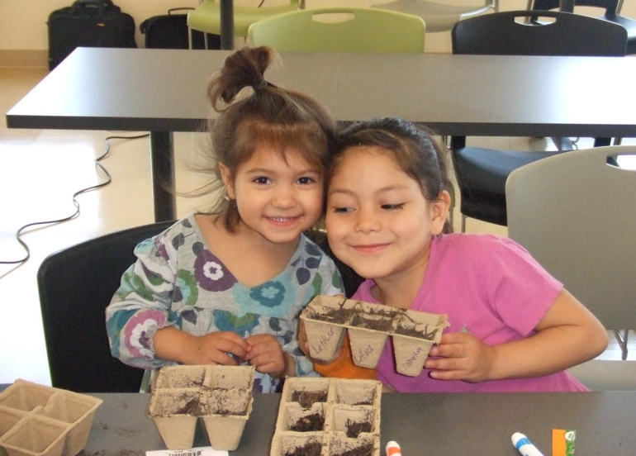
Healthy Living Programming
Nutrition
2012 Programming:
CSU E.F.N.E.P
Fresh Takes Kitchen
Community Gardening

Slide 8
Healthy Living Programming
Nutrition
2013 New Programming:
Cooking Matters
Kitchen Cue
Fresh Takes to take SNAP benefits

Slide 9
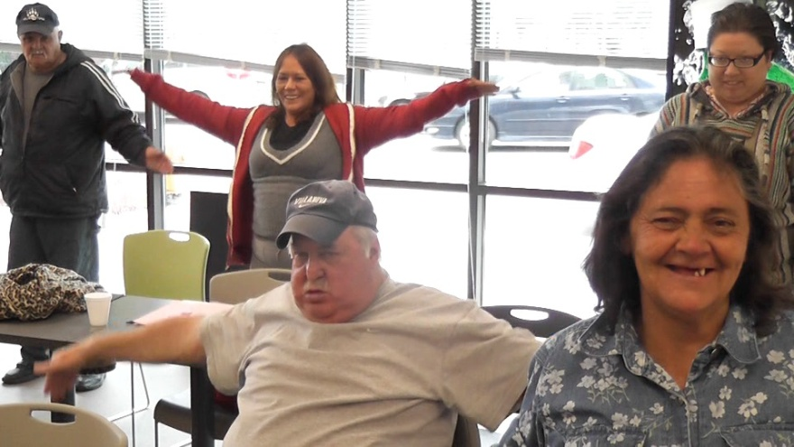
Healthy Living Programming
Fitness
2012 Programming:
Denver B-Cycles
Weigh-In Challenge

Slide 10
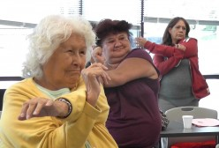
Healthy Living Programming
Fitness
2013 New Programming:
Yoga for the People
Walking Club
Sit and Be Fit
Zumba

Slide 11
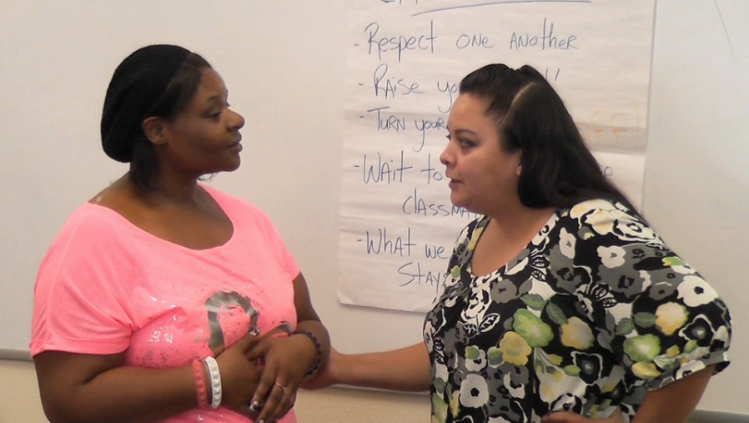
Healthy Living Programming
Education
2012 Programming:
With Every Heartbeat is Life
CHARLAR
Metro-Crisis Center

Slide 12
Healthy Living Programming
Education
2013 New Programming:
Self Defense Classes
Stress Management
Bright Beginnings
First Aid

Slide 13
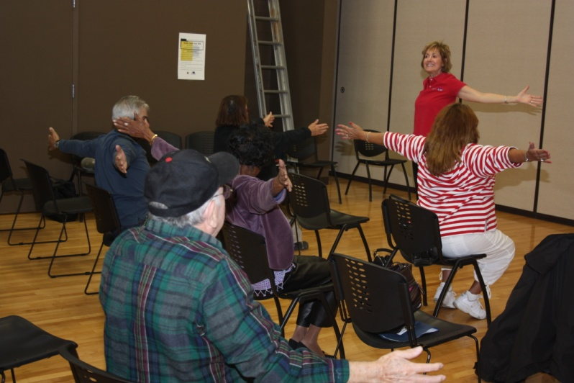
Healthy Living Programming
Wellness
2012 Programming:
Flu Shots
Medicare Info Sessions
Family Dinner Night

Slide 14
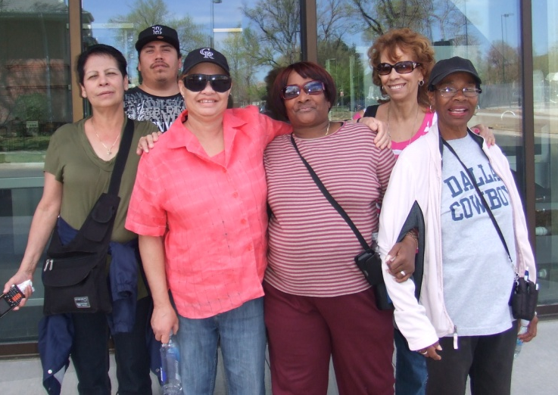
Healthy Living Programming
Wellness
2013 New Programming:
Dominican Sisters: Weekly Health Clinics and CNA home visits
Estara

Slide 15
Contact me:
Bob Prettyman
720-932-3169
bprett@denverhousing.org

