Slide 1
Health in Mind Improving Education through Wellness
Rochelle Davis
President + CEO, Healthy Schools Campaign
June 2012
Notes:
Thank you for inviting me to speak to you today.
I am pleased to be asked to share with you this morning Healthy Schools Campaign’s national policy campaign Health in Mind.

Slide 2
About Healthy Schools Campaign
Notes:
For the last 10 years, in addition to our work at the state and national levels, Healthy Schools Campaign has focused significant efforts in Chicago, where we have worked to improve the food and fitness environment in the public schools.
Our programs focus on identifying and supporting agents of change – including parents, teachers, students, principals and school nurses - and helping them make changes at their schools and in the district. Through this work, we have had the opportunity to see how federal, state and local decisions impact schools. We have come to understand the importance of empowering individuals to be change agents, the need for teachers, principals, and other school staff to have the knowledge and skill to create the conditions for health in classrooms and schools, the role transparency and accountability have in encouraging health promoting changes and academic excellence in schools and the importance of school nursing.

Slide 3
Health in Mind Recommendations
Federal agency recommendations around:
Professional Development
Metrics and Accountability
Recognition Programs
Institutional Capacity
School Health
Notes:
Over the last six months, through a series of national convenings involving over 100 local, state and national health and education practitioners, policymakers and researchers, we have had the opportunity to learn from each other and deepen our understanding of how to support student health and wellness in schools. The recommendations of Health in Mind, which came out of this process, focus on the federal agency role. We know that change needs to happen at the local level but understand the power federal policies can have in driving local change.
I have never met a principal, teacher, school administrator or policymaker who did not understand that health is directly linked to a student’s ability to learn. In spite of an almost universal agreement that health is important, most teachers and principals do not prioritize health because they do not have the necessary knowledge and skills to translate that understanding into their work, and because the metrics and accountability systems for evaluating schools do not include health and wellness. As a result, most school officials aren’t able to integrate what they know to be important into their classrooms or schools.
Thanks to the work of many, including the CDC, EPA and USDA, there are excellent materials and best practices to guide schools in addressing health. The challenge is how to motivate school leaders to fully integrate health into education policy and practice. Our experience and research suggest that key strategies for this include providing teachers, principals and other school staff with the knowledge and skills to integrate health into all school policies and practice and to incorporate health and wellness into school measurements including school report cards, school improvement plans and longitudinal data systems.
The goal and challenge of Health in Mind is to make concrete recommendations that fall within US Department of Education and US Health and Human Services regulatory authority and budget, and can have a significant and sustainable impact on two national priorities: reducing the achievement gap and transforming our health care system.
Our recommendations cover these six areas:
READ THEM.
Before I review each of these in greater detail, I want to share with you some important research that has allowed us to connect this discussion about health more directly with the concerns and goals of educators.

Slide 4
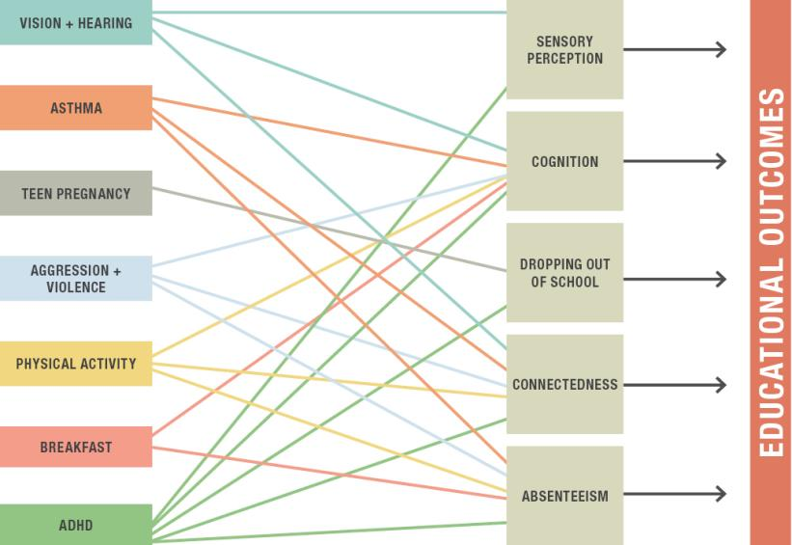
Health and the Achievement Gap
Notes:
His research identified seven health conditions for which there is high prevalence and disparities that impact learning and can be successfully addressed in schools. Dr. Basch concludes that without tackling these problems, other efforts to address the achievement gap are likely to be compromised.
The seven health conditions are….
Educationally relevant health disparities impede motivation and ability to learn through at least ﬁve causal pathways: sensory perceptions; cognition; connectedness and engagement with school; absenteeism; and dropping out.
His report documents the disparities for each of these conditions and links each condition to one or more of the five causal pathways. For example, let’s look at asthma:
14% of all children under 18 have asthma, 8.8% of white students, 12.8 black and 21.5 Puerto Rican.
Asthma impacts cognition, connectedness and absenteeism. Research has shown that students with asthma have a hard time concentration, are often tired since asthma impacts sleep. This impacts cognition, they are less involved in extra-curricular activities, more problems with peers and more anxious, impacting their connectedness and students with asthma have higher rates of absenteeism due to doctor visits or hospitalizations, to avoid environmental triggers and since they are more susceptible to repository illness.
Dr. Basch’s also points out that multiple health factors will be greater than the effects of individual factors, therefore school health program must focus on multiple facts to maximize the educational yield from investments.
Dr. Basch’s research allowed us to speak more directly to the concerns of educators. The Obama administration has made addressing the achievement gap a top priority. Health in Mind provides simple common sense recommendations for helping schools address student health, a critical component of a successful strategy for addressing the achievement gap.

Slide 5
RECOMMENDATION 1 Professional Development
Notes:
In spite of the importance of health and the multiple ways in which teachers, principals and other school administrators impact the health of students, everything from making sure students can be physically active, providing students with access to water, identifying students who need a health related referral or making sure that the school has healthy air teachers and principals receive little or no coursework or professional development on children’s physical and emotional develop or other concrete tools for integrating health in every subject, reward systems, classroom management strategy and school policy or practice.
The National Council for Accreditation of Teachers only offers vague guidance on what pre-service coursework relating to health teachers should receive. It is not surprising that when teachers were surveyed about their confidence to address health issues in the classroom that most of them did not feel that had adequate preparation.
In our survey of state for required coursework in health related fields, we should that more 50% of the states had no health related requirement at the pre-service or for ongoing professional development. Only five states require some general health related course work on health or child development.
Refer to picture

Slide 6
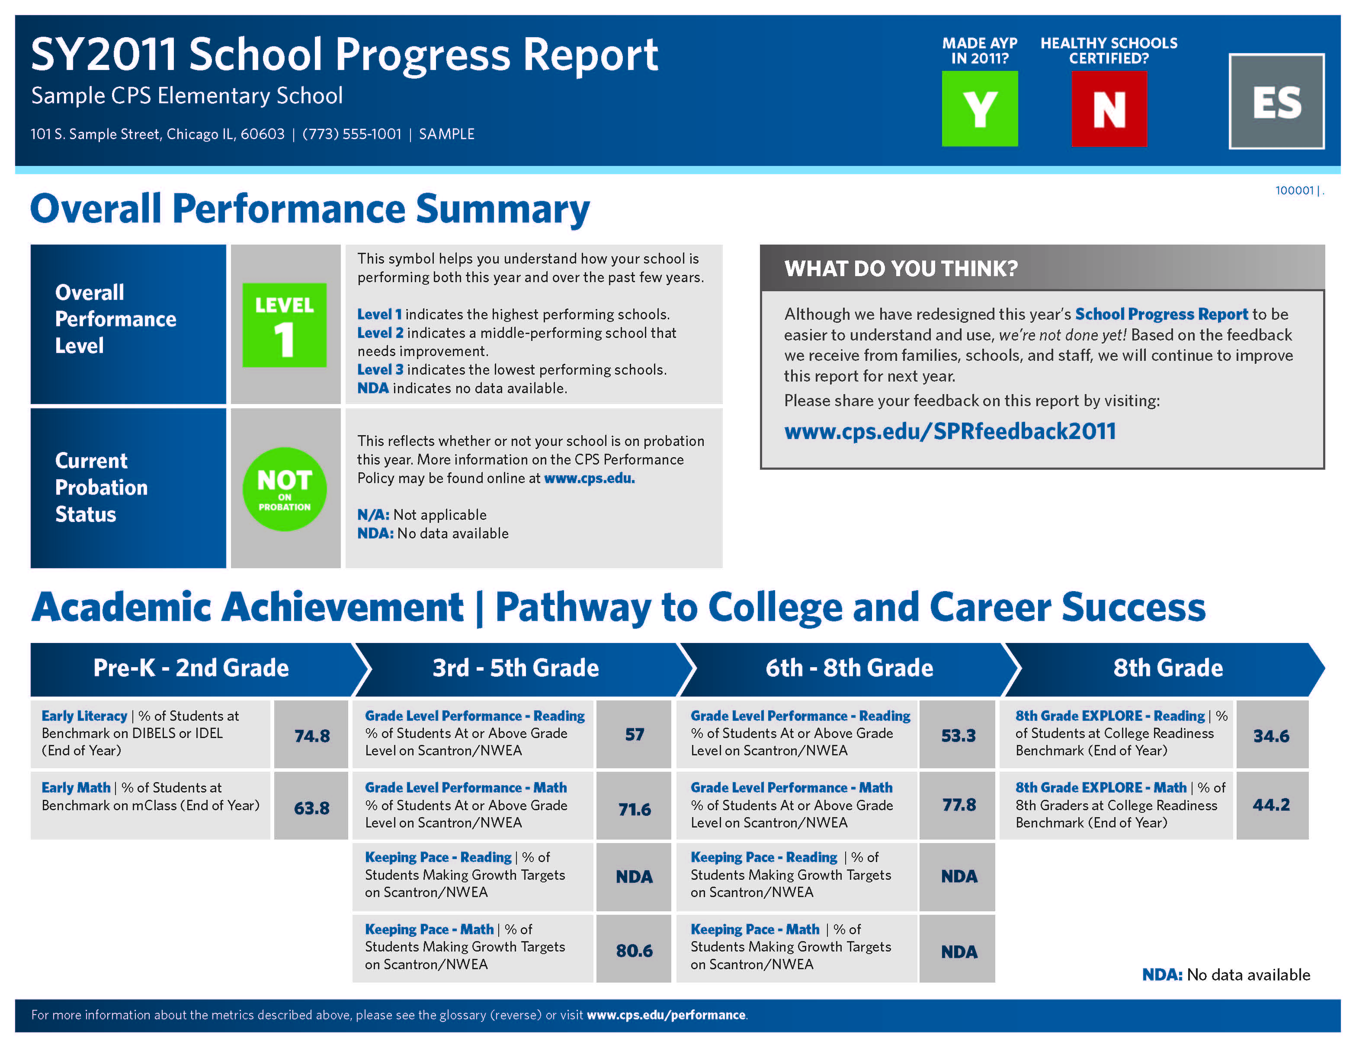
RECOMMENDATION 2 Metrics and Accountability
Notes:
In Chicago, we were successful in getting the district to add a health and wellness measure to the school progress report.
Also, SIPAAA
For the last 10 years national education policy has emphasized the need for state and local educational agencies to be very publicly accountable for tracking school and student performance and has encouraged states and local educational agencies to disaggregate the data to better understand the academic achievement of various groups of students. This allows resources to be directed to the lowest preforming students.
To date, these accountability systems have focused almost exclusively on academics and do not address other factors, including student health even though many of the lowest preforming students experience health related challenges.
Given the importance of student health and the key role that schools can play in promoting student health and wellness, incorporating metrics for health and wellness into data tracking systems, research and school report cards will provide educators, policy makers and the public with a more complete understanding of how student health and wellness is impacting learning and academic outcomes.
Reference picture.
Impact…

Slide 7
RECOMMENDATIONS 1 + 2 Recommendations
Incorporate health and wellness into professional development and school metrics and accountability by:
Supporting innovative programs
Creating guidance and best practice guides
Notes:
Two general strategies: Supporting innovation programs by making health a competitive grant priority in a number of grant programs and issuing of guidance documents and best practices.
To Support Innovation:
For professional development: The Office of Innovation and Improvement, where many of the professional development programs are housed, should include health as a competitive grant priority.
For parents: Include health as a competitive priority in grant programs like the Parent Information Resource Center.
For metrics and accountability: Institute for Education Sciences should encourage the development of state longitudinal data systems that integrate health
Create guidance and best practice guides
For professional development: Issue voluntary guidance to colleges and universities on best practices for supporting teachers and school health leaders ability to address student health needs. Also, creating voluntary guidance to states on professional development standards relating to health.
For parents: Issue voluntary guidance on high quality parent engagement programs that integrate a focus on health and wellness.
For metrics and accountability: Issue voluntary guidance for states on how to integrate health into state data tracking systems and school accountability programs.

Slide 8
RECOMMENDATION 3 Recognition Programs
Notes:
Recognition programs offer a simple, cost-effective strategy to motivate schools to adopt specific practices.
In Chicago, we have..

Slide 9
RECOMMENDATION 3 Recognition Programs
Incorporate health and wellness into recognition programs, including the Blue Ribbon Schools Program
Notes:
The most coveted award in education is the Blue Ribbon program. We want the Department to leverage its most successful recognition program, the Blue Ribbon program, to include health and wellness as part of its strategy to improve academic performance.

Slide 10
RECOMMENDATION 4 Capacity Building

Slide 11
RECOMMENDATION 4 Capacity Building
Build Department of Education’s capacity to provide school health leadership:
Expanding the Office of Safe and Healthy Students’ mandate
Ensuring appropriate leadership
Notes:
Our recommendations include building the capacity of the Department of Education to address health issues by expanding the mandate of the Office of Safe and Healthy Students and appointing a Deputy Assistant Secretary to the office. This will better prepare the Department of Education to address emergency situations, build the capacity of other offices within the Department, and provide important guidance to universities, states and school districts. We also recommend have a school nurse consultant to disseminate knowledge and advance the practice of school nursing.

Slide 12
RECOMMENDATION 5 School Health
Notes:
Our School Nurse Leadership Training Program has provided training to 150 school nurses, providing them with the knowledge and skill to be change agents.
And, change agents they did become, with xx% of making to changes to one or more policy or practice.
There is lots of research with validates our experience.
Daily presence of a school nurse:
Reduces ER visits
Improves test scores
Decreases number of students without insurance
Reduces absenteeism
55% of students do not have a full time school nurse.
However, with the economic downturn, school nurses are being laid off.
We starting looking at how school nurses are funded and founded that most of school nursing costs are funded by education sector.
We found that some small regulatory changes will greatly impact schools ability to have a full-time nurse, particularly in schools that serve low-income students.
We are working on this regulatory change and will continue to address funding and other issues until all schools have a full-time nurses.

Slide 13
RECOMMENDATION 5 School Health
Reduce existing barriers to reimbursement from Medicaid
Recognize schools as eligible community benefit
Create a new vision to explore full potential of schools as key centers for supporting children’s health
Notes:
HHS is the lead agency in developing and implementing a national prevention strategy. This strategy recognizes that health and well-being fall outside of the health care setting and that what happens in other institutions, including schools, is critical.
First, we are asking HHS to reduce current barriers that schools face in receiving reimbursement for health services delivered to Medicaid-eligible students. Currently, the reimbursement school districts receive for school health services is severely restricted by various regulations that have no basis in federal Medicaid law and in fact, have been ruled by HHS’ own Department Appeals Board as unenforceable.
We are also asking schools to be an eligible community benefit. This will create or strengthen the relationship with hospital and schools with the hope and expectation that they will be able to work together to support student health.
We are asking HHS to use the National Prevention Council or its advisory committee to explore the full potential that schools can play in health and wellness promotion, creating a new vision for schools’ roles.

Slide 14
Health in Mind Improving Education through Wellness
Notes:
On May 9 we had the opportunity to present these recommendations to Secretary Duncan and Secretary Sebelius. Both the President of NEA and AFT were on hand to reinforce the importance of these issues to schools and support our recommendations. Both Secretary Duncan and Sebelius pledged their supporting in working with us to implement these recommendations. We are in the process of doing just that and welcome your support and involvement.

Slide 15
Thank you!
Rochelle Davis
President and CEO, Healthy Schools Campaign
rochelle@healthyschoolscampaign.org
Visit healthinmind.org to receive the report when it is available.

