Slide 1
Grantmakers in Health
© Ed McMahon, Urban Land Institute
Denver, Colorado
November 13, 2013

Slide 2

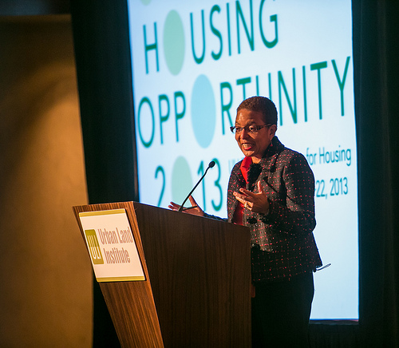
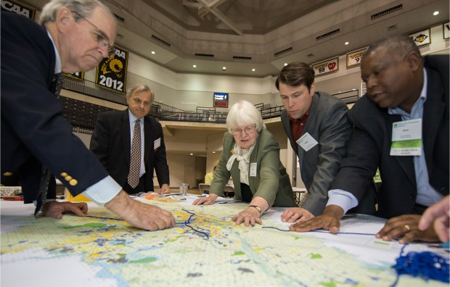
Urban Land Institute
Global non-profit with 30,000 members representing the entire spectrum of real estate and land use professionals
Provides leadership in the responsible use of land and in creating and sustaining thriving communities worldwide
Fosters best practices through research, education, programs and publications

Slide 3

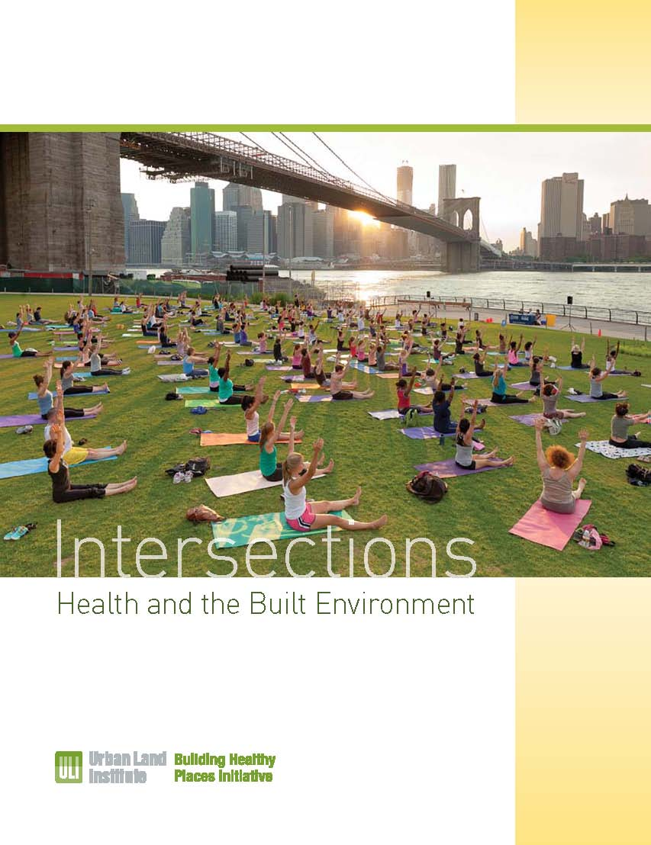
An overarching theme for all ULI programs, centers, and activities.
Leverage the power of ULI’s global networks to shape projects and places in ways that improve the health of people and communities
Conferences, research and publications, District Councils, grants and awards, etc. www.uli.org/health

Slide 4

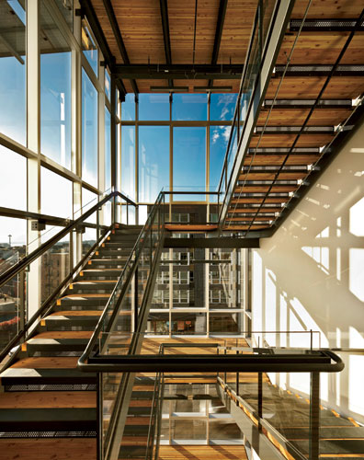
Areas of Impact
Awareness: Connection between health and the built environment
Tools: Best practices, criteria, checklists, standards which advance approaches to healthy buildings
Value: Understanding of the market and non-market factors at play in building healthy places
Commitments: To work, build and operate in more health promoting ways

Slide 5
Education and Awareness
Fall Meeting. ULI’s Fall Meeting in Chicago will have a Building Healthy Places track, and feature other programming. (Chicago, November, 2014)
Building Healthy Places: Unlocking the Value. Conference will convene real estate leaders to explore topics related to health and the built environment. (Los Angeles, February, 2014)
Spring Meeting. ULI’s Spring Meeting will feature programming on health. (Vancouver, Canada, April, 2014)
Housing Opportunity 2014 Conference. This annual convening hosted by the Terwilliger Center will focus on connections between health and housing. (Denver, CO, May, 2014)

Slide 6

Urban Innovation Grants
41 grant applications, 37 focused on health
14 grant awards (from $10,000 - $25,000)
Total of $250,000 awarded – all for health
ULI Hines Competition
Competition to challenge graduate students to think about health & built environment
ULI Colorado – Cities on the Move Summit (October 2013)
ULI Asia Pacific
Enhanced partnerships, research and convenings
Building Healthy Places Seminar in South Korea
ULI & RICS Joint Seminar on Building Healthy Communities
ULI Northwest
Survey on biking and walking trends; BHP Conferences in Portland and Seattle

Slide 7
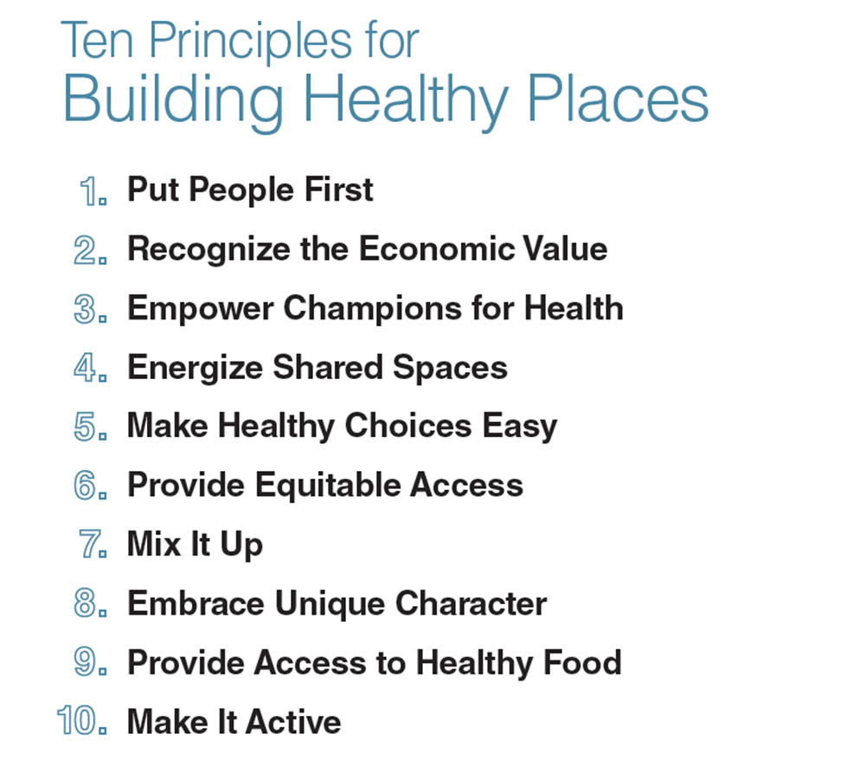
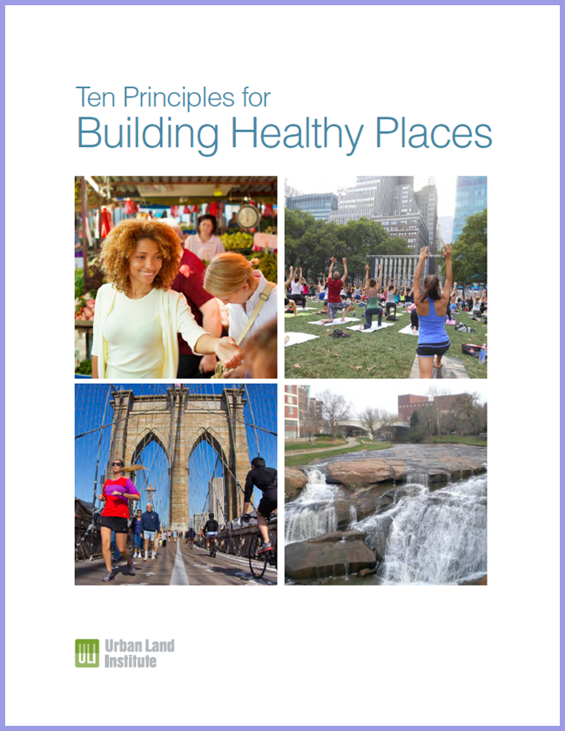
ULI Publications

Slide 8

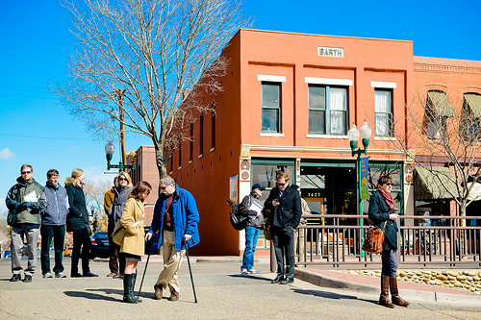

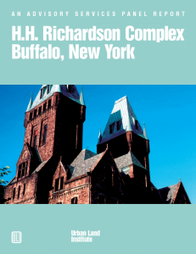
ULI Advisory Services
Since 1947 over 600 Advisory Service teams have helped find creative, practical solutions for some of the most challenging issues facing urban, suburban and rural communities and land owners.
ULI assembles a team of experts, reviews briefing materials prepared by the sponsor, tours the study area, interviews stakeholders, makes a public presentation on the panel recommendations, and provides a written report

Slide 9
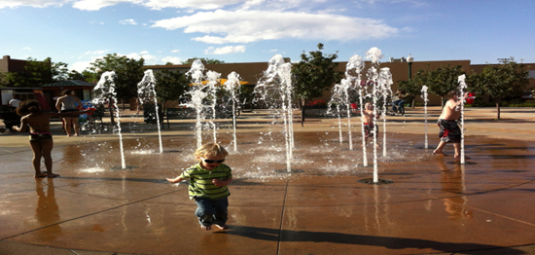
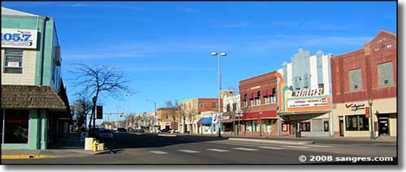
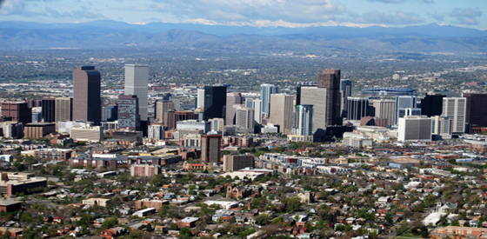
Colorado Advisory Service Panels
Arvada, Colorado Suburban community
Lamar, Colorado Small town
Westwood, Colorado Urban neighborhood

Slide 10
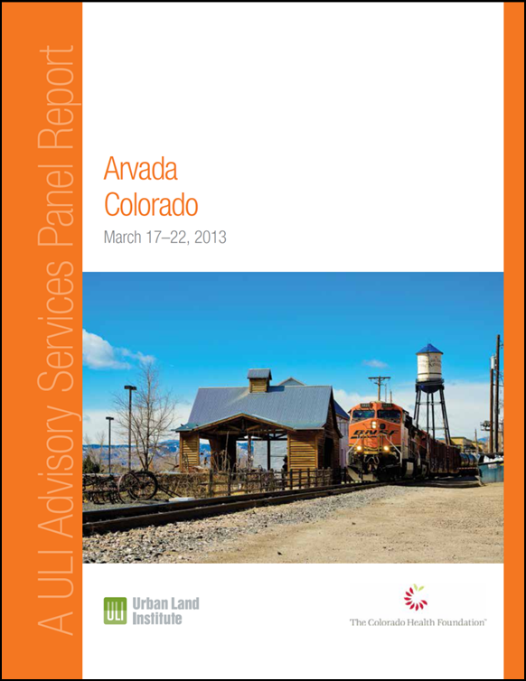
Lessons Learned
Every community has different assets and challenge's
To get the attention of public officials, healthy communities should be linked to economic and/or community development.
Creating healthy communities is only partially about the built environment. It is also about programs, education and activities (i.e soft infrastructure)

Slide 11
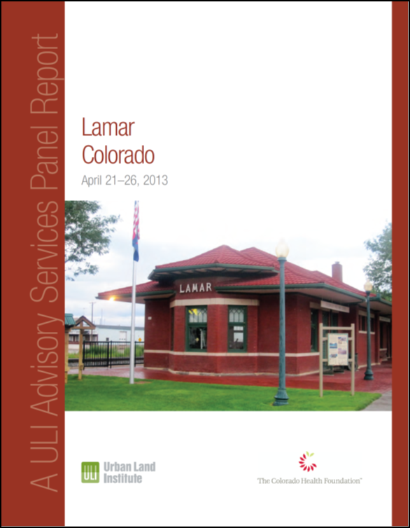
Lessons Learned
Health is an emerging market differentiator.
Access to parks, green space and recreation facilities can increase real estate value.
Many of the design principles for healthy communities are the same as the principles for smart growth and sustainable development (Mixing uses, connected streets, transportation options, etc.)

Slide 12
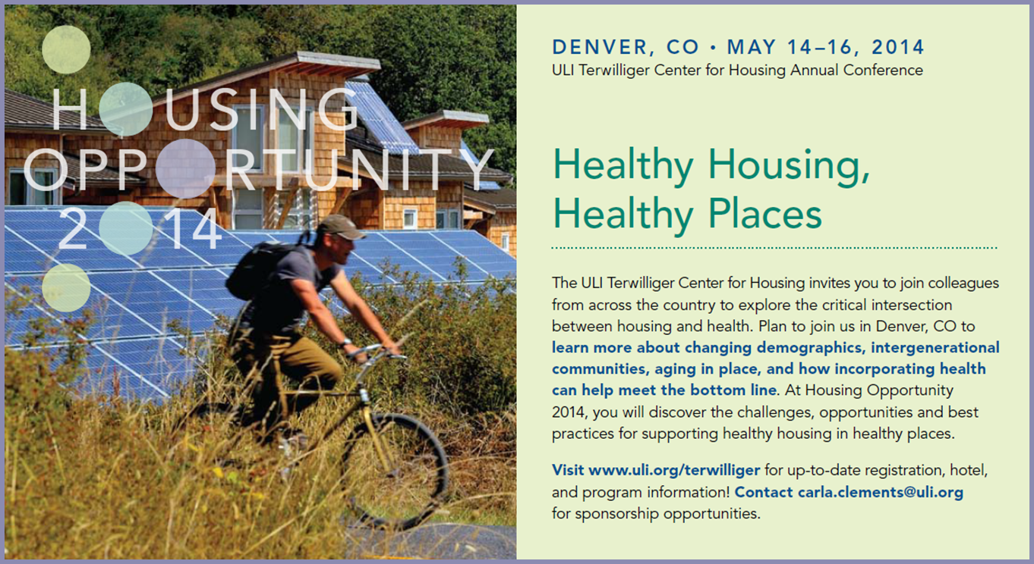
ULI Conferences

Slide 13
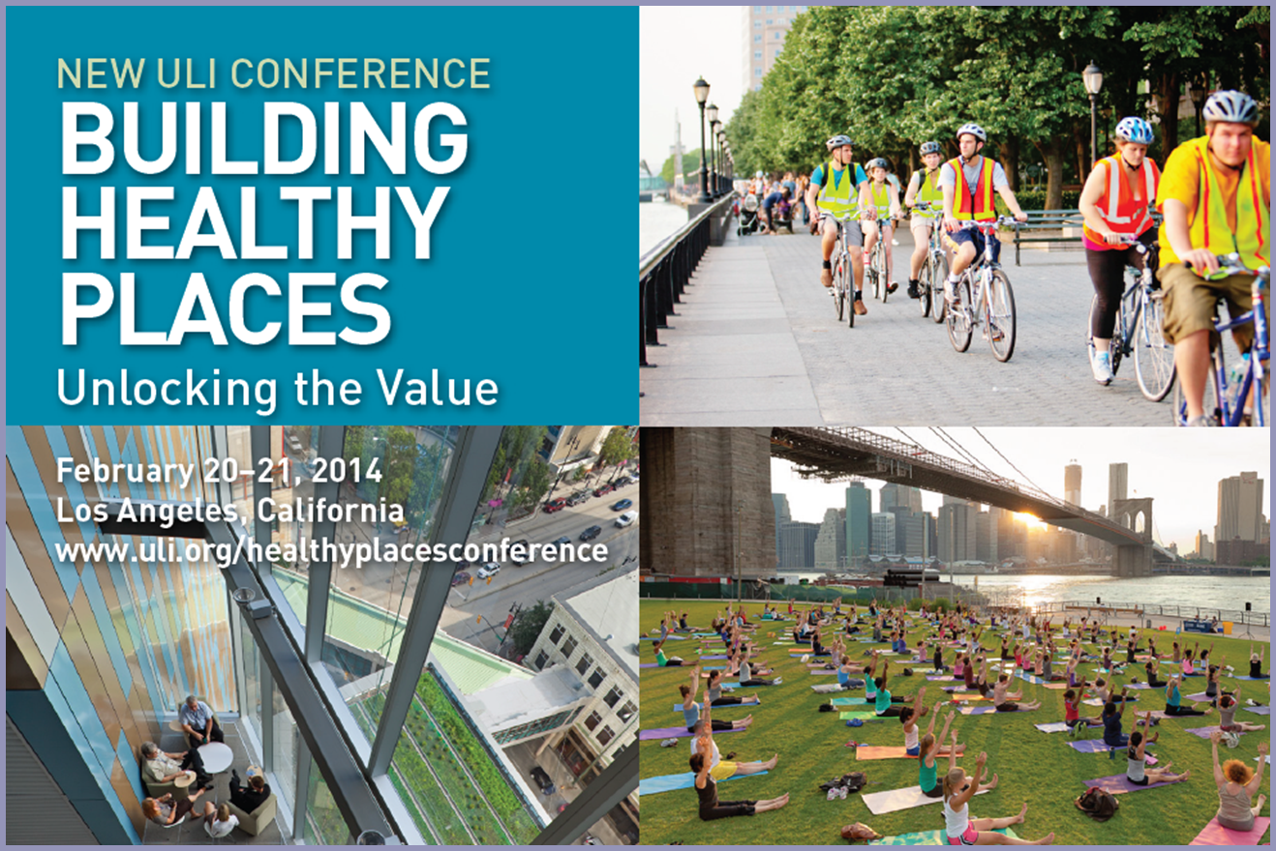
ULI Conferences

Slide 14
Health and Value
68% of Gen Y thinks proximity to a park is important
78% of Gen Y thinks walkability is important
Homes near parks command price premiums of 5% to 25%
Homes located in neighborhood s with good walkability are worth $34,000 more on average
12 bikes can fit in one parking space, presenting opportunities for development cost savings

Slide 15
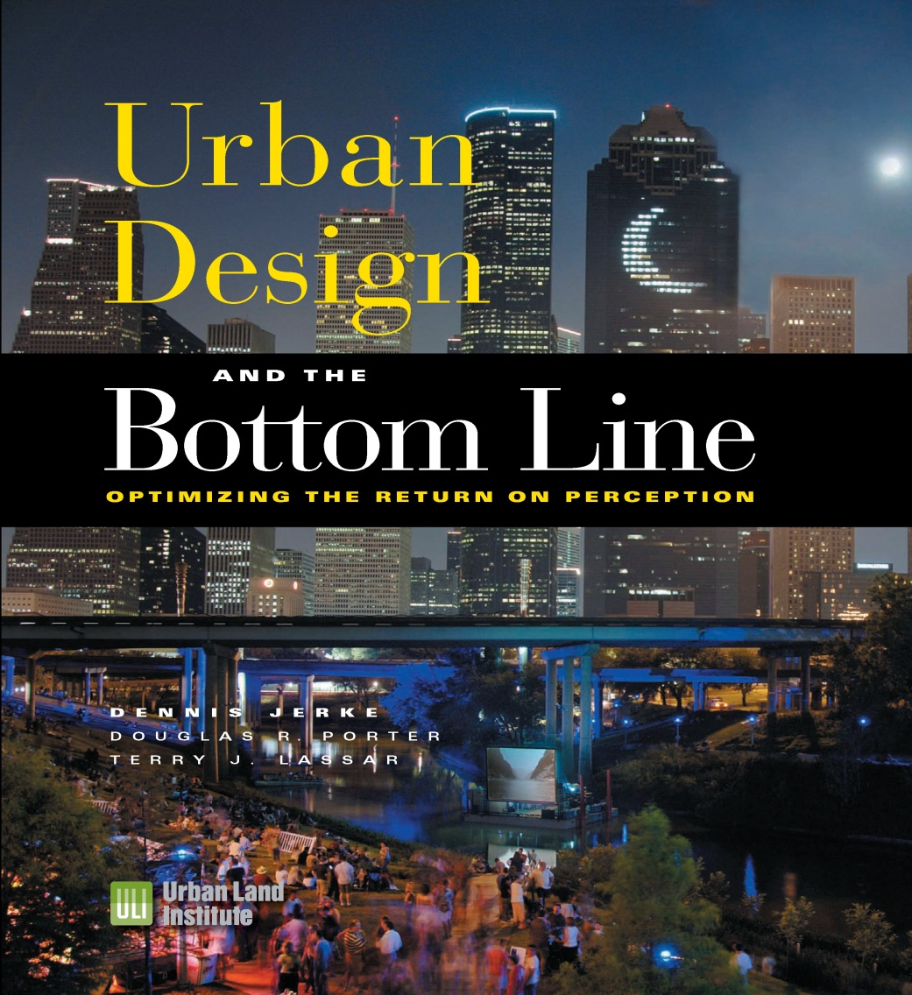
Green Space & Property Values
“The relationship between rising property values and green spaces is well documented.”
“Some studies find as much as a 15 to 30 % increase in the value of properties adjacent to parks and open space.”
Source: Urban Design & the Bottom Line, ULI, 2008

Slide 16
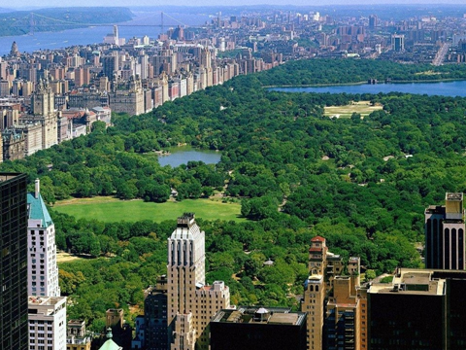
Where is the most valuable land in New York?
Notes:
Aerial view of central bank

Slide 17
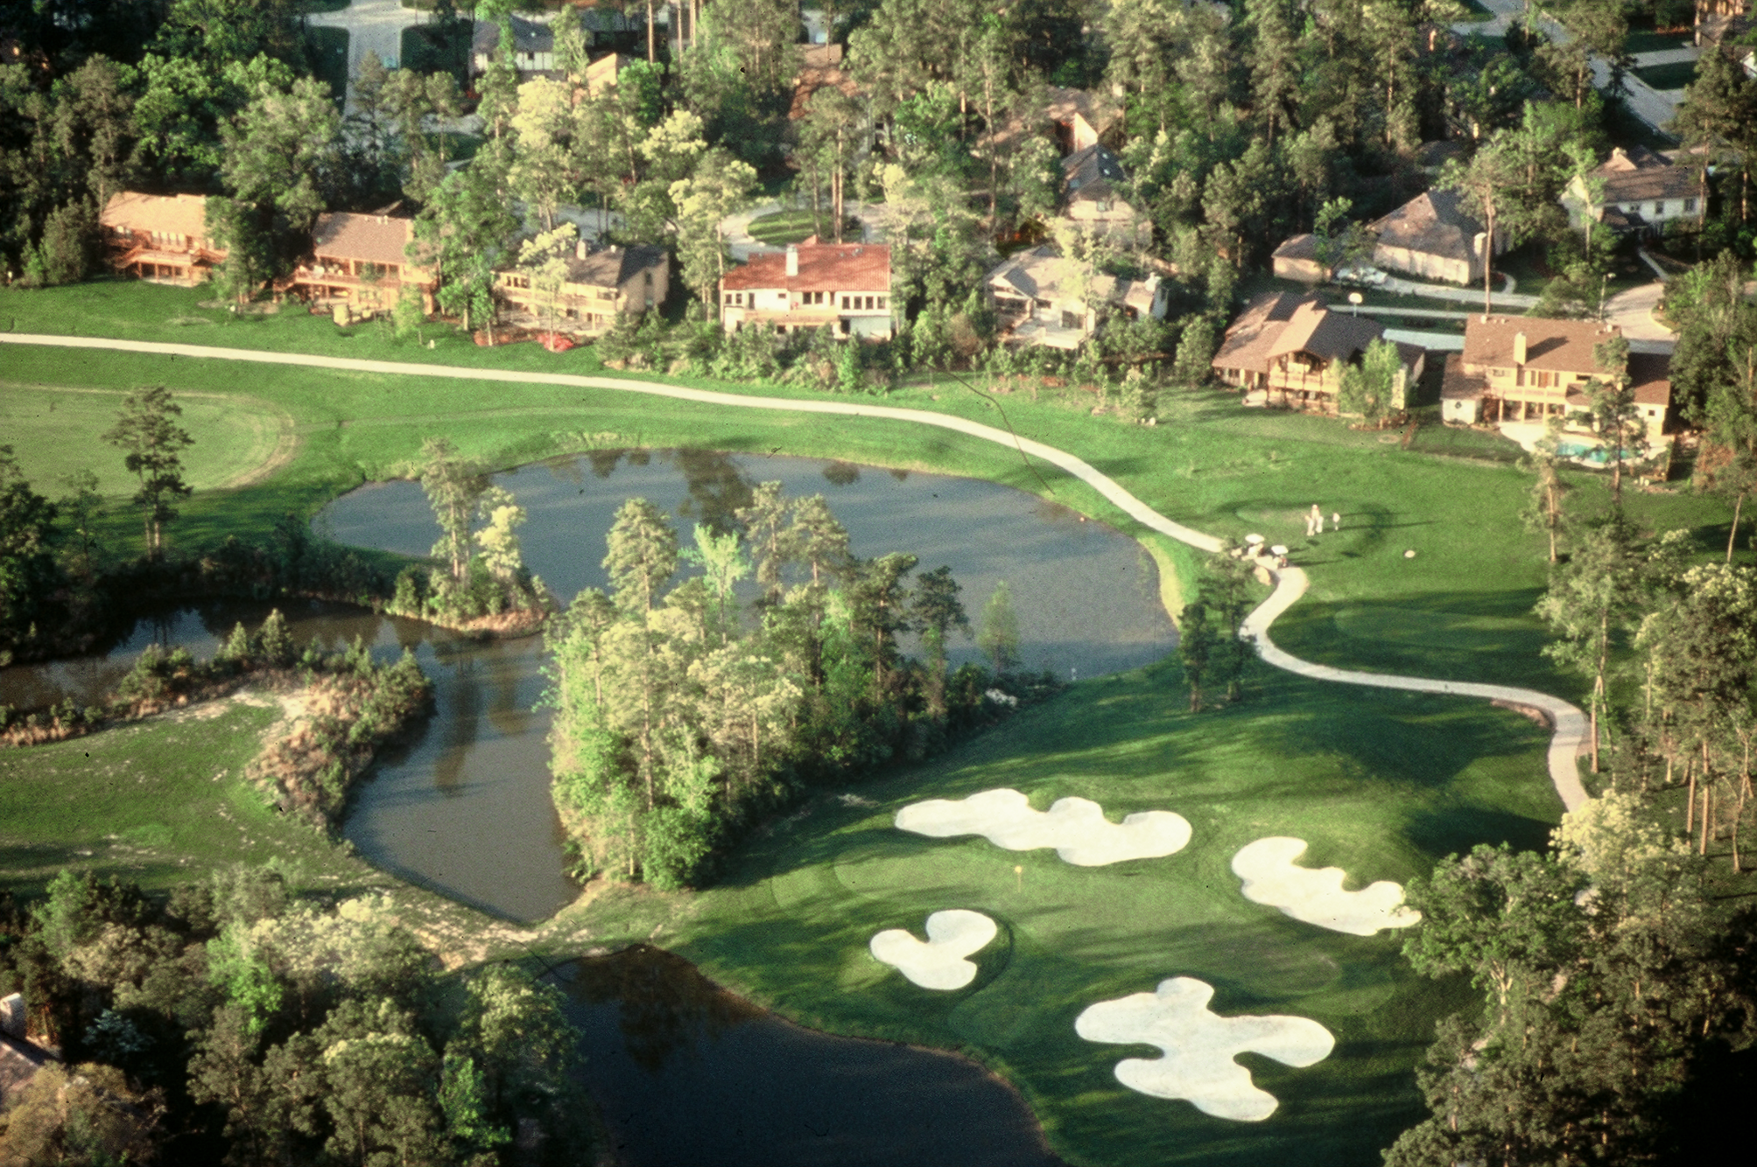
Houses next to golf course

Slide 18
Value of Open Space
Developers build golf courses because golf courses sell real estate at premium prices
Very expensive to design, build & maintain golf courses
Parks and open spaces also sell real estate at premium prices at lower costs to create and maintain

Slide 19
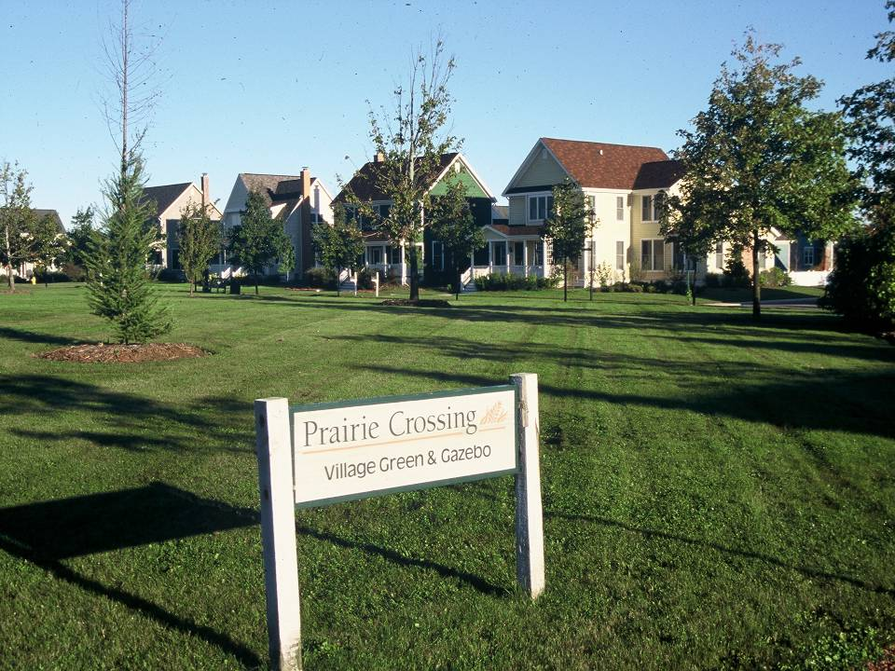
Notes:
Character of neighborhood more important than the size of the lot

Slide 20
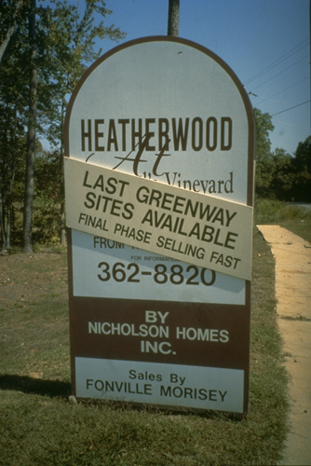
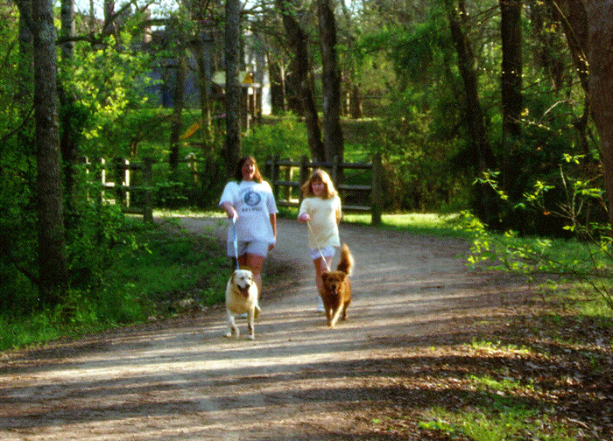
Green Space Creates Value
National Association of Realtors & the National Homebuilders Association - residential properties realize a 10 to 25% gain in value the closer they are located to greenspace

Slide 21
The Patterns of Development
Where you put development
How you arrange development
What development looks like
Notes:
When we think about the future, we should think about the patterns of development:

Slide 22
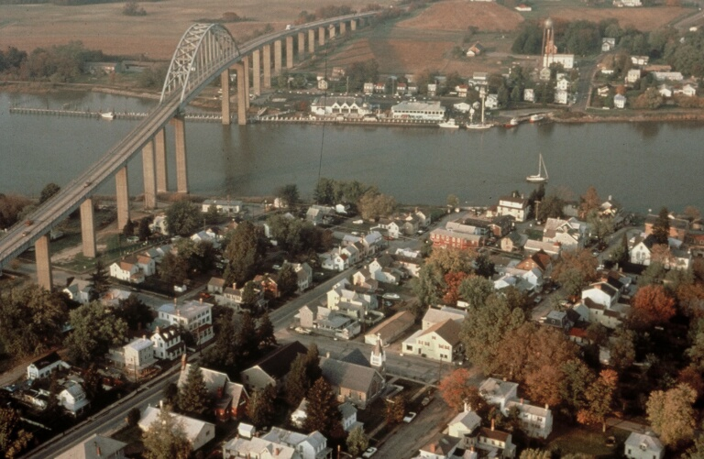
Chesapeake City, MD – A town

Slide 23
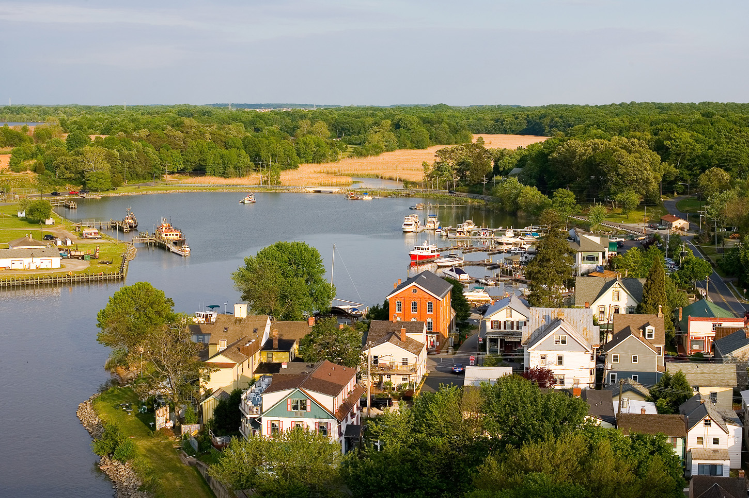
Characteristics of a Town
Edge & a center
Mix of Uses and housing types
Walkable & pedestrian friendly
Architecturally coherent & interesting
Strong sense of community & Place

Slide 24
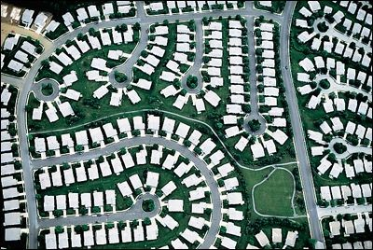
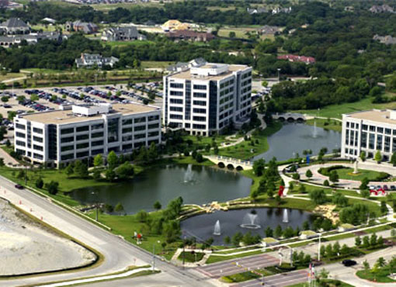
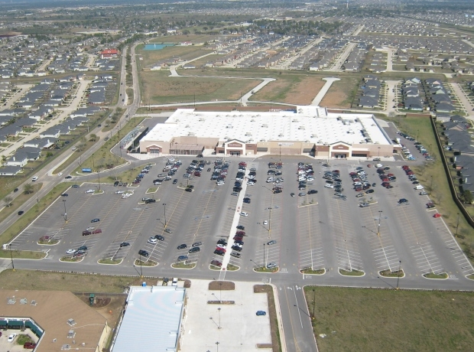
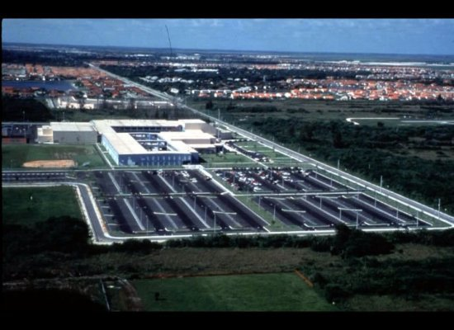
Sprawl
Housing Subdivision Office Park
Big Box Stores Regional High School

Slide 25
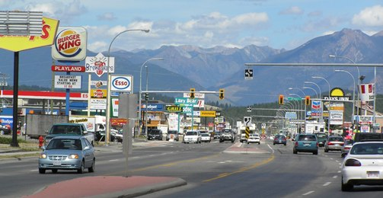
Characteristics of Sprawl
No edge & no center
All uses are segregated
Must drive everywhere for everything
Architecturally chaotic & ugly
No sense of place
Hard to have a sense of community

Slide 26
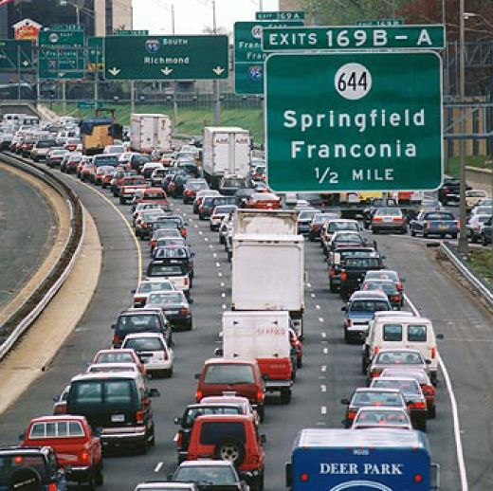
Development Pattern Reinforced Driving
Notes:
This caused us to drive everywhere for everything.

Slide 27
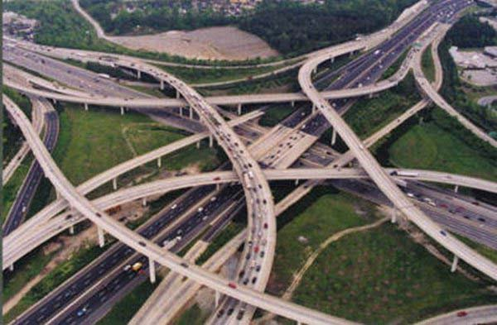
More Roads – Less Money
Between 1970 and 2000, the US doubled its road network.
During the same period the average American went from spending 10% of their household income on transportation to spending 20% of their household income.
Low income Americans spend even more on transportation

Slide 28
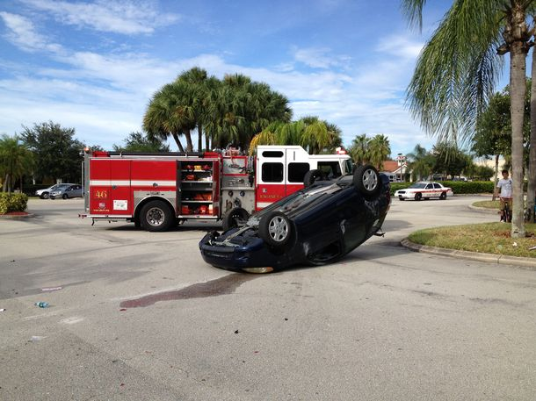
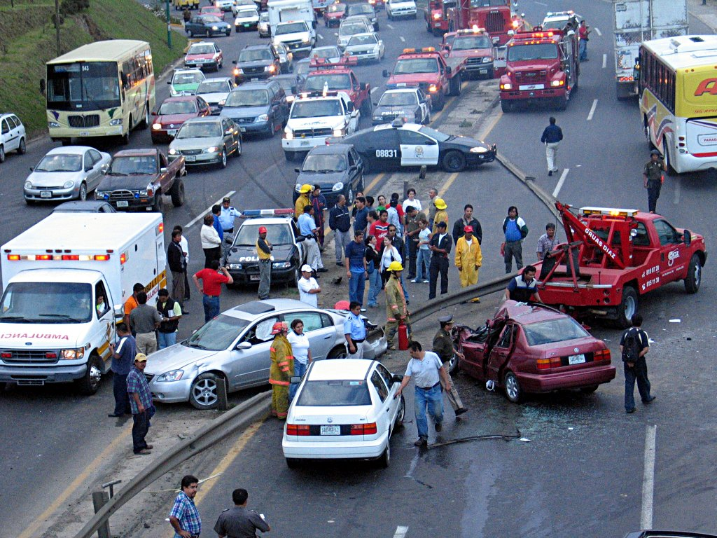
Auto Accidents Per Capita
US 12 per 100,000
UK 7 per 100,000
Japan 4 per 100,000
NYC 3 per 100,000
Tulsa 14 per 100,000
Orlando 20 per 100,000
Source: The Walkable City, Jeff Speck, 2013

Slide 29
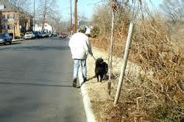
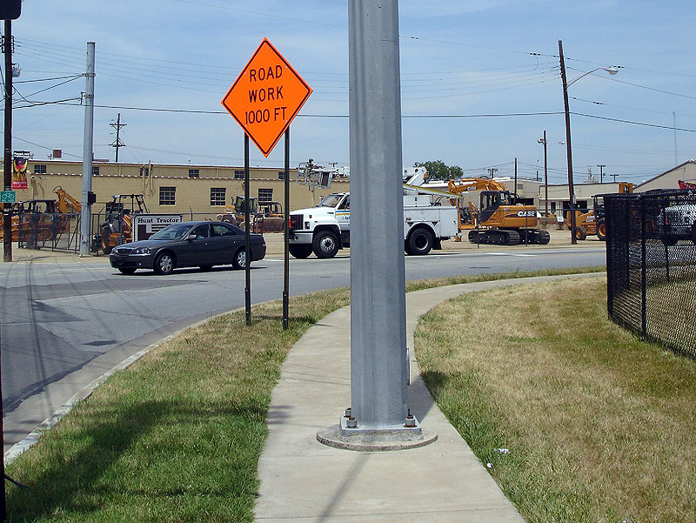
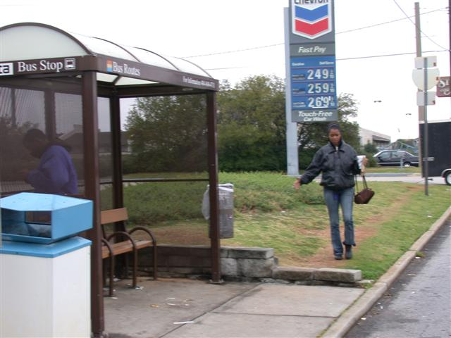
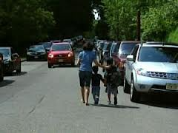
Barriers to Walking
Walking is often difficult, dangerous or unpleasant.

Slide 30
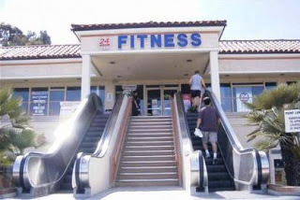
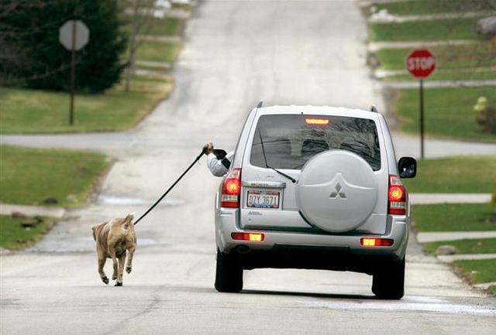
Physical Activity
Physical activity, once part of our normal lives has been designed out of daily routines.

Slide 31
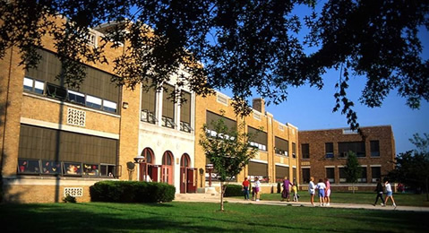
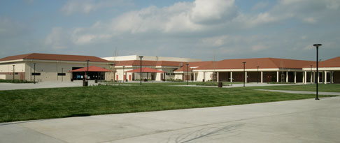
Schools on the Fringe
Then: Schools were the social and physical center of the community
Now: Schools are on the edge of town, to far for kids to walk

Slide 32
Do we have any alternatives to sprawl that are more attractive, more efficient, more profitable and healthier?

Slide 33
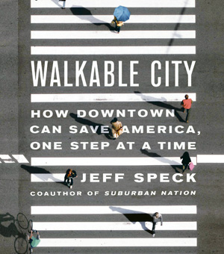
Designing Cities for Cars
“Sprawl is America’s worst idea because it takes our money, wastes our time and makes us less safe.”
Jeff Speck, Author – Walkable City

Slide 34
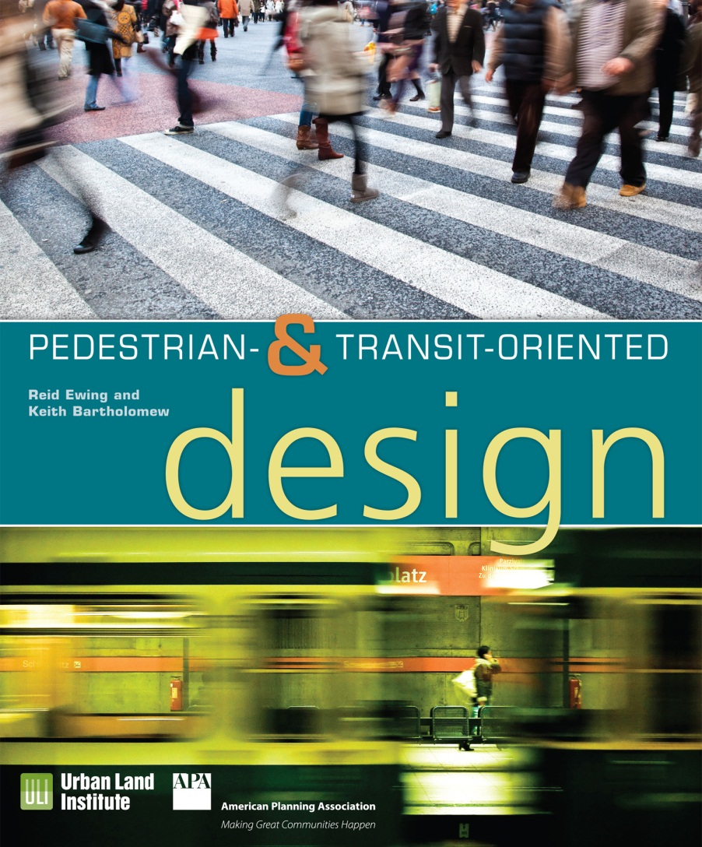
Designing Cities for People
Can Make Us:
Wealthier
Healthier
Environmentally Sustainable

Slide 35
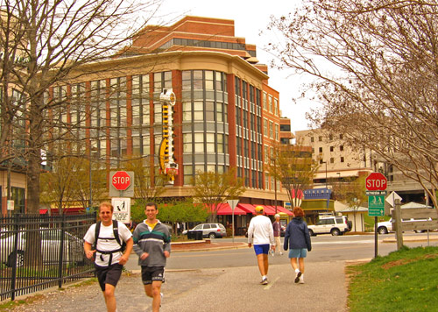
What could we do differently?
Mix uses
Location choices
Preserve nature and open space
Land use is an infrastructure and a health solution

Slide 36
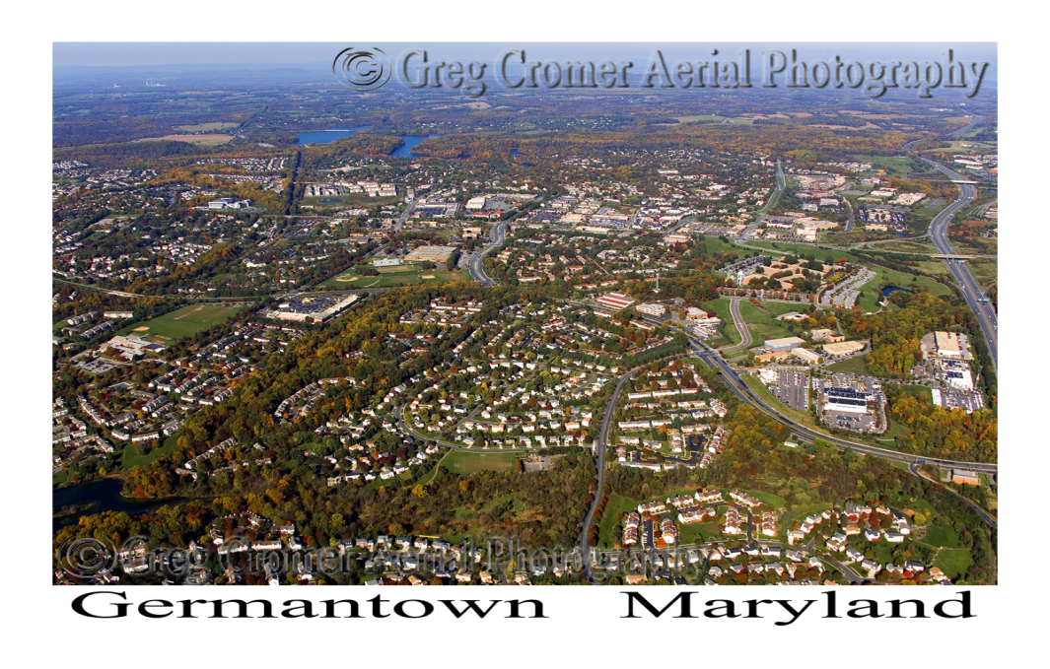
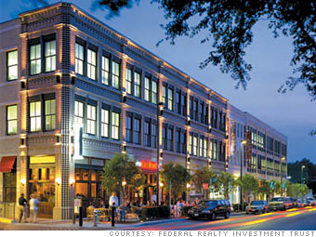
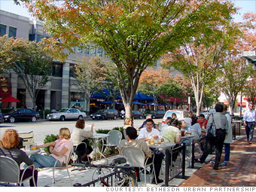
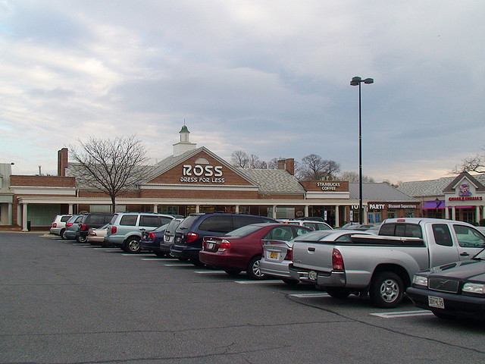
Bethesda vs. Germantown
In Bethesda, MD 75% of workers walk or take transit to run errands, go to lunch or go shopping.
In Germantown, MD 90% of workers drive to run errands, go to lunch or go shopping.

Slide 37
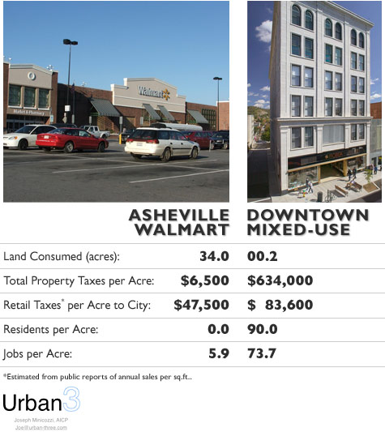
Mixed Use Pays
The smart math of mixed use development
Notes:
It turns out that this is very good for a community fiscal health.

Slide 38
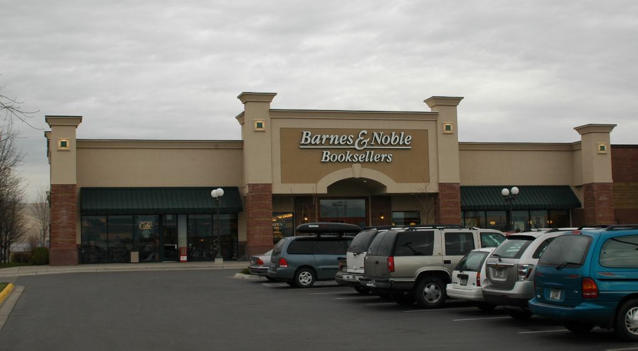
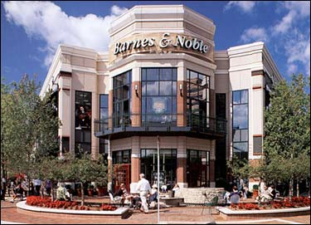
Design effects health & profitability!
Rockville, MD
Bethesda, MD
1 story 3 stories
Lots of parking in front of building
No parking in front of building
Notes:
Which one makes more money?

Slide 39


Which one is healthier & more profitable?
1 Way to get here:
Drive your car
4 Ways to get here
Drive your car
Take Metro
Ride your bike
Walk
Rockville Pike
Downtown Bethesda
Notes:
More choices means more profit.

Slide 40

“People stay longer,
spend more money
and come back more often to places that attract their affection.”
Source: Urban Design and the Bottom Line, ULI, 2009
Notes:
The Place-Making Dividend

Slide 41


What can we do differently?
Active transportation (biking and walking)
Trails and sidewalks
Complete streets
Right sized parking
Car sharing
Transit options

Slide 42

Community Amenities
Sought by Homebuyers
Walking trails/bike paths - 36%
Parks/natural areas - 26%
Playgrounds - 21%
Daycare - 14%
Soccer Fields - 9%
Golf Course - 6%
        - April 2004
        National Association of Realtors
        National Assn. of Homebuilders

Slide 43

Bicycling & Trail Recreation
“Bicycling makes a $133 billion contribution to the US economy. It supports 1.1 million jobs and generates $17.7 billion in annual federal and state tax revenue.”
Pine Creek Bike Trail

Slide 44

Bike Shops
There are 4200 specialty bike shops in the US.
The average bike shop employees 6 full time employees.
In 2012, 18.7 million bikes were sold in the US (4.2 million more than all auto sales)
Bikes shops are not evenly spread throughout the US.

Slide 45


Denver vs. Atlanta
Denver: 1996 population 2 million+
Bicycle Dealers: 149
Trail miles: 200+
Atlanta: 1996 population 3 million+
Bicycle dealers: 28
Trail miles: 10-

Slide 46



Connects 45 neighborhoods
40% increase in Atlanta parkland
22% of population lives in planning area
Will include trails and transit

Slide 47


Atlanta Beltline
Eastside Trail – Before Eastside Trail - After

Slide 48


What can we do differently?
Access to healthy food
Farmers markets
Urban grocery stores
Community farming

Slide 49


The Value of Food
The renovated Ferry Terminal Market in San Francisco is one of the city’s top 5 visitor destinations.
It attracts more than 1 million visitors a year and generates $1,250 per sq. ft. in food sales.
Ferry Terminal Market, San Francisco, CA

Slide 50


Union Market – Washington, DC
Union Market in Washington, DC is the heart and soul of a broader district bringing renewed spirit and economic activity to a once blighted neighborhood.
The market district currently has more than 100 businesses employing 1,500 people.
Union Market – Before and After

Slide 51

What can we do differently?
Accessible and attractive stairs
Exercise facilities
Operable windows
Universal design

Slide 52
ULI Messages
We can build our way to better health
When it comes to health, the built environment is an important part of the story
Real estate and land use professionals have a role to play.
Projects and places that promote health will see their value endure over time.
Healthy communities tend to also be valuable communities.
Access to nature and recreation is good for both people and business.
We need to make the healthy choice, the easy choice

Slide 53
Thank You!
Ed McMahon, Urban Land Institute
emcmahon@uli.org

