Slide 1
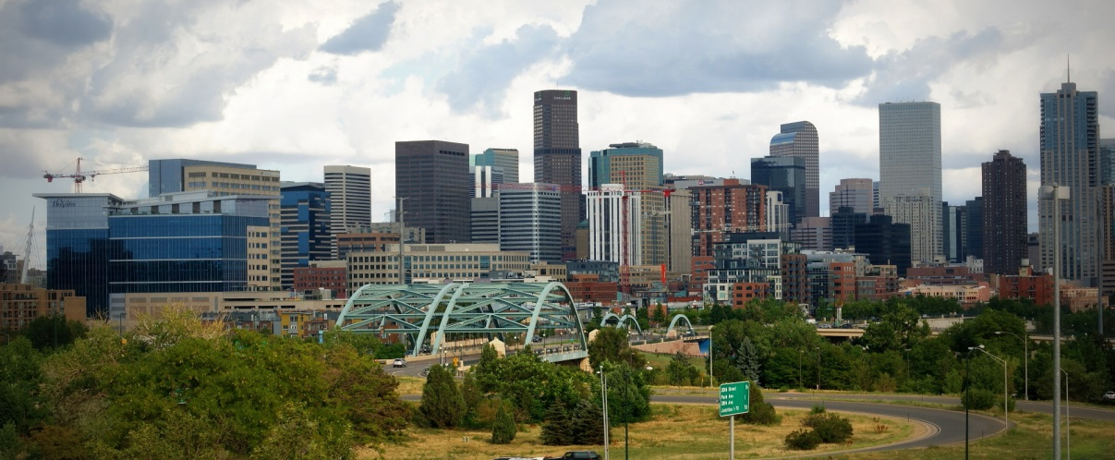
Notes:
As the Denver metro region continues to grow, FRESC: Good Jobs, Strong Communities is committed to fighting for policies that ensure that the most vulnerable members of our population, especially low income people, people of color, and immigrants, benefit the most.
Coloradans who work hard should be able to provide for their families and have the opportunity to achieve a good quality of life. The public should have a meaningful voice in the government decisions and investments that impact their communities and their lives.
Economic development and public investments should build environmentally safe and sustainable communities where ordinary people can afford to live, work and thrive.

Slide 2
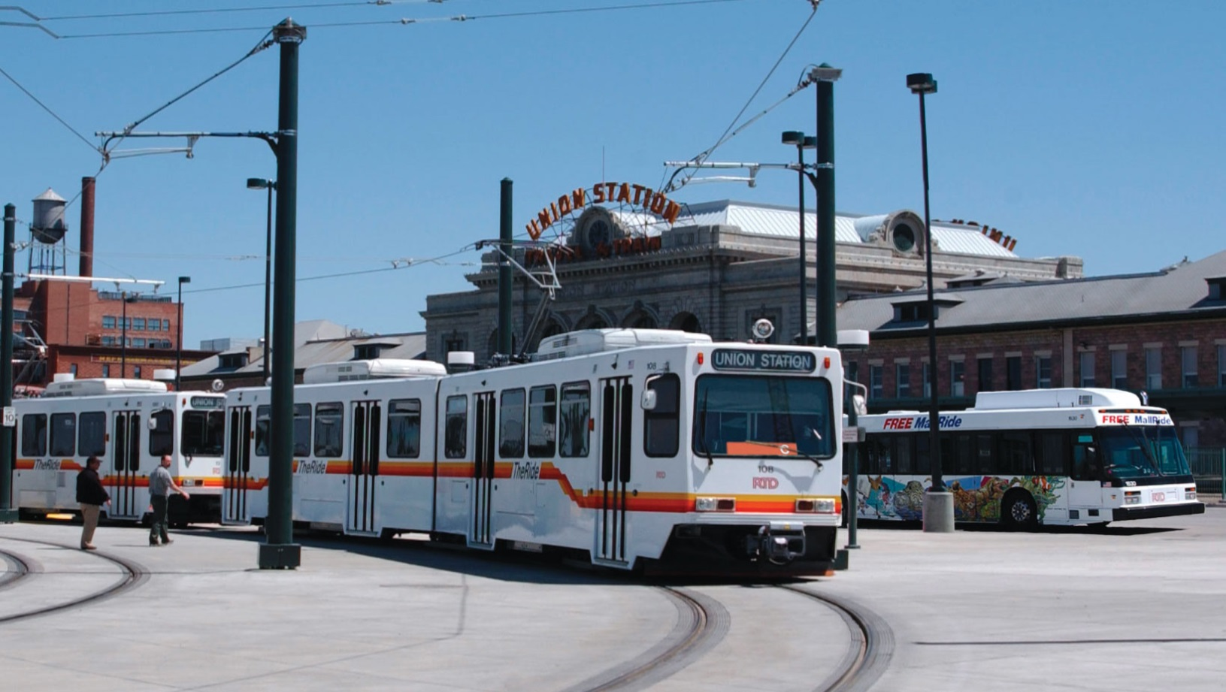
Big Public Investment: Transit Expansion
Notes:
$ Billions investment
How will communities benefit
Public $ = good for everyone

Slide 3
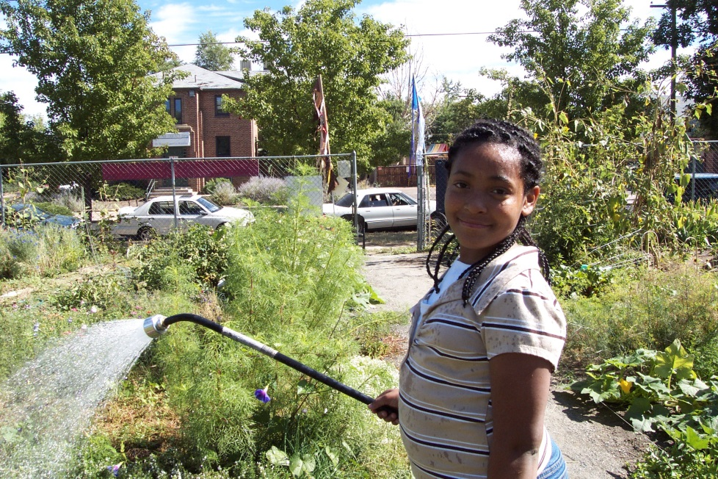
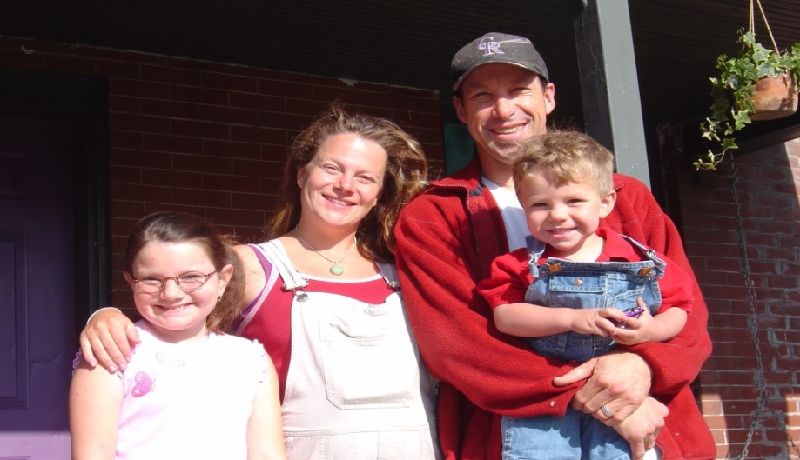
The Opportunity and the Price of Development
Notes:
Like most cities throughout the nation, the urban communities near our downtown area, have become more attractive for new development. The problem is that as this development happens, families are being priced out of their neighborhoods.----further from jobs…
FRESC is seizing this opportunity to lift up the issues of the thousands community members that are renting, and being priced out of the communities they’ve called home.
Trnsporttion + housing = 60% income
Good jobs access (healthcare, wages, bus scheduling to fit job schedules
Eco psses (especilly in mjoy employment hubs)
Smll businesses provide trnsit psses

Slide 4
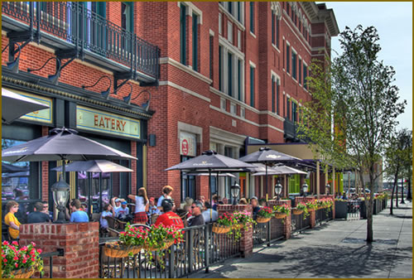
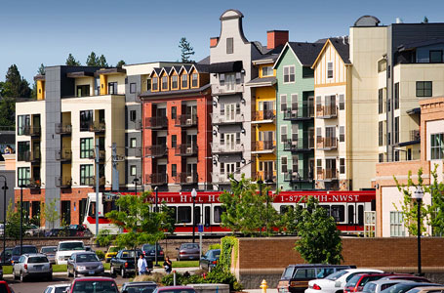
Transit Oriented Development Live, Work, Play
Who is this designed for?

Slide 5
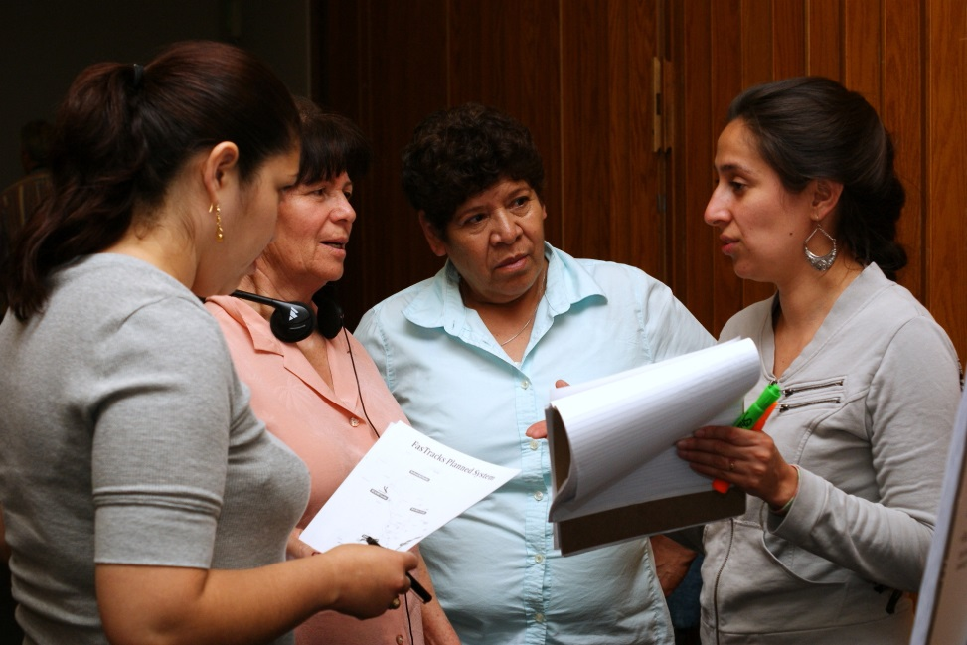
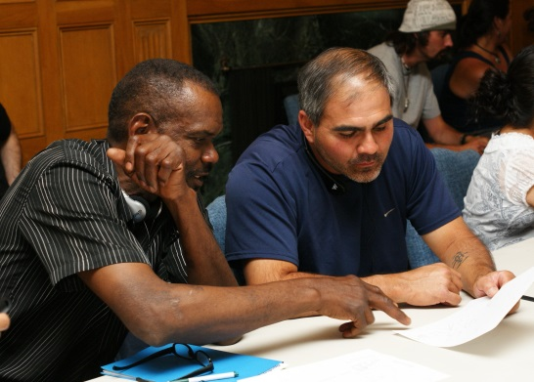
Planning and Vulnerable Communities

Slide 6
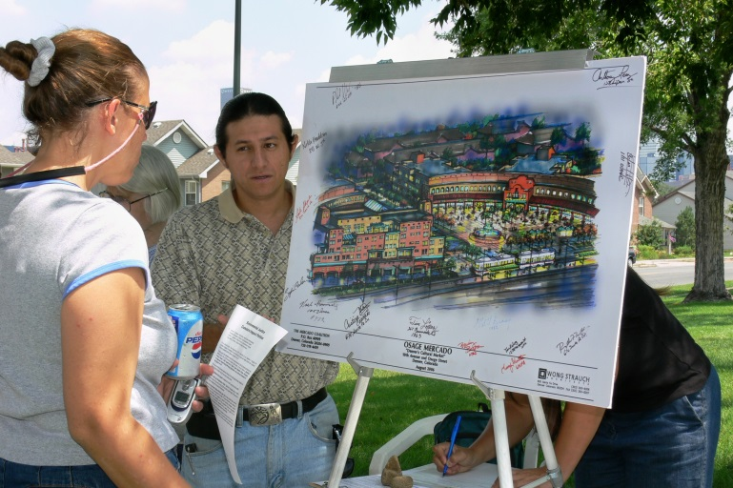
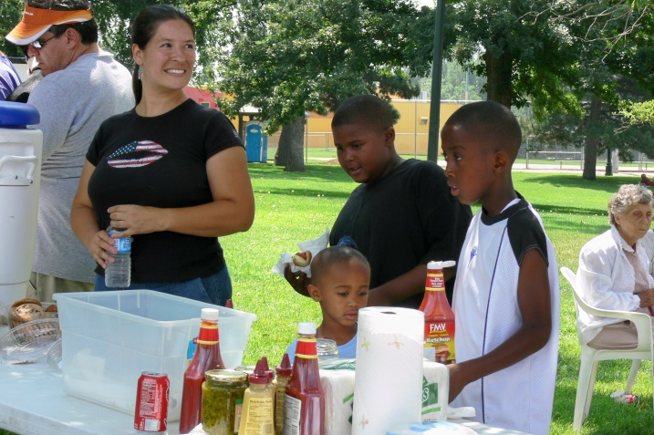
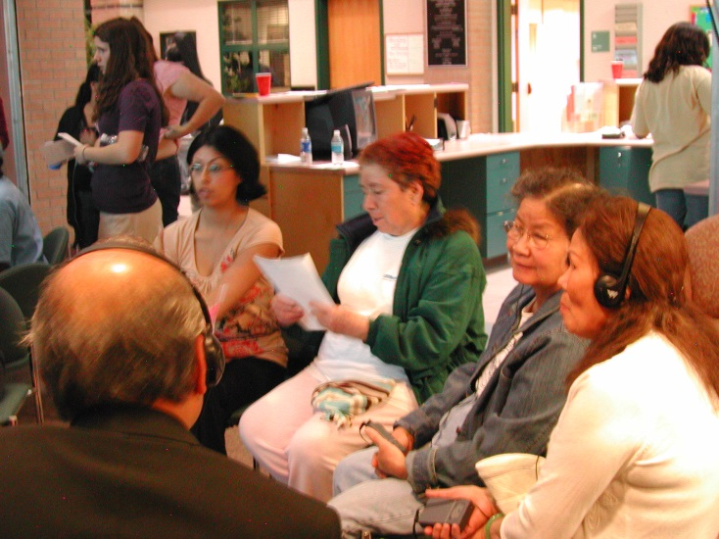
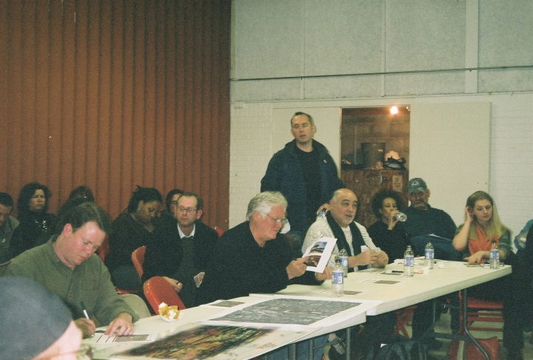
What makes La Alma different?

Slide 7
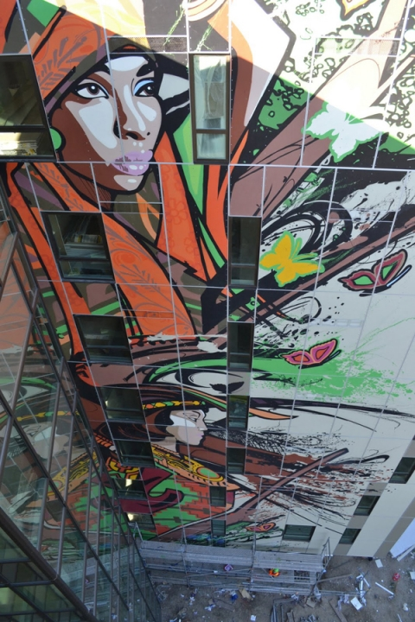
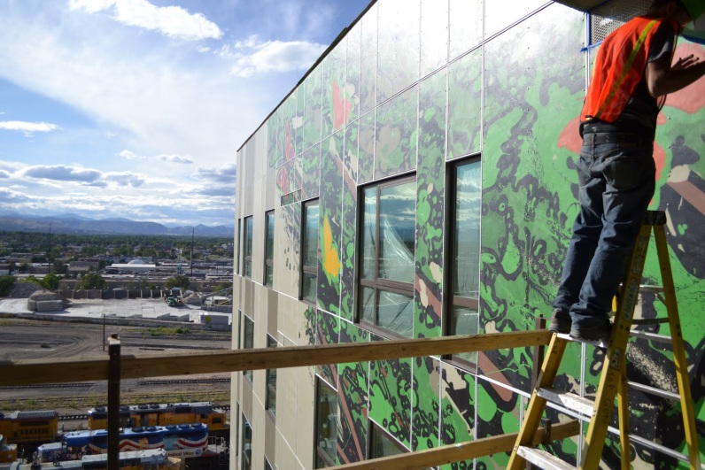
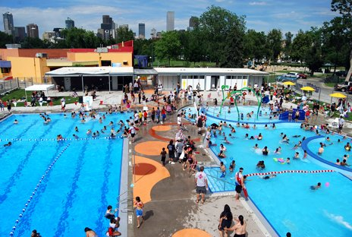
What can we win?

Slide 8
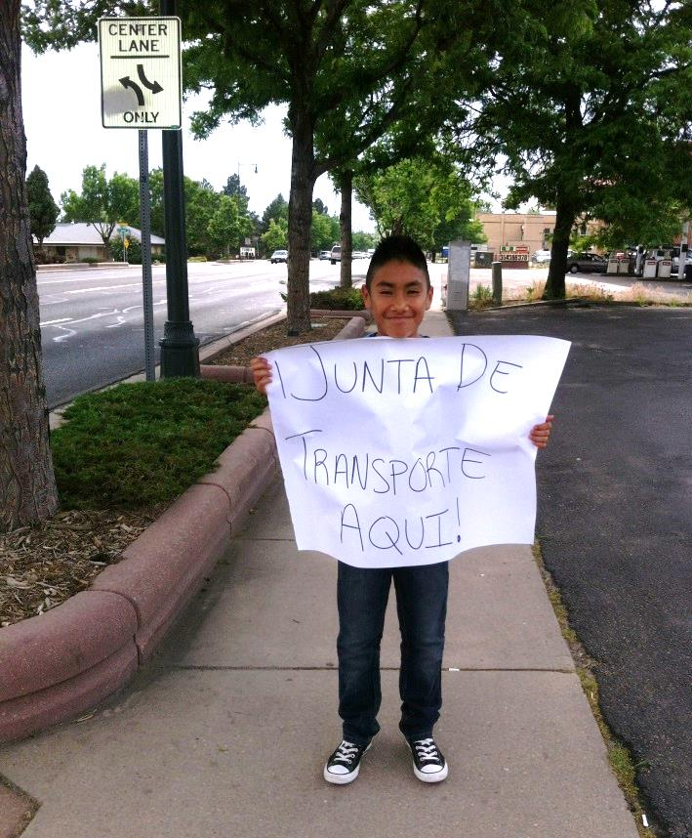
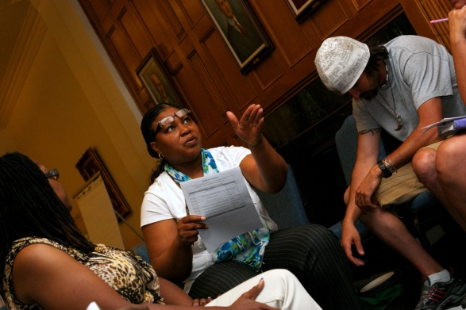
Organizing: Building Community Leadership

