Slide 1
Hospital Community Benefit: Policy, Practice and Potential
Jessica Curtis, JD
Director, Hospital Accountability Project
jcurtis@communitycatalyst.org;
617-275-2859

Slide 2
Background
Key community benefit policy concepts
Current practice and considerations
How communities are engaging and partnering with hospitals—or aim to!
© 2014

Slide 3
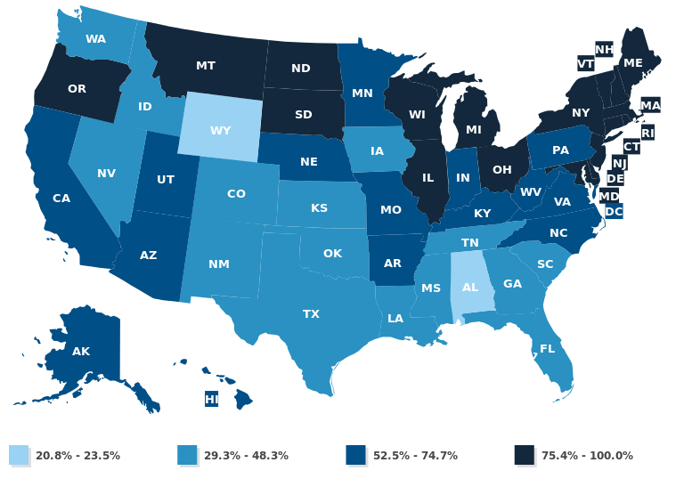
National Breakdown: Non-Profit Hospitals
National Numbers*
2,903 non-profit
1,045 state or local gov’t
1.025 for-profit
*Community hospitals (open to general public)
Source: Hospitals by Ownership Type, State Health Facts, Kaiser Family Foundation (2011).

Slide 4
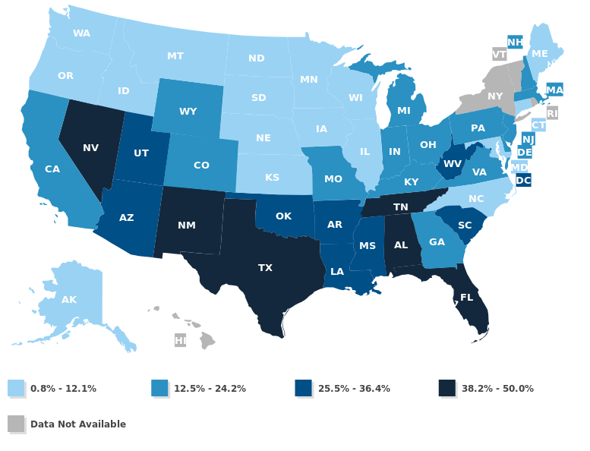
National Breakdown: For-Profit Hospitals
National Numbers*
58.4% non-profit
21% state or local gov’t
20.6% for-profit
*Community hospitals (open to general public)
Source: Hospitals by Ownership Type, State Health Facts, Kaiser Family Foundation (2011).

Slide 5
Legal Structure Can Be Multi-Layered
Federal (Constitution, Affordable Care Act, IRS)
State (Tax codes, licensure, health planning statutes, AG rules)
Local (Municipal ordinance, boards of health, etc.)
Other (PILOT, binding legal agreements)
© 2014

Slide 6
Community Benefit: Federal Developments
“Community benefit” is required for hospitals with federal tax-exempt status but vaguely defined
In exchange for not paying federal taxes, non-profit hospitals are expected to provide benefits to promote the health of the community (1969 Revenue Ruling)
Additional nuances appear in federal tax reporting forms
IRS and Treasury Department
Define terms
Set reporting rules (Form 990)
Investigate, monitor and enforce
Affordable Care Act (ACA)
Responded to abuses
Set new requirements
Hospital Tax Exemption = $12.6 Billion Annually (2002)
Source: Nonprofit Hospitals and the Provision of Community Benefit, Congressional Budget Office, 2006
Notes:
See pages 16-17 of the IRS Form 990 Schedule H instructions for more detailed definitions of what the IRS considers to be “community benefit.” In many ways, it mirrors the “best practices” put forward by leading hospital organizations like the VHA and Catholic Health Association.

Slide 7
Community Benefit: Federal Definition
Generally, community benefit includes programs or activities that:
Improve access to health care and/or community health, advance medical or health knowledge, or relieve or reduce government or community burden; AND
Respond to an identified community need, placing particular focus on the voices and issues facing the underserved in a given place.
NOT community benefit if 1) really a marketing ploy, or 2) if the hospital benefits more than the community. Examples:
Designed to increase third-party referrals
Required for hospital licensure or accreditation
Restricted to hospital employees
Sources: 2013 IRS Form 990, Schedule H Instructions, pages 16-17; “Defining Community Benefit,” Catholic Health Association; Community Benefit Model Act and Commentary, Community Catalyst.

Slide 8
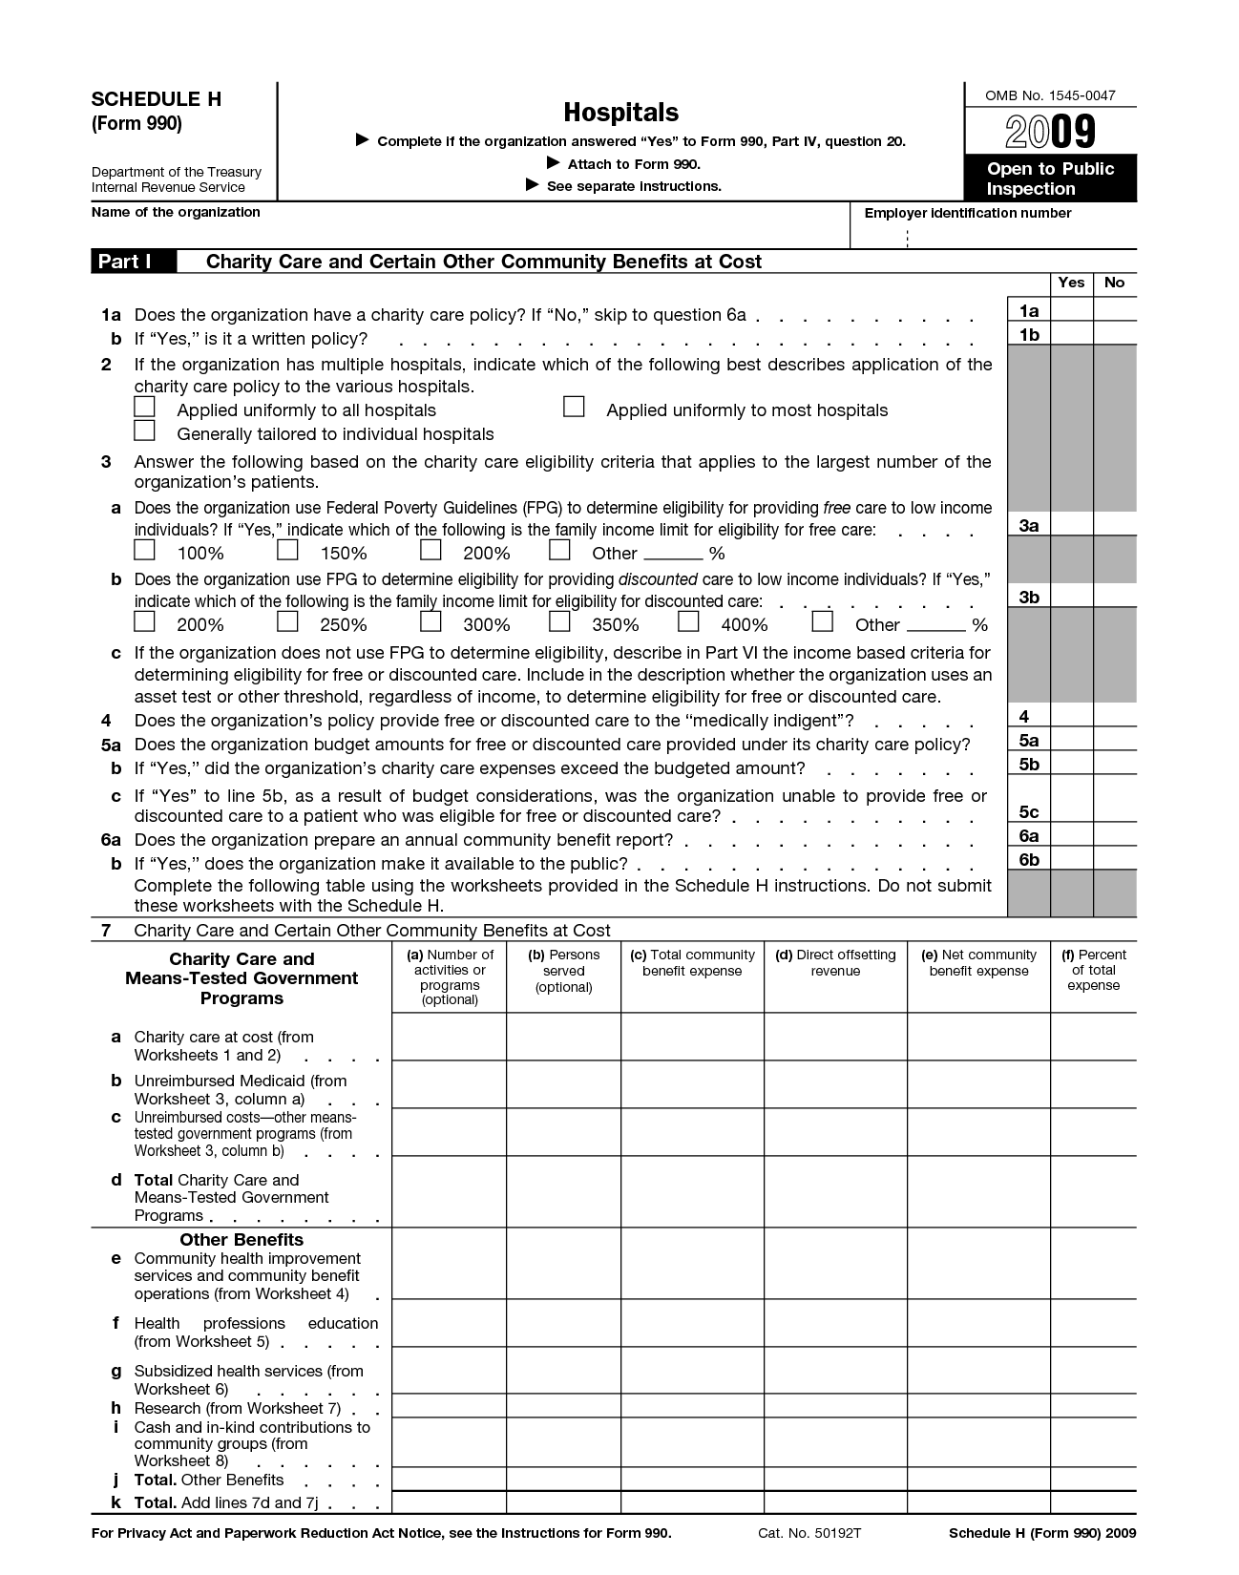
Community Benefit: Federal Reporting
Federal reporting requirements do specify what “counts” as community benefit, and what doesn’t, in the Form 990, Schedule H non-profit hospitals must file every year.
Source: 2013 Schedule H and Instructions, Internal Revenue Service.

Slide 9
Community Benefit: Federal Reporting
Community Benefit | NOT Community Benefit (Still Reported in Schedule H)
Financial Assistance | Bad Debt
Medicaid Shortfall (plus other public programs for low-income people) | Medicare Shortfall
Community health improvement services | Community building
Health professions education
Subsidized health services
Research
Cash and in-kind contributions to other groups
Improves access for low-income people, helps avoid medical debt from out-of-pocket costs
Patients end up in collections, plus all businesses write off some bad debt
Improves access for low-income people; hospitals may take financial hit
All over 65 qualify regardless of need; Medicare rates set so hospitals can profit
Both count “upstream” activities that address the social determinants of health, like economic development, environmental health, workforce development, housing—even coalition building, leadership development, health advocacy. There is a higher threshold for a program to count as community benefit.
Source: 2013 Schedule H and Instructions, Internal Revenue Service.
Notes:
In some cases, hospitals can claim certain work on issues that impact the social and economic determinants of health, including economic, environmental, housing, community support, leadership development, and workforce issues with the IRS. These activities could qualify as “community building” work if they were done to “protect or improve the community’s health or safety” (IRS Form 990 Schedule H 2013 Instructions, page 4). Things that mostly or only benefit the hospital—or that they would have to do anyway to comply with a law, get accredited, or maintain licensure—cannot be reported here or elsewhere.
In some cases, “community building” activities might also qualify as community benefit, sliding over into the “community health improvement” column. To qualify as a “community health improvement activity” and get “credit” for providing a community benefit, hospitals must meet a higher standard. First, the activity or program has to be subsidized by the hospital, with the express purpose of improving community health. (Sliding scale fees or nominal fees are okay.) In addition, the activity must meet a higher community benefit standard. Specifically, it has to be connected back to a community-identified need and meet a community benefit objective (see Slide 7 for examples).

Slide 10
Community Building: Movin’ on Upstream…Slowly
Community Building | Examples
Physical Improvements and Housing | Rehabbing or providing housing for vulnerable populations, neighborhood improvement projects, developing parks or playgrounds to increase physical activity
Economic Development | Assisting small business development for vulnerable populations; creating new jobs in areas with high joblessness rates
Community Support | Child care and mentoring programs for vulnerable populations; violence prevention; disaster preparedness (beyond what’s required by law)
Environmental improvements | Alleviating air or water pollution; waste removal and treatment
Leadership development and training for community members | Conflict resolution training; medical interpreter skills for community residents; civic, cultural or language skills
Coalition building | Participating in community coalitions and other collaborations to address health and safety
Community health improvement advocacy | Supporting policies and programs (access, housing, environment, transportation)
Workforce development | Recruiting to shortage areas; training and recruiting health professionals needed in community
Notes:
Source: 2013 Schedule H and Instructions pp. 4-5, Internal Revenue Service.

Slide 11
Under the Affordable Care Act, all non-profit hospitals must have:
Written, well-publicized financial assistance policy
Fair charges for patient care
Fair debt collection practices
Regularly assess the health needs of their communities, with input from community and public health leaders, and develop implementation plans to address needs
The Affordable Care Act changes the requirements for federal tax-exempt status for hospitals.
Notes:
Historically, many hospitals have taken an ad hoc approach to community benefit. They haven’t spent those dollars in a very effective way or with a mind to what may be happening outside community walls. But many advocates—including hospitals and public health leaders—have pushed for a long time for hospitals to adopt strategies used in public health, by community health centers, and others to regularly and systematically review the needs and assets that exist in their communities and target their resources accordingly. The ACA (and the proposed IRS rules) simply adopt what’s already been recommended as good practice.

Slide 12
Community Benefit: Proposed Federal Rules
Allow collaboration
Require input from public health and community members and representatives
Provide an additional tool for advocates to use to weigh in on health equity, access, and public health issues impacting the community
Require board approval on community benefit, financial assistance, billing and collection policies
© 2012

Slide 13
So, Where Are We Today?
In 2009, U.S. hospitals spent:
7.5% overall expenses on community benefit
Over 85% focused on access to care
Chart Credit: Martha Somerville, Somerville Consulting. Source Credit: Based on Young, G., et al. (2013) Provision of community benefit by tax-exempt U.S. Hospitals. N. Engl J Med. 368: 16
© 2014

Slide 14
Across U.S., Most Community Benefit Dollars Still Spent on Access to Care
Based on:
UWPHI County Health Rankings & Roadmaps Ranking Methods: Health Factor Weights for the 2013 Health Rankings | Young, G., et al. (2013) Provision of community benefit by tax-exempt U.S. Hospitals. N. Engl J Med. 368: 16
Credit: Martha Somerville, Somerville Consulting.
© 2014

Slide 15
Source: 2012 Community Benefit Reporting Report, Oregon Health Authority Office of Health Analytics
© Community Catalyst 2014
Notes:
While state-level data isn’t yet available, here is one example from Oregon, a state that mandates community benefit reporting and makes searchable data available online to the public.

Slide 16
Community Benefit: Canary in the Coal Mine or Lever for Change?
“Adopting a population-based approach to care that encompasses the spectrum of determinants of health is essential for care systems to thrive in the ACA era. To improve health outside their walls, hospitals and care systems must engage in multisectoral partnerships….”
- American Hospital Association and Association for Community Health Improvement
Source: “Trends in Hospital-Based Population Health Infrastructure: Results from an ACHI and AHA Survey,” Association for Community Health Improvement (December 2013)
© 2014
Notes:
“Most notably, the Affordable Care Act (ACA)…compels hospitals to address the socioeconomic, behavioral, and environmental factors that affect people before hospital admission and after discharge. The ACA is accelerating the shift [to value-based care]. Care systems are now being held accountable for the health of their patient population and are responsible for implementing health improvement strategies to address community health needs.” – Same source.

Slide 17
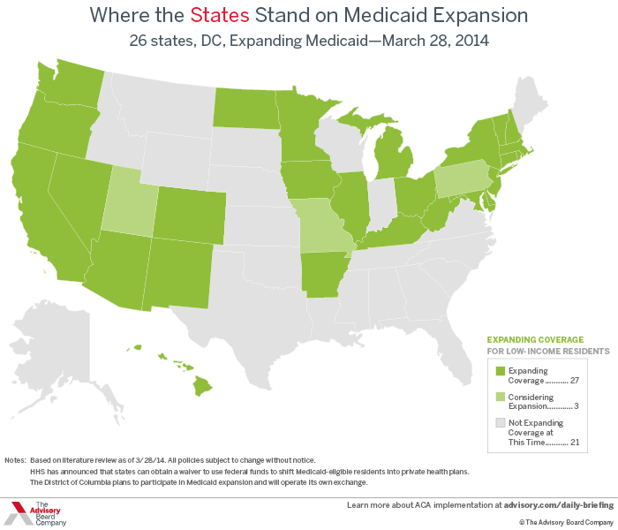
Community Benefit: Canary in the Coal Mine or Lever for Change?
© 2014

Slide 18
Looking Ahead: Potential to Partner
Three-site pilot program
The Bronx, New York City
Phillips Neighborhood, Minneapolis
Metro Portland, OR
Staff support and technical assistance
Policy analysis
Analyzing hospital community benefit data/process
Preparing for hospital meetings
Test training curriculum (June 2014 release)
Personal → systemic
Broad view of health (economic, environmental)
Community benefit, hospital dynamics
Basic organizing skills (CBPR, negotiations)
© 2014

Slide 19
Fundamental Premise
“Regardless of the scale on which a community assessment is conducted, it is likely to be most effective if it…respects both stories and studies, and places its heaviest emphasis on eliciting high-level community participation throughout the assessment [implementation and evaluation] process.”
Hancock and Minkler, “Whose Community? Whose Health? Whose Assessment?”
© 2014

Slide 20
$$$$
Influence
Expertise & Resources
Data

Slide 21
Initial Observations
Data gaps (especially for racial and ethnic minorities, limited English proficiency speakers, and other vulnerable populations)
Defining the community – some surprises
Training participants/organizations generally not at the table for hospital planning/assessment phases, or during prioritization
Community health needs assessment (CHNA) tend to use broad definition of health, but implementation strategies were narrowly tailored to “legacy” programs and/or issues more closely related to health care
Community appetite for financial information and interest in pursuing next steps with hospitals
© 2014

Slide 22
Questions
Is all the data we need or want publicly available? Are there any findings that surprise us? Things we want hospitals to improve? Shared interests?
Whose voices and perspectives did the hospital seek? Whose are missing?
How were community needs prioritized? Who decided and with what criteria?
Are there missing pieces or relationships that we can bring to bear?
How is the hospital moving forward? How can we be part of that?
© 2014

