Slide 1
A Practitioner’s Framework
Dr. Tony Iton
The California Endowment

Slide 3
Inequities
Disparities
Family & Culture
Health
Health

Slide 4
Inequities
Disparities
Family & Culture

Slide 5
Conditions
Consequences
Family & Culture

Slide 6
Family & Culture
School Absence/Truancy
Grade Failure
Drop-Out

Slide 7
Family & Culture
Narrative
Policy
Place
power

Slide 8
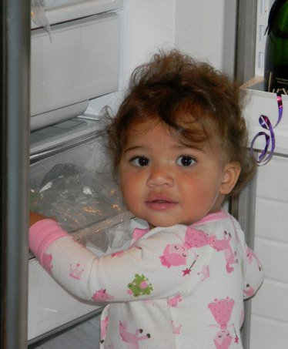
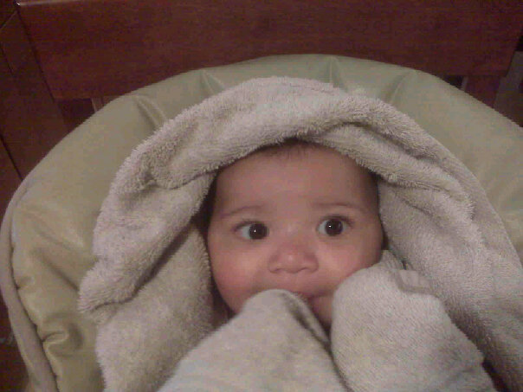
Contact Information
Tony Iton, MD, JD, MPH
Senior Vice President
The California Endowment
Aiton@calendow.org
(510) 271-4310

