Slide 1
Change.org:
A Tool for Media Impact

Slide 2
What’s Change.org?

Slide 3
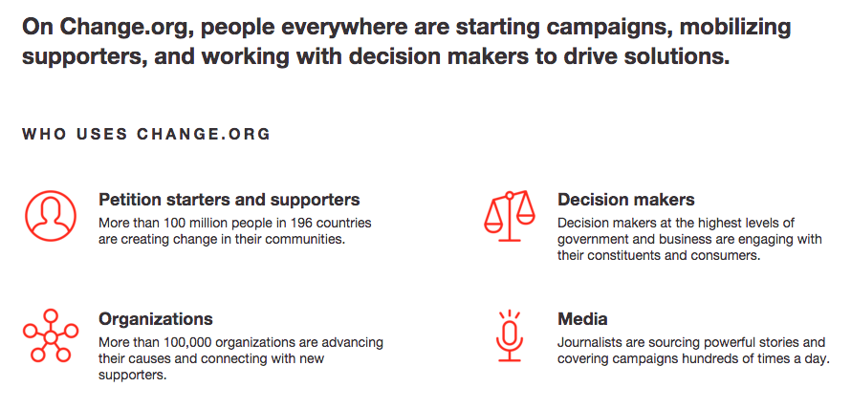
Remember
Good slides are simple
Slides are cheap

Slide 4
What makes a strong campaign?
Let’s talk impact.

Slide 5
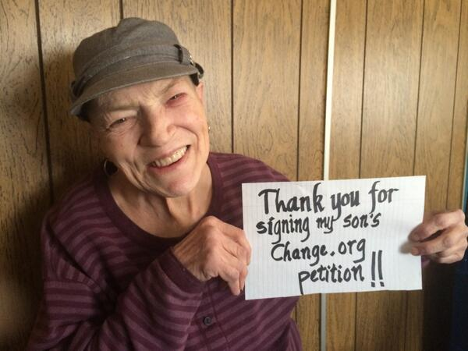

Slide 6
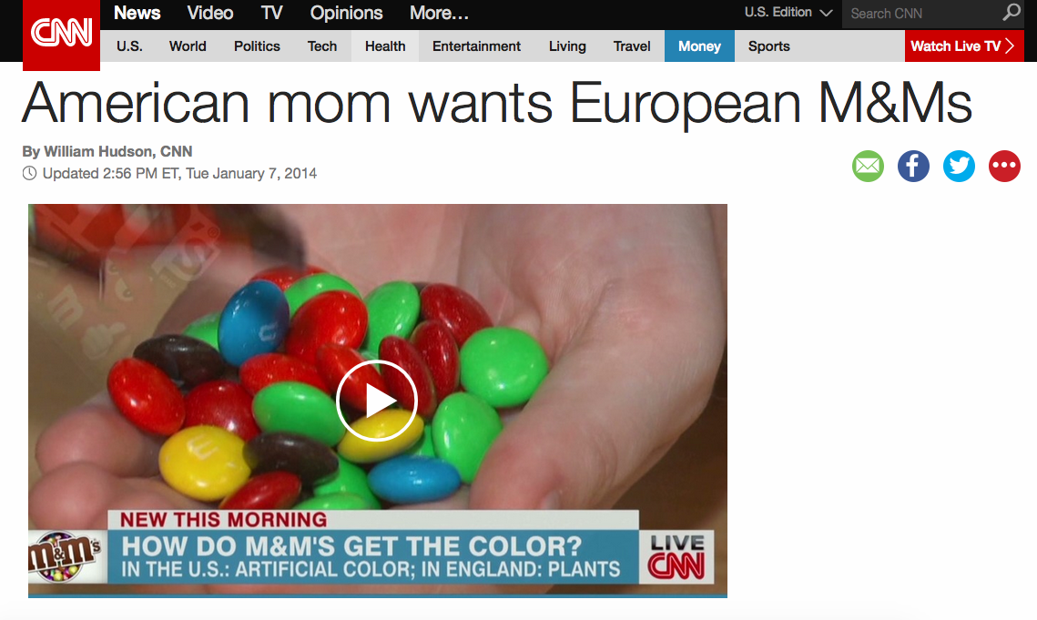

Slide 7


Slide 8
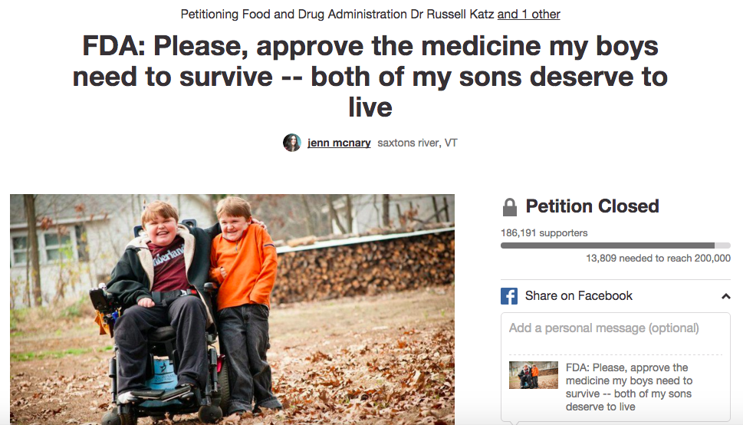

Slide 9
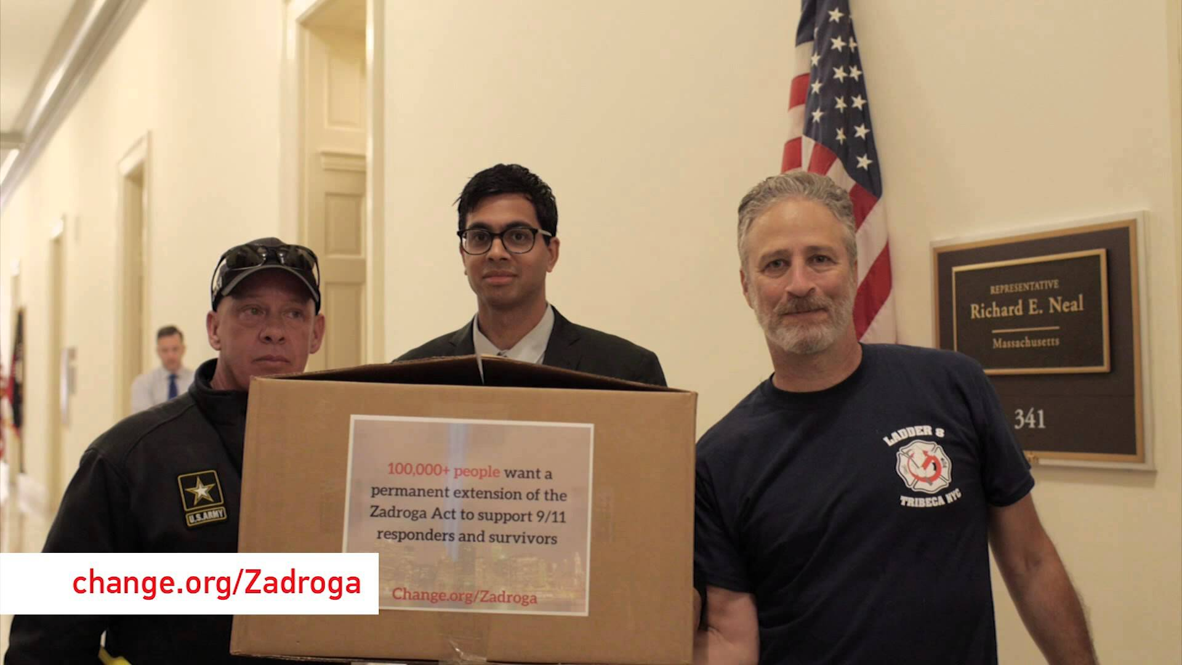

Slide 10
Change.org:
Empowering people everywhere to make the change they want to see.

