Slide 1

Lessons on Effective Coalitions
Tanya Beer
Center for Evaluation Innovation
2016 GIH Policy Forum

Slide 2
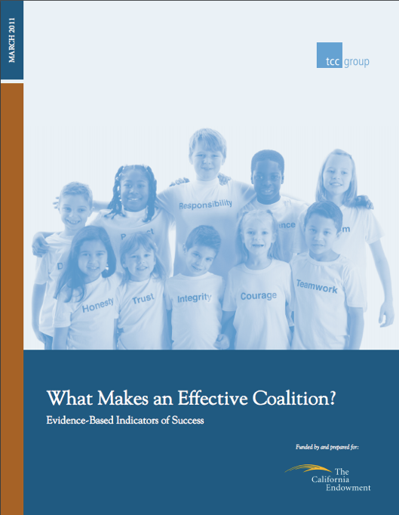
Research from the TCC Group
Coalitions are “networks in action” where members:
Agree upon purpose
Share decision-making
Aim to influence an external audience
Maintain autonomy
A coalition is a means to an end,
not an end in itself.

Slide 3
Shared Purpose
Goal Destination
(What is the coalition trying to achieve?)
Value Proposition
(Why is the coalition the right approach?)
Near term, specific and tactical
Connected to organizations’ own work
Common lens on expectations
Minimize transaction costs
Maximizing social utility
Seek internal stability re: inclusion
When either of these evaporates, let the coalition die.
Notes:
One area of agreement: shared purpose/vision that builds cohesion. Two aspects:
Goal Destination: Coalitions generally have agreed upon goals that are short-term/tactical; need to connect it with orgs own work
Why short-term? Reduce costs of compliance and thus minimize freeloader state of parity; however, the pay-off of collaboration is likely to increase over time as efficiencies build through trust and shared experience, but for a smaller group.
“Shared understanding”—about getting to a common lens for expectations. To do this requires both the ability to understand causal relationship patterns from the past AND project causal chains into the future.
As role specialization increases, understanding need be more complementary; as specialization decreases, understanding needs to be more similar.
Value proposition: Minimize transaction costs and maximize social utility. Making the cost-benefit case.
Seek internal stability (no member wants to leave) and external stability (no non-members want to join), though exclusivity can be a factor in perceived prestige.
Rules, procedures and D-M: no “one-size-fits all”, but about coming to agreement.
Consensus Decision Making leads to larger coalitions, with more moderate effort levels
Voting: fewer participants but higher levels of engagement
Leadership core: interlocutors that can bridge gaps (Jonathan Fox, 2009) and provide cohesive direction
Faultline activation when leaders approach from entitlement perspective
Action-oriented: coalitions are not generally a means unto themselves, as networks sometimes are. Rather, they are a means to an end.
Strategic membership: inclusive or exclusive—needs to be context driven.

Slide 4
  Clarity about the
  value proposition
Coalition → Policy Goal
  Counterbalance to widespread or powerful opposition
  Pressure from multiple points and constituencies
  Political cover for decisionmakers
Organization → Coalition
  Access, influence, credibility with critical audiences
  Advocacy skills & expertise
  Time
Coalitions with clarity at all of these levels demonstrate more trust, transparency, and satisfaction.
Coalition → Organization
  Strategic contribution to organizational mission
  Gap filling
  Reciprocating relationships/capital

Slide 5
Coalition Capacities
1
Leadership
Goal Destination
(What is the coalition trying to achieve?)
Value Proposition
(Why is the coalition the right approach?)
Create cohesion
Rules, procedures, and decision-making that fit the situation
Bridge gaps and provide cohesive direction
Action-oriented rather than only purpose oriented
Strategic membership that’s context driven
Common Funder Error
Inattention to power dynamics within coalitions
Notes:
Rules, procedures and D-M: no “one-size-fits all”, but about coming to agreement.
Consensus Decision Making leads to larger coalitions, with more moderate effort levels
Voting: fewer participants but higher levels of engagement
Leadership core: interlocutors that can bridge gaps (Jonathan Fox, 2009) and provide cohesive direction
Faultline activation when leaders approach from entitlement perspective
Action-oriented: coalitions are not generally a means unto themselves, as networks sometimes are. Rather, they are a means to an end.
Strategic membership: inclusive or exclusive—needs to be context driven.

Slide 6
Coalition Capacities
2
Adaptive Capacity
Systematic environmental monitoring
Shared political analysis
Effective planning grounded in action
Ability to re-configure approach rapidly
Evaluating success & members
Flexible resourcing
Promote inter-member Collaboration
Common Funder Error
Restricting use of funds or requiring detailed plans
Notes:
Adaptive: the ability of a nonprofit organization to monitor, assess, and respond to internal and external changes (such as networking/collaborating, assessing organizational effectiveness, evaluating programs and services and planning).
Enviro monitoring: to maximize draw of coalition
Planning: Grounded in action rather than “lofty goals” or theory
Evaluating members: somewhat controversial, but compliance is a critical component of effective coalitions.

Slide 7
Coalition Capacities
3
Management Capacity
Communication that’s frequent and productive
Cultivating membership engagement
  Deliver on reciprocity
  Task/goal focused
  Clarity of member/staff roles
  Conflict management
  Careful record-keeping
Common Funder Error
Confusing bureaucratic process with competence
Common Error
Notes:
Communication: not just about sharing—it is about use
Deliberate: presumed mutual understanding is one of the largest pitfalls in coalition work.
As an aside, evaluators can potentially play a bridging role (the interlocutor) to enhance communication skills. Things like logic models and other mechanisms for ensuring shared understanding can facilitate better communication.
Coalitions across linguistic groups can be very challenging and generally require stronger centralized leadership
Member participation: coalitions at their best when members are engaged and feel work is productive and meaningful. 5 practices:
Conflict management: address power differentials

Slide 8
Coalition Capacities
4
Technical Capacity
Membership Diversity
Coalition Staffing
Policy/Advocacy Expertise
Tangible Non-Human Resources
Resource Development Skills
Common Funder Error
Pushing coalition to hire staff who are “doers”
Notes:
Technical: the ability of a nonprofit to implement all of the key organizational and programmatic functions (such as finance, budgeting, fundraising, technology, marketing, and communications).
Member diversity: one author describes the coordination of coalitions as between actors of differing ideologies, distinguishing them from movements.
Heterogeneous coalitions theoretically have the broadest pool of resources to draw upon
Coalition staffing: paid staff not always good. If coalition can’t pursue goals without hired sttaffing, not likely to do so with.
Five roles: coach, director, linking agent, “doer”, and coordinator.
Doer is least effective role
Valuable when organize disparate parts in a fast-moving environment like policy.
Resource development:
Coalition may be in competition with some of its own members—requires sensitivity and transparency
Fiscal agency
Make clear case for overhead costs

Slide 9
Seven Deadly Sins of Coalitions
Debate to Death
Social Orientation
Avoidance of Conflict
Lack of Technical Expertise
Turn it Over to the Staff
No Ongoing Role for Members
Fight over Recognition
For funders
in particular
8. Holding on when purpose is gone
9. Confusing your purpose with theirs
10. “Over-coalitioning” a community
Notes:
Seven Deadly Sins of Coalitions
Debate to Death: Belaboring every bit of information or potential action, favoring argument over action.
Social Orientation: Committing to the group for its own sake rather than as a vehicle for action with a clear goal destination and value proposition.
Avoidance of Conflict: Masking disagreement to create harmony at the expense of thoughtful vetting and buy-in. One of the most valuable roles that a coalition can play is to uncover sticking points and resolve them within the coalition rather than publicly.
Lack of Technical Expertise: Feeling that forming a coalition substitutes for knowledge of things such as policy and advocacy work, fundraising, or evaluation. Creating a coalition is not advocacy, but rather a tool for it.
Turn it Over to the Staff: Leaving the work of the coalition to staff members (whether employed by the coalition or dedicated staff from member organizations).
No Ongoing Role for Members: Failing to agree upon specific tasks for coalition members.
Fight over Recognition: As the coalition makes gains, members try to take individual credit for success instead of acknowledging partners.

Slide 10
1
Leadership
2
Adaptive Capacity
3
Management Capacity
4
Technical Capacity
How does your grantmaking approach enable or constrain the characteristics of effective coalitions?

Slide 11
For more…
Jared Raynor at the TCC Group
www.tccgrp.com

