Slide 1
Health Coverage for Children: Where do we stand?
Joan Alker/Sabrina Corlette
Georgetown Health Policy Institute
February 4, 2014

Slide 2
How Children Are Covered, 2011
66.2% of Low-income children are on Medicaid/CHIP
Children = 72.8 million

Slide 3
Children’s Coverage Under the ACA
An estimated two million children will have individual market exchange coverage

Slide 4
Status of Medicaid Expansions
(1/1/31)
VT
ME
WA
NH
MT
ND
MN
OR
MA
SD
WI
NY
ID
MI¹
CT
RI
WY
PA
NJ
NE
IA
OH
DE
NV
IL
IN
MD
CA
UT
CO
WV
VA
KS
MO
KY
DC
NC
AZ
TN
NM
OK
AR
SC
MS
AL
GA
AK
TX
LA
FL
HI
Moving Forward at this Time (26 States including DC)
Not Moving Forward at this Time (20 States)
Ongoing Discussion (5 States)
States with Extended Waivers (2 States)
SOURCES: State decisions on the Medicaid expansion as of October 21, 2013. Based on data from the Centers for Medicare and Medicaid, Kaiser Family Foundation and state legislative scan by Georgetown CCF.
4

Slide 5
Open Enrollment: Mid-Way Point
  Rates lower than projected vs. “rate shock”
  Early renewals and policy cancellations
  Rocky websites
  Back end glitches
  SBMs outperforming FFMs
  Coverage gaps
  Provider network issues

Slide 6
Open Enrollment: Mid Way Point
Where are the Uninsured?
  Continued lack of awareness
81% do NOT know about March deadline
47% have unfavorable view
24% have favorable view
7 in 10 uninsured adults have not yet been to marketplace
Uninsured adults in 30s less likely to know about options than other age cohorts
Main reason uninsured?
“I can’t afford it.” 69%
69% do not know financial help is available
Source: Enroll America,
Results from a National Survey of Uninsured Adults 18 to 64
Conducted Dec. 12-22, 2013; KFF January 2014 tracking poll
Notes:
Only 11% of those enrolled to date previously uninsured. McKinsey survey
Last week tracking poll – found that among uninsured, more have an unfavorable than favorable view, by a 2-1 margin

Slide 7
Open Enrollment: Mid-Way Point
Enrollment Status
Web Site and Call Center Activity
  53.2M visits to websites
  11.3M calls to call centers
Eligibility Determinations and Plan Selection
  3 M have selected plan
  Public program data is not yet very useful
Source: Assistant Secretary for Planning & Evaluation, HHS
Monthly status report October 1-Dec. 28, 2013 and
Centers for Medicare and Medicaid Services

Slide 8
Open Enrollment: Mid-Way Point
Enrollment Status
Breakdown: Gender
  46% Male
  54% Female
Breakdown: Age
  6% < 18
  24% between 18-34
  55% between 45-64
Breakdown: Popular Plans
  20% Bronze
  60% Silver
  13% Gold
  7% Platinum
  1% Catastrophic
Breakdown: Subsidies
  79% receiving subsidies
Source: Assistant Secretary for Planning & Evaluation, HHS
Monthly status report October 1-Dec. 28, 2013
Notes:
Projected number of kids?
Wellpoint earnings call: “encouraged” by level of applications we’ve received as well as by the health-risk profiles of new members

Slide 9
ACA Marketplaces: Policy Issues to Watch
  Enrollment
  Premiums
  Narrow networks
  Provider capacity
  Cost-sharing
  Benefits
  Employer-based coverage

Slide 10
ACA Marketplaces: Issues for Families
  E&E Assistance
  Health insurance literacy
  Appeals
  Coverage problems
  Use of services
  Churn
  Reconciliation
Notes:
All about consumer assistance – pre-enrollment, post-enrollment and into tax filing season….
I would make clear here that complex family coverage circumstances create a related set of issues for famililes – maybe this is where we hand off a bit. In other words there are issues that affect kids getting tax credits/exchange covearge and then there are issues re kids who will be/are getting medicaid/chip coverage. Some are the same like the need for conusmer assistance. But coverage problems obviosuly different set of issues for the two sets of kids.

Slide 11
Children’s Coverage in the United States, 2014
28% of separate CHIP kids moving to Medicaid

Slide 12
National Eligibility Levels, 2013
Potential Coverage Gap

Slide 13

Affordability Test - Individual
Subsidies for an employee with an ESI coverage offer
Are available only if:
Premium cost for:
Self-only
>
9.5%
Income of:
Household

Slide 14


Affordability Test – Family Glitch
Subsidies for a family with an ESI coverage offer
Are available only if:
Premium cost for:
Self-only
>
9.5%
Income of:
Household

Slide 15
Affordability Test – Preferred Outcome
Subsidies for a family with an ESI coverage offer
Are available only if:
Premium cost for:
Household
>
9.5%
Income of:
Household

Slide 16
Future of CHIP?

Slide 17
CHIP Funded through 2015
Maintenance of Effort through 2019
Family glitch and other glitches underscore the need for CHIP to continue
Future Key question – How will marketplace coverage work for kids?
  Recent GAO study was limited in scope – found benefits similar but not cost-sharing
  CMS comparability study later this year?
  CCF/NASHP benefits study coming soon but much more work is needed

Slide 18
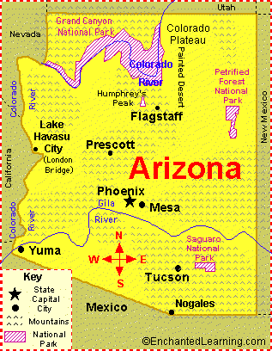
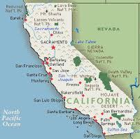
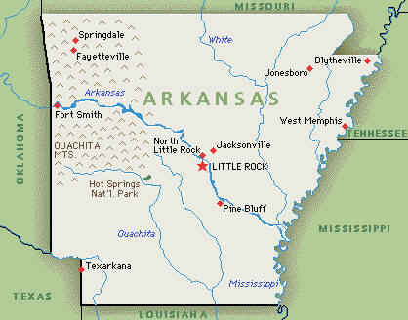
Future of CHIP: State Directions?

Slide 19
Future of CHIP
Arkansas approach – using Medicaid/CHIP to buy marketplace coverage
  Cost effective??
  Will kids get the same benefits?
  Family together?
  Access to providers?
Arizona – world with no MOE – kids in exchange
  Family glitch, enrollment glitches
  Benefits/cost-sharing
California - CHIP is a financing source for Medicaid

Slide 20
For More Information
Joan Alker:
  jca25@georgetown.edu
  ccf.georgetown.edu
  www.theccfblog.org/
Sabrina Corlette
  sc732@georgetown.edu
  chir.georgetown.edu
  www.chirblog.org/

