Slide 1


Changing the Conversation About Medicare
Debra Whitman, EVP, Policy, Strategy & International Affairs
Lina Walker, Director, Health Policy, Public Policy Institute
AARP
November 6, 2013

Slide 2
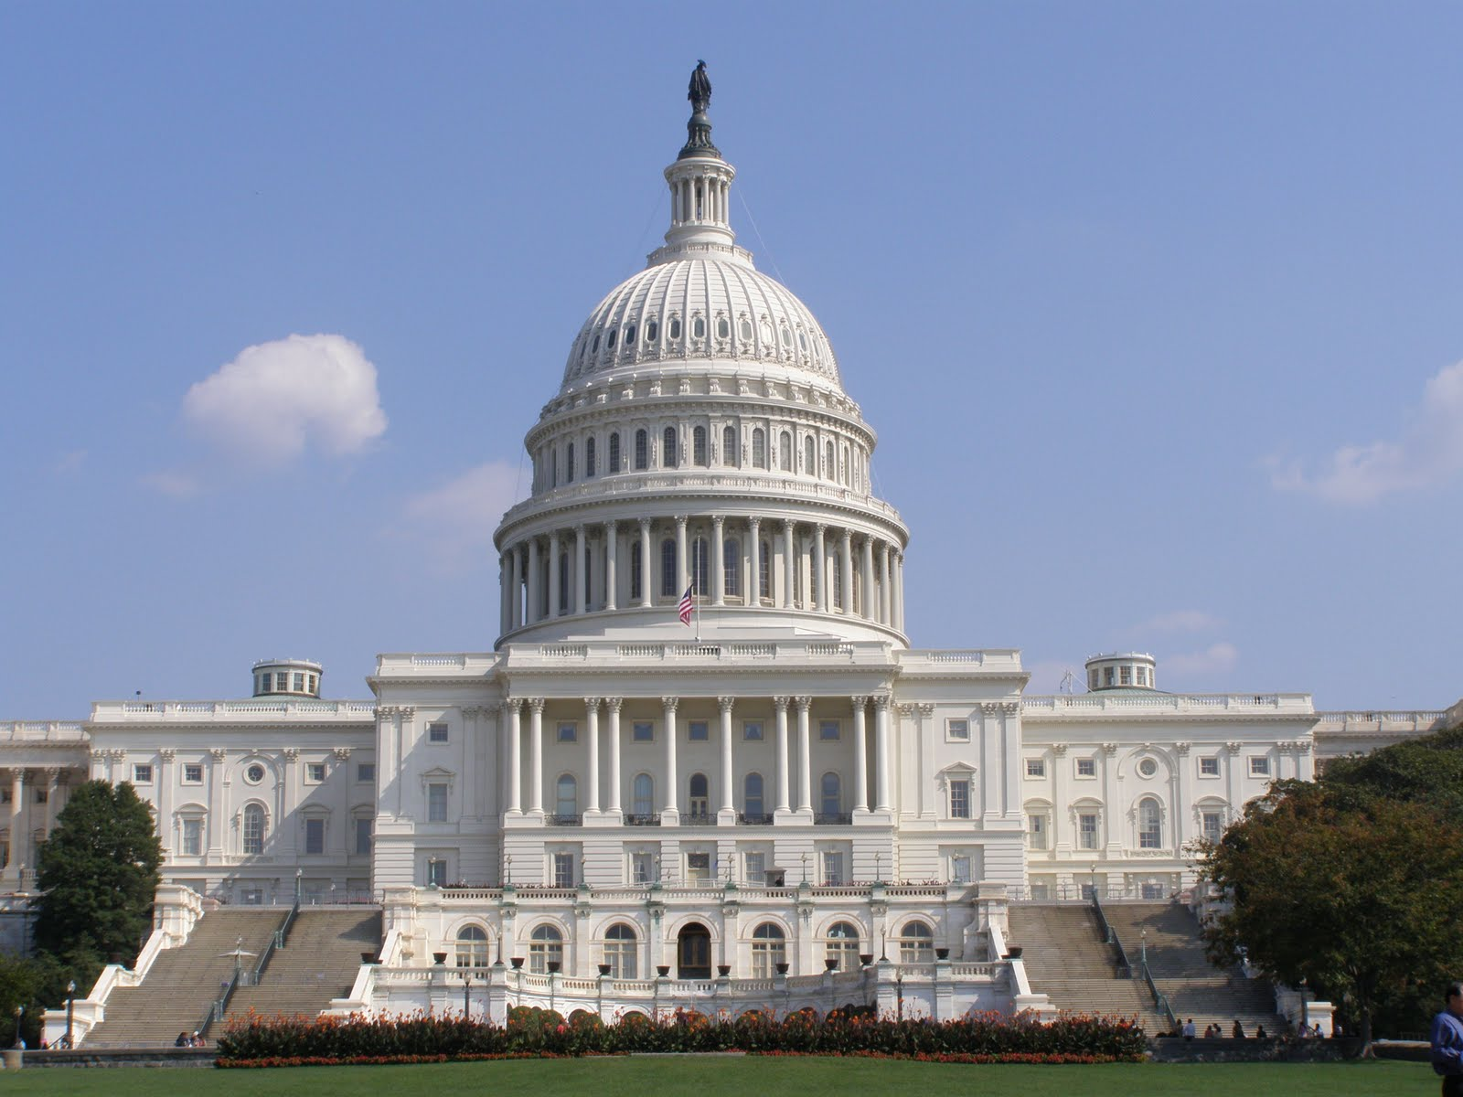
Some Medicare Reform Proposals Affecting Beneficiaries
Restructuring Medicare A/B
Raising Medicare’s eligibility age
Restricting supplemental insurance coverage for Medicare
….among others
Notes:
Tricia will cover what’s happening on the Hill so no need to spend a lot of time on the reform proposal slide

Slide 3

Implications of Most Proposals
Lower federal spending by:
Asking Medicare beneficiaries to pay more;
and/or
Blunt cuts to providers

Slide 4

Often Overlooked……
Medicare beneficiaries are not wealthy
Half with annual income:
$22,500 a year, or less (median)
Half with very little savings:
  $63,100 (median)
Among Blacks and Hispanics:
By Race | Median Income | Median Savings
Blacks | $15,250 | 11,650
Hispanics | $13,800 | 12,050
Notes:
Make the point that both income and savings decline as individuals age
2012 data, source: Kaiser Family Foundation, http://kaiserfamilyfoundation.files.wordpress.com/2013/09/8477-wide-disparities1.pdf

Slide 5

Often Overlooked……
Beneficiaries already pay a lot
Half spent at least 16.4% of income
  out-of-pocket (median)
Burden of out-of-pocket spending:
high and increases with age
Burden of Out of Pocket Spending by Age
 | Under 65 | 65-69 | 70-74 | 75-79 | 80-84 | 85+
Total OOP Spending as Percent of Income (median) | 13.4% | 11.8% | 16.8% | 18.9% | 22.1% | 24.8%
Notes:
Say here that shifting more costs to Medicare beneficiaries will add to their already high burden. What would be the impact? Studies suggest that it could lead to adverse health outcomes; although other studies (RAND) find no impact on health – too much weight given to early RAND study, which did not include older adults. Need more research that focuses on the older population.
Source: PPI’s calculation, using 2010 Medicare Current Beneficiary Survey (MCBS) Cost and Use data files.

Slide 6

Misconceptions: Not Just Capitol Hill
Many don’t know:
17% of Medicare beneficiaries under 65
Will face high out-of-pocket costs in Medicare
Long-term care, dental, vision, hearing aids not covered by Medicare
Higher-income beneficiaries already contribute more
Notes:
17% = 8.5 million in 2012
About 4% pay income-related premiums

Slide 7

Few Are Aware…
New Medicare innovations, could save money
Part of health reform law, testing new care models
Private sector and states working together to innovate
Focus of new models:
Improve quality,
Patient experience
Lower costs
Notes:
Mention innovations in both care delivery and payment approaches but CMMI speaker will cover this so no need to spend much time here.
Can discuss geographic variation and Dartmouth’s assessment that about a 1/3 of Medicare spending could be reduced if all were paid the lowest cost area. That’s probably not a good approach but make the point that large variation in spending that can’t be explained by differences in health status and other factors might be due to unnecessary or wasteful spending.
Talk about ACO, patient-centered medical homes/advanced primary care practices.

Slide 8
Funders: Disseminate What We Know and Gather More Evidence
Funders can provide:
Accurate, unbiased information to consumers and opinion leaders (local, state, federal)
Bring balance to the discussion: discuss federal budget but also consumer impact. More research needed: impact on older persons
Promote new models of care – more funding to support CMMI projects, and to go beyond those projects
Notes:
On point #1 – getting the word out is so critical. Educate the public and policy leaders.
On point #2 – Steer the conversation to present both sides of the issue, not just about saving money. But, also need more data on what the impact will be fore older persons if they have to take on more cost-sharing and pay higher OOP costs. Right now, only speculation.
On point #3 – Funders could dovetail with CMMI initiatives by providing additional funding to CMS awardees to fund non-covered demo costs such as: A) start-up costs, B) HIT costs, C) incentives for providers and beneficiaries, and D) extension of relatively successful demos that CMS does not want to continue; or fund research and demos that are not funded by CMS, such as those that involve collaborations between private payers.
Can multiple foundations combine grants to fund larger efforts?

Slide 9

Reforming Medicare Physician Incentives
Fee-for-service payments – not the wave of the future (recently released bipartisan/bicameral draft proposal)
Impact will vary across physician groups (primary vs various specialty groups)
Some doctors threatening to leave Medicare
Notes:
Mention here the bipartisan, bicameral draft proposal to reform Medicare physician payments

Slide 10

Funders Can Illuminate Truth & Dispel Myths
Are Medicare physicians under- or over-paid?
Are doctors leaving Medicare?
Need local data, funding for surveys at the community level

Slide 11

More Active Role for Consumers
What role can consumers play?
More shared decision making. Eg: Choosing Wisely.
Challenges:
Limited information on quality and costs,
Not always consumer-friendly
Notes:
Want a more active role for consumers – but what should that role be? What is an appropriate consumer role to help reduce health care cost growth?
Under consumer friendly point – talk about how measures are not standardized, how they are not presented in a way that consumers can easily understand or compare, etc

Slide 12

Funders: Support Better Tools for Consumers
Educate need for & fund:
More transparency
Standardized measures
Translators – turn complicated information into consumer-friendly tools/steps

Slide 13
Thank you!
Debra Whitman, dwhitman@aarp.org
Lina Walker, lwalker@aarp.org
Follow us at https://twitter.com/AARPpolicy
November 6, 2013

