Slide 1
SAGE and Health Strategies for LGBT Older Adults
Presented by Michael Adams
madams@sageusa.org
October 30, 2013

Slide 2
SAGE - Services and Advocacy for GLBT Elders
Country’s oldest and largest LGBT aging organization
Services & info – NYC HQ and 26 affiliate sites
Policy Advocacy – Federal, State and Local
Cultural Competency Training – National Resource Center on LGBT Aging

Slide 3
Model Partnerships: Overcoming Barriers to Care
“Ask the Docs”
“Meet the Pharmacist”
On-Site Nursing Support
Cancer Support Groups
Notes:
Ask the Docs is a partnership with Beth Israel Department of Geriatric Medicine. SAGE provides LGBT CC training to their Fellows and Residents, and they provide a monthly Health Education series to the SAGE Center membership. Evaluation results from year 1 show that participants were more likely to discuss certain health issues (depression, memory loss, and diabetes to name a few) with their physicians as a result of the workshops.
Meet the Pharmacist is a partnership with Duane Reade/ Walgreens in which clinical pharmacists provide educational workshops, and hold open hours for participants to bring in their medications and have a consultation about side effects, contra-indications, etc.
SAGE Center has on-site nursing support from the Continuum Community Health Division twice a week; the RN provides individual screening and assessments, health seminars and brings in other Community Health partners for special presentations.
Currently SAGE partners with both Cancer Care and the Lesbian Cancer project of the NYC LGBT Community Center, and provides a Men’s prostate cancer group, as well as a Women’s Cancer support group. SAGE is in the planning stages of creating specific Breast Health initiatives with the Lesbian Cancer Project.

Slide 4
Model Services: Health Prevention and Support
SHE: healthy weight for older women
SAGE Positive: HIV & Hepatitis testing and counseling program
SAGECap: Caregiver Support
Mental Health Screening & Referral
Notes:
SHE (Strong, Healthy, Energized) is a partnership with The Lewin Group, a health and evaluation group and funded by the Office for Women’s Health, that focuses on creating healthy eating and exerciese plans coupled with group support to address obesity in the Lesbian and Bisexual community.
SAGE Positive – health screening, counseling and support with a foundation of understanding that for LGBT older adults with HIV/AIDS, their co-morbidities and medication management is often the most challenging part of their diagnosis.
SAGECAP- dual focus on supporting caregivers in their role, and in preparing the LGBT community-at any age- to address their futures, whether legally, financially, support-wise, etc.
SAGE provides, through their staff of masters-level social workers, mental health and substance abuse screening for all clients, with automatic referral to community partners if results indicate depression or substance abuse issues.

Slide 5
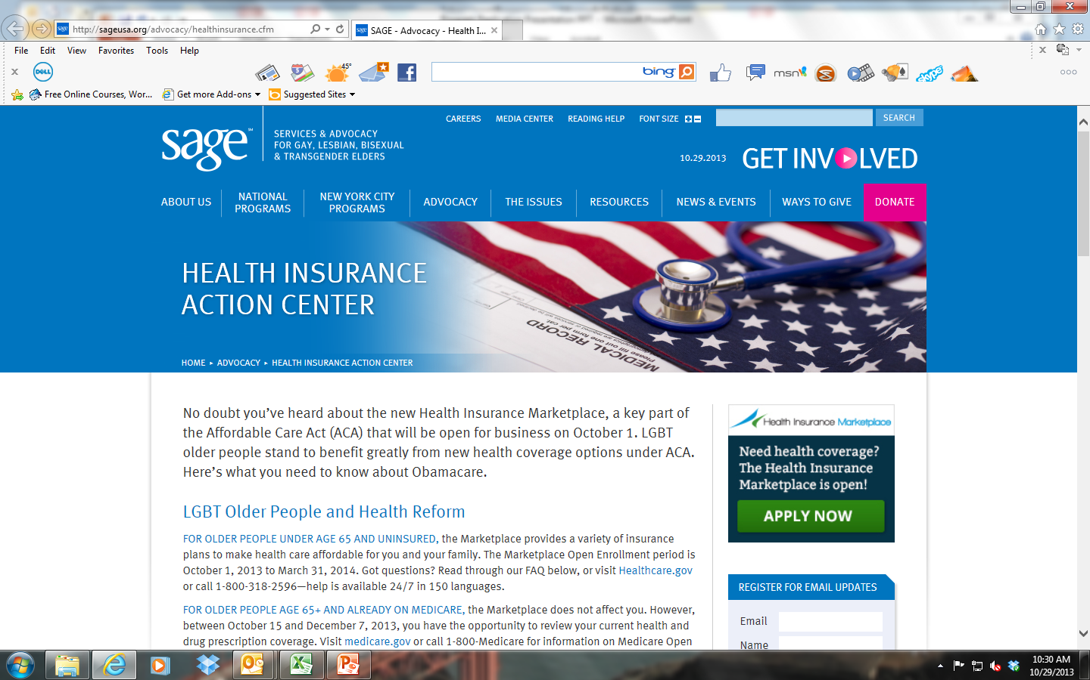
Information is Power

Slide 6
Health Policy Analysis

Slide 7
Health Policy Advocacy
Affordable Care Act – National Prevention Strategy
HIV & Aging Policy Advocacy
Social Security & Medicaid Benefits for Same-Sex Couples
Defense of Federal Safety Net

Slide 8
Constituent – Driven Advocacy

Slide 9
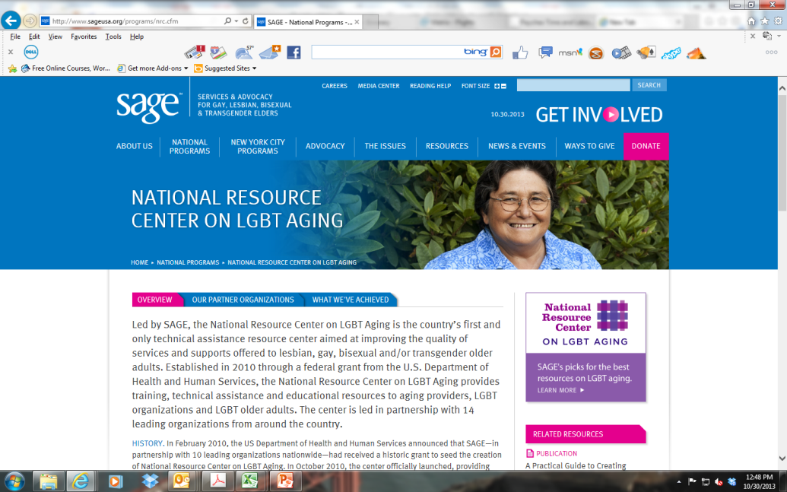
Cultural Competency Training
National Resource Center on LGBT Aging
Model Provider Training: Audit & System-Wide Training
Model Provider Training: Adapted Curriculum & Train the Trainer
Notes:
Jody- can you put in a screen shot of the NRC here?
Provider trainings are designed to fit the needs, scale and interest of the organization. Models range from staff-wide trainings through live and webinar formats, creation of adapted curricula and training of trainers, to organization-wide audits to determine level of LGBT competency in HR policies, materials, medical record language, etc.

Slide 10
Closing Thoughts for Funders
ROI for Strategies that Bridge Care Barriers
Assess & Assist Adaptability of Service Models
Support Dissemination and Replication
Encourage Partnerships
Reinforce Existing Assets – Caregivers, Peer Support
Information & Advocacy Strengthen Essential Systems

Slide 11
Michael Adams - Executive Director, SAGE
Email: madams@sageusa.org
Tel: 212-741-2247

