Slide 1
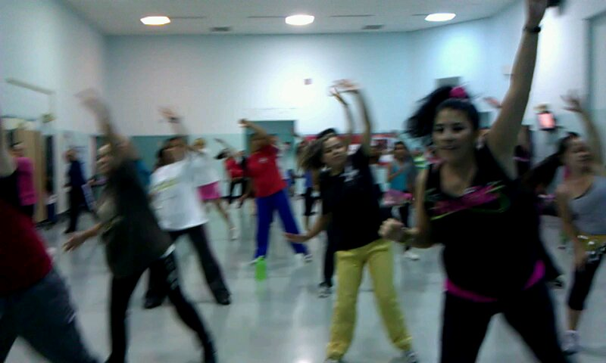
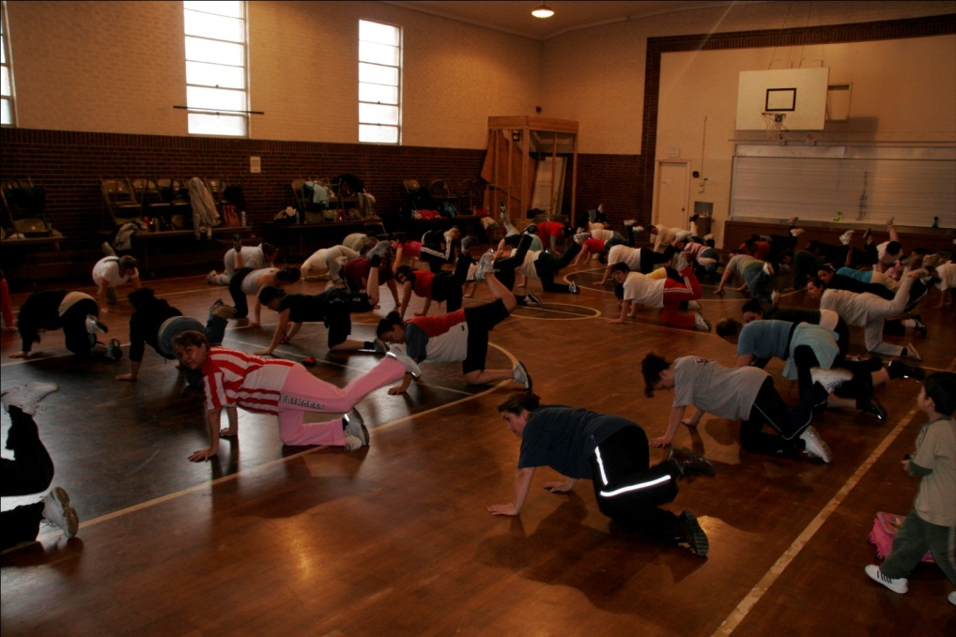
Westwood Neighborhood:
Healthy Communities Grants & Grassroots Partnerships
Rachel Cleaves, LiveWell Westwood
Jose Esparza, BuCu West
Eric Kornacki, Revision International

Slide 2
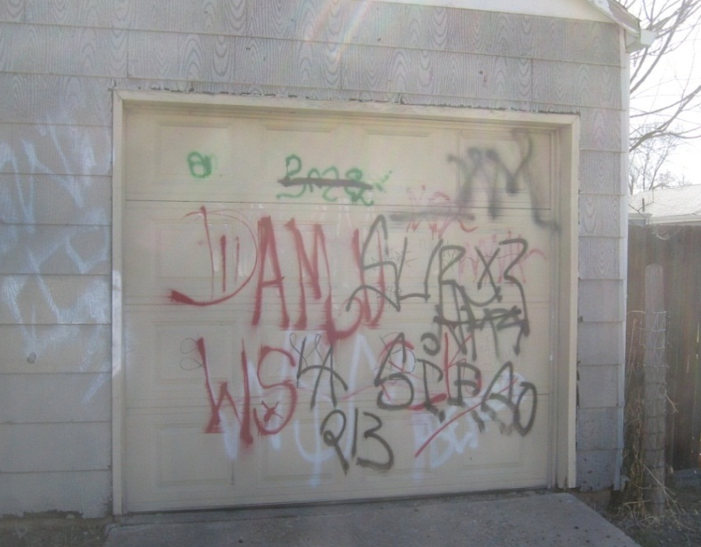
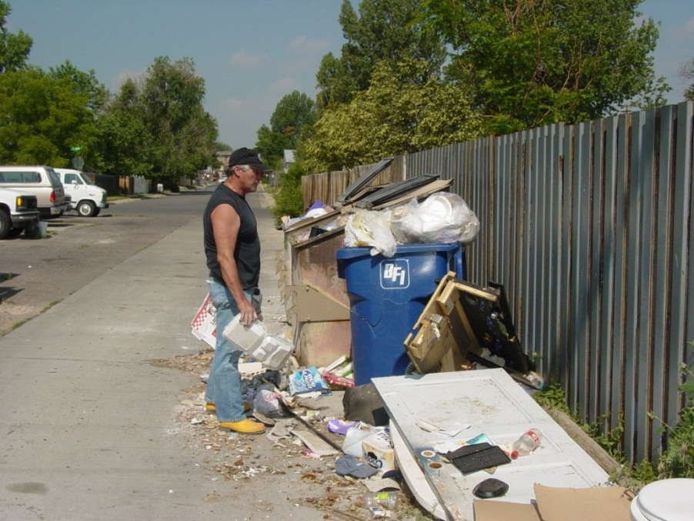
Social Determinants of Health in Westwood, Denver
Socio-Economic Factors
High poverty levels
50% Spanish-speaking
#1 for foreclosures in Colorado
Built Environment Factors
Wide streets / Narrow sidewalks
Few walkable destinations
Very under-served for parks / rec
High levels of litter and graffiti
Dark streets and alleys
No grocery store
No community center
Notes:
Background
Westwood is a populous Denver neighborhood with approximately 16,500 residents. Here you see it outlined in red in southwest Denver. The neighborhood is predominantly Latino, with 76 percent of residents of Latino descent, 17 percent Caucasian, 3.4 percent Asian, 1.4 percent Native American and 1.2 percent African American.
Westwood’s demographics put it at particular risk for overweight and obesity due to high poverty, low educational achievement, and lack of access to healthy eating and active living resources. This degree of need drove the formation of LiveWell Westwood.
The poverty rate in Westwood is nearly 10 percent higher, at 24.1 percent, than Denver’s rate (14.3%). In 2007, Westwood’s foreclosure rate was the highest in CO.
Twenty-five percent of residents are non-English speakers. The neighborhood also has a large immigrant population; 60 percent of births are to foreign mothers.
Among Denver neighborhoods, Westwood trends very young; it is the second most densely populated by children and one-third of the population is under age 18.
2

Slide 3
LiveWell Westwood
LiveWell Westwood mission is to increase safe and affordable active living and healthy eating for all who live, work, play, and learn in Westwood.
LiveWell Westwood is funded for 9 years, approximately $1 million
LiveWell Westwood partnered with the Denver Foundation and Urban Land Conservancy to fund Westwood Unidos

Slide 4
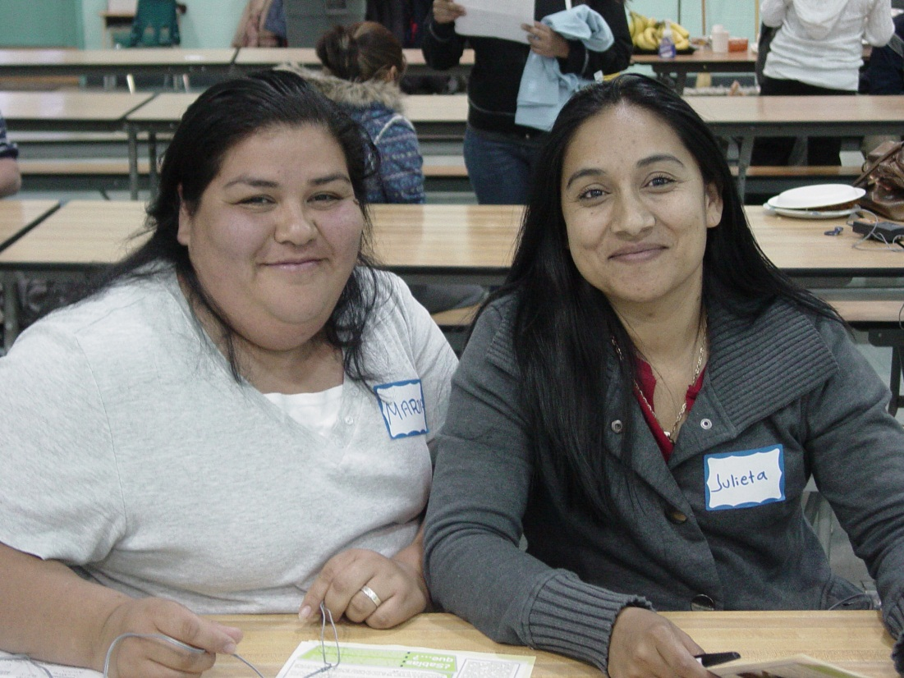
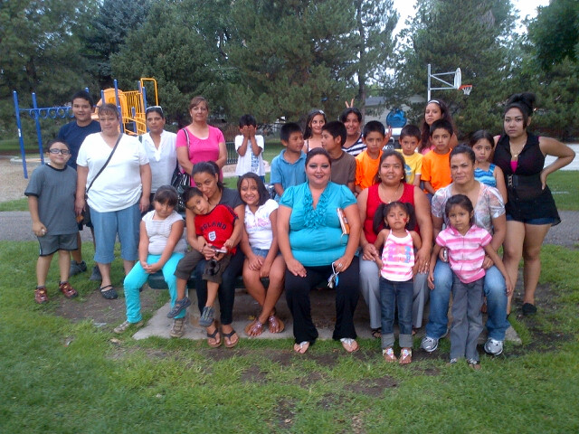
Westwood Unidos Values
Residents at Center
Inclusive
Democratic
Transparent
Uniting
Listen for what to do

Slide 5
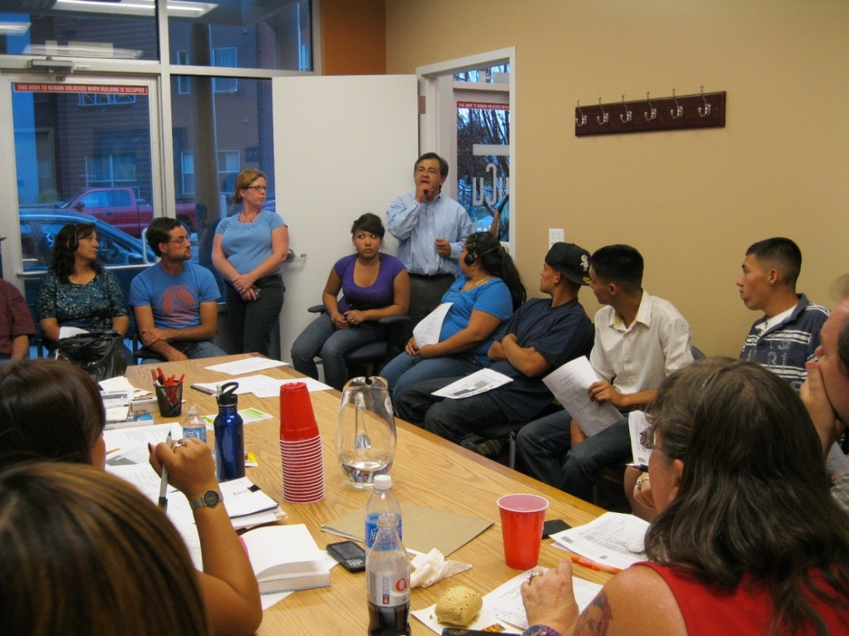
Asset-Based Approach
Listening Conversations
Resident-Centered Organization
Hired 2 residents as “Community Connectors” to connect with other residents
Conducted hundreds of “Listening Conversations”
Identified community leaders and invited them to participate
Formed Action Committees to work on the projects residents’ identified

Slide 6
Local Coalition for Health
BuCu West supporting small businesses and creates attractive built environment on Morrison Road.
Revision International conducts resident empowerment, economic development, and establishes food systems to create self-sufficient communities.
Extreme Community Makeover coordinates volunteer teams to partner with underserved people to improve their own homes and neighborhoods.

Slide 7
Westwood Unidos
Contributing Organizations
Denver Foundation
$25,000
Urban Land Conservancy
$25,000
LiveWell
Westwood
$60,000
Gang Reduction Initiative
$5,000
Revision International (In-Kind – Co-Chairs Food Access Committee)
Extreme Community Makeover
(In-Kind Co-Chairs Safety Committee)
BuCu West Business Association
(In-Kind Co-Chairs Built Environment Committee)

Slide 8
Westwood Unidos
Resident / Organizational Leadership Team
Guides process
Sets budget
Built Environment Action Committee
Safety Action Committee
Food Access
Action Committee
Education Center
Action Committee

Slide 9

Westwood Unidos Projects:
  Community members teach zumba, English, computers, dance, etc to hundreds of residents per day
  Monthly alley clean-ups and safety walks organized by residents
  Sidewalks widened around Munroe Elementary
  Bike lanes installed and traffic calming measures implemented
  Community Kitchen funded for Revision International
  Neighborhood Plan process slated to begin in 2014 in partnership between Westwood Unidos and Planning Department
  Selected by Colorado Health Foundation as a Healthy Places Community

Slide 10


What Is Healthy Places?
Healthy Places is a five-year initiative of the Colorado Health Foundation to promote better health through the built environment. The foundation is committing financial technical resources toward the initiative.
The three communities involved in the initiative include:
The southeast portion of Arvada
Lamar, CO
Westwood neighborhood in Denver

Slide 11
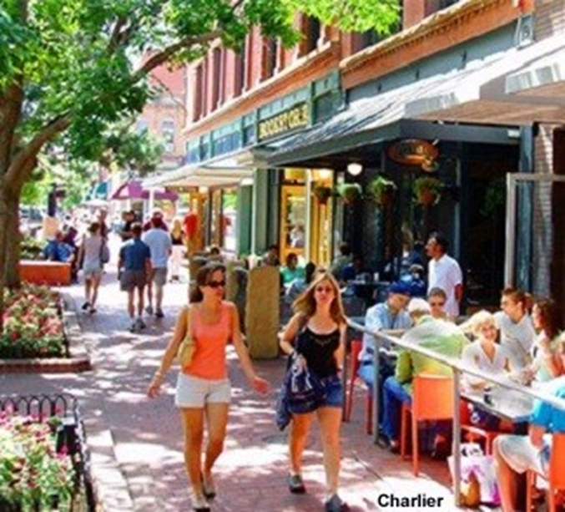
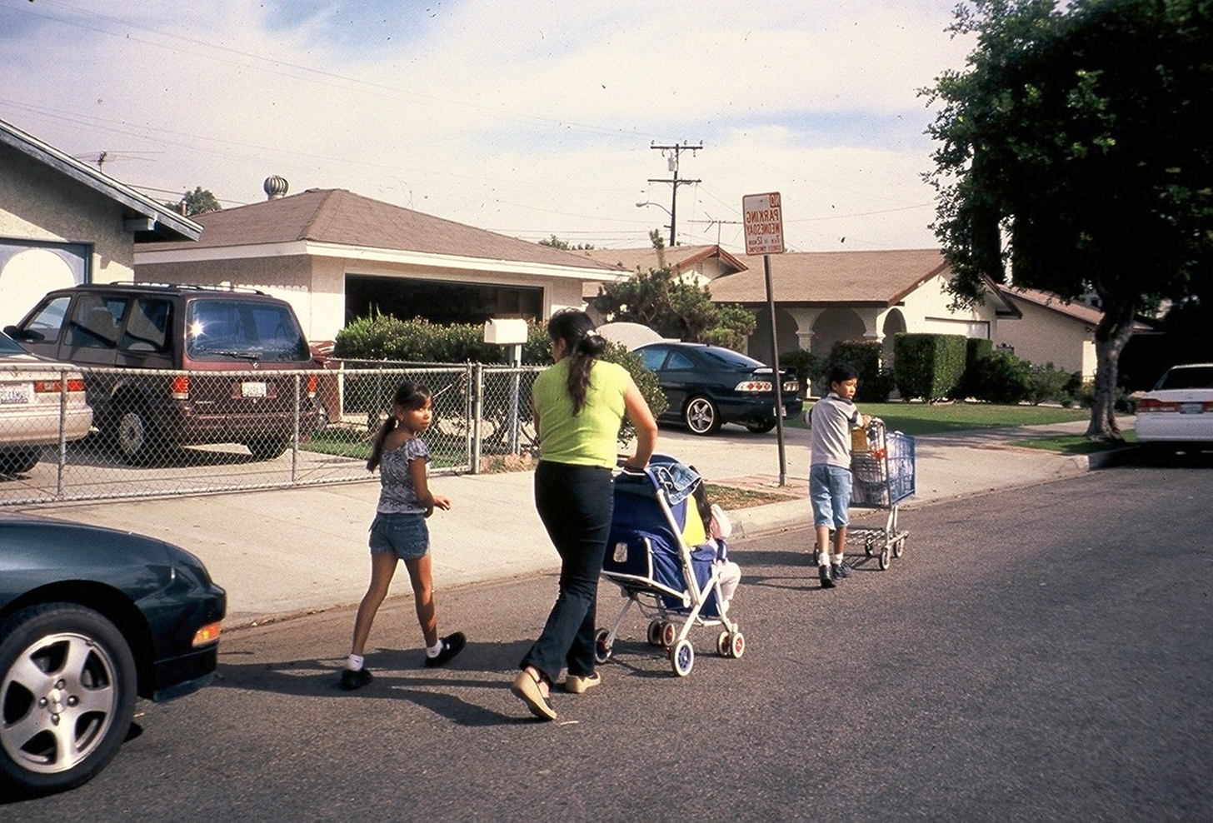
HEALTHY PLACES ARE WALKABLE PLACES
Walkable communities are good places to live, work and invest
Walking can sometimes be dangerous and difficult
Planners and engineers can create walkable communities

Slide 12
THE PANEL’S ASSIGNMENT
As part of the Colorado Healthy Places Initiative the ULI Panel was ask to consider how Westwood could foster a built environment that would make it easier to walk, bike, play and engage in daily activities that encourage movement and connection.
1
The panel was also asked to recommend specific infrastructure investments that promote walking, biking, and access to open space and recreational facilities
2

Slide 13
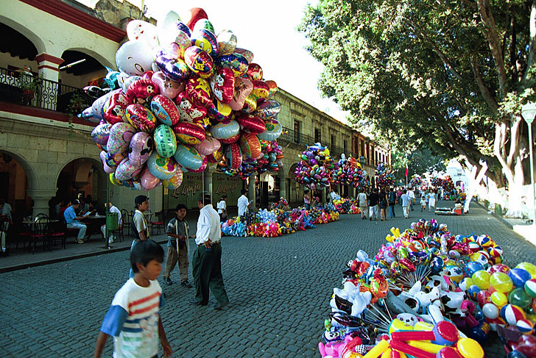
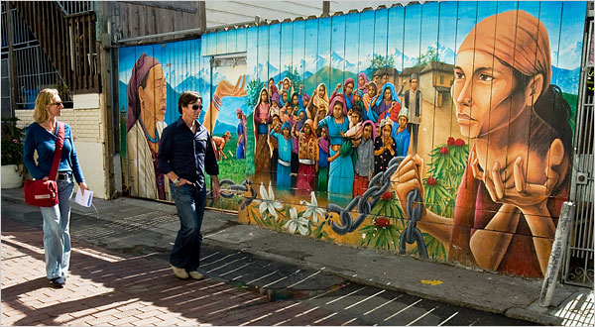
BIG IDEAS
Create a unique identity – Latino Cultural District
Create a Main Street – Transform Morrison Road
Create a plaza at the heart of the neighborhood
Create neighborhood connections using open space and greenways

Slide 14
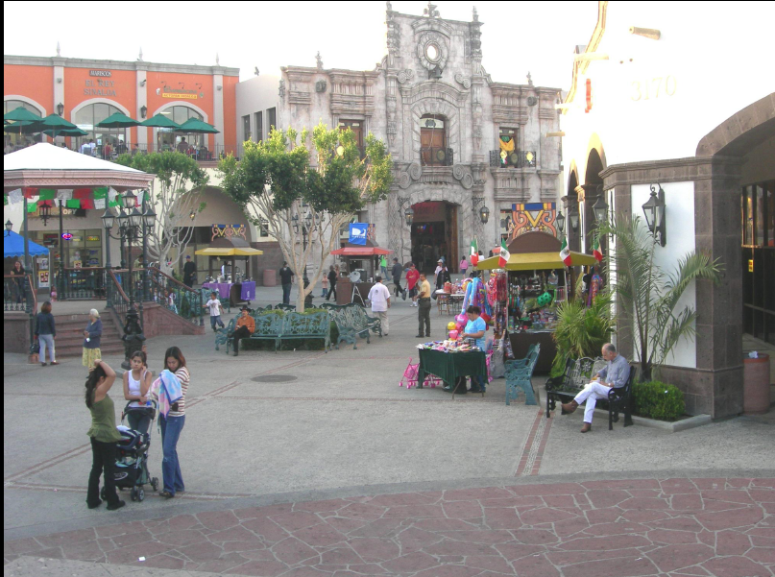
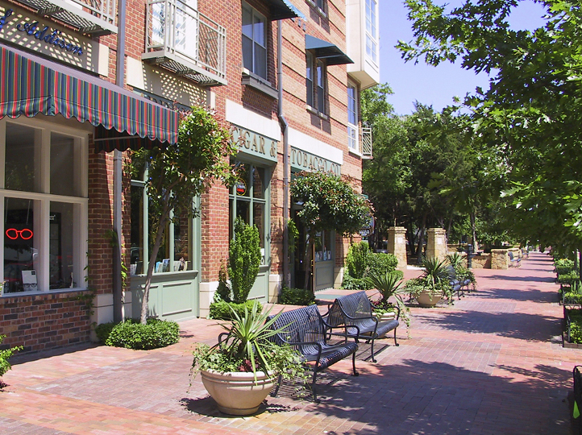
“MAIN STREET” with Gathering Areas
Transform Morrison Road from “Divider” to “Connector”
Community spine activated with shopping, restaurants, services, businesses, urban housing
Core area between Kentucky and Virginia; central node at Exposition
Safe pedestrian crossings/traffic controls, traffic calming
Virginia

Slide 15
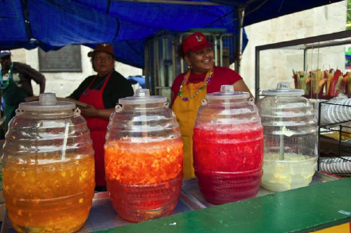
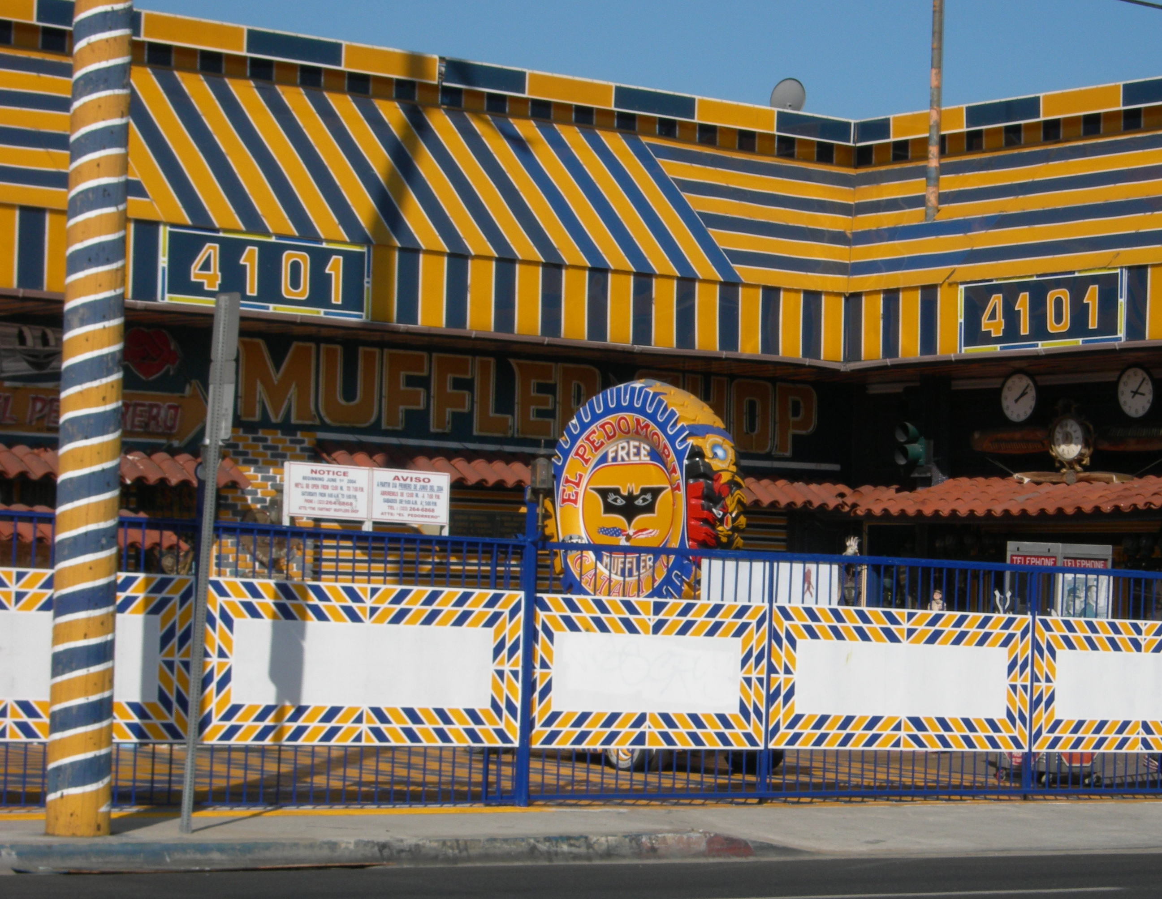
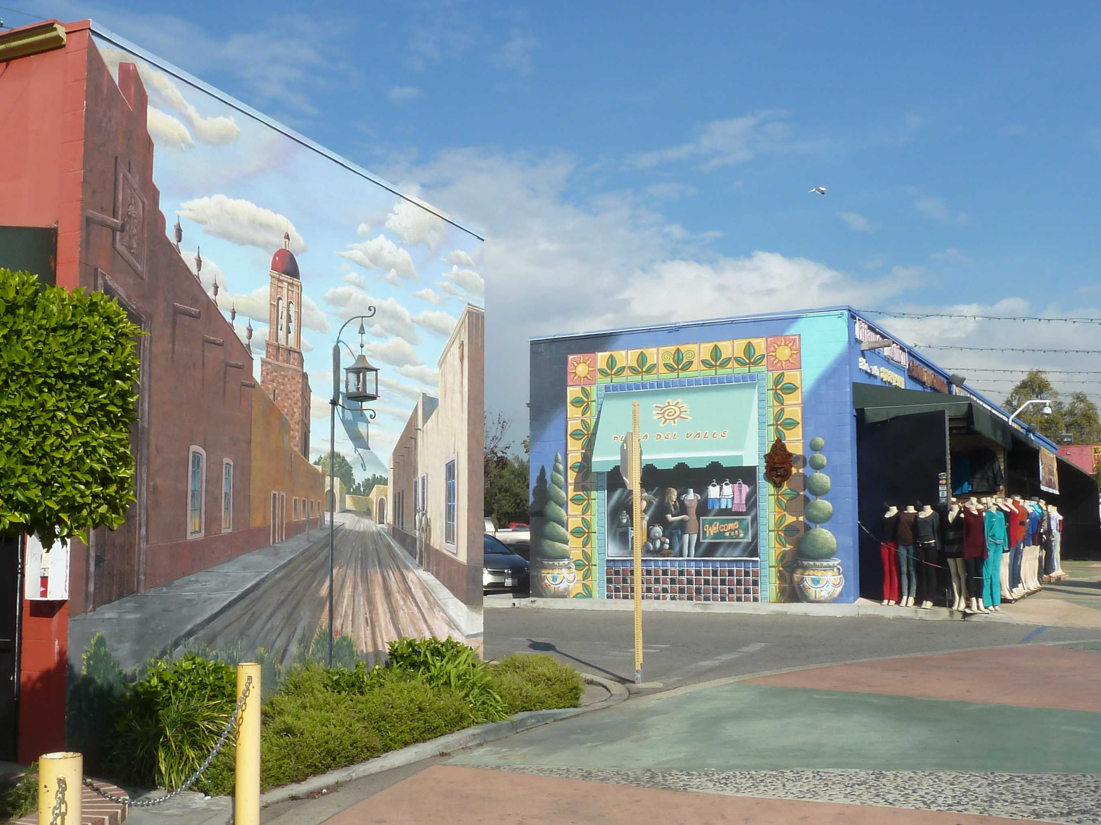
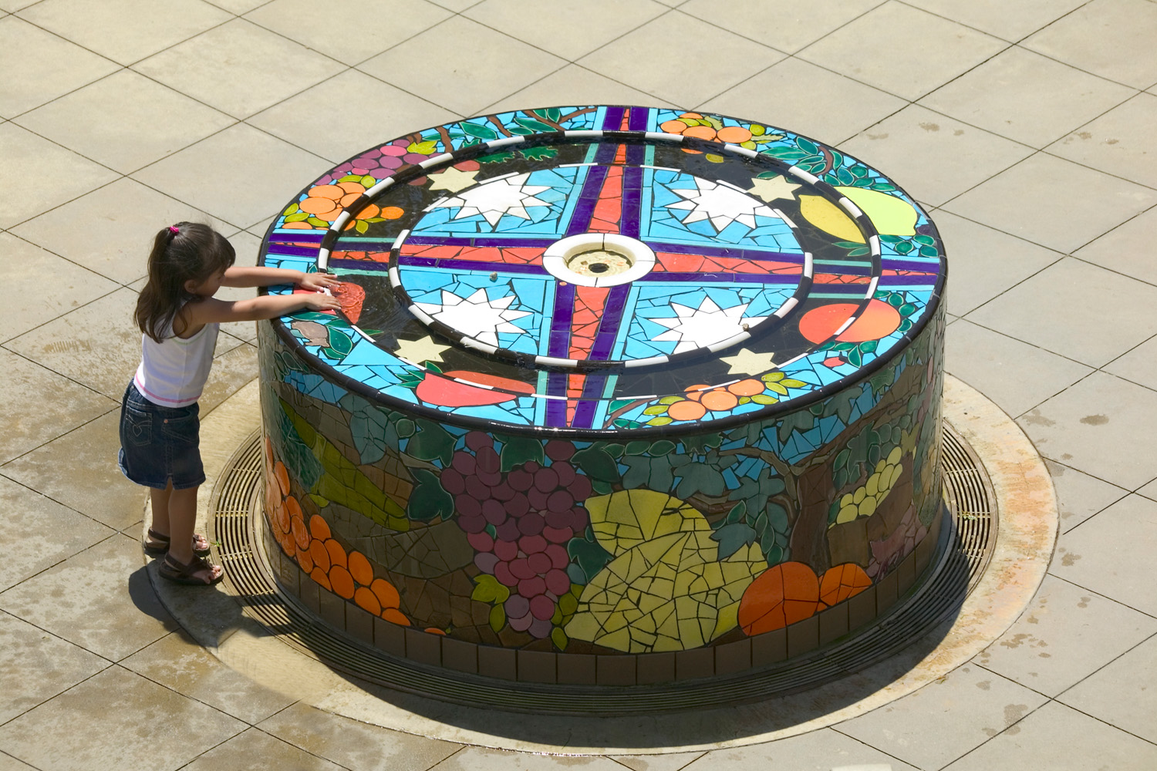
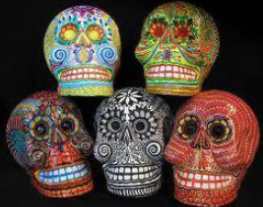
CULTURAL DISTRICT

Slide 16
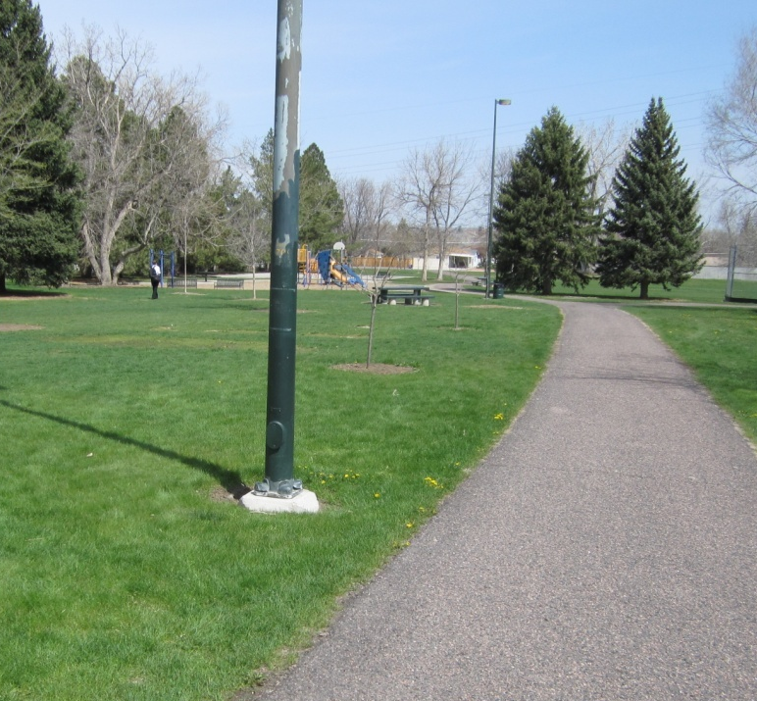
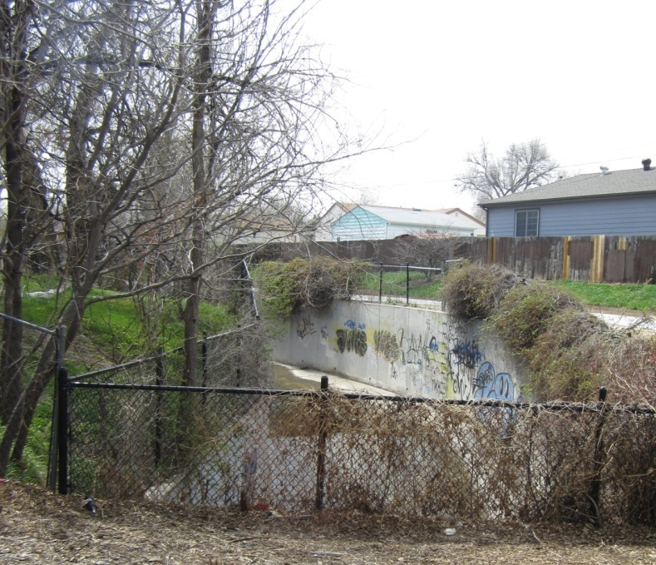
PARKS + RECREATION FACILITIES
Denver Standard: 10 acres of parkland/1,000 residents
Westwood Today: 1.2 acres of parkland/1,000 residents = 10% of City standard

Slide 17
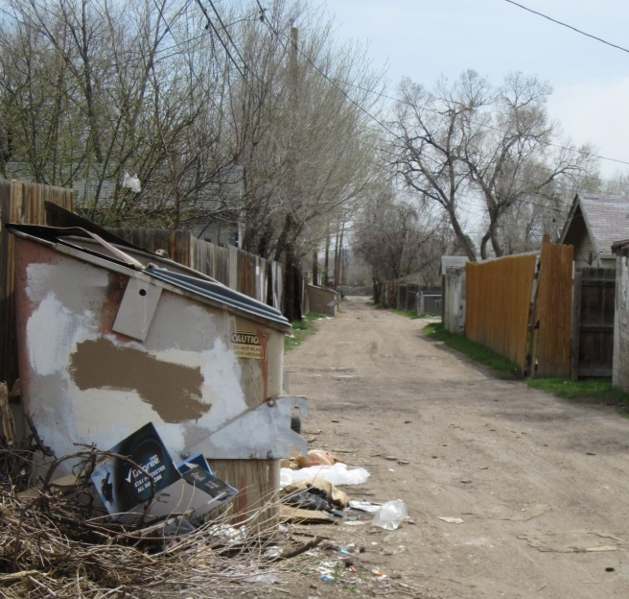
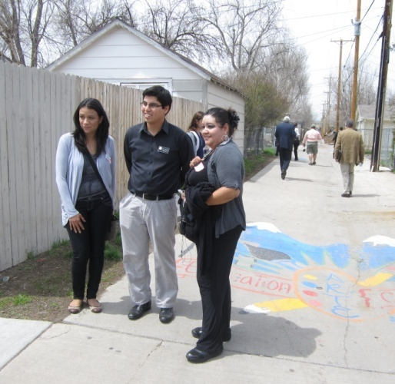
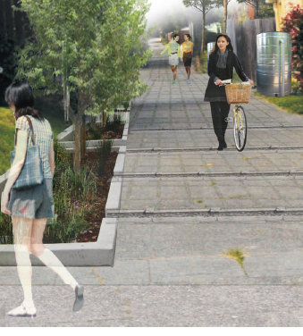
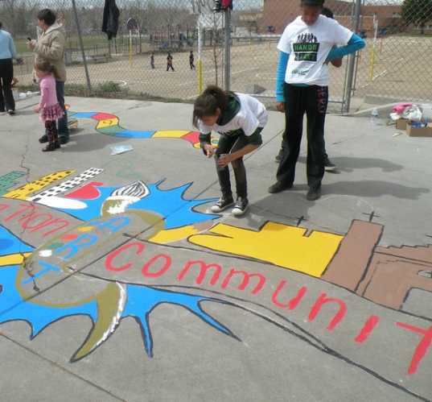
ALLEY IMPROVEMENT PILOT PROJECT
Expedite conversion to barrel pickup
Close off alleys for safe play, art, neighborhood connections
Focus on east area initially

Slide 18
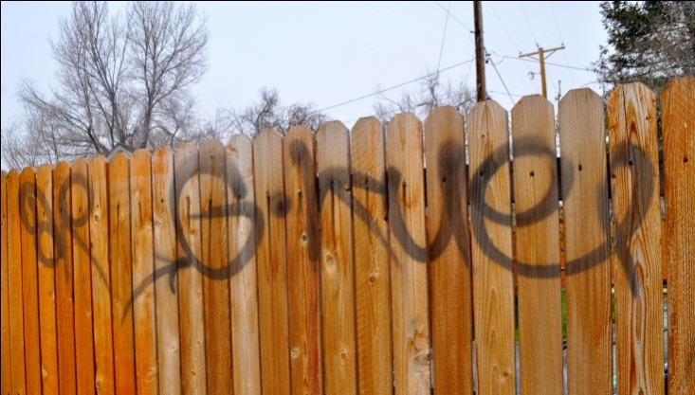
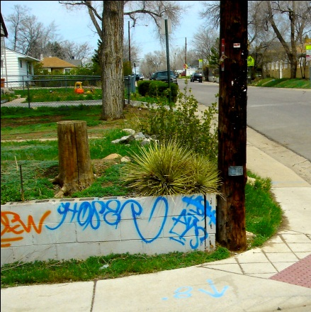
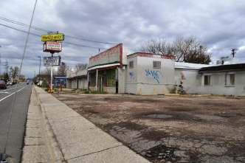
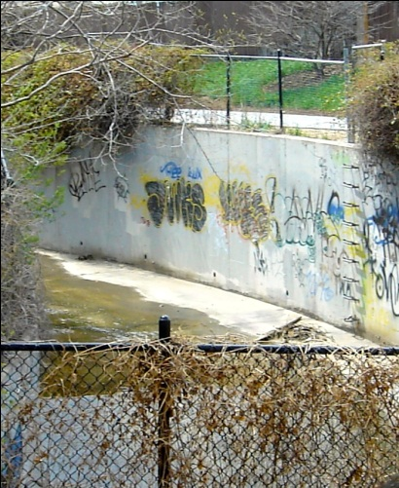
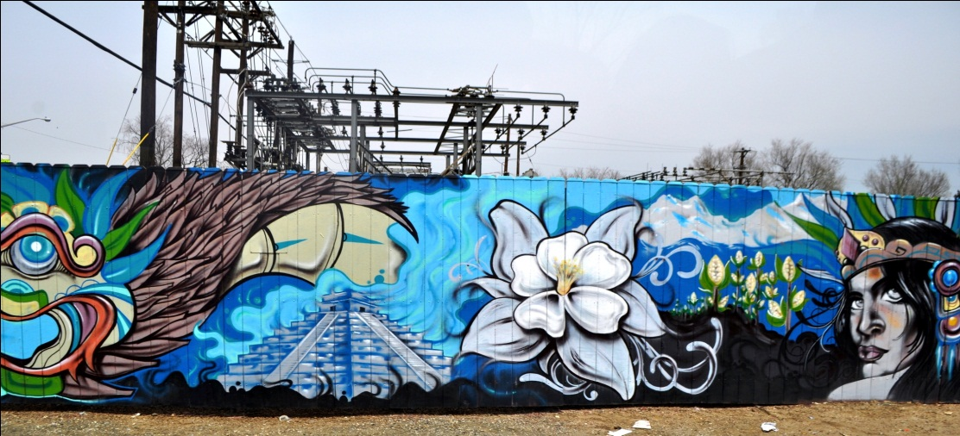
COMMUNICATION AND ENFORCEMENT:
Safety, Trash, and Graffiti
Improve coordination to remove tagging
Expedite conversion from dumpsters to barrel pick-up
Address vacant, crime-ridden buildings
Improve police responsiveness

Slide 19
Conclusion
Think outside the box: diverse residents, city agencies, and organizations often have common goals.
Taking a resident-centered approach increases opportunities for funding and partnership.
City agencies can connect in a meaningful way to residents by working with strong resident-led organizations.

