Slide 1
Accelerating Care and Payment Innovation: The CMS Innovation Center

Slide 2
Thank You
For the hard work you are doing to improve your care systems every day
For your commitment to health care reform, innovation and transformation

Slide 3

Health Care Innovation:
One Patient’s Story
Marie Jones, a high
risk patient, with her dedicated nurse case manager.
“The idea of the program is to keep me healthy, keep me out of the hospital, and keep costs down. I don’t think I would still be here without this program. It has been my lifeline.” – Marie Jones
New York Times, June 21, 2010

Slide 4
We need delivery system and payment transformation
Current State –
Producer-Centered
Volume-Driven
Unsustainable
Fragmented Care Systems
FFS Payment Systems
Future State –
People-Centered
Outcomes-Driven
Sustainable
Coordinated Care Systems
New Payment Systems
Value-based purchasing
ACO shared savings
Episode-based payments
Care management fees
Data transparency
PRIVATE
SECTOR
PUBLIC
SECTOR

Slide 5
Our Strategy: Conduct many model tests to find out what works
The Innovation Center portfolio of models
will address a wide variety of patient populations, providers, and innovative approaches to payment and service delivery
5

Slide 6
Delivery Transformation Continuum
Delivery Transformation Continuum
Providers can choose to participate in the testing of different care delivery transformation models
with different amounts of Medicare payments at risk, while benefiting from supports and resources designed to spread best practices and enhance quality.
Partnership for Patients
Bundled Payment
Accountable Care Organizations
The Patient-centered
Health Care System
of the future
Comprehensive Primary Care
Health Care Innovation Awards
Tools to Empower Learning and Redesign:
Data Sharing, Learning Networks, RECs, PCORI, Aligned Quality Standards
6
Notes:
Shrunk it down means fewer dots…

Slide 7
Providers are Driving Transformation
More than 50,000 providers are or will be providing care to beneficiaries as part of the Innovation Center’s current initiatives
Over 250 organizations are participating in Medicare ACOs
More than 4 million Medicare FFS beneficiaries are receiving care from ACOs
More than 1 million Medicare FFS beneficiaries are participating in primary care initiatives

Slide 8
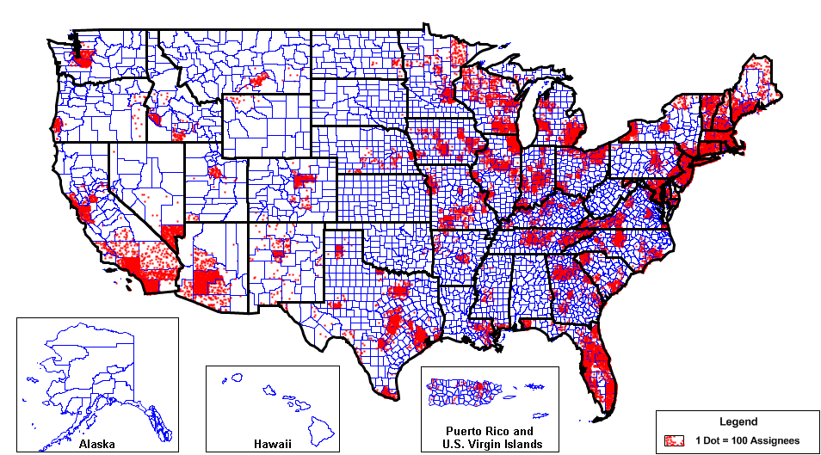
4 million Medicare beneficiaries having care coordinated by 220 SSP and 32 Pioneers ACOs
(Geographic Distribution of ACO Population)

Slide 9
The Pioneer ACO Model
GOAL: Test payment arrangements with higher risk and reward than MSSP, including partial- and full capitation arrangements, as well as a transition from FFS to population based payments.
Designed for health care organizations and providers that are already experienced in coordinating care
Requires ACOs to create similar arrangements with other payers.
Option for transition from shared savings to population-based payment in Year 3
32 Participating ACOs announced in December 2011
Over 900,000 aligned beneficiaries
First performance period began in January 2012.
9

Slide 10
Comprehensive Primary Care Initiative
GOAL: Test a multi-payer initiative fostering collaboration between public and private health care payers to strengthen primary care.
Collaborating with public and private insurers in purchasing high value primary care in communities they serve.
  Requires investment across multiple payers
  individual health plans, covering only their members, cannot provide enough resources to transform primary care delivery.
Medicare will pay approximately $20 per beneficiary per month (PBPM) then move towards smaller PBPM to be combined with shared savings opportunity.
The 7 markets selected:
Ohio (Dayton), Oklahoma (Tulsa), Arkansas, Colorado,
New Jersey, Oregon, New York (Hudson Valley)
10
Notes:
10

Slide 11
Health Care Innovation Awards Round Two
GOAL: Test new innovative service delivery and payment models that will deliver better care and lower costs for Medicare, Medicaid, and Children’s Health Insurance Program (CHIP) enrollees.
Test models in four categories:
Reduce Medicare, Medicaid and/or CHIP expenditures in outpatient and/or post-acute settings
Improve care for populations with specialized needs
Transform the financial and clinical models for specific types of providers and suppliers
Improve the health of populations
Letter of Intent due June 28, 2013
Applications due August 15, 2013

Slide 12
National Outcomes are Improving

Slide 13
We are starting to see results nationally
Cost trends are down, Outcomes are Improving & Adverse Events are Falling
Total U.S. health spending grew only 3.9 percent in 2011
Medicare 30-day, all-cause readmission rate is estimated to have dropped 1 percent after being at 19 percent for five years
70,000 fewer readmissions in 2012
Expanding coverage with insurance marketplaces gearing up for 2014

Slide 14
Results: Medicare Per-Capita Spending Growth at Historic Low
Source: CMS Office of the Actuary, Midsession Review – FY 2013 Budget

Slide 15
Our Ask:
Continue the work of improving quality and patient safety
Push your organizations to support this transition to a sustainable patient center healthcare system
Chose Your Pathways:
  ACOs, Models focused on Primary Care, Bundled Payments for Care Improvement, State Innovation Models
Make your personal commitment to transformation

