Slide 1
Namaste Charter School: Grantmakers in Health June 2012

Slide 2
Namaste Charter School “The light in me sees the light in you”
A public charter school founded in 2004 with 90 students
450 Kindergarten – 8th grade students in fall 2011
85% low-income and 90% minority student population
No tuition and no selection criteria for enrollment; admission is by blind lottery
Health and physical fitness as an avenue to reach higher student achievement
New model of teaching and learning

Slide 3
Why Focus on Health & Wellness?
More than 1/3 of America’s children are overweight or obese with a disproportionate impact on low-income, minority populations
Nearly one-half of children in Chicago’s under-resourced communities are overweight or obese
Healthy students are better learners
Aerobic fitness and healthy Body Mass Index levels are associated with faster cognitive responses and increased engagement
Physical inactivity and being overweight correlate with lower student reading and math scores
Physical activity during academic time improves attention and working memory
80% of overweight or obese children maintain an unhealthy weight their entire lives
It is Namaste’s responsibility to establish students’ lasting healthy habits, parallel to academic excellence, in the elementary and middle school years

Slide 4
The Namaste Way What makes us unique?
Our Pillars
Healthy Lifestyles Program
Nutrition, Health and Wellness
Movement
Peaceful School Culture
Core Teaching and Learning Beliefs
Balanced Learning
Language and Culture
Collaborative Practice
Focus on healthy lifestyles parallel to academic excellence

Slide 5
The Namaste Way Nutrition, Health and Wellness
U.S. Department of Agriculture’s HealthierUS School Challenge Gold Award of Distinction
Alliance for a Healthier Generation: 2010 and 2011 Healthy Schools Program recognition
Variety of whole grains
Comprehensive food policies
Nutrition education for students and parents
Fresh fruit and vegetable snack program
Cafeteria as a learning laboratory
Daily Wellness Block
Daily salad bar increases consumption of fresh fruits and vegetables.

Slide 6
The Namaste Way Movement
Increased time for physical activity and physical education
One hour of physical fitness instruction daily and movement integrated throughout the school day
Morning Movement purposefully designed to increase students’ “readiness to learn”
Daily recess with a purpose
Yoga integrated into PE and classroom instruction
Fitness Center to promote lasting independent exercise habits
After School fitness

Slide 7
The Namaste Way Peaceful School Culture
Mental health linked to academic performance
“Peaceful People” Tools : common language for teachers, students and parents to solve problems peacefully
Logical consequences and lower incidence of discipline issues
Instruction on space, energy modulation and “thermometer in the body”
Study of peacemakers
Developmentally appropriate instruction includes middle school Advisory and service learning
Putting on the “brakes” as a calm-down tool

Slide 8
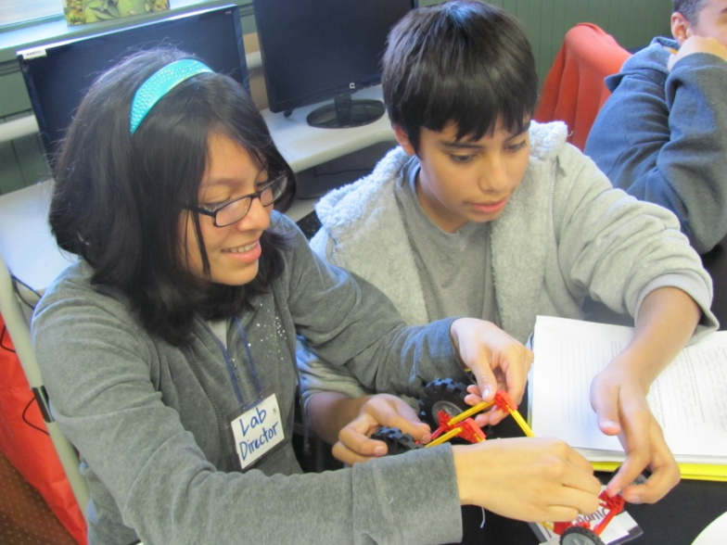
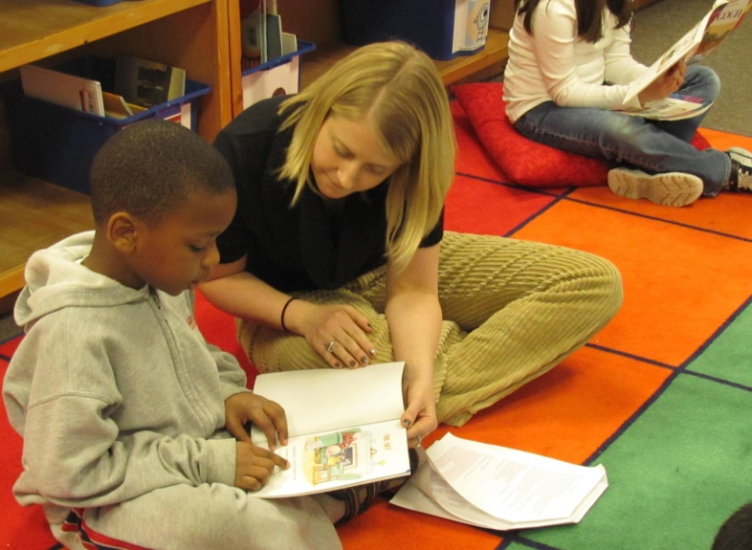
The Namaste Way Balanced Learning
Differentiated and inquiry-based instruction throughout the curriculum
High academic standards with socio-emotional support
Model inclusion support program (23% of students have Individualized Education Plans) and Response to Intervention Program
Community service graduation requirement
Middle school apprenticeship program
Inquiry-based science
Individualized instruction

Slide 9
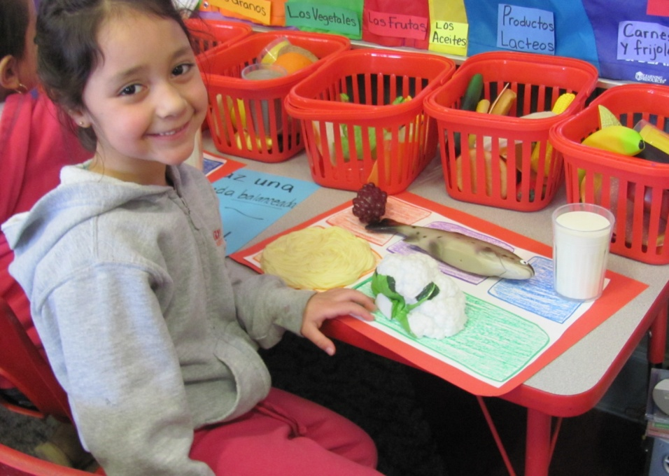
The Namaste Way Language and Culture
Dual Language program option leads to bilingual, bi-literate and bicultural students
Groundbreaking Spanish immersion model for native English and native Spanish speakers together in the same classroom
Country study program develops cultural awareness throughout elementary years
After-school program with multiple language and cultural opportunities
Spanish language instruction across all content areas

Slide 10
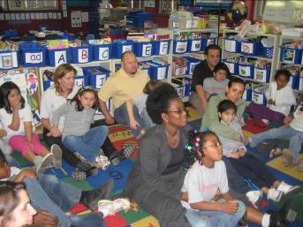
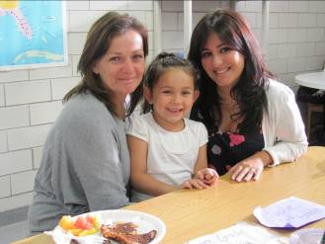
The Namaste Way Collaborative Practice
Family Center with lending library and Family Coordinator
Weekly Friday Family Breakfasts promote shared parent/child time and the importance of healthy meals
Parent classes and seminars
Monthly school events
Volunteer expectations and opportunities
Instructional focused leadership model
Weekly professional development and individualized teacher coaching
Family educational events
Teachers join Friday Family Breakfast

Slide 11
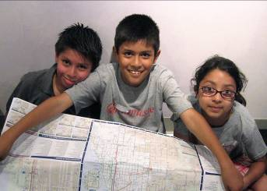
Innovative School Structure
Year-round academic calendar
Enrichment-based “Intercession” programs
Purposeful daily schedule, differentiated by developmental level, with frequent breaks
After-school partnerships
Job-embedded professional development for teachers
122 hours of high-quality professional development in 2010-2011, 70% more than typical Chicago Public Schools
Two full-time Instructional Leaders
Unique student enrichment opportunities

Slide 12
2011 - 2012 State of the School How are we doing?
Notes:
First school year without any construction, moving, renovation – tremendous impact on student achievement and school-wide success

Slide 13
Student Learning & Success
86.7% of Namaste students meet or exceed state standards (2011 ISAT), including all Special Education students (20% of student population) and English Language Learners
Compared to 73.4% of all Chicago Public Schools students
Bests CPS selective enrollment elementary schools (85% meets/exceeds) AND other non-selective elementary schools (71%)
More than 95% of Namaste students in the general education curriculum meet or exceed state standards
Compared to 79% of students citywide
96% average daily attendance
91% Chicago Public Schools’ average
Healthy, engaged students have better attendance and learn better
Commitment to ongoing data analysis and growth

Slide 14
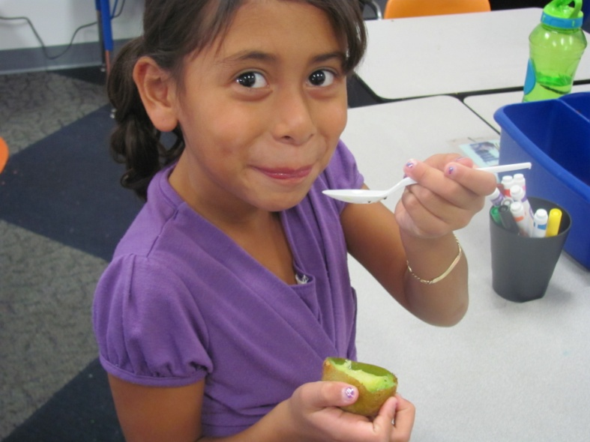
Healthy Students & Lifelong Healthy Habits
Children’s Memorial Hospital Partnership
There was a significant change in activity patterns (p<.01), including reductions in sedentary activity and increases in vigorous activity. Student vigorous activity increased 47.6%.
Mean BMI percentile did not increase; percent overweight fell.
Most students decreased their BMI Z score and BMI percentile (more than 77% of girls and more than 45% of boys)
Preliminary results indicate that Namaste's immersion intervention holds promise and merits further study.

Slide 15
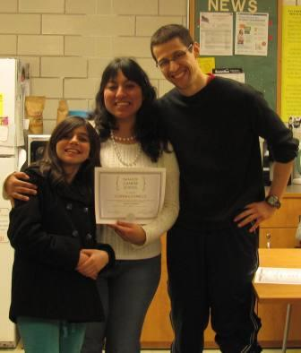
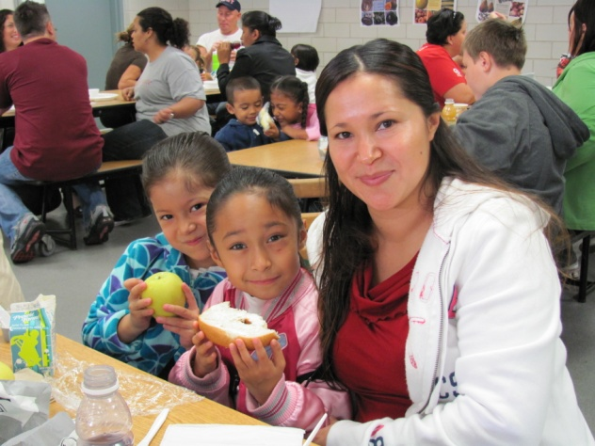
Family Engagement
There were 48 family opportunities in the second trimester and 64 days of school
There was a family opportunity every 1.3 days
99% of families participated in at least one T2 event!
98% of families participated in T2 conferences!

Slide 16
Looking to High School and Beyond
100% of students have been admitted to high schools other than their neighborhood high school
94.7% have been admitted to a school in their top 3 choices
35% of students who applied to selective enrollment schools were accepted
60% of students who applied to International Baccalaureate schools were accepted
100% of students who applied to charter schools were accepted to at least one charter
75% of graduating 8th graders have an apprenticeship!

Slide 17
Sharing Best Practices
Hosted more than 150 visitors in two trimesters! Highlights include:
Delegation from Beijing learning about Youth Development
Noreen Ahmed, Chicago Tribune and Theresa Gutierrez, Channel 7 news reporting on recess
Teachers, curriculum coordinators, principals from Kamehameha Schools in Hawaii learning about dual language
“The Namaste Way” presentations accepted for presentation at: AAPHERD, Schools that Can Conference, Department of Education Grantees Meetings
Timeline and work plan completed for Namaste Pilot Learning Institute to be held in June, 2012

Slide 18
Learning the Namaste Way
40 applications received from schools in Chicago, across Illinois, Mississippi, Michigan, Indiana and Arizona
20 Institute participants accepted
16 attended from June 20-22
Extremely valuable learning time for participants

Slide 19
Learning the Namaste Way
2 ½ day Institute engaging more than 10 Namaste staff members
Intense classroom observation and debriefing
Staff Led workshops
In depth coaching and professional development on Program Implementation for school based teams
Significant interest from charter starter teams– plan to develop new fall institute for this group

Slide 20
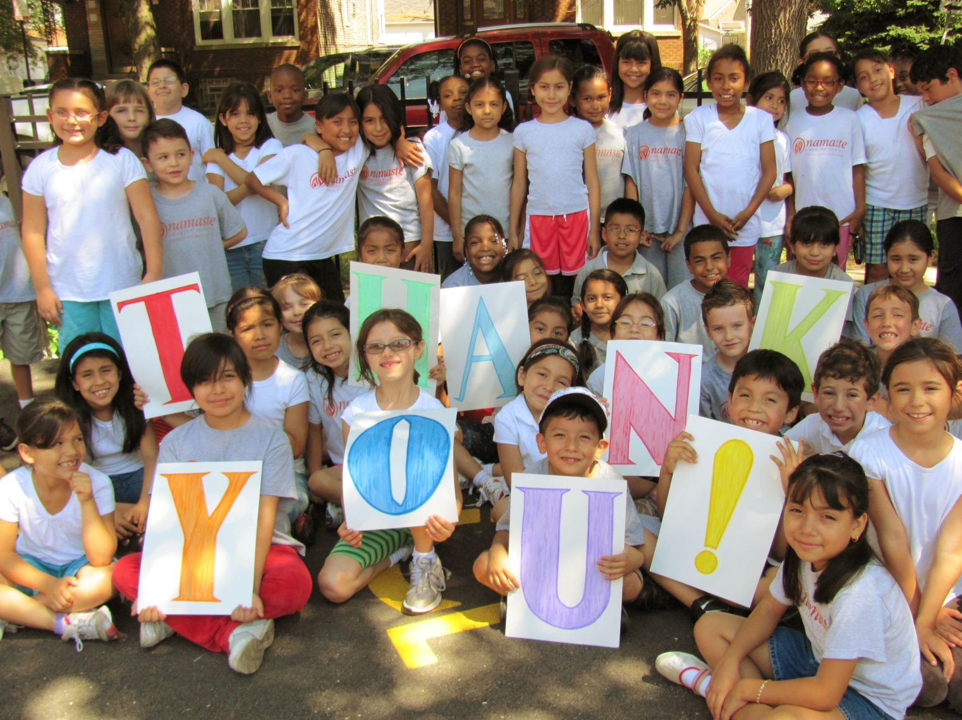
The Namaste students say…

