Slide 1
Coordinated School Health: What We Did, What We Learned
May 16, 2013
Susan G. Zepeda, Ph.D.
President/CEO, Foundation for a Healthy Kentucky
www.healthy-ky.org

Slide 2
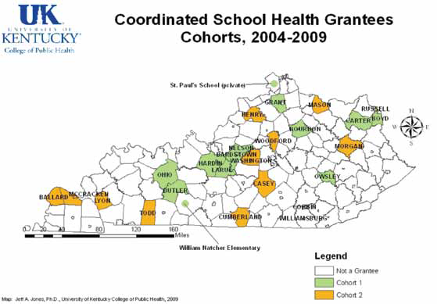
What We Did
Funded 2 cohorts of grantees in 29 Kentucky school districts, involving more than 97,800 students, K-12

Slide 3
What We Did
One year full funding ($50,000 or $25,000); second year half funding; years 3 – 5, data-gathering support only
External evaluator designed evaluation metrics; augmented with phone interviews and site visits to assess level of adoption/implementation of CSH and extent of supportive policy change
2 training institutes per year – one targeted to grantee sites, one open to all interested. In years 3 – 5, one Institute only. Years 4-5, partnered with other children’s advocacy organization (Growing Healthy Kids)
Technical Assistance (TA) through partnership with Kentucky Department of Education

Slide 4
Philosophical Frame
Training and TA
Transfer of start-up risk from community to Foundation – NOT ongoing support
Help linking to promising practices
Evaluation assistance - reporting requirements
Community at risk for continuing the services

Slide 5
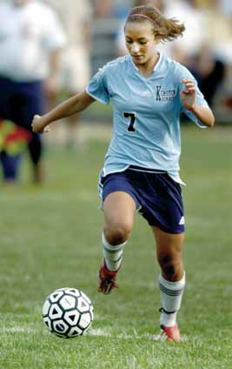
What We Learned
Good news
Increased physical activity
Grant as impetus for policy change

Slide 6
What We Learned…we need:
Up-front engagement of district and school leadership, with focus on policy change work
Shared evaluation design, to meet grantee, policymaker needs
To understand the dynamics of how policy change happens in schools, districts: Who does the wellness council report to? Is it “listened to”?
To match funding level to expectations –
Policy change “costs” less, takes time and investment
School-based health services more costly – need to assure sustainable revenue stream – licensing? Are providers school staff? Health dept or FQHC staff? Other?

Slide 7
What We Learned
We found KDE, other partners did not know how school health services were funded, staffed – this led to funding survey of school districts
Having a planning period precede implementation would have helped –
Get buy-in on sustainable policy change
Understand scope of CSH and available models and measures for achieving lasting change
Introduce model policies from other districts sooner rather than later

Slide 8
What We Would Do Differently
Growing up healthy: What will it take in your community?
School
Laws
Family
Other caring adults
Child
CBOs
Health Care
Customs
Others
Faith
Community
Dieticians
Physical environment

Slide 9
What We Would Do Differently
Time to plan
Willing and capable partners
Clear, feasible goals
A process for lasting change
A way to measure success

Slide 10
Useful References
Coordinated School Health: Healthy Kids, Healthy School
More Than Child’s Play
Well Fed

Slide 11
Questions?
Contact:
Susan Zepeda
szepeda@healthy-ky.org

