Slide 1
Healthy Food Financing Initiatives: Lessons from Ohio on a Growing National Movement
December 6, 2016 4:00 p.m. Eastern
Cosponsored with
Sustainable Agriculture and Food Systems Funders
Valerie Heiby, Finance Fund
Olivia Rebanal, Capital Impact Partners
Heather Torok, St. Luke’s Foundation of Cleveland, Ohio

Slide 2
Capital Impact Partners
Healthy Food Financing Programs
December 6, 2016

Slide 3
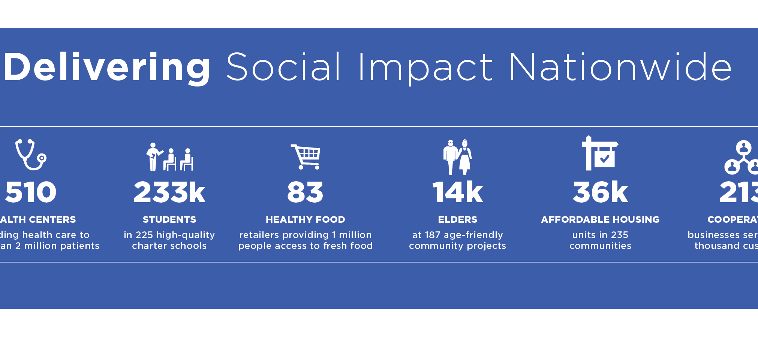
Over 30 years, working to address systemic poverty, build equitable communities, create healthy communities and ensure inclusive growth

Slide 5




Healthy Food Financing Programs

Slide 6
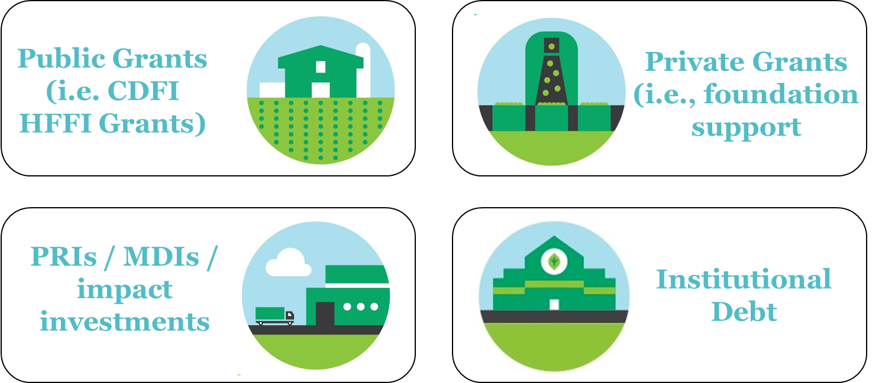
Various Financing Sources
support in amounts
from $250,000 to $3,000,000

Slide 7
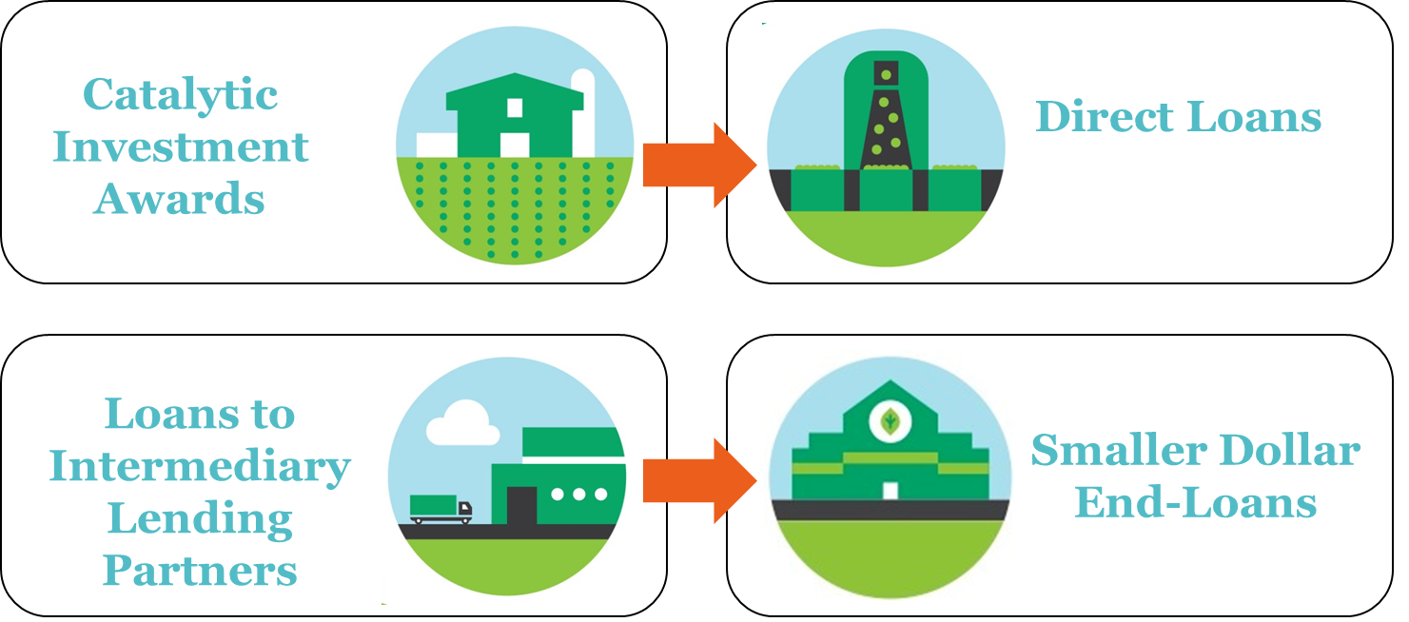

Various Financing Products
New Markets Tax Credits
End products in amounts from $2,500 to $5,000,000+

Slide 8
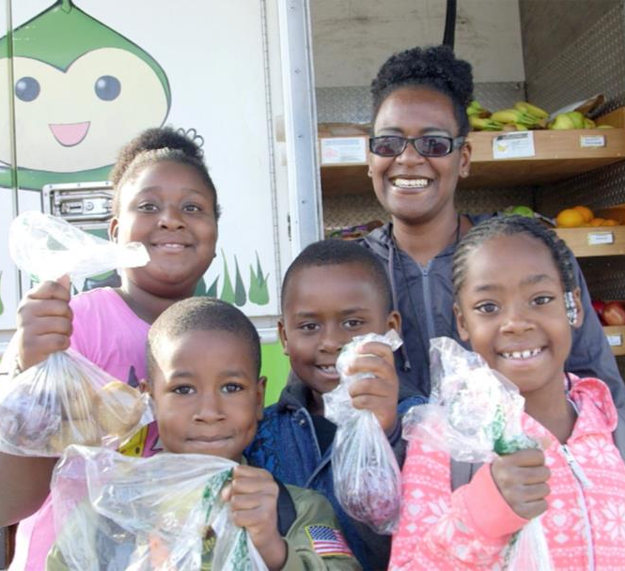
MICHIGAN GOOD FOOD FUND
Investors & Funders
$30 million public-private partnership:
Fisher Foundation
$250,000 PRI
The Kresge Foundation
$500,000 Grant
The Kresge Foundation
$800,000 PRI
Northern Trust Bank
$1,000,000 PRI
W.K. Kellogg Foundation
$3,000,000 PRI
CDFI HFFI
$3,000,000 Grant

Slide 9
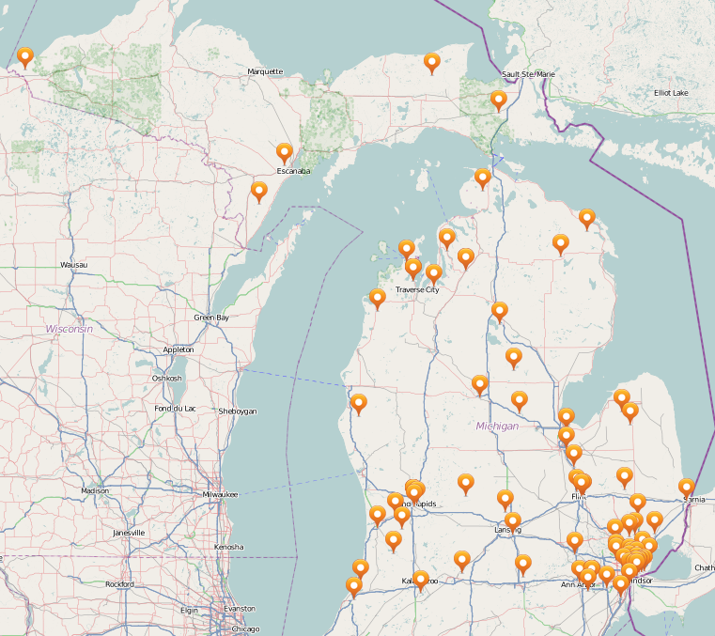
MICHIGAN GOOD FOOD FUND
Across the value chain
Retail
  Grocery Stores & Coops
  Farm Markets
Value-Added Processing
  Artisanal Products (pickling, olive oil, seasonings, smoothies, juice, coffee, jerky, granola)
Growers / Processors
  Farms
  Aquaponics
  Urban Agriculture
Other
  Food Service / Catering
  Incubator / Education
Requests range from $5,000 to $5,000,000

Slide 10
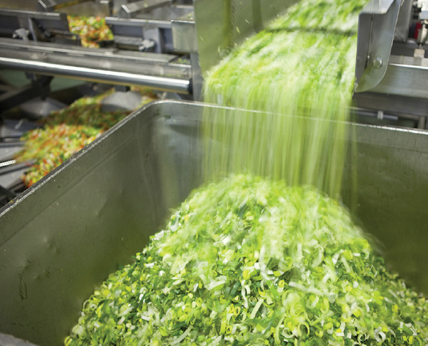
Other Trends in Healthy Food
Programs seem to be more effective when coupled with:
Nutrition Education
Community Involvement
Food Assistance Programs
Co-located with other services (i.e., health center located at a supermarket; farmers market located at a health center)

Slide 11
Thank You
Olivia Rebanal
orebanal@capitalimpact.org

Slide 12
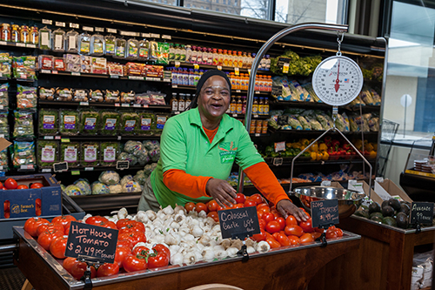
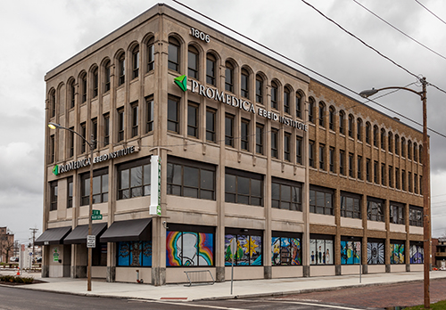



Healthy Food for Ohio
Healthy Food Financing Update
December 6, 2016

Slide 13
WHO WE ARE
  Finance Fund
    Established in 1987
    Statewide nonprofit financial intermediary
  Finance Fund Capital Corporation
    Established in 2003
    Community Development Financial Institution (CDFI) lending affiliate certified in 2009
  Founded to connect low-income communities with public and private sources of capital
    State, Federal, Banks, Private Institutions
| 614.221.1114 T 614.221.7493 F | www.ﬁnancefund.org
Notes:
Simplify the complexities of the financing process to help good ideas come to life.
These ideas change systems, create jobs, address community needs, turn things around and improve the quality of life.

Slide 14



OHIO’S HEALTHY FOOD FINANCING INITIATIVE BACKGROUND
| 614.221.1114 T 614.221.7493 F | www.ﬁnancefund.org
Notes:
Over 2 million Ohio residents including more than half a million children live in lower-income communities underserved by supermarkets
31% of children ages 10-17 are overweight
Ohio is 6th worst state for supermarket access and 10th highest for infant mortality
The Commonwealth Fund 2013 Annual Report ranked Ohio 40th for overall health among all states.
The State spends $57 billion every year to address burden of chronic diseases
Fruit and vegetable intake can increase up to 32% with each additional supermarket in a community
Potential health care savings by 2020 if Ohio’s BMI is reduced by 5%

Slide 15
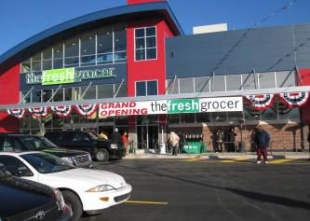
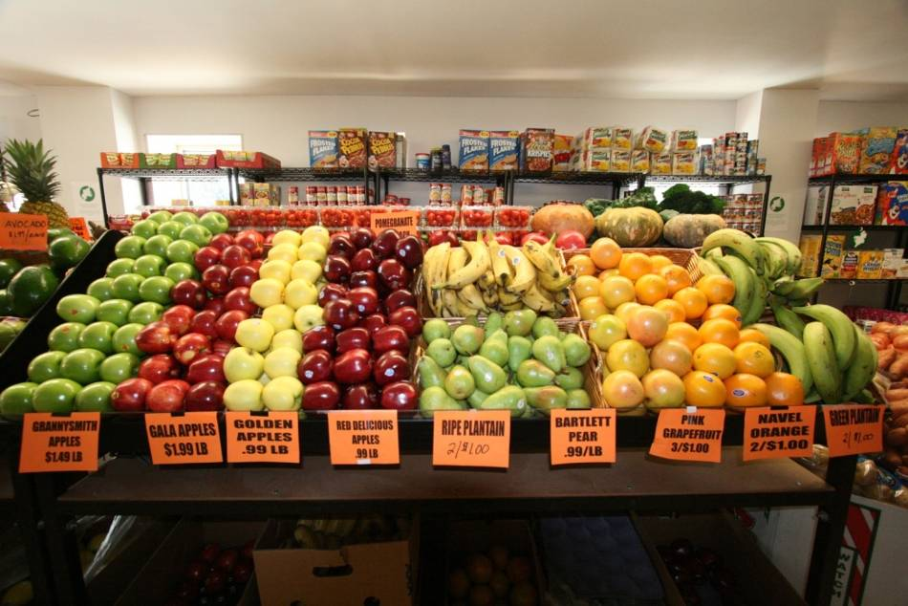
PENNSYLVANIA FRESH FOOD FINANCING INITIATIVE
  Increase access to healthier food options in low-income areas
  Create of maintain jobs
  Boost economic development in communities
  Help to improve health outcomes
Progress Plaza, Philadelphia
Romano’s Market, Philadelphia
| 614.221.1114 T 614.221.7493 F | www.ﬁnancefund.org
Notes:
What you seeing on the screen are examples of the range of projects supported by the PA FFFI including current photo of progress plaza, a bustling shopping center in the middle of North Philadelphia, a corner store that got a renovation in Philadelphia, a small town grocer in Gettysburg, PA and a farmer's market in a rural small town of PA.
The Fresh Grocer at Progress Plaza: The Supermarket closed it’s doors in 1998, which had disastrous effects on local residents, who had to start relying on convenience stores or take multiple buses to access the closet full service supermarket.
Fortunately, with funding available through the Pennsylvania Fresh Food Financing Initiative, a new, and much needed supermarket, returned to the Progress Plaza site in 2009.
PA FFFI provided $1 million in grant funding for predevelopment costs for a new supermarket as well as $1.8 million in loans for equipment financing and $13.7 million in New Market Tax Credit Savings.
The Fresh Grocer market brings fresh foods to the neighborhood, employees 225 full-time people, with 80 percent of them living within a two mile radius.
Bloss Holiday Market: want to highlight one of the many stores that we have funded in Pennsylvania’s rural communities. When the owners of Bloss Holiday Market decided to retire, the 1,400 person rural community of Blossburg, Pennsylvania, faced the loss of its only food market and the only supplier of groceries and fresh produce miles. A closed market would mean the loss of almost 30 jobs and the loss of the only store in the area to accept food stamps and vouchers for families in need from the local Salvation Army.
The FFFI provided an entrepreneurial, young couple, Melanie and Ryan Shaut, with $25,000 in grant funding, to assist them in completing the purchase of the market and acquiring much-needed new equipment. This one-time funding helped to overcome the high up-front costs associated with purchasing the store; today sales at the market have been strong and the business is thriving. The FFFI enabled this community to continue to have walkable access to fresh, healthy foods and retain and add good jobs.
Romano’s Grocery, Philadelphia: is another interesting project that received funding through the program. Formerly a typical corner store selling dry goods, candy, sundries, and a small selection of fresh foods, Romano’s Grocery has been completely transformed. With funding from FFFI and DCED’s Minority Food Retailer Program, along with support from the William Penn Foundation and TRF’s Sustainable Development Fund, the owner, Juan Romano, renovated the store using green building practices. Romano’s Grocery is now able to expand its business and stock more fresh fruits and vegetables. Energy-efficient lighting, refrigerators that are 25% to 35% more efficient than standard ones and a ductless HVAC system minimize the additional energy costs associated with the refrigeration needed to stock fruits and vegetables.
Lancaster, Central Market: Situated in the heart of Lancaster, Central Market is the oldest farmer’s market in the country and the only major source of fresh food in the city. When this historic community asset needed critical infrastructure improvements to continue operating, FFFI partnered with city, state, and regional efforts to ensure that Central Market could continue to serve the fresh food needs of residents. With grant funding from FFFI, the Market was able to make important improvements so that the 60 plus small business vendors selling a variety of local fresh produce, meats, and seafood can remain in that location. As a result, Central Market will continue to remain a treasure and an important economic generator for Lancaster City and County for generations to come.
$100,000 Grant
$4,000,000 Total Project Costs

Slide 16
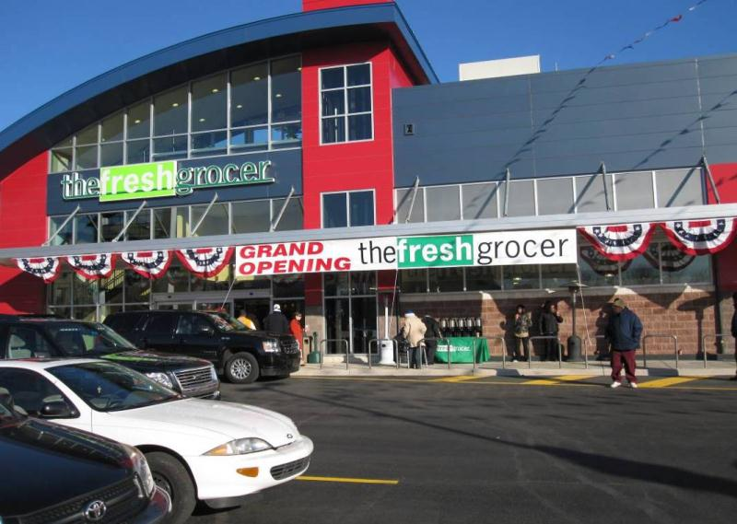
HEALTH AND ECONOMIC DEVELOPMENT IMPACTS
88 projects
5,000+ jobs
1.6 million square feet of retail
$165 million total project investment
| 614.221.1114 T 614.221.7493 F | www.ﬁnancefund.org

Slide 17

MAPPING NEED ACROSS THE STATE
| 614.221.1114 T 614.221.7493 F | www.ﬁnancefund.org

Slide 18
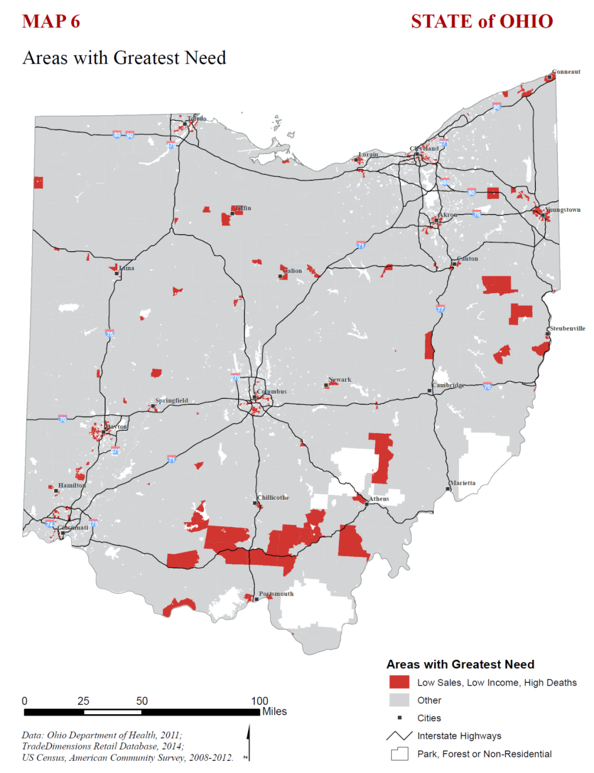
NEW MARKETS TAX CREDIT
| 614.221.1114 T 614.221.7493 F | www.ﬁnancefund.org

Slide 19
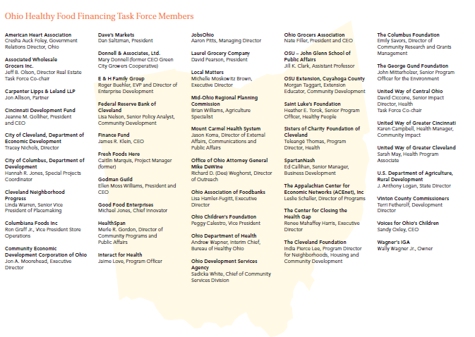
CURRENT PROGRAMS: FCAP
| 614.221.1114 T 614.221.7493 F | www.ﬁnancefund.org
Notes:
And so the Healthy Food Financing Task Force - a group of nearly 50 grocery industry, public health, economic development, philanthropic and other leaders, convened in the spring on 2014 to address this issue of a lack of access to healthy foods in unreserved areas throughout the state. Over the course of a year the group identified the key barriers to grocery store development in underserved areas and developed recommendations to overcome those barriers.

Slide 20

POLICY RECOMMENDATIONS
| 614.221.1114 T 614.221.7493 F | www.ﬁnancefund.org
Notes:
This Policy recommendation report included 10 policy recommendations put forth by the Ohio Healthy Food Task Force. We used this report to educate the policy makers about the need around the state and how collective we came to a solution.

Slide 21
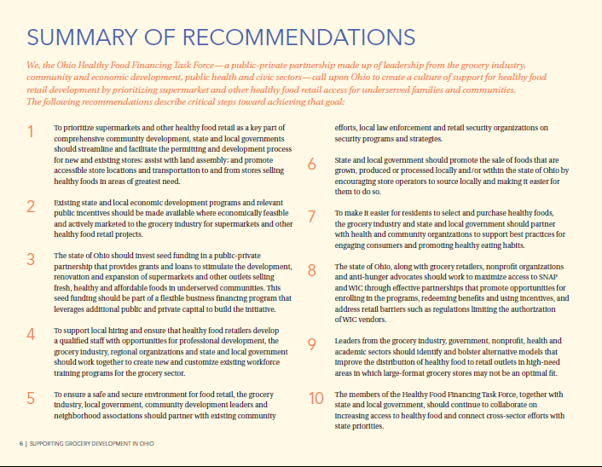
| 614.221.1114 T 614.221.7493 F | www.ﬁnancefund.org
Notes:
The 10 recommendations of the group were synthesized in a report released in February of 2015

Slide 22
PROGRAM FUNDING GOALS
State funding approved $1.85MM
Federal funding approved $2MM of HFFI
Raise $16MM total
  Grants: $4MM
  Banks: $7MM
  Foundations: $3MM
  Other Partners: $2MM
| 614.221.1114 T 614.221.7493 F | www.ﬁnancefund.org

Slide 23
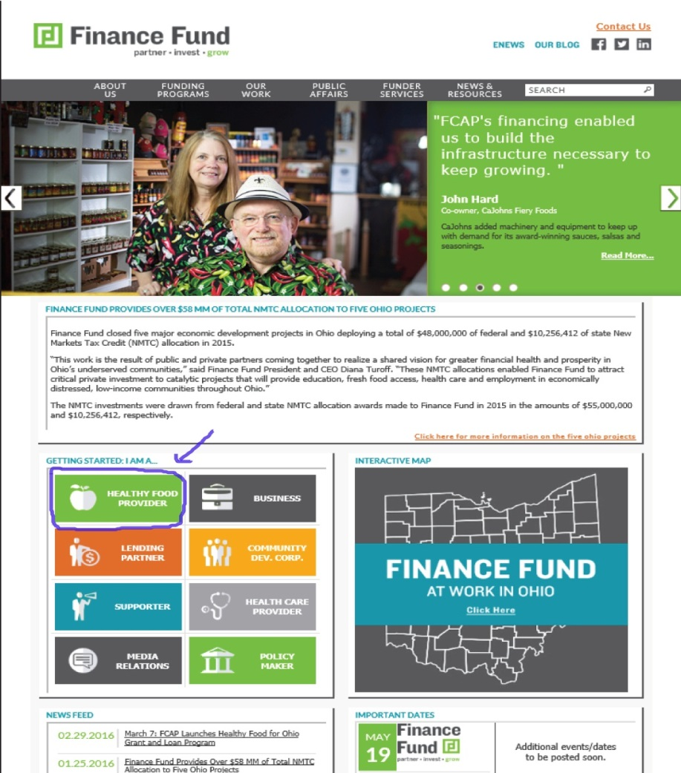
HEALTHY FOOD FOR OHIO LAUNCHED
| 614.221.1114 T 614.221.7493 F | www.ﬁnancefund.org
Notes:
(Valerie Slide)
In a moment, Risa will walk you through the eligibility criteria and application process. All of the information in your packets, and that Risa will refer to, can also be found on our website. As you see in the screenshot up here, from the Finance Fund website, click: I am a Healthy Food Provider…

Slide 24
PROGRESS
Raised over $10.7MM of capital
Total Pending requests of over $7MM
Received 25 Pre-applications for HFFO eligibility
Invited over 10 Projects to submit Full applications
| 614.221.1114 T 614.221.7493 F | www.ﬁnancefund.org

Slide 25
HFFO CAPITAL CAMPAIGN
GRANTS | BANKS | FOUNDATIONS | OTHER PARTNERS | TOTAL
$4,000,000 | $7,000,000 | $3,000,000 | $2,000,000 | $16,000,000 | Goal
$4,489,167 | $3,000,000 | $1,330,000 | $1,970,000 | $10,789,167 | Secured
$ (489,167) | $4,000,000 | $1,670,000 | $30,000 | $5,210,833 | Remaining
- | $6,000,000 | $1,015,000 | - | $7,015,000 | Pending
| 614.221.1114 T 614.221.7493 F | www.ﬁnancefund.org

Slide 26
HFFO CAPITAL CAMPAIGN
| 614.221.1114 T 614.221.7493 F | www.ﬁnancefund.org

Slide 27

ST. LUKE’S FOUNDATION PARTNERSHIP
Involvement: Task Force Member, Grant support and PRI support
Mission: Saint Luke’s Foundation is dedicated to improving and transforming social and physical conditions in our neighborhood and improving the health and well-being of individuals and families in Greater Cleveland. Our program strategy framework positions us to build sustainable solutions to key issues that impact our community.
| 614.221.1114 T 614.221.7493 F | www.ﬁnancefund.org

Slide 28
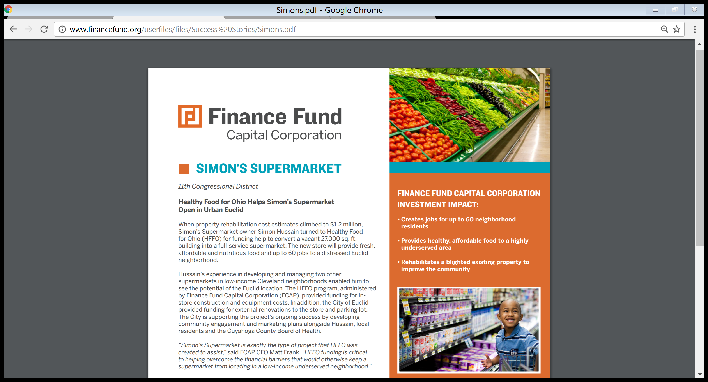
SIMON’S SUPERMARKET
Euclid, OH
Vacant 27,000 sq. ft. building converted into full-service supermarket
Funding for in-store construction and equipment
Creating up to 60 jobs in a distressed neighborhood
| 614.221.1114 T 614.221.7493 F | www.ﬁnancefund.org

Slide 29
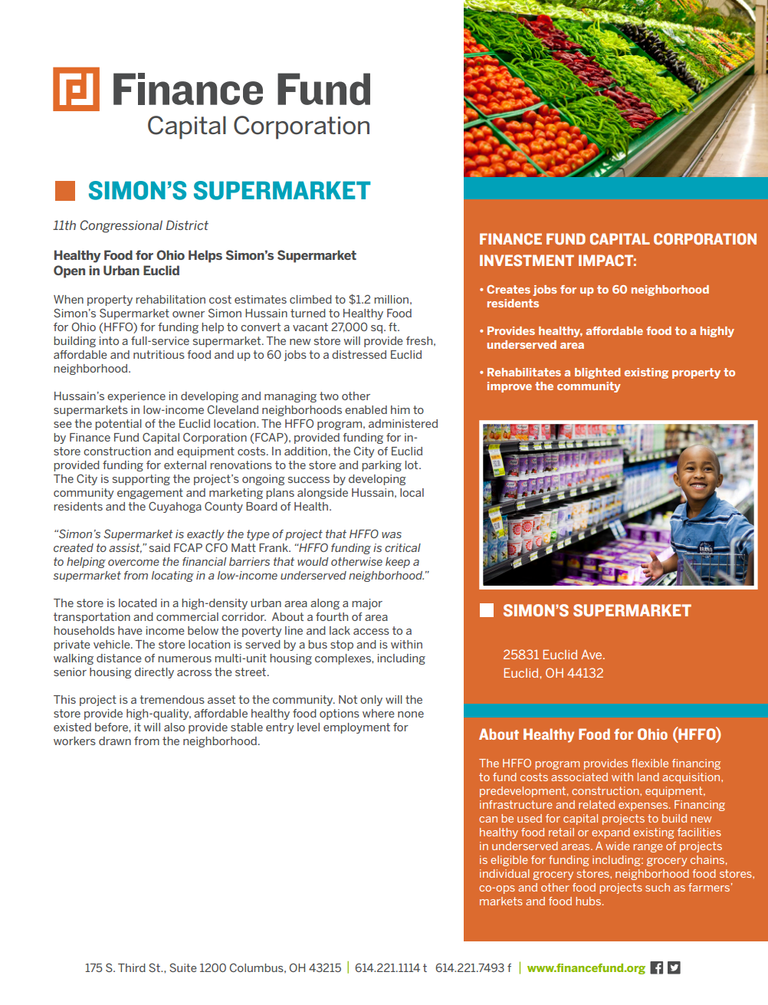
SIMON’S SUPERMARKET
| 614.221.1114 T 614.221.7493 F | www.ﬁnancefund.org

Slide 30
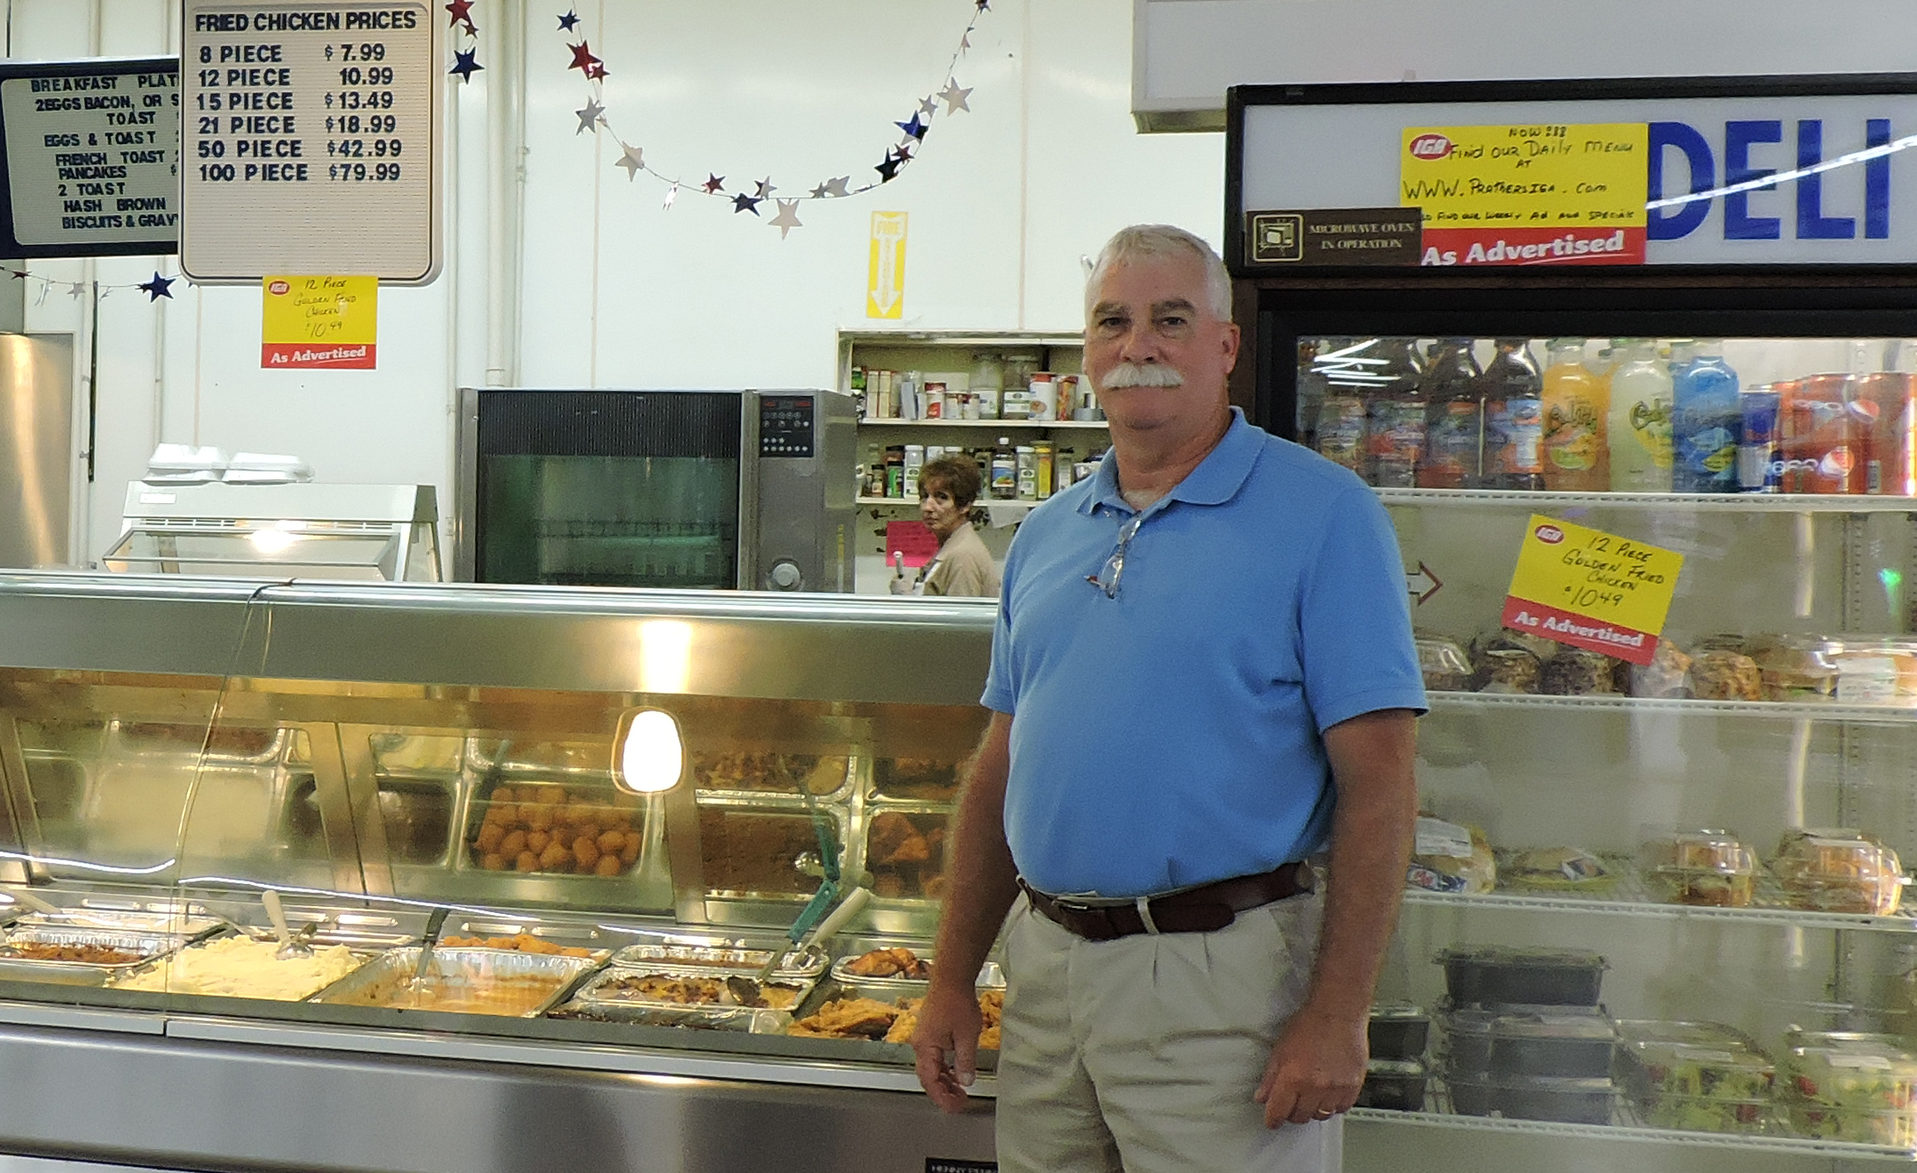
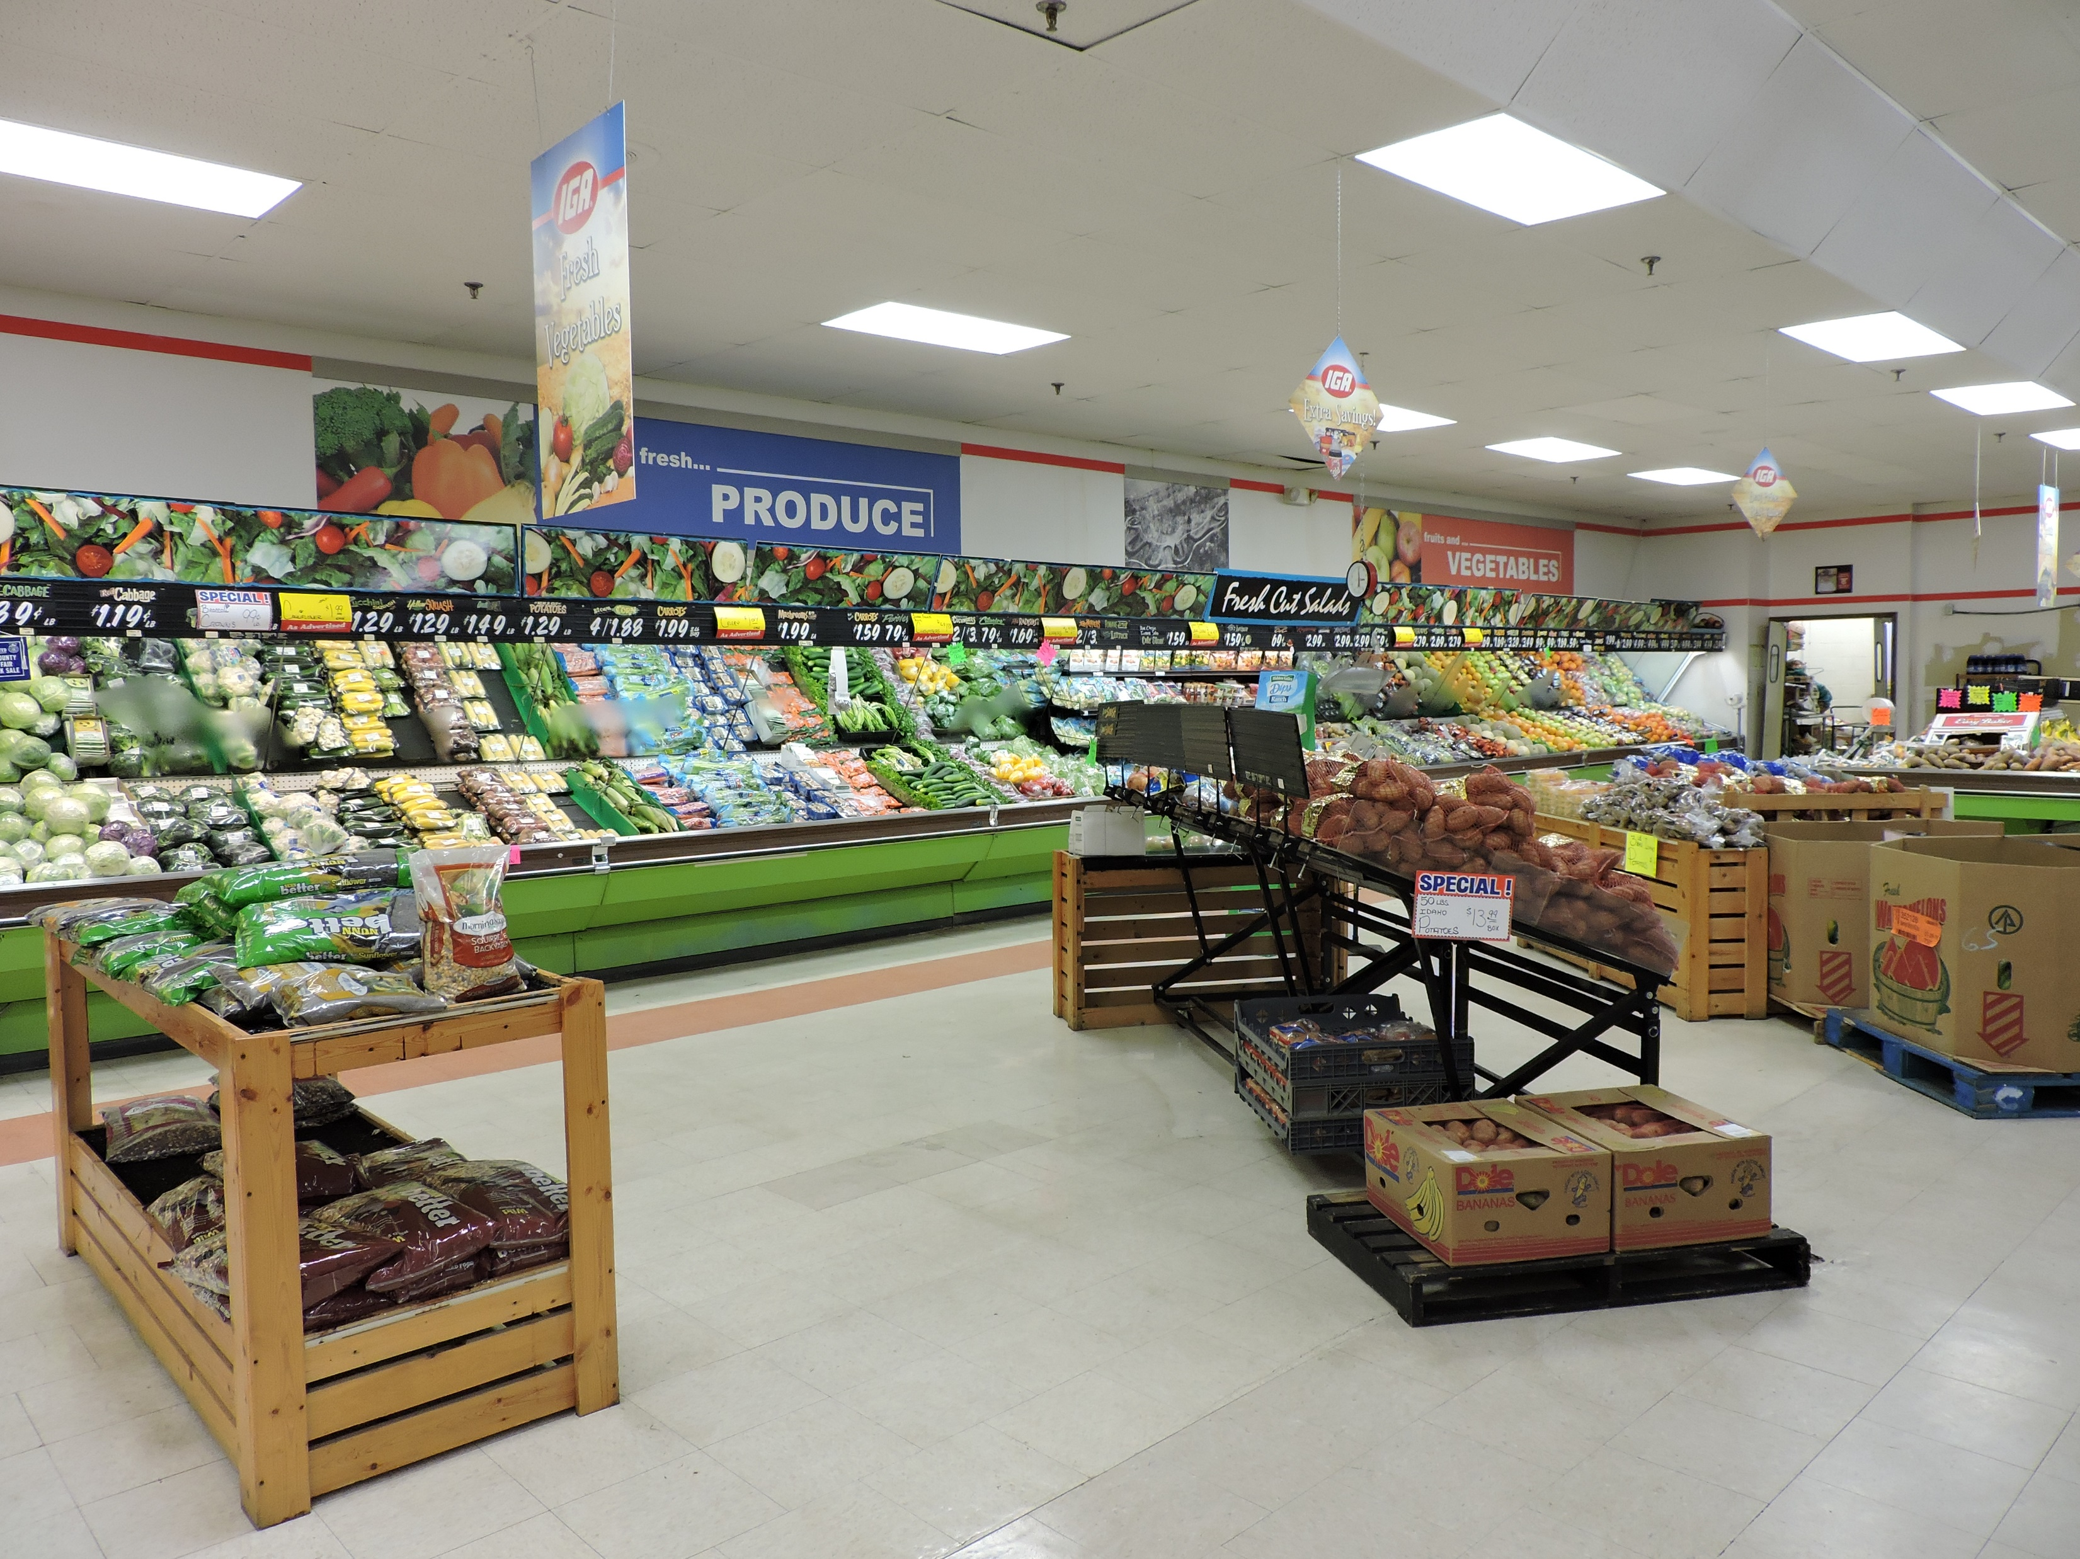
PRATHER’S IGA
West Union, OH
Family owned and operated 22,000 sq. ft. IGA grocery store
Funding for improved fresh food selection, reduced operating costs
Retains 38 jobs in rural community
| 614.221.1114 T 614.221.7493 F | www.ﬁnancefund.org

Slide 31
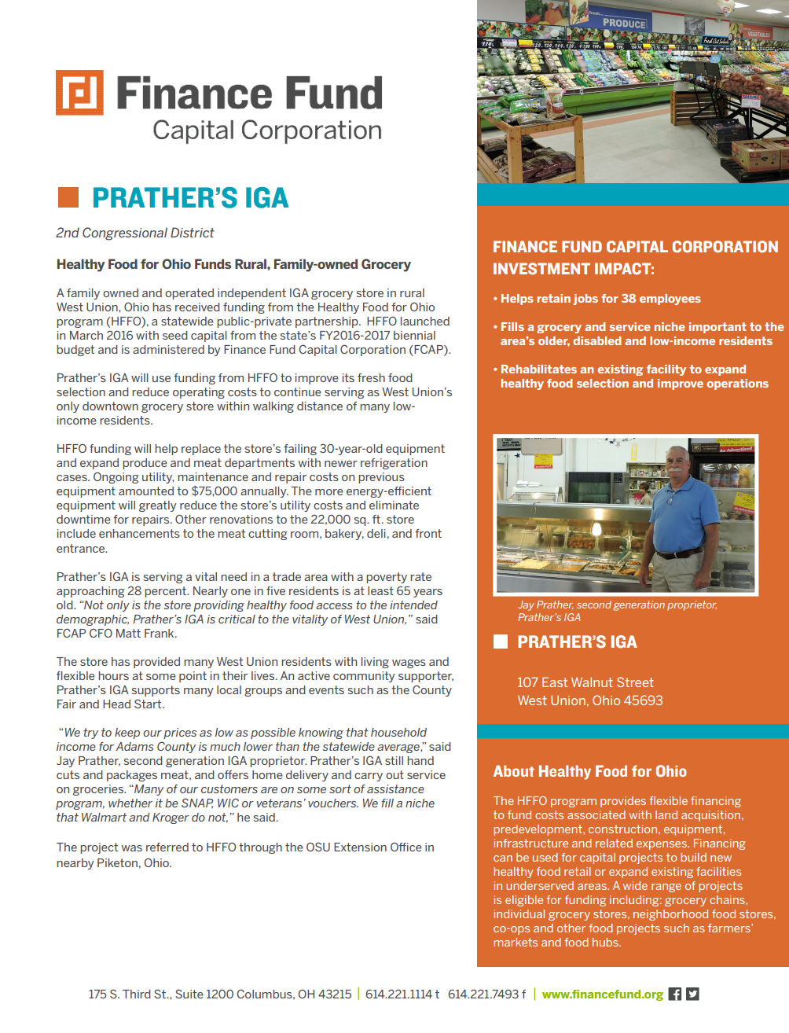
PRATHER’S IGA
| 614.221.1114 T 614.221.7493 F | www.ﬁnancefund.org

Slide 32
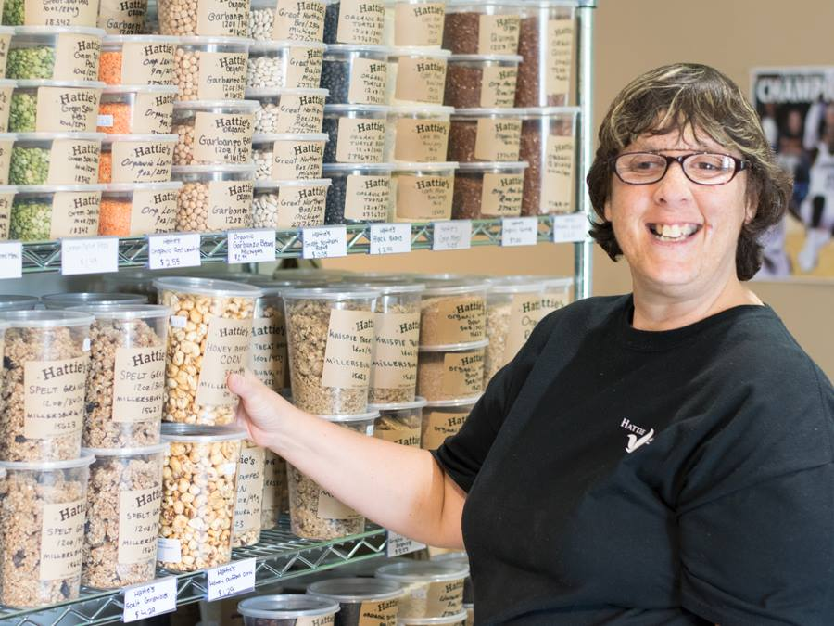

HATTIE LARLHAM FOOD HUB
Akron, OH
4,400 sq. ft. fresh food corner market
Funding for start-up equipment, operating support for mobile market
Produce for local residents and job opportunities for people with disabilities
| 614.221.1114 T 614.221.7493 F | www.ﬁnancefund.org

Slide 33
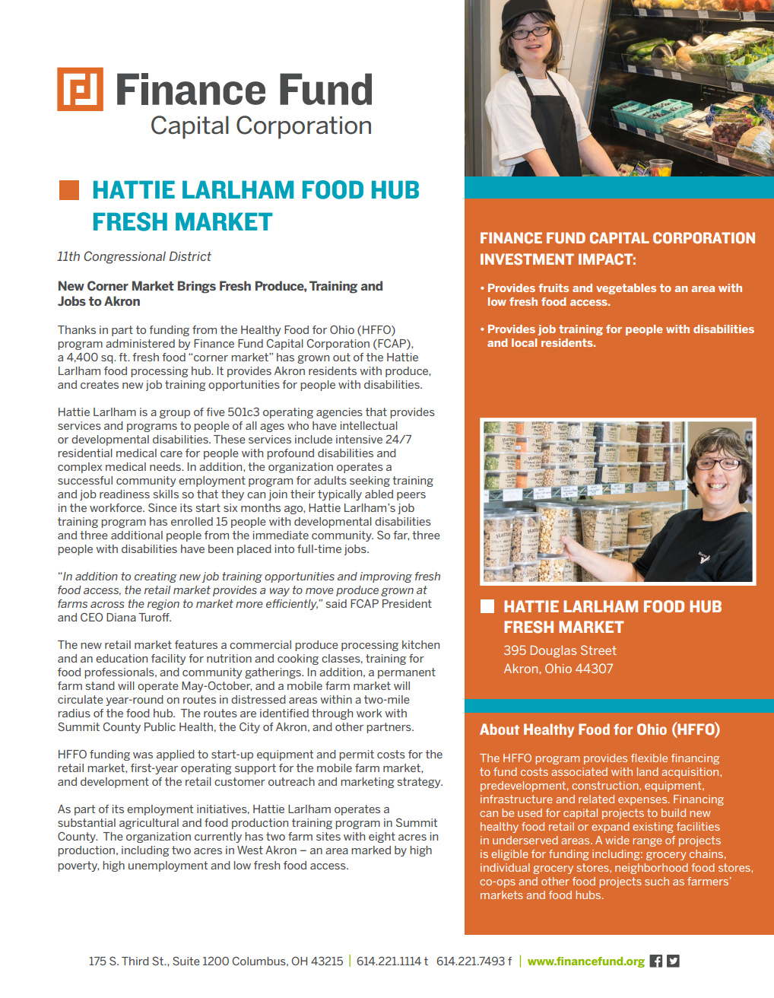
HATTIE LARLHAM FOOD HUB
| 614.221.1114 T 614.221.7493 F | www.ﬁnancefund.org

Slide 34


CONTACT US
  Heather E. Torok, MPH
  Senior Program Officer, Healthy People
  Saint Luke’s Foundation of Cleveland, Ohio
  htorok@saitlukesfoundation.org
  QUESTIONS?
| 614.221.1114 T 614.221.7493 F | www.ﬁnancefund.org

Slide 35

FSA
IMPORTANT HFFI UDPATE
On November 28, USDA officially announced the Healthy Food Financing Initiative (HFFI) program at Rural Development. More information on the program is coming soon. Contact James Barham, agricultural economist, USDA Rural Development: James.Barham@wdc.usda.gov, or 202-690-1411.
UPCOMING SAFSF WEBINARS
Jan. 19th: Amplifying Agroecology: Scaling Solutions for Healthy Food, Soil, Water and Seeds
Feb. 2nd: Sustainable Food Systems & Real Estate
Contact Huyen Nguyen, program & membership associate, for more information about our network and programming: huyen@safsf.org and visit our website www.safsf.org
2017 Federal policy briefing

Slide 36
More webinars on this topic?
New topics you want to tackle or learn more about?
Innovative work that you want to share?
A question you want to pose to your colleagues?
Contact us at heal@gih.org

