Slide 1

What’s Next for Maryland?
Building a Legacy of Healthy Children
Grantmakers for Children, Youth and Families and Grantmakers in Health
January 14, 2014
Enrique Martinez-Vidal
Vice President, State Policy and
Technical Assistance, AcademyHealth
Director, State Coverage Initiatives

Slide 2


AcademyHealth:
Improving Health & Health Care
AcademyHealth is a leading national organization serving the fields of health services and policy research and the professionals who produce and use this important work.
Together with our members, we offer programs and services that support the development and use of rigorous, relevant and timely evidence to:
  Increase the quality, accessibility and value of health care,
  Reduce disparities, and
  Improve health.
A trusted broker of information, AcademyHealth
brings stakeholders together to address the current
and future needs of an evolving health system,
inform health policy, and translate evidence into action.

Slide 3
Presentation Overview
Maryland Landscape Overview
Maryland Health Reform Activities
Lessons from Previous Reforms
Ingredients Needed for Reform
What Roles Can Philanthropy Play?

Slide 4
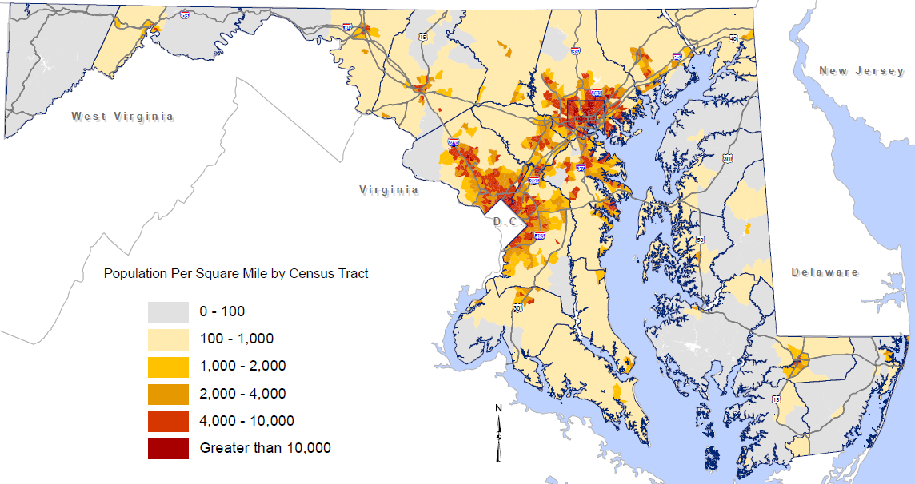
Maryland Has 5.9 Million People
Source: Map prepared by the Maryland Department of Planning, from the U.S. Census Bureau.

Slide 5
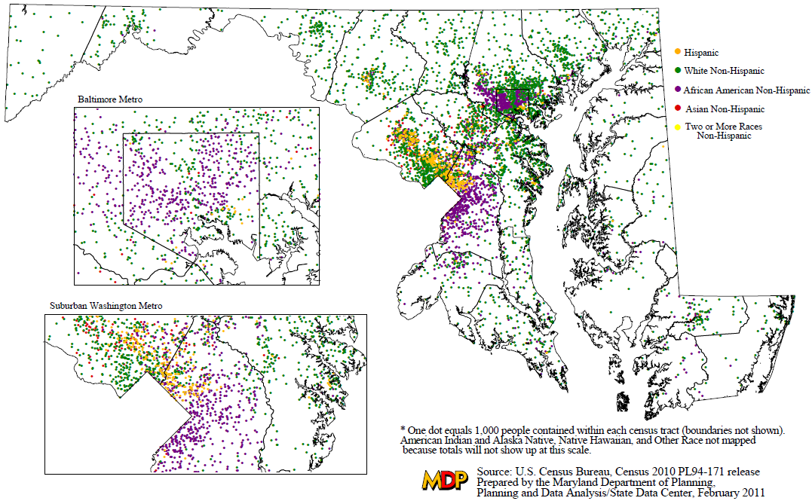
Maryland is Racially & Ethnically Diverse

Slide 6
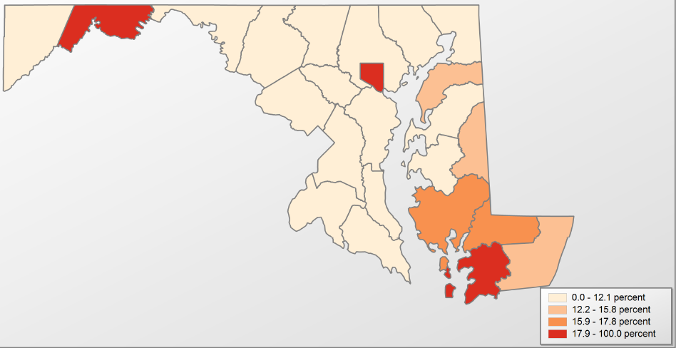
Maryland is an Affluent State
With Pockets of Poverty
Garrett 12.0%
Allegany
19.1%
Washington 11.8%
Carroll 5.5%
Baltimore County 9.6%
Cecil 9.7%
Harford 8.3%
Frederick 6.6%
Baltimore City
24.5%
Kent 13.9%
Howard
6.0%
Montgomery 6.7%
Anne Arundel 6.1%
Queen Anne’s 8.7%
Prince George’s 9.4%
Caroline 13.1%
Talbot 10.8%
Calvert
6.1%
Charles 7.7%
Dorchester 17.5%
Wicomico 17.7%
St. Mary’s 8.6%
Worcester 13.0%
Somerset
26.2%
Source: Bureau of the Census,
Small Area Income and Poverty Estimates.

Slide 7
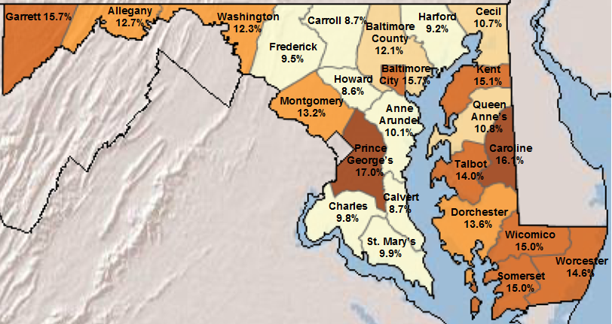
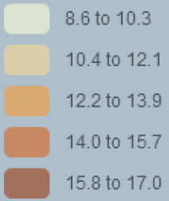
Many Residents Are Insured, But Not All
Source: U.S. Census Bureau and the Centers for Disease Control and Prevent. SAHIE/State and County by Demographic and Income Characteristics, 2010.

Slide 8
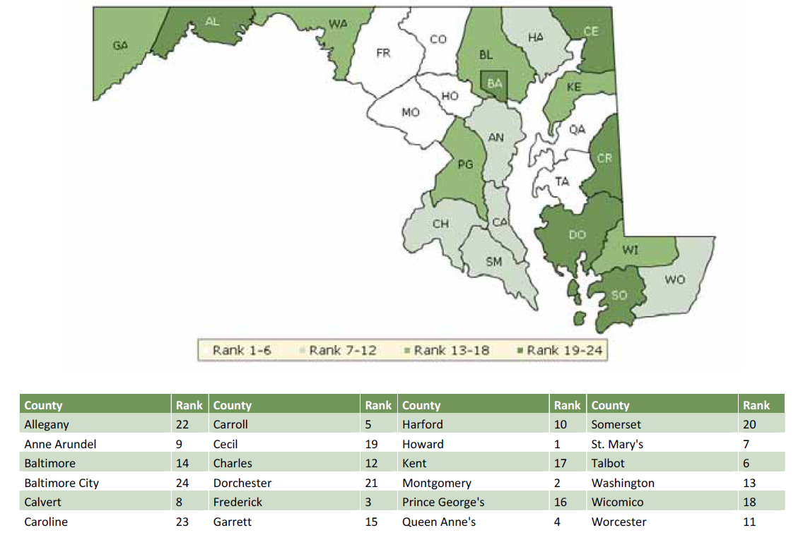
County Health Rankings Correspond to Uninsured Rates
Source: University of Wisconsin Population Health Institute. County Health Rankings 2013. County Health Rankings & Roadmaps: A Healthier Nation, County by County. 2013 Rankings: Maryland.

Slide 9
Maryland Coverage Statistics (2011-12)
 | Nonelderly Adult - % | Nonelderly Adult - # | Children - % | Children - #
Employer | 65% | 3,286,900 | 59% | 843,000
Other private | 5% | 258,700 | 4% | 51,700
Medicaid | 13% | 663,500 | 27% | 383,000
Other public | 2% | 106,200 | -- | --
Uninsured | 15% | 755,900 | 9% | 128,000
Total | 100% | 5,071,200 | 100% | 1,428,900
Source: Analysis of the Census Bureau’s March Supplement to the Current Population Survey (the CPS Annual Social and Economic Supplement or ASEC) by the Kaiser Commission on Medicaid and the Uninsured and the Urban Institute.

Slide 10
Health Reform Strategic Approach
Five Key Components
Promote access to care
Promote wellness & community health through public health/medicine integration
Address pockets of intense health disparities
Reform incentives for hospitals
Use mapping, hot-spotting, and data analysis to support robust primary care and community outreach
Five Key Initiatives
Exchange/Medicaid expansion
State Health Improvement Process
Health Enterprise Zones
Modernizing the Waiver
The State Innovation Model
Source: Health Systems and Infrastructure Administration, Maryland Department of Health and Mental Hygiene.

Slide 11
Maryland Coverage Initiatives: Exchange
5 carriers in individual market: 45 plans
  36 include embedded pediatric dental benefits
  20 stand-alone dental plans by 4 dental carriers
    8 plans offer pediatric dental benefits only
    12 plans offer family coverage
    All plans are offered statewide
Small group market (SHOP): not launched yet
Benefit Plan
  Small group market plan, supplemented with:
    Pediatric Oral (State CHIP)
    Pediatric Vision (FEDVIP)
    Plans required to cover habilitative services benefits for members age 19 and above in parity with benefits covered for rehabilitative services.
Source: Maryland Health Benefit Exchange.

Slide 12
Consumer Outreach/Education/Assistance
Branding, Marketing and Advertising
Outreach and Education
Web Portal/On-line Communications
Navigators/In-person Assisters
Brokers (2,000+)
Customer Service Center
Decision Support Tools

Slide 13
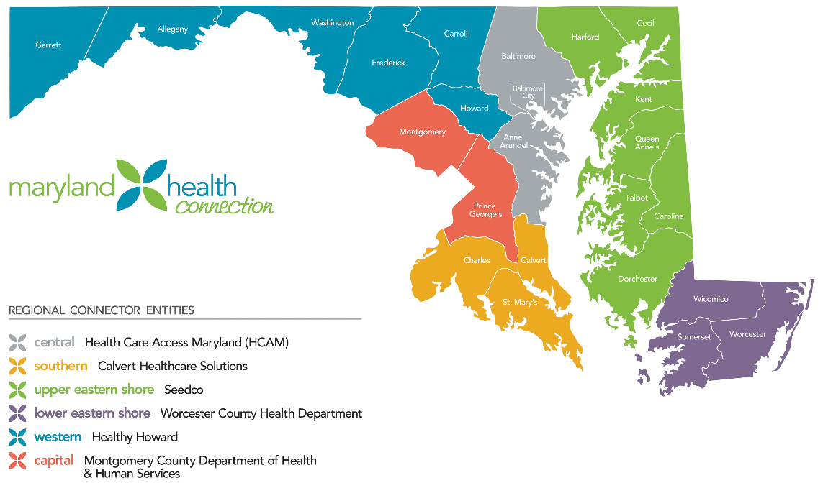
Maryland Health Benefit Exchange:
Six Connector Entities
Source: Maryland Health Benefit Exchange.

Slide 14
Estimates of 2014 ACA Enrollment for Maryland
Medicaid Expansion (Includes PAC Enrollees) 90,639
Medicaid "Woodwork" Effect 11,046
Exchange (138-200% FPL) with Subsidy 37,452
Exchange (200-400% FPL) with Subsidy 67,289
Exchange (Above 400% FPL) without Subsidy 34,023
Small Business Health Options Program (SHOP) 8,469
Total New Medicaid and Exchange Coverage 248,918
Source: Hilltop Institute, UMBC. 7/13/12.

Slide 15
Maryland Coverage Initiatives:
Exchange and Medicaid Expansion
As of 1/4/14: 162,000 Marylanders are on track to receive health coverage under ACA
20,358 into Qualified Health Plans
91,570 moved into Medicaid from Primary Adult Care (PAC) program
50,522 found eligible for Medicaid program through Exchange
  26,500 now enrolled/remainder on track (retro to 1/1)
Source: Maryland Health Benefit Exchange,
January 10, 2014.

Slide 16
State Health Improvement Process (SHIP)
Framework and resources to align local action to continuously improve population health/health equity
18 Local Health Improvement Coalitions
  Typically co-chaired by hospital and public health leaders and include cross-section of health and human services
State and Local Accountability
  39 measures: health outcomes and determinants
  State and county baselines and 2014 targets
  Racial/ethnic disparity information
Source: Health Systems and Infrastructure Administration, Maryland Department of Health and Mental Hygiene.

Slide 17
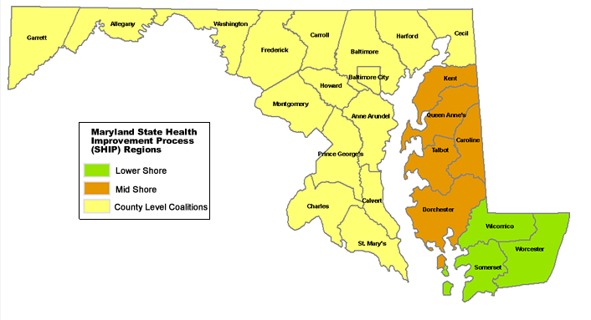
18 Local Health Improvement Coalitions (LHICs) Across Maryland
Source: Health Systems and Infrastructure Administration, Maryland Department of Health and Mental Hygiene.

Slide 18
The Role of LHICs in Community Health Improvement Today
Convening/facilitating/coordinating
Planning and priority-setting
Performance monitoring
Source: Health Systems and Infrastructure Administration, Maryland Department of Health and Mental Hygiene.

Slide 19
Aligned Action in 6 Focus Areas to Increase Life Expectancy
Healthy Babies
Infectious Disease Reduction
Prevent and Control Chronic Disease
Healthy Social Environments
Safe Physical Environments
Improve Health Care Access
Source: Health Systems and Infrastructure Administration, Maryland Department of Health and Mental Hygiene.

Slide 20
What is the Health Enterprise Zone (HEZ) Initiative?
A project of the Lt. Governor, Department of Health and Mental Hygiene, and Maryland Community Health Resources Commission
Aims to reduce chronic diseases among ethnic groups that are more likely to suffer from these illnesses
Over the next four years, will provide up to $16 million to fund five HEZ programs across the state
  MedStar St. Mary’s Hospital, Greater Lexington Park
  Dorchester County Health Department, Competent Care Connections
  Prince George’s Health Department, Capitol Heights
  Anne Arundel Health System, Annapolis
  Bon Secours Baltimore Health System, West Baltimore Primary Care Access Collaborative

Slide 21
HEZ Initiative Goals
Improve health outcomes for people with chronic illnesses
Increase the number of primary care professionals in underserved communities
Increase the number of community members involved in promoting health
Increase healthy options in underserved communities
Reduce preventable emergency department visits and hospitalizations for people with chronic illness
Reduce health care costs of people with chronic illness
Source: PowerPoint presentation by Novella Tascoe at AcademyHealth’s meeting on Delivery Systems Meeting: Transforming Health and Health Care – Focus on Maryland, June 21, 2013.

Slide 22
Example: Greater Lexington Park HEZ
Main Activities/Goals
Integrated Care Team Model in the HEZ
Culturally Competent HEZ Healthcare Environment
Community-based Clinical Care Coordinators
Evidence-based Community Health Worker Program
HEZ Medical Transportation Route
Mobile Dental Clinic
Lexington Park Community Health Center
Source: PowerPoint presentation by Joan Gelrud at AcademyHealth’s meeting on Delivery Systems Meeting: Transforming Health and Health Care – Focus on Maryland, June 21, 2013.

Slide 23
Example: West Baltimore Primary Care Access Collaborative HEZ
A group of sixteen federally-qualified health centers, hospitals, community-based organizations, and academic institutions
Aims to reduce cardiovascular disease (CVD) in West Baltimore ZIP Codes 21216, 21217, 21223, 21229
Creates an independent organization, West Baltimore CARE (Community Asset & Resource Exchange) to target 86,000 residents for health and social services to reduce CVD
  Strengthens the Community
  Improves Health Outcomes
  Enhances Quality of Heath Care
  Saves Health Care Costs
Source: PowerPoint presentation by Novella Tascoe at AcademyHealth’s meeting on Delivery Systems Meeting: Transforming Health and Health Care – Focus on Maryland, June 21, 2013.

Slide 24
West Baltimore CARE
(Community Asset & Resource Exchange)
Center for Quality
Center for Community Enrichment
Center for Primary Care and Workforce Development
PCMH Progress Monitoring
Technical Assistance
HEZ Data Collection & Reporting
Quality Improvement
HEZ Program Implementation Oversight
Evidence Base Assessment
Research
CARE Performance Evaluation
IT Coordination and Support
Outreach Team (11)
Disease Management Classes
Health Education Classes
Medical and Social Service Referrals
Health Promotion Campaigns
Food Retailer Partnerships
Group Fitness Classes
Community Fitness Venues
Community Health Events
HEZ Program Development
Disease Management Curriculum Development
Technical Assistance
Primary Care Workforce Assessment
Primary Care Professional Recruitment
Incentive Programs
Provider Training
WBPCAC Employee Orientation
Internships
Scholarships
CHW Training
Care Team Training
Care Coordination Training
Student and Community Health Advocate Recruitment & Training
Curriculum Development
Technical Assistance
PCMH Technical Assistance

Slide 25
CMMI State Innovation Model: Design Grant
Design a statewide, multi-payer Community Integrated Medical Home (CIMH) program
Primary care providers lead a team of health professionals focused on coordinating personalized care that meets the complex needs of patients
Community Integrated Medical Homes will engage with enhanced local health improvement coalitions
  Offer complementary supports to high-risk patients
  Identify and respond to hot spots of health needs
  Monitor community and population health
Source: State Innovation Model (CMMI) Design Grant
received by Maryland Department of Health and Mental Hygiene.

Slide 26
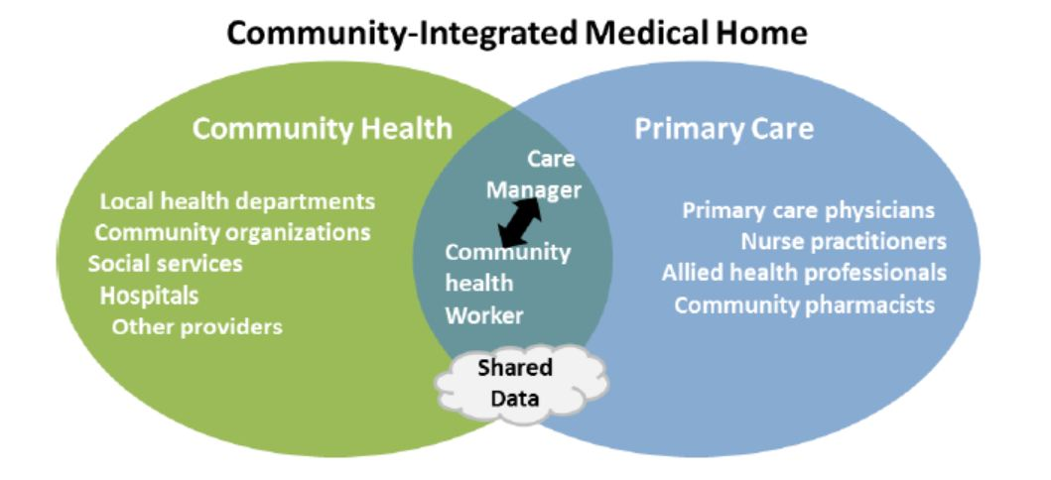
Framework for Medical/Public Health Integration in Maryland
Integration of a multi‐payer medical home model with community
health resources and public health approaches
Source: State Innovation Model (CMMI) Design Grant
received by Maryland Department of Health and Mental Hygiene.

Slide 27
CIMH Core Measure Set: Children
Type | NQF | Measure Description | Data Source
Utilization | 69 | Appropriate Treatment of Children with Upper Respiratory Infection | APCD
 | AHRQ | Preventable Hospitalizations: AHRQ PDI | CRISP
 | 2 | Appropriate Testing for Children with Pharyngitis | APCD
prevention and screening | 24* | Weight Assessment and Counseling for Nutrition and Physical Activity for Children/Adolescents | EMR/Hub
 | 38* | Childhood Immunization Status | APCD
 | 1392* | 6+ Well Child Visits, 0-15 months | APCD
 | 28* | Preventive Care & Screening: Tobacco Use Assessment | EMR/Hub
 | 28* | Preventive Care & Screening: Tobacco Cessation Intervention | EMR/Hub
asthma | 1 | Asthma Assessment | APCD
 | 47* | Use of Appropriate Medications for People with Asthma | APCD + Rx
 | 1381* | ER Use for Asthma | CRISP
mental health | 108 | ADHD: Follow-up Care for Children Prescribed ADHD Medication | APCD + Rx
* HHS preferred measure
Source: Health Systems and Infrastructure Administration, Maryland Department of Health and Mental Hygiene.

Slide 28
The Chesapeake Regional Information System for our Patients (CRISP)
The Affordable Care Act and other Maryland payment initiatives have promoted a level of care coordination that will be reliant on accurate patient identity management and exchange processes...that is, having an awareness and an understanding of an individual’s identity and clinical data beyond a single facility/encounter…
Admission Readmission Revenue (Maryland Specific)
Total Patient Revenue (Maryland Specific)
Accountable Care Organizations
Patient Centered Medical Homes
Bundled Payments
CMS Readmission Reduction (MI, CHF, Pneumonia)
Source: Adapted from PowerPoint presentation by Scott Afzal at AcademyHealth’s meeting on Delivery Systems Meeting: Transforming Health and Health Care – Focus on Maryland, June 21, 2013.

Slide 29
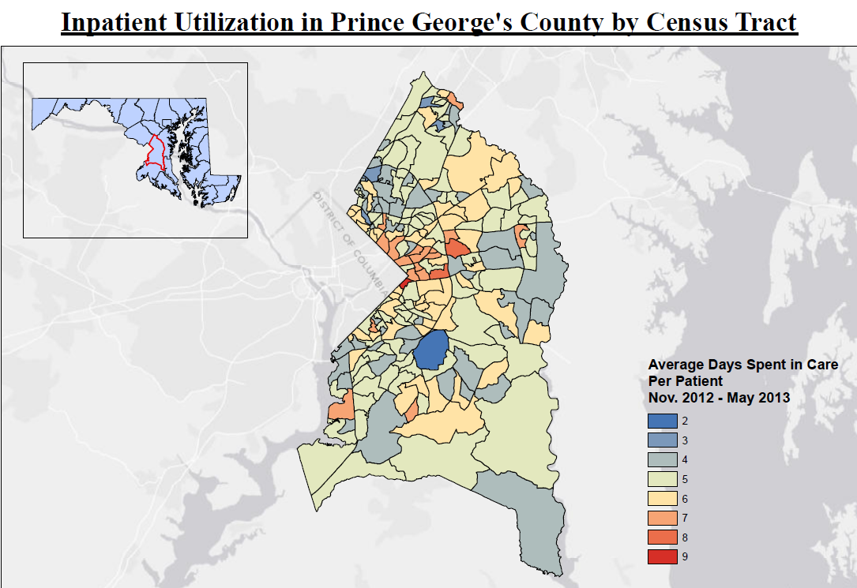
Geographic Information System (GIS) Mapping Capability
Based on the indexed utilization information, CRISP can produce visualizations of hospital utilization data in near real time
Community-Integrated Medical Home project can leverage geographic data to better understand localized use of services and opportunities for the most efficient / targeted interventions
Top 1% Utilizers
Source: Adapted from PowerPoint presentation by Scott Afzal at AcademyHealth’s meeting on Delivery Systems Meeting: Transforming Health and Health Care – Focus on Maryland, June 21, 2013.

Slide 30
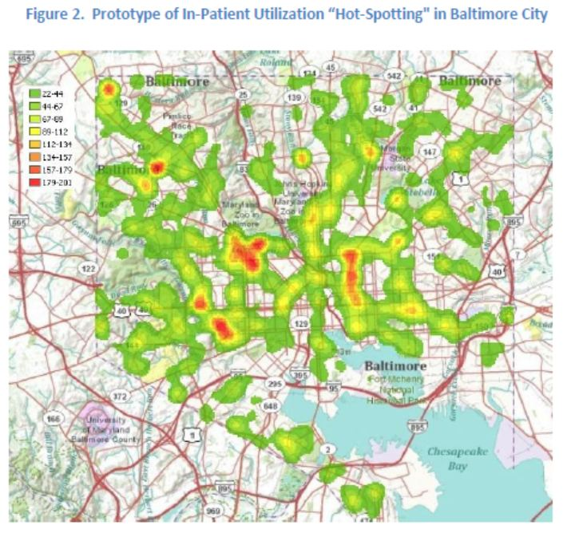
Source: State Innovation Model (CMMI) Design Grant
received by Maryland Department of Health and Mental Hygiene.

Slide 31
Challenges to Children’s Coverage Under the ACA
Outreach and Consumer Assistance
  Some families have complex coverage situations
  Need holistic approach
  Leverage CHIP and Medicaid assets (established community relationships)
  Leverage CHIP/Medicaid lessons learned
Eligibility and Enrollment
  Address Churn/Simplify enrollment (express lane eligibility)
  Shorten/eliminate CHIP waiting periods
Affordability
  Subsidize Qualified Health Plans (QHPs) for lower-income families
  Eliminate/waive premiums for families facing “premium stacking”
Access to Providers Appropriate for Children and Youth
  Work to align Medicaid/Chip providers/plans with Exchange QHPs
  Include Essential Community Providers that traditionally serve children (e.g., children’s hospitals, school-based health centers, FQHCs)
Access to Appropriate Benefits
  Use Medicaid/CHIP benefits as models for habilitative services and pediatric services
  Align benefits across benefit programs (churn)
Source: Dolatshahi, J., et al. Health Care Reform and Children: Planning and Design Consideration for Policymakers.
National Academy for State Health Policy. June 2013.

Slide 32
Lessons from Previous CHIP/Medicaid Expansions
Dual Challenges
  Raising consumer awareness of new coverage options (“air game”)
  Providing application assistance to those needing help navigating system (“ground game”)
Lessons Learned
  Marketing and public education is critical to raise awareness of new coverage opportunities
  Community-based outreach and education is a critical component to broader marketing campaigns
  Need for hands-on application assistance using trusted community groups and providers
  Trusted community groups closely tied to ethnic and other communities are most effective in reaching “hard to reach”
  Achieving high participation rate will take time
Source: Urban Institute. Reaching and Enrolling the Uninsured: Early Efforts to Implement the Affordable Care Act. October 2013.

Slide 33
Lessons from CHIPRA Quality Demonstrations
Goals and Activities
Quality Improvement Collaboratives
  Patient-Centered Medical Homes
  Use of Children’s Core Measures Set
  Practice-Level quality measurement to identify problem areas/monitor progress
  Improve Quality Improvement skills and knowledge
Practice facilitation/coaching to build internal capacity to transform
Workforce Augmentation (care coordinators; QI specialists)
Patient/Family Engagement (advisory councils)
Challenges
Data Collection/Analysis was considered burdensome
Difficult with Family Engagement
Not just clinical QI but complex practice transformation
Sustainability (need to partner with other payers and change agents)
Source: Devers, K et al., “Nine States’ Use of Collaboratives to Improve Children’s Health Care Quality in Medicaid and CHIP.” Academic Pediatrics; Vol 13, No. 6S, Nov-Dec 2013.

Slide 34
Ingredients for Successful Reform
Triple Aim: Improve Population Health, Enhance Patient Experience, and Constrain Cost Increases
Public/Private Partnerships: Share Information, discuss common goals, showcase innovations across settings
  Leadership
  Trust
  Communications Channels
Research, Data and Evidence (including HIT/HIE infrastructure)
  Drivers to determine which direction to take
  Understand if improvement is occurring
Patient-Centeredness and Empowerment
  Give patients/families data and attitude for collaborative decision-making with their practitioners and health care team, and other community-based resources
Source: Adapted from Steinwald, B., et al. Transforming Health and Health Care: Focus on Maryland, AcademyHealth. December 2013.

Slide 35
What Role Can Philanthropy Play?
Help convene stakeholders and share lessons/best practices
Help develop other improvement partnerships (e.g., National Improvement Partnership Network [MD Pediatric Improvement Partnership])
Participate in collaboratives (e.g., bring expertise; participate in goal establishment; help develop measures/materials; help initiatives engage with families/communities)
Support/leverage state/university partnerships
Help fund community needs assessments
Support organizational policy changes to improve population health (e.g., bike trails; safe walking; sugary drinks initiatives)
Help promote health and wellness at community level
Support health plan cooperatives (e.g., funding for marketing)
Support FQHC/CHC/ECP transformation
Support solutions for residual uninsured
Help elevate child and adolescent health policy agenda on an ongoing basis – not just as a single intervention

Slide 36
Enrique Martinez-Vidal enrique.martinez-vidal@academyhealth.org
202-292-6729 www.academyhealth.org www.statecoverage.org www.statenetwork.org
THANK YOU!

