Slide 1
A Look at the Future of Children’s Health Insurance Coverage
Joan Alker, Executive Director
Georgetown University Center for Children and Families
January 14 2014
Baltimore, MD

Slide 2



About Georgetown CCF

Slide 3
Our nation has made unprecedented progress in covering children.
Lowest uninsured rate since census started collecting data in 1987!

Slide 4
Families with Children Living in Poverty Increased from 2008-2012
 | 2008 | 2012 | Percentage Point Increase
Maryland | 8.2% | 11.3% | 3.1
United States | 15.2% | 18.8% | 3.6

Slide 5
Uninsured Children Continued to Decline, Even as Child Poverty Decreased
 | Children Living in Poverty 2010-2012* | Uninsured Children Overall 2010-2012* | Uninsured Children in Poverty 2010-2012*
Maryland | +0.8 | -1.0 | -0.8
United States | +0.9 | -0.8 | -2.0
Note: *Percentage point change is significant.
Source: CCF analysis of 2012 American Community Survey, US Census Bureau.

Slide 6
31 States Had Lower Uninsurance Rates for Children than the National Average
WA
NH
MT
VT
ME
ND
OR
MN
ID
WI
MA
SD
NY
WY
MI
RI
IA
PA
CT
NV
NE
OH
NJ
UT
IL
IN
DE
CA
CO
KS
WV
VA
MD
MO
KY
NC
DC
AZ
OK
TN
NM
AR
SC
MS
AL
GA
TX
LA
AK
FL
HI
No statistically significant difference from the national average (5 states)
Uninsured rate lower
than national rate
(31 states, including DC)
Uninsured rate higher
than national rate
(15 states)
Notes:
6

Slide 7
Change in the Percent of Uninsured Children Under 18, 2010 and 2012
 | Percent Uninsured | 2012 Percent Uninsured | 2010-2012 Change in Uninsured | 2012 Rank for Percentage Uninsured
United States | 8.0 | 7.2 | -0.8* | -
D.C | 2.3 | 1.7 | -0.6 | 2
Delaware | 5.3 | 3.5 | -1.8* | 5
Maryland | 4.8 | 3.8 | -1.0* | 7
Pennsylvania | 5.2 | 5.1 | -0.1 | 18
Virginia | 6.6 | 5.6 | -1.0* | 24
Note: * Percentage point change is significant.
Source: Georgetown CCF Children’s Coverage on the Eve of the Affordable Care Act November 2013.
Notes:
Reorder table so DC is on top ie use rank as the order from top to bottom and then bold maryland

Slide 8
Percentage of Children who are uninsured by Race, 2012
Source: 2012 American Community Survey 1-year estimates, US Census Bureau.

Slide 9
Hispanic Children are Disproportionately Uninsured, 2012
Source: 2012 American Community Survey 1-year estimates, US Census Bureau.
Notes:
Hispanic children are disproportionately uninsured in Maryland and the US overall, however, there is a bigger discrepancy in Maryland.

Slide 10
Uninsured Latino Children, 2008-2012
Source: 2008-2012 American Community Survey 1-year estimates, US Census Bureau.

Slide 11
Uninsured Children by Urban/Rural Areas, 2012
Source: 2012 American Community Survey 1-year estimates, US Census Bureau.

Slide 12
Maryland Counties with the Highest Percentages of Uninsured Children
County/ County Equivalents* | Percentage of Uninsured Children
Cecil County | 6.3
Baltimore City | 5.4
Prince George’s County | 5.3
St. Mary’s County | 4.9
Washington County | 4.3
Note: *Out of the 16 counties and county equivalents with populations of 65,000 or more.
Source: 2012 American Community Survey 1 Year Estimates, US Census Bureau.

Slide 13
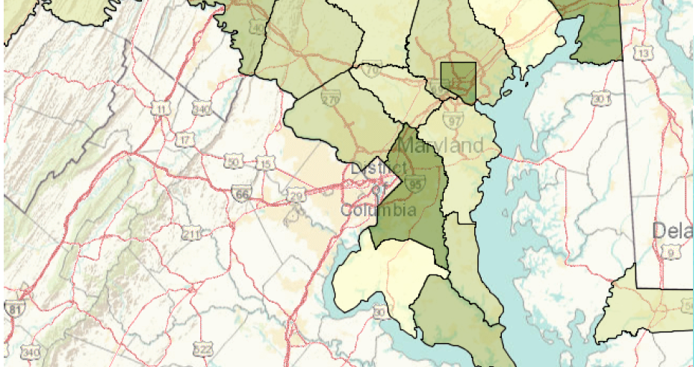
Maryland Counties with the Highest Percentages of Uninsured Children
Washington County 4.3%
Cecil County 6.3%
Baltimore City 5.4%
Prince George’s County 5.3%
St. Mary’s County 4.9%

Slide 14

But our work is not done.

Slide 15
Participation has risen but 70% of uninsured children are eligible but not enrolled.
Notes:
EBUs are where the game is

Slide 16
Medicaid/CHIP Participation Rates, 2011
United States | 87.2%
D.C. | 94.3%
Delaware | 92.8%
Maryland | 90.3%
Pennsylvania | 88.5%
Virginia | 88.1%
Source: G. M. Kenney, N. Anderson, and V. Lynch, “Medicaid/CHIP Participation Rates Among Children: An Update,” Urban Institute (September 2013).
Notes:
Bold maryland

Slide 17
Eligible but Uninsured Children, 2011
 | Estimated Total | Share of US Total
United States | 4,001,000 | -
D.C. | <10,000 | -
Delaware | <10,000 | -
Maryland | 45,000 | 1.1%
Virginia | 63,000 | 1.6%
Pennsylvania | 124,000 | 3.1%
Source: G. M. Kenney, N. Anderson, and V. Lynch, “Medicaid/CHIP Participation Rates Among Children: An Update,” Urban Institute (September 2013).

Slide 18
What policies could Maryland adopt?
Simplifying enrollment and eligibility will reduce the # of eligible but unenrolled kids…
Get exchange and other parts of ACA working…
12 month continuous eligibility
Presumptive eligibility
Cover foster care youth aging out in other states

Slide 19
What should funders be thinking about?
Parent coverage i.e. Virginia/Pennsylvania Medicaid expansion!
Reaching the eligible but unenrolled kids
  Do a deep dive with the ACS data and really look at who they are; then think about targeted community based strategies
Round 2 of streamlining eligibility/enrollment systems
  This could include a look at what policy changes are still needed after the dust settles

Slide 20
Assuming that most kids are covered….
Quality of care, making EPSDT work.
Racial and ethnic disparities; population health
Encouraging wellness in a productive and non-punitive way and for the whole family
Kids who still aren’t covered (immigrant kids)

Slide 21

The Children’s Coverage Landscape:
Public Policy Going Forward

Slide 22
ACA - Affordable Care Act (2010)
Keeps children’s coverage stable until 2019
Extends CHIP funding through FY2015 and increases each state’s matching rate by 23 percentage points starting in FY2016
Aligns children’s income eligibility in Medicaid (i.e. “stairstep” kids transfer from CHIP to Medicaid)
Notes:
If a state runs out of federal CHIP funding, children can be enrolled in Exchange plans with comparable coverage. The Secretary of Health and Human Services will be required to review and certify which plans in the Exchanges provide CHIP-comparable benefits and cost sharing.
All kids under 133 in Medicaid 0-19
Covering parents is good for kids: gets more children connected to coverage, healthy adults
Kids more likely to have coverage and get the preventive care they need
Parents untreated health or mental health problems can pose risk to children’s wellbeing
parent’s health can affect kids health and well-being
Potential for 40% decline in rate of uninsured children

Slide 23
Children’s Coverage in Maryland

Slide 24
Medicaid and CHIP
Notes:
Update??

Slide 25
Georgetown CCF Resources
Getting Into Gear for 2014: Findings from a 50-State Survey of Eligibility, Enrollment, Renewal, and Cost-Sharing Policies in Medicaid and CHIP, 2012-2013
  http://ccf.georgetown.edu/ccf-resources/getting-into-gear-for-2014/
Children’s Health Coverage on the Eve of the Affordable Care Act, 2010-2012
  http://ccf.georgetown.edu/ccf-resources/childrens-health-coverage-on-the-eve-of-the-affordable-care-act/
Notes:
Update

Slide 26
For More Information
Joan Alker:
  jca25@georgetown.edu
  Twitter @joanalker1
Our website:
  ccf.georgetown.edu
Say Ahhh! Our child health policy blog:
  www.theccfblog.org/

