Slide 1
Open Enrollment Opportunities and Challenges September 23, 2020 4:00 p.m. Eastern
Vincent DeMarco, Maryland Health Care Coalition for All
Zepporah Fuller, National Council of Urban Indian Health
Carrie Mead, Community Catalyst
Ernestine Nasingoetewa, Native Health
Carrie Rogers, Community Catalyst
Madiha Tariq, Arab Community Center for Economic and Social Services

Slide 2
Our webinar will be an hour long.
This webinar will be recorded and posted to the GIH website later this week.
All participant lines have been muted.

Slide 3
If you have any questions or comments, please type them into the Questions Box on your control panel.

Slide 4
If you would like to be unmuted to ask a question or make a comment, please use the Raise Hand option in your control panel.

Slide 5
Like many organizations, we are running webinars from our homes.
If technical difficulties any arise that you cannot solve, please contact Program Assistant, Monique Jackson (mjackson@gih.org).

Slide 6
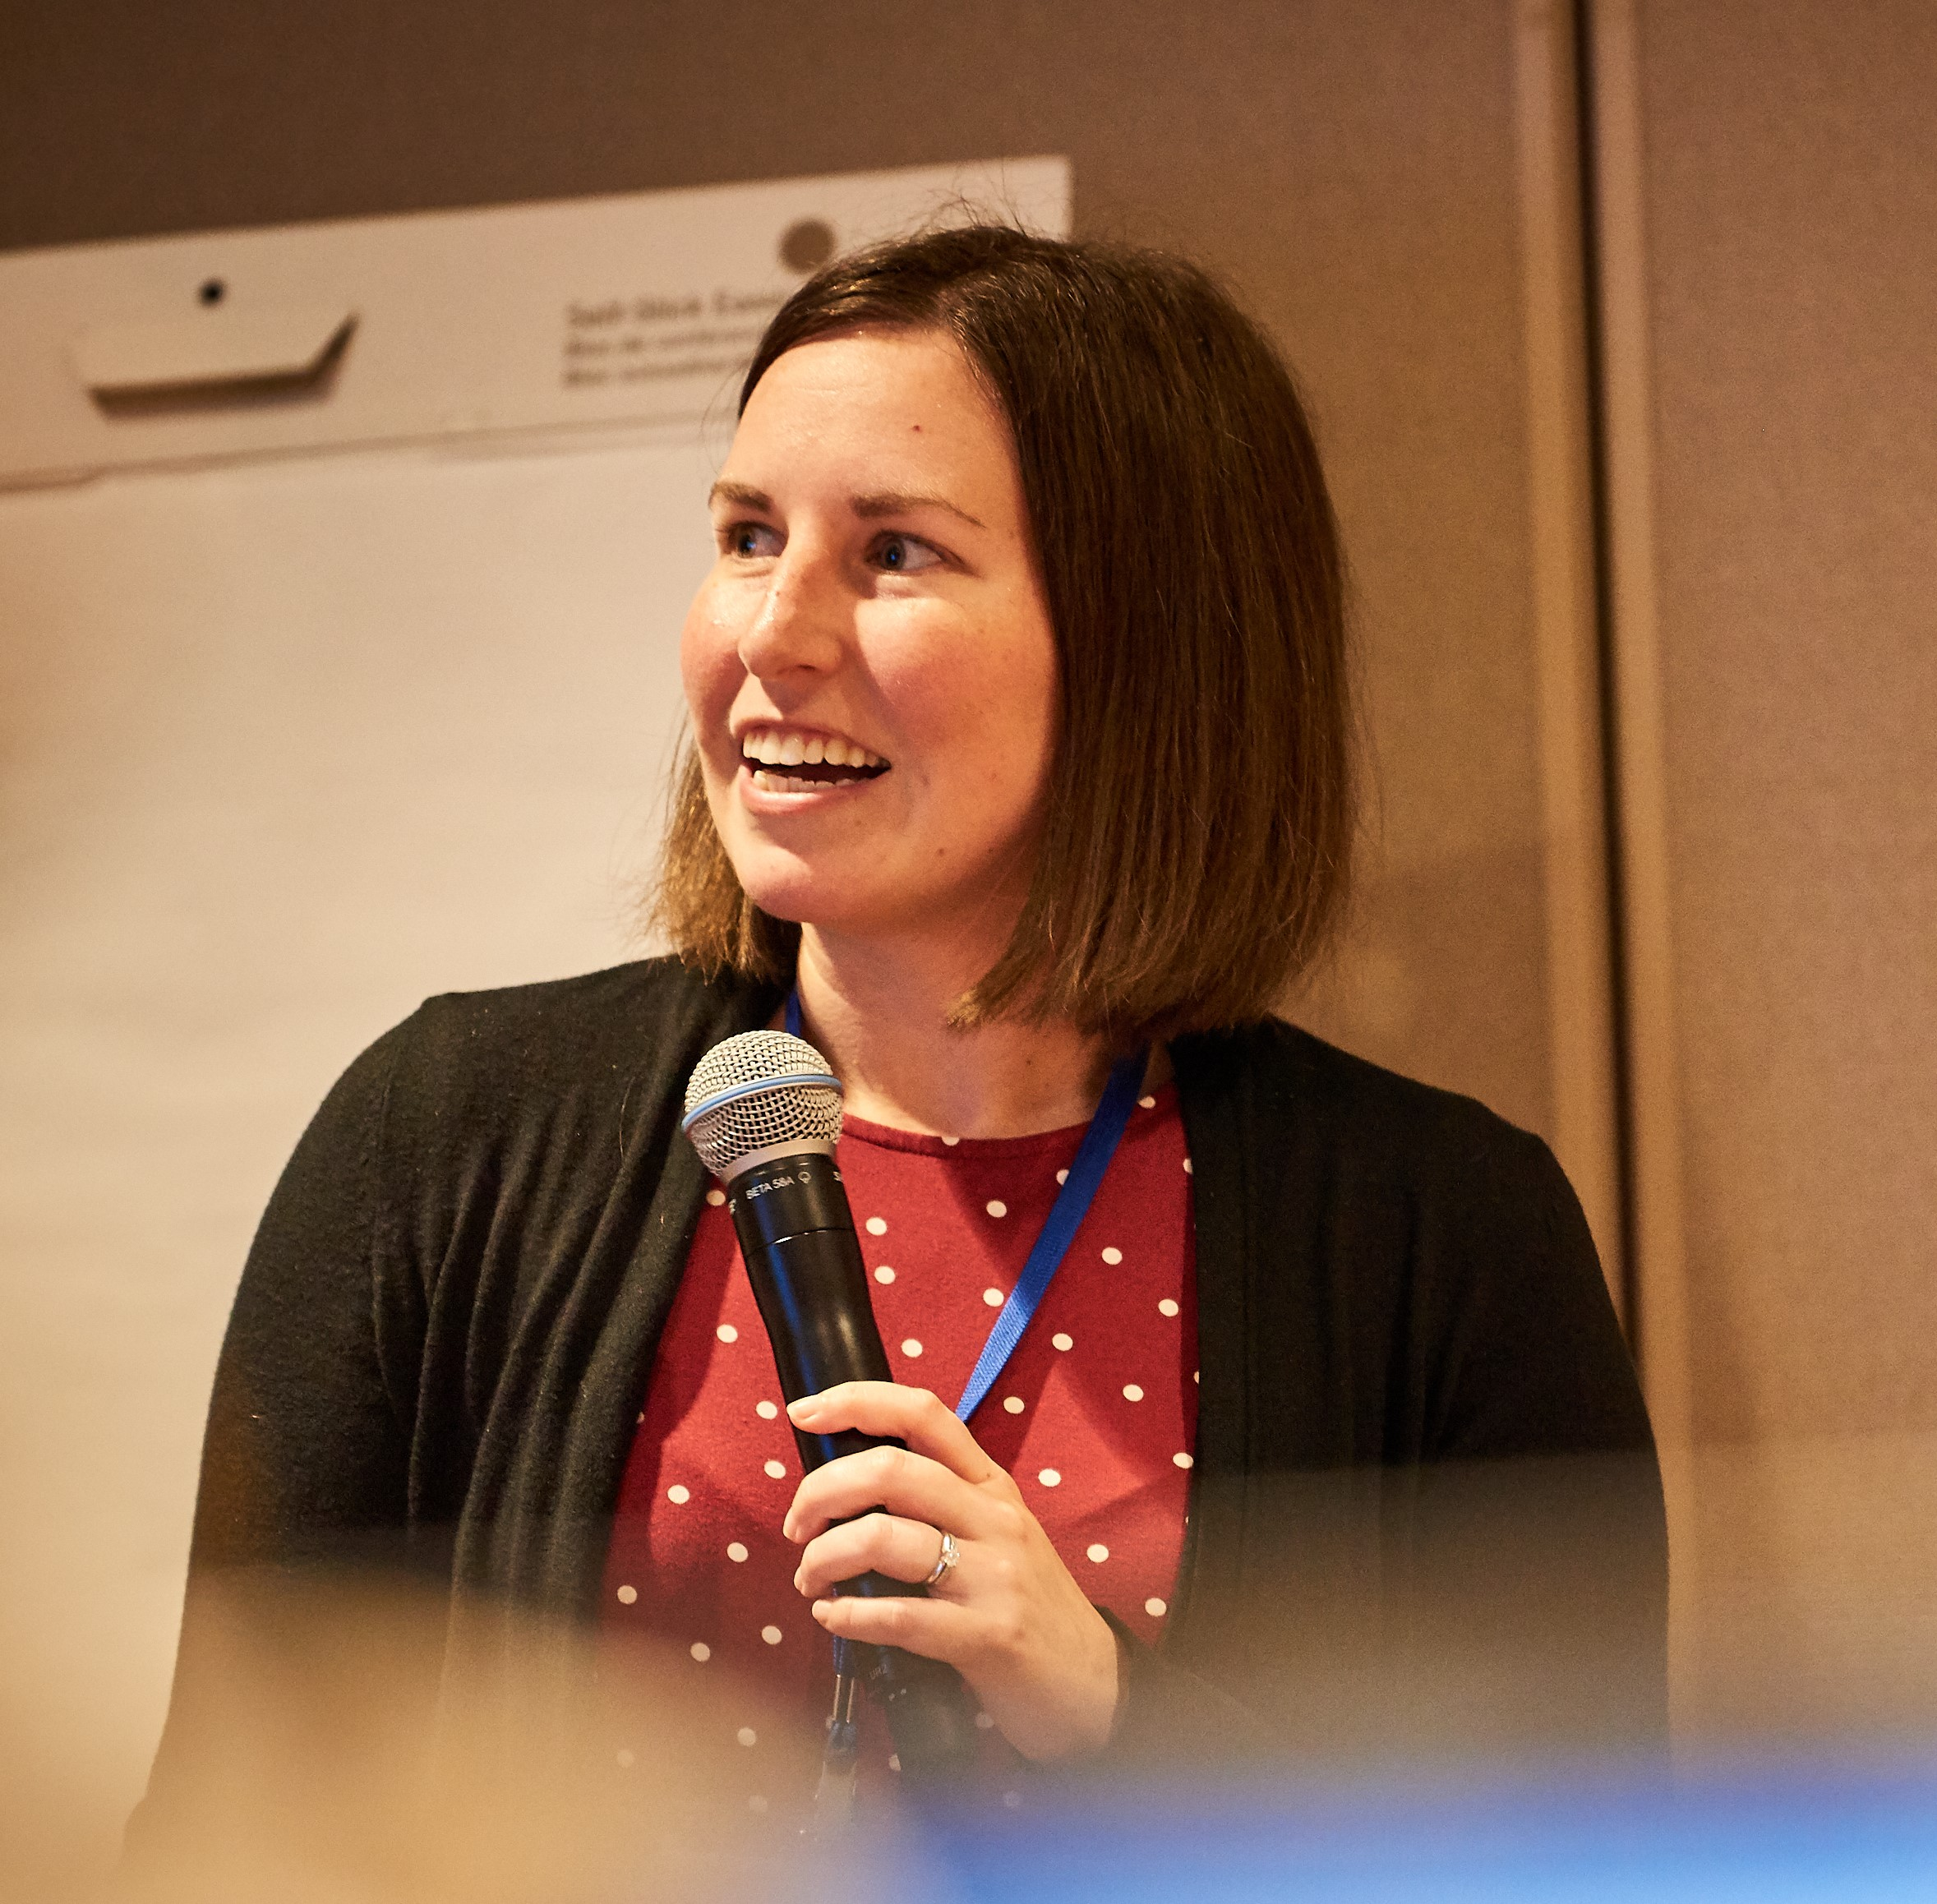
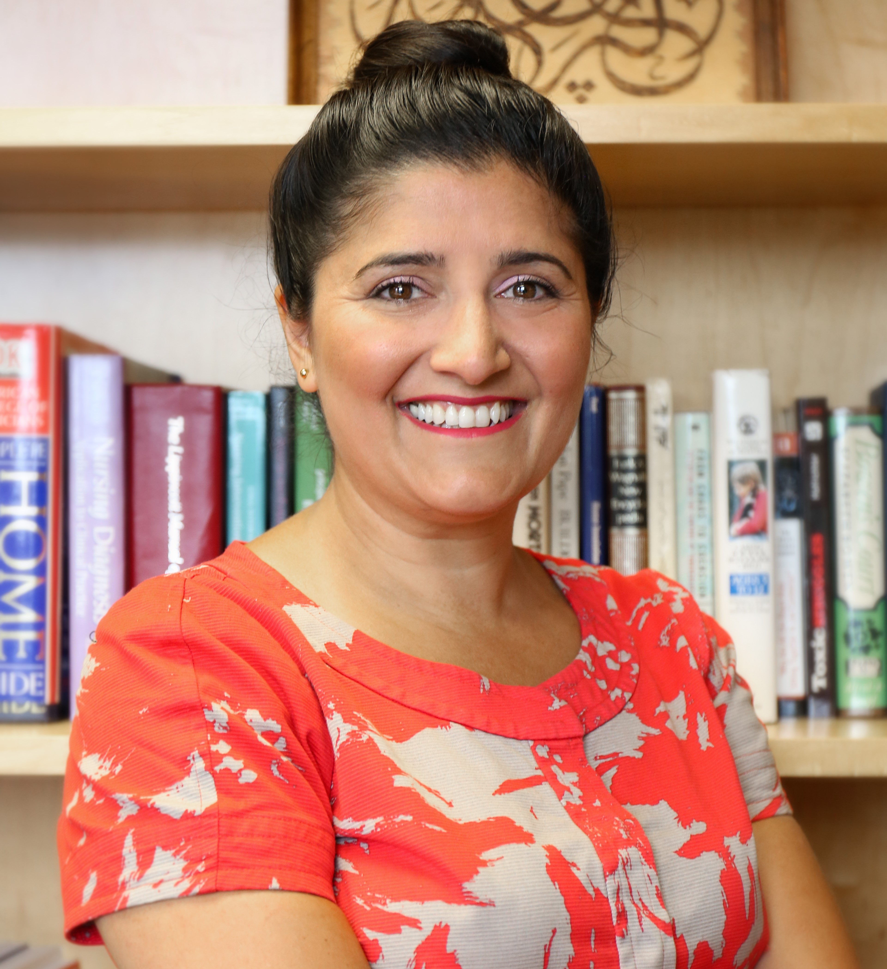
Speakers
Carrie Rogers
Community Catalyst
Carrie Mead
Community Catalyst
Madiha Tariq
Arab Community Center for
Economic and Social Services

Slide 7
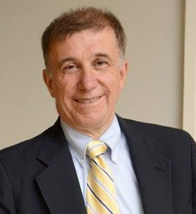
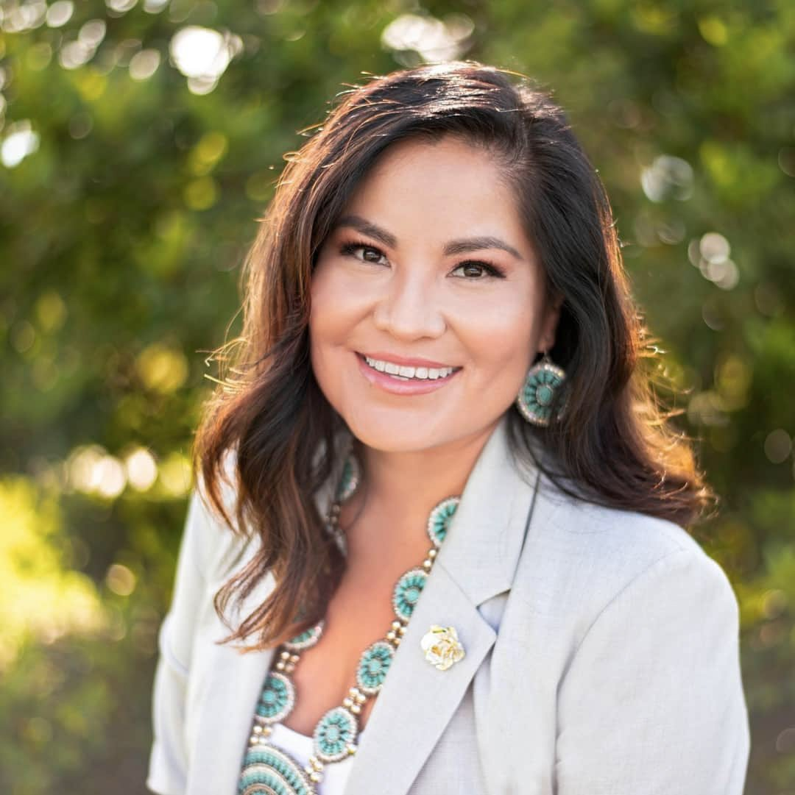
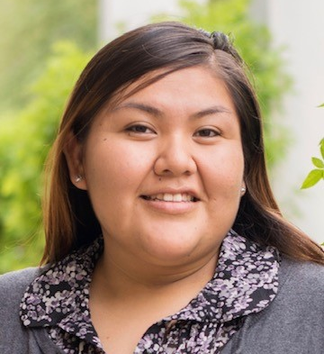
Speakers
Vincent DeMarco
Maryland Health Care
Coalition for All
Zepporah Fuller
National Council of
Urban Indian Health
Ernestine Nasingoetewa
Native Health

Slide 8
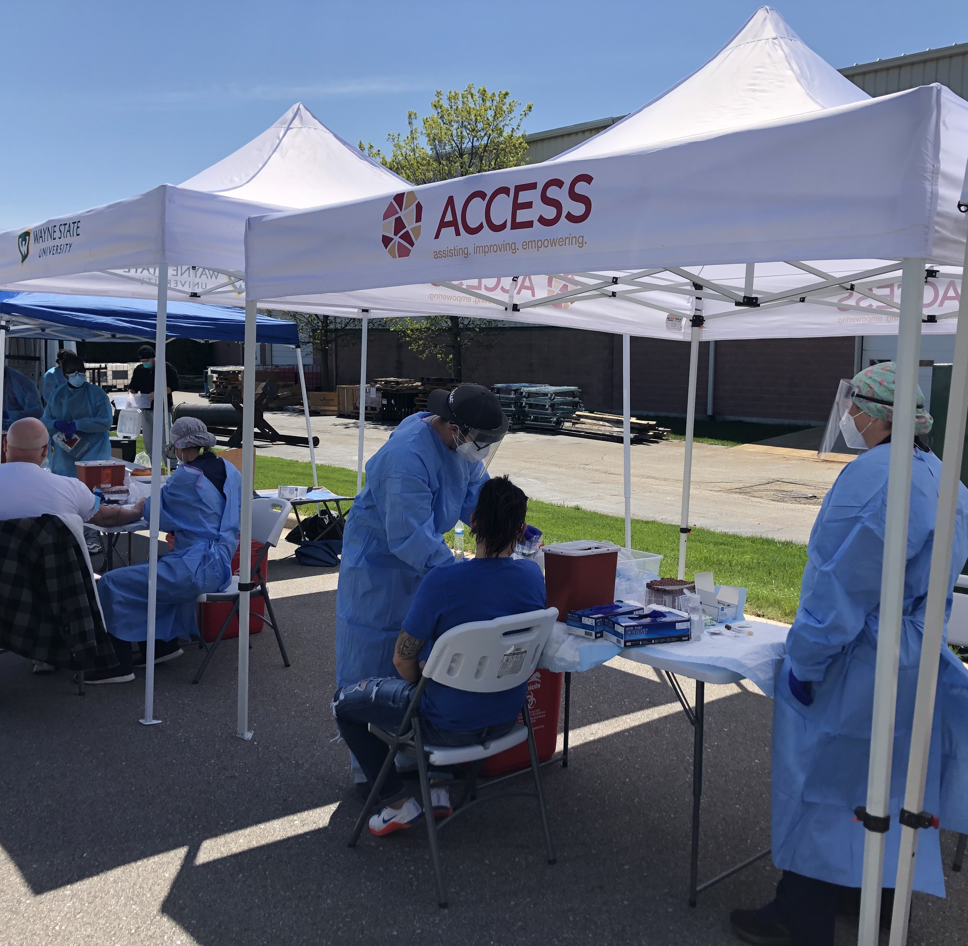
Michigan

Slide 9
BARRIERS THAT OUR COMMUNITY FACES
Language barrier
The ongoing pandemic has also weakened the systems that support immigrant workers.
Lack of health coverage
Misinformation
Public Charge
Executive Orders
CDC guidance
Notes:
Immigrant and refugee communities who are still adapting, the language barrier has made the pandemic that much harder to deal with. There needs to be clear, accurate translations of government resources ensure that people in need understand the supports that are available to them.
We've been working with the AG because we don't feel like the ethnic media has covered the EO as it should have
The ongoing pandemic has also weakened the systems that support immigrant workers. Some immigrant-serving organizations have already faced temporary or permanent closure; others have sought to navigate the difficult shift to virtual job-seeking, training, and upskilling programs—often hindered by the fact that clients, staff, and volunteers alike may lack internet access or needed equipment, such as laptops. (We know of a Somali organization in San Diego that was operating and serving the community without any protective equipment)
Misinformation
Most of the information our community gets is From whatsapp groups and social media
Public Charge: which threatens the green card eligibility of immigrants who receive publicly funded benefits such as Medicaid, has made many immigrants reluctant to seek needed care.

Slide 10
MICHIGAN RANKS 6TH
Notes:
Due to the job losses, over 200k Michiganders have lost their health coverage during the COVID-19 pandemic.
A recent report from Families USA, states that Michigan, the 10th most populous state, has the sixth highest number of newly uninsured adults.
At the same time that folks are losing health care and people are afraid should they contract the disease and be infected and go into the hospital and have immense bills when they come out, we have an administration that is trying to dismantle the Affordable care act
Essential workers, who are mostly immigrants and refugees, are the ones that suffer the most

Slide 11
Those who drive our country
Notes:
Even more troubling, health care is either inaccessible or out of reach for many immigrants and refugees, especially those in low-wage jobs.
Many immigrant are ineligible for cash assistance, unemployment insurance, health care, or food assistance programs that are crucial to enabling families to weather the current economic and health crises.
They're the ones most at risk and yet they're left out of the economic relief efforts because of immigration status and inability to navigate the system
Client Story: Resident at a local hospital and part of the COVID-19 response team. Him and his family are immigrants and he is unable to add his parents to his health insurance plan. His family has EMS Medicaid and he was scared that they would contract the virus through him and would not be able to get tested or treated.
This is why we at ACCESS advocated and won the fight to get EMS to cover COVID-19 testing and treatment.
What did we learn?
There needs to be an approach that accounts for immigrant and refugee workers’ diverse needs, for their communities, and for the organizations working on their behalf. Policy makers must ensure that all immigrant and refugee workers, their families, and their businesses are included in relief programs like CARES, as well as in future relief or stimulus packages.

Slide 12
COVID-19 RESPONSE
ACCESS COVID-19 Drive-Thru Testing Site
Notes:
Our drive-thru testing site is free and it has benefited many immigrants and refugees.
Share client story: Pregnant client who is an immigrant and her husband is an uber driver. They are only eligible for EMS Medicaid and she also has the MOMS Mediciad plan but the state had not clarified whether or not they would be covering COVID-19 testing and treatment under either of those plans. She became ill at the beginning of the pandemic and our COVID-19 testing site was able to assist her and get her tested free of charge.
We also offer on-site health insurance enrollment at many of our drive-thru testing sites.
Our navigator program also enrolls individuals into affordable health insurance coverage virtually
Since the COVID-19 pandemic our virtual navigator program has been able to assist on average 566 clients a month. That’s nearly 150 more clients a month compared to our 2019/2018 numbers.

Slide 13
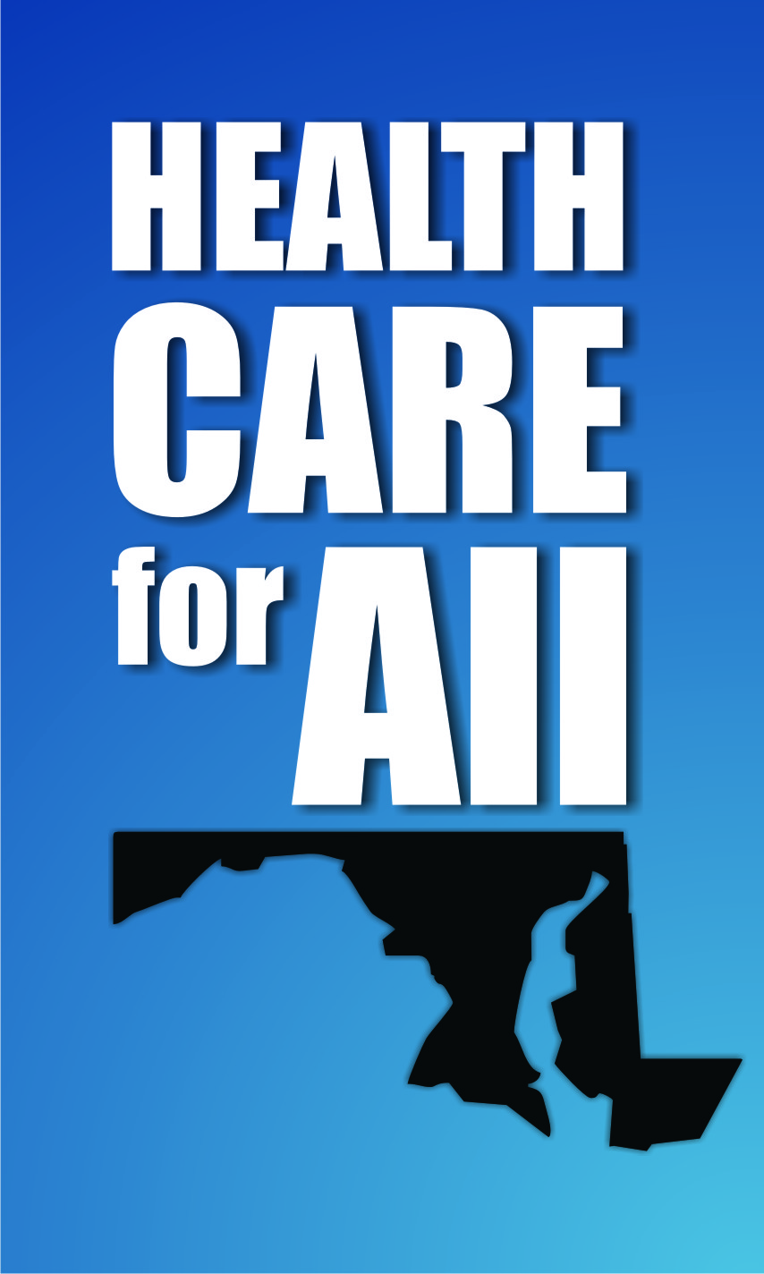
Maryland Citizens’ Health Initiative Education Fund, Inc.
Vincent DeMarco, President

Slide 14
Maryland fully implemented and built upon the ACA to maximize health care coverage:
Maryland Health Insurance Coverage Protection Commission
Maryland Easy Enrollment Health Insurance Program
Special enrollment period
Reinsurance program

Slide 15
Easy Enrollment Promotional Campaign

Slide 16
Easy Enrollment Metrics

Slide 17
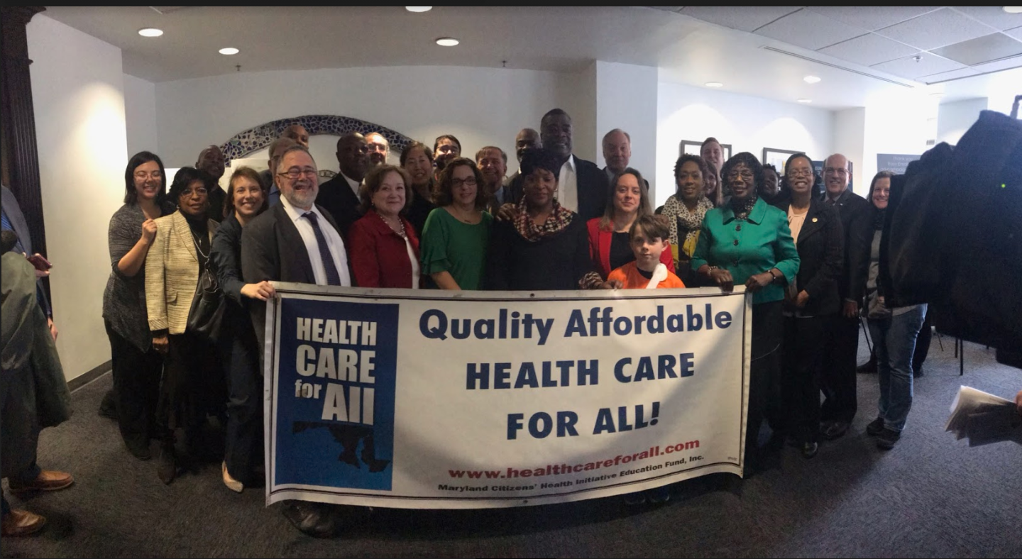
Next steps
Host focus groups with uninsured Marylanders who are eligible for subsidized coverage.
Explore strategies to improve affordability and further streamline enrollment.

Slide 18
“Open Enrollment Opportunities and Challenges”
Zepporah Fuller (Navajo)
Director of Technical Assistance
National Council of Urban Indian Health (NCUIH)

Slide 19
“Urban Indian”
An American Indian or Alaska Native who lives in an urban or suburban area
Urban Indians may variously be permanent residents including long term residents, forced residents, or medium and short term visitors (higher education)
Approximately 78% AIAN live in metropolitan/urban or suburban areas
Specific issues include: Migration, Identity, Inter-tribal/Pan-Indian perspectives.

Slide 20
National Council of Urban Indian Health
The only national non-profit organization devoted to the support and development of quality, accessible, and culturally-competent healthcare services for American Indians and Alaska Natives living in urban settings.
Created in 1998 by Urban Indian Leaders to advance health care of American Indians/Alaska Natives. |  | Provides technical support to UIOs for implementing quality accessible health care services.
Advocates for Indian Health Care with Congress and Federal Government. |  | Provides technical assistance support to the 41 Title V Urban Indian Organizations across the nation.

Slide 21
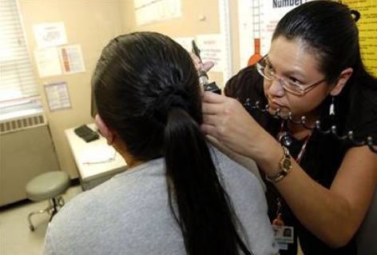
Health Care & Federal Trust Responsibility
Health reform offers new opportunities to access health insurance to AI/AN citizens and employees
The government’s historical and unique legal relationship with tribes is based on treaties, laws, and Supreme Court decisions
Indian Health Service offers health care to AI/AN citizens on or near Indian reservations and in some urban Indian communities
Notes:
Passage of the Affordable Care Act marked a continued commitment to the historical and unique legal relationship with tribes. Health care reform reaffirms the federal commitment to provide health care based on hundreds of treaties and numerous laws and Supreme Court decisions. The law supports, strengthens, and recognizes the entire Indian Health Service delivery system as the primary health system for American Indians and Alaska Natives, all the while providing new opportunities to access affordable or free health insurance through a variety of programs.

Slide 22
How AI/ANs Receive Healthcare: I/T/U
Indian Health Service (Federal Agency)
Provide direct care via IHS clinics and hospitals
Provide funds for T/U to provide direct care (compact)
Tribal (Sovereign Nations)
Contract with IHS for IHS to provide some services*
Compacts with IHS to receive IHS funds to provide direct care
Urban (Non-Profits)
Compacts with IHS to receive IHS funds to provide direct care
→UIOs receive < 1% of the IHS Budget (one line item)

Slide 23
What are the Advantages of Enrolling
in Health Insurance for the AI/AN Community?
Investments made in the Marketplace promote affordable care!
Health care needs
will be met!
A visit to an Urban Program can be billed to insurance
More Resources are available for the patient
Notes:
So now that you know all the details why it’s important to even consider purchasing insurance?
Let’s start at the beginning:
We learned earlier that a local clinic can increase its revenues under the law because of changes to billing practices and expanded access to insurance for individuals.
We also learned that some individuals may not have to pay anything for coverage through Medicaid and the insurance marketplaces.
So now think about what happens when a person is insured and goes to the local clinic. The local clinic bills for the services provided and gets paid from the federal government or insurance company for those services.
That means they haven’t lost any money seeing the individual. Which means there will be more resources for the clinic because insurance companies will pay those costs instead of Contract Health Services (CHS).
All-in-all that means that your health care needs will be met and your helping your community leverage those all important CHS dollars better!
Basically, invest in the Marketplace if you can afford it and…More CHS funds available to help other tribal members!

Slide 24
AI/AN Enrollment Statistics
In 2018, 48% of all active UIO clients were enrolled in Medicaid
75% of Residential Treatment clients were on Medicaid
71 % of Outreach and Referral clients, and 78% of limited ambulatory patients used “unknown” insurance (aka likely to be uninsured or not using insurance).
There are 11 UIOs that are also HRSA Health Centers. In 2018:
79% of Children (<18 yrs) were on Medicaid
16% of Children were Uninsured
40% of Adults (>18 yrs) were on Medicaid
41% of Adults were uninsured
Source: Recent Trends in Third Party Reimbursement at UIOs (NCUIH 2020)
Notes:
Key point:
Many UIO clients still lose insurance when “aging out” of childhood Medicaid eligibility, including young parents
Extra notes (can add data if needed to cover this)
Medicare enrollment and dual eligilbity is also a goal, given relatively high proportion and overlap.
Enrollment at Limited ambulatory, OR&R, and Residential Treatment centers a priority for support

Slide 25
Enrollment = Sustainability of Care
Source: Recent Trends in Third Party Reimbursement at UIOs (NCUIH 2020)
Notes:
Key Points:
“UIOs rely on enrollment more than ever to sustain their programs.
The amount of money UIOs receive from IHS has barely increased in the past ten years (orange line). When adjusted for urban medical inflation, the real dollars appropriated to UIOs has actually decreased!
However, since enactment the ACA, third party reimbursement at UIOs has more than doubled (blue line), largely due to expanded opportunities for enrollment”
Note if asked: the dotted line is a projection based on growth rate since 2013. 2020 will likely be much lower due to coronavirus”

Slide 26
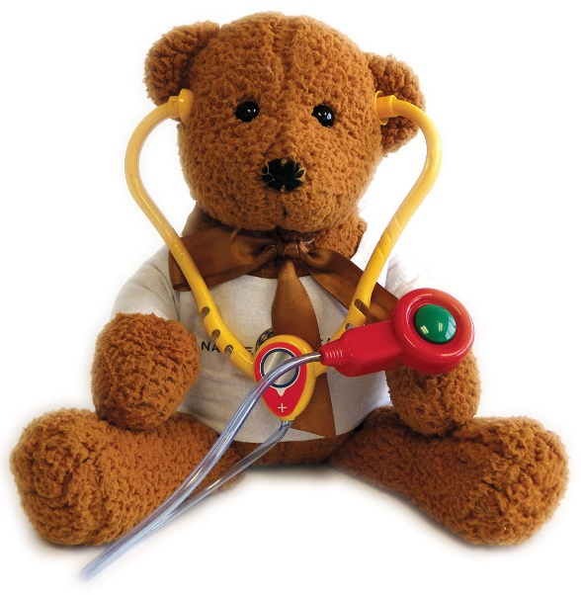
Outreach and Enrollment Assistance at Native Health
Ernestine Nasingoetewa
Lead Family Health Advocate
September 2020

Slide 27
Native Health Central
Native Health Mesa
NHW Community Health Center

Slide 28
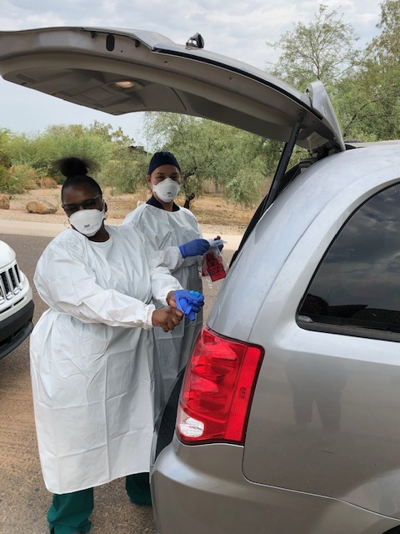
Native Health
Patient Centered Medical and Dental Home in Phoenix, Arizona
Virtual and telephonic care available
Drive Thru Flu Shot Events
Food Distribution
Dept. of Economic Security on-site
Virtual Cultural Classes
4041 N. Central Ave
Phoenix, AZ 85012

Slide 29
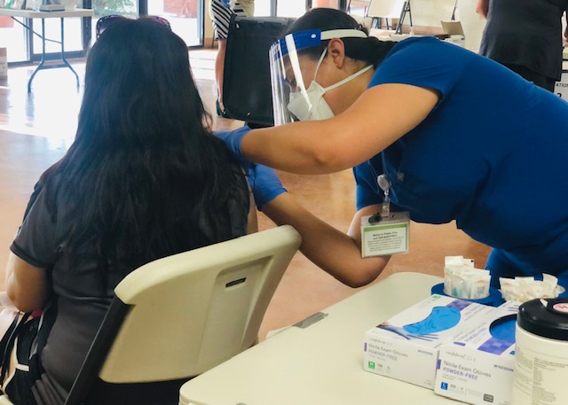
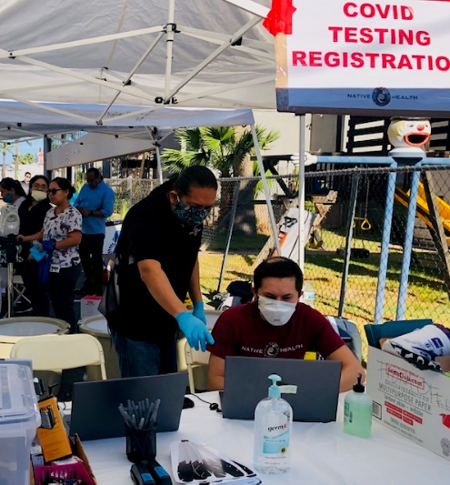
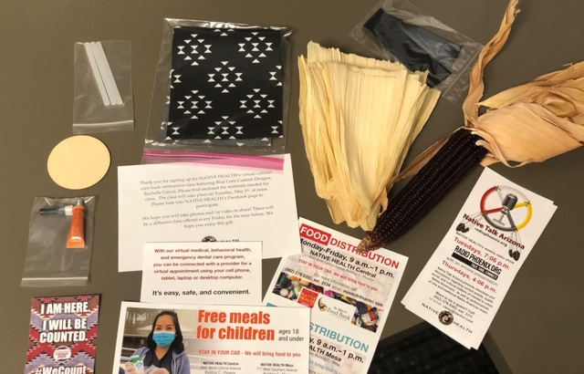
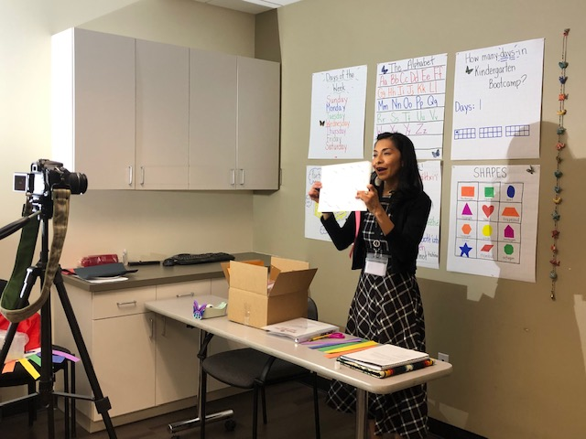
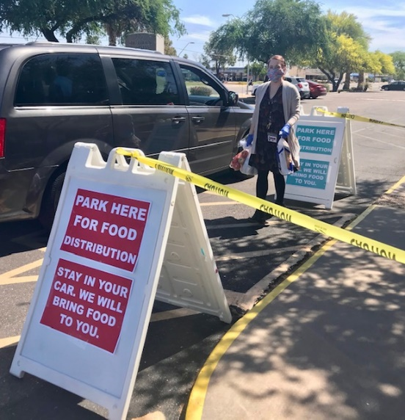
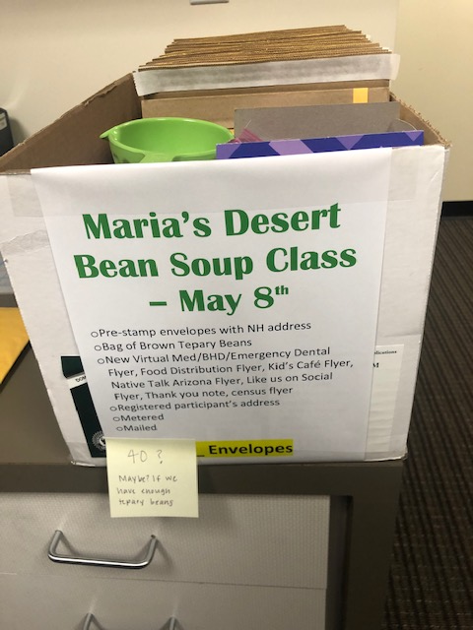

Slide 30
Modifications Due to Pandemic
Shift to virtual appointments
Update on public benefit programs policies due to COVID-19
Decrease in application numbers due to state waivers in place that automatically renewed those with coverage
Partner with other organizations and their social media streams for outreach
Many were first time applicants or had never been on public benefit programs

Slide 31
Barriers to Enrollment
Understanding the role of health insurance
People tend to relate it to have a life saving emergency and needing it for $100,000+ hospital bills
Understanding terms like deductibles, co-insurance, etc.
Utilizing technology to provide documents
Difficulty in reaching tribal offices and previous employers
Average wait time 90 minutes to follow up on their applications

Slide 32
Solutions
Ask providers to elaborate on the importance of enrolling into coverage
All states having access to a portal that allows for pulling decision data
Create-up-to-date data portals that show accurate income
Troubleshooting assistance for learning how to use technological devices
Verify tribal enrollment online

Slide 33
Client Testimonials
“Hi my is XX Veronica is my case manager from des it is a calming to have her helping me she don't judge ,she is very efficient, she stick to the rules but also makes a difficult and embarrassing thing easier to deal with thank you for her”
“I applied for food stamps and health benefits with veronica today at the native health location. She was very pleasant and help me with the entire process of applying with ease. I really appreciate her positive attitude.”

Slide 34
If you have any questions or comments, please type them into the Questions Box on your control panel.

Slide 35
If you would like to be unmuted to ask a question or make a comment, please use the Raise Hand option in your control panel.

Slide 36
Questions
Final thoughts?
Vinny DeMarco: demarco@mdinitiative.org
Zepporah Fuller: zfuller@ncuih.org
Carrie Mead: cmead@communitycatalyst.org
Carrie Rogers: crogers@communitycatalyst.org
Madiha Tariq: mtariq@accesscommunity.org

