Slide 1

Nature & Health: Creating Healthy Communities
Grantmakers In Health & Blue Sky Funders Forum

Slide 2


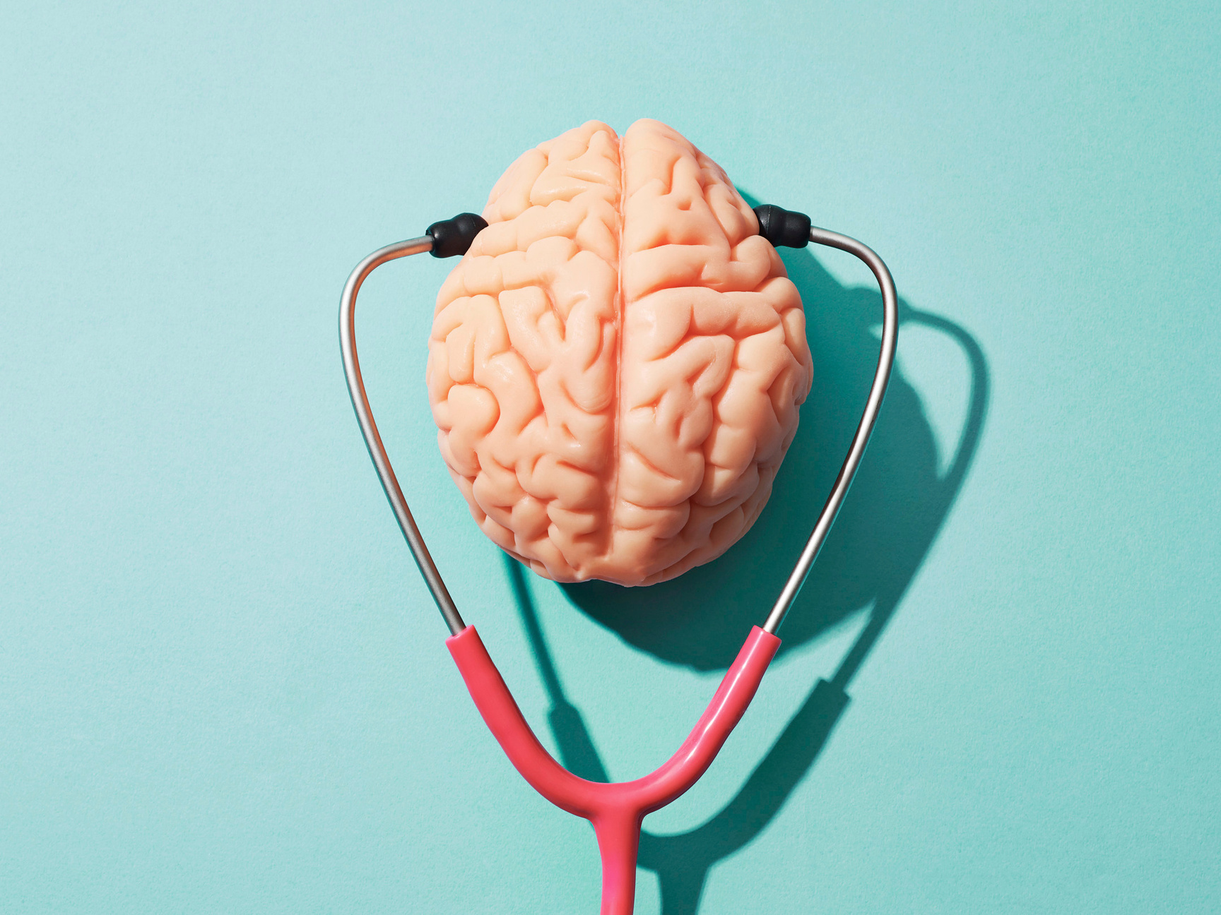
What is health?
Health is a "state of complete physical, mental, and social wellbeing and not merely the absence of disease or infirmity." WHO, 2000
Health depends on our ability to understand and manage the interaction between human activities and the physical and biological environment. WHO, 1992

Slide 3
90% OF THE NATION'S $3.3 TRILLION SPENT ON ANNUAL HEALTH CARE IS FOR CHRONIC AND MENTAL HEALTH TREATMENT
CDC, 2018

Slide 4
A Legacy of Spending Mismatches
Health Determinants
National Health Expenditures
Access to care: 6%
Genetics: 20%
Socioeconomic and physical
environments:
22%
Medical services:
90%
Healthy
behaviors:
37%
Interactions among determinants:
15%
Healthy behaviors: 9%
Other: 1%
Data from NEHI 2013

Slide 5
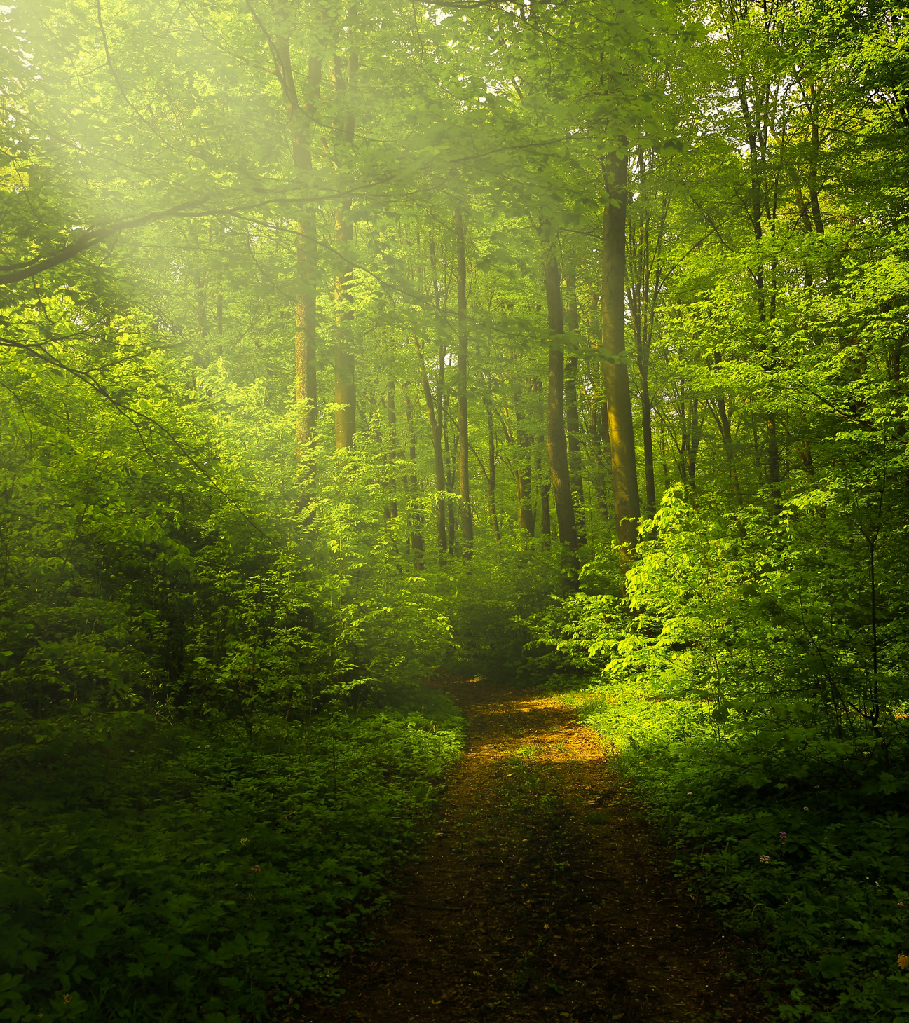
Nature is a commonly accepted SDH.
"Recognition that access to care and quality of care are not enough to be healthy has led to a recent rapid growth of SDH interventions within health care."
South, Kondo, & Razani, 2020

Slide 6

59% of an individual's health determinants could be positively influenced by nature-based health interventions
Data from NEHI 2013

Slide 7
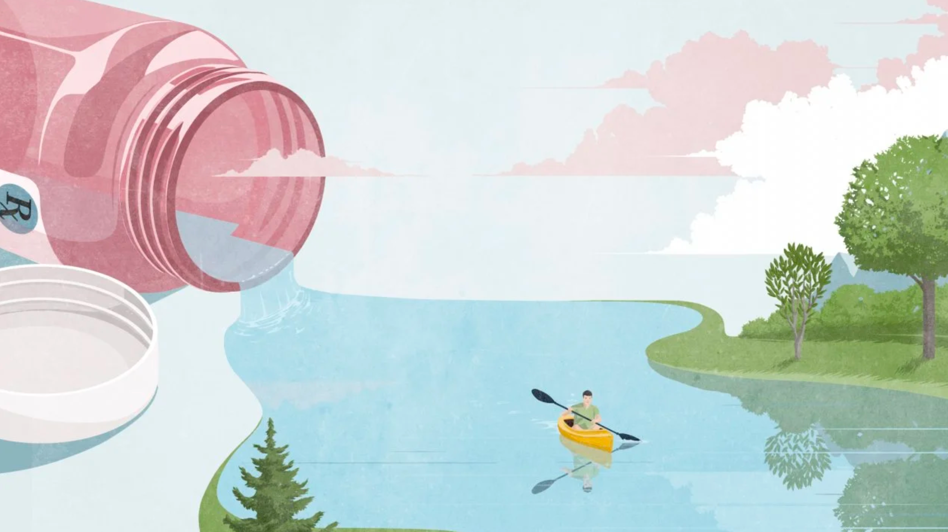
Nature provides people with multiple health & well-being benefits

Slide 8
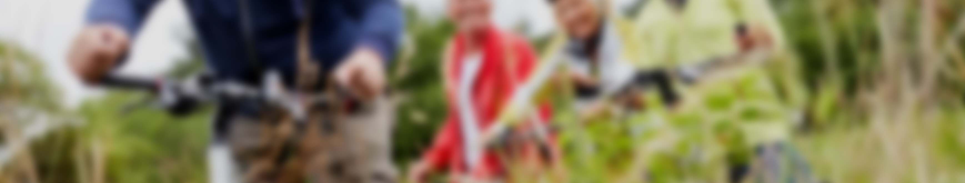
Physical Benefits
Diseases & Illnesses
General Physical Health
Physical Activity
  Reduces hypertension
  Improves diabetes symptoms and reduces blood glucose
  Increases number & activity of human natural killer cells
  Improves immune function
  Improves post-operative recovery
  Reduces risk of cardiovascular disease
  Reduces systolic & diastolic blood pressure
  Improves pulse rate
  Improves sleep
  Promotes healthier birth weights
  Reduces nearsightedness
  Increases vitamin D levels
  Reduces headaches
  Greater feelings of revitalization
  Increased energy
  Greater satisfaction
  Lowers risk of obesity/BMI

Slide 9

Psychological Benefits
Cognitive Function
Psychological Wellness
Mental Illness
  Reduces mental fatigue
  Improves academic performance
  Improves productivity
  Promotes attentional restoration
  Improves ability to perform tasks
  Increases self-esteem
  Improves mood
  Reduces stress
  Reduces anger/frustration
  Reduces anxiety
  Improves behavior
  Contact with nature improves
    depression
    anxiety
    mood disorders
    PTSD
    addiction recovery

Slide 10

Social Health Benefits
Social Connectedness
Social Coherence
Resilience
  Increases sense of belonging
  Decreases social isolation
  Promotes social ties
  Improves relationship skills in children
  Increases interation with community
  Increases longevity in older people
  Reduces crime rates
  Reduces violence
  Enables interracial interaction
  Urban forests and parks build physical resistance in a community and can help mitigate natural disasters
  Natural resource stewardship correlates to increased civic engagement

Slide 11





MITIGATION & RESTORATION MECHANISMS
The Nature-Health Link
  DHEA
  adiponectin
  normalized blood glucose
  relaxation
  awe
  vitality
  attention restoration
  immune function
ACTIVE INGREDIENTS
HEALTH OUTCOMES
NATURE EXPOSURE & CONTACT
03
  phytoncides
  negative air ions
  mycobacterium vaccae
  environmental biodiversity
  natural sights
  natural sounds
  decrease air pollution
  decrease heat
  decrease violence
  Growing list of evidence of nature experiences contributing to both health promotion & disease prevention
  Need for more experimental research
  time in nature
  views of nature
  residential green
  destination green
  distance to park
  quality of greenspace
  virtual reality
  etc.
01
05
02
INSTORATION MECHANISMS
04
  physical activity
  decrease obesity
  sleep
  social ties
Based on Kuo, 2015; Hartig et al., 2014; and White et al., 2020
EFFECT MODIFIERS:
SITUATIONAL & INDIVIDUAL

Slide 12
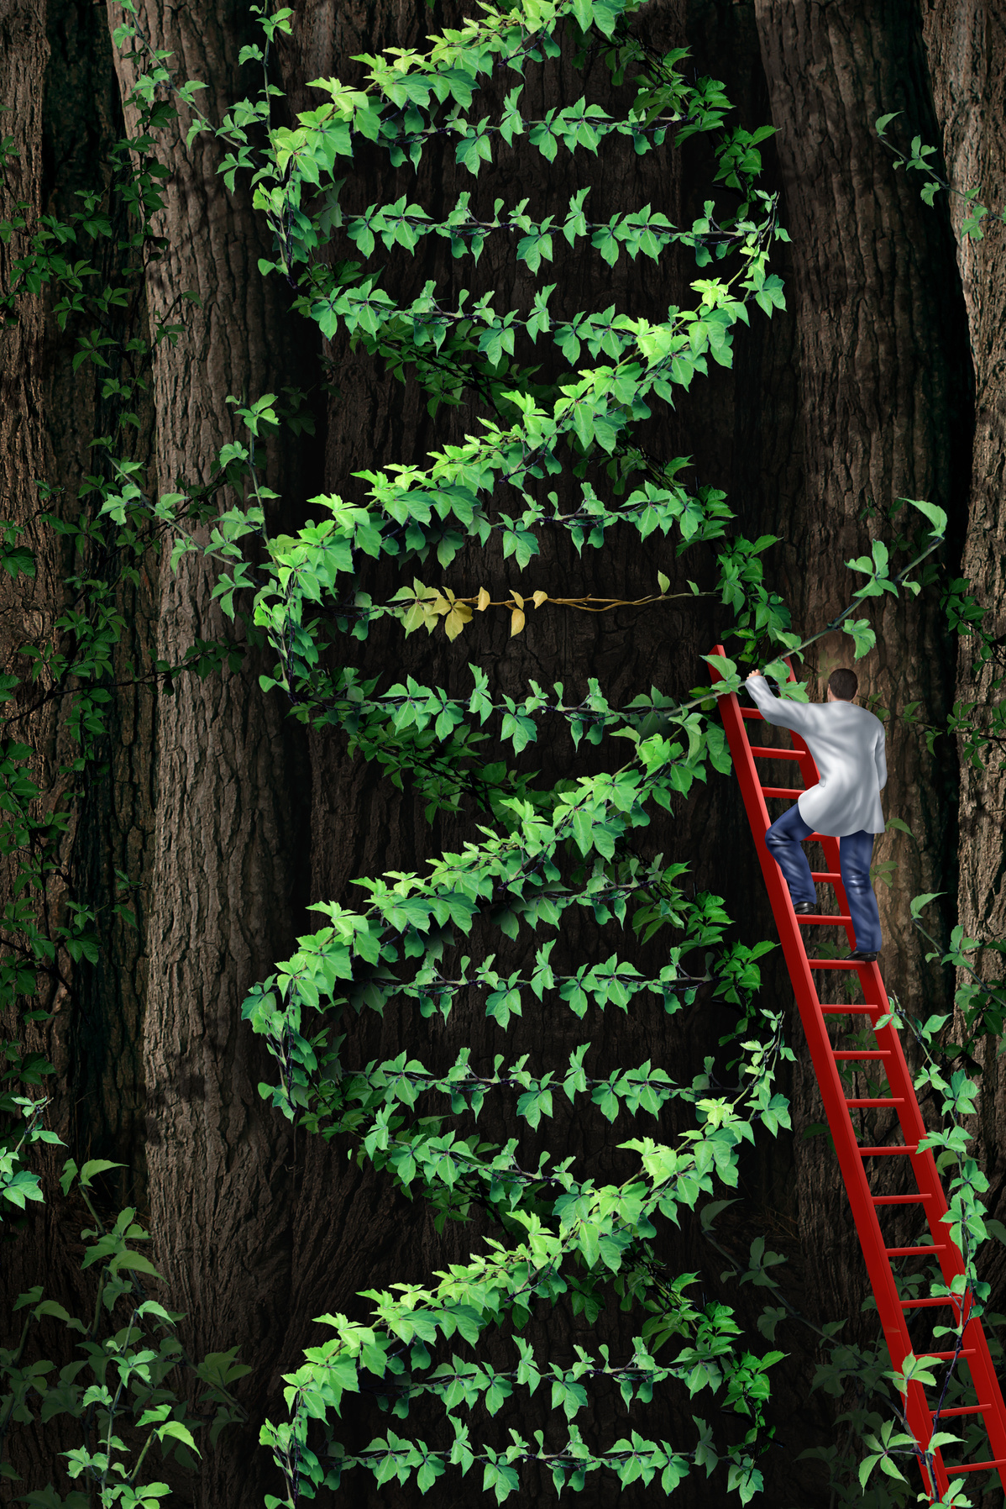
Biophilia suggests immersion in nature is inherently satisfying.
Kellert & Wilson, 1995
Stress Reduction Theory (SRT) suggests time in nature activates the parasympathetic
nervous system to reduce stress.
Ulrich et al., 1991

Slide 13
This includes both human and environmental health.
Increasing contact with, and connection to nature, helps improve human and planetary health.
Martin et al., 2020
Foster
Place Attachment
Sense of Place & Belonging
Pro-Environmental Behaviors
Redefine Conservationist

Slide 14
What did you think of when you heard "nature"?

Slide 15
Nature is not just "my" river, or the tundra, the highlands, an island, an empty beach or a perfectly sculpted woodland. Nature is not always silent and a bringer of healing. It is not for any one type of person, with any particular background.
Quote from thin places by Kerri ní Dochartaigh

Slide 16





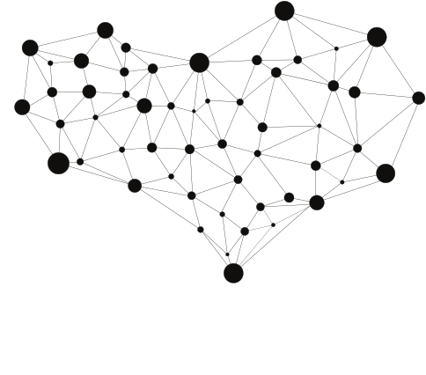
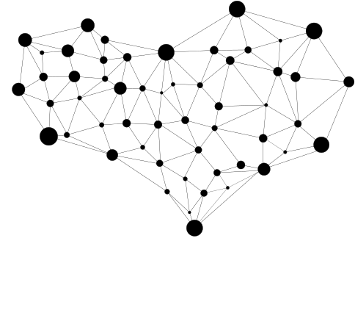
WICKED PROBLEM
noun | 'wikid | praa-bluhm
A problem that is difficult or impossible to solve because of incomplete, contradictory, and changing requirements that are often difficult to recognize.
Rittel & Webber, 1973

Slide 17

Nature and health have always been entwined and culturally recognized
In the Canon of Medicine, completed in 1025 CE, the Persian and Muslim Physician–scholar Avicenna extols the virtues of fresh air found in dense urban forests and near trees for human health.
South, Kondo, & Razani, 2020

Slide 18
But not all environments
and experiences are the same.

Slide 19
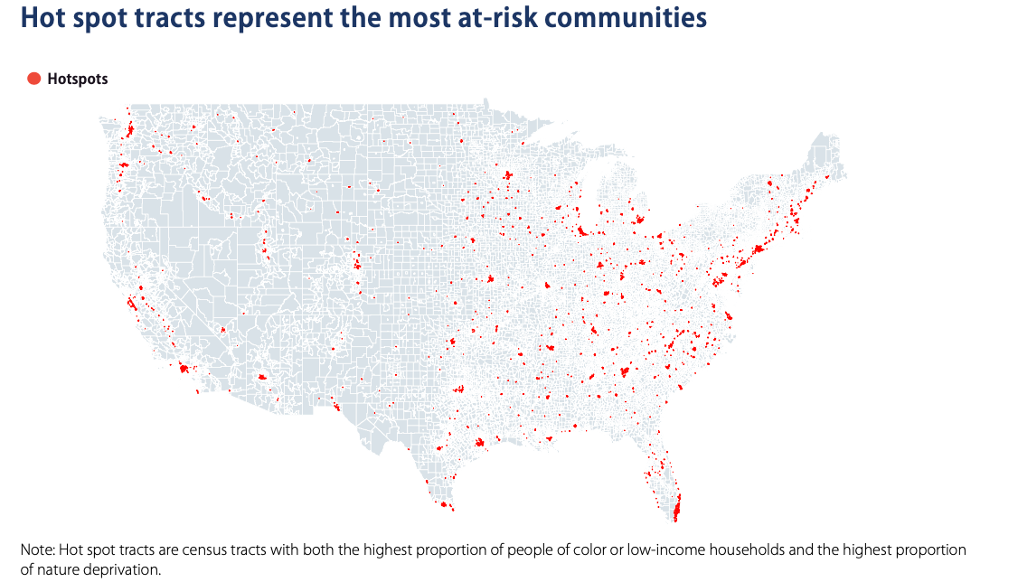
Redlining
is Visible
in Nature Deprivation Risk
The Nature Gap Report by Center for American Progress and Hispanic Access Fund

Slide 20
More than 76% of people who live in low-income communities of color live in nature-deprived places
Communities of color are 3 times more likely than white communities to live in nature-deprived places.
The Nature Gap Report by Center for American Progress and Hispanic Access Fund

Slide 21

Who benefits from nature?
Inequalities exist in nature contact when viewed from both supply-side perspectives (i.e., spatial distribution) and demand-side perspectives (i.e., use disparities).
Colley, Irvine, & Currie, 2022

Slide 22
Health Equity
"Health equity is the ethical and human rights principle motivating efforts to eliminate health disparities."
Braveman et al., 2017, p. 12
Exposure to healthy green space can move the needle toward health equity by mitigating health disparities such as hazardous exposures.
Rigolon et al., 2021

Slide 23
Nature Access is Health Equity.
What can you
do to help?

Slide 24

JEDI
02
Community
Ecosystem Approach to Health
Health
01
03
Health care
Environment

Slide 25

NBHIs
NBHIs can facilitate behavioural change through a somewhat structured promotion of nature–based experiences and, in doing so, promote improved physical, mental, and social health and wellbeing.
NBHIs are programs, activities, or strategies that aim to engage people in nature–based experiences with the specific goal of achieving improved health and wellbeing.
Shanahan et al., 2019

Slide 26

What's in a name?
NBHIs struggle with a conflation of many terms: Green Prescriptions, Nature Prescriptions, Park Prescriptions, Social Prescribing, Nature-based Solutions, Green Exercise, Nature Therapy, Surf Therapy, etc.

Slide 27
Nature-based Programming Continuum
Public land-focused programming can creatively repackage existing efforts
Healthcare-centric programs can use prescriptions, referrals, or even be provider led
Outdoor Recreation
Health Behavior
Community-led programming directly engages community members with nature through
plug-and-play options to bespoke approaches

Slide 28

HOW MUCH IS ENOUGH?
Dis-ease
You
Ease
STRESS
DEPRESSION & BLOOD PRESSURE
DEPRESSION
HIGH WELLBEING
20-30 minute session
1 garden visit per week (peak 4-5 visits)
Hunter et al., 2019
120 minutes per week
(peak 200-300 minutes)
Cox et al., 2017
>30 minutes per week
White et al., 2019
Shanahan et al., 2016

Slide 29
Getting the data
Defining nature, measuring exposure, and determining thresholds for dose/duration of nature exposure for given health effects and mechanistic pathways still needs maturation.
Majority of data is on urban study populations. Including more narratives across geography, income, and identity is critical.

Slide 30




Questions?
Courtney Schultz, PhD
Courtney@HealthandTechnologyPartners.com
HealthandTechnologyPartners.com

