Slide 1
The Future of Access to Reproductive Health in the US
Abortion in a Post-Roe World
Alina Salganicoff, PhD
Senior Vice President and Director, Women's Health Policy
Presentation to Grantmakers in Health
September 28, 2022

Slide 2
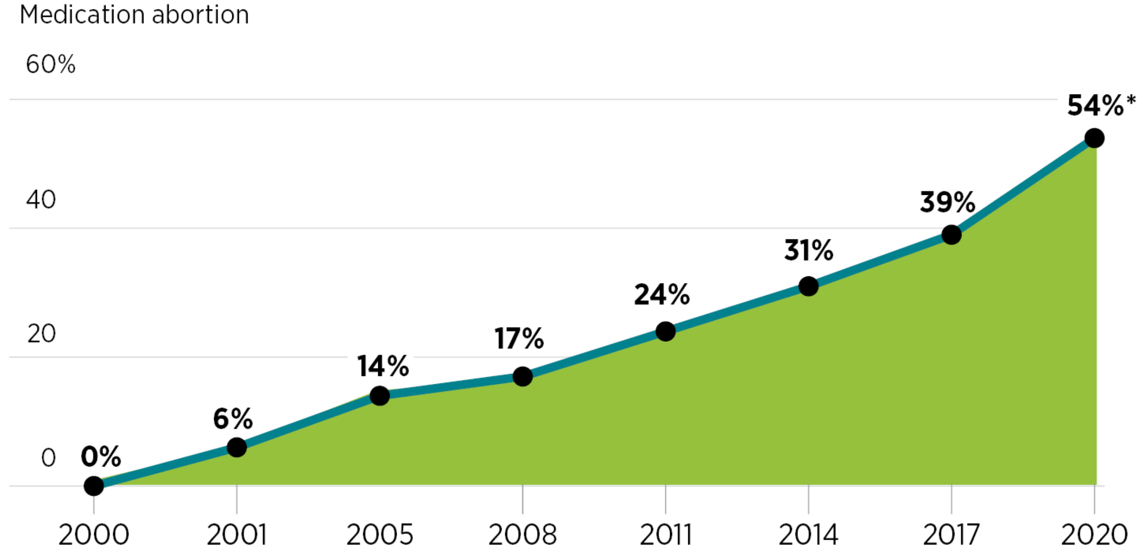
Data Collected Before Dobbs Finds Most Abortions are Obtained Earlier in Pregnancy and Over Half were Medication Abortion
9 in 10 abortions in the US occur in the
first trimester, 2019
NOTE: Gestational data are from 43 reporting areas; excludes nine reporting areas (California, DC, Illinois, Maryland, Massachusetts, New Hampshire, New York State, Pennsylvania, and Wisconsin) that did not report, did not report by gestational age, or did not meet reporting standards. Abortion rate data are for 48 reporting areas; excludes California, DC, Maryland, and New Hampshire. *Based on preliminary data. SOURCE: Kortsmit K, Mandel MG, Reeves JA, et al. Abortion Surveillance — United States, 2019. MMWR Surveill Summ 2021;70(No. SS-9):1–29.
Jones RK, Nash E, Cross L, Philbin J, Kirstein M. Medication abortion now accounts for more than half of all US abortions. Guttmacher Institute. February 2022.

Slide 3
People Who Get Abortions Have Been Disproportionately Low-income, Women of Color, Young, and Have Children
NOTE: The Federal Poverty Level (FPL) was $11,670 for an individual in 2014.
SOURCE: Guttmacher Institute, Characteristics of U.S. Abortion Patients in 2014 and Changes Since 2008, May 2016.

Slide 4
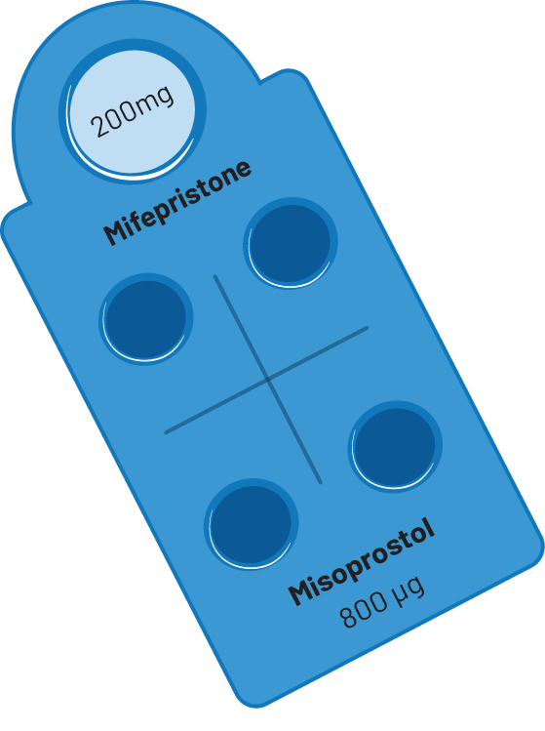
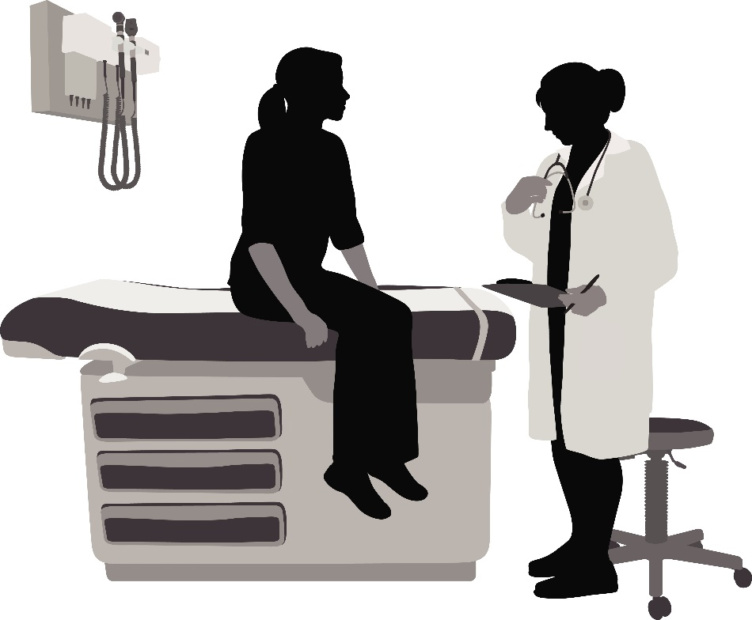
Abortion Options
Medication Abortion
For pregnancies up to 10 weeks gestation
Patients take two medications:
200mg of mifepristone (FDA approved 2000);
800mg misoprostol taken 24-48 hours later.
Can be safely done in a patient's home
Safe and highly effective method of pregnancy termination—pregnancy is terminated 99.6% of the time, with a .4% risk of major complications, & an associated mortality rate of less than .0001 percent.
TeleHealth abortions use these drugs
Different than, but often confused with, Emergency contraceptive pills
In Clinic Abortions
Vacuum aspiration:
Most common in-clinic abortion
Uses gentle suction to empty contents of uterus
Can be used until ~14-16 weeks
Dilation & Evacuation (D&E)
Uses suction and medical tools to empty uterus
Almost all abortions after 21 weeks are performed by D&E
SOURCE: KFF, The Availability and Use of Medication Abortion, June 2021; KFF, Abortions Later in Pregnancy, December 2019; Planned Parenthood, In-Clinic Abortion, Accessed November 19, 2021.

Slide 5
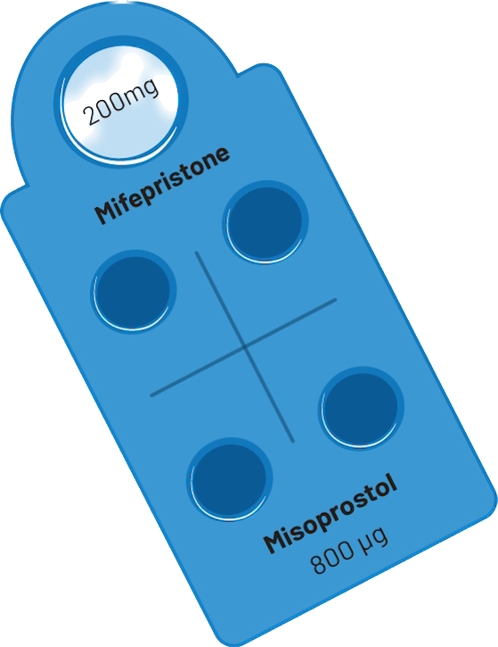
Telehealth abortion has gained traction during the COVID-19 pandemic – but some states acting to block
FDA had historically limited access to Mifepristone, only allowing in-person dispensing of the medication
In 2021, FDA dropped the in-person dispensing requirement opening the door to telehealth
COVID spurred growth in use of telehealth abortions, but even before, research had found safety/effectiveness was equivalent to in-person
There are 15 states that do not currently ban abortion but have instituted laws that require at least one in-person visit, effectively banning telehealth for medication abortion
No in-person visits required
SOURCE: Ramaswamy A, Weigel G, Sobel L, and Salganicoff A. Medication Abortion and Telemedicine: Innovations and Barriers During the COVID-19 Emergency. KFF. June 16, 2021.

Slide 6
Lack Of Awareness And Knowledge About Abortions Creating Opportunity for Mis/Disinformation Efforts
Percent who have heard of mifepristone, or medication abortion, which is a drug available in the form of a pill that can be taken to end a pregnancy
Percent who say each of the following false statements are true:
Most abortions in the U.S. occur after 8 weeks of pregnancy
Less than 10% of women in the U.S. have had an abortion
A woman who has gotten an abortion will have a harder time getting pregnancy again
A woman who has gotten an abortion has a higher chance of getting breast cancer
SOURCE: KFF Health Tracking Poll (May 10-19, 2022)

Slide 7
Obtaining an abortion can be costly, and costs are higher in the second trimester
In 2021, the Median Cost of Abortion Services Exceeded $500
Costs are even higher when you consider transportation, child care, lodging, and lost wages
The Federal Reserve estimates that nationally about one-third of people do not have $400 on hand for unexpected expenses
Insurance coverage for abortion services is heavily restricted in certain private insurance plans and public programs like Medicaid and Medicare
Medication abortion
First trimester procedural abortion
Second trimester procedural abortion
SOURCE: Advancing New Standards in Reproductive Health (ANSIRH), University of California, San Francisco. Trends in Abortion Care in the United States, 2017-2021.

Slide 8
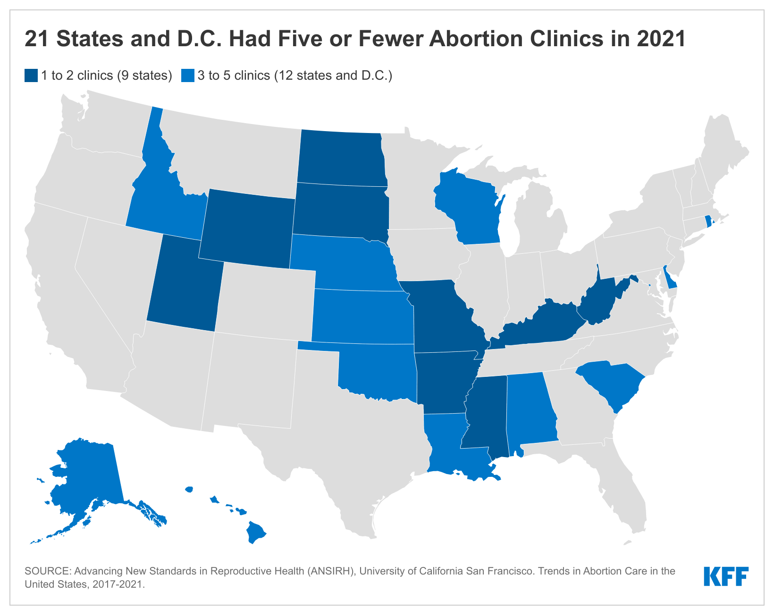
Prior to the Overturning of Roe v. Wade, Abortion Access was Already Highly Limited in Nearly Half of States
Pre-Dobbs abortion restriction | No. of states
Ultrasound provision | 27 states
State-imposed threshold for abortions later in pregnancy | 22 states
Waiting periods - between 18 – 72 hours | 27 states
Parental notification and consent | 37 states
Sex and race selection abortion ban | 11 states
Targeted regulations of abortion providers and clinics | 24 states
Counseling on irrelevant/misleading abortion information | 18 states
Medication abortion restrictions | 32 states
Inaccurate information medication abortion reversal | 8 states
Bans on certain types of abortion procedures | 23 states

Slide 9
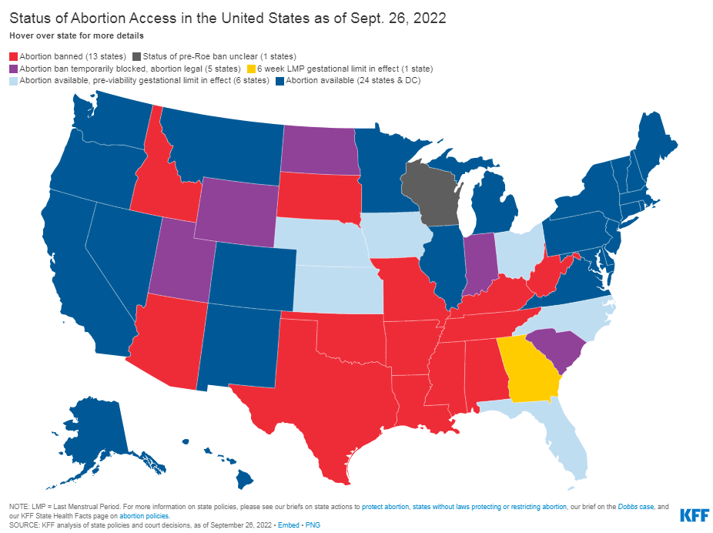
With Roe overturned, states now regulate abortion – with no federal standards
States can ban abortions – They can impose civil and criminal penalties on people who get an abortion and those who provide abortion services. They can also limit exceptions, and many have
States can impose restrictions making abortion access very limited – without outright banning it – Restrictions that SCOTUS had previously ruled as unconstitutional are now allowed.
States can choose to maintain and protect abortion rights

Slide 10
State Constitutional Protections for Abortion Future litigation challenging state restrictions will likely be in state courts
State Supreme Court Decision
Five states have state supreme court decisions establishing a state constitutional right to abortion, but no state law explicitly protecting abortion
Alaska, Minnesota, Kansas (no current challenges to the state constitutional protection)
Florida (15-week ban) and Montana (AG challenging the constitutional protection)
Iowa just reversed its prior ruling interpreting state constitution as protecting right to abortion but has not yet established the standard by which abortion regulations will be evaluated
Ballot Initiatives
Banning Abortion
Kentucky will have voter initiative to pass a constitutional amendment stating that nothing in the state constitution creates a right to abortion
In August 2022, Kansas voters rejected a similar ballot initiative
Protecting Abortion
California, Michigan, and Vermont to vote on constitutional amendment to protect abortion

Slide 11
Legal Concerns for Clinicians & Pregnant People
Penalties vary ― Fear of prosecution or civil penalties are a deterrent for many
Some states have imposed criminal penalties including jail time for providers
Some states have civil penalties like Idaho, Texas and Oklahoma
Alabama, Louisiana, Missouri, Ohio, Tennessee considering similar bills
Interaction between states
Unclear if states will try to prosecute clinicians providing services in other states where abortion is legal and how states criminalizing abortion will enforce penalties
Some states have passed laws to protect clinicians and people seeking services from civil and criminal liability imposed by other states

Slide 12
The Implications of Overturning of Roe v. Wade are Just Beginning To Surface
IVF treatment
Health Implications of
Overturning
Roe v. Wade
Abortion Access Banned or Severely Limited in Half the States
Access to Care and Treatment that Meets Current Medical Standards
Workforce
Travel Assistance
Criminal and Civil Liability of:
Clinicians
Employers
Community members
Health Professional Education
Privacy
Access to Emergency Contraception
Miscarriage Management
Access to Drugs to Treat Autoimmune Diseases
Cancer Treatment
Maternity Care

Slide 13
Abortion Funds can Provide Some Assistance to those Needing Financial and Logistical Support
Abortion funds provide assistance to people seeking abortions who cannot afford the procedures
Many funds are run and led by volunteers
On average, callers receive $215 grants
Many funds also provide transportation, childcare payment, lodging, translation services, abortion doulas, and more.
Abortion funds are unable to help everyone who connects with them
SOURCE: National Network of Abortion Funds, Abortion Funds 101, Accessed Sept. 22, 2022. National Network of Abortion Funds, Seeds & Roots, Fortifying Network Infrastructure and Leading with Values, Annual Report July 2018-June 2020, Accessed November 22, 2021.

Slide 14
The Federal Response is Hamstrung by Lack of Congressional Action and Limits to Executive Action
Biden Administration
EMTALA
FDA regulation of Mifepristone
Anti-Discrimination Enforcement (Section 1557)
Hyde Amendment limits use of federal funds for abortion to case of rape, incest or life threat
Congress
Women’s Health Protection Act
Lindsay Graham’s 15-week abortion ban

Slide 15
There Has Been a Proliferation of Resources and Information about Accessing Abortion Services by Both New and Long-standing Organizations

Slide 16
The Future of Abortion
Access to abortion has long depended on where you live, but now huge swaths of the country will lack access.
The states are in the driver’s seat, and the outcome of the midterm elections will directly affect abortion access in a handful of states.
Impact greatest on low-income and young people, women of color, and those living in the South and Midwest. Community-based organizations will be on the frontlines.
Medication abortion, either through telehealth or through self-managed options, is an option for some, but provides access to those early in their pregnancy
Many now must travel long distances. Some will not or cannot get an abortion because they can’t afford it or can’t take time off from work or family responsibilities.
Congressional action on this issue is unlikely to pass. The Administration has few options to act on its own.
The need for accurate reliable information about abortion and contraception will only grow, but be challenged by ongoing disinformation/misinformation efforts.

Slide 17
Thank you.
Alina Salganicoff
alinas@kff.org
For more information: www.kff.org/womens-health-policy

