Slide 1

Next Generation of the Healthcare Workforce Project
November 13, 2023
NGA Center for Best Practices
Notes:
Rachael

Slide 2
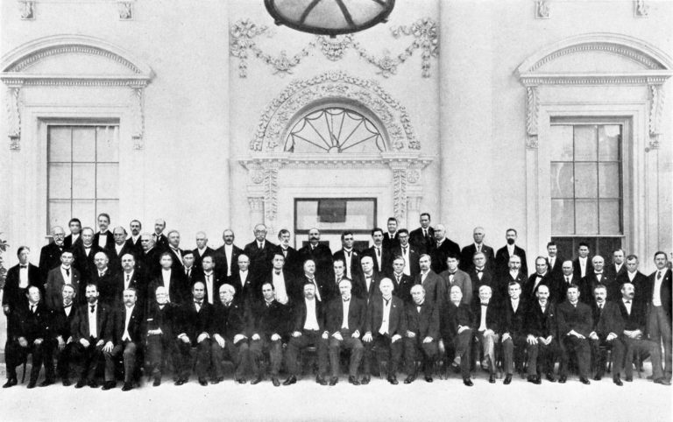
NGA: Over 115 Years Serving Our Nation’s Governors
Founded in 1908, the National Governors Association (NGA) is the nonpartisan organization of the nation’s 55 Governors. Through NGA, Governors share best practices, address issues of national and state interest and share innovative solutions that improve state government and support the principles of federalism.
Conference of Governors at the White House, 1908
2

Slide 3
Next Generation of the Healthcare Workforce Project
NGA launched the Next Generation of the Healthcare Workforce project in 2022 with support from HRSA
The project supports Governors’ offices and other senior state officials in implementing strategies to strengthen and grow the next generation of the healthcare workforce
Year 1: 2022
  4 Learning Collaborative states and 12 Knowledge Exchange Network states focused on short term and organizational planning, sharing best practices, and state action plans
Year 2: 2023
  20+ states and territories in the Knowledge Exchange Network focused on sustaining the effort and long-range planning through peer learning, harnessing partnerships, and regional dialogues
3

Slide 4

Next Generation of the Healthcare Workforce Project States
WA
MT
ND
ME
OR
MN
VT
ID
SD
WI
NY
NH
MA
WY
MI
RI
2023 Knowledge Exchange Network
2022 and 2023 Knowledge Exchange Network
2022 Learning Collaborative and 2023 Knowledge Exchange Network
IA
PA
CT
NV
NE
OH
NJ
UT
IL
IN
CA
CO
WV
DE
KS
MO
KY
VA
MD
TN
NC
AZ
NM
OK
AR
SC
MS
AL
GA
TX
LA
AK
FL
HI
4
AS

Slide 5

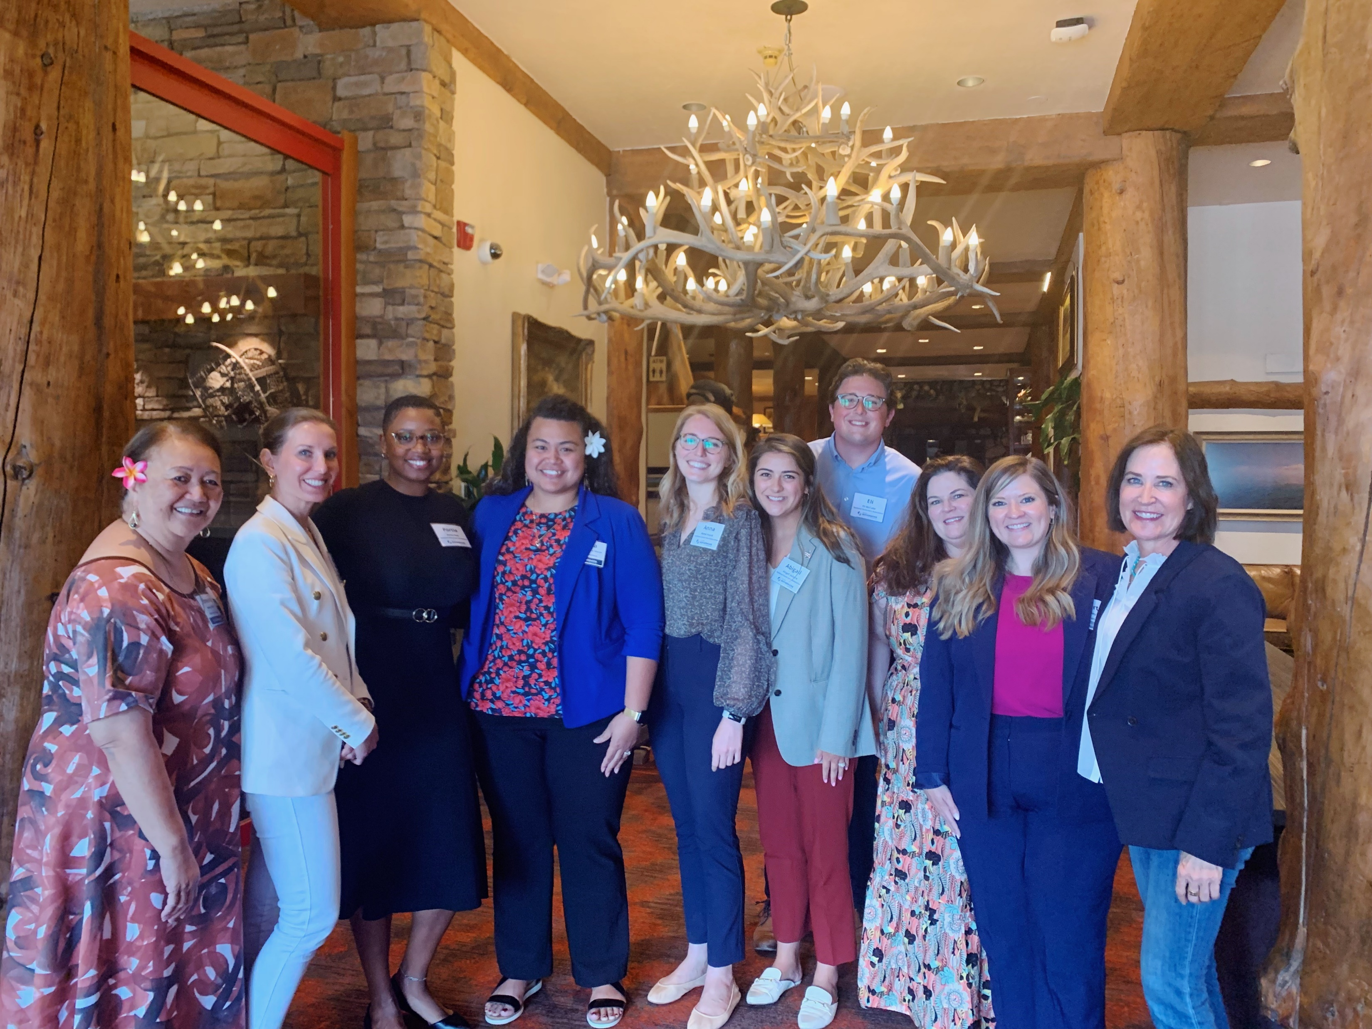
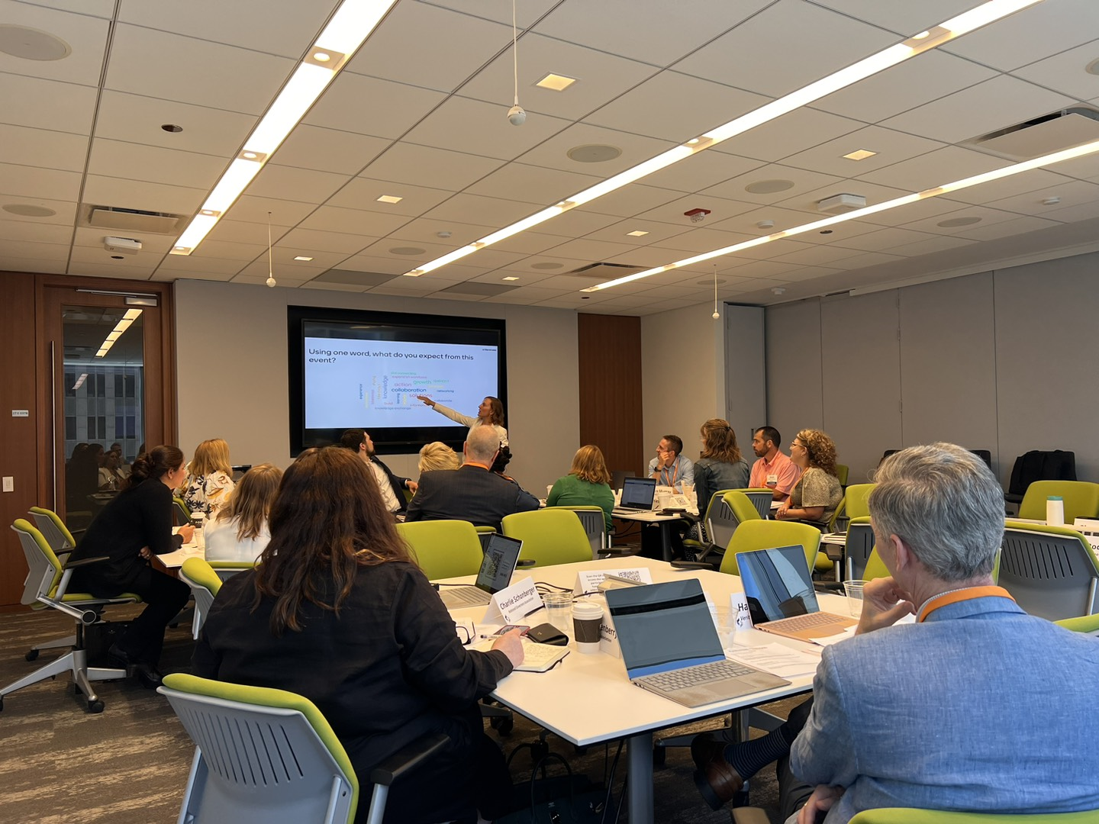
Healthcare Workforce Convenings 2023
The NGA Center held a series of three regional workshops to bring together healthcare and workforce leaders to engage in regional discussions focused on common healthcare workforce challenges, hear from industry experts, and develop innovative solutions
  Washington, DC – May 2023
  Jackson Hole, WY– June 2023
  Chicago, IL – July 2023
5

Slide 6
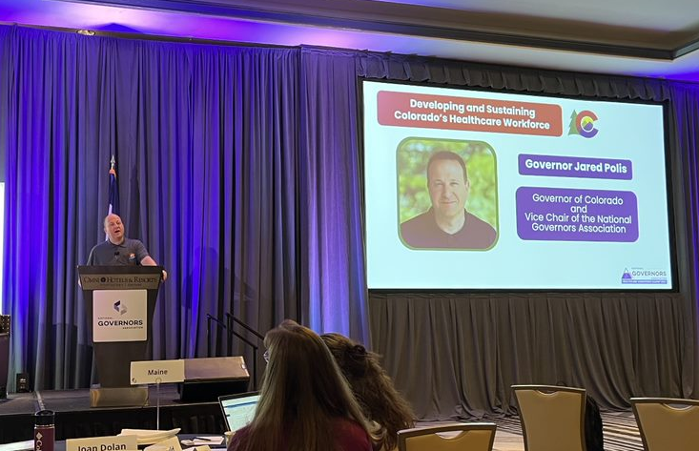
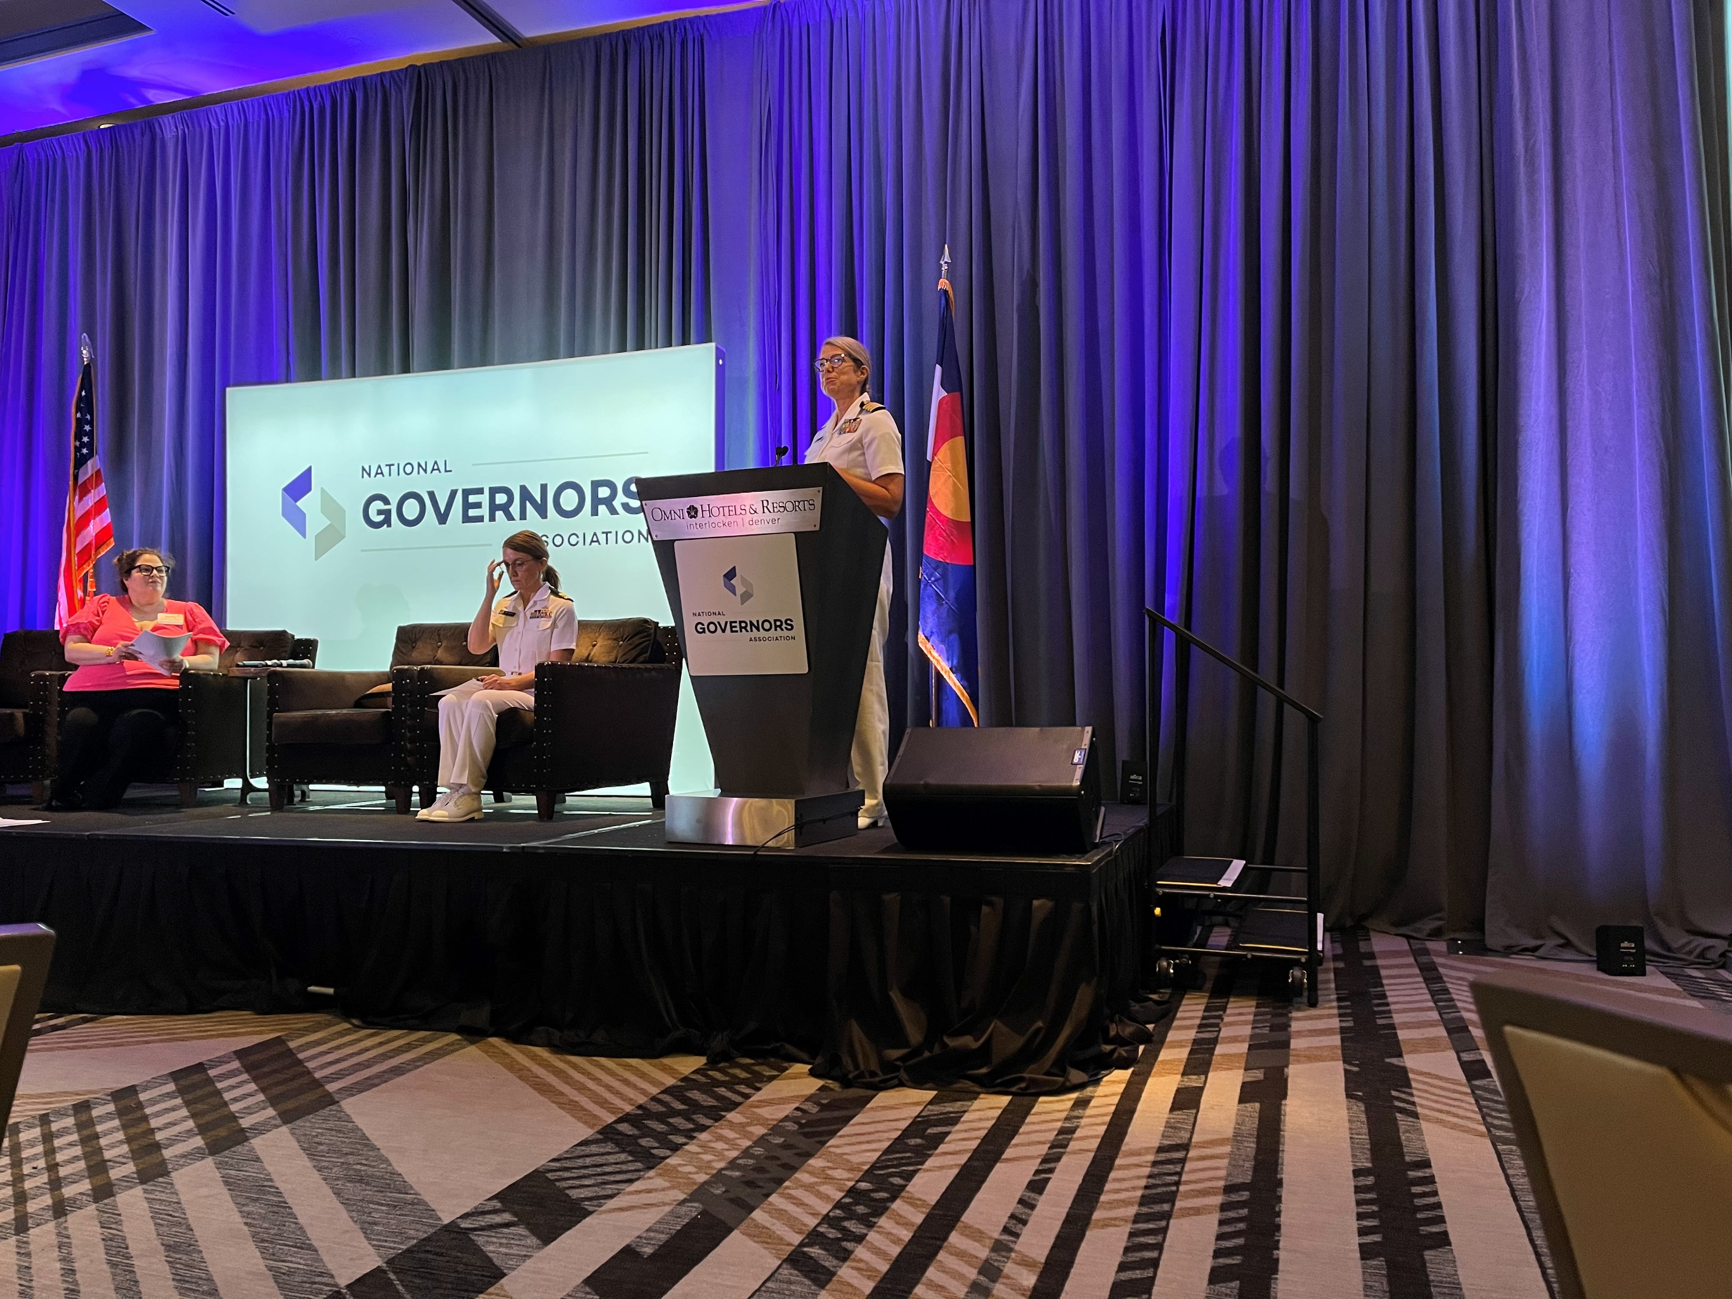
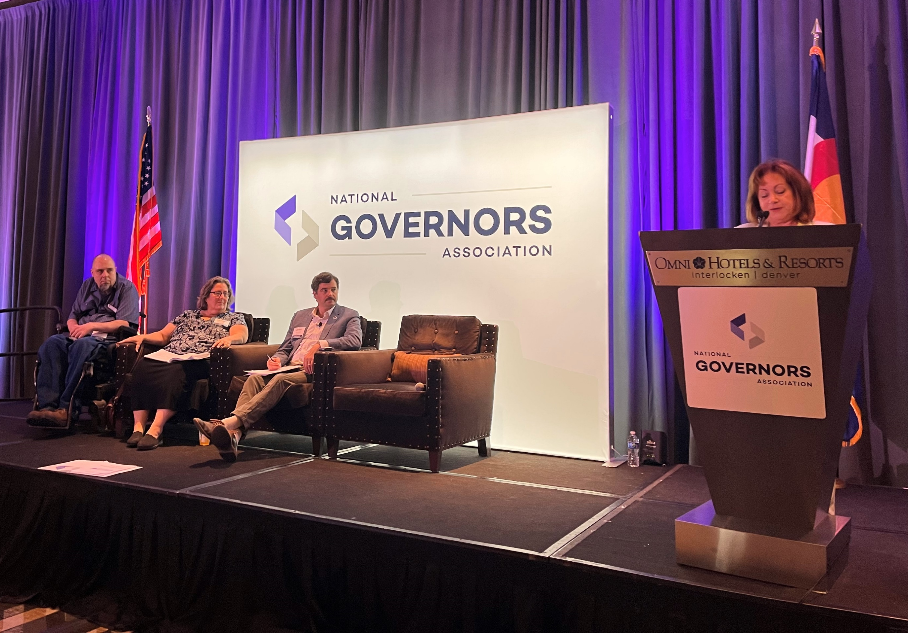
Healthcare Workforce Convenings 2023
The NGA Center hosted a major healthcare workforce summit in the Denver, CO area in August 2023 that featured presentations from healthcare workforce experts and NGA partners in addition to providing opportunities for peer-to-peer learning and goal planning sessions
  Colorado Governor Jared Polis
  Captain Alicia Souvignier and Lieutenant Commander Kathi Murray, HRSA
  Colorado Lieutenant Governor Dianne Primavera and Governor Polis’ policy advisors
6

Slide 7

State Healthcare Workforce Toolkit
Profession-Specific Resources
Data and
Planning
Licensing and Regulation
Training, Recruitment, and Retention
Healthcare Workforce Project Team Resources
7

Slide 8

Preparing The Next Generation Of The Healthcare Workforce: State Strategies For Recruitment And Retention
The NGA Center developed a report summarizing outcomes from the first year of the Next Gen Healthcare Workforce project, including:
  Outcomes for the four learning collaborative states
  Strategies for recruiting and retaining healthcare workers arranged by profession
  Examples of state tools and approaches for initiative coordination
8

Slide 9


Healthcare Workforce Year One Report
Themes:
    Initiative coordination. Cross-agency coordination is key as healthcare workforce issues touch multiple departments and communication across these groups can contribute to a holistic approach.
      Example: California created a new position (Assistant Deputy Secretary of Healthcare Workforce) and convened the California Health Workforce Education and Training Council.
      Peer-to-peer discussion. The project states learned from one another and occasionally adopted innovations from other states.

Slide 10


Healthcare Workforce Year One Report
Themes:
    Stakeholder engagement. Many states have engaged their local communities, industry and healthcare groups, and other stakeholders to better understand community healthcare needs and healthcare workforce needs to inform their initiatives.
      Example: Wyoming engaged other state offices such as the travel and tourism office as well as community partners and educational institutions.
    Healthcare workforce data. This data can be a challenge to gather and analyze, especially across agencies and from private healthcare systems, but it is essential to understand how to formulate initiatives to support these workers.
      Example: Rhode Island shares and matches health professional licensure data with wage records and other datasets to better understand workforce supply, demographics, wages, and career progression.

Slide 11



Healthcare Workforce Year One Report
Themes:
    Employer partnerships. States are partnering with employers on healthcare career pathways to develop sustainable pipelines of talent.
      Example: Missouri is focused on employer-driven apprenticeships, coordinating these opportunities through the Department of Higher Education & Workforce Development.
    Evaluation. With so many new and expanded programs to support the healthcare workforce, it will be important for states to evaluate these efforts to understand which initiatives are the most effective and provide a sufficient return on investment.
      Example: West Virginia has surveyed its physicians to understand why they choose to continue working in the state.
    Initiative sustainability. States are also focused on maintaining momentum to sustain these efforts.
      Example: Colorado has asked local governments to partner in sustainability strategy development.

Slide 12
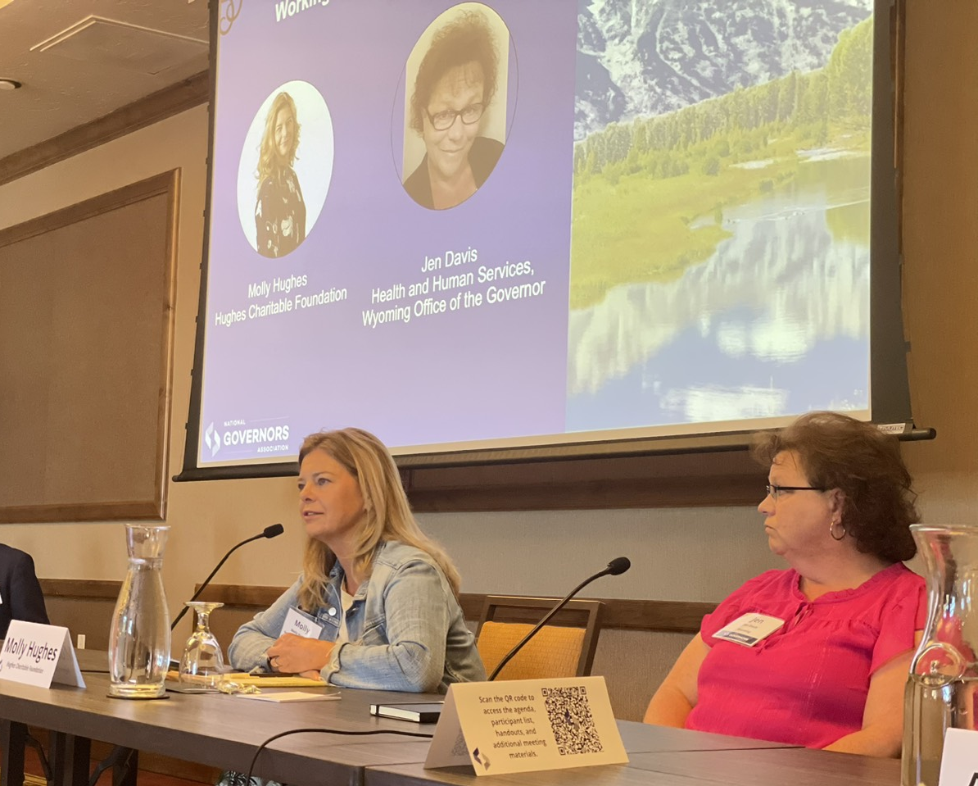
Healthcare Workforce and Philanthropy
NGA’s regional workshop in Jackson Hole, Wyoming featured a session on “Working with Philanthropy” to hear about Wyoming’s work with the Hughes Charitable Foundation to strengthen the behavioral health workforce
Philanthropy can maximize the impact of state healthcare workforce investments and initiatives by:
  Synergizing funding to maximize impact
  Leveraging community relationships
  Solving for local challenges and creating national partnerships
  (L to R):
  Molly Hughes, Hughes Charitable Foundation, and Jen Davis, Office of Governor Mark Gordon, Wyoming
12

Slide 13
The Next Phase of NGA’s Healthcare Workforce Project
Policy Academy:
    NGA is hosting a policy academy to support up to four states or territories for a period of eight months in designing, implementing, and/or strengthening the state/territory strategy on recruiting and retaining the next generation of the healthcare workforce.
    Activities will include:
      Virtual kick-off meeting
      Strategic action plan development
      Implementation of the action plan
      Ongoing technical assistance
      In-person wrap-up meeting and technical assistance site visit
Knowledge Exchange Network:
    NGA will continue hosting a Knowledge Exchange Network to provide states and territories with technical assistance, topical webinars, and policy resources.

Slide 14
Questions?
Contact:
Dr. Shelby Hockenberry shockenberry@nga.org
Anna Heard aheard@nga.org

