Slide 1

Preserving Medicaid for
Adults with Disabilities
H. Stephen Kaye, PhD
Professor Emeritus
University of California San Francisco
February 7, 2025
Notes:
Statistics presented in this document are based on analyses I conducted of public use, person-level data from 3 nationally representative Federal surveys:
The American Community Survey (ACS), 2010–2023
The National Health Interview Survey (NHIS), 2010–2017 and 2019–2023
The Medical Expenditure Panel Survey (MEPS), 2019–2022
I omitted 2020 data from all analyses due to the disruption caused by the COVID-19 pandemic. ACS is representative of the entire U.S. population. NHIS & MEPS are representative of the civilian, household-resident population. ACS & NHIS are conducted by the Census Bureau, the latter on behalf of the National Center for Health Statistics (NCHS). MEPS is conducted by Westat on behalf of the Agency for Healthcare Research and Quality (AHRQ) and NCHS.
The ACS, MEPS, and this analysis of years 2010–2017 of the NHIS use a standard 6-question definition of disability. Questions ask about “serious difficulty” hearing; seeing; concentrating, remembering, or making decisions; and walking or climbing steps; as well as difficulty dressing or bathing and doing errands alone outside the home. Respondents endorsing one or more of these questions were classified as having disabilities.
This analysis of years 2019–2023 of the NHIS uses an alternative disability measure, the Washington Group Short Set on Functioning – Enhanced (WG-SS Enhanced). The WG-SS (unenhanced version) asks about difficulty hearing, seeing, communicating, remembering or concentrating, walking or climbing steps, and washing or dressing. The Enhanced version fills in some of the gaps of the Short Set by including additional questions on upper body mobility, anxiety, and depression.

Slide 2
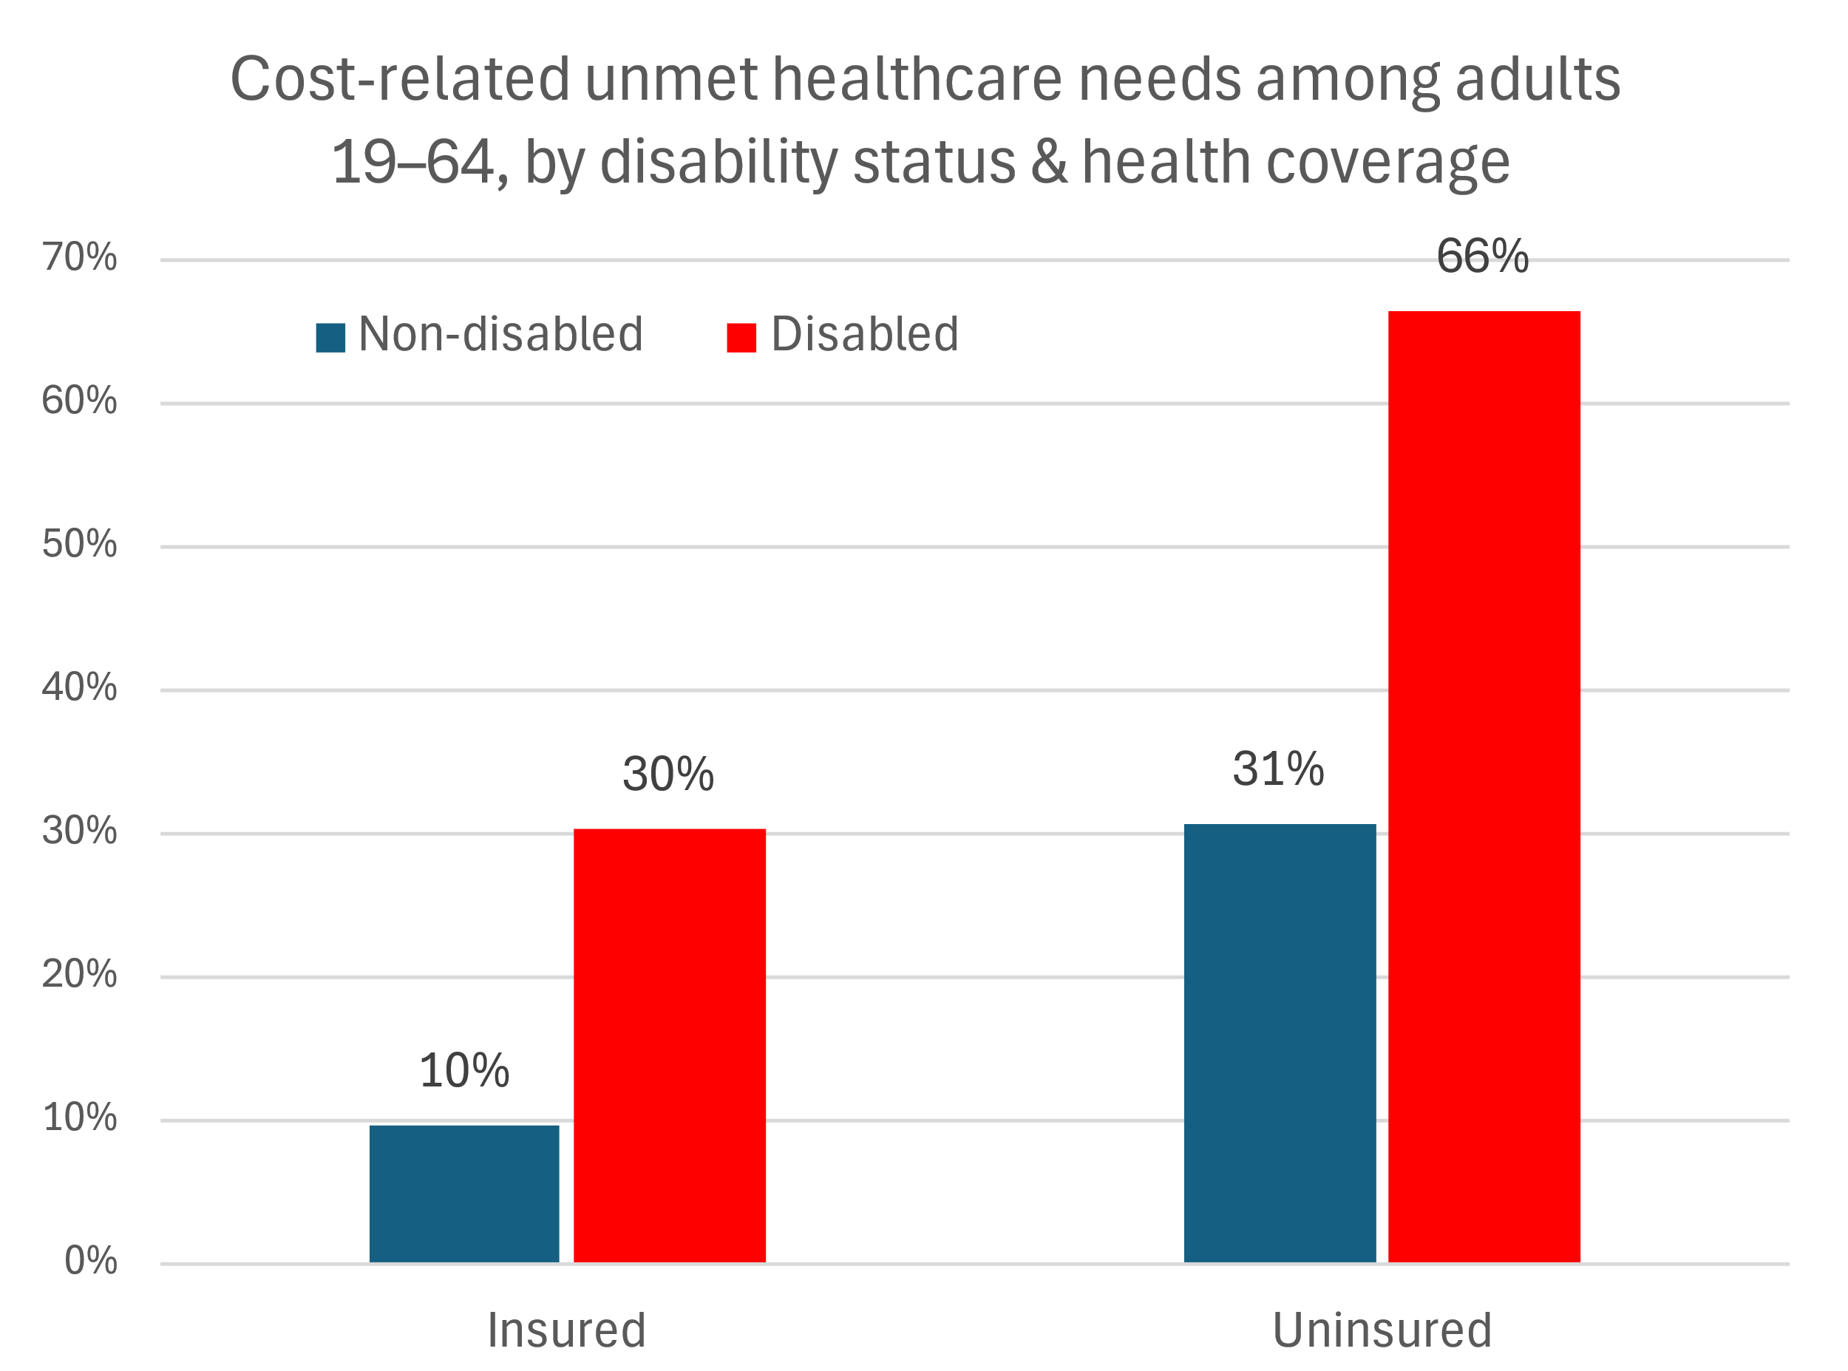
Health coverage matters even more for disabled people
Notes:
About 2/3 of uninsured, disabled, working-age adults experience one or more unmet healthcare needs. In contrast, 90% of insured, non-disabled working-age adults have their healthcare needs met (only 10% have unmet needs). Note that the measures only address cost-related unmet needs, not unmet needs caused, for example, by inability to get to the provider’s office, difficulty getting a referral, or providers who are not knowledgeable about the persons health condition or disability. Therefore, the true level of unmet need for healthcare is likely much larger than the statistics shown in the chart.
Source: DREDF analysis of data from the National Health Interview Survey, 2019–2023.

Slide 3
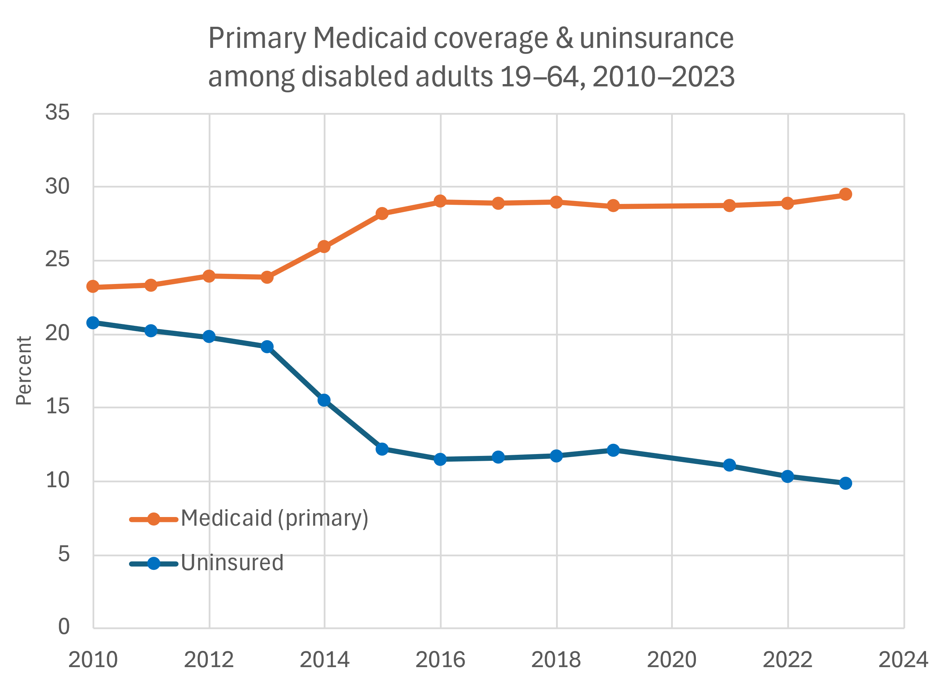
ACA, esp Medicaid expansion, cut uninsurance in half
Notes:
Source: DREDF analysis of data from the American Community Survey, age adjusted to the 2023 population.

Slide 4
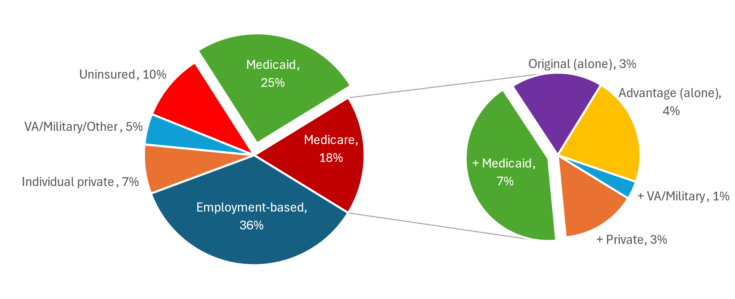
Medicaid covers 1/3 of working-age disabled adults
Primary payer among disabled adults 19–64, 2023
Medicare type &
supplemental coverage
Notes:
The pie on the left shows the primary healthcare payer (source of coverage that generally pays first) for disabled working-age adults.
Private, employment-based group insurance, obtained from a current or former employer or union, is the most common, with more than 1/3 having such coverage.
Next is Medicaid (light green), which provides coverage for 1/4 of disabled working-age adults.
17% have Medicare coverage.
Individual, private insurance policies cover only 7% (5% purchased via Exchanges plus 2% obtained directly from insurer).
Only 1/10 of disabled working-age adults are uninsured, down from about 1/5 before the Affordable Care Act took effect.
Details of Medicare coverage are shown in the pie on the right.
7% of disabled working-age adults are on Medicare without any supplemental coverage: 4% on Medicare Advantage and 3% traditional Medicare.
The rest have additional coverage, generally paying for the 20% of costs that Medicare typically doesn’t pay: 7% of disabled working-age adults are duals, covered by both Medicaid and Medicare, and 3% have private coverage, mostly Medigap plans.
An additional 1.4% have Medicaid coverage neither as primary nor as supplementary to Medicare (not shown on chart), for a total of 34.1% of disabled working-age adults on Medicaid.
Source: DREDF analysis of data from the National Health Interview Survey, 2021–2023.

Slide 5
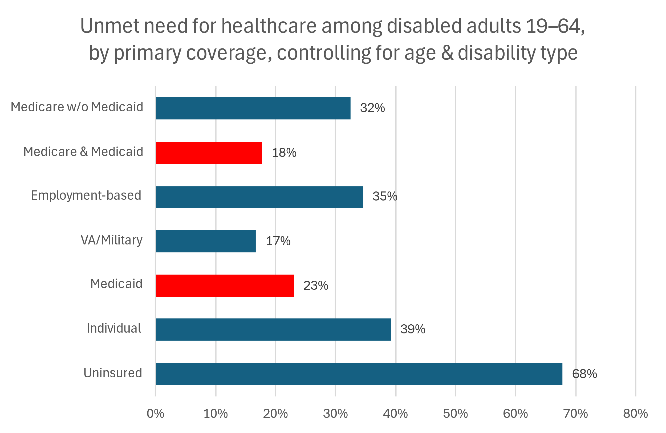
Medicaid meets disabled people’s needs better!
Notes:
Dual Medicare-Medicaid beneficiaries (18%) and people on Medicaid alone (23%) are substantially less likely than those in the other coverage categories to have unmet healthcare needs: 32% among those on Medicare without Medicaid, 35% for those with employment-based coverage, and 39% for people with individual private coverage. Coverage from the VA or the military is about equivalent to dual coverage.
To make the comparisons across coverage categories more fair, I have controlled for differences in age and disability type and severity.
Source: DREDF analysis of data from the National Health Interview Survey, 2019–2023.

Slide 6
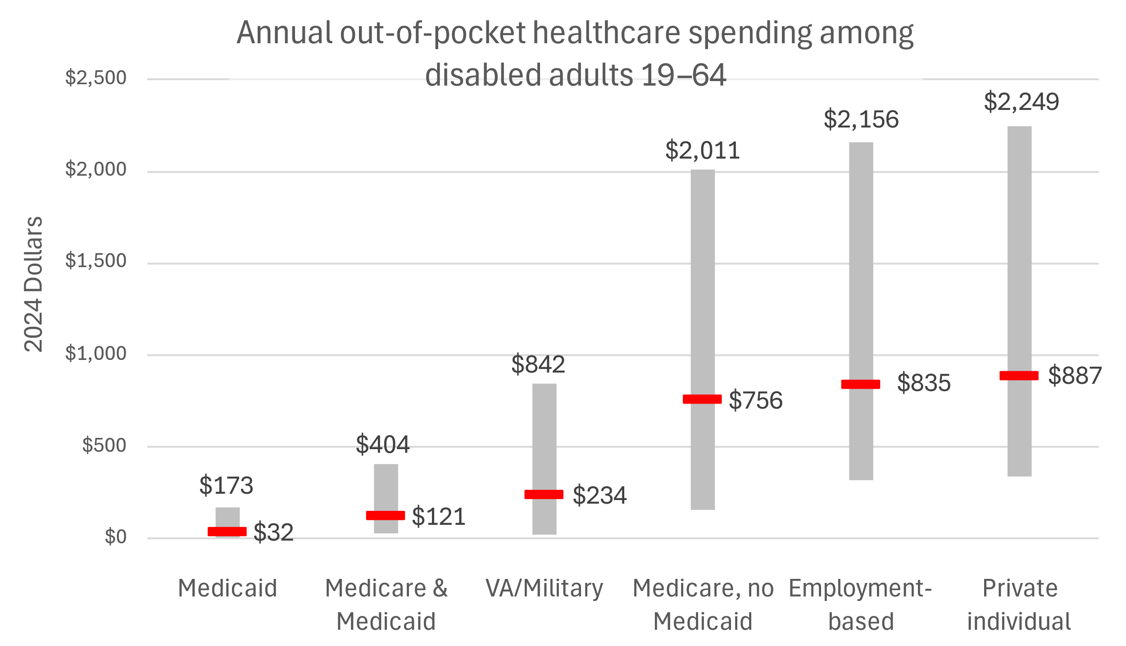
Medicaid makes healthcare affordable
*
75th percentile
Median
25th percentile
*Excludes premiums
Notes:
This chart illustrates the typical costs paid out-of-pocket by disabled working-age adults across primary coverage categories. The red lines indicate the median out-of-pocket spending for each coverage type; in other words, half of people in that group spend less than the median amount and half spend more. The grey bars indicate a typical range of out-of-pocket payment amounts: The top end of each bar represents the 75th percentile of out-of-pocket costs, meaning that 3/4 of people spend less than the amount and 1/4 spend more. The bottom of the gray bars represents the 25th percentile; 1/4 of people in that coverage category pay less and 3/4 pay more.
Among disabled working-age adults on Medicaid, median out-of-pocket costs are only $32 per year for people not covered by Medicare and $121 for duals. People with VA or military coverage pay a median amount of $234. All other categories are substantially higher: $756 for Medicare without Medicaid, $835 for employment-based coverage, and $887 for individual private coverage. The 75th percentile out-of-pocket amounts for Medicaid beneficiaries in either category are also fairly low, but the the amounts for Medicare without Medicaid and both types of private insurance are above $2,000. Again, this means that at least 1/4 of disabled working-age adults with those types of coverage must pay more than $2,000 in out-of-pocket costs per year.
Insurance premiums are not included in out-of-pocket costs. Dollar amounts were adjusted to 2024 dollars using the Consumer Price Index for Medical Care.
Source: DREDF analysis of data from the Medical Expenditures Panel Survey, 2019–2022.

Slide 7
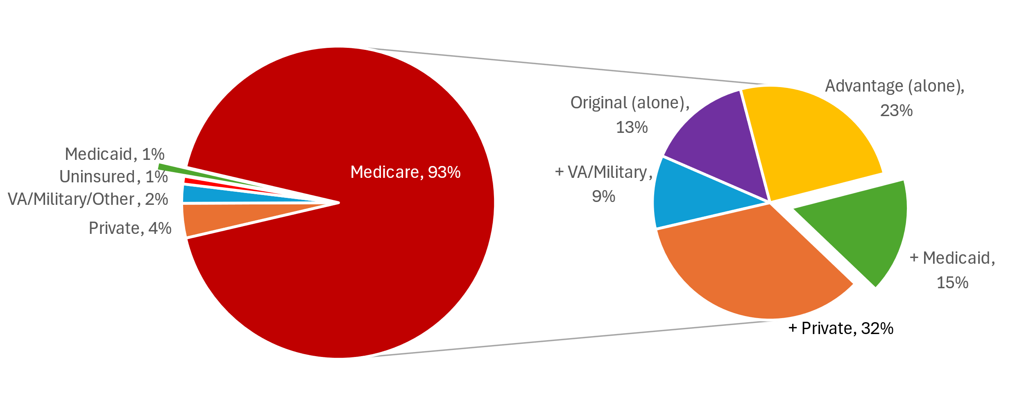
Medicaid covers 16% of older adults, mostly duals
Primary payer among disabled adults 65+, 2023
Medicare type &
supplemental coverage
Notes:
This pair of pie charts shows coverage for disabled older adults at least 65 years of age. Primary coverage, shown on the left, is mostly Medicare, at 93%. Of the remaining 7%, most have private coverage or get healthcare from the VA, military, or some other government program. Only 1% rely on Medicaid as their primary coverage, and 1% are uninsured.
On the right are the details of Medicare coverage. Of all disabled older adults, the largest group is people with Medicare plus private coverage, at 32%. This is mostly Medigap policies. Medicare Advantage plans, without supplementation, are next, at 23%; then dual Medicare plus Medicaid coverage, at 15%; original Medicare (13%); and finally Medicare plus the VA and/or military coverage (9%).
Source: DREDF analysis of data from the National Health Interview Survey, 2021–2023.

Slide 8
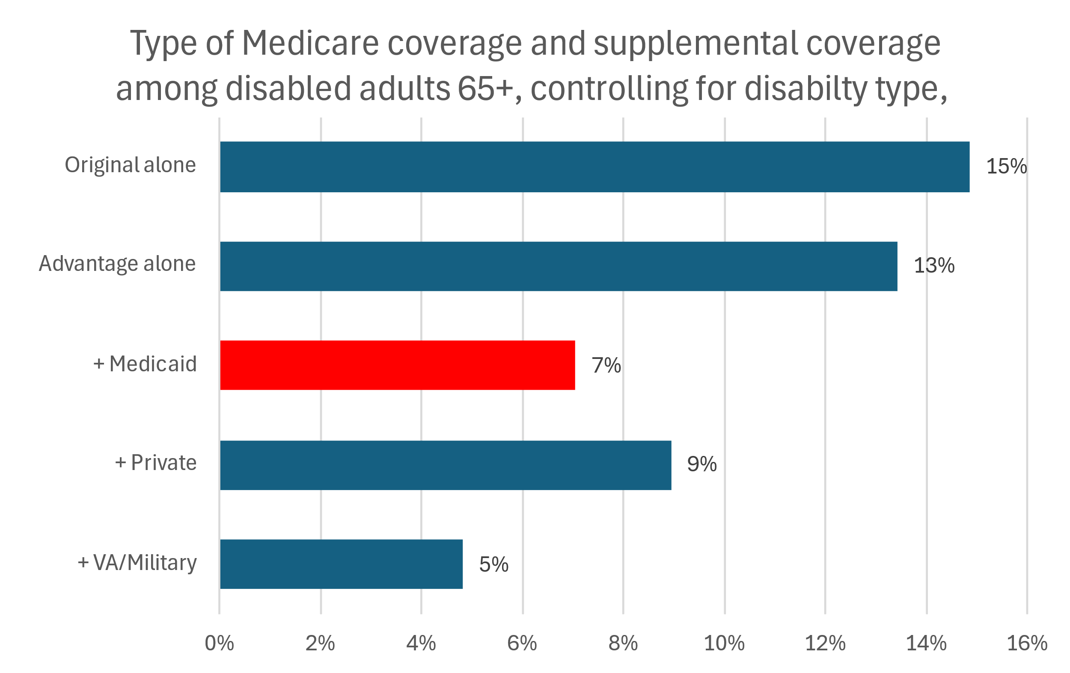
Duals have less unmet need
Medicare
Notes:
Unmet healthcare needs (any of the unmet needs for care or prescription medications) are less prevalent among disabled older adults (age 65+) than among their working-age counterparts. Among disabled older adults on Medicare alone, 13–15% have unmet needs. Supplemental coverage decreases that percentage. For dual Medicare-Medicaid beneficiaries, 7% have unmet need.
Source: DREDF analysis of data from the National Health Interview Survey, 2019–2023.

Slide 9
Policy threats: Medicaid work requirements
Labor force & disability classification of Medicaid beneficiaries 19–64
Disability indicator | %
On SSI (exempted) | 39.6
Of those not on SSI:
On SSDI | 35.9
Reports work limitation | 84.4
Disability by ACS Qs | 79.1
Need for healthcare | %
Fair or poor health | 60.7
Frequent provider visits | 40.3
Hospitalized prior year | 23.9
Median all-payer $/yr $7,451
Kids under 18 living @ home: 72.7%
(exempt AR 2018)
Notes:
The pie chart represents working-age Medicaid beneficiaries divided into mutually exclusive categories according to labor force status, school attendance, and broadly defined disability status:
55.5% are in the labor force, meaning that they are either working or actively looking for work.
3.7% are not in the labor force but are attending school.
29.3% are in neither of the above categories but can be considered disabled (see table at upper right):
36.6% receive Supplemental Security Income (SSI), and therefore become eligible for Medicaid benefits through the “disabled” pathway.
Of those not on SSI:
35.9% receive Social Security Disability Insurance (SSDI) benefits, and therefore also (like SSI beneficiaries) meet the Social Security Administration definition of work disability.
84.4% self-report a limitation in their ability to work due to “a physical, mental, or emotional problem.”
79.1% are classified as disabled according to the standard 6-question ACS disability measure.
Medicaid beneficiaries in this disabled category have high healthcare needs (table at bottom right): 25.3% report poor health and 60.7% report fair or poor health; 40.3 percent are frequent healthcare users, seeing healthcare providers at least 10 times per year; and 23.9% had been hospitalized in the prior year. Median healthcare expenditures (from all payers, including public programs, private insurance, and out-of-pocket) for this group are $7,451 per year.
The remaining 11.5% do not fall into any of the above categories.
Labor force participants and students generally meet proposed or existing Medicaid Work requirements, and people on Medicaid because of SSI recipiency are exempted. The remaining members of the disability category, those not on SSI, would typically not be automatically exempted, but would need to either meet the work requirements or file paperwork to prove that they were exempt by some other means, such as being “medically frail.” As a population with high healthcare needs, their participation in Medicaid is essential to their well-being and survival.
Note that, among the final category, 72.7% would have been exempted from the 2018 Arkansas work requirements because they had a child under 18 living at home with them. That fact alone would have made the beneficiary exempt from the 2018 Arkansas Medicaid work requirements. The 2025 Arkansas 1115 Waiver application does not feature exemptions per se, but mentions having a "dependent child is in the household” as a factor to be considered in whether the beneficiary meets the requirements.
It’s hard to know which beneficiaries the authors of such work programs had in mind when designing them. A cynic might say that the goal was to kick some of the more costly (i.e., disabled) beneficiaries off of the program.
Source: DREDF analysis of data from the National Health Interview Survey, 2017 & Medical Expenditure Panel Survey, 2019–23 (for expenditures).

Slide 10
Long-term services & supports (LTSS)
Medicaid is the only public payer for most people
Home and Community-Based Services (HCBS)
  Not required but provided by all states
  Keeps people in their homes & communities, ideally thriving
  Prevents institutionalization
  Access often limited by workforce shortages
Institutional services, e.g., nursing homes
  Few people want to live in a restricted environment
  Quality issues, often due to short-staffing
Medicaid LTSS has steadily shifted toward HCBS & away from institutional services

Slide 11
Policy threat: Cuts to Federal match
Reduced FMAP → Automatic Medicaid Contraction in at least 12 states (KFF, 11/24): Doubles uninsurance & unmet need
States make various cuts,
esp. provider rates &
optional programs
LTSS program spending
  Great Recession: Large,
  temporary FMAP bump
  In 2011, FMAP reduced 8–20
  percentage points
  Nearly every state cut 1+ HCBS
  program
  Many HCBS waitlists doubled
  Every state cut 1+ LTSS program
LTSS spending reductions*, 2010–12
 | Spent less per person |  | Served fewer people
 | # states | Average reduction | # states | Average reduction
HCBS | 47 |  | 40
IDD Waiver programs | 33 | 10.8% | 8 | 2.2%
Other Waiver programs / PCS | 35 | 11.8% | 20 | 8.3%
Home health | 23 | 22.2% | 29 | 15.1%
Nursing facilities | 31 | 6.7% | 33 | 2.6%
Intermediate Care Facilities | 30 | 11.8%
Any LTSS program cuts | 51 |  | 48
*Inflation-adjusted expenditures

Slide 12
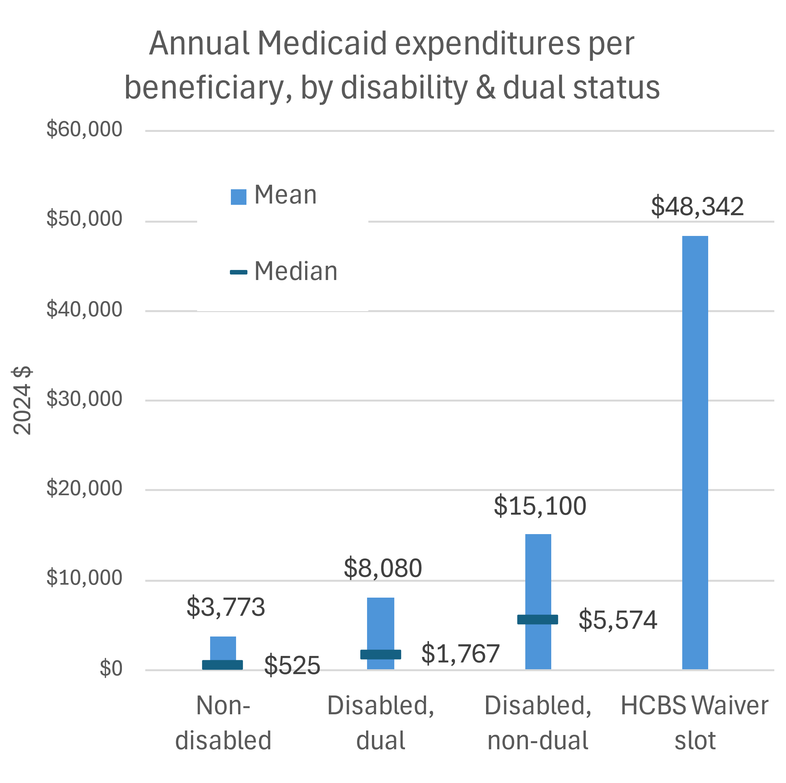
Policy threat: Per capita caps / block grants
Federal match is no longer guaranteed
  Currently 50–77%
  Most states pay < ½ of Medicaid $
  Match is 90–95% for expansion
Caps/Block grants: States get a fixed budget
  Must pay 100% of any excess
  2 to 4 times normal share
Encourages states to target high-cost programs & beneficiaries
  Cap/cut HCBS, DME, $$ treatments
  Reverse LTSS rebalancing progress
  Harms disabled people, esp. LTSS users
What happens to Federal oversight & incentives?
Notes:
Whichever method they use, “per capita caps”* or block grants, the aim is to end the guaranteed Federal match of state Medicaid expenditures. The current Federal match (the Federal Medical Assistance Percentage, or FMAP) ranges from 50%, for the higher-income states, to 77%, for the lowest-income state. (Territories get an FMAP of 83%.) The FMAP can be even higher if Congress wants to give the states an incentive to change a policy or adopt a program. Medicaid expansion, for example, was originally matched at 90%, and that figure was raised even higher, to 95%, in the American Rescue Plan Act, to encourage states that had not already expanded to do so.
Without a guaranteed Federal match, states would get a fixed, pre-appropriated Medicaid budget from the Feds. If they go over, they have to pay 100%. That would be between twice and four times their ordinary share, or as much as 10 to 20 times if it’s for an incentivized program like the expansion. State Medicaid administrators will be quaking in their boots at the prospect of overspending. What will they do? They’ll take a close look at the high-cost programs and high-cost beneficiaries and institute caps and cuts.
Note the typical (median) annual Medicaid expenditures shown in the chart (horizontal lines), which are much higher for disabled working-age beneficiaries (and especially disabled beneficiaries not also on Medicare) than for non-disabled. Mean expenditures (blue bars) are much greater in all categories; it’s the mean expenditures, not the median, that determine program costs. Compare those means with the much greater mean (nearly $50K annually) for a 1915(c) HCBS Waiver slot. HCBS programs will be first on the chopping block!
Another likely program cut: States that allow people with incomes up to 300% of the Federal Poverty Level could reduce that to 100%, excluding a lot of more middle-class beneficiaries from coverage. Cuts, caps, and failure to launch new programs will halt and possibly reverse all the progress that has been made in rebalancing LTSS spending in favor of HCBS programs rather than institutions.
*Pet peeve: “Per capita” usually means per person in the general population. So a per capita cap would be an amount calculated based on the state population, not an amount based on the number of beneficiaries.
Sources: DREDF analysis of data from the Medical Expenditure Panel Survey 2019–23; CMS/Mathematica 2022 LTSS report.

Slide 13
Key points
Medicaid is essential for disabled beneficiaries, both for health coverage itself and LTSS/HCBS.
Medicaid expansion resulted in coverage for many formerly uninsured disabled (and non-disabled) adults
Medicaid work requirements allegedly exempt disabled beneficiaries but may actually target many
Cutting Medicaid by FMAP reductions, block grants, or caps inevitably leads to cuts in essential services for disabled beneficiaries.

