Slide 1
Medicaid: Threats and Responses
Mona Shah, Senior Director, Policy & Strategy
Mauch 2025

Slide 2
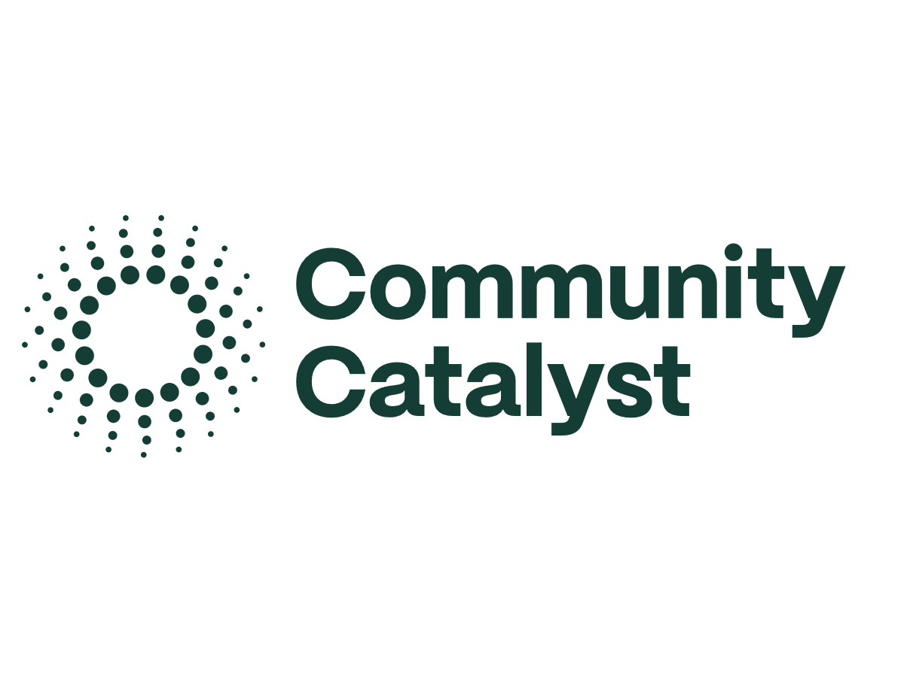
We’re a national organization dedicated to building the power of people to create a health system rooted in race equity and health justice and a society where health is a right for all. Together with partners, we’re building a powerful, united movement with a shared vision of and strategy for a health system accountable to all people.
300+ partner organizations at the local and state level
45+ states where we do our work
9 states where we’ve incubated health advocacy organizations
Aracely
Storyteller and advocate
Notes:
Thank you for the opportunity to share how Community Catalyst is approaching the growing threats to Medicaid—and how we’re working with partners to both defend critical gains and build toward long-term transformation.
We are national organization dedicated to building the power of people to create a health system rooted in race equity and health justice and a society where health is a right for all. Together with partners, we’re building a powerful, united movement with a shared vision of and strategy for a health system accountable to all people.
At Community Catalyst, we’re advancing a “yes/and” strategy:
Yes, we’re fighting to protect health coverage, access, and equity in the face of ongoing rollbacks and harmful proposals;
And we’re setting the stage for broader change by growing cross-issue partnerships, shifting the narrative, and building power with state and local advocates.

Slide 3
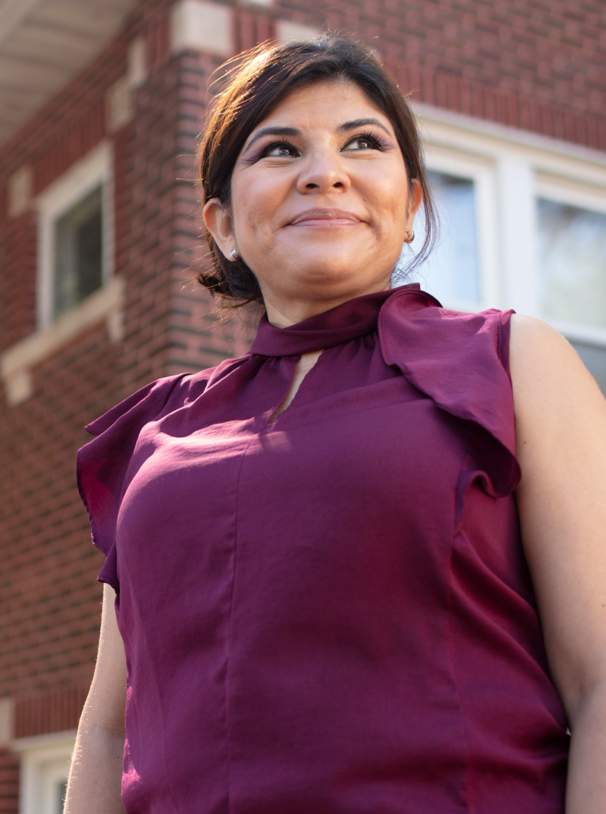
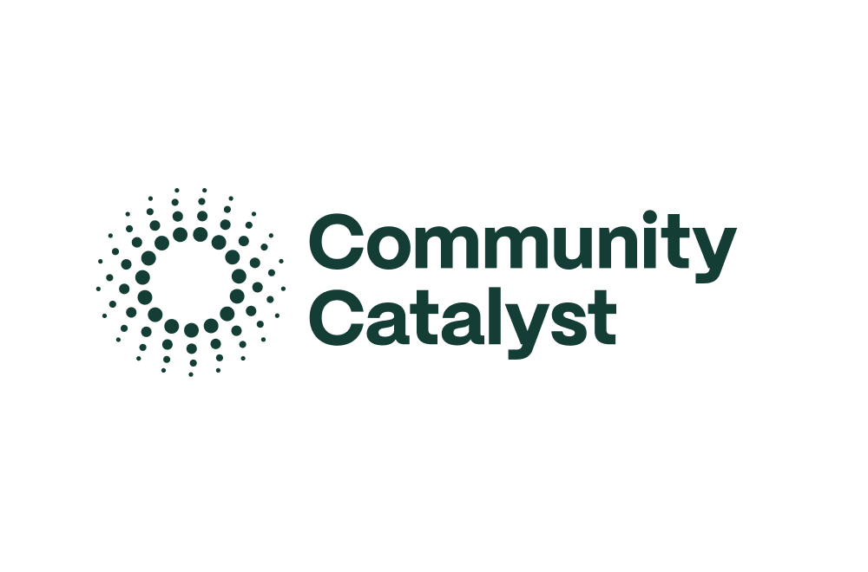
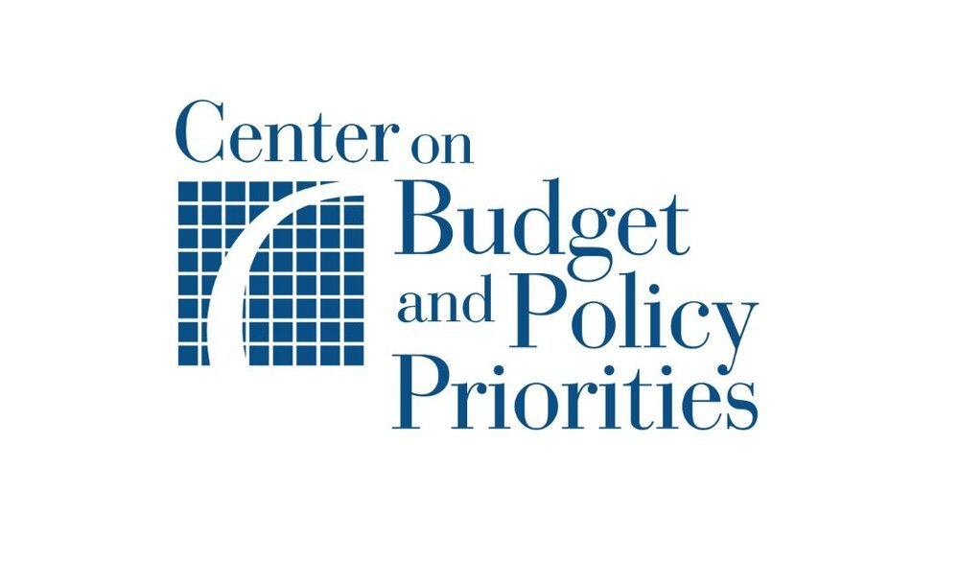
Co-leading a national effort called the State Health Table
©COMMUNITY CATALYST 2025
Notes:
Since January, we’ve been co-leading a national effort called the State Health Table alongside CBPP, Georgetown CCF, Families USA, and NHeLP. Together, we’re coordinating Medicaid defense resources and aligning national support for state advocates. That includes:
Regular strategy calls
Messaging guides
Social media toolkits
Policy fact sheets These tools help ensure advocates on the ground have what they need to respond quickly and effectively.
What sets Community Catalyst apart is our deep, long-standing relationships with state and local partners—especially in places on the front lines. We act as a bridge between national strategies and local realities, ensuring this work is community-informed and equity-driven.

Slide 4
State-Level Strategy & Support
16 target states
Engaging over 80 organizations
3 Medicaid Defense calls with nearly 1500 registrants
Convened advocates from states with FMAP trigger laws
Press event with 8 Southern States
Surveyed state partners to assess needs for Congressional outreach
©COMMUNITY CATALYST
Notes:
[State-Level Strategy & Support]
We’ve helped coordinate a campaign in 16 target states, engaging over 80 organizations.
In Pennsylvania, we’re supporting the Health Access Network as they expand a 125-member coalition (aiming for 200) to link Medicaid threats with the rise in medical debt.
We hosted three Medicaid Defense calls with nearly 1500 registrants
We convened advocates from the states with FMAP trigger laws to align on coordinated state/federal strategies.
We held a press event with 8 Southern States
We surveyed state partners to assess needs for Congressional outreach and are tracking outcomes to inform rapid-response supports.

Slide 5
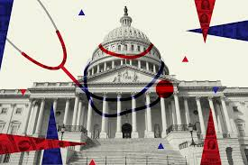
Federal Engagement & Narrative Change
Preparing and supporting national and state partners in meetings with Congressional delegates
Provided partners with Congressional recess toolkits
Producing public-facing education tools
Working with cross-movement allies
Connecting to a broader narrative on health care, ACA, and medical debt
©COMMUNITY CATALYST
Notes:
[Federal Engagement & Narrative Change]
We’re preparing and supporting national and state partners in meetings with Congressional delegates, helping advocates shape clear and persuasive messages.
We’ve provided partners with Congressional recess toolkits including resources on organizing strategies, talking points, messaging guides, email templates, and a social media toolkit
We’re producing public-facing education tools, including an explainer and video on work requirements, with more coming soon.
And we’re working with cross-movement allies—including gender, aging, disability, and economic justice organizations—to connect Medicaid defense to broader fights:
Justice in Aging and Caring Across Generations (impact on older adults and disabled people)
Families Over Billionaires, Fair Share America, Americans for Tax Fairness (tying Medicaid threats to tax fights)
And participated in #WellnessWed chats with Moms Rising.

Slide 6
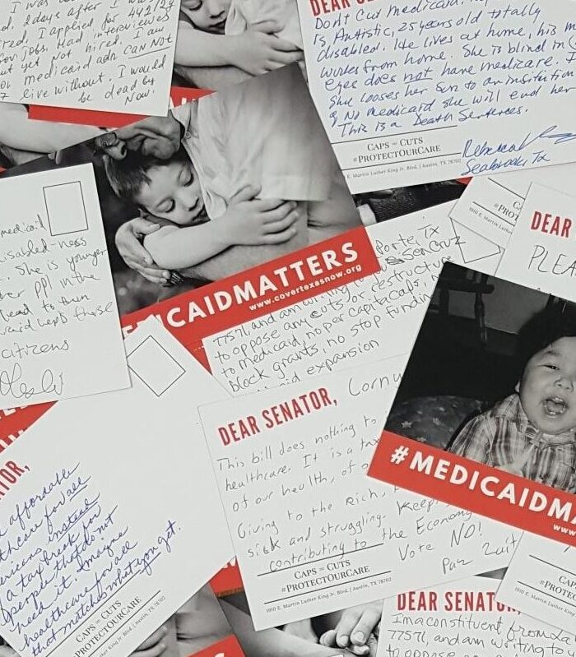
What’s Next
Protecting coverage and care
Advancing race equity
Building community power for lasting systems change
©COMMUNITY CATALYST
Aracely
Storyteller and advocate
Aracely
Storyteller and advocate
Notes:
[Why This Matters Now]
These threats aren’t happening in isolation—they’re part of a coordinated effort to erode access to care and undermine public programs that serve people pushed to the margins. But we have an opportunity to meet this moment with urgency and long-term vision.
We’re not just defending—we’re organizing, building narrative power, and strengthening the field.
[Call to Action]
As we continue this work, we welcome partnerships with those who share our commitment to:
Protecting coverage and care
Advancing race equity
Building community-led power for lasting systems change
Thank you again for standing with us and our partners in the fight for health justice.

Slide 7
Questions?
Thank you!

