Slide 1
The Skinny on the Debate Over Medicaid Cuts
Larry Levitt
Executive Vice President for Health Policy, KFF
Grantmakers in Health

Slide 2
Medicaid Cuts Could be Up to $880 Billion…or More
Things are still very up in the air
Differing House and Senate budget resolutions
Potential use of a “current policy” baseline
Potential federal funding cuts
Impose work requirements
Eliminate the enhanced federal match for the ACA expansion
Per capita caps (overall or on the Medicaid expansion group)
Limit the use of provider taxes and state-directed payments to hospitals
Lower the FMAP floor
Roll-back major Biden rules
Target states that have expanded coverage for immigrants

Slide 3
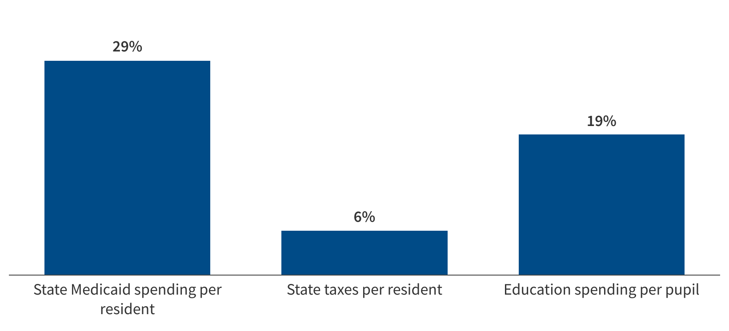
Potential federal Medicaid cuts represent 29% of state Medicaid spending per resident, 6% of state taxes per resident, and 19% of education spending per pupil.
$88B in annual federal cuts as a share of state Medicaid spending per resident, state taxes per resident, and state education spending per pupil
Source: KFF analysis of 2024 Medicaid spending and enrollment data, U.S. Census Bureau 2024 Resident Population Data, U.S. Census Bureau 2023 Annual Survey of State Government Tax Collections, National Association of State Budget Officers (NASBO) 2024 State Expenditure Report, National Center on Education Statistics Digest of Education Statistics, K-12 Enrollment. See Putting $880 Billion in Potential Federal Medicaid Cuts in Context of State Budgets and Coverage for more information.

Slide 4
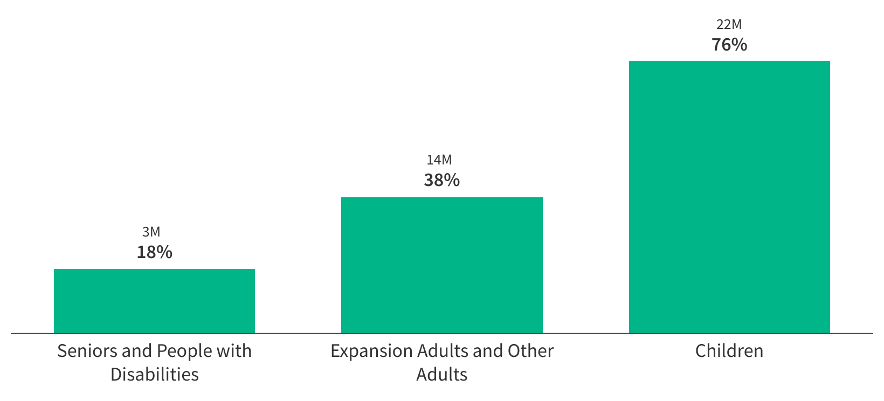
Potential federal Medicaid cuts are equivalent to Medicaid spending for 18% of seniors and people with disabilities, 38% of adults, or 76% of children
Number and share of enrollees in each group equivalent to $88B in federal cuts based on total spending per enrollee
Source: KFF analysis of 2024 Medicaid enrollment and spending data. See Putting $880 Billion in Potential Federal Medicaid Cuts in Context of State Budgets and Coverage for more information.

Slide 5
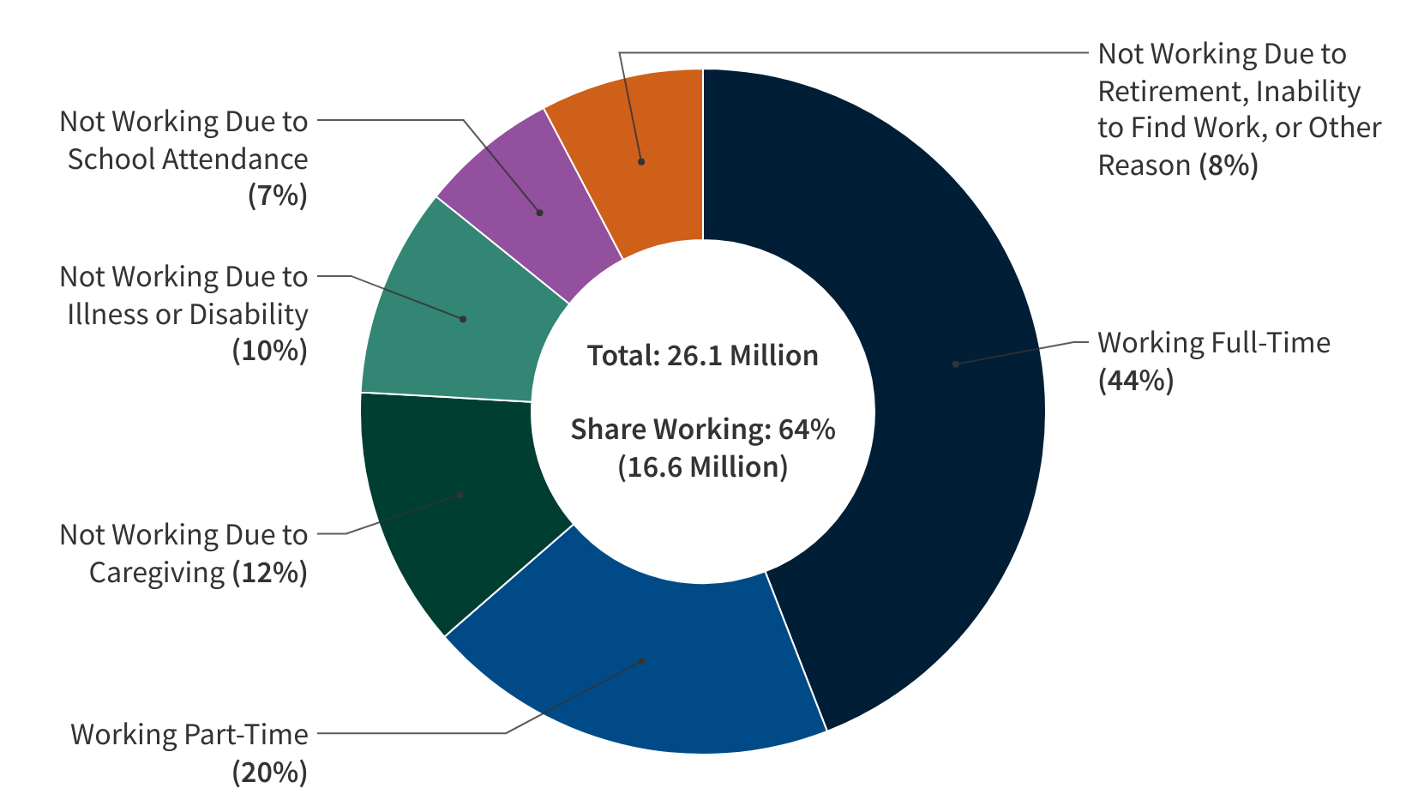
Congress Is Considering Work Requirements in Medicaid Despite Data That Show 92% Are Working or Face a Barrier to Work
Work Status and Barriers to Work Among Medicaid Adults, 2023
Note: Total may not sum to 100% due to rounding. Working Full-Time is based on total number of hours worked per week (at least 35 hours). Full-time workers may be simultaneously working more than one job. Includes Medicaid covered adults (age 19-64) who do not receive benefits from Supplemental Security Income (SSI) or Social Security Disability Insurance (SSDI) and are not also covered by Medicare.
Source: KFF analysis of the March 2024 Current Population Survey ASEC Supplement

Slide 6
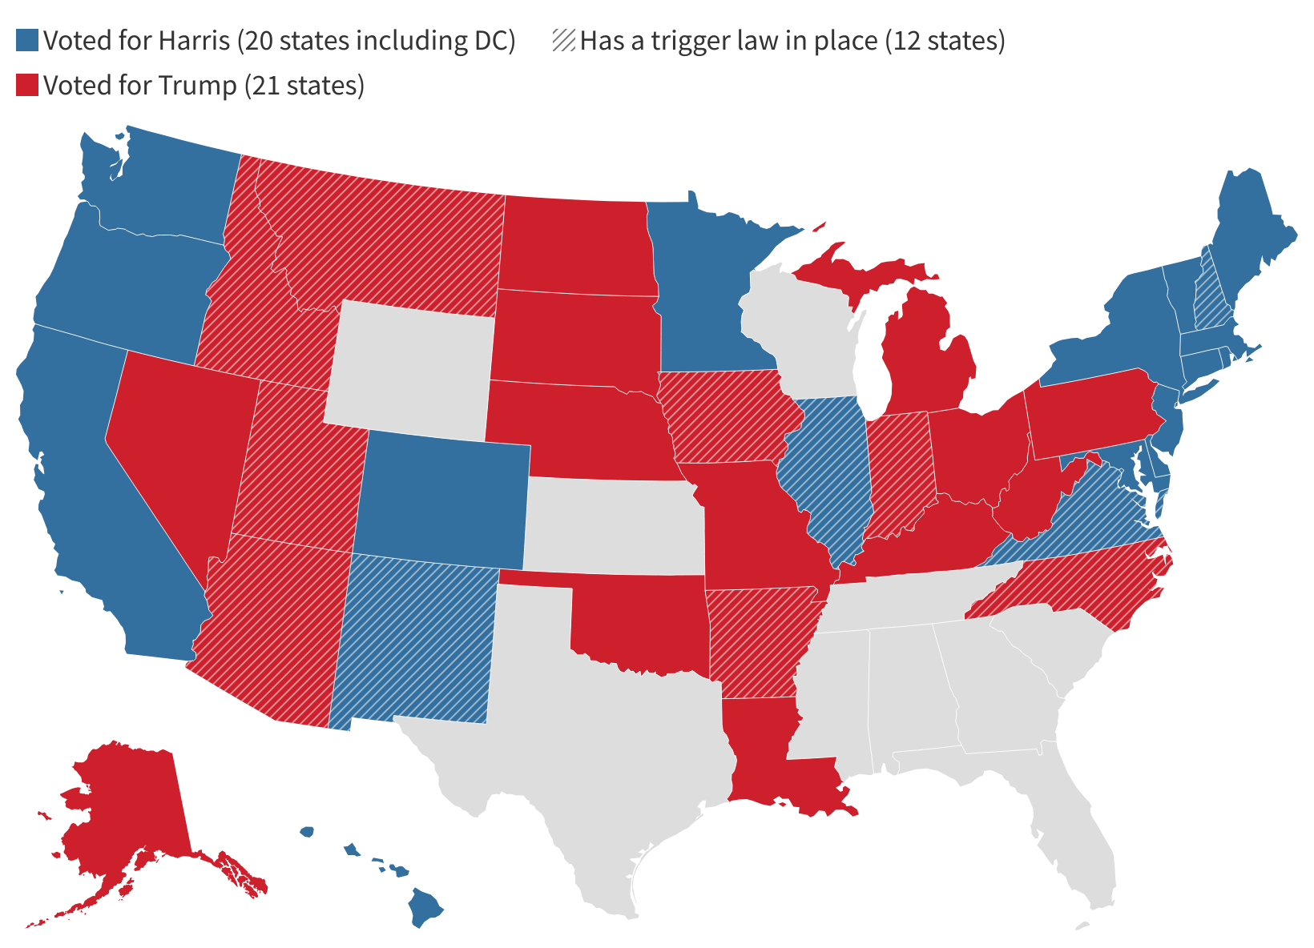
Take-up of Medicaid Expansion Is Evenly Divided Between States That Voted for Trump and Harris
States that Have Adopted the Medicaid Expansion by Presidential Election Voting Result
Note: Trigger laws are laws that would end expansion coverage or require states to take steps to mitigate increases in state costs if federal funding for the expansion is reduced.
Source: KFF tracking of state Medicaid expansion decisions and Searing, Adam. "Federal Funding Cuts to Medicaid May Trigger Automatic Loss of Health Coverage for Millions of Residents of Certain States." Say Ahhh! Georgetown Center for Children and Families, November 27, 2024.

Slide 7
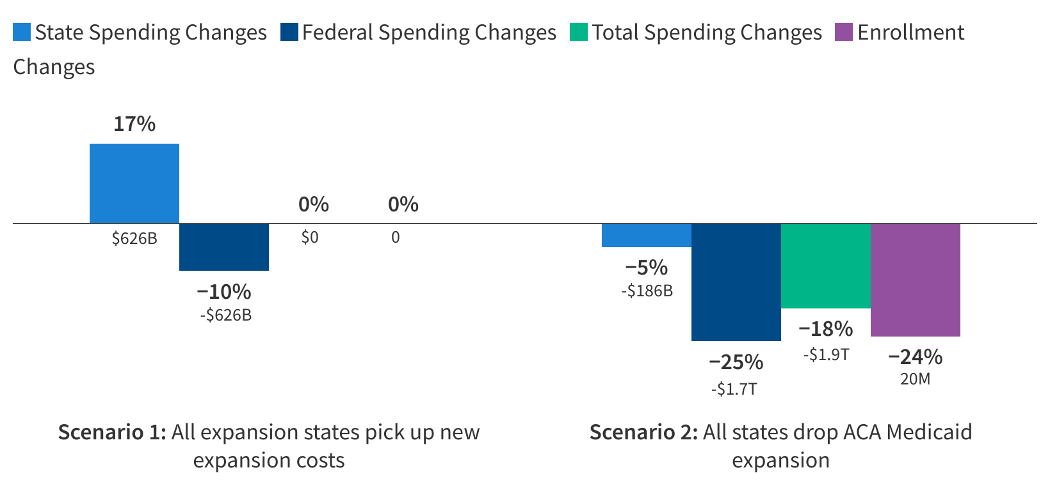
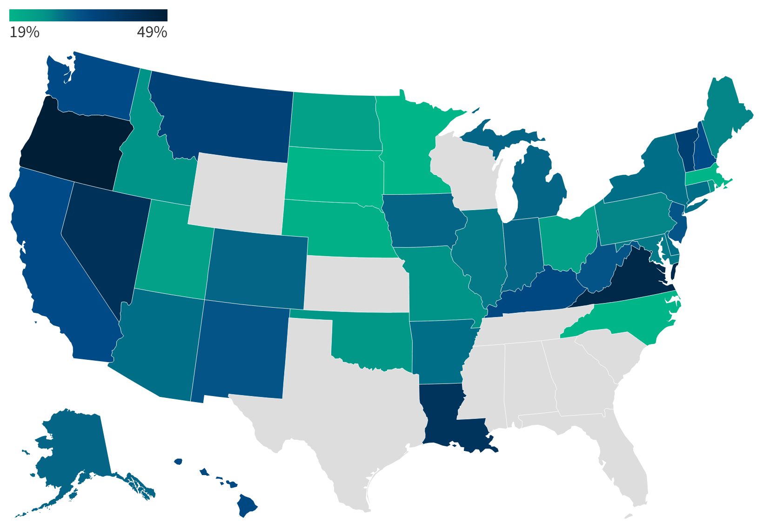
Eliminating the ACA Expansion Match Could Reduce Total Federal Spending by 25% and Enrollment by 20 Million (19% - 49% Across Expansion States)
Estimated percent change in Medicaid enrollment (FY 2034) and spending (FY 2025 - FY 2034) under two illustrative scenarios
Estimated percent decline in Medicaid enrollment (FY 2034) if current expansion states dropped the expansion
Note: Changes show the differences in spending and enrollment from KFF's baseline projections that occur if state expenditures for the ACA population were matched at the state's FY 2026 FMAP rather than 90%, starting in FY 2026.
Source: KFF analysis of Medicaid enrollment and spending data from various sources. See Methods of "Eliminating the Medicaid Expansion Federal Match Rate: State-by-State Estimates " for more information about projections and assumptions.
Source: KFF analysis of Medicaid enrollment and spending data from various sources. See Methods of "Eliminating the Medicaid Expansion Federal Match Rate: State-by-State Estimates " for more information about projections and assumptions.

Slide 8
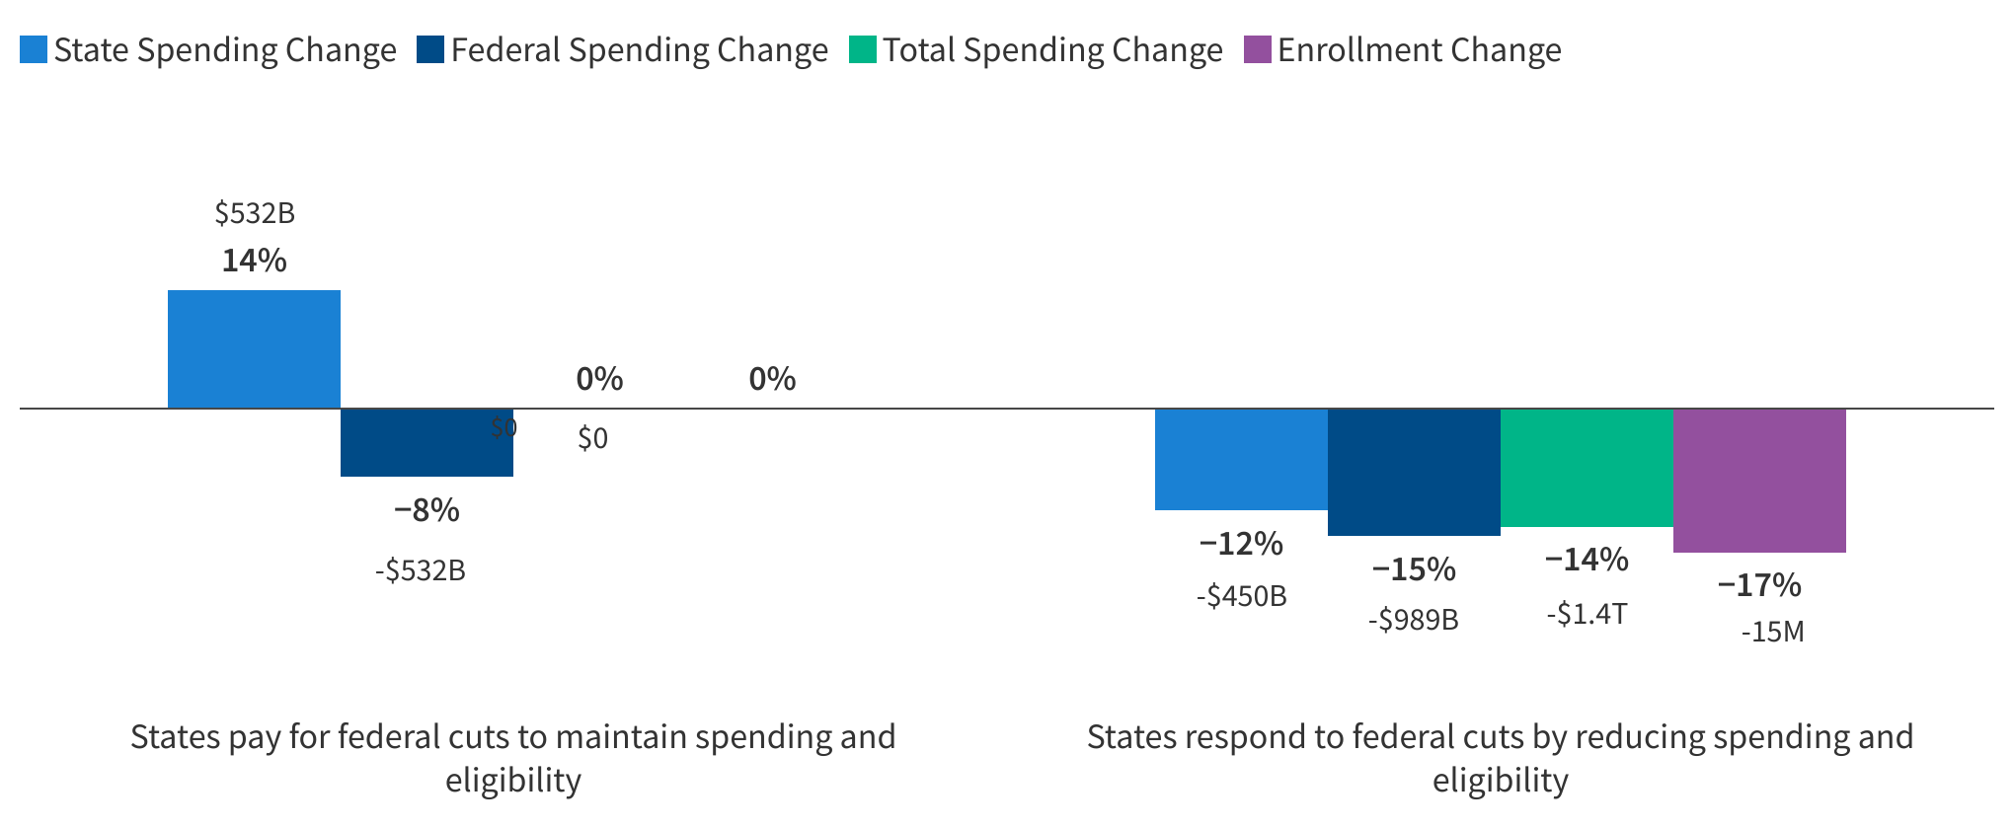
Capping per Enrollee Spending Could Shift Costs to States or Reduce Total Medicaid Spending by 14% Over 10 Years
Estimated percent change in Medicaid spending (FY 2025 - FY 2034) and enrollment (FY 2034) from a per capita cap, by type of state response
Note: Changes show the differences in spending (FY 2025-2034) and enrollment (2034 only) from KFF's baseline projections that would occur if federal expenditures were limited by the growth in medical inflation starting in FY 2027.
Source: KFF analysis of Medicaid enrollment and spending data from various sources. See Methods of "A Medicaid Per Capita Cap: State by State Estimates " for more information about projections and assumptions.

Slide 9
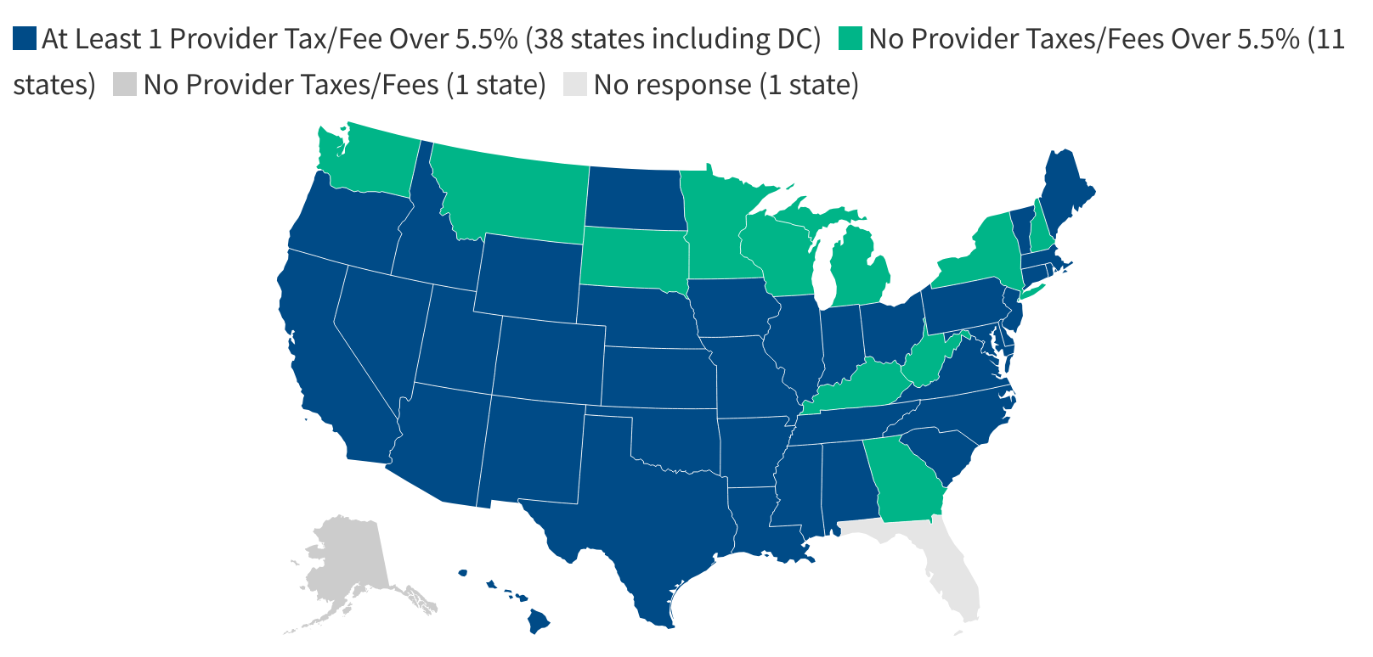
Most States Have a Provider Tax Over 5.5%, Close to the Federal Maximum of 6%
Notes: SFY = state fiscal year. Size of tax is reported as a percentage of net patient revenue (as of July 1, 2024). Includes Medicaid provider taxes as reported by states. FL did not respond to the 2024 survey; publicly available data used to verify taxes in place but not the size of the taxes. Source: Annual KFF survey of state Medicaid officials conducted by Health Management Associates, October 2024

Slide 10
At Least Half of either Republican or Democratic Congressional Districts Have 21% or More Residents Enrolled in Medicaid
CA22 (R)
Share of congressional district enrolled in Medicaid: 64%
Total Medicaid Enrollees: 495,200
Adults: 114,400
Seniors: 34,200
Children: 176,600
Individuals with Disabilities: 30,200
ACA Adults: 139,800

Slide 11
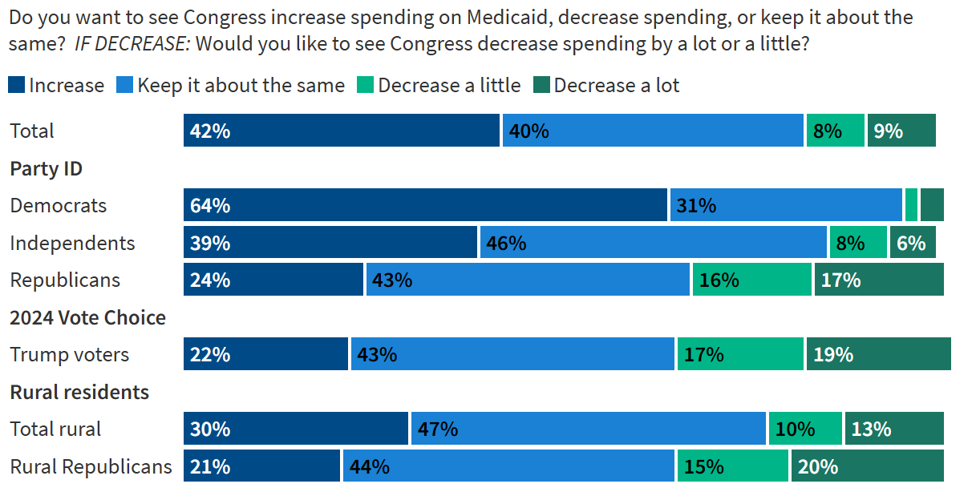
Recent polls indicate that the public generally wants to increase or maintain current spending on Medicaid.
Source: KFF’s Health Tracking Poll February 2025: The Public’s Views on Potential Changes to Medicaid

Slide 12
Focus group participants opposed cuts to Medicaid and appealed to lawmakers to consider how changes would negatively affect people who rely on the program.
I think Trump knows that people are struggling right now, and I don't think he's gonna do, at least not right now, cut anything Medicaid because he just knows people's financial problems right now. – 45-year-old, Hispanic male (Trump voter, Arizona)
I would just beg them please to do their best to keep medical coverage for people that need it. And I mean, I live every day, day to day taking my meds and I need Medicaid. I don't know what I would do without it. –39-year-old, Black male (Trump voter, Ohio)
Well, I think they should step back and look at it and realize that we're not just a number on a spreadsheet. We're actually people and what they decide to do has consequences. –39-year-old, White male (Harris voter, Kentucky)
Ask yourself, if you're the person to make the decision to cut [Medicaid], if it was you and someone in your family [who would be affected], what would you do? - 59-year-old, White male (Harris voter, Pennsylvania)

