Slide 1

Lori Freeman
CEO
National Association of County & City Health Officials
Philanthropy’s Role in Protecting Public Health
Brian Washington
Strategist, Initiatives
Missouri Foundation for Health
Avital Havusha
VP of Programs
New York Health Foundation
Monday, July 21 at 3:00 p.m. Eastern
Visit GIH.org to learn more

Slide 2


Grantmakers in Health
Philanthropy and Public Health Webinar
July 21, 2025
Lori Tremmel Freeman
Chief Executive Officer
NACCHO

Slide 3


About NACCHO
NACCHO is comprised of over 3,300 local health departments across the United States. Our mission is to serve as a leader, partner, catalyst, and voice with local health departments.
There’s value in belonging
Notes:
A few words about NACCHO
NACCHO is the only organization dedicated to serving every local health department in the nation. NACCHO serves 3000 local health departments and is the leader in providing cutting-edge, skill-building, professional resources and programs, seeking health equity, and supporting effective local public health practice and systems.
Pronounced: NAY-cho NOT NOTCHO – as in crispy corn chips ☺
We are headquartered in downtown DC, have an annual budget right now of about $75M and employ approximately 185 staff.
Local health departments are the backbone of the public health system in the United States. As a leader, partner, catalyst, and voice for LHDs, NACCHO advances the work of local health officials and their staffs to create healthy, thriving communities.

Slide 4
















What We Do
Serve on an advisory group or committee
Advocacy
Partnerships
Funding
Attend a conference
Training and education
Apply for an award
Networking
Resources, tools, and
technical assistance
Join the Congressional Action Network
Become a member
Notes:
Although NACCHO serves a number of critical purposes at the national level, our work with local health departments is the keystone of our purpose.
We serve as a conduit of information to our local health departments, create and support many partnerships and networks, provide recognition for local public health successes and initiatives, market and brand public health, do policy development and offer professional development.
There are variety of ways that you can actively participate in our organization. By getting involved, you’ll strengthen the practice of local public health and help launch your career to the next level. Become a member, if you aren’t already. Join our Congressional Action Network, which advocates for the issues critical to local health departments. Apply for an award like the LHD of the Year Award or the Model Practices Award Program. Attend a conference like NACCHO Annual, the Preparedness Summit, or the biannual informatics conference. Finally, lend your expertise to a NACCHO advisory group or committee, which are responsible for shaping NACCHO’s priorities and directing NACCHO’s work on everything from food safety to accreditation. Here some of the ways you can actively participate and strengthen our mission. You can learn more at www.naccho.org.

Slide 5

NACCHO Programs
Technical Assistance
Training
Peer Networks
Tools & Resources
Communications
Partnership Development
Conferences
Workgroups
Research
Demonstration Sites
Facilitation
Publications
Policy Development
Evaluation
Consulting
Notes:
Community Health
Chronic Disease Prevention
Maternal and Child Health
Adolescent Health
Infectious Diseases
Injury and Violence Prevention
Tobacco Prevention
Environmental Health
Environmental Public Health Tracking
Health Impact Assessments
Health in All Policies
Food Safety
PHIS
Accreditation Preparation
Quality Improvement
Assessment and Planning
Health Equity and Social Justice
Public Health Transformation
Workforce Development
Informatics
Public Health Preparedness
Pandemic Preparedness and Catastrophic Response
Public Health Preparedness
Medical Reserve Corps
Bio-surveillance
TA, training, peer networking, tools, resources, conferences, publications, workgroups, research, policy development, research etc.

Slide 6


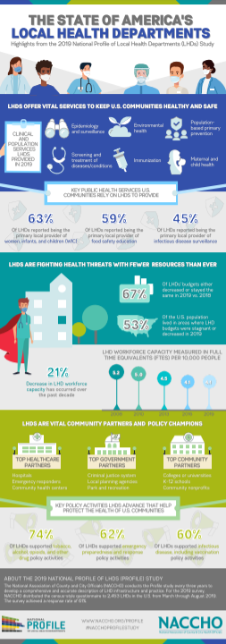
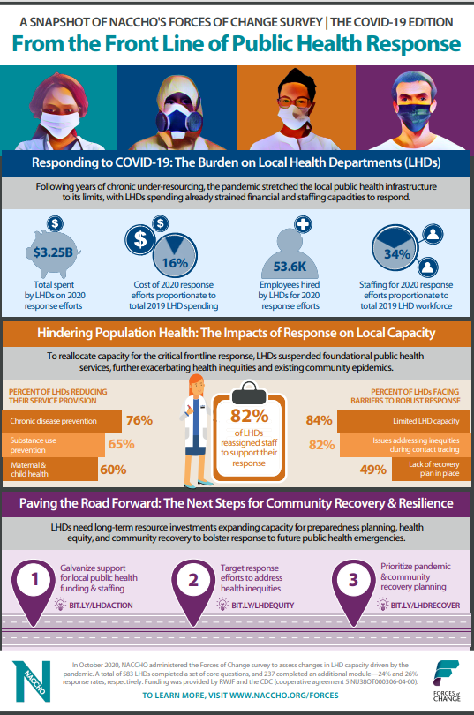


Additional Data Products
Visit www.naccho.org/profile and www.naccho.org/forces
PDF Reports
Profile Dashboard
Infographics
Webinar
Research Briefs and Journal Articles
  Workforce and finance trends
  Emergency preparedness capacity
  Harassment of LHOs

Slide 7

The National Landscape of Public Health

Slide 8
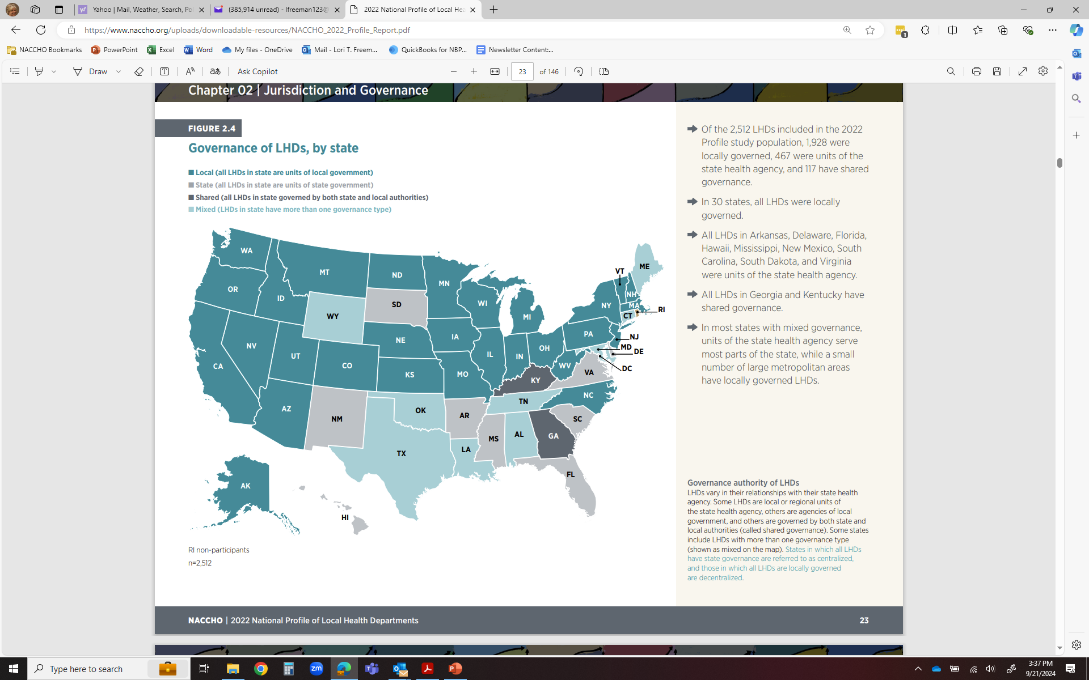
The Local Public Health Landscape
Notes:
Of the 2,512 LHDs included in the 2022 Profile study population, 1,928 were locally governed, 467 were units of the state health agency, and 117 have shared governance.
In 30 states, all LHDs were locally governed.
All LHDs in NINE (9) States: Arkansas, Delaware, Florida, Hawaii, Mississippi, New Mexico, South Carolina, South Dakota, and Virginia were units of the state health agency.
All LHDs in TWO (2) Georgia and Kentucky have shared governance.
In most states with mixed governance, units of the state health agency serve most parts of the state, while a small number of large metropolitan areas have locally governed LHDs
Although only 6% of all LHDs were classified as large, they served more than half of the U.S. population.
The majority of LHDs were small, but together, they served less than 10% of the U.S. population.

Slide 9
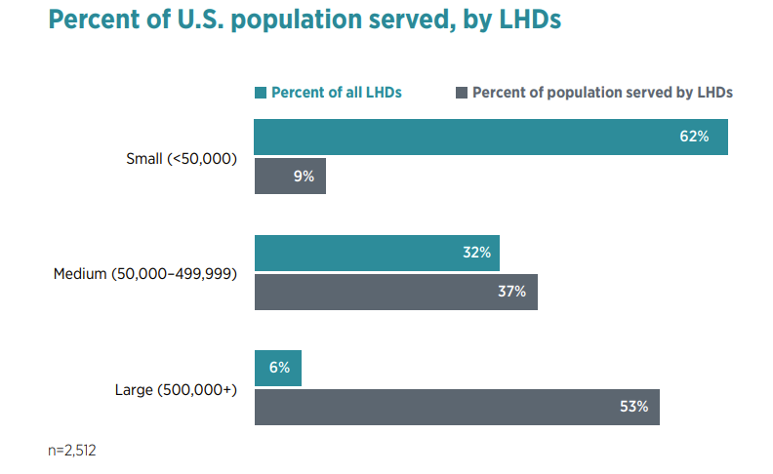
The Local Public Health Landscape
Notes:
Of the 2,512 LHDs included in the 2022 Profile study population, 1,928 were locally governed, 467 were units of the state health agency, and 117 have shared governance.
In 30 states, all LHDs were locally governed.
All LHDs in NINE (9) States: Arkansas, Delaware, Florida, Hawaii, Mississippi, New Mexico, South Carolina, South Dakota, and Virginia were units of the state health agency.
All LHDs in TWO (2) Georgia and Kentucky have shared governance.
In most states with mixed governance, units of the state health agency serve most parts of the state, while a small number of large metropolitan areas have locally governed LHDs
Although only 6% of all LHDs were classified as large, they served more than half of the U.S. population.
The majority of LHDs were small, but together, they served less than 10% of the U.S. population.

Slide 10
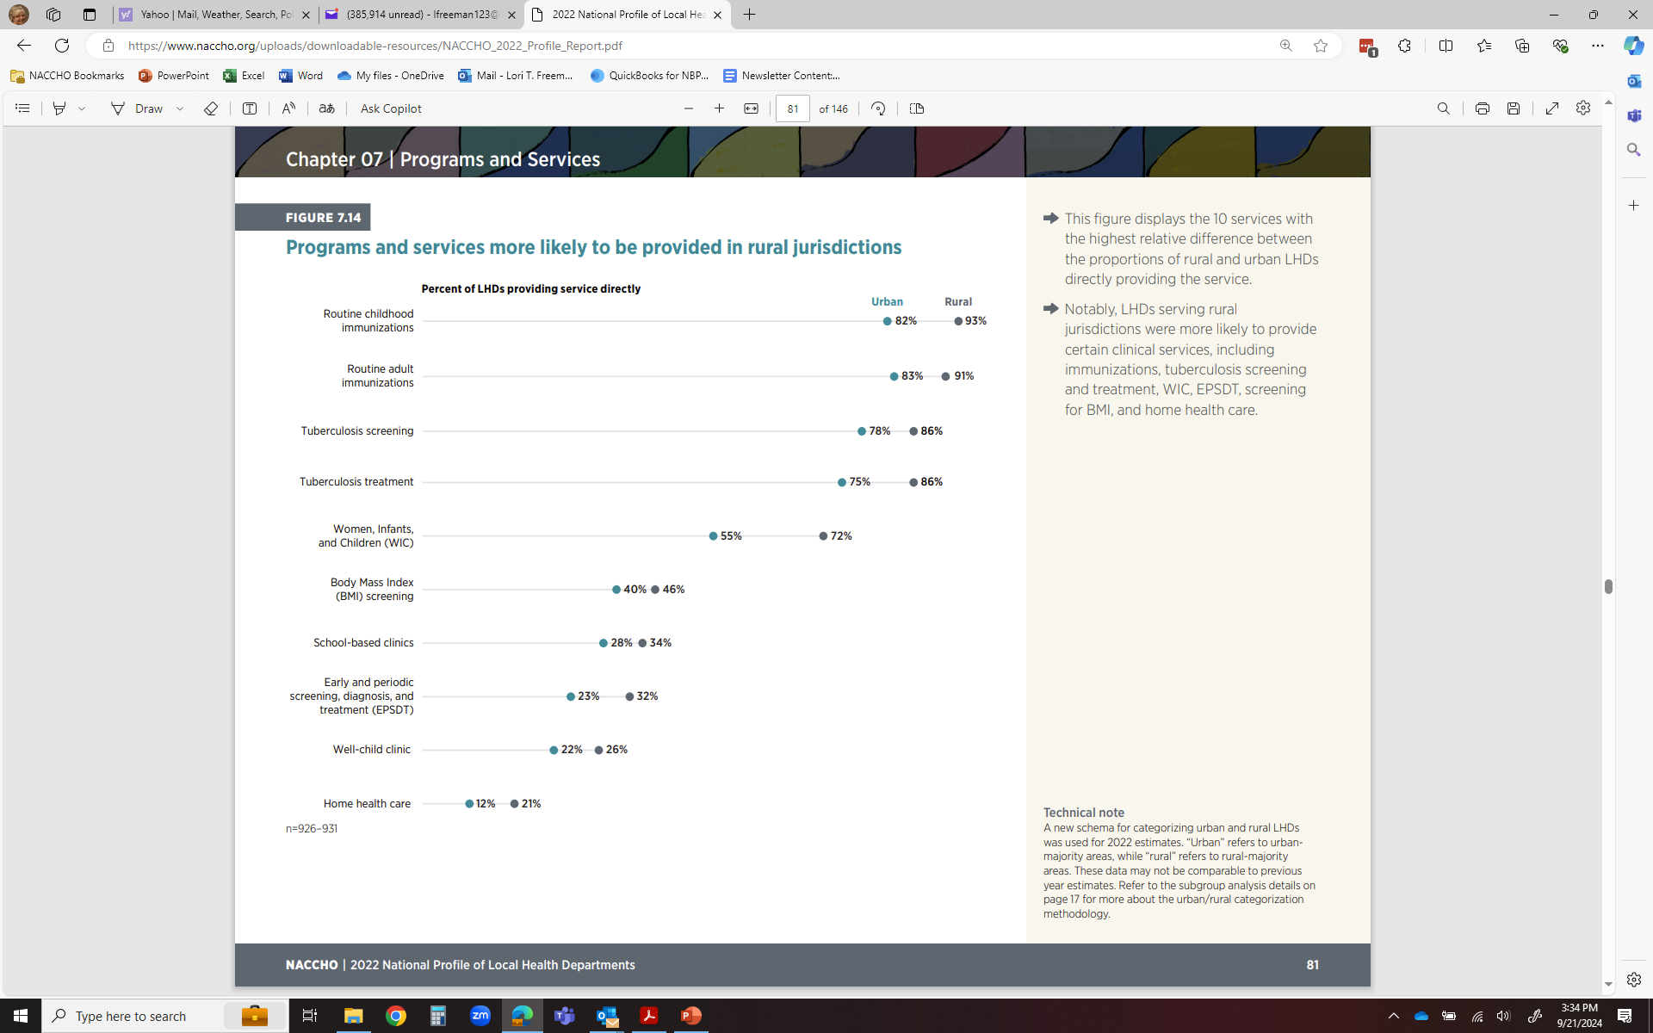
The Local Public Health Landscape
Notes:
This figure displays the 10 services with the highest relative difference between the proportions of rural and urban LHDs directly providing the service.
Notably, LHDs serving rural jurisdictions were more likely to provide certain clinical services, including immunizations, tuberculosis screening and treatment, WIC, EPSDT, screening for BMI, and home health care.

Slide 11
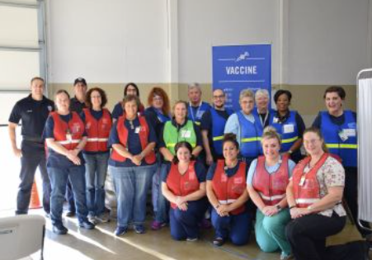
The Public Health Workforce Landscape

Slide 12
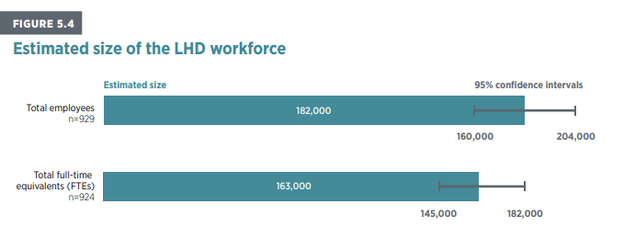
The Public Health Workforce
Notes:
LHDs employ approximately 182,000 employees or 163,000 FTEs.

Slide 13
The LHD workforce grew by 19% after an influx of funding during the pandemic.
Total number of employees and total number of Full-Time Equivalents (FTEs) at LHDs, over time (n=924–2,232)
2020: Onset of COVID-19 pandemic, declaration of public health emergency and supplemental funding efforts
Notes:
An influx of funding was offered to LHDs in 2021 and may be one of the reasons we see the substantial growth in the LHD workforce
While the workforce has grown since 2019, coupled with increased funding and expenditures by local public health, data collected from PHWINS and analyzed by NACCHO found that 3 in 10 local public health staff are considering leaving their position – and those who experience harassment or bullying are more likely to report considering this.
However, without sustained funding to support hiring, retention, and protections of local PH staff, LHDs may still be at risk to the impacts of harassment—specifically, the attrition of their staff and leaders, which could erase this gro
Overall, the LHD workforce grew by approximately 19% from 2019 to 2022— after continuously decreasing between 2008 and 2019. Notably, there was a national declaration of public health emergency in 2020 after the onset of the COVID19 pandemic; supplemental funding efforts to temporarily bolster the LHD workforce occurred during this period. At the time data were collected, nearly $60 billion in short-term federal emergency supplemental funding was available to state, tribal, local, and territorial jurisdictions for the COVID-19 pandemic response. This may explain the large jump in workforce. This large influx in federal funding expires in 2024, and no further federal resources are expected.

Slide 14
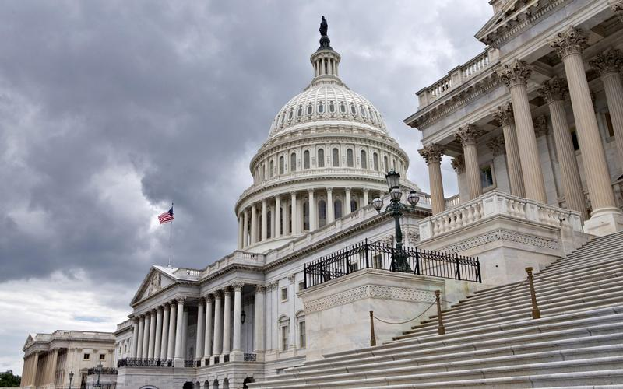
The Federal Landscape

Slide 15
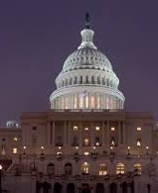
The Voice of Local Public Health at the Federal Level of the U.S.
Highlight the role of local health departments with members of Congress and the Administration
Increase understanding of role of local health departments in communities
Obtain federal funding to support local programs
Inform legislation that establishes and continues key (authorizing) federal programs
Nominate local health officials to federal advisory committees
Submit regulatory comments
Work in coalition to achieve mutual goals
@NACCHOAlerts
Notes:
NACCHO GA is your voice within Congress and the Administration. It is our job to amplify your message and the voices of 3,300 of your closest local health department friends on Capitol Hill.
You role in this is crucial. You are the subject matter experts to make sure we get things right. We want to make sure you’re receiving what’s most useful to you. Your work informs our work.
Highlight the role of local health departments with members of Congress and the Administration
Increase understanding of role of local health departments in communities
Obtain federal funding to support local programs
Inform legislation that establishes and continues key (authorizing) federal programs
Nominate local health officials to federal advisory committees
Submit regulatory comments
Work in coalition to achieve mutual goals

Slide 16

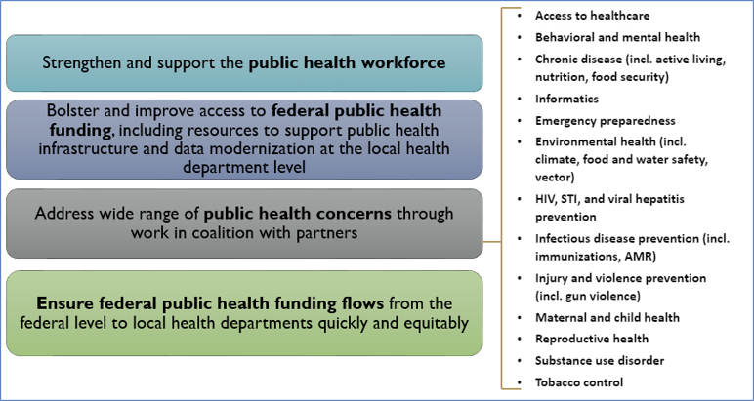
Why It Matters
External Affairs from Policy to Community
NACCHO 2025 Legislative Agenda
Notes:
What guides us in our legislative work federally is a Board-approved yearly federal legislative agenda. This is 2024’s agenda and includes focus on:
Public Health Workforce
Public Health Funding to support infrastructure and data modernization AT YOU LEVEL of the governmental public health system.
Working in coalition on a range of public health topics that you see here.
Ensuring federal funding flows to local health departments quickly and equitably. It is NOT enough to fund the largest of our jurisdictions – they are critical but you leave out half the country and small, rural, medium, and even some of our largest cities.
TNACCHO and LHDs emphasized the needs of their local communities and called attention to three ways Congress can help:
Establish a public health loan workforce repayment program
Gained 15 new cosponsors and $25M included in FY23 House appropriations bill
Became law December 2022
Provide predictable, sustained, disease-agnostic funding to support core public health infrastructure
$200M appropriated in FY22 law; $350M in FY23
Ensure public health funding reaches local health departments equitably and efficiently
Directive language from Congress in FY22 appropriations about allocating funds to local health departments
hrough these efforts, we had success during the pandemic and CDC topline funding improved from $8.4b to $9.3b.
Highlight the role of local health departments with members of Congress and the Administration
Increase understanding of role of local health departments in communities
Obtain federal funding to support local programs
Inform legislation that establishes and continues key (authorizing) federal programs
Nominate local health officials to federal advisory committees
Submit regulatory comments
Work in coalition to achieve mutual goals

Slide 17
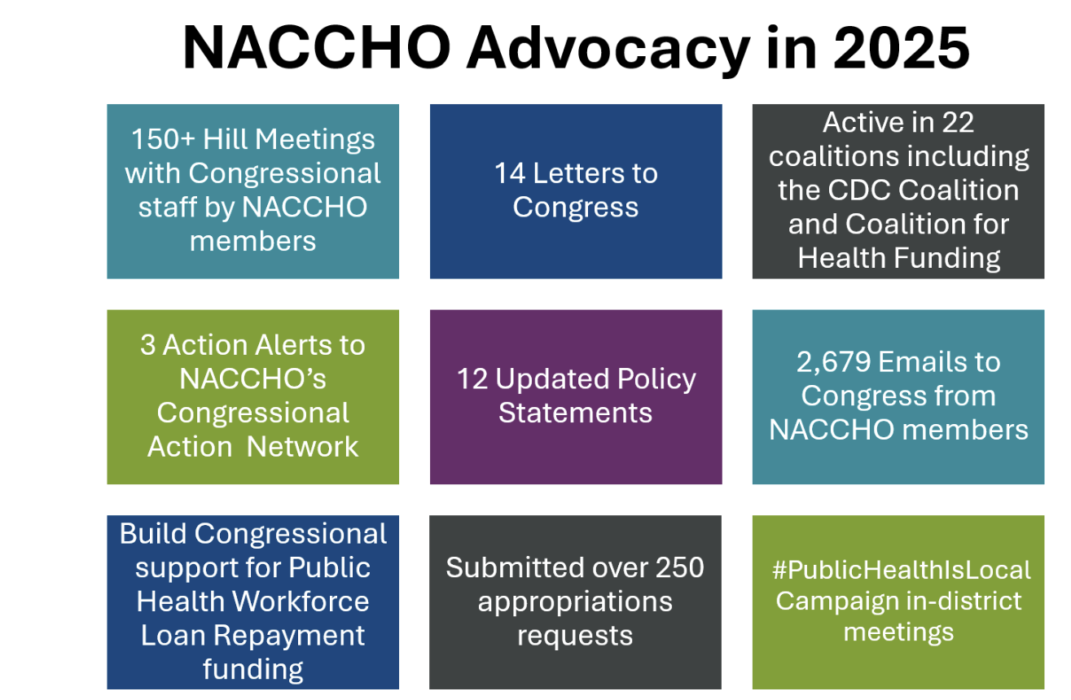
Why It Matters
External Affairs from Policy to Community
Notes:
What guides us in our legislative work federally is a Board-approved yearly federal legislative agenda. This is 2024’s agenda and includes focus on:
Public Health Workforce
Public Health Funding to support infrastructure and data modernization AT YOU LEVEL of the governmental public health system.
Working in coalition on a range of public health topics that you see here.
Ensuring federal funding flows to local health departments quickly and equitably. It is NOT enough to fund the largest of our jurisdictions – they are critical but you leave out half the country and small, rural, medium, and even some of our largest cities.
TNACCHO and LHDs emphasized the needs of their local communities and called attention to three ways Congress can help:
Establish a public health loan workforce repayment program
Gained 15 new cosponsors and $25M included in FY23 House appropriations bill
Became law December 2022
Provide predictable, sustained, disease-agnostic funding to support core public health infrastructure
$200M appropriated in FY22 law; $350M in FY23
Ensure public health funding reaches local health departments equitably and efficiently
Directive language from Congress in FY22 appropriations about allocating funds to local health departments
hrough these efforts, we had success during the pandemic and CDC topline funding improved from $8.4b to $9.3b.
Highlight the role of local health departments with members of Congress and the Administration
Increase understanding of role of local health departments in communities
Obtain federal funding to support local programs
Inform legislation that establishes and continues key (authorizing) federal programs
Nominate local health officials to federal advisory committees
Submit regulatory comments
Work in coalition to achieve mutual goals

Slide 18


The Current Threat & Opportunity Environment in Public Health

Slide 19
Why It Matters
The Future (is NOW) – Active PH Threats
Federal Government/HHS/White House
  HHS Reorganization
  Workforce Reduction Impact
  $11.4B COVID Recissions – Pocket Recission Tool by September?
  Funding Uncertainty
  Related agency impacts (FDA, EPA, CMS/Medicaid, DHS)
State and Local Health Department Impacts
  Comprehensive, Widespread, Real Programmatic Impact
Ongoing Public Health Concerns
  Measles – Over 1K US cases in 31 jurisdictions
  Dengai Outbreak in PR
  H5N1, MPOX, Oropouche, Screw Worm
Notes:
Federal Government/HHS/White House
HHS Reorganization
Workforce Reduction Impact
$11.4B COVID Recissions
Funding Uncertainty
State and Local Health Department Impacts
Comprehensive, widespread
Real Programmatic Impact
As of May 15, 2025, a total of 1,024 confirmed* measles cases were reported by 31 jurisdictions
Organized Response/Collective
24x7x360 Crisis Room / For Our Health / Protect Our Care / Coalition for Trust in Health and Science / Vaccine Integrity Project / PriorityONE / Americans for Healthy Communities
NACCHO Impacts – Reimagination of Local Public Health

Slide 20
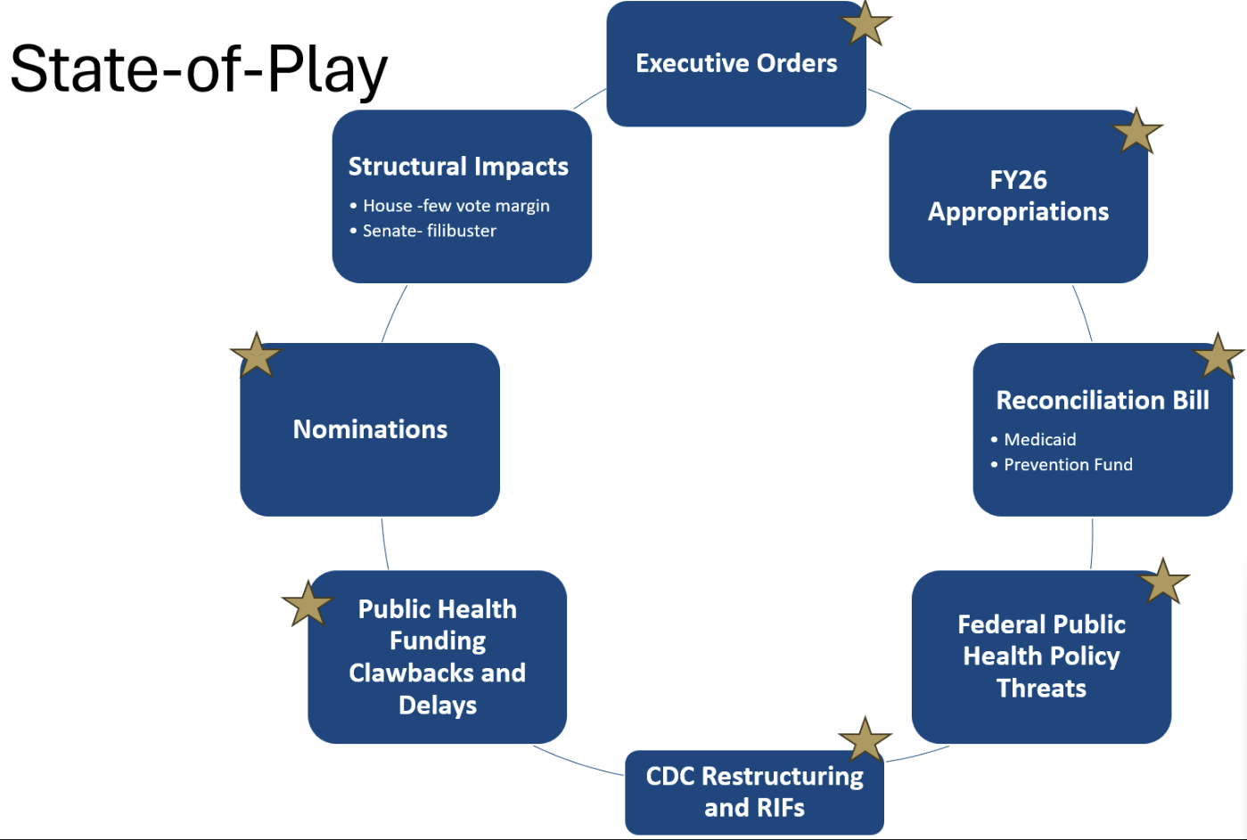
Why It Matters
The Future (is NOW) – Active PH Threats

Slide 21
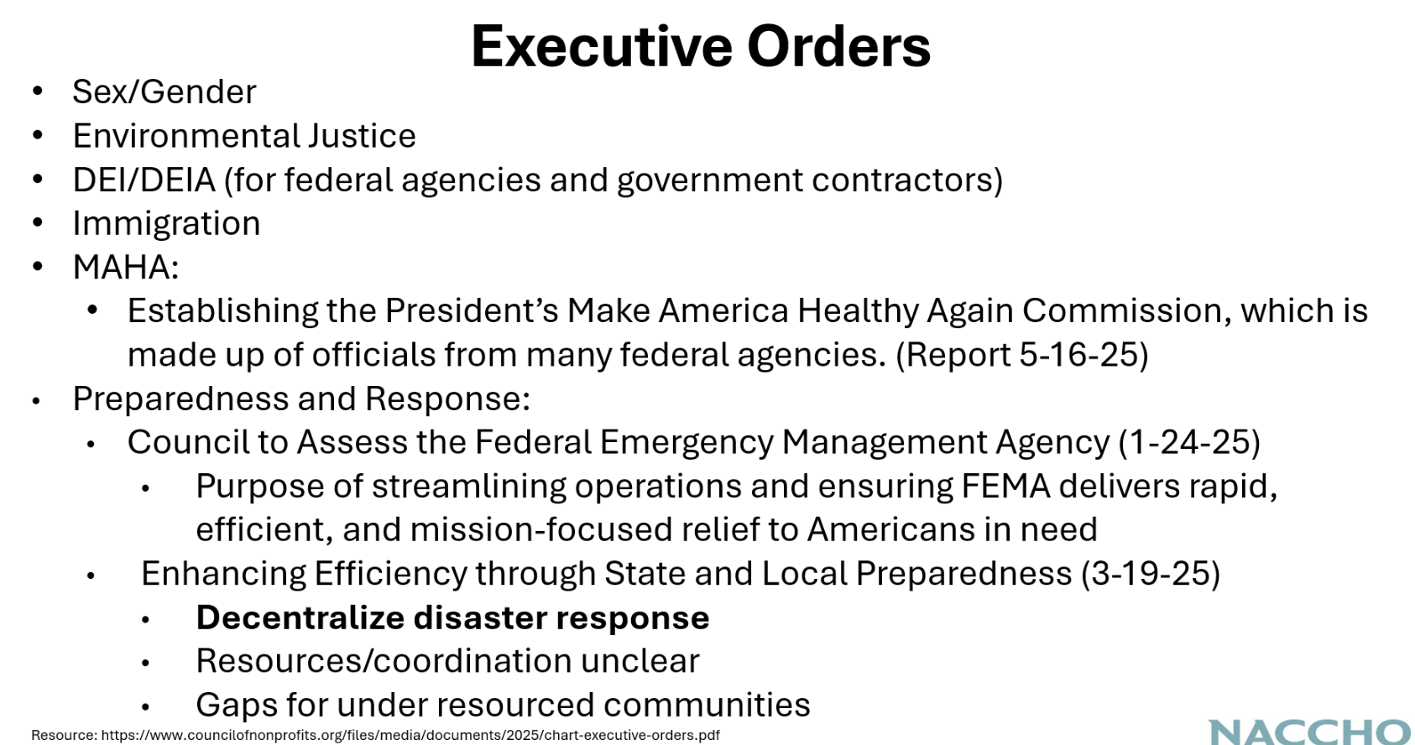
Why It Matters
The Future (is NOW) – Active PH Threats

Slide 22
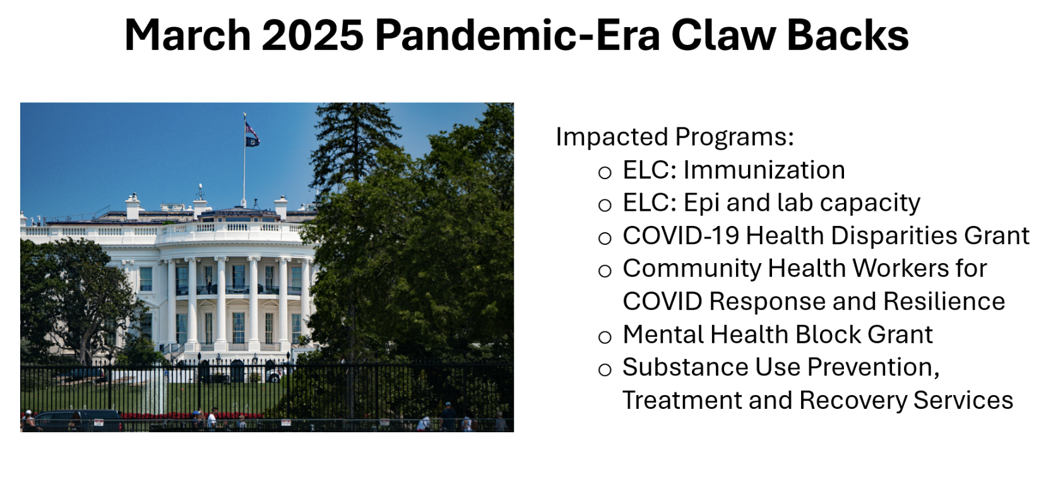
Why It Matters
The Future (is NOW) – Active PH Threats

Slide 23
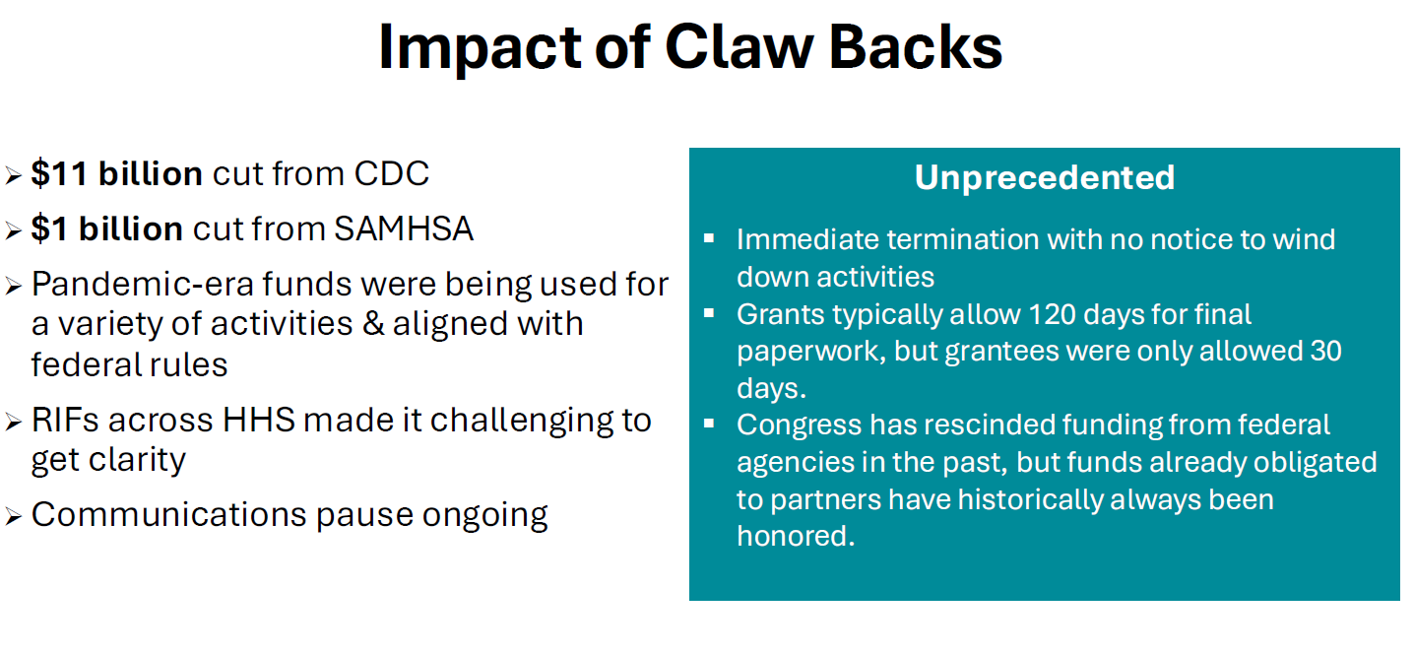
Why It Matters
The Future (is NOW) – Active PH Threats

Slide 24
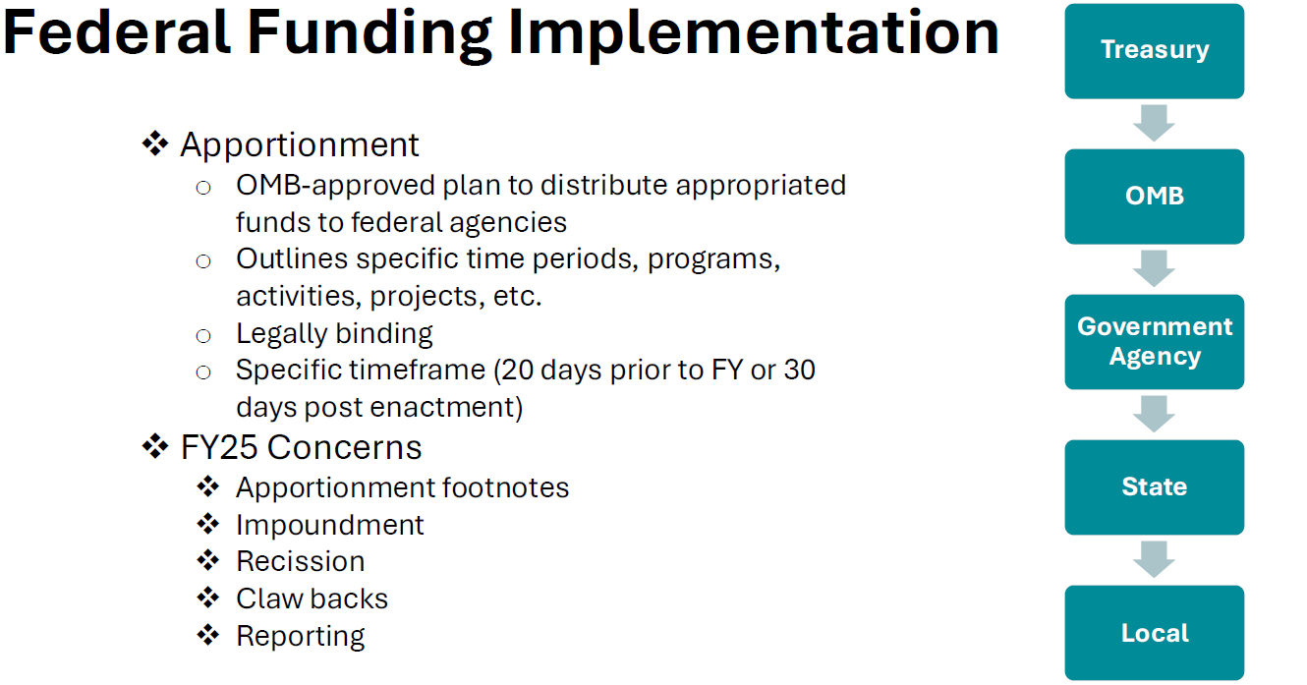
Why It Matters
The Future (is NOW) – Active PH Threats
Notes:
FUNDING DELAYS
State Health Departments sending out notices asking grantees not to incur additional costs for certain programs
Delays from OMB to federal agenciesSmaller Partial AwardsEntire Offices RIF'd
Waiting on FY26 Labor-HHS Appropriations bills

Slide 25
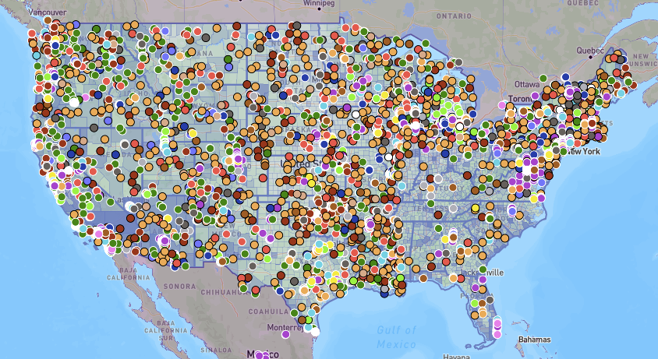
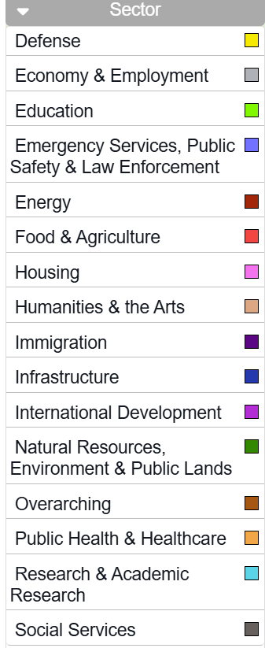
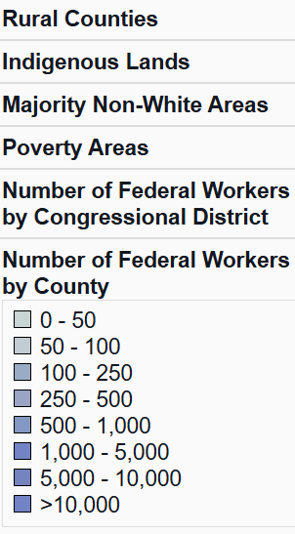
Why It Matters
The Current (NEW) Threat Environment
Map Last Updated: 7/11/2025
If you reference, reproduce, or use data or content from this website, please include a citation and proper attribution. We ask that you cite The Impact Project with a direct link to our website. For example, “Data Provided by The Impact Project (2025) theimpactproject.org.”
Notes:
Map Last Updated: 7/11/2025
If you reference, reproduce, or use data or content from this website, please include a citation and proper attribution. We ask that you cite The Impact Project with a direct link to our website. For example, “Data Provided by The Impact Project (2025) theimpactproject.org.”

Slide 26
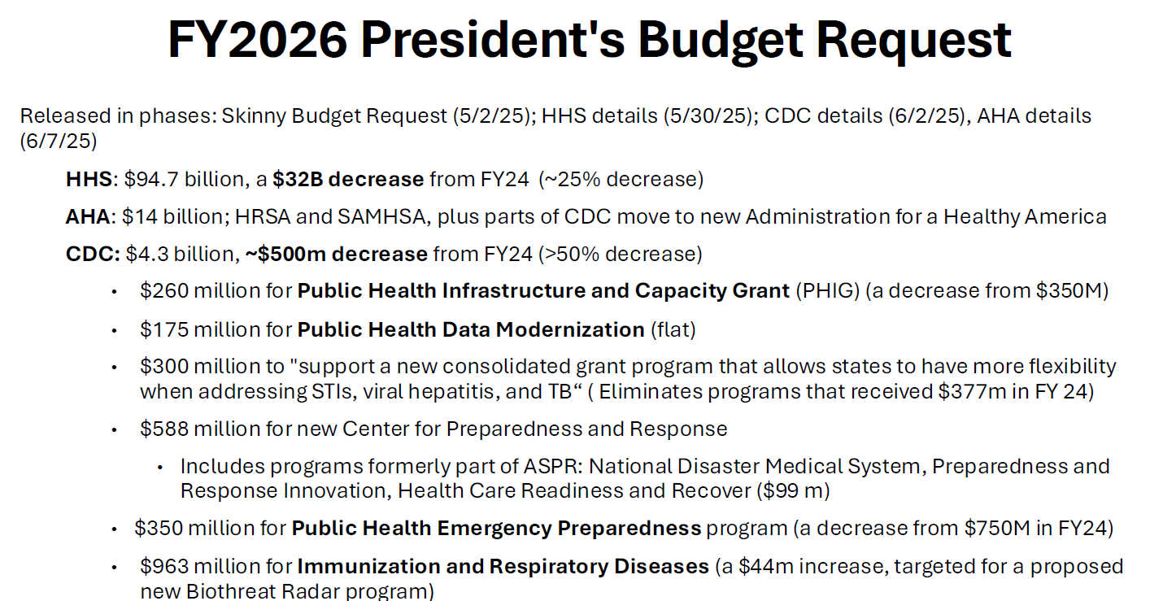
Why It Matters
The Future (is NOW) – Active PH Threats
Notes:
FUNDING DELAYS
State Health Departments sending out notices asking grantees not to incur additional costs for certain programs
Delays from OMB to federal agenciesSmaller Partial AwardsEntire Offices RIF'd
Waiting on FY26 Labor-HHS Appropriations bills

Slide 27
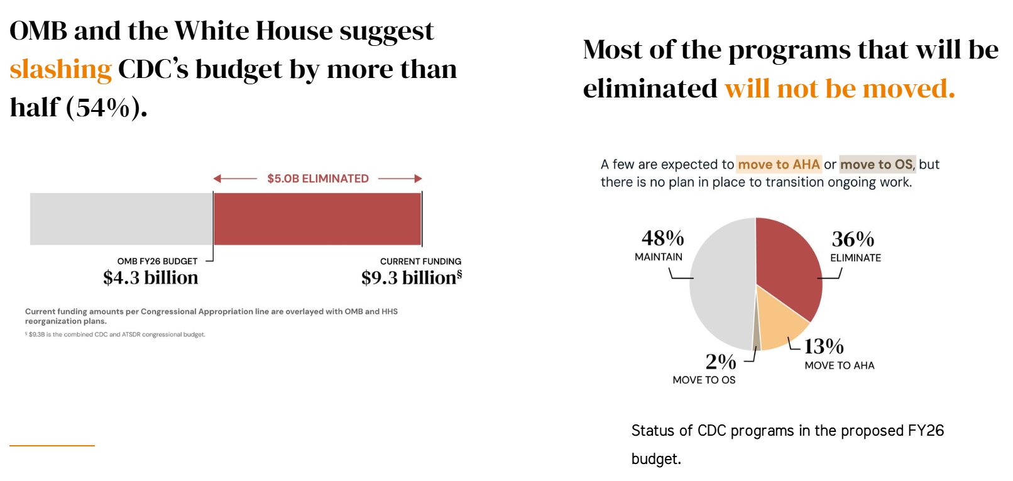
Why It Matters
FY26 President’s Budget
Notes:
The Data Project – Fired but Fighting

Slide 28
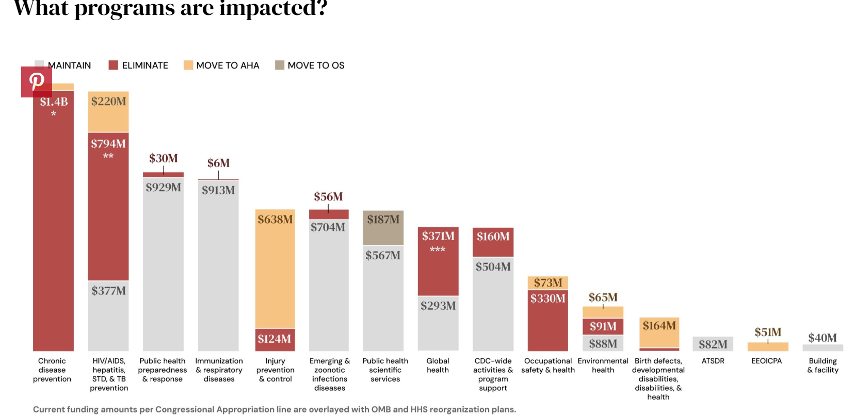
Why It Matters
FY26 President’s Budget
Notes:
The CDC Data Project
www.cdcdataproject.org
Former CDC Staff Members

Slide 29

Why It Matters
CDC Grant Funding

Slide 30
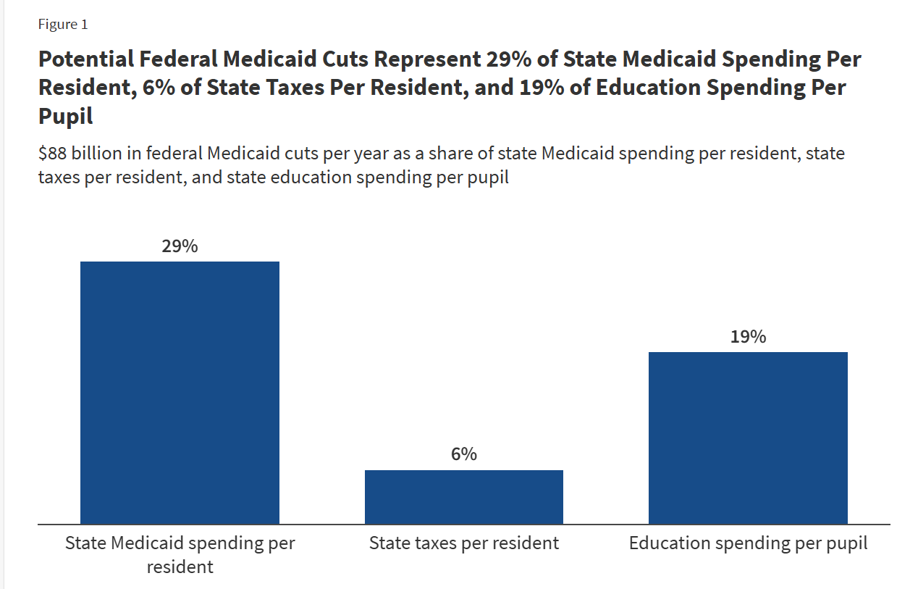
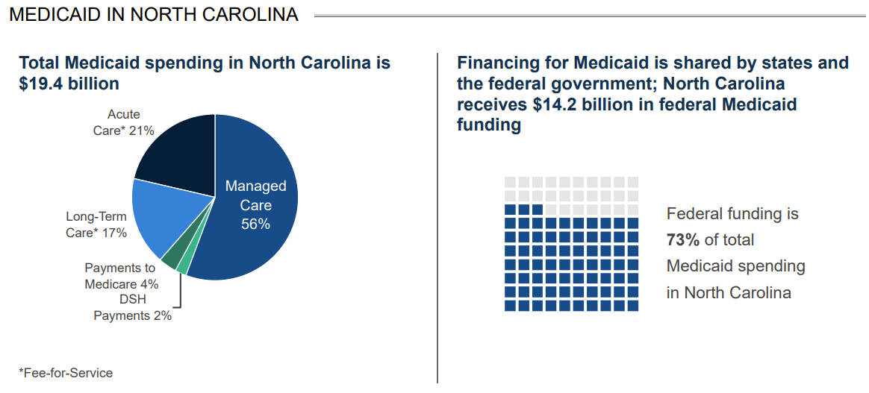
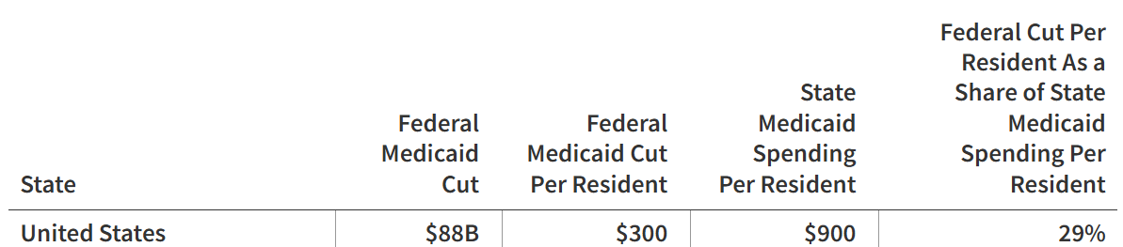
Why It Matters
Potential Medicaid Impacts
Notes:
Source: KFF analysis of 2024 Medicaid spending and enrollment data, U.S. Census Bureau 2024 Resident Population Data, U.S. Census Bureau 2023 Annual Survey of State Government Tax Collections, National Association of State Budget Officers (NASBO) 2024 State Expenditure Report, National Center on Education Statistics Digest of Education Statistics, K-12 Enrollment. See Methods of "Putting $880 Billion in Potential Federal Medicaid Cuts in Context of State Budgets and Coverage" for more information.Get the dataDownload PNG
This was a broad analysis of what proposed Medicaid funding impacts would be at the state level. On average, states would lose about 29 percent of their overall state Medicaid spending per resident – to the right is the data broken down by state and you can see that North Dakota would lose about $163M in federal funding equating to about $200 per resident or near that national average and 28% as a share of state Medicaid spending per resident.

Slide 31
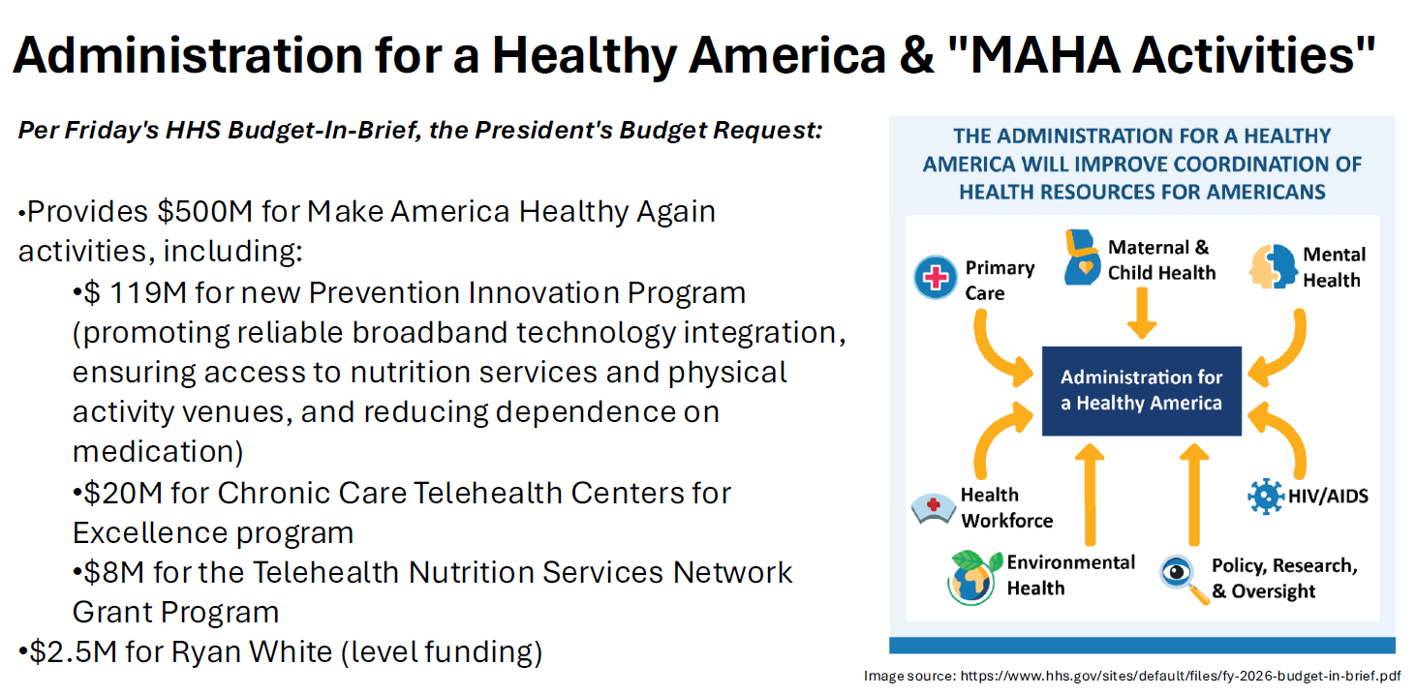
Why It Matters
FY26 President’s Budget

Slide 32
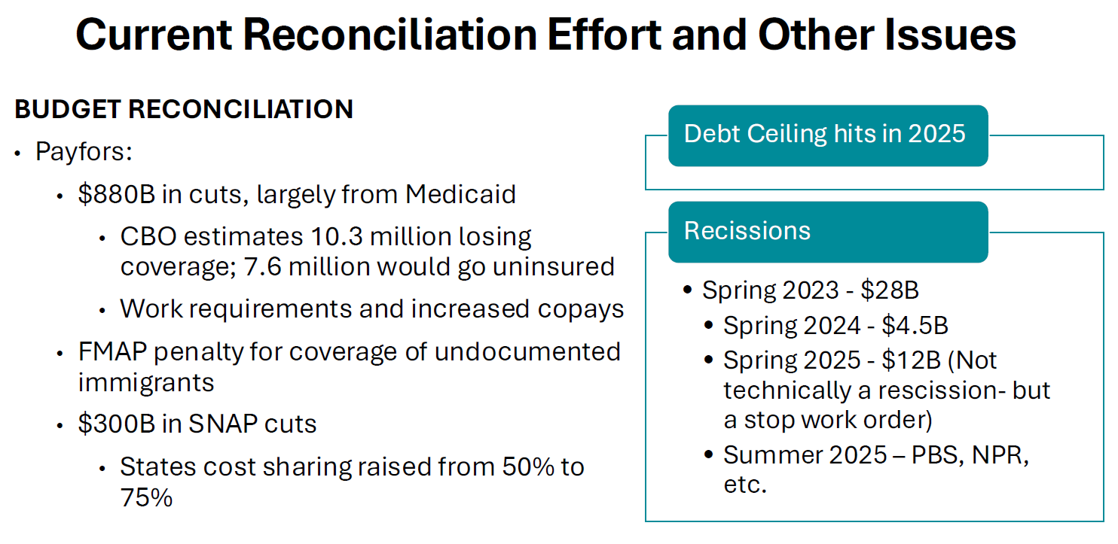
Why It Matters
Budget Reconciliation
Notes:
What is budget reconciliation?
Powerful tool to change current law to adjust revenue and spending levels
Budget reconciliation is sometimes used to quickly advance fiscal legislation
Tax, spending, and debt limit legislation only
Why does Congress use budget reconciliation?
The Senate’s rules require most bills to get a supermajority of votes (60 out of 100 senators) to overcome a filibuster and pass.
The “budget reconciliation” process allows senators to expedite certain legislation’s approval with a simple majority vote.

Slide 33
Why It Matters
The Way Forward
Organized Response/Collective
  24x7x360 Crisis Room
  For Our Health
  Protect Our Care
  Coalition for Trust in Health and Science
  Vaccine Integrity Project / Northeast Public Health Collaborative
  PriorityONE
  Americans for Healthy Communities
  Fired But Fighting
NACCHO
  Coalition Work
  Advocacy/Education
  Funding to LHDs
  Sharing of Information
  Reimagining Local Governmental Public Health and Innovating in the Moment
Notes:
Organized Response/Collective
24x7x360 Crisis Room
For Our Health
Protect Our Care
Coalition for Trust in Health and Science
Vaccine Integrity Project /
PriorityONE
Americans for Healthy Communities
NACCHO
Coalition Work
Advocacy/Education
Funding to LHDs
Sharing of Information
Reimagining Local Governmental Public Health and Innovating in the Moment

Slide 34
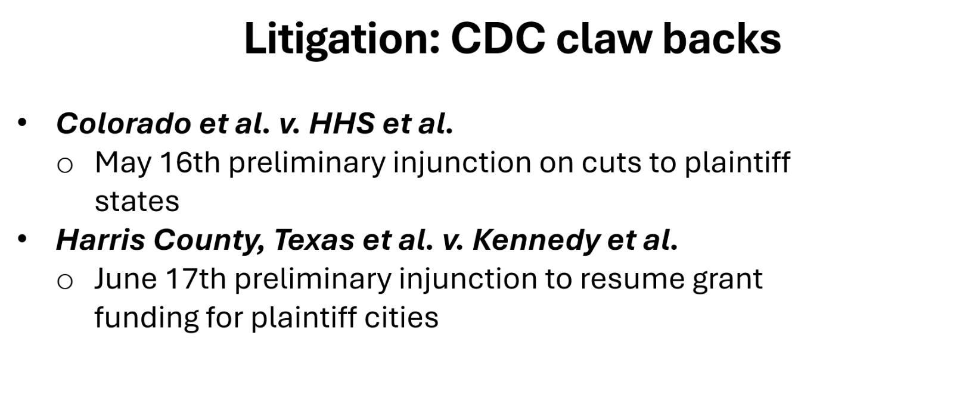
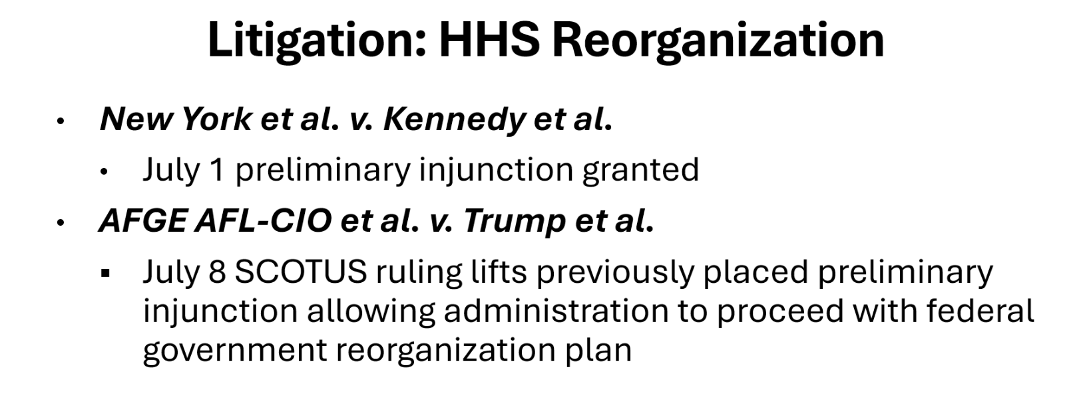
Why It Matters
The Future (is NOW) – Active PH Threats

Slide 35
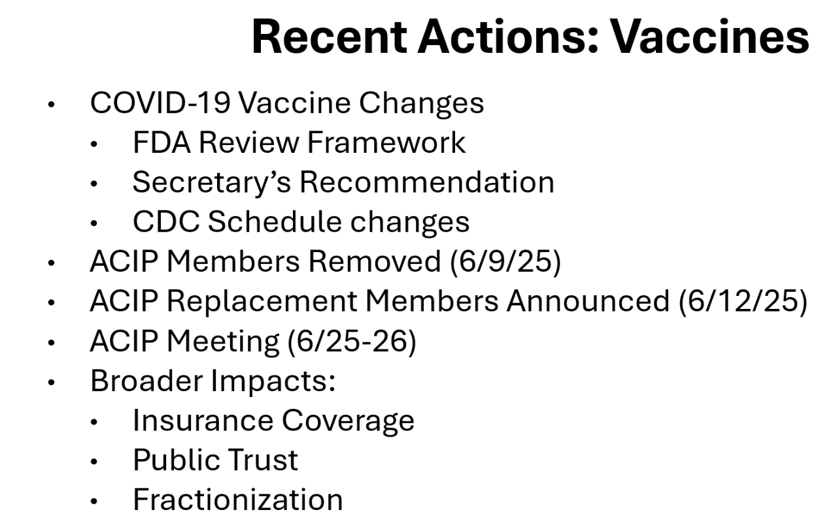
Why It Matters
The Future (is NOW) – Active PH Threats

Slide 36
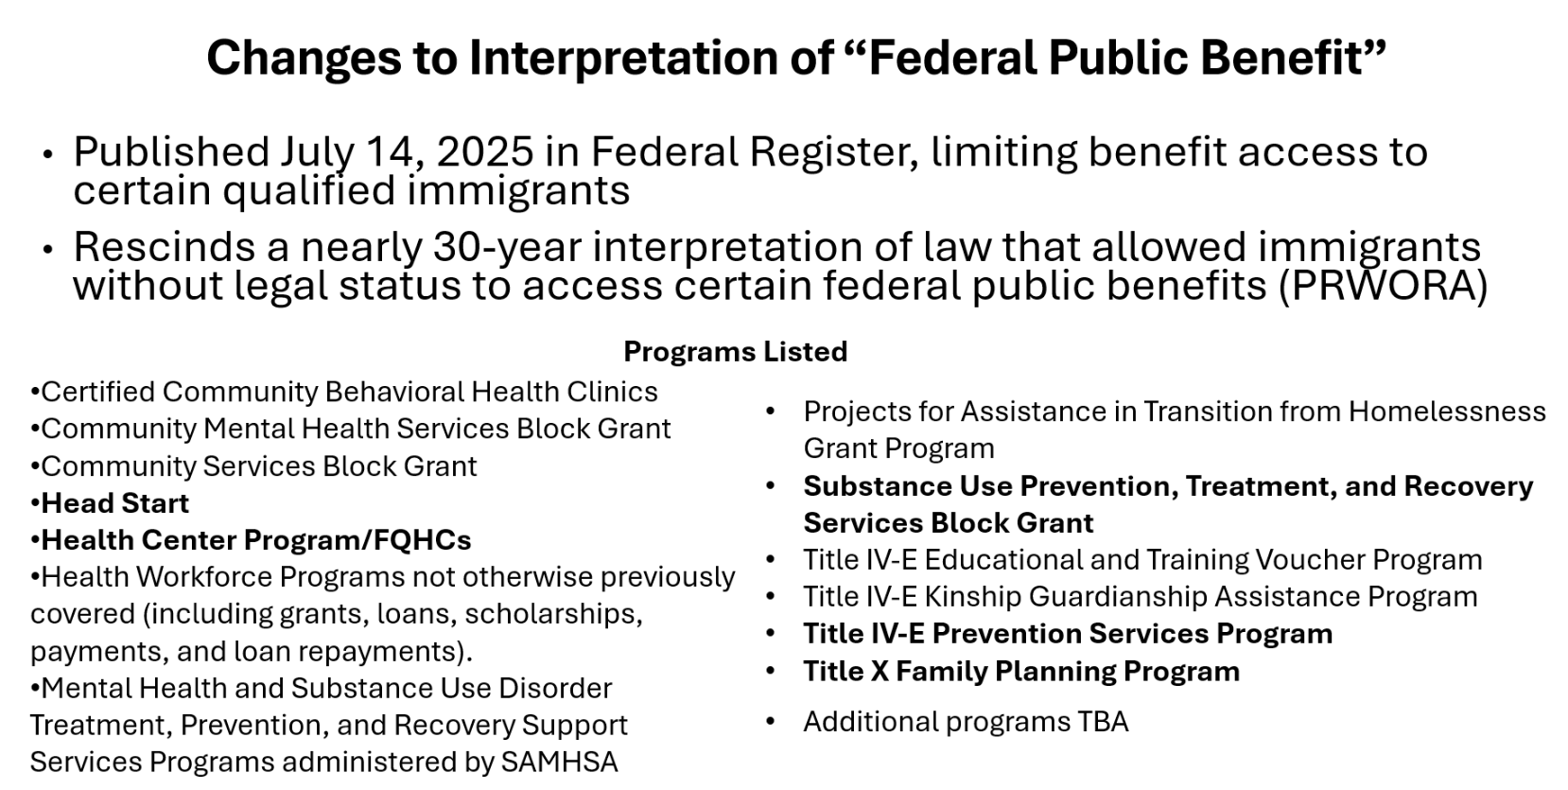
Why It Matters
The Future (is NOW) – Active PH Threats

Slide 37
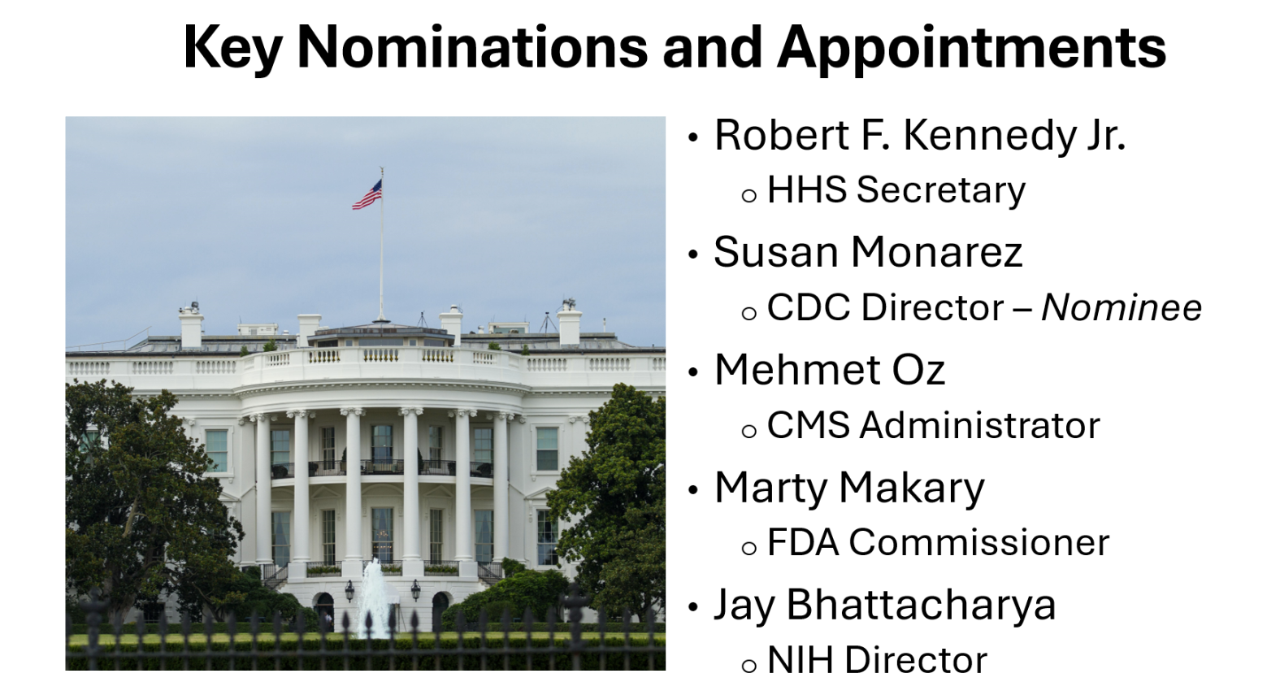
Why It Matters
Watching…
Notes:
Organized Response/Collective
24x7x360 Crisis Room
For Our Health
Protect Our Care
Coalition for Trust in Health and Science
Vaccine Integrity Project /
PriorityONE
Americans for Healthy Communities
NACCHO
Coalition Work
Advocacy/Education
Funding to LHDs
Sharing of Information
Reimagining Local Governmental Public Health and Innovating in the Moment

Slide 38
Why It Matters
Watching…
Susan Monarez
ACIP
AHA Conversations
NOFOs and NOAs
FY25 Funding Appropriated but Not Released – OMB Issue
POCKET RECISSIONS
A Note About Active Litigation
Notes:
Organized Response/Collective
24x7x360 Crisis Room
For Our Health
Protect Our Care
Coalition for Trust in Health and Science
Vaccine Integrity Project /
PriorityONE
Americans for Healthy Communities
NACCHO
Coalition Work
Advocacy/Education
Funding to LHDs
Sharing of Information
Reimagining Local Governmental Public Health and Innovating in the Moment

Slide 39
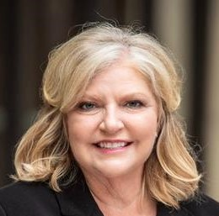
Thank you!
Lori Tremmel Freeman
Chief Executive Officer
National Association of County and City Health Officials (NACCHO)
1201 Eye St NW, 4th Floor
Washington, DC 20005
www.naccho.org
202.507.4271 Direct
lfreeman@naccho.org

Slide 41
Understanding and Supporting Public Health in Missouri
Brian Washington, MHA
Strategist-Initiatives

Slide 42

Agenda
Background on MFH
Challenges
Foundation & State Activity
Opportunities
Looking Forward

Slide 43
About Us

Slide 44
About Us

Slide 45
About Us
Notes:
Talk about how we operate as more than just a funder. We’re strategic in our investments and it relies on relationship building, sharing knowledge,

Slide 46
Where We Work

Slide 47
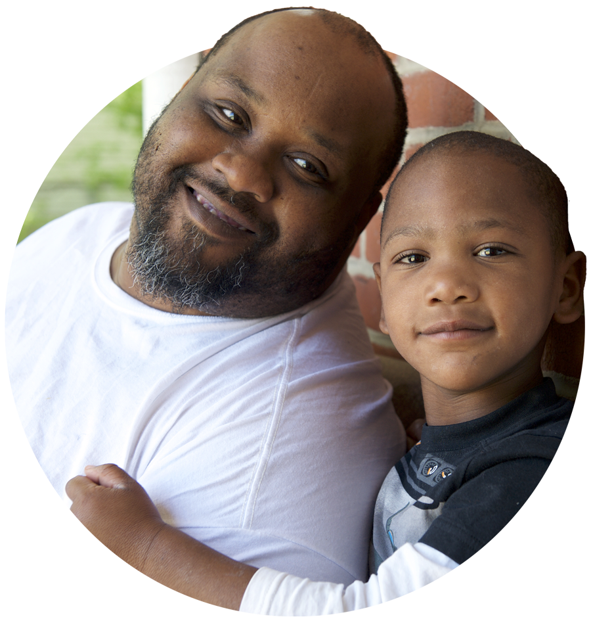
Challenges
Funding
  $6.37M between 2001-2016
  $7 per capita (2023)
  Restricted funding
Infrastructure
  Physical locations
  Technology and data systems
  Workforce

Slide 48
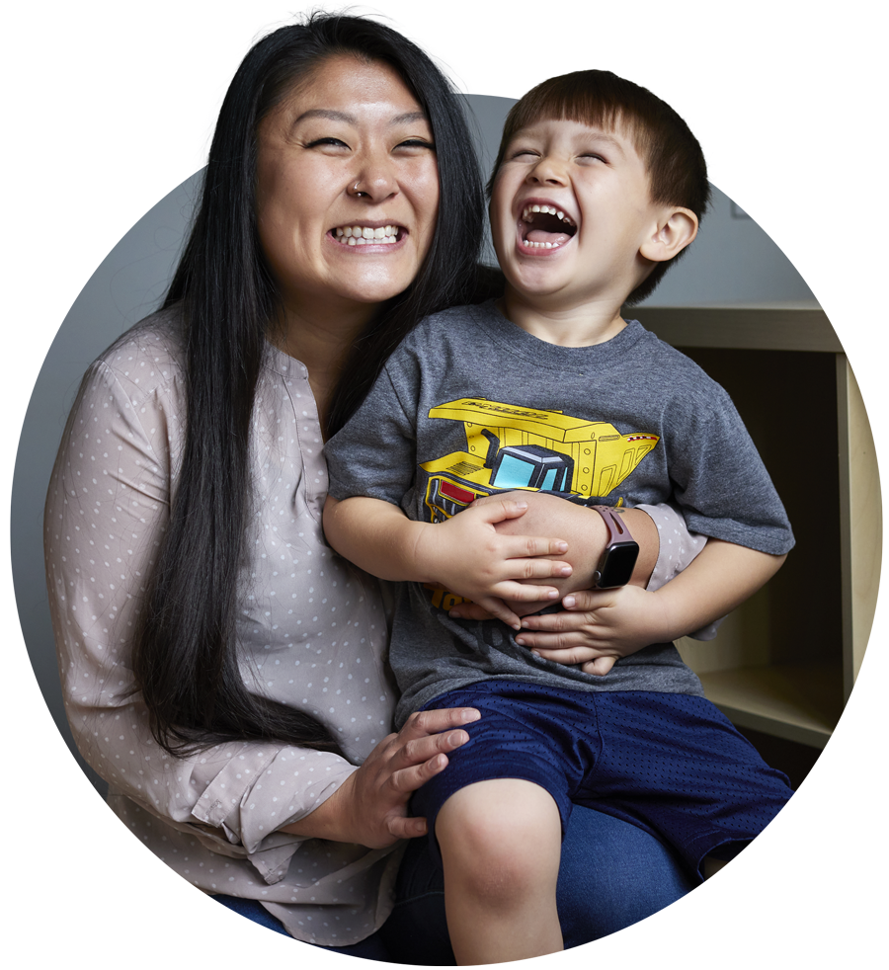
Challenges
System Discordance
  Professional contention
  Levels of authority
Regionalization
Public Image
  Weakened further by COVID

Slide 49

PH Infrastructure Initiative 2017-2019
$5.6M PHI program
Three-pronged approach
HealthierMO (2017) – established MO’s Foundational Public Health Services (FPHS) Model
Notes:
Public Health Infrastructure Initiative (2017-2019)
$5.6M PHI program
Goals:
Detect emerging issues
Seek new & innovative ideas
Pilot approaches to strengthen infrastructure
Three-pronged approach
Direct funding to LPHAs
Support innovation to strengthen infrastructure
Convene stakeholders

Slide 50
2021-2023 Foundation Activities
Reimagine The Strategy
  Hired a Sr. Director of Public Health Transformation
  Invested in strategy alignment, coordination, and accreditation
Stakeholder Conversations
Funding
  MO Center for PH Excellence public health institute
  MO DHSS - Increase staff capacity to support reaccreditation
  Advocacy strategy alignment
Notes:
Stakeholder conversations – 37 representatives from DHSS, professional associations, & local agencies

Slide 51
2024-2025 MO Activities & Changes
MFH
  MO State Health Assessment Steering Committee
  Public Health Funders Lunch
State Level
  New Governor and DHSS Director
  Positive public opinion poll results
MO Public Health Institute
  Growth in membership and contracts
  Awarded NNPHI membership
Notes:
National Network of Public Health Institutes
Missourians generally like and trust their local agencies

Slide 52

Opportunities
Accreditation & Coordination
  State accreditation earned
  County accreditation growing
  Agencies prioritizing alignment
Funding
  PHIG grant: $45M (+$5M)
  Gen. Revenue: $6.1M (2023)
Notes:
Mention MOALPHA and MPHA merging
DHSS and MOPHI partnering
Public Health Infrastructure Grant
DHSS strategic plan – 5 point plan, one focuses on building relationships

Slide 53
Foundation Efforts Going Forward
Continue to foster authentic relationships
Incorporate public health into more initiative work
Champion for public health
Notes:
Relationships – MFH & PH, serving as a facilitator of connections, making new ones and strengthening existing ones. Meeting as humans is key.
Championing – mention our support in connecting MOPHI to other partners

Slide 54
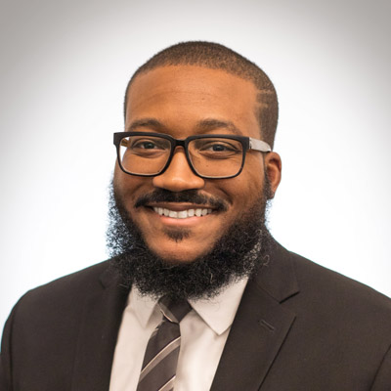
Contact
Brian Washington, MHA
Strategist-Initiatives
(314) 345-5578 | bwashington@mffh.org

Slide 55

Philanthropy’s Role in Protecting Public Health
Avital Havusha
Vice President of Programs
Monday, July 21, 2025

Slide 56

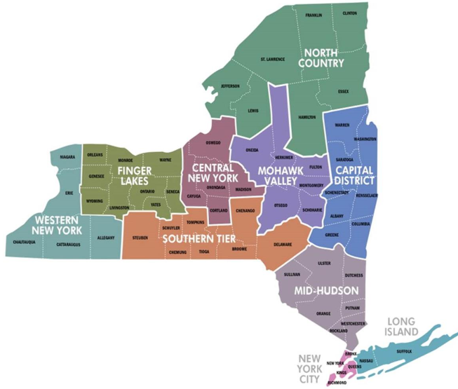
New York State: Snapshot
62 Counties (24 non-metro)
New York State Department of Health and 58 local health departments (LHDs)
190 total health professional shortage designations; persistent inequities and disparities
FY26 budget includes $34.2 billion to Medicaid
Source: https://www.osc.ny.gov/files/reports/pdf/challenges-faced-by-rural-new-york.pdf

Slide 57
New York State Trends: Snapshot
LHDs have experienced a 49% reduction in staff since 2008; increasingly forced to rely on temporary staff
Across State (excluding NYC), 95% of LHDs lack staff needed to provide essential services
Smaller departments, serving State’s most rural communities, face the greatest challenges
Overall, New York is facing a loss of $15 billion because of federal budget bill
Source: https://nysacho.org/wp-content/uploads/2025/03/Enumeration-Data_Advocacy_corrected.pdf

Slide 58
Philanthropy’s Role: Ideas for Discussion
Partnering with associations and members
Leveraging coalitions and partner networks
Promoting funder collaboration, coordination, and co-funding
Using our voice and resources
Source: https://nysacho.org/wp-content/uploads/2025/03/Enumeration-Data_Advocacy_corrected.pdf

Slide 59
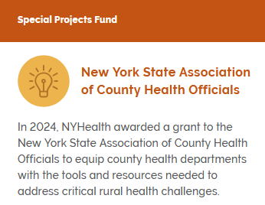
Partnering with Associations
“Public health is not sitting behind a desk. It's going out to the community. When you're in a rural community, you bring public health to the people.”
  Communications for narrative framing and advocacy (e.g., Frameworks Institute)
  Leadership development and transition/succession planning (e.g., mentorship)
  Public health value proposition to advance local policy and collective goals (e.g., learning hub)

Slide 60
Partnering with Associations, Cont.
Strengthening infrastructure of statewide membership and trade associations: e.g., merger of behavioral health, substance use, and mental health associations
Delivering technical assistance and capacity building to members: e.g., expert support to community health centers
Integrating philanthropy perspective: e.g., Public Health Funders Network at American Public Health Association

Slide 61


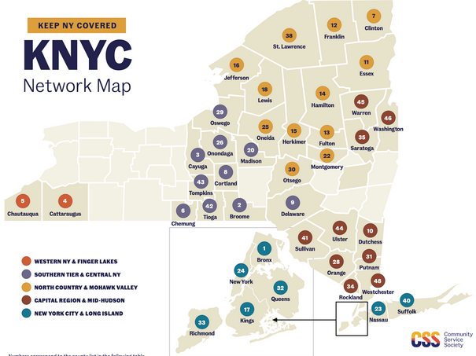
Leveraging Coalitions and Partner Networks
Hunger Solutions NY and Community Food Advocates unwavering campaign for universal school meals. NYHealth leaned into testimony and writing to build momentum
Multi-funder collaborative supported “Keep NY Covered” Initiative for Medicaid “unwind”

Slide 62


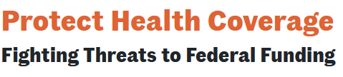
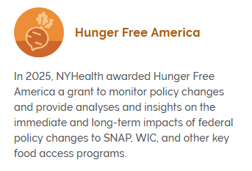
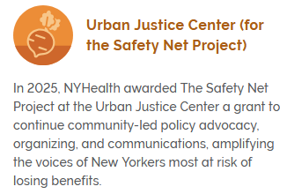
Leveraging Coalitions and Partner Networks, cont.
Monitor, assess, advocate, and respond to federal policy changes: Medicaid/public insurance, food benefits and access
  “Strange bedfellow” coalition
  Community member voice
Coordinate and maximize service delivery
  “Hub and spokes” outreach
  Care for migrant and immigrant communities
  Vaccine equity
Notes:
.

Slide 63
Promoting Funder Collaboration and Coordination
Co-funding models to maximize resources and partner engagement
Regional funder analysis, coordination, and action (e.g., led by New York Community Trust, Community Foundation for Greater Buffalo, Central NY Community Foundation, Philanthropy NY, and others)
Unified approaches to capacity building and technical assistance
Joint action on communications and advocacy

Slide 64
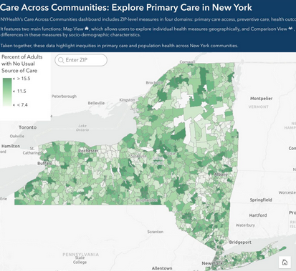
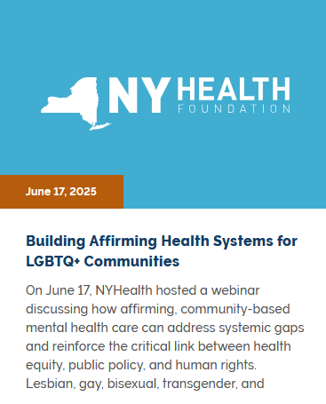
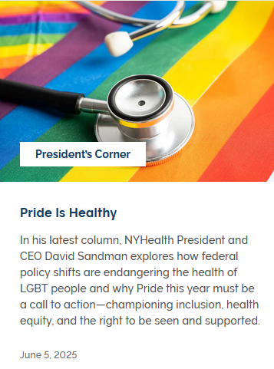
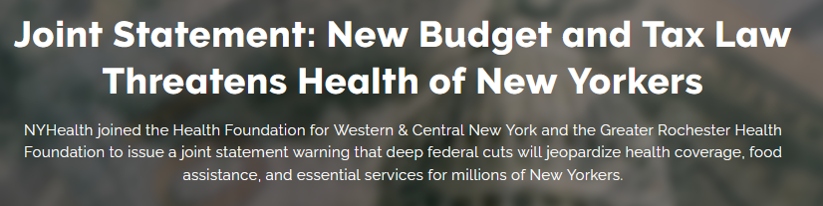
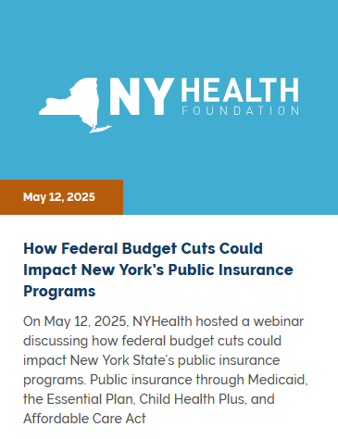
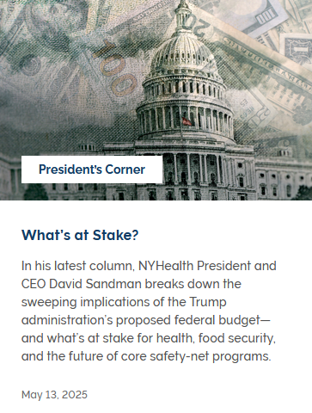
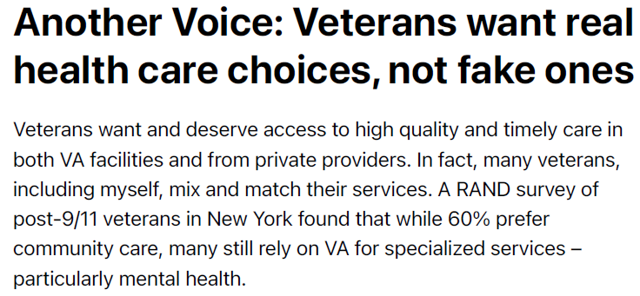
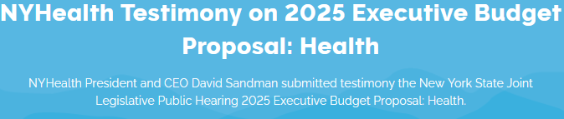
Using Our Voice and Resources

Slide 65
Thank you!
Send us a message at population@gih.org if you have any questions.
Visit GIH.org to access upcoming webinars and view past recordings.

