Slide 1
HR 1: Overview of Legislation and Implications for Grantmakers
August 4, 2025

Slide 2



FY 2025 Budget Reconciliation: Key Takeaways
  On July 4, President Trump signed, H.R. 1, the “One Big Beautiful Bill Act,” following a 51-50 vote in the Senate and a 218-214 vote in the House
  The bill was the President’s major legislative initiative to extend individual tax cuts and boost spending on defense and border security. This spending was partially offset with significant Medicaid reductions
FY 2025 Budget Reconciliation: “One Big Beautiful Bill Act”
  Today we’ll discuss the impacts of the law and the implications for philanthropy

Slide 3
Themes in the Legislation
Immigration Status
Work Requirements
Enhanced Eligibility Verifications
Increasing State Share of Costs

Slide 4
Congressional Budget Office (CBO) Score
Overall, $1.06 trillion reduction in spending on Medicaid and ACA marketplaces
10 million more uninsured

Slide 5
Key Medicaid Policies
Total Spending Reduction: $911 Billion
More than 85% of the reduction comes from 5 policies
Medicaid Provider Taxes
Reducing State Directed Payments
Eligibility and Enrollment Rules Freeze
More Frequent Eligibility Checks
Work
Requirements
$326B
$191B
$149B
$122B
$63B

Slide 6
Medicaid Work Requirements: Key Facts
Mandatory for ALL states
Applies to adults 18-64 without dependents*
Start date
Dec 31, 2026
80 hrs/mo work, community engagement or school

Slide 7
Eligibility and Exceptions
Applicable Individuals
Mandatory Exceptions for Specified Excluded Individuals
Optional Short-Term Hardship Exceptions
  Individuals who must meet work and community engagement requirements include:
    Expansion population
    In expansion waiver program
  Between ages 19-64
  Not pregnant
  Not enrolled or eligible to enroll as a dual-eligible beneficiary with Medicare
  For all or part of the month:
    Individuals under the age of 19
    Pregnant or receiving postpartum assistance
    Certain Native American populations
    Parent or family caregiver for a dependent child 13 or under, or for a person with a disability
    Veteran with a total disability rating
    “Medically frail or has special medical needs”
    Receives SNAP or TANF and is eligible for applicable work requirements
    Participating in a drug or alcohol treatment and rehabilitation program
    Inmate of a public institution at any point in the prior 3-month period
  Individual receives inpatient hospital services, nursing facility services, services in an intermediate care facility for individuals with intellectual disabilities, inpatient psychiatric hospital services, or such other services of similar acuity (including outpatient care relating to these services) for part or all of a given month
  Individual must (or has dependent who must) travel outside of their community for an extended period of time to receive medical services necessary to treat a serious or complex medical condition not available within the community
  Individual lives in a county subject to an emergency or disaster declaration, or with a significant unemployment rate

Slide 8
Provider Taxes
Background
Provider taxes have been a mechanism for states to enhance Medicaid funding. States impose taxes on provider sectors and then offset those costs with supplemental payments
Changes in HR1
Legislation imposes stricter limitations on provider taxes
Impact
Members expressed concern for rural hospitals
$50B rural health transformation program was added to relieve financial pressures
Freeze effective immediately

Slide 9
State Directed Payments
Background
States generally limited in how they can direct MCOs. State directed payments allow states to tell MCOs to make specific provider payments to support state policy goals like quality, access, priority health needs
Changes in HR1
Legislation imposes tighter caps on SDPs; limits to 100 or 110% of Medicare rates (today they can pay up to commercial rates)
Impact
$191 billion in savings
Impacts all providers, but expect more deep impacts to hospitals, pediatric providers and rural providers

Slide 10
Freeze on Biden-era Rules
Background
Biden administration finalized Medicaid rules designed to increase access to the program and streamline enrollment.
Changes in HR1
Legislation freezes those rules, effective immediately, through September 30, 2034
$122 billion in savings
Changes to simplify enrollment process won’t occur
Impact

Slide 11
Eligibility Redeterminations for Expansion Population
Background
Previously, redeterminations generally required every 12 months
Changes in HR1
Legislation says they must be conducted at least every 6 months; states can do even more frequent checks
Impact
$63 billion in savings
Some people who may otherwise qualify for coverage may lose it due to not being aware of administrative requirements or able to produce documentation of their exemption
Takes effect 12/31/2026

Slide 12
Additional Provisions
Eligibility
Limit which immigrants qualify for Medicaid coverage. Effective 10/1/2026.
Family planning
Restrict payments to certain family planning providers (this was aimed at prohibiting Planned Parenthood sites from receiving Medicaid funding, which impacts their ability to conduct cervical cancer screenings). Effective upon enactment for one year.
Cost sharing
Require states to impose cost sharing requirements on Medicaid expansion adults with income exceeding 100 percent of the federal poverty level. Effective 10/1/2028.

Slide 13
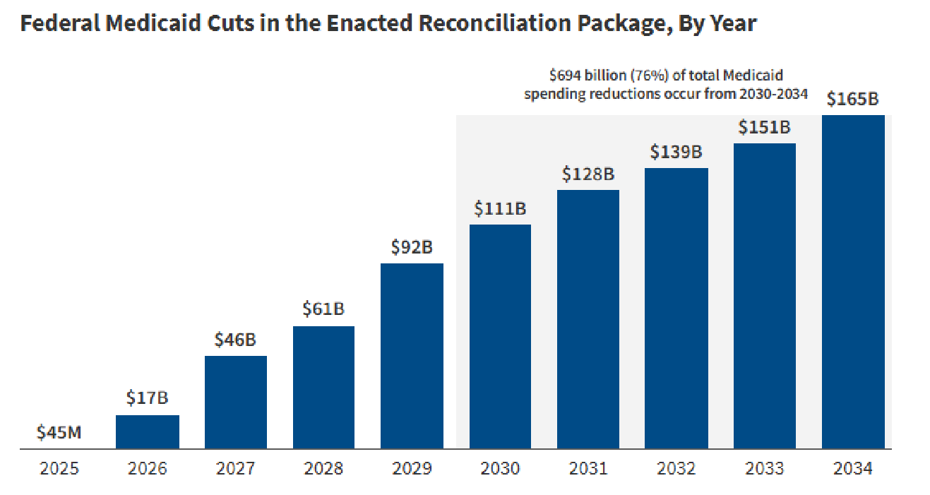
More than ¾ of spending reductions happen 2030-34
Source: KFF “Allocating CBO’s Estimates of Federal Medicaid Spending Reductions Across the States: Enacted Reconciliation Package”

Slide 14
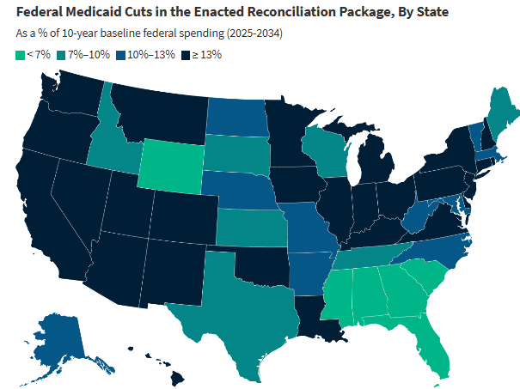
Projected impacts vary by state
Source: KFF “Allocating CBO’s Estimates of Federal Medicaid Spending Reductions Across the States: Enacted Reconciliation Package”

Slide 15

Rural Health Transformation Program
The law provides $10 billion for each fiscal year, to be allocated across applicant states, with 50 percent allocated equally among states and the remaining 50 percent allocated according to a methodology that accounts for relative shares of rural populations, rural facilities, etc.

Slide 16
Next Steps and Key Program Processes
Request for Applications:
State Application Development:
Application Approval and Allotment Determinations:
CMS will need to request state applications for allotments under the program, in addition to providing any necessary clarifying guidance for application contents. The application submission period can end no later than 12/31/25.
States will need to develop applications for funds, inclusive of detailed rural health transformation plans, certain program integrity certifications, and other information required by CMS.
CMS must approve or deny all applications by 12/31/25.

Slide 17
State Flexibilities and Allowable Uses
The statute requires states to use the funds for 3 or more health-related activities, which include, among other items:
Making payments to health care providers (broadly defined, consistent with other Medicare and Medicaid provisions);
Promoting technology-driven solutions, with an emphasis on chronic health and prevention;
Supporting rural health workforce recruitment and retention initiatives;
Advancing value-based care and innovative payment models; and
“Additional uses designed to promote sustainable access to high quality rural health care services, as determined by the Administrator” (an apparent catch-all category affording states additional flexibility, subject to CMS’s discretion)

Slide 18
Supplemental Nutrition Assistance Program
SNAP Changes:
Expand work requirements which currently apply to non-disabled adults without dependents up to age 54. The bill would expand these work requirements for these individuals up to age 64.
Limit the work requirements exemption for people with dependents age 18 and below to dependents age below age 14.
Limit state waiver requests from the work requirements.
Increase states’ share of costs. Effective October 1, 2027, for most states.

Slide 19
Policies Excluded from the Final Legislation
Out
Changes to Excise Tax on Foundations
"Terrorist Supporting Organizations"
Prohibition on Medicaid Spending on Gender Affirming Care
Lower FMAP for States Covering Undocumented Immigrants

Slide 20


Remaining “To-Dos” in 2025
To-Do Legislative Items in 2025
FY26 Funding
Expiring ACA Tax Credits
Medicare Extenders
Health Care as “Pay-fors”
Raise the Debt Ceiling
Expiring Individual Tax Cuts

Slide 21
Implications for Funders

Slide 22
2025
2027
Essential Plan (NY & OR)
Provider Tax Freeze
Rural Grant Application Due
Planned Parenthood
Nursing home staffing standards
Work requirements
6-month redetermination
Narrowing of eligibility for lawfully present immigrants
Medicaid Address requirements
Short
Term
Impact
2026
Provider Tax Cap
Premium Tax Credit
Disenrollment of lawfully present immigrants from Essential Plan
Emergency Medicaid reduction for immigrant eligibility (50%)
Notes:
Provider Taxes – States tax payors and providers on net patient revenue. Those payments are reinvested into Medicaid rate. This would trigger higher federal match. This used to be capped at 6%. Expansion states are now capped at 3.5% and non expansion states are frozen, and unable to raise the tax. This limits State revenue generated by those taxes because now less federal match than before.
Rural grant – pooled fund for rural hospitals (ostensibly prevent essential hospitals from closing)
Premium tax credit eliminates subsidies for all exchange coverage, everyone’s premiums go up – (KFF article 75% increase request)

Slide 23

FUNCTIONAL IMPACTS
HR-1 Impacts on Access to Care
Losses of eligibility create gaps in access that have profound impact on safety net providers
Redetermination creates administrative burden without sufficient technical assistance ($1.5m per state)
Other components of HR1 compound existing crises

Slide 24
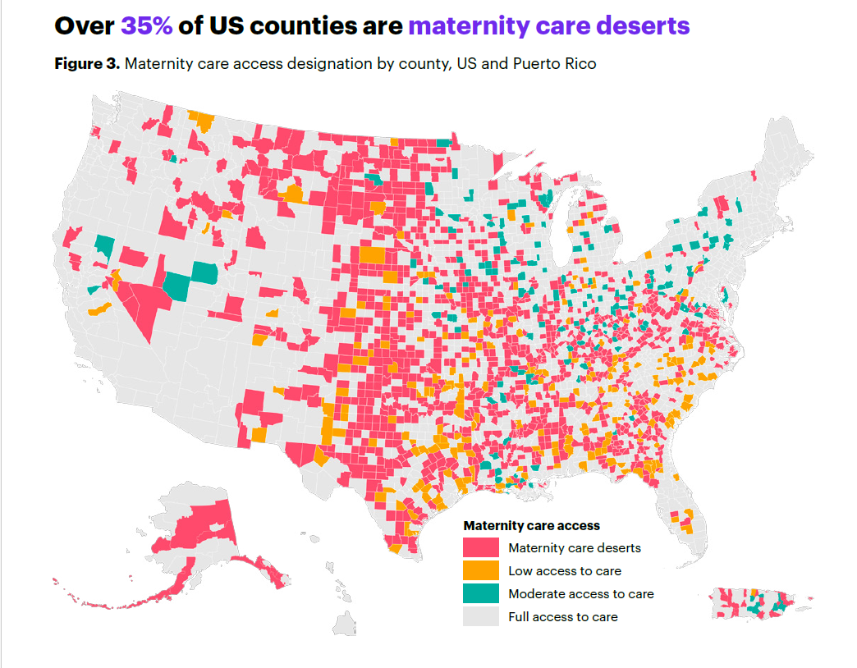
Maternity care deserts are counties where there is a lack of maternity care resources:
No hospitals or birth centers offering obstetric care
No obstetric providers
2.2 million women of childbearing age live in maternity care deserts
States with the highest percent of maternity care deserts
Top Row: ND, SD, OK
Bottom Row: MO, NE, AR
Source: March of Dimes, 2024. No Where to Go: Maternity Care Deserts Across the US.

Slide 25
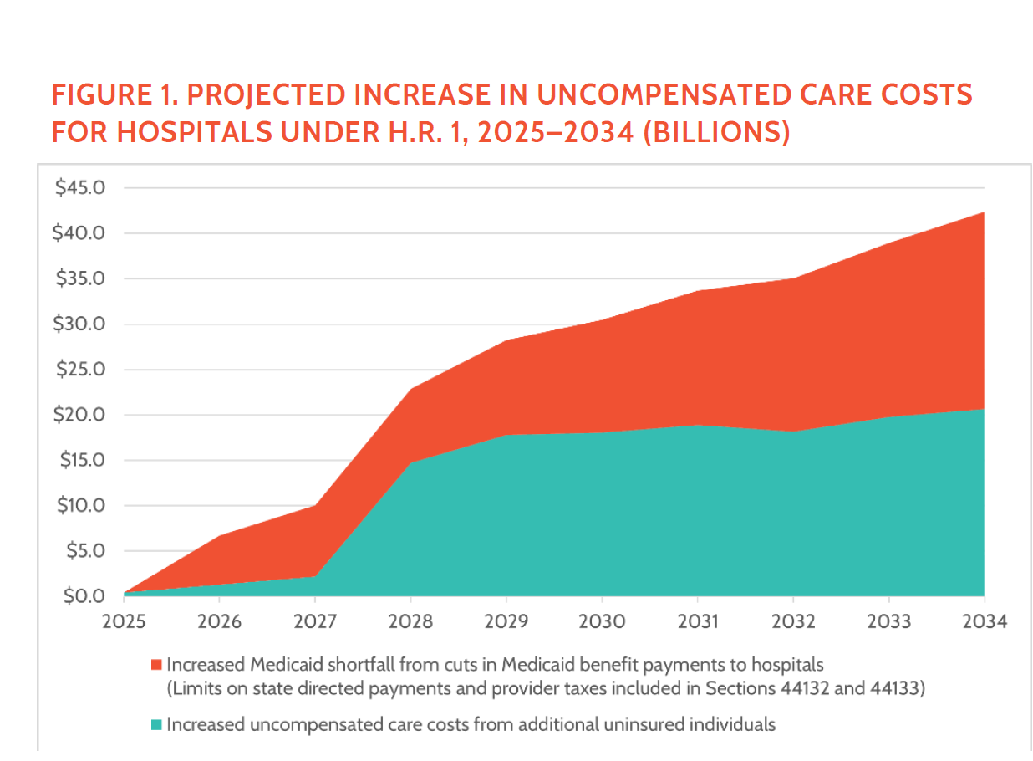
Risk of Increased “Bad Debt”
Bad debt refers to the unpaid bills that hospitals cannot collect from patients or payors
Drivers of Bad Debt
Uninsured patients
Medicare penalties
High deductible plans

Slide 26
Health outcomes and social need are recursive
Social factors that may impact health outcomes
Health outcomes that may influence social factors
  Lack of insurance
  Physical Environment
  Education and work
  Housing status
  Food security
  Adverse Childhood Experiences (ACES)/Trauma
  Debt
  Morbidity
  Physical Health Status
  Behavioral Health Status
  Functional Limitations
  Toxic Stress /Chronic Stress
  Health Care Expenditures

Slide 27
Other Considerations

Slide 28
NEW CMS GUIDANCE INTERACTS WITH HR-1
HRSN Guidance
DSHP & DSIP Guidance
Recission of Medicaid 1115 HRSN guidance. HRSN services will be considered for renewal on case-by-case basis. Affects:
Housing
Nutrition
Employment
Medical Respite
Infrastructure funding for delivery system
Rescinds authority to use Federal Match Funds for State Expenditures in such programs, introducing risk.
Affects programs like
HRSN services
Youth with Special Health Care Needs
Enhanced Care Management
Populations affected: people experiencing homelessness; or with low housing security;
people with BH needs (SMI, SUD); low/no food security and high-risk pregnancy; post-partum;
high utilizers; justice involved, etc
Source: https://www.medicaid.gov/medicaid/section-1115-demonstrations/about-section-1115-demonstrations
Potentially Affected States

Slide 29
Designated State Health Program and Designated State Investment Programs Recission – Programs At Risk
New YORK DEEP DIVE
Program | Funding
Newborn Screening (medical testing–mostly genetic–to identify disorders that without intervention have permanent impacts on children and families) | 20,549,336
Elderly Pharmaceutical Insurance Coverage (EPIC) (Medication costs for low-income individuals after Medicare Part D) | 204,407,520
Supportive Housing Initiative (Medicaid Supportive Housing) | 197,222,030
Nourish NY (Emergency food purchasing for pantries, food banks) | 200,000,000
Community Services for the Elderly (Supports aging in place for frail, low-income older adults) | 122,500,000
Rural Health programs (Supports formal partnerships between health and human services providers) | 30,283,930
Supplemental Support to Ryan White Programs (health care and supportive services for people w/ HIV who are low income or uninsured) | 72,992,020
Vital Access Providers Assurance Program (VAPAP) (financially distressed facilities) | 2,019,200,000
End of AIDS (range of services, data surveillance, medications for uninsured etc. ) | 49,131,104
Expanded In-home Services for the Elderly (EISEP) (non-medical in-home services) | 240,700,000

Slide 30
BIG PICTURE
New administrative burdens are functionally unfunded mandates
Grantees with high % government grant funds will need to diversify
Safety net providers whose payor mix is mostly Medicaid can’t absorb a big decrease in revenues and new bad debt associated with coverage losses

Slide 31
WHAT HEALTH AND HUMAN SERVICES PROVIDERS NEED: NOW/SOON
Mitigation of Provider-level Impacts
Technical assistance to help beneficiaries maintain coverage
Operating support for the staff needed to do more frequent redeterminations
Support for Safety Net Providers with consideration for differences in urban and rural safety net provider needs and patient engagement pathways
Support for health-related social needs that stabilize patients and prevent adverse events like readmission and excess utilization
Mitigation of Community-level Impacts
Support for access to preventive services
Access to care for the uninsured and the uninsurable
Coverage and access navigation for mixed status families
Support for health-related social needs programs to keep people and communities healthy

