Slide 1
A Look at Medicaid Changes in the Reconciliation Law
Jennifer Tolbert
Deputy Director, KFF’s Program on Medicaid and the Uninsured

Slide 2
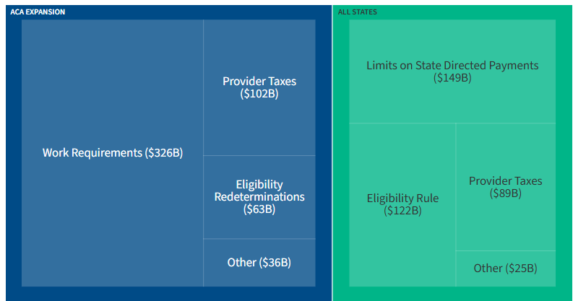
The reconciliation package would reduce federal Medicaid spending by $1 trillion over 10 years.
Notes:
Provisions that would only apply to ACA expansion states account for $526 billion, over half of the total gross federal spending reductions.

Slide 3
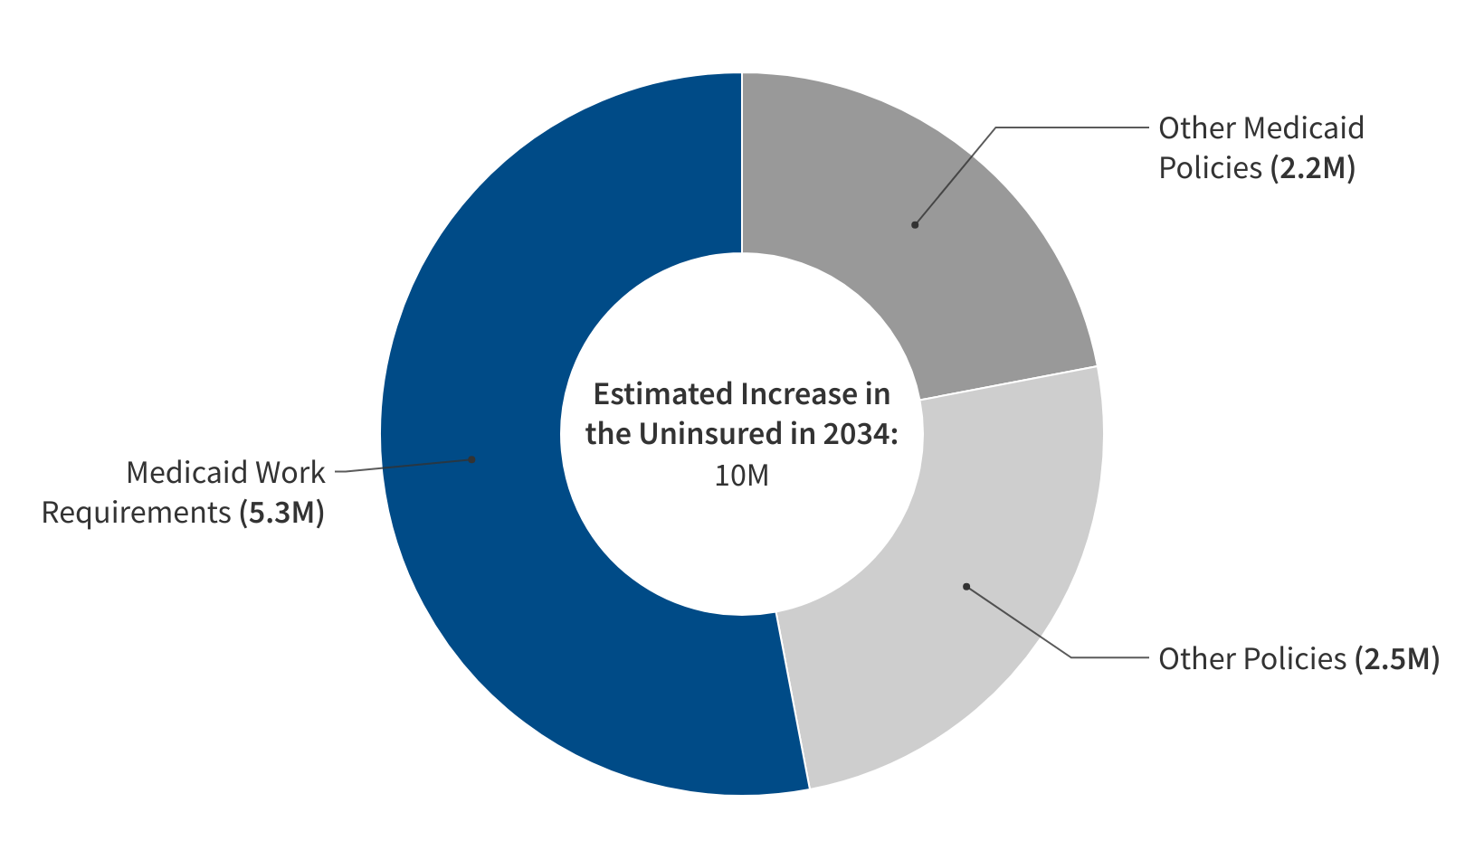
Work requirements are estimated to lead to 5.3 million more uninsured in 2034.
CBO estimates of the increase in the uninsured in 2034 due to the enacted budget reconciliation package, by source of change:
Note: Total and "other policies" includes 300,000 in estimated coverage loss due to interaction between policies. “Other policies” also include Medicare and Marketplace changes.
Source: KFF analysis of CBO estimates of the enacted reconciliation package

Slide 4




Some key Medicaid changes in the reconciliation package include:
Restrict Eligibility
Conditions Medicaid eligibility for expansion adults on meeting work requirements
Requires eligibility redeterminations every 6 months for Medicaid expansion adults
Restricts eligibility for certain legal immigrants
Impose New Cost Sharing
Requires states to impose cost sharing of up to $35 per service on expansion enrollees with income 100-138% FPL
Limit Provider Taxes and State Directed Payments
Prohibits states from establishing new provider taxes or increasing existing tax rates; revises conditions for receiving waivers of certain requirements
Caps total payment rate for inpatient hospital and nursing facility services at 100% of Medicare payment rate for expansion states and 110% for non-expansion states
Delay Implementation of Nursing Home Staffing Rule
Delays until 2034 implementation of a rule requiring LTC facilities to meet minimum staffing levels and providing funding to increase the number of nurses working in nursing homes

Slide 5
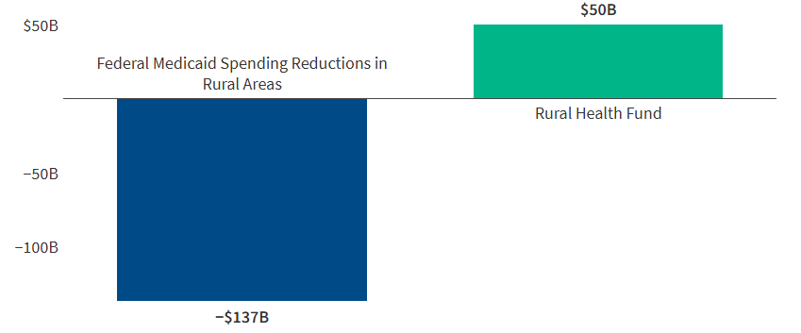
Reconciliation package would reduce federal Medicaid spending in rural areas by $137 billion, more than the $50 billion set aside in the rural health fund.
Note: The analysis uses T-MSIS data to estimate the percentage of Medicaid spending that paid for services used by rural enrollees. Those percentages were then applied to national estimated reductions in federal Medicaid spending from KFF's broader analysis of federal Medicaid spending reductions.
Source: How Might Federal Medicaid Cuts in the Senate-Passed Reconciliation Bill Affect Rural Areas?

Slide 6
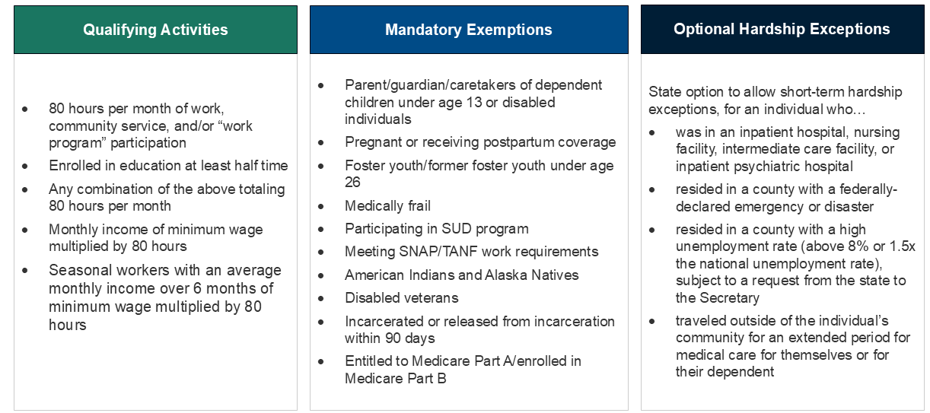
The new law requires states to implement work requirements for the expansion group by January 2027.
States would be required to condition Medicaid eligibility for individuals ages 19-64 applying for coverage or enrolled through the ACA expansion group on meeting qualifying activities or exemption criteria:
Source: KFF’s A Closer Look at the Work Requirement Provisions in the 2025 Federal Budget Reconciliation Law
Notes:
Medically frail categories defined in text include blind/disabled, SUD, physical/intellectual/developmental disability that interferes with at least one ADL, serious and complex medical condition

Slide 7
States will have limited time to develop or change implementation plans, protocols, and systems.
6/01/2026
Secretary of HHS to release interim rule
Interim rule on implementing work requirements
9/30/2026
States required to begin outreach about new work requirements
Deadline dependent on timing of first compliance “look back” period
01/01/2027
Work requirements required to go into effect
State option to implement earlier
12/31/2028
Delayed implementation deadline, at Secretary’s discretion
States experiencing challenges implementing work requirements may potentially delay implementation, at the Secretary’s discretion
Source: KFF’s A Closer Look at the Work Requirement Provisions in the 2025 Federal Budget Reconciliation Law

Slide 8


Experience in Arkansas and Georgia highlight implementation challenges with work requirements.
AR
GA
  Enrollee awareness / outreach: complex policies caused “confusion and uncertainty.”
  Exemptions: enrollees struggled to access safeguards for people with disabilities and had trouble navigating the process to qualify for exemptions.
  Data matching: about 2/3 of enrollees successfully data matched and exempted from reporting. Among those who had to actively report, about 70% did not obtain an exemption or report compliance, resulting in over 18,000 people losing coverage.
  Verification at application: since launch of “Pathways” program, GA has only enrolled 8,600 individuals—far short of the state’s own estimated enrollment of 25,000 adults in the first year and 64,000 over 5 years.
  Administrative costs: recent investigative reporting found “Pathways” program has cost the federal and state government more than $86 million (as of the end of 2024), with three-quarters spent on consulting fees.
Source: KFF’s A Closer Look at the Work Requirement Provisions in the “Big Beautiful Bill” and KFF’s Implementing Work Requirements on a National Scale: What We Know from State Waiver Experience

Slide 9
When do the new changes take effect and what to watch for?
Fall 2025 States submit applications for rural health funds
January 2026 Expiration of enhanced premium tax credits
Other ACA marketplace changes take effect, including new limits on coverage for immigrants
October 2026 Reduced Medicaid FMAP for emergency Medicaid for immigrants
Restrictions on immigrant eligibility for Medicaid
December 2026 More frequent renewals for Medicaid expansion enrollees
January 2027 Medicaid work requirements for expansion enrollees
New restrictions on ACA coverage for legal immigrants
October 2027 Reductions in existing provider taxes start to phase in for Medicaid expansion states
January 2028 Reductions in existing state-directed payments start to phase in for Medicaid expansion states
Cost sharing requirements for Medicaid expansion enrollees with incomes 100% - 138% FPL
Pre-enrollment verification required for ACA Premium Tax Credits
Notes:
How states respond – what actions will states take to fill gaps from reductions in federal funding or what actions to reduces rates / covered services?
What will happen to coverage and how will that vary across?
How will providers respond – will there be additional hospital closures, what does this mean for access to health services?

Slide 10
THANK YOU
For more information, contact: jennifert@kff.org

