Slide 1

Caroline Montojo
President and CEO
Dana Foundation
Protecting Our Health: Funder Collaborations for Scientific Research
Sam Gill
President and CEO
Doris Duke Foundation
Julie Morita
President and CEO
The Joyce Foundation
Thursday, October 30, 2025 at 1:30p.m. ET
Jill Shumann
Vice President of Programming
Grantmakers In Health
Visit GIH.org to learn more

Slide 2
The Portfolio to Protect Science
Conﬁdential - Fall 2025

Slide 3

U.S. Science Under Attack
A Snapshot: Science in 2025
Over 1,500 NSF grants – worth $1 billion – have been terminated.
More than 4,000 NIH grants totaling $5.3 billion have been cancelled.
Funding for STEM education accounted for 54% of NSF grant terminations.
Leading research institutions – such as Harvard – have been directly targeted and have lost critical federal funding as a result.
2

Slide 4





The Effects Will Be Devastating
Permanent Reductions
Threat to Journalistic & Academic Integrity
Brain Drain Data Loss
Economic Impacts
3

Slide 5


The Science Crisis: Two Time Horizons
Medium/ Long Term
Near Term
Prevent funding cuts and protect science
Improve and reimagine science
4

Slide 6


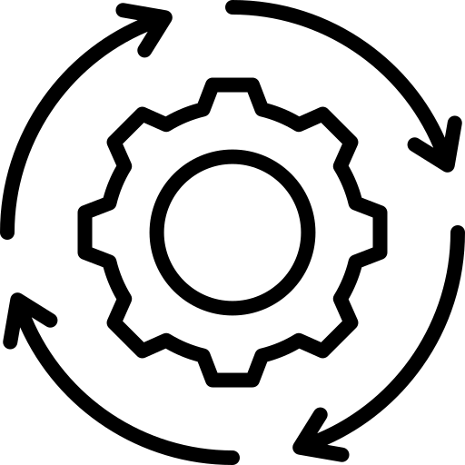
FACTS
Success To Date:
88
foundations and advisors, represented by 172 individuals, have been active participants in FACTS since its launch in March, 2025.
Creating connective tissue across funders
Coordinating on due diligence for proposals
Ongoing interest from foundations interested in joining FACTS
5

Slide 7




The Portfolio to Protect Science
Areas of investment include:
Safeguarding Critical Scientiﬁc Data and Infrastructure
Restore Government Funding for Science
Protect the Place of Science in Public Policy
Preserve High-Value Research and the Science Workforce
Contributing funders can provide directly to portfolio grantees or invest in a pooled vehicle.
6

Slide 8



How the Portfolio to Protect Science Is Organized
Holistic Strategy
Philanthropic Opportunities
Informed Resource Allocation
7

Slide 9

Four Priority Pillars
Urgent Challenges
Strategies to Avert Them
1. Restore Government Funding for Science
Launched 8/5, Updated 9/3
Proposed catastrophic cuts
Funding freezes
Coordination
Education
Legal intervention
Independent advisory bodies
Access to guidance
Watchdogs & fact-checkers
Insider access
2. Protect the Place of Science in Public Policy
Launched 8/5, Updated 9/3
Erosion of expertise
Close gaps in guidance
Anti-science policymaking
3. Safeguarding Critical Scientiﬁc Data and Infrastructure
Launched 9/3
Monitor at-risk data
Public engagement
Bridge funding for datasets
Coordination
Infrastructure
Loss of data
Fragmented archives
Data to action gaps
Complex needs
Role of government
4.Preserve High-Value
Workforce support
Bridge project funding
Fellowships
Research and the Science
Threatened talent pipeline
Terminated research
Workforce
Launched 10/16
8

Slide 10







Guided by Expertise
Strategy First
Key Criteria
14 Key Advisors
What’s At Stake
URGENCY
70+ Subject-matter experts engaged
Urgent Challenges
IMPORTANCE
TRACTABILITY
Advisory Committee of scientiﬁc experts
Winning Strategies to address urgent challenges
NEED FOR COORDINATION

Slide 11

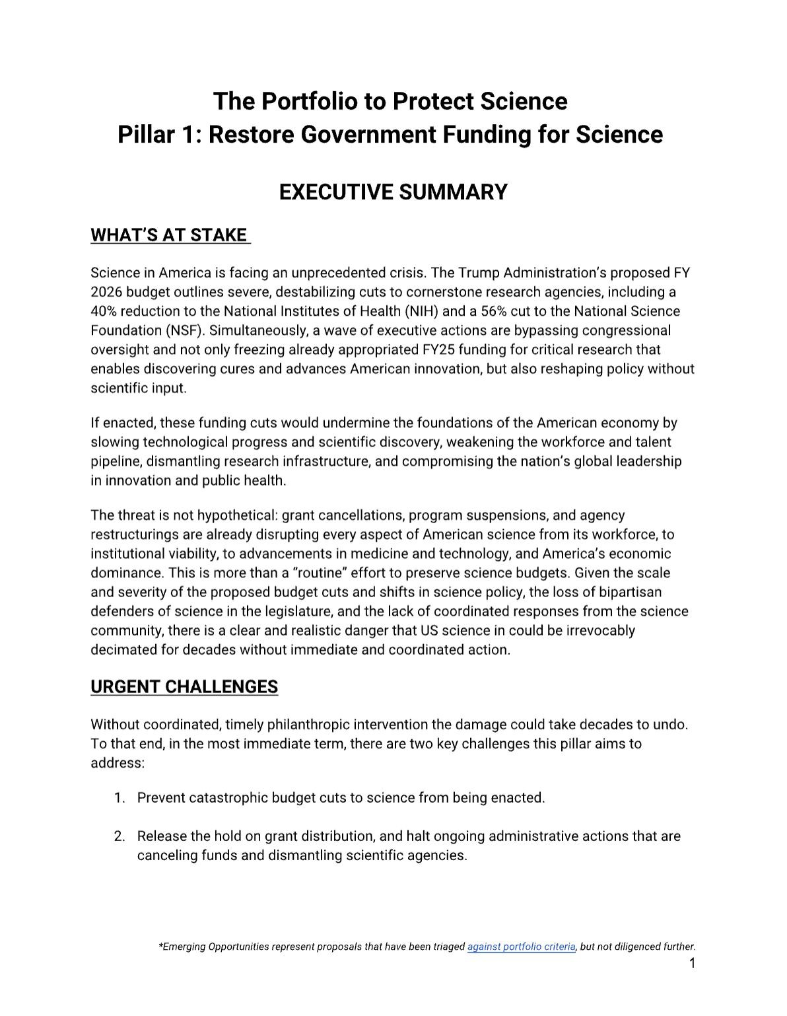

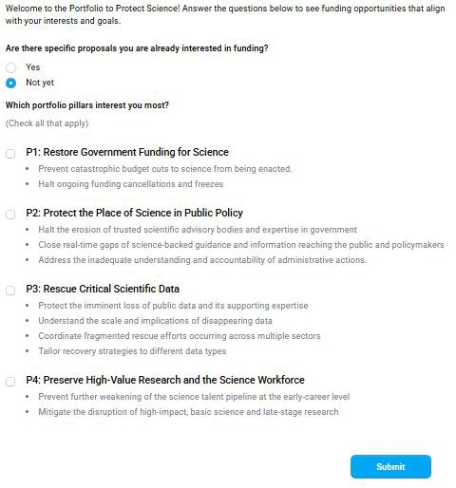

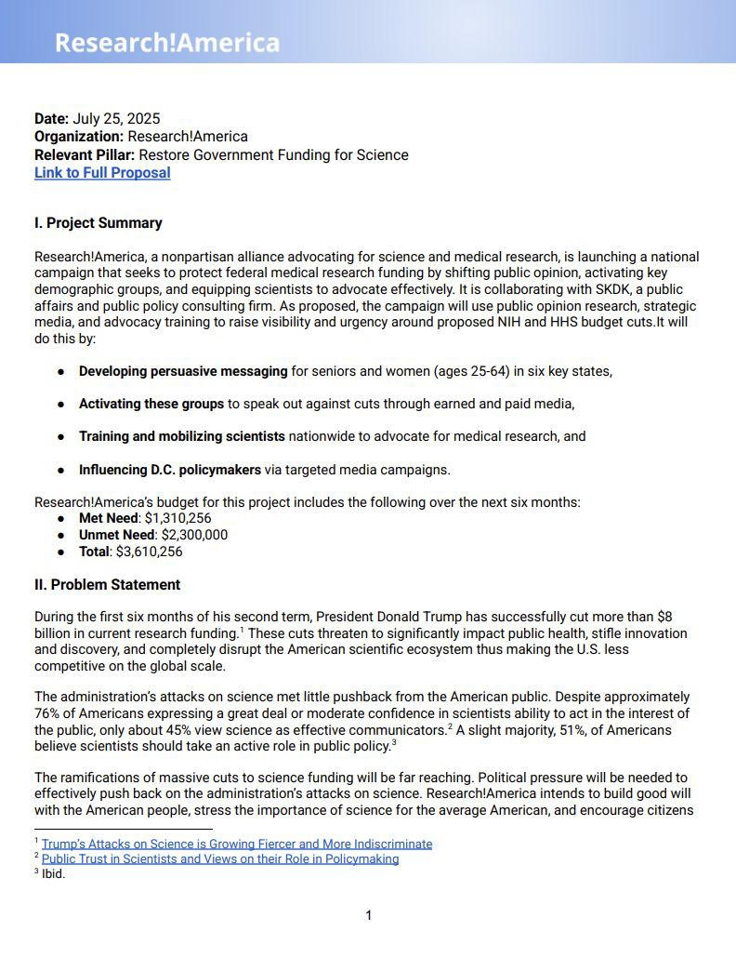

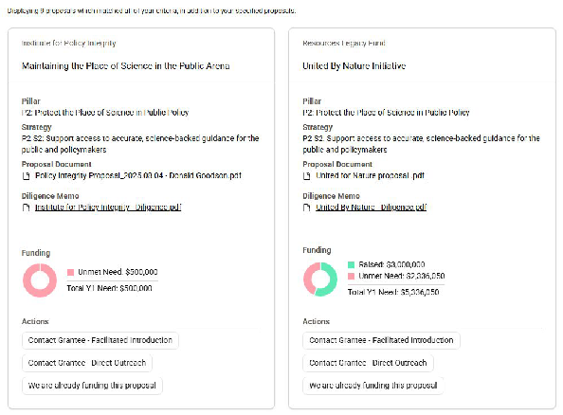
Portfolio Deliverables and Resources
Pillar Strategy Memo
Funder Interest Form
Diligence Memo
Portfolio Project Dashboard
10

Slide 12
Pillar 1-3 Progress
Pillar 1
Pillar 2
Pillar 3
$25.56 M
Total met need*
$20.43 M
Total met need*
$ 57.77M
Total Met Need
$11.78 M
Total met need*
$31.8 M
Total Pillar Need
$39.6 M
Total Pillar Need
$31.1 M
Total Pillar Need
* Includes pledges that have not been allocated to speciﬁc grantees, and pledges for 2026.
11

Slide 13
Pillars Ready for Investment
1. Restore Government Funding for Science
2. Protect the Place of Science in Public Policy
3. Critical Scientiﬁc Data & Infrastructure
8
Projects ready for investment
₁₃ Projects ready
₁₂ Projects ready
for investment
for investment
$31.8 M
Total Pillar Y1 Need
$20.4 M
Met Pillar Need*
$11.4 M
Unmet Pillar Need
$39.6 M
Total Pillar Y1 Need
$25.6 M
Met Pillar Need*
$14 M
Unmet Pillar Need
$31.1 M
Total Pillar Y1 Need
$11.8 M
Met Pillar Need*
$19.2 M
Unmet Pillar Need
* Includes pledges that have not been allocated to speciﬁc grantees, and pledges for 2026.
12

Slide 14
Portfolio Strategies Already Delivering Impact
Pillar 1
Pillar 2
Pillar 3
Secured release of $15B in frozen NIH funds
(United for Science & United for Cures)
Partnered with 5 leading medical associations to sustain vaccine conﬁdence (Vaccine Integrity Project)
1000+ data rescues cataloged; 700+ datasets rescued
(Data Rescue Project)
Blocked $19.4B cut
(United for Science & United for Cures)
Working with 25+ countries to improve data infrastructure (Invest in Open Infrastructure)
Coordinating 100 staff from 19 states for COVID vaccine access (GovAct)
Prevented $6.5 billion dollar loss through universal injunction (AAMC)
Observing the highest growth rate of atmospheric CO2 in one year (Keeling Curve)
Enabling participation of 60+ US scientists in IPCC
(AGU)
13

Slide 15
Pillar 4: Preserve High-Value Research and the Science Workforce

Slide 16



Pillar 4: Three Core Functions
Ampliﬁcation
Partnership
Speed

Slide 17



Pillar 4: Key Strategies Designed to Mitigate Harm
Stabilize and build resilience of the research enterprise
Expand the impact of established research rescue and fellowship efforts
Emergency support “in a box” templates to stand up rescue funds and fellowship programs

Slide 18
Pillar 4 Launching with Inspiring Momentum
$56.46M to support postdoctoral fellows in various domains (Moore, and others)
$2M fueling breakthroughs in Alzheimer’s research (Thome Memorial Fund)
$5M safeguarding racial and indigenous health equity research (RWJF)
$1.77M pledged via pooled funding
$65,430,000
in philanthropic commitments toward Pillar 4 strategies

Slide 19

Facilitating Partnership to Protect Scientiﬁc Talent
$55,000,000 → 30 universities
Postdoctoral fellows in astronomy, physics, biology, and Earth and planetary sciences.

Slide 20

Investment Opportunities
Strategy 1: Stabilize and build resilience of the research enterprise
Renaissance Philanthropy, Talent Mobility Fund
Protecting the Future of US Climate Science: A Philanthropic Response to Unprecedented Federal Cuts, Climate Science and Communications Fund
The Leadership Alliance
Catalyze R&D
Strategy 2: Expand the impact of established research rescue and fellowship efforts
Fellowship Programs
Research Rescue Funds
The Jane Coﬃn Childs Fellowship, Jane Coﬃn Childs Memorial Fund
NOAA Climate & Global Change Postdoctoral Fellowship,
UCAR
Climate Science Saving America Fellowship, Project Drawdown
Global Climate Research Fellowship, National Academies of Sciences, Engineering, and Medicine
Computing Innovation Fellows (CI Fellows), Computing Research Association
Kavli Scholars Program, Kavli Foundation
Postdoctoral Fellow Support, Moore Foundation*
Treating Others Fairly Bridge Program, American Society of Hematology
ASH Bridge Grant Program, American Society of Hematology
Last Mile Firearms Research Rescue Fund, Joyce Foundation
Thome Memorial Foundation: Rescue of Terminated NIH Grants at the Intersection of Alzheimer’s Disease and Health Equity, Health Resources in Action
Bridge Funding for Disrupted Neurodegenerative Research Grant Program, Alzheimer's Association & Michael J. Fox Foundation
Rapid Response: Reinvesting in Racial and Indigenous Health Equity Research, Robert Wood Johnson Foundation
* In development

Slide 21
The Portfolio to Protect Science - How to Participate
Direct Project Funding
Pooled Fund
Let us know your interests
https://portfolio-to-protect-science.vercel.app
Connect with portfolio grantees directly.
Allow the Portfolio to count your investment in its funding coordination.
Housed at Global Impact.
Contact Portfolio@tfreedmanconsulting.com to learn more.
*In development.
20

Slide 22
Thank You

