Slide 1

Bill Smith and Angela Kimball
Inseparable
Behavioral Health in the Balance: Navigating the Impact of the 2025 Budget Reconciliation Act
Neel Harja and
Sarah Wasil
Michigan Health Endowment Fund
Itai Dinour and
Hazel Guzman
Carmel Hill Fund
Monday, October 27, 2025 at 1:30 p.m. ET
Jill Shumann
Grantmakers In Health
Visit GIH.org to learn more

Slide 2

Advancing Access to Mental Health Care
October 27, 2025

Slide 3
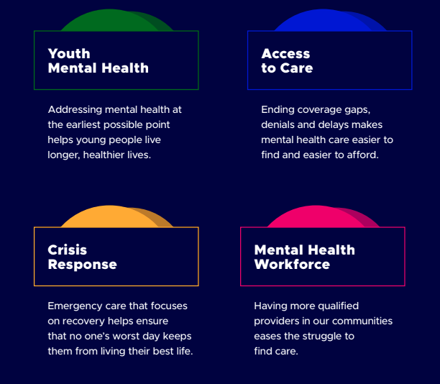
Notes:
“Inseparable is building a future where mental health care is treated like every other kind of health care.”
57 policy wins in 20 states since 2022
3-part approach: Policy + People + Political Power
Hope-driven, bipartisan progress.

Slide 4
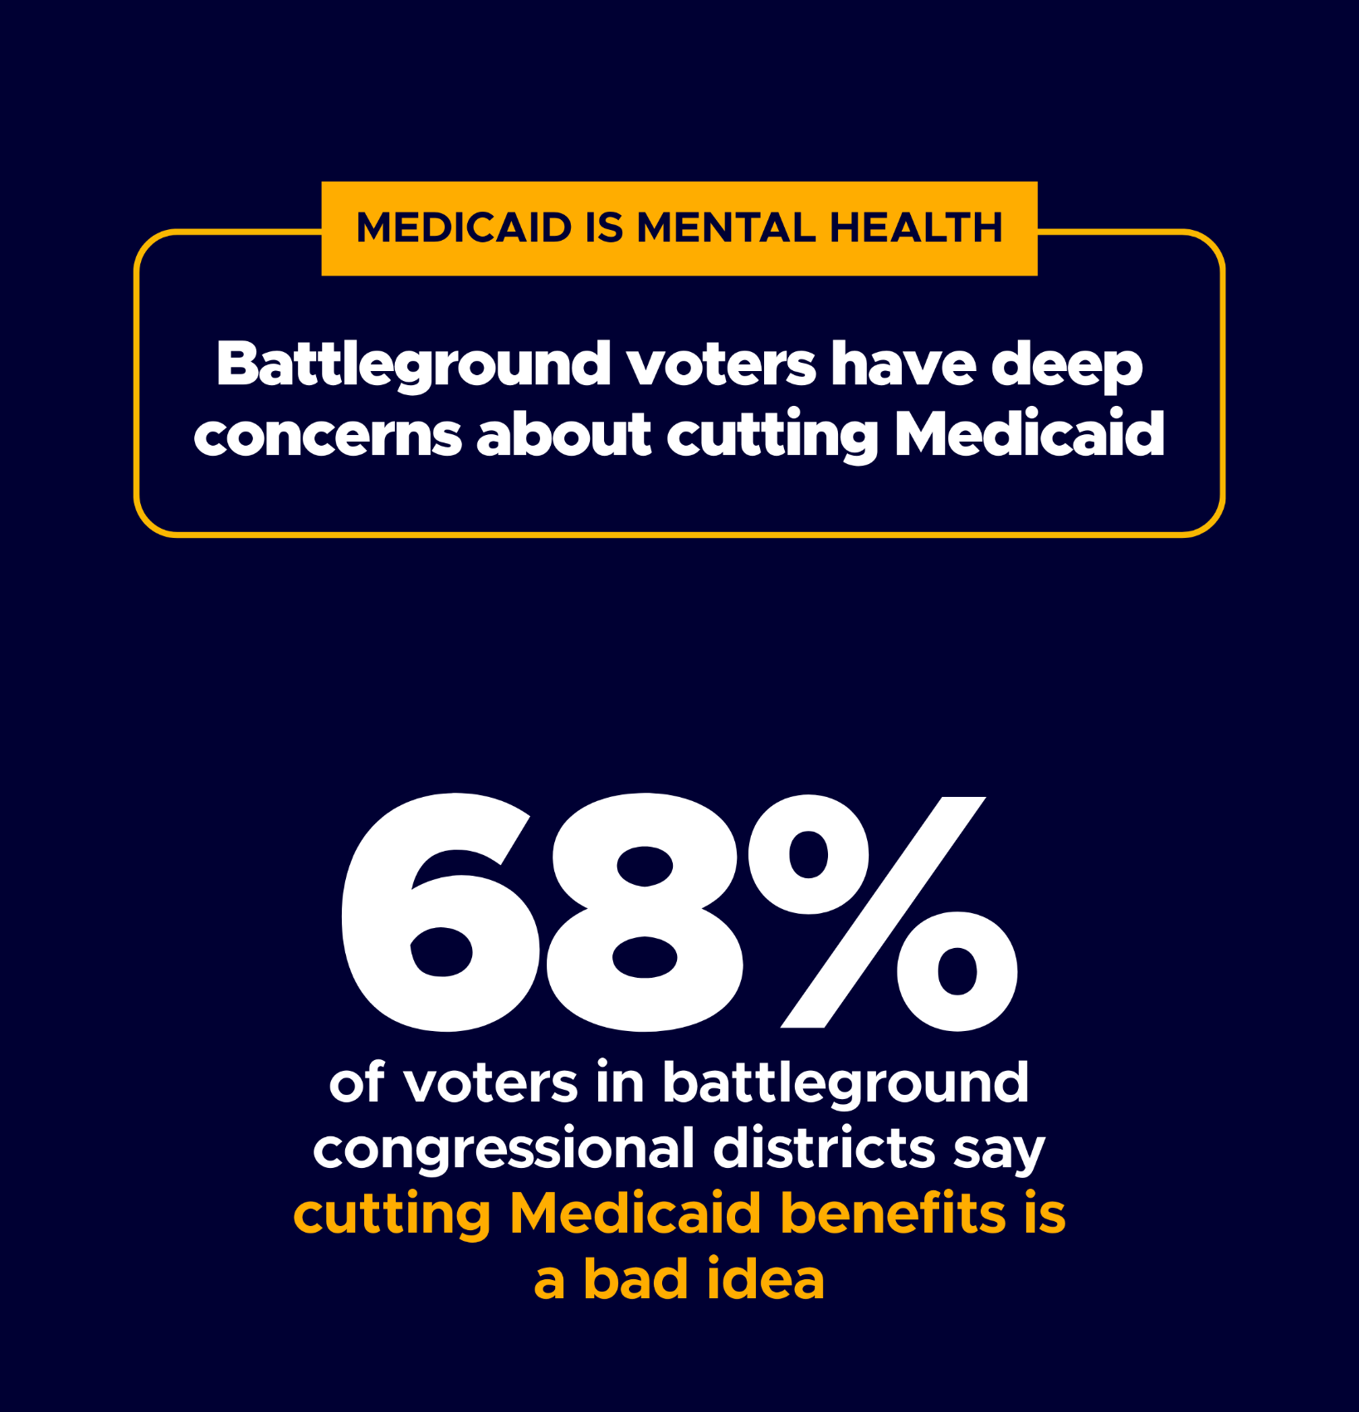
Medicaid is the backbone of mental health care in America
Cuts could remove coverage from 17+ million Americans and restrict access to community-based services
For millions of Americans, Medicaid is mental health care.

Slide 5
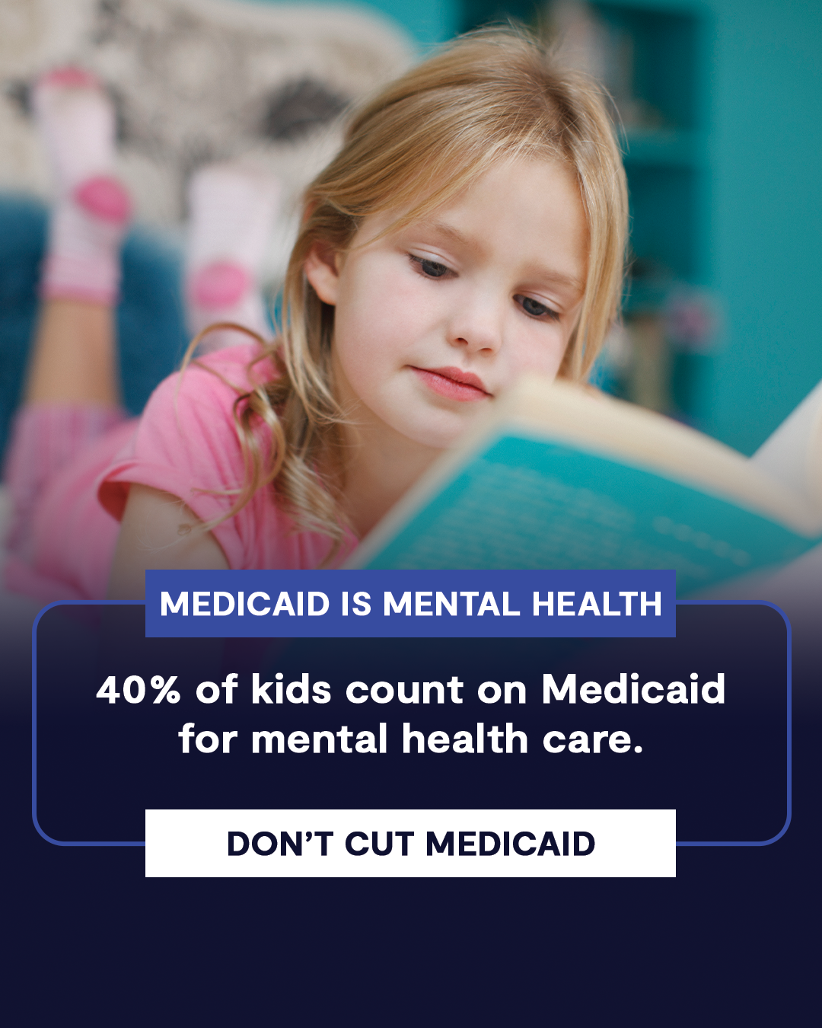
Federal Policy Shifts
New Medicaid work and redetermination rules will cause major coverage losses
End of enhanced premium tax credits could cause many to forego insurance
Notes:
40% of American kids rely on Medicaid. A lot of their parents do too. Cuts aimed at adults hurt kids too.
-1 in 4 children live with a parent with a substance use disorder
-Research shows that when parents lose coverage, their kids are more likely to lose their coverage too.

Slide 6
Medicaid & Mental Health Campaign
Medicaid & Mental Health Summit in New Orleans in November
“Playbook” on H.R. 1 for State Agencies and Policymakers
Tracking of state efforts to minimize impacts of loss of enhanced premium tax credits and Medicaid
Notes:
These are things in our wheelhouse. Would be remiss if I didn’t also mention cuts to SAMHSA, and gutting of infrastructure writ large that will have far-reaching impacts to YMH work.
Coverage:
Colorado HB 1002 and Washington HB 1432: Landmark legislation establishing fair standards in mental health care, including strong parity enforcement and patient protections.
Youth Mental Health:
In Georgia between two bills (HB 268: / SB 179: Youth Mental Health & a budget bill) we secured over $11 million to expand school social worker and mental health coordinator capacity
Crisis Response
In Illinois (SB 2120: 988 Crisis Funding) we passed a 911 fee increase to fund 988 crisis services
Workforce
Delaware (SB107), Georgia (HB81), Oklahoma (HB2261) all passed interstate compacts for social workers and school psychologists.

Slide 7




What Philanthropy Can Do
Support policymakers:
Support production and distribution of youth-led storytelling
Education, implementation tools, and advocacy
Amplify youth voices:
Play a convening role:
Use foundation credibility to
elevate bipartisan framing and mobilize state/local responses
Support innovation and sustainability:
Fund technology to simplify enrollment and exemptions; outreach to people at risk

Slide 8

thank you
please stay in touch
Bill Smith
Founder & CEO, Inseparable
bill@inseparable.us

Slide 9
MICHIGAN HEALTH ENDOWMENT FUND
2025 POLICY RESPONSES
Re-affirming commitment to health equity
Listening to grantees
Launching Rapid Response Fund
Re-formulating grant language to protect grantees’ funding streams
Coordinating with Michigan’s DHHS to mitigate impacts
Sponsoring health policy education for legislators
Funding health policy fellowship to equip nonprofit leaders with advocacy tools
Hiring Sr. Policy Fellow with Medicaid expertise to advise Health Fund & partners

Slide 10
Thank you!
Send us a message at bh@gih.org if you have any questions.
Visit GIH.org to access upcoming webinars and view past recordings.
Join GIH for the 2025 Health Policy Exchange: November 18-21, 2025
Notes:
https://web.cvent.com/event/404f7668-bfd7-4eff-af28-b5d10e833e31/websitePage:638b680e-4338-4be8-9e5e-656ab2b7ede1

