Slide 1

Cara V. James
President & CEO
Grantmakers In Health
New Vaccine Guidance: What Funders Should Know
Julie Morita
President & CEO
The Joyce Foundation
Katelyn Jetelina
Founder
Your Local Epidemiologist
Julia Spiegel
Founder & CEO
GovAct
Litjen (LJ) Tan
Chief Policy Partnerships Officer Immunize.org
Co-chair, National Adult and Influenza Immunization Summit
Thursday, January 29, 2026, 2:30 ET
Visit GIH.org to learn more

Slide 2

Vaccine Landscape and Response
Grantmakers In Health | January 2026

Slide 3
Current Landscape
Notes:
KJ

Slide 4
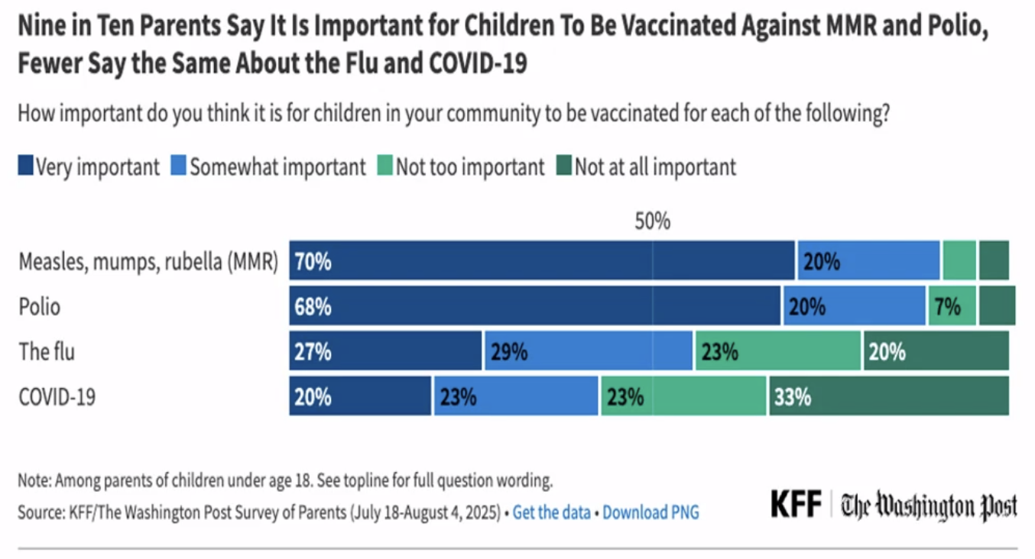
Many, many people still support vaccines
The vast majority of people (80%) believe the benefits of routine childhood vaccines, like MMR and Polio, are important
Strength of vaccine support and support behind vaccine mandates have dramatically shifted after the pandemic

Slide 5
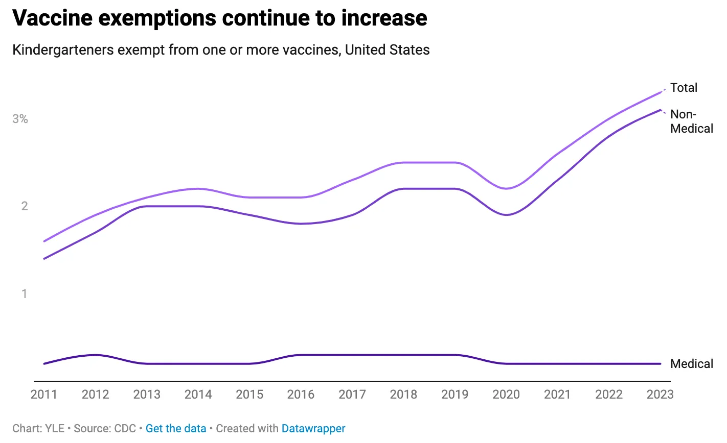
States primarily control vaccine policy
Vaccine policy is primarily governed by individual states (e.g., school attendance)
Very little variability across all 50 states on requirements
Vaccine exemptions increasing

Slide 6
The federal government has direct & indirect levers
Direct
FDA determines the safety and effectiveness of vaccines
CDC determines who is eligible for vaccines and when
Vaccine Injury Compensation Program
Indirect
Withholding funds
  Congress and Grace Act (religious exemptions)
  Department of Education funds from schools with vaccine mandates
Sewing doubt and confusion about vaccines
Demand (legally or access) -> manufacturers stop making vaccines

Slide 7
Stepping Up
Notes:
KJ

Slide 8
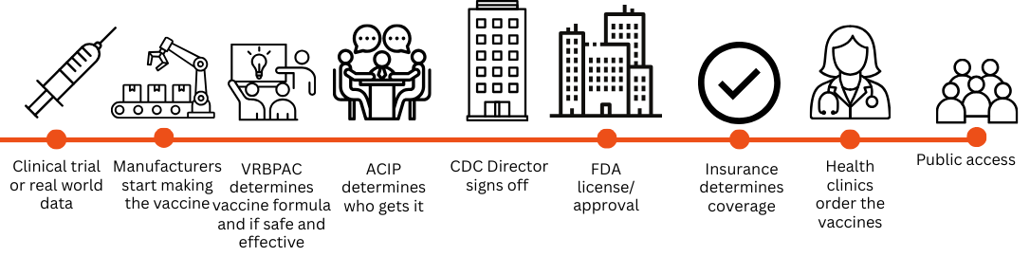
Shared Goal: Maintain Broad Access to Vaccines

Slide 9
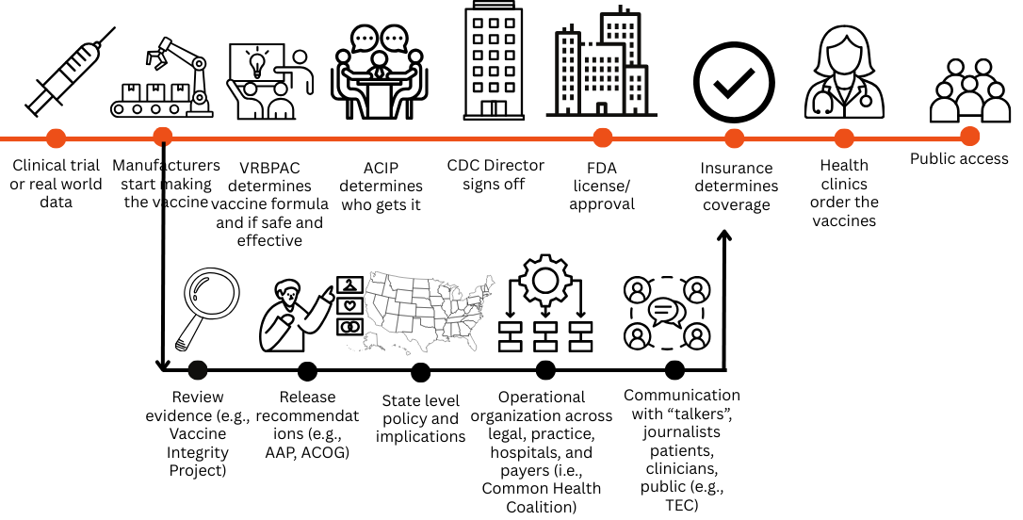
Shared Goal: Maintain Broad Access to Vaccines

Slide 10
Shared Goal: Maintain Broad Access to Vaccines
New Infrastructure
The Evidence Collective (Your Local Epidemiologist)
Common Health Coalition
Vaccine Integrity Project
Governor’s Public Health Alliance
West Coast Health Alliance
East Coast Public Health Collaborative
PopHIVE
Expanded Efforts
Specialty societies (ie AAP and AAFP)
ASTHO
Voices for Vaccines
State-based immunization coalitions
ApHA
Immunize.org
American Families for Vaccines
Children’s Hospital Association
Existing Work
Specialty societies
STAT
NACCHO
Big Cities Health Coalition
AIM
CMSS
APG
IDPN
ApHA
Industry partners (BIO, manufacturers)
Payer organizations (AHIP, ACHP)
Medicaid Medical Directors Network
CSTE

Slide 11
Example
Notes:
KJ

Slide 12

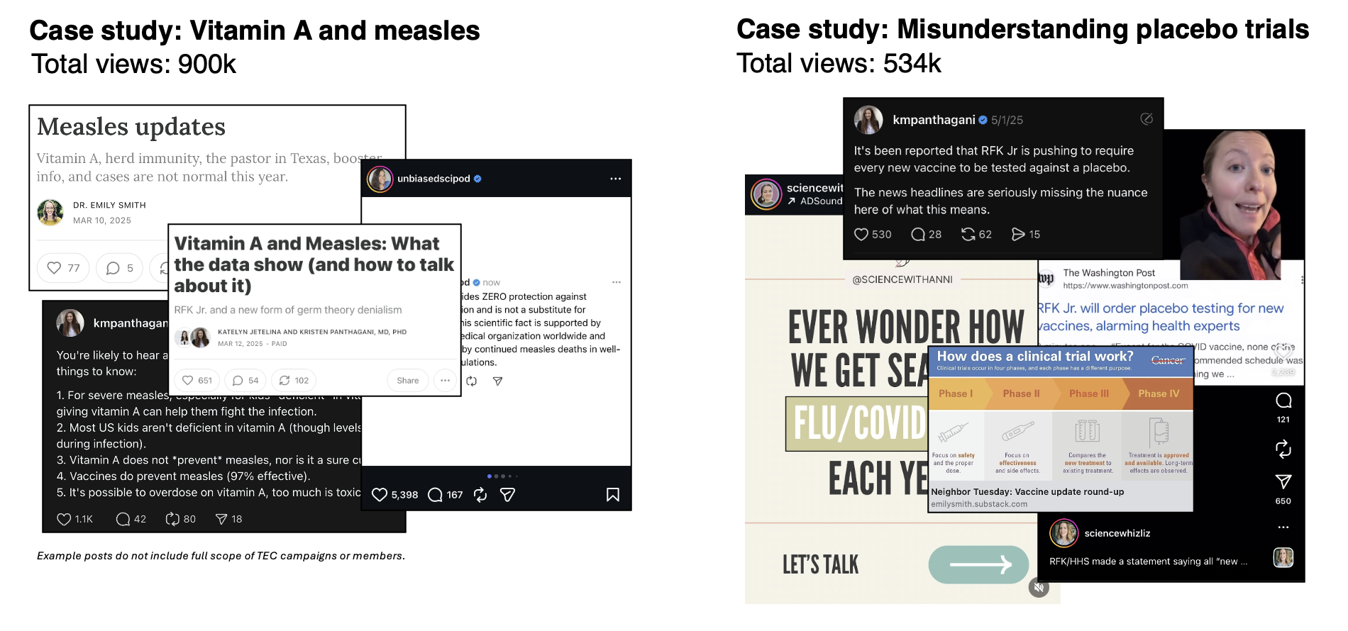
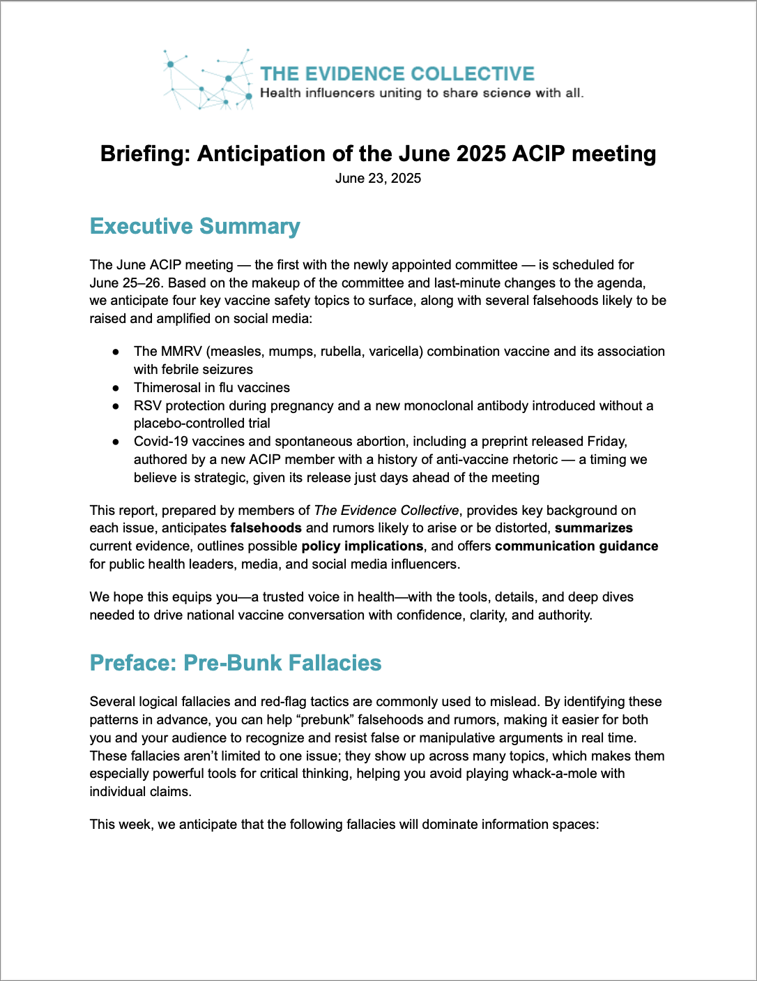
The Evidence Collective
New infrastructure: Speed, coordination, and echochambers
Create a coordinated surround sound approach on social media of evidence-informed content
A coalition of 30 scientific influencers and communicators with more than 200 million monthly impressions.
Listen: Surface a wider array of concerns and questions emerging in disparate online communities.
Prebunks: Develop data- and research-backed one-pagers & briefings about emerging issues to equip creators and other trusted messengers with timely, accurate information.
Empower: Distinct online networks reach diverse audiences with evidence-informed content through the channels and voices they rely on.

Slide 13

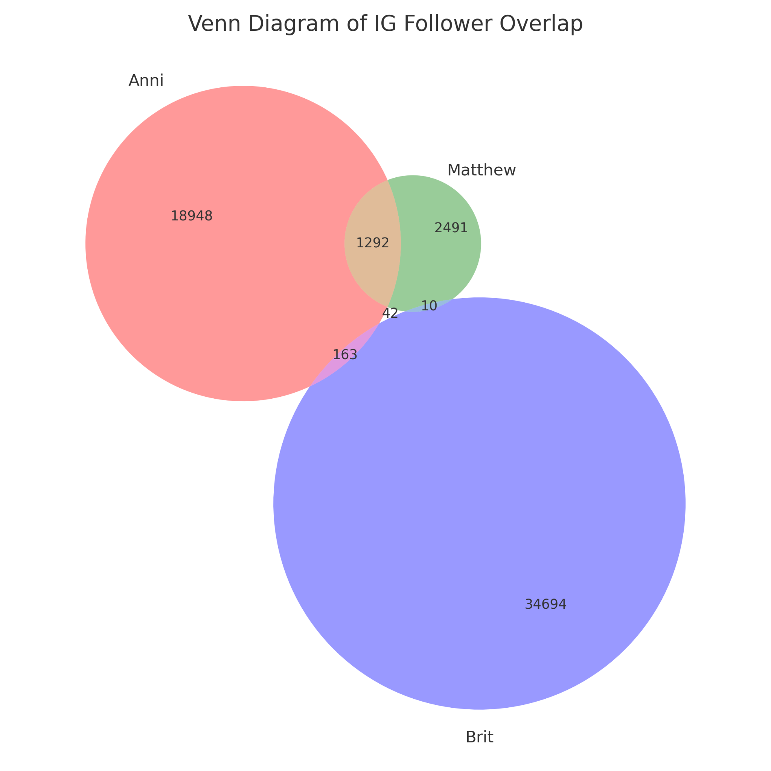

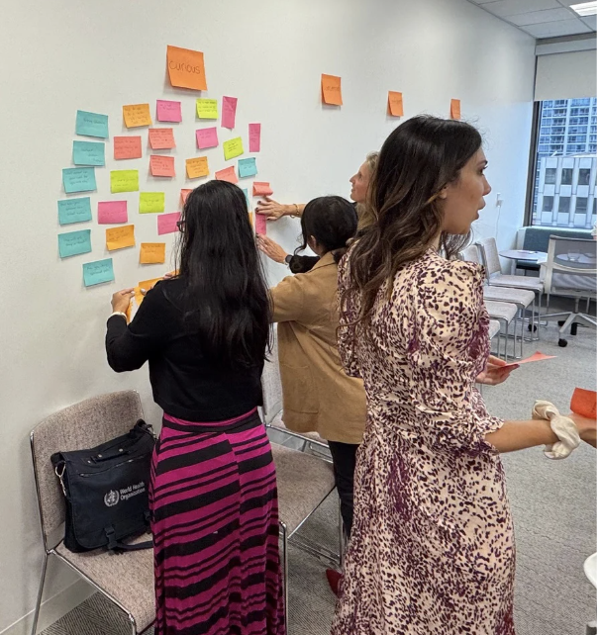
Breaking Echo Chambers
Bring together odd bedfellows (scientists and mom influencers) to:
Build a collaborative partnerships
Foster a cross-community network
Expand trainings, resources and learn from each other
Break online echo chambers online: Reach more with evidence-based information
Up next:
Convening with faith-based influencers (Feb 11)
Notes:
But I’m very concerned about echochambers. So Finding the other nodes that are less traditionally thought of to start breaking echo chambers. Was magical. Added a layer of reseearch on here.

Slide 14
Example
Notes:
KJ

Slide 15


AN ALLIANCE OF

Slide 16

WHO WE ARE
Lauched in October 2025, Governors Public Health Alliance (PHA) is a nonpartisan coalition of Governors working together to protect the health and well-being of their residents by:
Coordinating messaging on public health threats
Supporting collaboration on technical and regulatory health matters
Exploring data exchanges with trusted partners
Liaising globally to exchange critical public health information

Slide 17

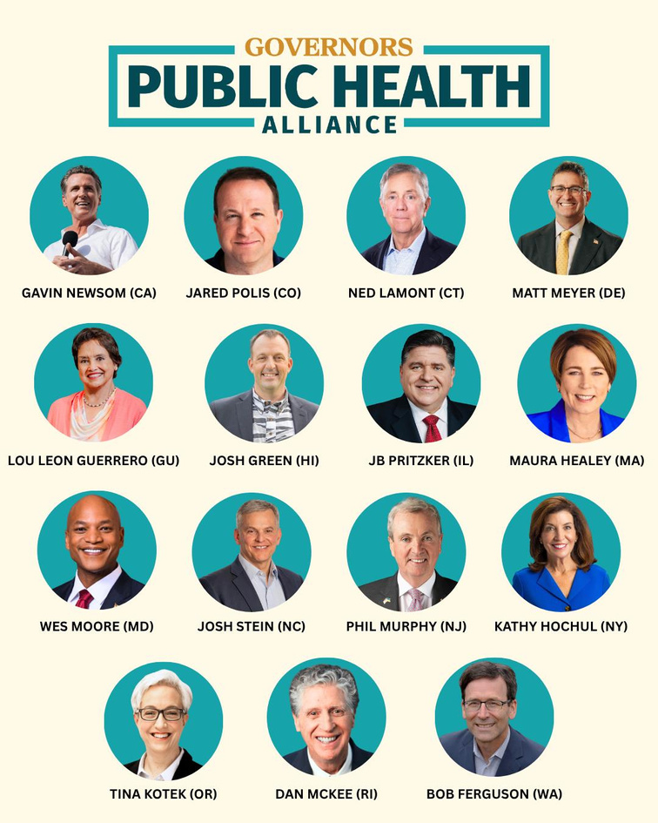



15
Governors
representing 130 million
1 in 3 people nationwide

Slide 18

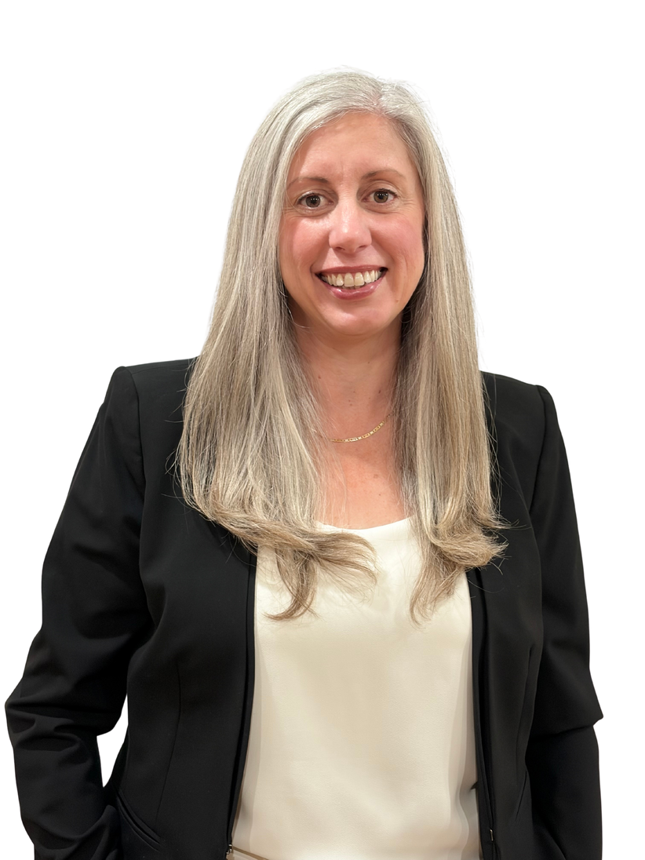
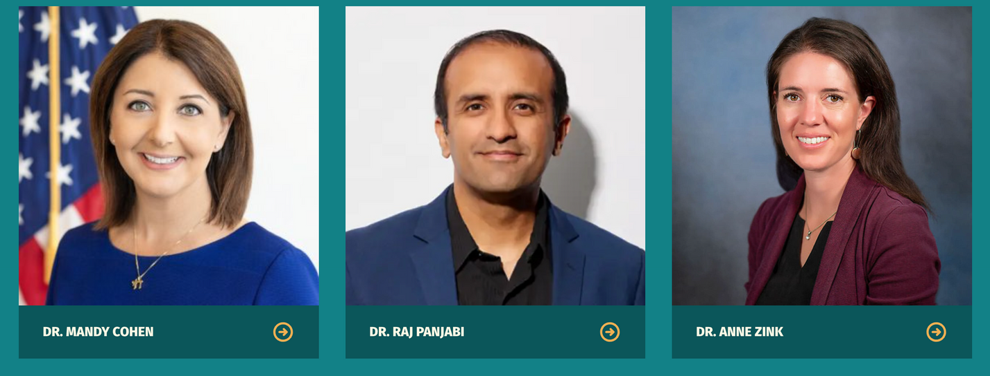
PHA LEADERSHIP
MANAGING DIRECTOR
ADVISORS
Dr. Mandy Cohen
Dr. Raj Panjabi
Dr. Anne Zink
Angela Botticella

Slide 19
PHA VACCINE WORK
Vaccine access is one of PHA’s three core pillars. To date, PHA has:
  Submitted a formal public comment urging ACIP to protect children’s access to vaccines.
  Coordinated rapid-response communications by Governors in response to recent developments affecting vaccine policy.
  Convened briefings on coordinated vaccination purchasing and distribution.
  Built and disseminated across states a Vaccine Access Toolkit to mitigate harm from federal action, including a template Executive Order. 28+ states have taken related actions.

Slide 20
PHA VACCINE WORK
  Endorsed the American Academy of Pediatrics 2026 children’s immunization schedule.
  Supports cross-state alignment on public health litigation, including convening PHA states to share legal analysis, emerging risks, and potential implications for governors’ authorities and public health operations.
  Submitting a letter to the Centers for Medicare & Medicaid Services raising concerns about the removal of childhood immunization rates from the Medicaid and CHIP Core Set of Children’s Health Care Quality Measures.
  Closely monitoring Advisory Committee on Immunization Practices (ACIP) and U.S. Preventive Services Task Force (USPSTF) actions to identify potential changes to vaccine and preventive-services recommendations and flag implications for Governors.
  Coordinates closely with state regional alliances

Slide 21
National Adult and Influenza Immunization Summit (NAIIS)
The Summit Adult Vaccination Recommendations Review (SAVRR) Council

Slide 22
Background: National Adult and Influenza Immunization Summit
Multi-sector coalition of organizations working toward increasing uptake of ACIP-recommended adult vaccines and influenza vaccine for all ages
Started in 2000 in response to influenza vaccine supply issues
Work done throughout year by 3 task groups (Equity/CBOs, Billing and Payment, Operationalizing Adult Vaccinations)
Over 130 public and private organizations

Slide 23
Summit Organizing Committee (as of November 2025)
American Academy of Family Physicians
American Academy of Pediatrics
American Academy of Physician Assistants
American Association of Nurse Practitioners
American College of Obstetricians and Gynecologists
American College of Physicians
American Medical Association
American Nurses Association
American Pharmacists Association
AMGA
Gerontological Society of America
Immunize.org
Infectious Diseases Society of America
National Foundation for Infectious Diseases

Slide 24
Objectives of the SAVRR Council
Provide stakeholder input on vaccination recommendations
Support effective clinical implementation of evidence-based vaccine recommendations

Slide 25
Provide stakeholder input on vaccination recommendations
Serve as a forum for designated stakeholder organization representatives to review and discuss draft or final vaccination recommendations from professional medical societies and the ACIP.
Offer feedback either during the recommendation development process or following publication, with a focus on practical implementation and operational issues from the stakeholder perspective.

Slide 26
Support effective clinical implementation of evidence-based vaccine recommendations
Summarize and clarify any differences among recommendations issued by professional medical societies and ACIP.
Identify and characterize clinical guidance challenges for specific patient populations and vaccination settings.
Propose and, when feasible, assist with implementation of solutions by Summit member organizations or Summit working groups.
Increase awareness and implementation of evidence-based vaccination recommendations, whether from ACIP or professional societies, leveraging NAIIS and Summit communication channels (e.g., website, email, webinars).

Slide 27
Thank you
Lj.tan@immunize.org
www.izsummitpartners.org
www.immunize.org/subscribe

Slide 28
Thank you!
Send us a message at info@gih.org if you have any questions.
Visit GIH.org to access upcoming webinars and view past recordings.

