Slide 2
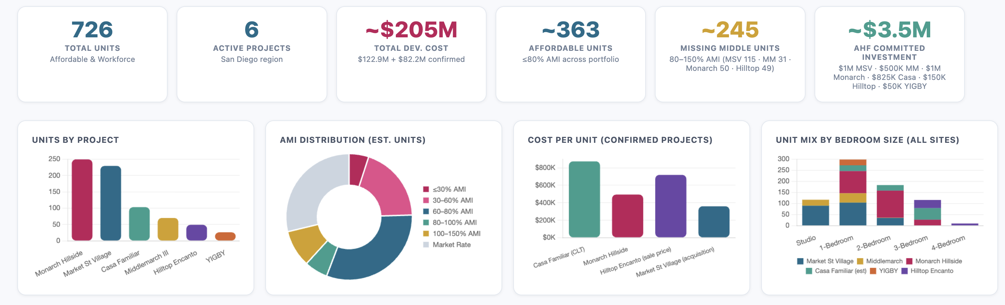
AHF HOUSING DASHBOARD

Slide 3
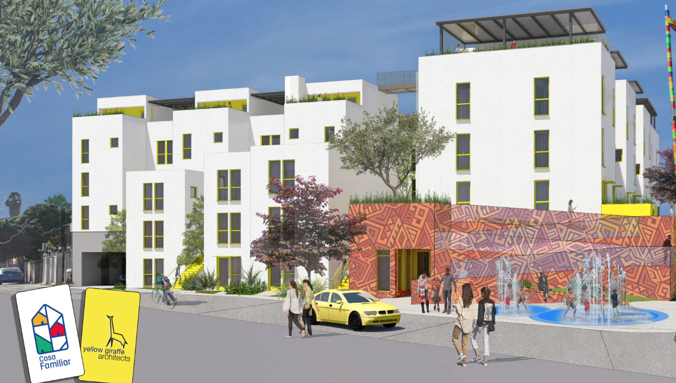
AVANZANDO SAN YSIDRO COMMUNITY LAND TRUST
103 units of deeply affordable housing (30-50% AMI)
New construction, rental housing
Transitions to home-ownership after LIHTC expire
Land is owned and governed by the community through CLT structure, allowing for modest wealth generation, without gentrification overtime (future unit sale prices are capped using AMI %)
Alliance Healthcare Foundation Role:
  Initial feasibility grant funding to assess project, hire legal counsel, set up structure and do community outreach.
  Follow-on working-capital loan during construction phase (large cash outlay followed by reimbursement created big swings in reserves)

Slide 4
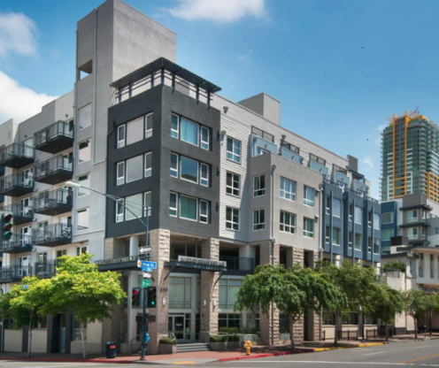
MARKET STREET VILLAGE
229 units of NOAH preservation
50% of units designated for veterans exiting homelessness (net new homeless housing)
50% for low-income residents earning up to 80% AMI
Onsite services and case management support
Alliance Healthcare Foundation Role:
  Served as local anchor funder to catalyze other matched investment
  Provided concessionary debt to unlock ~$80M in national investment from Community Solutions Large Cities Fund
  Tied 30-year deed restrictions to all units requiring them to stay at 80% or below AMI rent levels

Slide 5
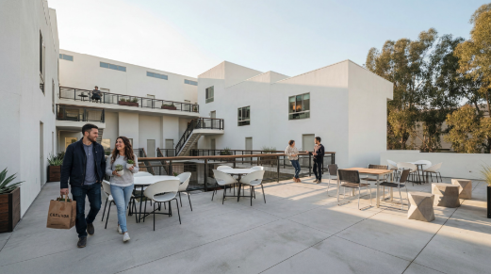
MIDDLE MARCH
    70 units, new construction
    Mixed income “missing middle” workforce housing
    31 units (45%) are deed restricted at 100% AMI
    5 units are deed restricted at 50% AMI
    34 units are market rate
    Alliance Healthcare Foundation Role:
      Early committed investor to give credibility to the project and unlock other local capital
      Middle March equity is what allows developer to deed-restrict a % of units at lower rents
      As project evolved, rather than insisting on same level of capital participation, we reduced our investment amount while increasing our share of the risk to help the project move forward at a critical stage.

Slide 6
WORKFORCE HOUSING: A SMART, MISSION-ALIGNED IMPACT INVESTMENT
Stabilizes working households
Supports essential workers priced out of both subsidized and market-rate rents.
Addresses widespread cost burden (≈58% of SD households) and helps prevent displacement
With only ~15% of households able to afford a median-priced home, workforce units keep families housed & local.
Recycles capital & generates true additionality
Structured mission-aligned investments (not grants) return capital for reuse.
Fills a financing gap not served by tax-credit programs or luxury development — AHF’s dollars directly catalyze projects that otherwise wouldn’t pencil.
Meets demand across the income spectrum
San Diego’s shortage of ~130,000 rental homes spans far beyond very low-income households.
Workforce housing acts as a “pressure valve,” easing market stress and helping moderate rent inflation system-wide.
Aligns with AHF’s mission & values
Advances equitable opportunity for working families who sustain the region but face growing housing insecurity.
Delivers both social impact and financial sustainability through recyclable, impact-focused capital.
Housing is one of the most fundamental Social Determinants of Health (it’s a “prevention” strategy).

Slide 7
REFINING OUR HOUSING “DECISION-SUPPORT”
Core Principles – Any AHF-backed housing investment should:
Increase supply (especially in underserved segments: deeply affordable and workforce), and/or preserve affordability that otherwise would be at risk of being lost
Prevent displacement, expand opportunity, and foster mixed-income stability.
Provide a reasonable path to capital preservation & return
Demonstrate feasible, timely execution with credible partners
Avoid reinforcing concentrated poverty.

Slide 8
REFINING OUR HOUSING “DECISION-SUPPORT”
FOUR KEY DECISION DOMAINS
Impact on People & Place (40%) Who will live here (income mix)? Does it advance equity? Does it create neighborhood-level opportunity (connectivity, mobility, services)? | Cost, Speed, & Financial Feasibility (25%) Is the project cost-effective? Does it reasonably return capital (for impact investing)? How quickly does it add units?
Affordability & Duration (20%) How long will affordability be preserved? For which income bands? | Developer Capacity & Risk (15%) Is the developer credible, stable, and community-grounded? Can they execute on time and on budget?

