Slide 1
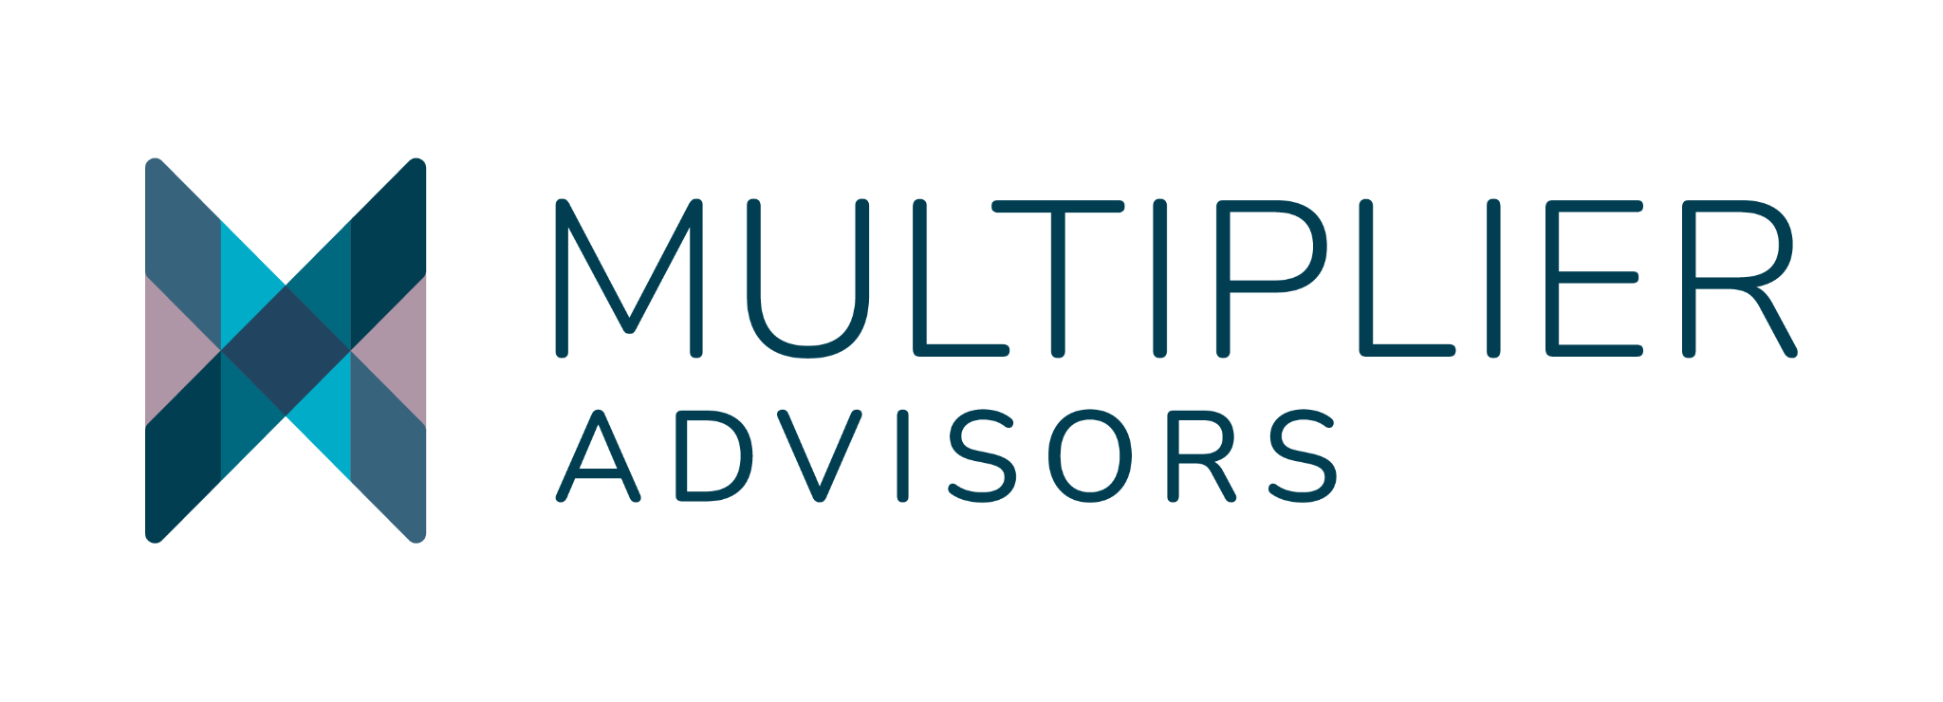
Aligning Assets with Mission:
Local Community Investing
Grantmakers in Health June 23, 2026

Slide 2
MISSION-ALIGNED INVESTING TOOLS
Program Related Investments (PRIs) - Investment made by a foundation to support its charitable or philanthropic goals, rather than to generate income. Counts toward 5% distribution.
Mission Related Investments (MRIs) - Investment made by a foundation that seeks to achieve financial return and align with mission objectives. Made from endowment, not grantmaking budget.
Guarantees - Financial tool where a foundation promises to cover a loan (or a portion of it) made by another lender—typically a bank or financial institution—if the borrower defaults. Guarantees can qualify as PRIs.
Whole-Portfolio Alignment - Strategy where entire investment portfolio—including grants, PRIs, MRIs, and public equities —aligns with its mission and values. The goal is to maximize both financial returns and mission-driven outcomes. Example: California Wellness Foundation,

Slide 3

CONCEPTUALIZING WHOLE RIVER IMPACT
Health foundations have a range of assets they can deploy toward mission, including their endowments; foundations can lead others to invest, unlocking even more capital to advance mission.
Legislation / Public Policy
Upstream
Investments
Mission-aligned investing
Improve community conditions
Community Partnerships
Midstream
Grantmaking
Address individuals’
social needs
Technical Assistance
Programs
Downstream
Provide direct individual intervention (e.g. medical care)
Source: Multiplier analysis.

Slide 4
THE SPECTRUM OF CAPITAL
Mission-Aligned Investing is generally understood as one of a range of strategies to advance positive outcomes.
Mission-Aligned Investing
Traditional investments | Negative screening | ESG integration | Thematic investments | Impact-first |  | Philanthropy
Deliver competitive financial returns
 | Mitigate Environmental, Social, and Governance risks
 |  | Pursue Environmental, Social, and Governance opportunities
 |  |  |  | Focus on measurable high-impact solutions
Impact-First Investing
Made with the intention to generate positive, measurable social and environmental outcomes alongside a financial return
Sources: Adapted from ”The Bridges Spectrum of Capital, How we define the sustainable and impact investment market,” Bridges Fund Management, 2013; Tideline analysis.
Notes: 1. Also referred to as sustainable investing, socially responsible investing (SRI), ethical investing, double- or triple-bottom-line investing, ESG investing, and Investing for Sustainability Impact (IFSI).
4
Notes:
Use of “Mission Aligned Investing”

Slide 5



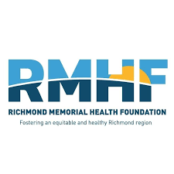
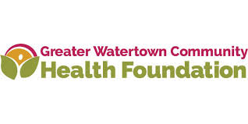

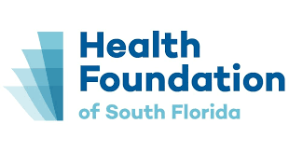
PEER INITIATIVES
A number of health foundations across the country are active in Mission-Aligned Investing, with projects ranging from renewable energy to affordable housing to local small business support.
What practices are being tested by peer foundations that might be incorporated into your strategy for mission-aligned investing?
Sample peers
Whole Endowment
PRIs
5
Notes:
MFH: Working with a local housing developer
Greater Watertown: Acquired a property that is mixed use including affordable housing, a YMCA, ECE, and workforce development. Invested in a local fund to provide bridge financing for local developers.
RMHF: Works closely with local CDFIs - going back to strategy to ensure that it continues to embed equity and expand circle of partners
HFSF: Pass to Janeisse

Slide 6




WHOLE RIVER IMPACT: A GROWING COMMUNITY OF PRACTICE
The recently published GIH field report states that there are currently 300 healthcare conversion foundations in the US, representing $53B in assets. Only 12% of survey respondents reported using impact investing as a primary tool.
COHORT 1
Whole River IMPACT was Launched by Multiplier Advisors with funding from RWJF, The California Endowment, and The California Wellness Foundation

Slide 7

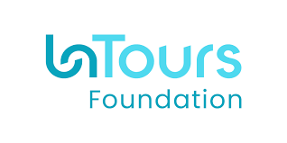
YOU CAN START NO MATTER WHAT YOUR SIZE IS
Examples of one large, one small foundation taking a “whole endowment” approach to their mission-aligned investing.
Key takeaways
The smallest endowment can unlock multiples of new capital
Small incremental and intentional steps can add up to systemic change
There are always ways to continue deepening the work to align assets with mission

Slide 8
STAKEHOLDERS
Board Members and Trustees: Champion the vision, provide fiduciary stewardship and oversight, ensure governance
C-Suite and Foundation Leaders: Champion the vision, develop the strategy and internal infrastructure including processes, staffing, and management structure; identify ways to connect to other programs internally and in the community
Staff: Support the vision, operationalize the strategy, assess and refine, connect to other programs internally and in the community
Community: Provide input into strategy creation, inform how and where investments are deployed, what partnerships are needed, and how to ensure effective impact

Slide 9

STEPS YOU CAN TAKE RIGHT NOW
Schedule a conversation with your Foundation Executive or Board Chair to explore this topic
Explore tools and research on philanthropy serving organization sites (Mission Investors Exchange, Health Anchor Network), Tideline Compass Series, CapShift/Multiplier Health Investing Primer)
Note in your webinar eval your interest in follow-on conversations through GIH
Learn more about Whole River IMPACT

Slide 10
ABOUT US
WOMEN-OWNED & LED
Multiplier Advisors is the first impact investing consultant uniquely founded to support health-focused investors in the U.S.

Slide 11
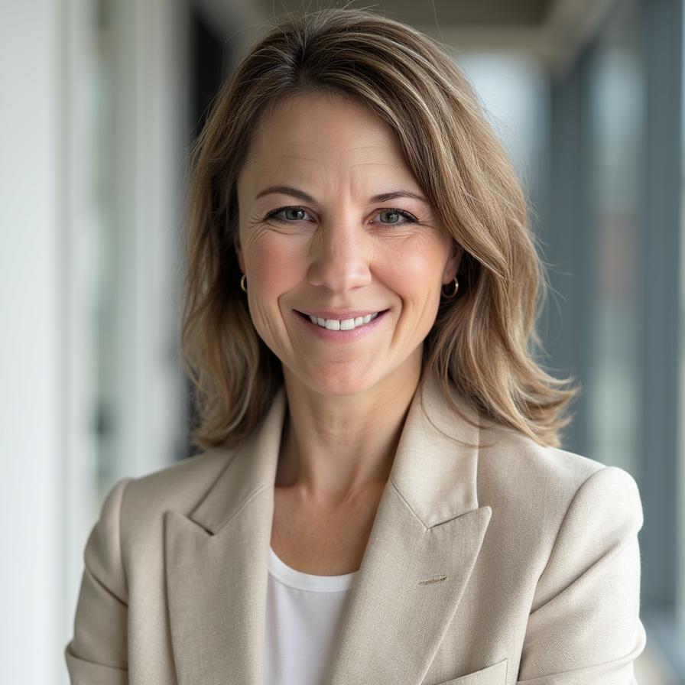
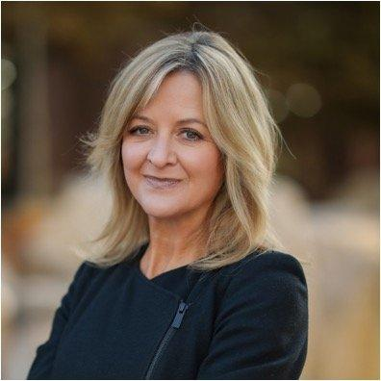
ABOUT US
Colby Dailey, MPP
Co-Founder
Colby@MultiplierAdvisors.com
LinkedIn
Mikelle D. Moore, MBA, MHSA
Co-Founder
Mikelle@MultiplierAdvisors.com
LinkedIn
Colby is a national expert on SDOH impact investing with deep experience launching global and national initiatives to advance equity and activate impact resources. She is a published thought leader and entrepreneur bringing over a decade of experience connecting institutions across sectors, building partnerships that advance equity and invest in SDOH. Colby advises boards, trustees and executive and management teams within health systems, banks, insurers, philanthropy, and other institutions to articulate, operationalize, and achieve their ﬁnancial and impact goals for health and wellbeing.
Mikelle, most recently the Chief Community Health Officer, President of Intermountain Community Care Foundation for Intermountain Health, is a national thought leader and passionate systems change-leader for the future of health in the United States. Mikelle brings more than 25 years’ experience in health system provider and payer operations, population health, health equity, social determinants of health, impact investing, and ESG. Mikelle is an early pioneer in population healthcare models and the use of anchor institutions’ assets to address social determinants of health.

Slide 12





Translating Complexity Across Sectors
Building Relationships For Long Term Success
Providing
Strategic Guidance
Stewarding
Impact
Fostering
Thought Leadership

